Slide 1
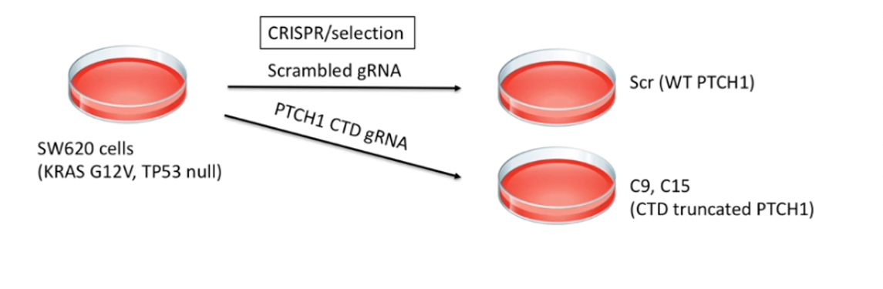

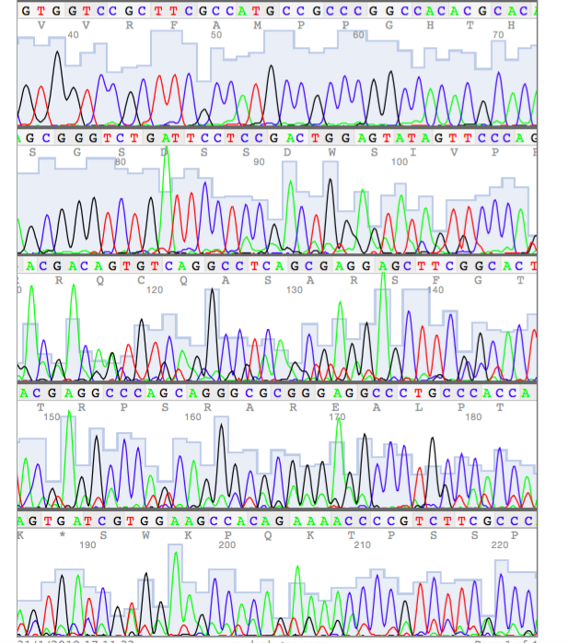
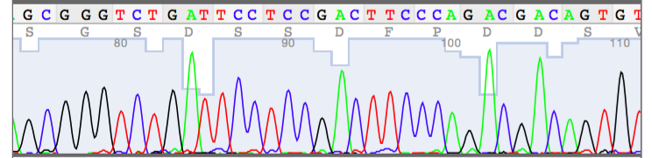
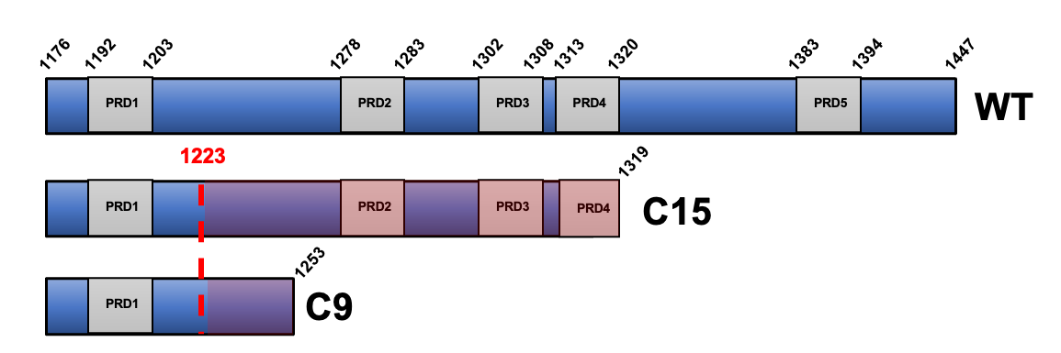
A
B
C
C9
1 bp deletion
D
C15
11 bp deletion
Figure S1: Generation of 2 independent clones in SW620 cells with a truncation in PTCH1 at S1223. A. Topological cartoon of PTCH1 highlighting the C-terminal domain (CTD) and the relative position of the truncation. B. CRISPR/Cas9 strategy in SW620 cells. SW620 cells were transfected with the CRISPR/Cas9 construct containing Scrambled sgRNA or sgRNA targeting the region desired in the CTD of PTCH1. After antibiotic selection we screened by sequencing to obtain two PTCH1 CTD truncated clones: C9 and C15. C. Sequencing of C9 and C15 CTD truncated clones in SW620 showing cutting site and resulting mutations. Model of CTD CRISPR/Cas9 engineered SW620 clones showing changed sequences in red and new stop. D. Expression of PTCH1 mRNA in SCR, C9 and C15 clones by qPCR (n=3). ns = not significant.

Slide 2
A
B
Figure S2. PTCH1 CTD truncation does not impair canonical Hh signalling. A. Schematic of Gli-luciferase assay in Ptch1^{-/-} MEFs. Deficiency of Ptch1 prevents SMO repression, resulting in high level of Gli-luciferase activity in unstimulated cells. Expression of WT PTCH1 restores SMO repression and regulation by Shh. B. The PTCH1 CTD is not required for canonical SMO repression. Ptch1-/- MEFs were transfected with a Gli-luciferase reporter and a constitutive Renilla luciferase reporter together with empty plasmid (pcDNA), wild-type PTCH1 (1-1447), and PTCH1 variants with shorter CTDs. Following 24 h, the media was changed to 0.5% FBS to induce ciliogenesis and supplemented or not with 0.1 μg/ml rShh. Relative Gli-luciferase activity is reported as % of pcDNA. One-way ANOVA followed by multiple comparisons. ****P<0.0001 (n=3).

Slide 3
Figure S3. Canonical Hh signalling is dispensable for proliferation of SCR, C9 and C15 cells. Comparative effect of 0.5 μM KAAD-cyclopamine (KAAD-CP), 20 μM GANT61 or DMSO control on cell proliferation of SCR, C9 and C15 cells over time (n=3). ns = not significant; * P<0.05; **P<0.01; ***P<0.001; ****P<0.0001.

Slide 4
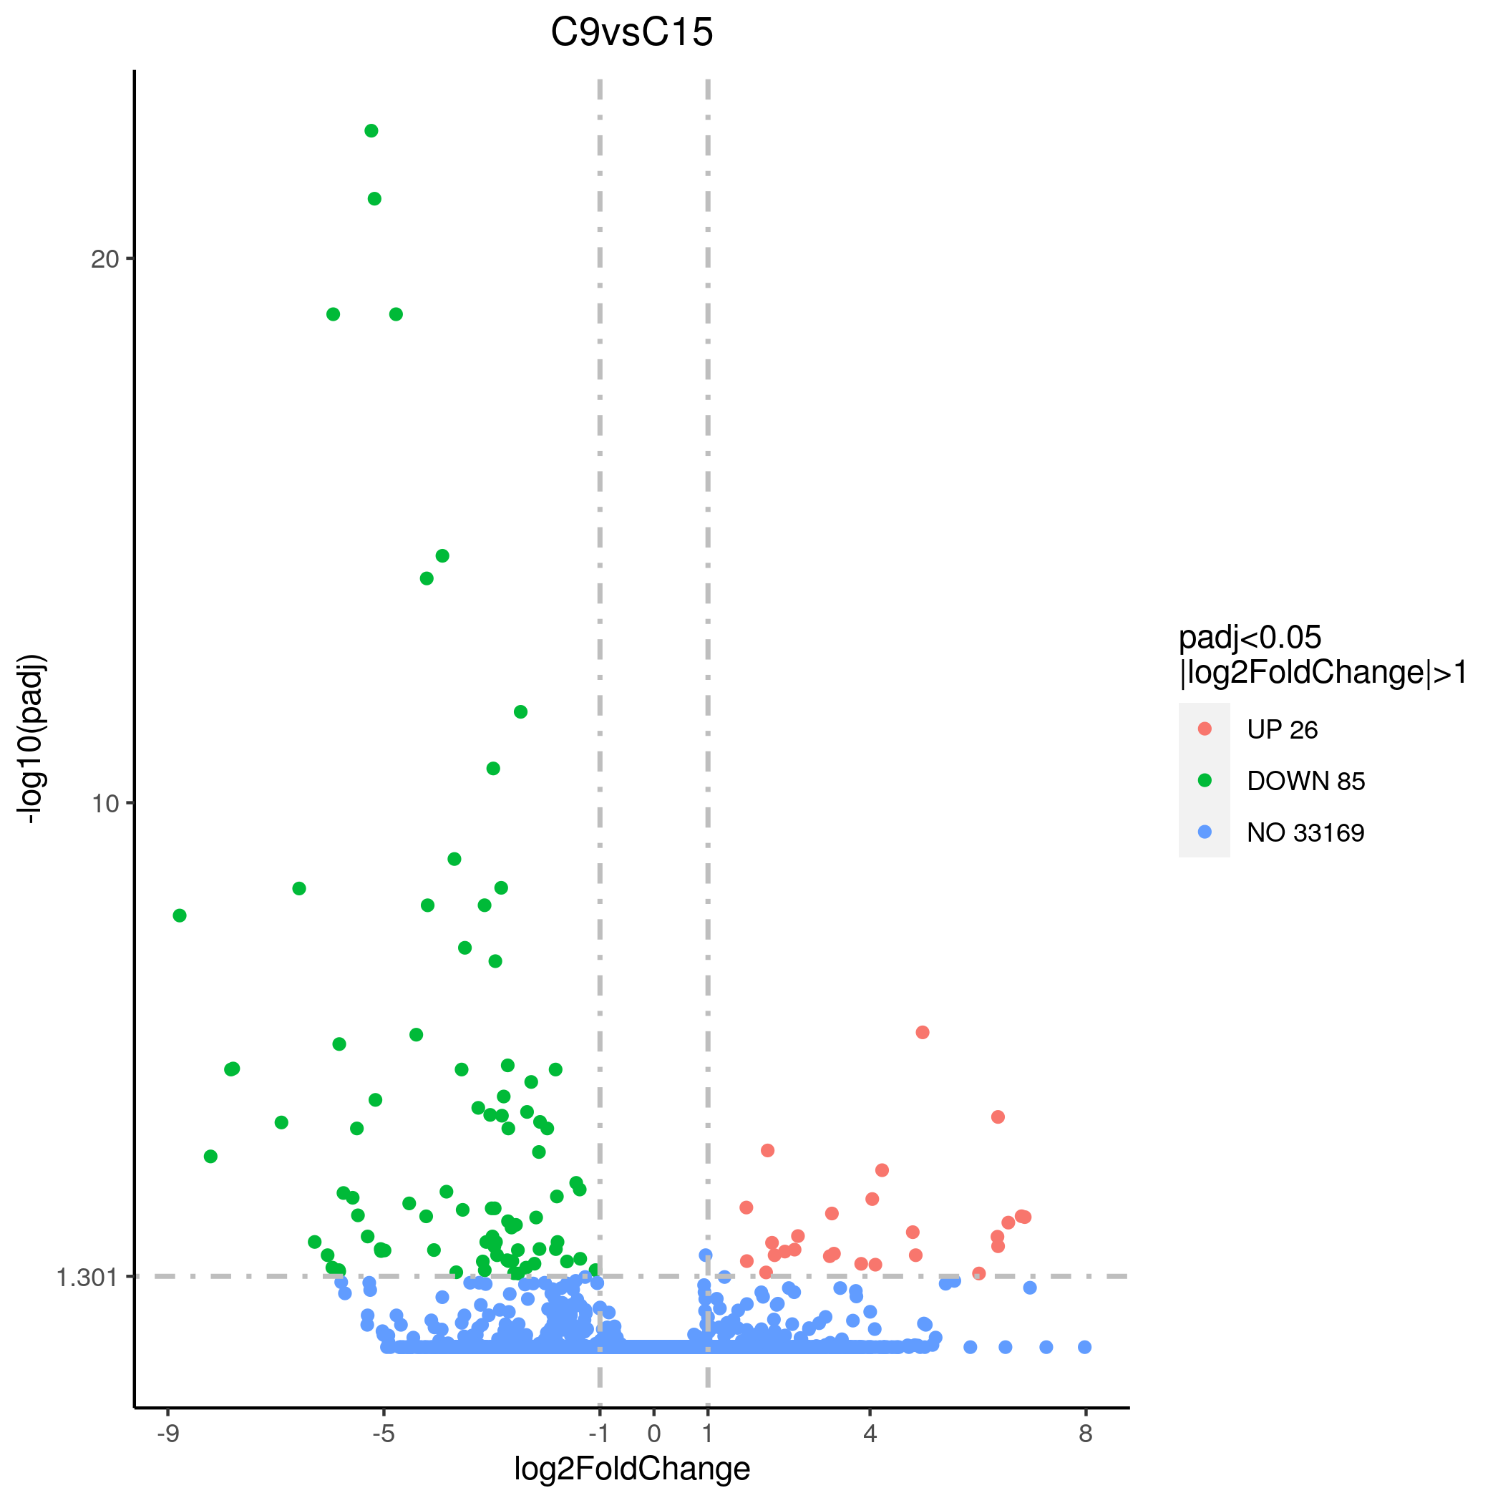
Figure S4. A. Volcano plot of statistically significantly expressed genes (-log10(Padj)>1.301) between C9 and C15 clones. B. Most upregulated pathways in C9 vs C15 cells by KEEG analysis. The size of the dot represents the gene count in that category and the colour reflects the Padj value.

Slide 5
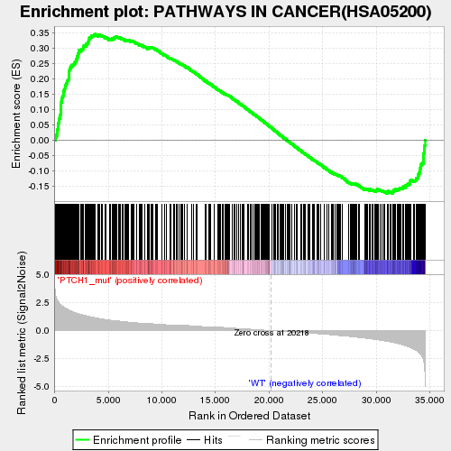
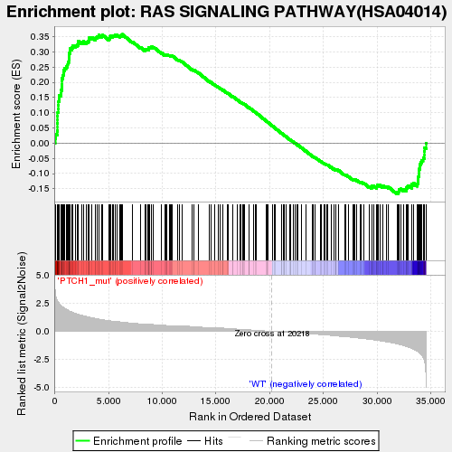
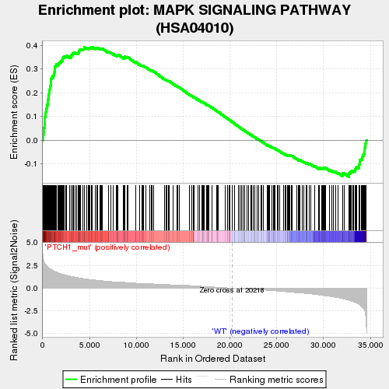
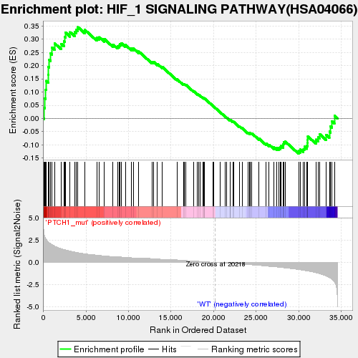
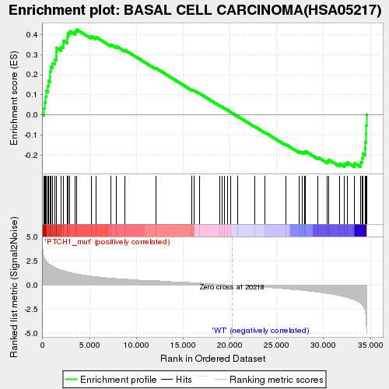
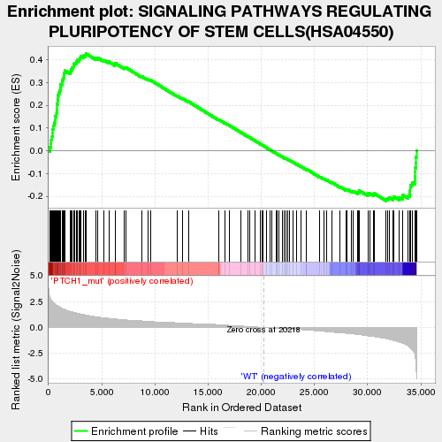
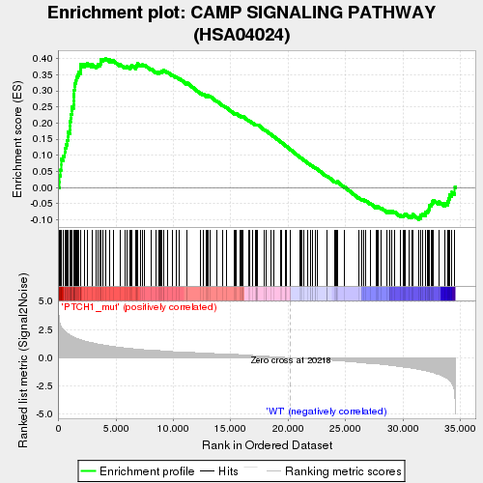
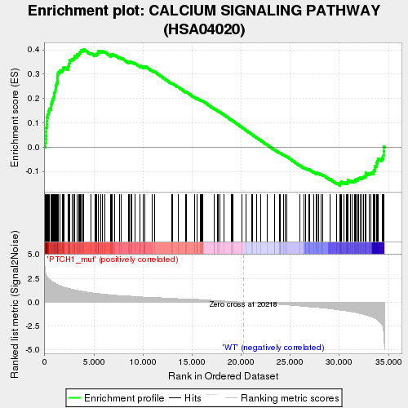
Figure S5. Gene set expression analysis of pathways upregulated in PTCH1 CTD mutant cells compared to PTCH1 WT cells.

Slide 6
Figure S6. Upregulation of EGRF, AREG and EREG in PTCH1 CTD mutant cells is GLI-independent. Normalised mRNA levels of EGFR, AREG and EREG in SCR, C9 and C15 cells treated with 20 μM GANT61 (n=3). ns = not significant; **P<0.01; ***P<0.001.

Slide 7
Figure S7. PTCH1 CTD mutant cells retain sensitivity to MEK inhibition. Effect of 30 nM Trametinib, 10 μM U0126 or DMSO vehicle on cell proliferation of SCR, C9 and C15 cells over time. Data represent the mean ± SEM of independent biological repeats (n=3).

Slide 8
Figure S8. GLI1 expression in PTCH1 CTD mutant cells is sensitive to PI3K inhibition. Effect of 48 h treatment of SCR, C9 and C15 cells with 50 mM LY294002 or DMSO on GLI1 mRNA expression (normalised to GAPDH as housekeeping control). (n=3; *P<0.05).

Slide 9
A
B
Figure S9. myr-Akt cannot rescue proliferation of PTCH1 CTD mutant cells upon inhibition of GLI1/2. A. SCR, C9 and C15 cells were transfected with empty plasmid (pcDNA) or a constitutively active Akt (myr-Akt), followed by treatment with 5 mM GANT61 or DMSO for 48 h. Changes in cell number were normalised to each group’s DMSO control (n=3). B. Transfection of SCR, C9 and C15 cells with myr-Akt-(HA) increases total Akt level and rescues phospho-Akt(S473) levels in the presence of GANT61. GAPDH was used as a loading control.

