Slide 1
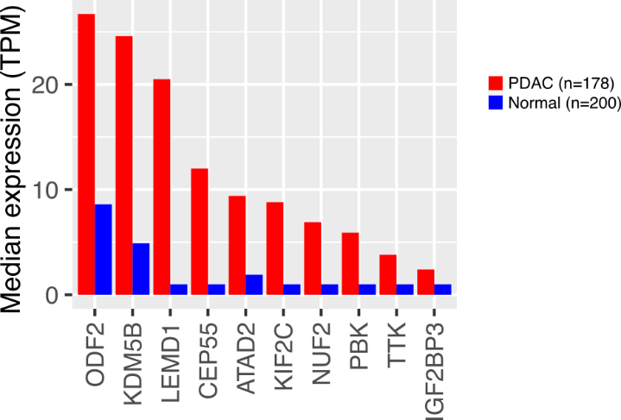
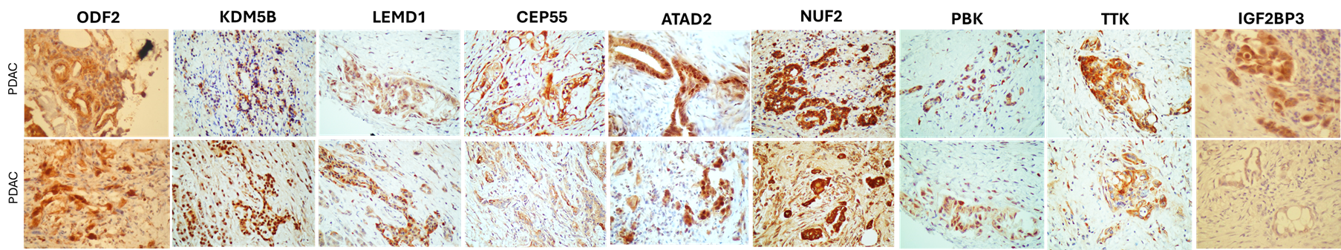
A
B
Genes upregulated in PDAC
available datasets
CTAgs
genes
Top 10
upregulated
CTAGs
in PDAC
GSE15471
GSE19280
GSE28735
GSE55643
GSE62165
GSE62452
GSE91035
10
1207
IGF2BP3
LEMD1
NUF2
CEP55
KIF2C
ATAD2
PBK
KDM5B
ODF2
TTK
C
Supplementary Fig 1. Identification of CTAg genes that are upregulated in pancreatic ductal adenocarcinoma
A. Seven independent microarray datasets of gene expression in PDAC were analysed to assess potential upregulation of known (265) and predicted (953) CTAg genes. 10 CTAg genes were consistently upregulated in tumour tissue. B. Further visualisation of the expression of these 10 genes in the PDAC TCGA + GTEx dataset and C. by immunohistochemistry on two primary PDAC tissue, confirmed its over-expression.

Slide 2
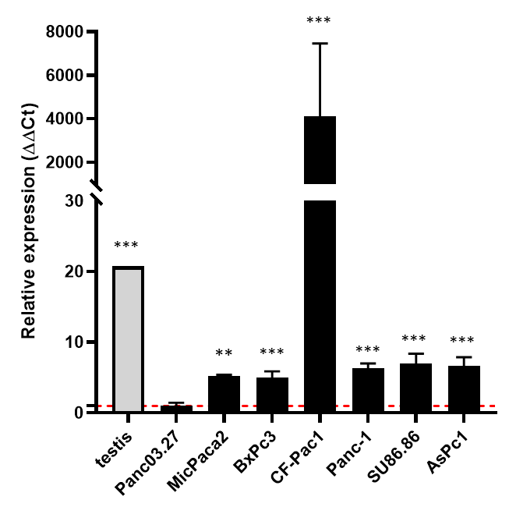
Supplementary Figure 2. Expression of IGF2BP3 in PDAC cell lines.
RT-PCR data showing IGF2BP3 relative expression in the panel of PDAC cell lines, compared to human testis sample (positive control).

Slide 3
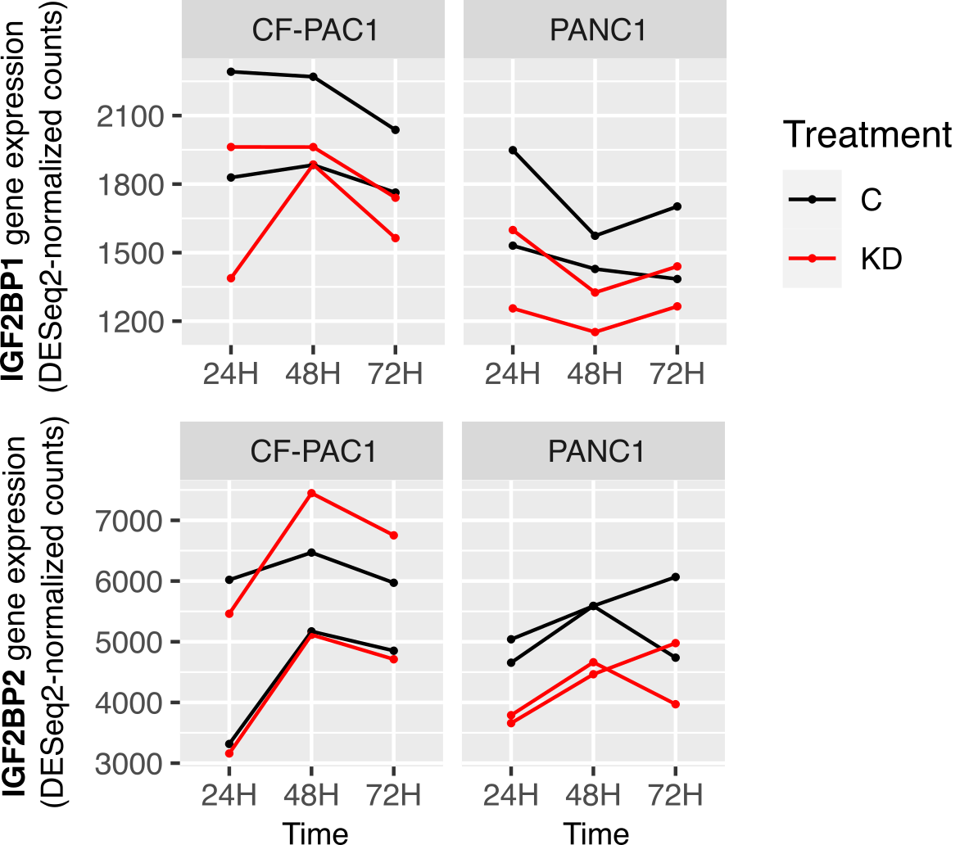
Supplementary Figure 3. Expression of RNA binding protein family genes IGF2BP1 and IGF2BP2
PDAC cell lines CF-Pac1 and PANC1 were transfected with siRNA against IGF2BP3. IGF2BP1 and IGF2BP2 expression assessed by RNA sequencing at 24, 48 and 72 hours post transfection in Control (C) and knockdown (KD) lines. KD vs C differential expression adjusted p-value < 0.05 *, <0.01 **, < 0.001 ***.

Slide 4
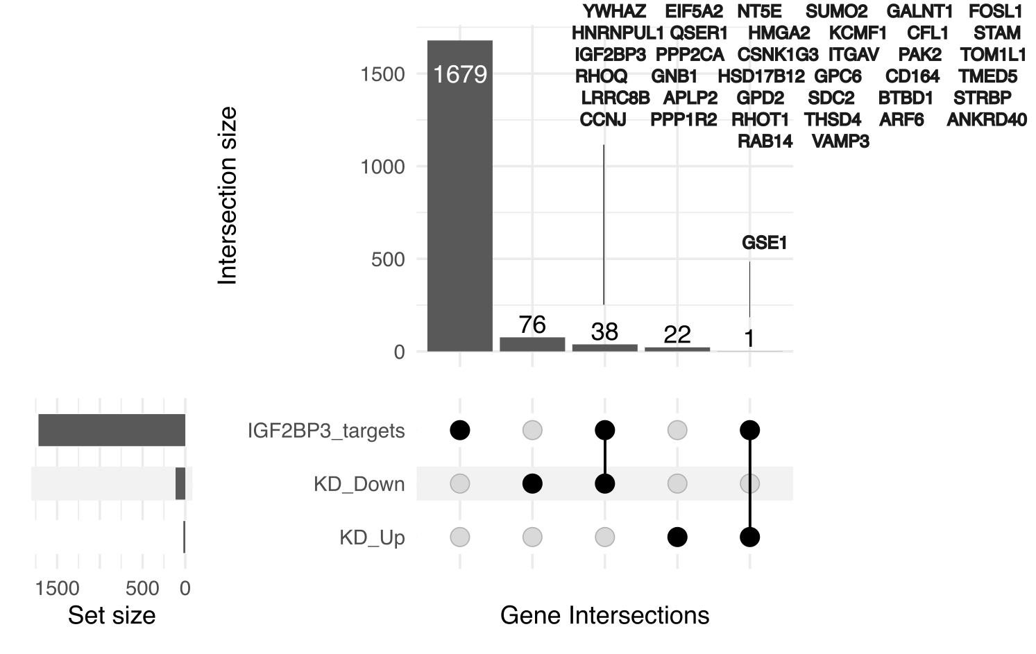
Supplementary Figure 4. Intersection of differentially expressed genes following IGF2BP3 knockdown with IGF2BP3 binding targets.
Intersections of genes identified by RIP-seq in PANC1 pancreatic cancer cell lines (Ennajdaoui et al., 2016) with genes differentially up/down-regulated following IGF2BP3 knockdown (48 hours post transfection).

Slide 5
Supplementary Figure 5. IGF2BP3 knockdown causes down regulation of genes associated with cancer cell apoptosis and proliferation.
Expression of genes downregulated after IGF2BP3 knock down in pancreatic cancer vs
normal control from TCGA dataset.

Slide 6
Supplementary Figure 6. IGF2BP3 knockdown leads to consistent reduction of proliferation in primary pancreatic cancer organoid cultures
Results show the values obtained from analysis of three different PDAC organoid cultures (PANC 040, 079 and S336). Proliferation rate was compared between control and IGF2BP3 knockdown group at 24, 48 and 72 hours. Significance was analysed using two-way ANOVA and post hoc multiple comparisons, with *** < 0.001 and * p < 0.05.

