Slide 1
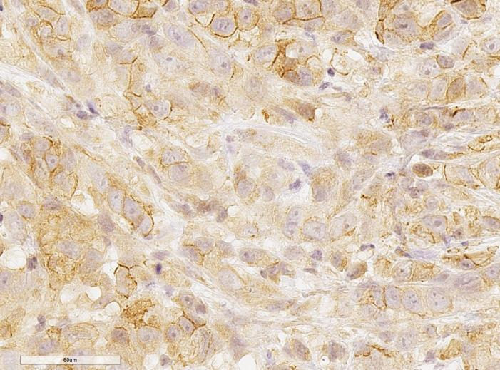
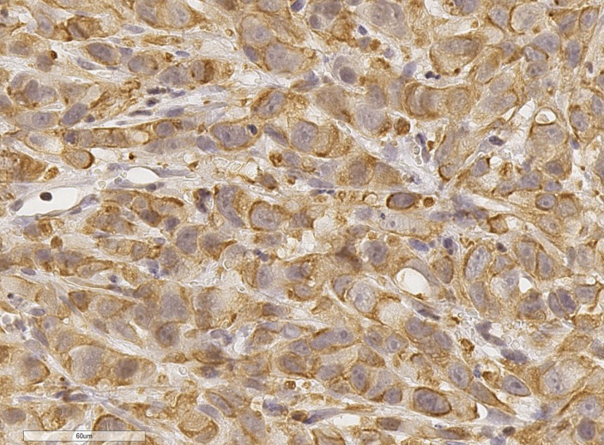
Hirt et al. Supplement Figure 2
PC-3
60µm
60µm
E-Cadherin
Vimentin

