Slide 1
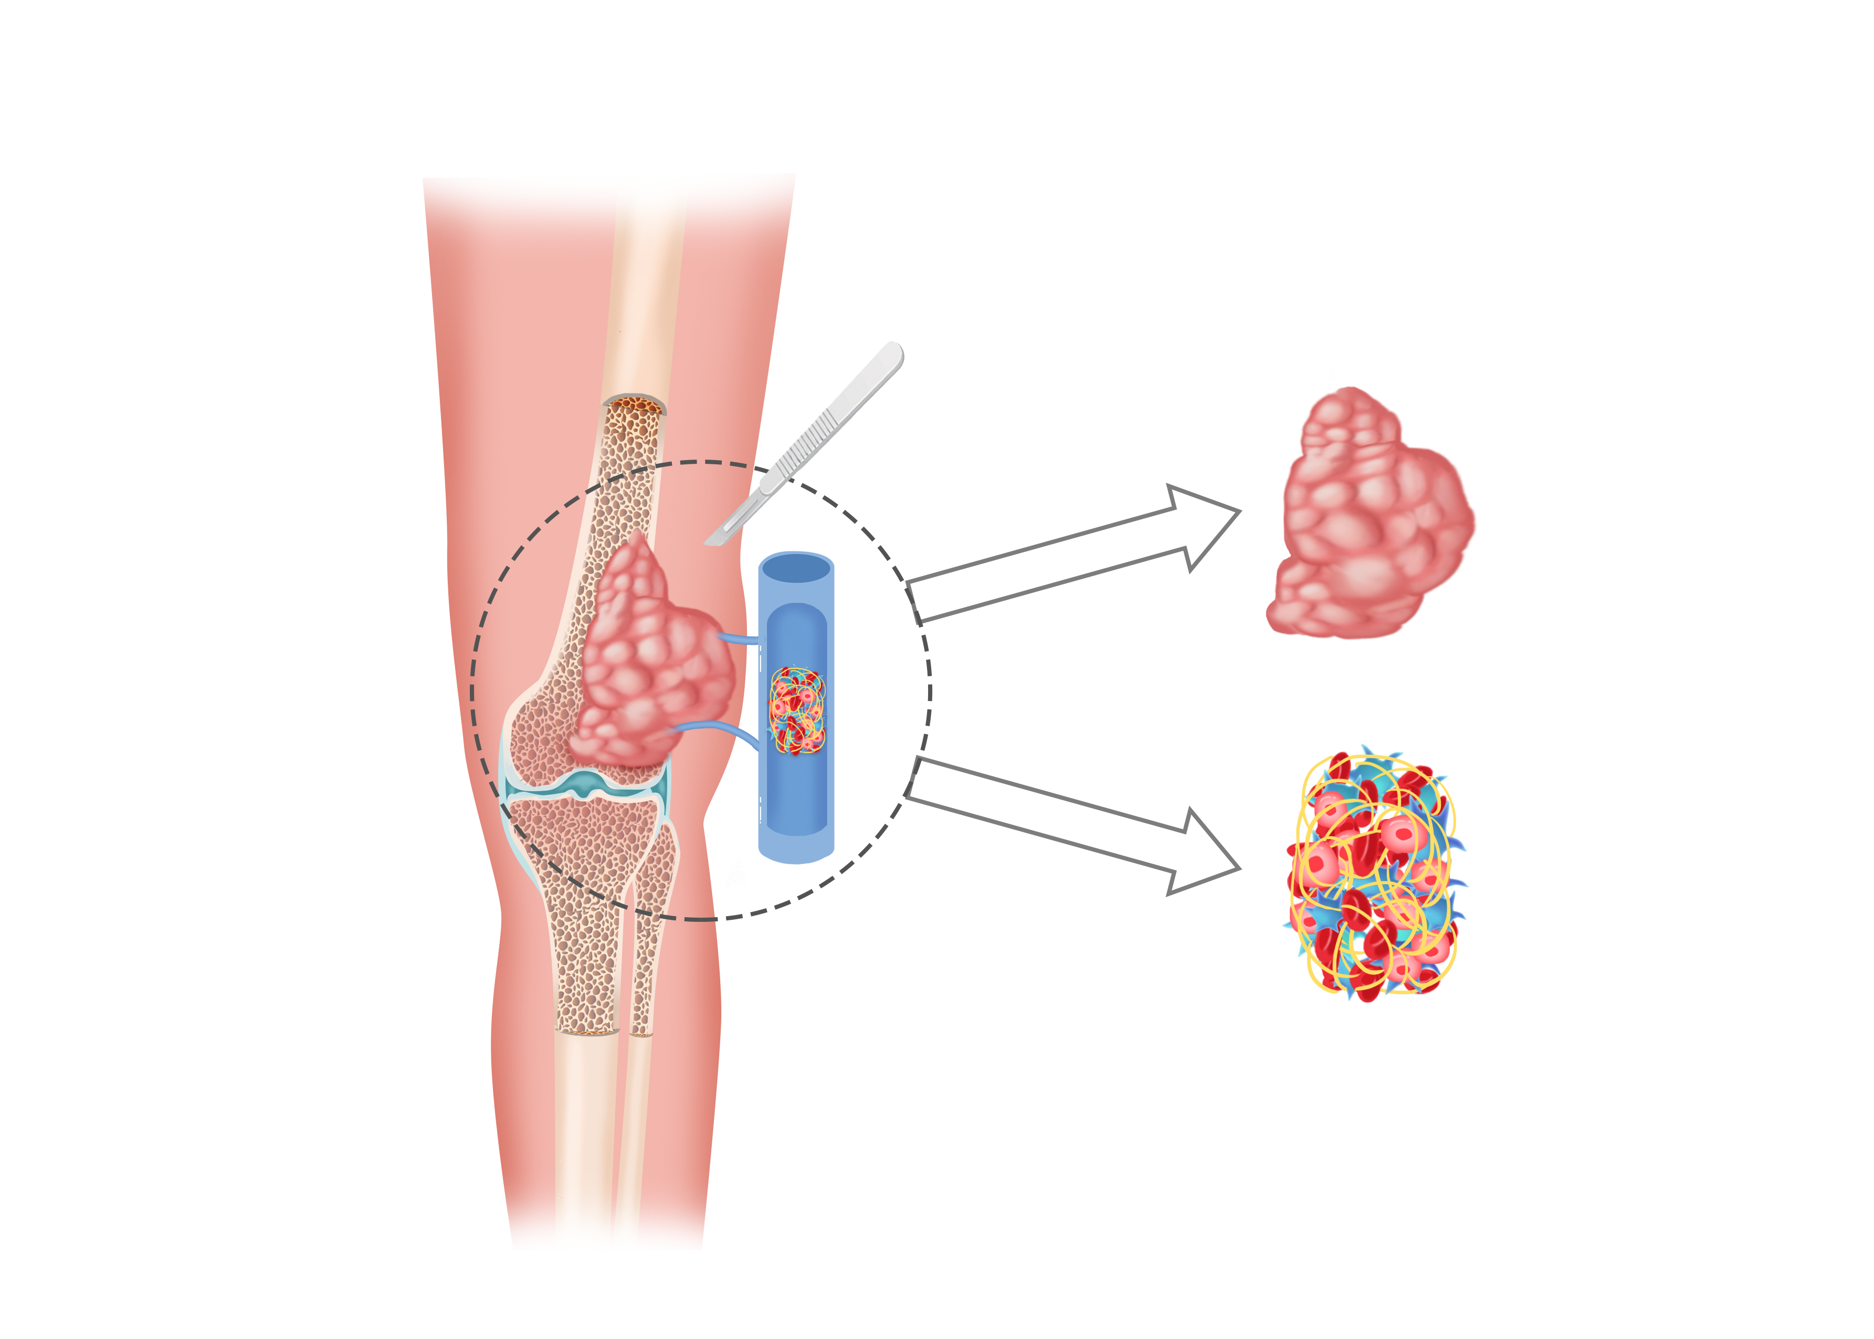
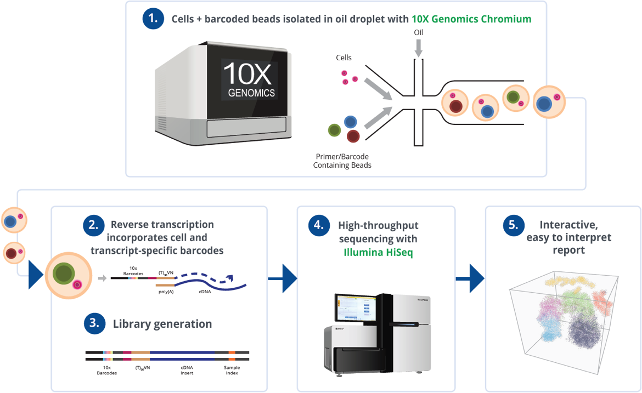
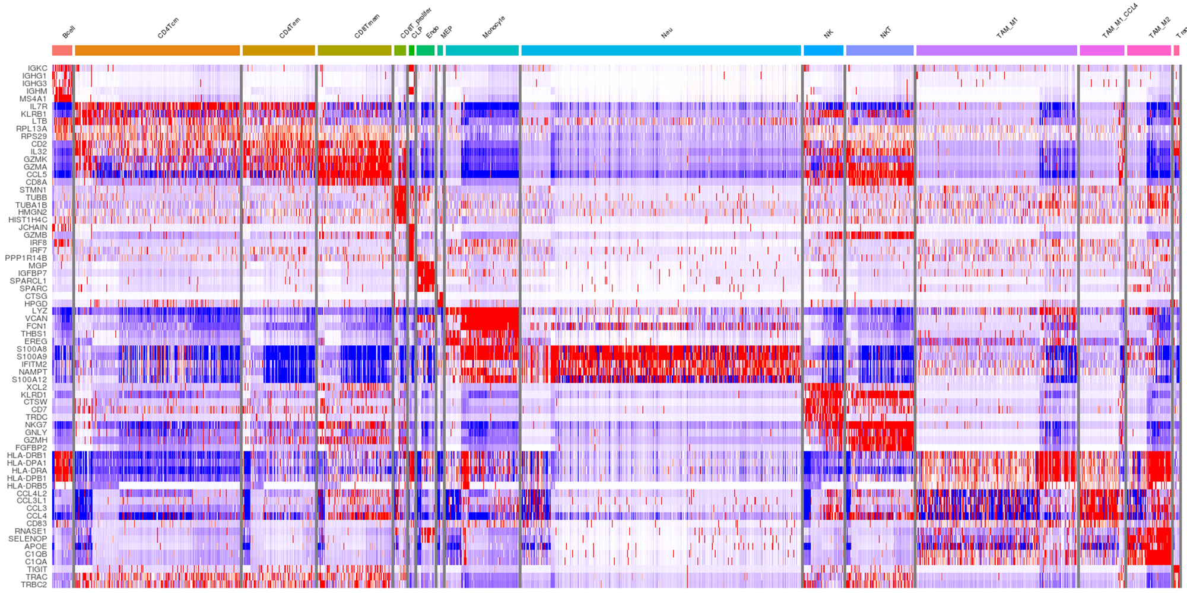
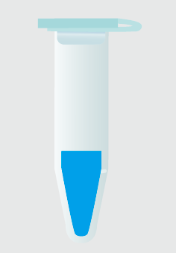
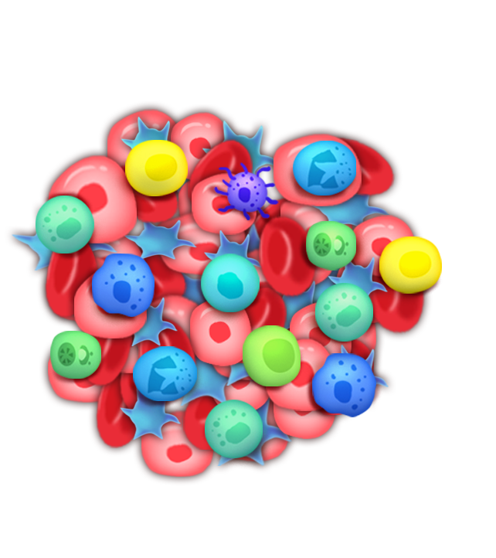
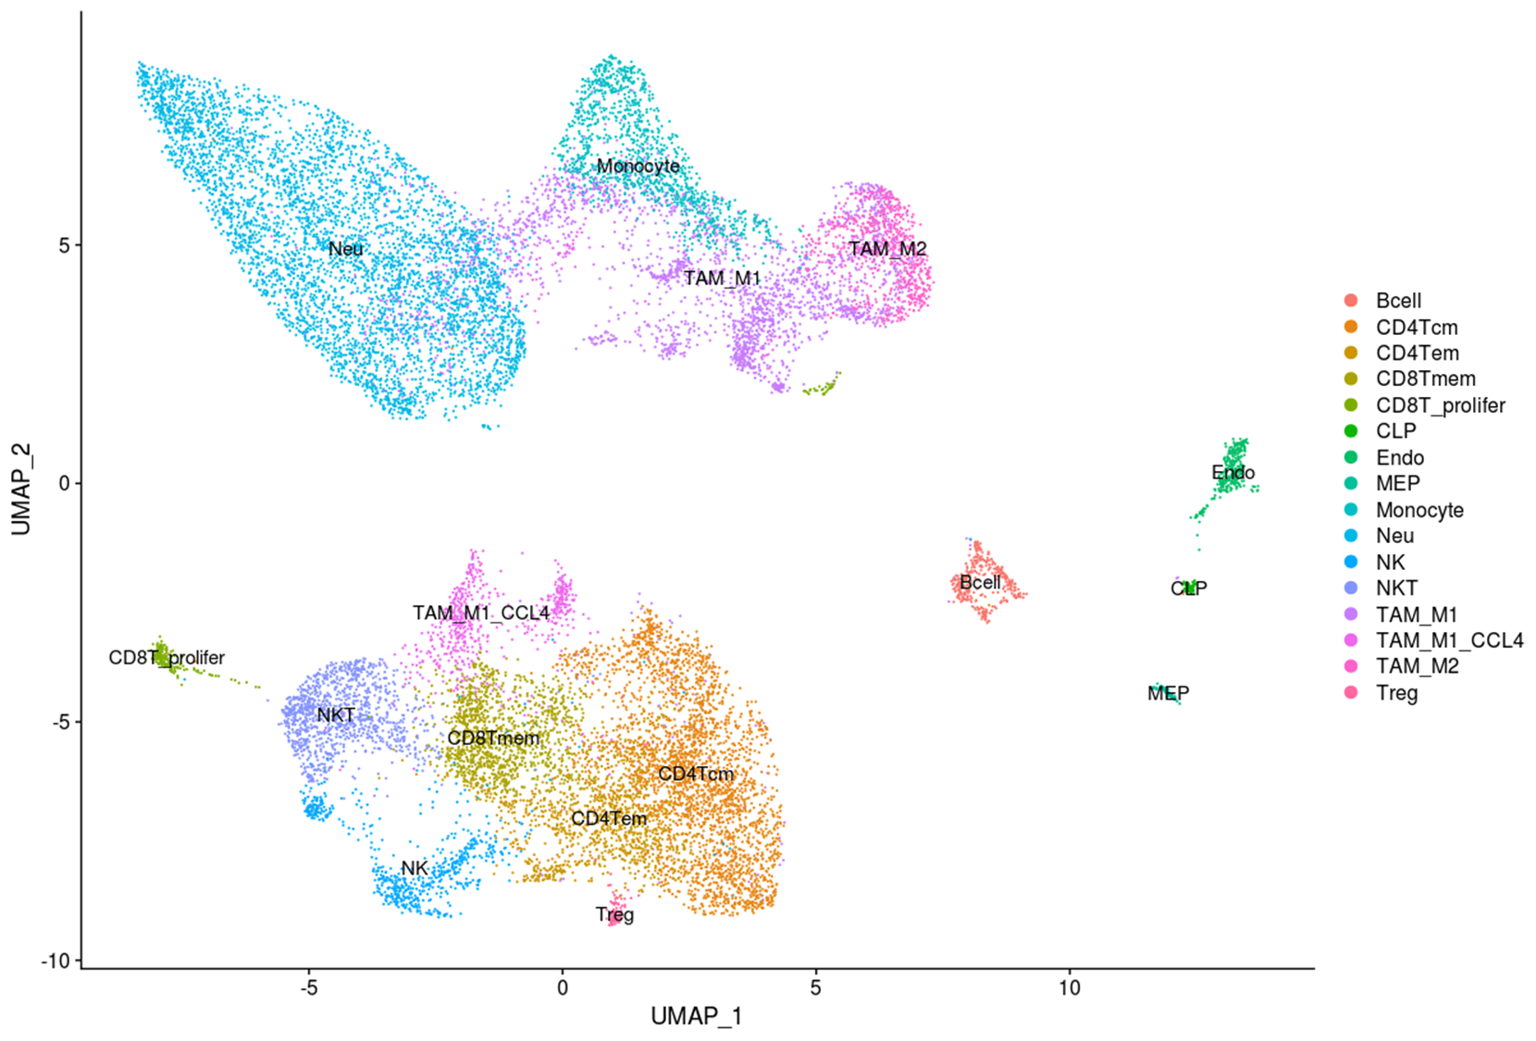
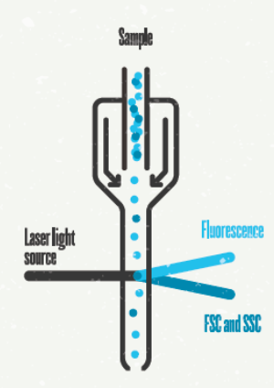
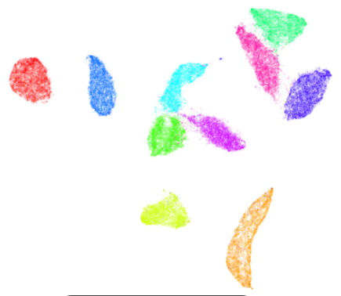
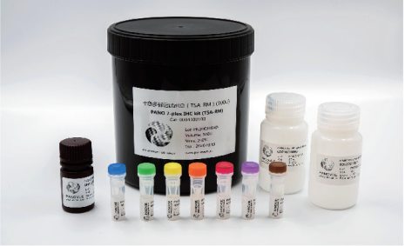
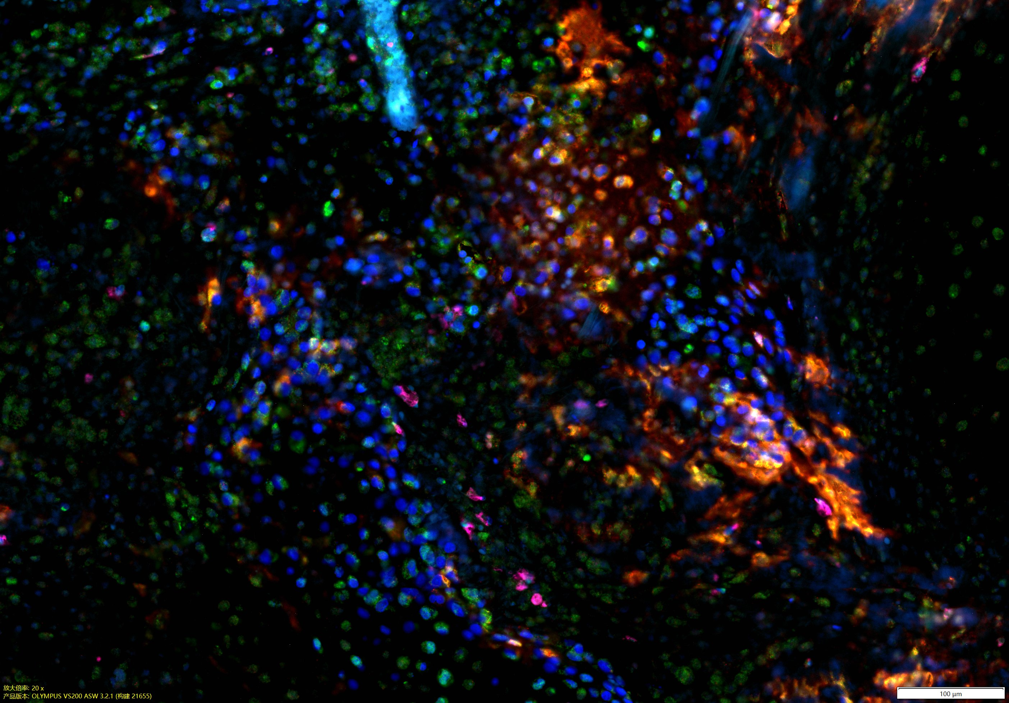
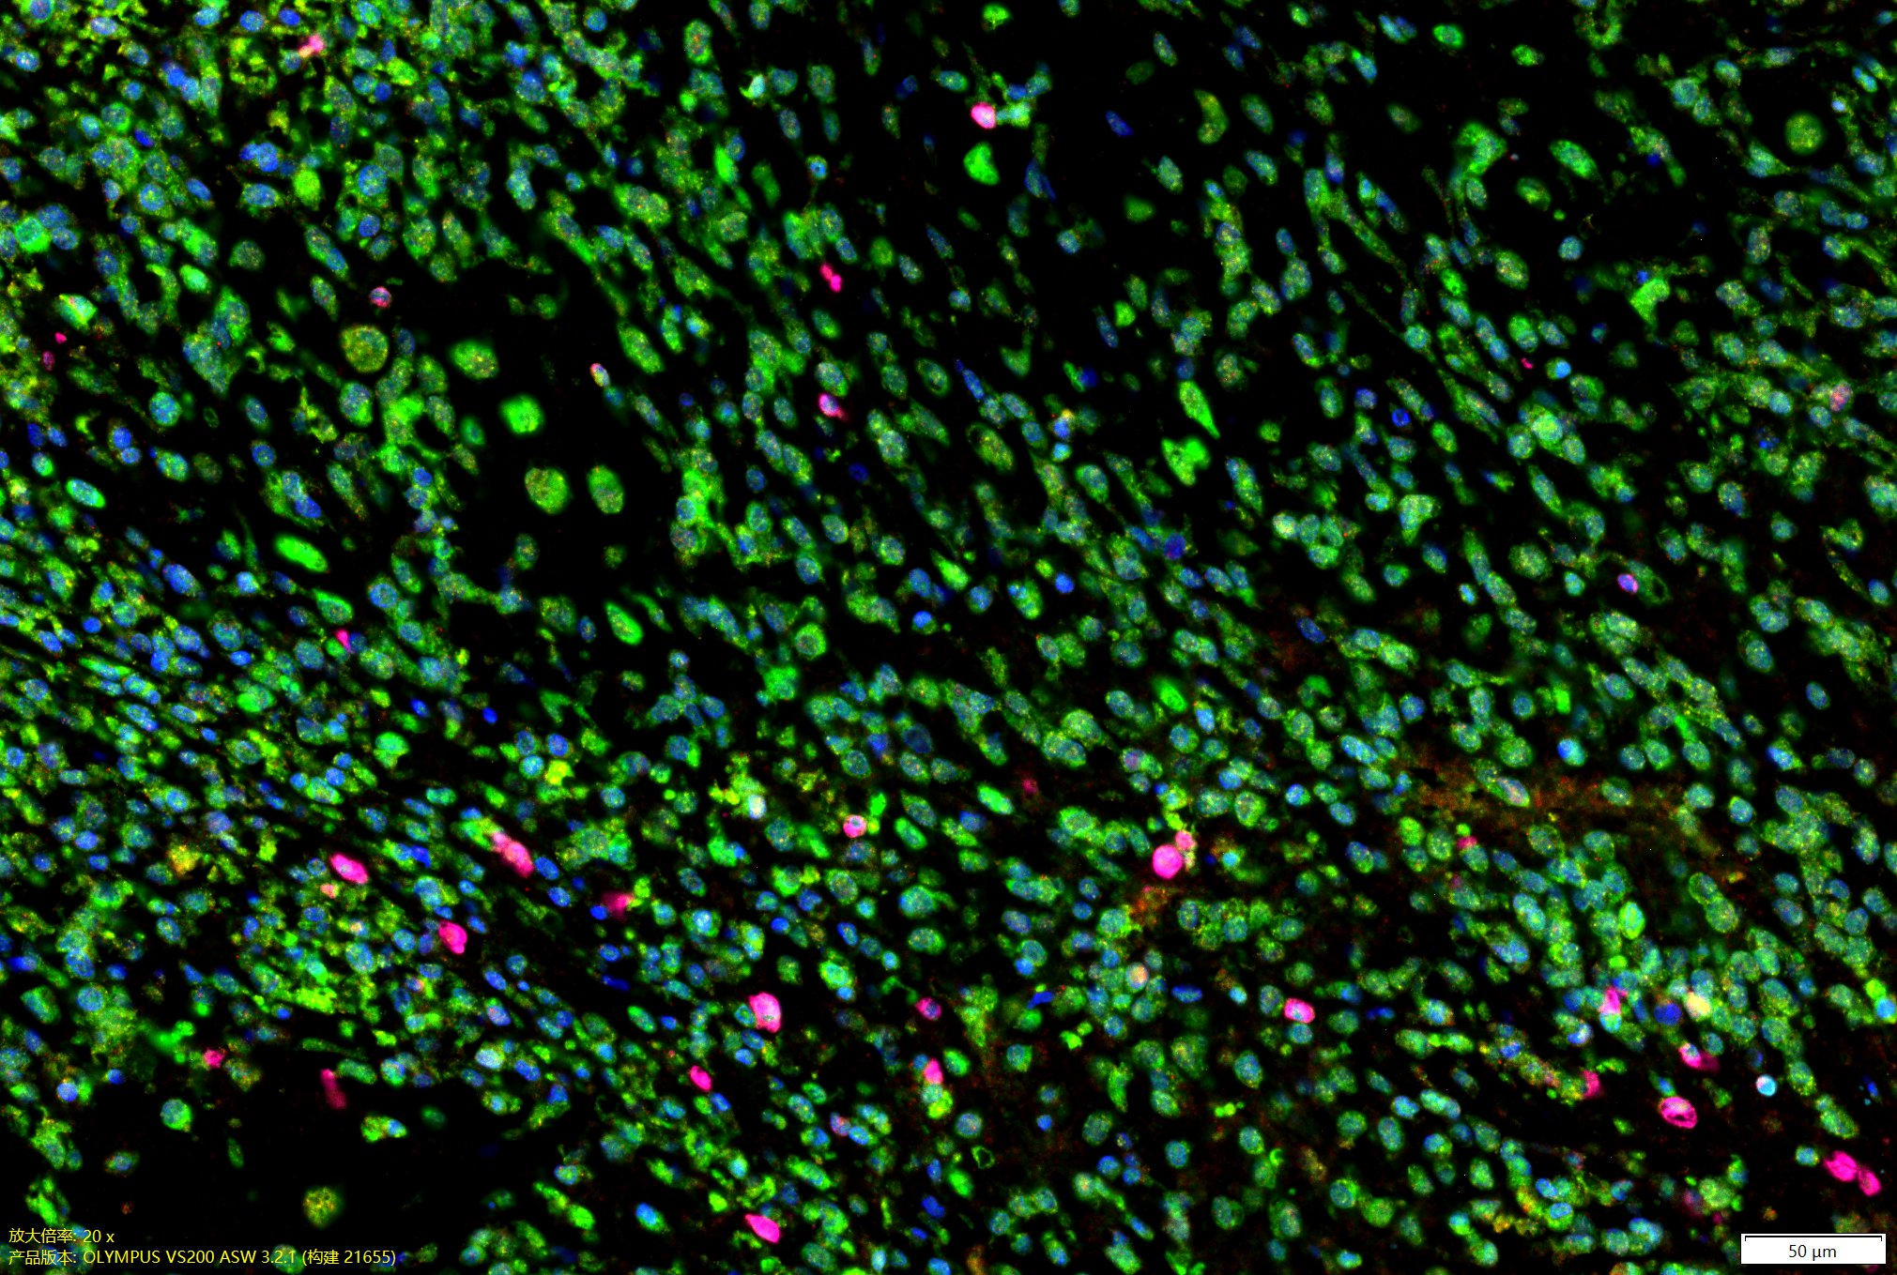
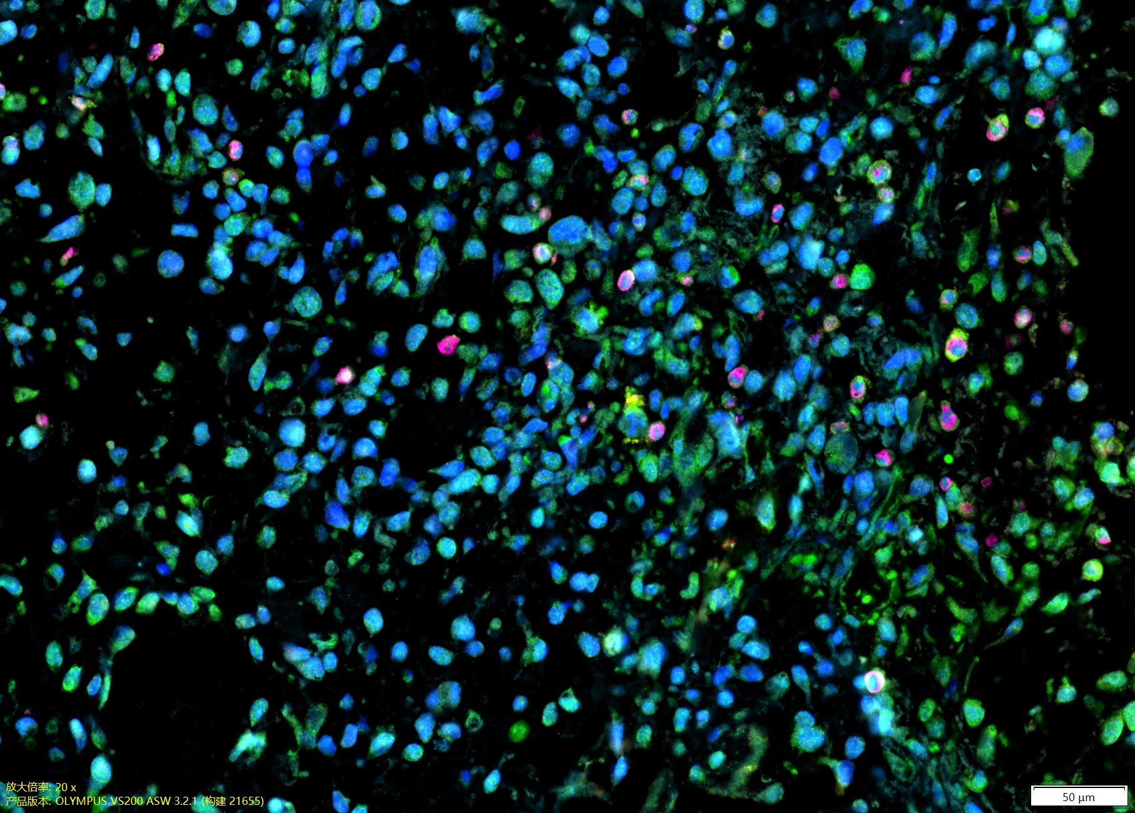
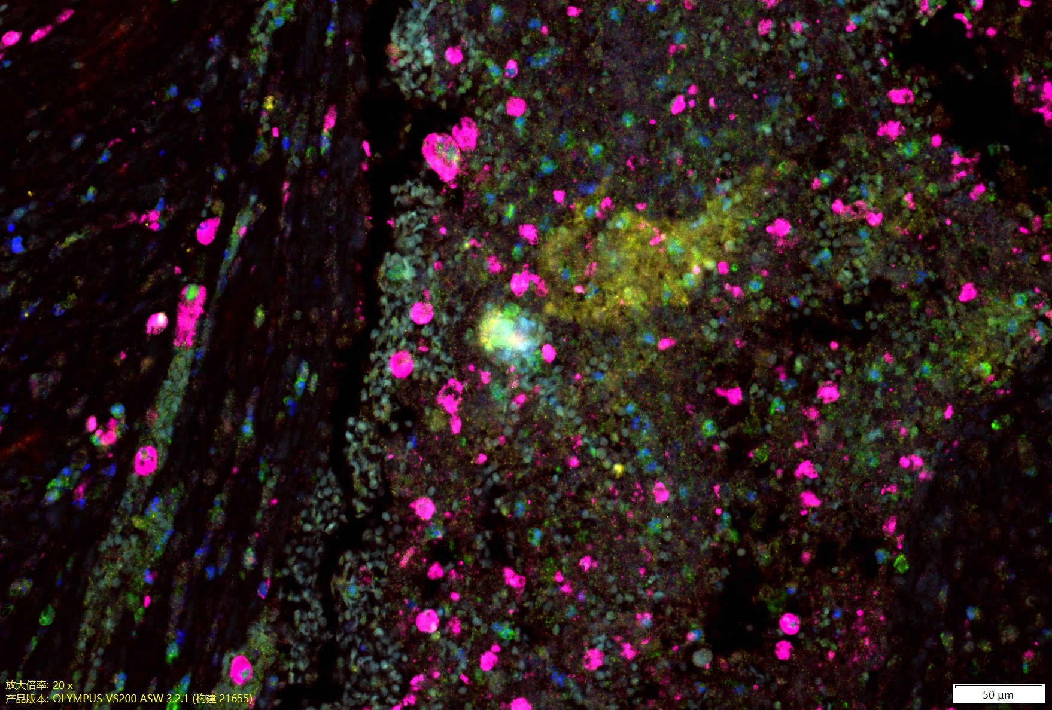
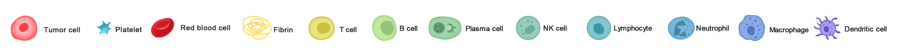
Figure S1
Paired tissue
DNA & RNA extraction
Sequencing & Data analysis
Primary tumor
Thrombus
Specimen collection
①WES+RNA-seq
(N=5)
②scRNA-seq
(N=2)
Single cell solution
preparation
Clustering of immune
cells
Single cell droplet
encapsuleting
Sequencing &
Data analysis
Beeds
③Multiplex IF validation
(N=2)
Cells
Oil
Tissue sections
preparation
Multiplex IF staining
Scanning & Data analysis
Figure. S1 Schematic view of the study design. Paired tumor thrombus and primary tumor samples of osteosarcoma were harvested during surgery, followed by whole-exome sequencing (WES) and bulk RNA-sequencing (RNA-seq). Single-cell suspensions were obtained from paired tumor thrombus and primary tumor samples followed by single-cell RNA sequencing (scRNA-seq) on the 10X Genomics platform. Multiplexed immunofluorescence (mIF) staining of additional slides verified the scRNA-seq findings in a visualized manner.

