Slide 1
Supplementary Figure 1
a
b
0 wk
(8 weeks of age)
16 wk
(24 weeks of age)
Normal diet
Normal diet feeding
Caloric restriction diet
Caloric restriction diet feeding
Ketogenic diet
Ketogenic diet feeding
c
d
e
f
g
Supplementary Fig. 1. Description of the ketogenic diet (KD) feeding model. Related to Figure 1. a, Schematic image showing the feeding models. b–d, Water intake (b), calorie intake (c), and body weight (d) changes during the feeding program. e–g, At the end of the feeding program, the fat mass (e, including the retroperitoneal, epididymal, and visceral fats pads), systolic blood pressure (f), and diastolic blood pressure (g) were measured.

Slide 2


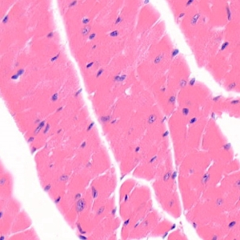

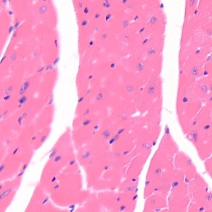
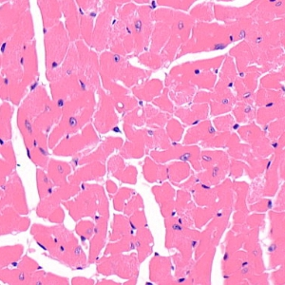






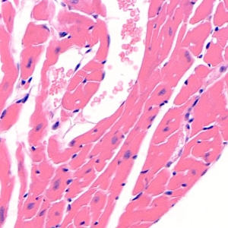








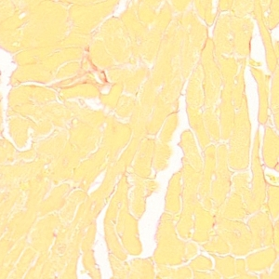





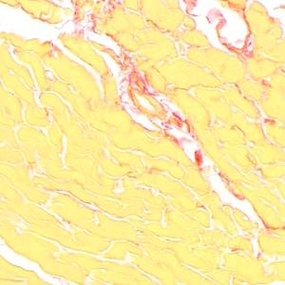




























































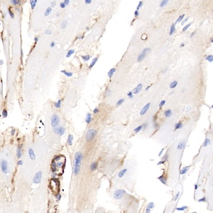

Supplementary Figure 2
a
Rat atrial tissue
Normal
CR
KD
2
3
4
5
6
2
3
4
5
6
2
3
4
5
6
H&E
Sirius Red
Masson
b
Rat atrial tissue
Normal
CR
KD
2
3
4
5
6
2
3
4
5
6
2
3
4
5
6
α-SMA
Collagen I
Collagen III
c
Rat atrial tissue
Normal
CR
KD
SN
4
5
6
4
5
6
4
5
6
α-SMA
Collagen I
Collagen III
Actin
Supplementary Fig. 2. KD induced a cardiac fibrosis phenotype. Related to Figure 1. a, H&E, Sirius red, and Masson staining results of atrial tissues from rats fed a normal diet, KD, or caloric restriction (CR) diet. b, Immunohistochemical (IHC) analysis of α-SMA, collagen I, and collagen III in atrial tissues of rats fed the different diets. c, Western blotting analysis of α-SMA, collagen I, and collagen III in atrial tissues of rats fed the different diets.

Slide 3
Supplementary Figure 3
a
Intraperitoneal injection model
b
c
0 wk
(8 weeks of age)
16 wk
(24 weeks of age)
Injection every other day
Injected with β-OHB, AcAc or saline
d
e
f
g
h
i
j
Supplementary Fig. 3. Description of the ketone body intraperitoneal injection model. Related to Figure 1. a, Schematic image showing the intraperitoneal injection models. b, Plasma β-hydroxybutyrate (β-OHB) concentrations of rats before β-OHB injection and at different time points after β-OHB injection. n = 3. c, Plasma acetoacetate (AcAc) concentrations of rats before AcAc injection and at different time points after AcAc injection. n = 3. d, Ketone body concentrations in the plasma and atrial tissues of rats with different injections (n = 6/group). e–g, Water intake (e), calorie intake (f), and body weight (g) changes during the injection program. h–j, At the end of the feeding program, the fat mass (h, including the retroperitoneal, epididymal, and visceral fats pads), systolic blood pressure (i), and diastolic blood pressure (j) were measured.

Slide 4





















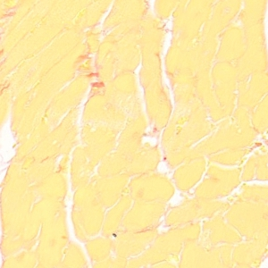



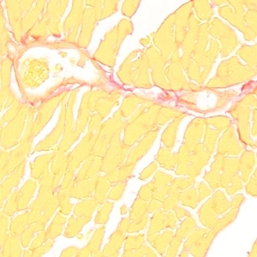

































































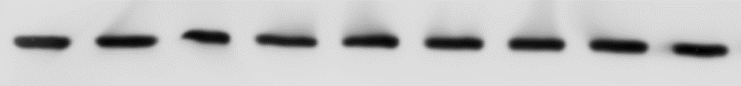
Supplementary Figure 4
a
Rat atrial tissue
Saline
AcAc
β-OHB
2
3
4
5
6
2
3
4
5
6
2
3
4
5
6
H&E
Sirius Red
Masson
b
Rat atrial tissue
Saline
AcAc
β-OHB
2
3
4
5
6
2
3
4
5
6
2
3
4
5
6
α-SMA
Collagen I
Collagen III
c
Rat atrial tissue
Saline
AcAc
β-OHB
SN
4
5
6
4
5
6
4
5
6
α-SMA
Collagen I
Collagen III
Actin
Supplementary Fig. 4. β-OHB induced a cardiac fibrosis phenotype. Related to Figure 1. a, H&E, Sirius red, and Masson staining results of atrial tissues from rats intraperitoneally injected with saline, AcAc, or β-OHB. b, IHC analysis of α-SMA, collagen I, and collagen III in atrial tissues from rats with different injections. c, Western blotting analysis of α-SMA, collagen I, and collagen III in atrial tissues of rats with different injections.

Slide 5








































































Supplementary Figure 5
a
b
c
d
Rat atrial tissue
Control
FDF
1
2
3
4
5
6
1
2
3
4
5
6
H&E
Sirius Red
Masson
e
Rat atrial tissue
Control
FDF
1
2
3
4
5
6
1
2
3
4
5
6
α-SMA
Collagen I
Collagen III
Supplementary Fig. 5. Frequent deep fasting (FDF) caused a cardiac fibrosis phenotype. Related to Figure 1. a, b, At the end of the feeding program, the body weight (a), fat mass (including the retroperitoneal, epididymal, and visceral fats pads) (b), were harvested from the rats and weighed. c, Ketone body concentrations in the plasma and atrial tissues of rats according to the feeding regimen. n = 6. d, H&E, Sirius red, and Masson staining results of atrial tissues from rats fed a normal diet or subjected to FDF. The right panel shows the quantitative results. e, IHC analysis of α-SMA, collagen I, and collagen III in atrial tissues of rats according to the feeding regimen. The right panel shows the quantitative results. Data shown are means ± standard errors. **p < 0.01, *p < 0.05 versus the corresponding control group according to Student’s t tests.

Slide 6
Supplementary Figure 6
a
b
c
Supplementary Fig. 6. Mitochondrial DNA damage levels in cultured cells (a) and cardiomyocytes from rat models (b, c). Related to Figure 3.

Slide 7
Supplementary Figure 7
a
b
c
d
e
f
Supplementary Fig. 7. β-OHB did not increase apoptosis levels in fibroblasts. Related to Figure 3. a, b, Mitochondrial mass determined by mitochondrial DNA quantification in MEFs (a) and primary mouse cardiac fibroblasts (b). n = 3. c, d, Oxygen consumption rates (OCRs) in MEFs (c) and primary mouse cardiac fibroblasts (d) treated with β-OHB or not. n = 3. e, f, Apoptosis in MEFs (e) and mouse primary fibroblasts (f) treated with β-OHB and Oxyrase. n = 3.

Slide 8
Supplementary Figure 8
a
b
Supplementary Fig. 8. β-OHB affected gene transcription. Related to Figure 4. a, Using microarray analysis, we found that SIRT7 and SIRT4 mRNA levels were upregulated in β-OHB-treated HEK293T cells. b, Gfm2 and Mrpl24 expression in SIRT4-overexpressing H9C2 cells. n = 3.

Slide 9
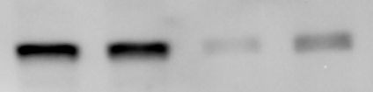
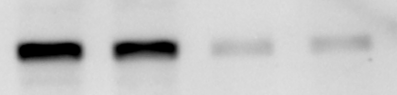



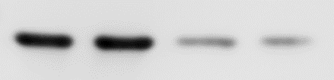
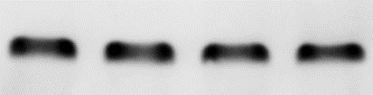
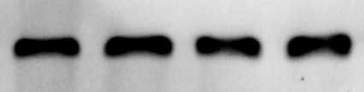


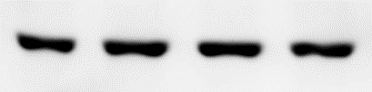


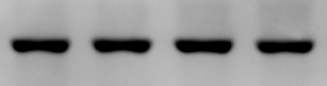
Supplementary Figure 9
a
b
Scrambled siRNA
Scrambled siRNA
Hdac1 siRNA-1
Hdac1 siRNA-2
Hdac3 siRNA-1
Control
Control
Hdac3 siRNA-2
HDAC1
HDAC3
Actin
Actin
c
d
Scrambled siRNA
Scrambled siRNA
Hdac4 siRNA-1
Hdac4 siRNA-2
Hdac5 siRNA-1
Control
Control
Hdac5 siRNA-2
HDAC4
HDAC5
Actin
Actin
e
f
Scrambled siRNA
Scrambled siRNA
Hdac7 siRNA-1
Hdac6 siRNA-1
Hdac7 siRNA-2
Control
Hdac6 siRNA-2
Control
HDAC6
HDAC7
Actin
Actin
g
Scrambled siRNA
Hdac8 siRNA-1
Control
Hdac8 siRNA-2
HDAC8
Actin
Supplementary Fig. 9. SIRT7 mRNA levels in cells with knockdown of histone deacetylases (HDACs) treated with or without β-OHB. Related to Figure 5. n = 3. The knockdown efficiencies were determined by western blotting.

Slide 10
Supplementary Figure 10
a
b
Supplementary Fig. 10. Trichostatin A (TSA) activated SIRT7 expression (a) and decreased mitochondrial mass (b). Related to Figure 5. n = 3.

Slide 11

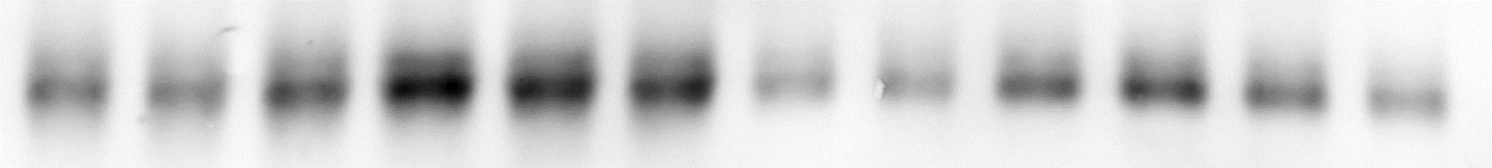














Supplementary Figure 11
a
7
8
SR
AF
SR
AF
9
10
11
12
7
8
9
10
11
12
13
14
15
16
17
18
13
14
15
SIRT7
16
17
18
CACNA1H
CACNA2D2
GFM2
MRPL24
Collagen I
Collagen III
SMA
Actin
19
20
SR
AF
SR
AF
21
22
23
24
19
20
21
22
23
24
25
26
27
28
29
30
25
26
27
28
29
SIRT7
30
CACNA1H
CACNA2D2
GFM2
MRPL24
Collagen I
Collagen III
SMA
Actin
b
4
5
6
7
8
9
10
SR
4
5
6
7
8
9
10
SIRT7
AF
Supplementary Fig. 11. SIRT7 was activated in cardiac tissues from patients with atrial fibrillation (AF). Related to Figure 6. a, Western blotting analysis of SIRT7, CACNA1H, CACNA2D2, GFM2, MRPL24, collagen I, collagen III, and α-SMA in atrial tissues from patients with sinus rhythm (SR) and AF. b, IHC analysis of SIRT7 in atrial tissues from patients with SR and AF.

Slide 12
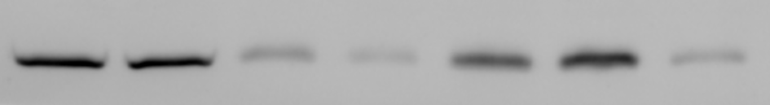
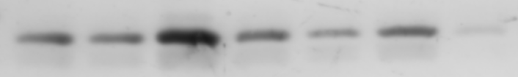
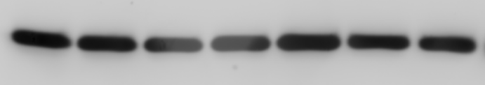
Supplementary Figure 12
Rat
Muscle
Kidney
Heart
Bone marrow
Whole Brain
Liver
Colon
SIRT7
HDAC2
Actin
Supplementary Fig. 12. SIRT7 and HDAC2 protein widely expressed in different rat organs. Western blotting analysis of SIRT7 and HDAC2 protein level in different organs of Sprague-Dawley rats.

Slide 13
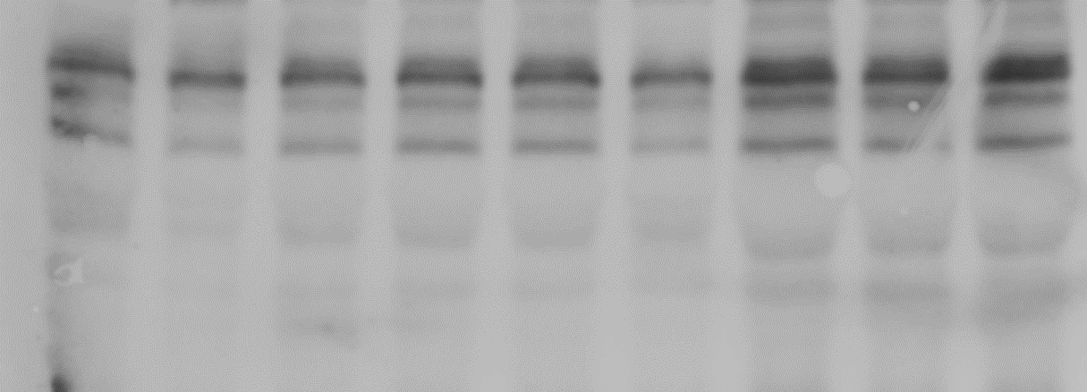
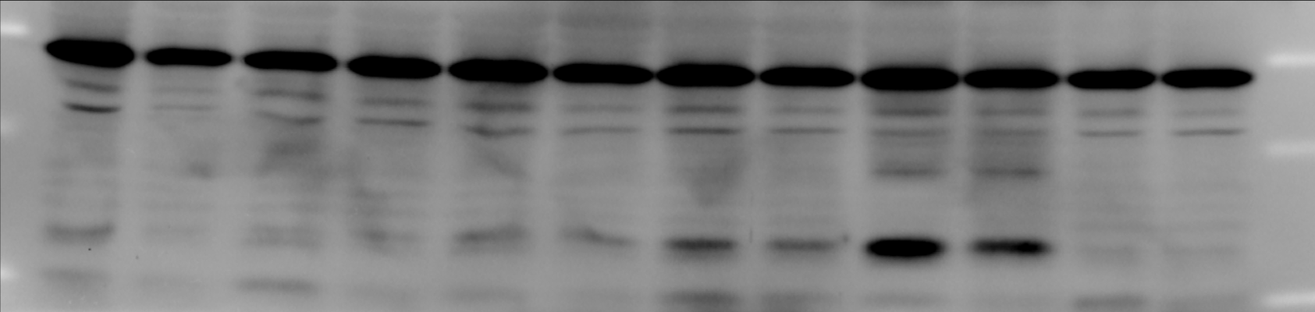
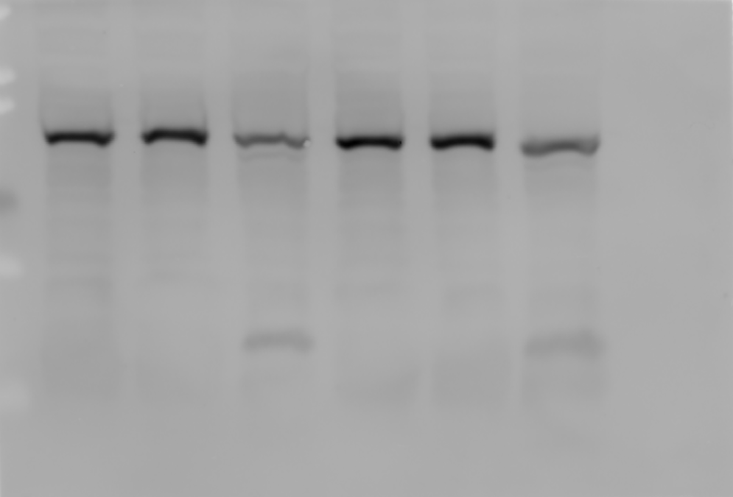
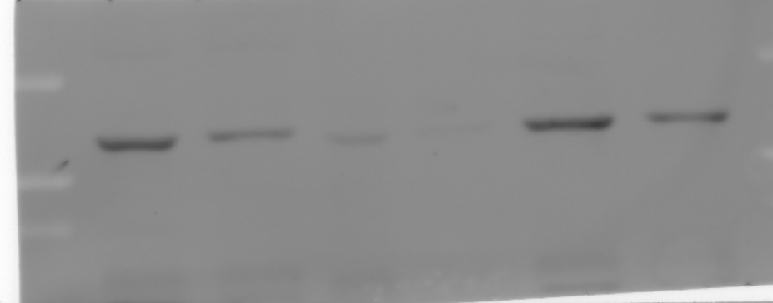
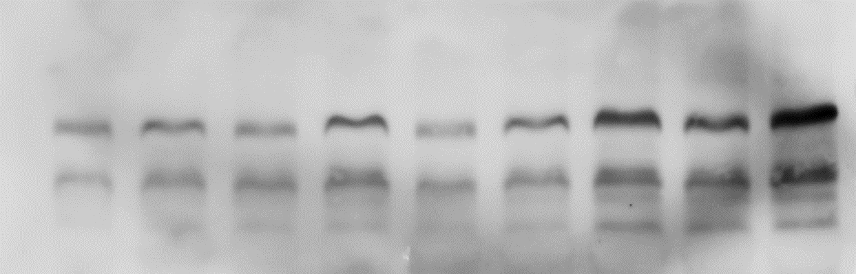
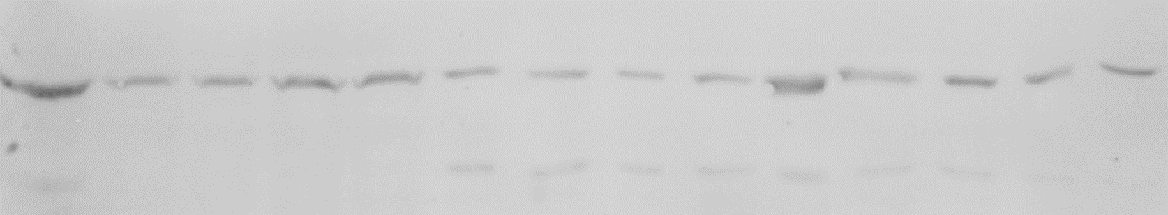
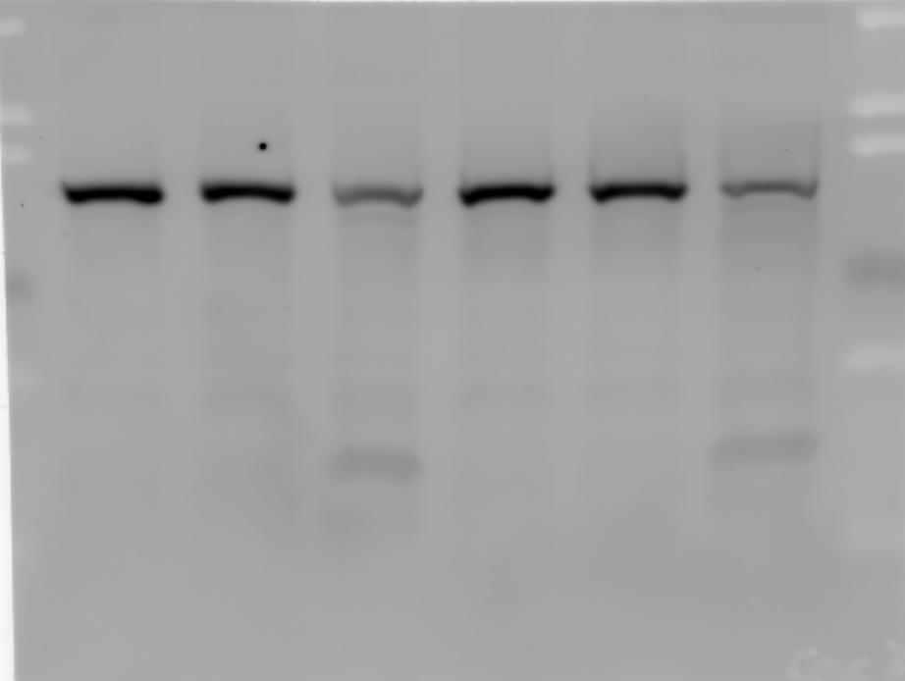
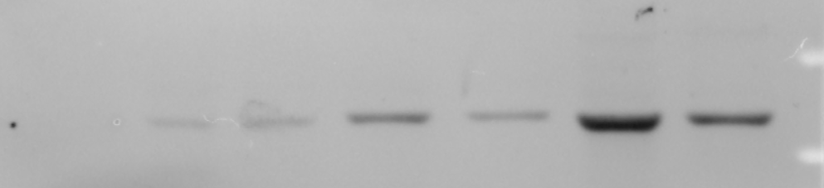
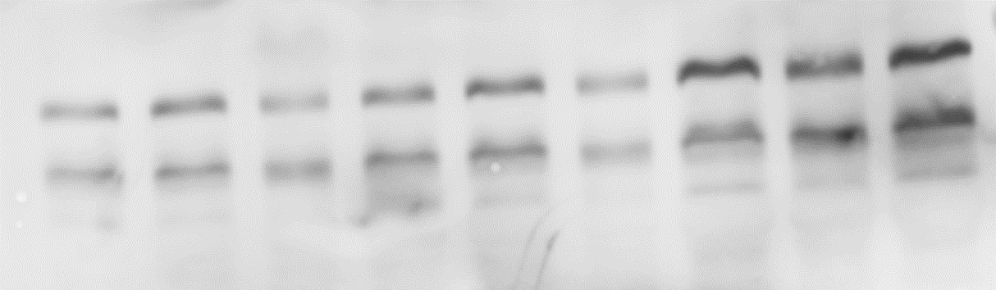
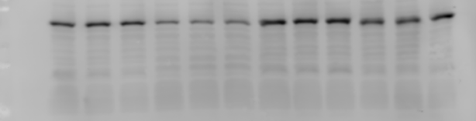
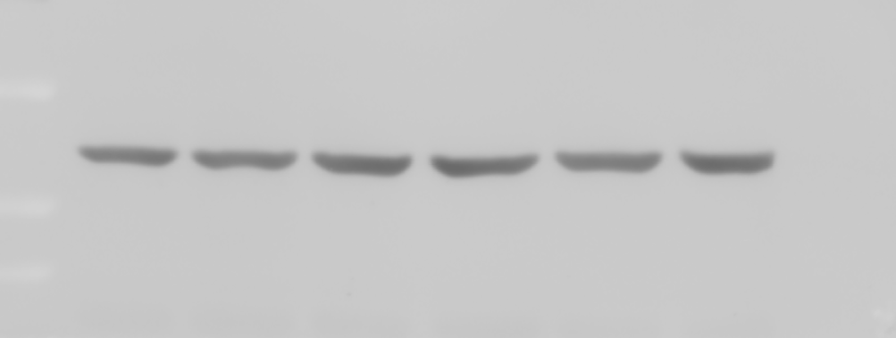
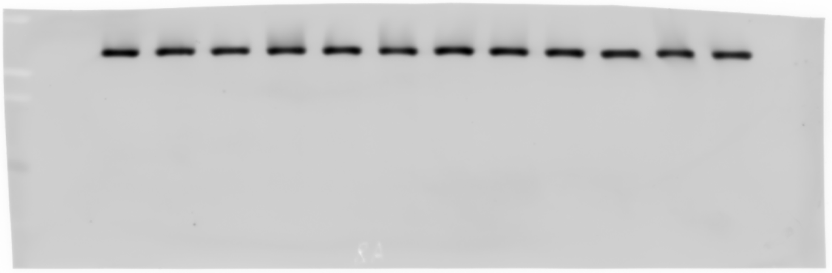
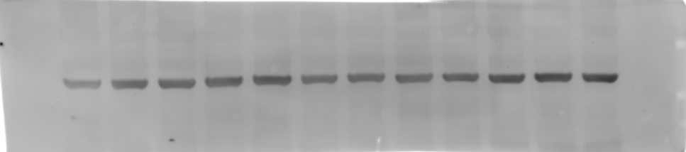
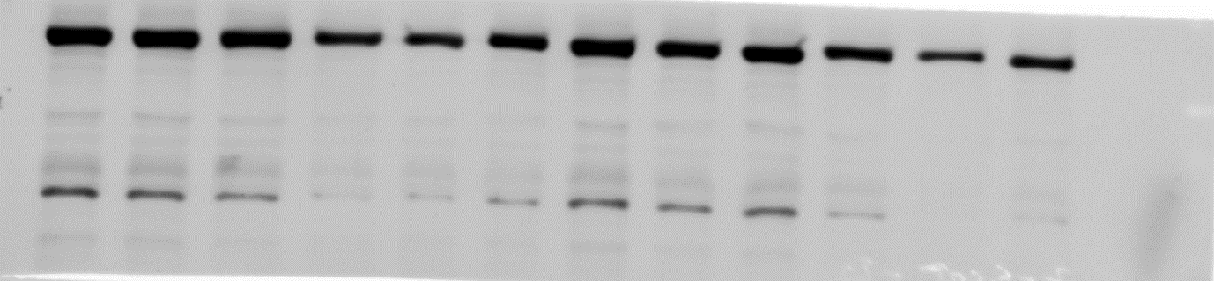
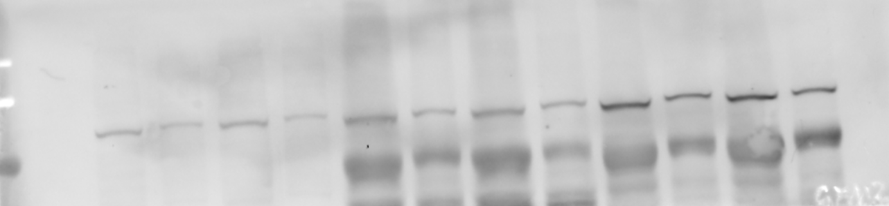
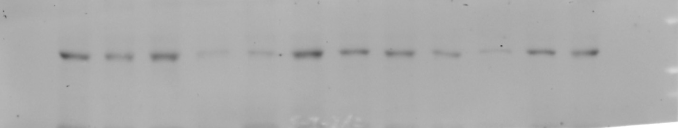
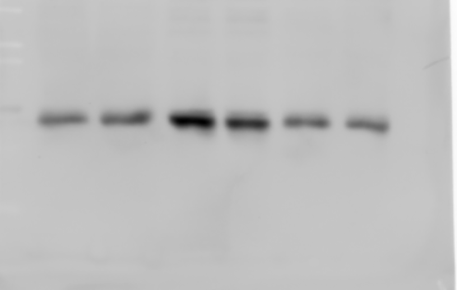
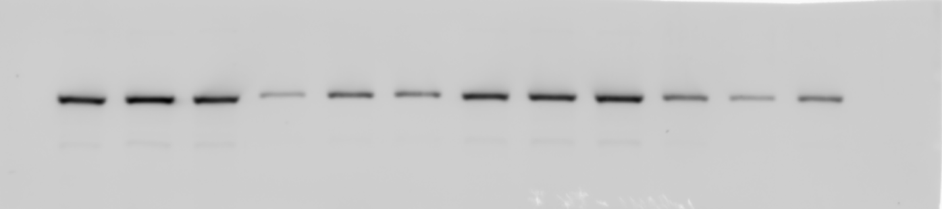
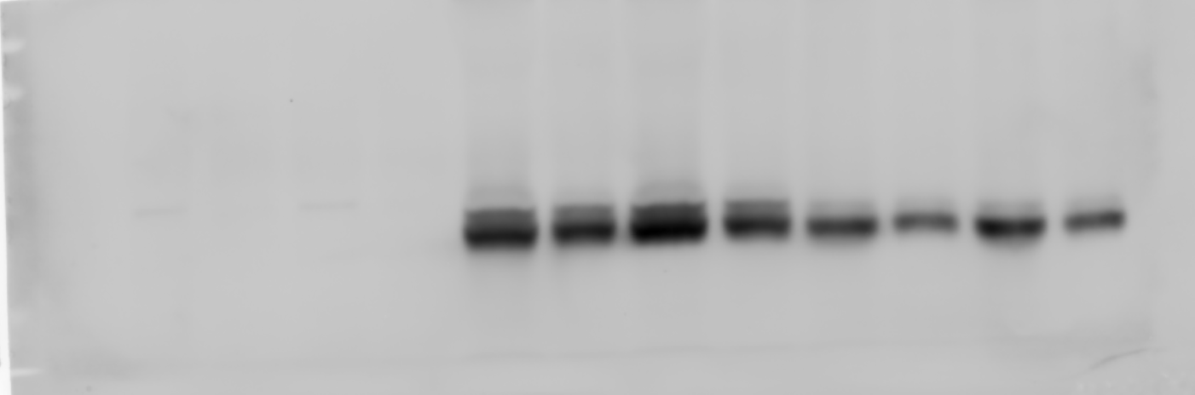
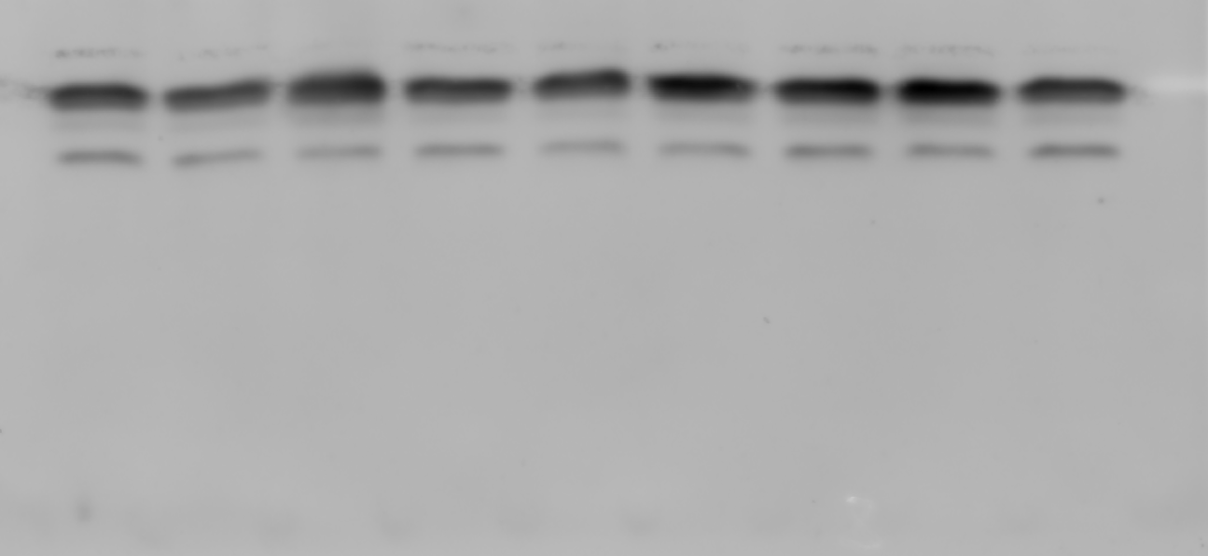
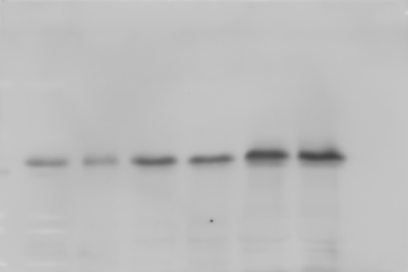
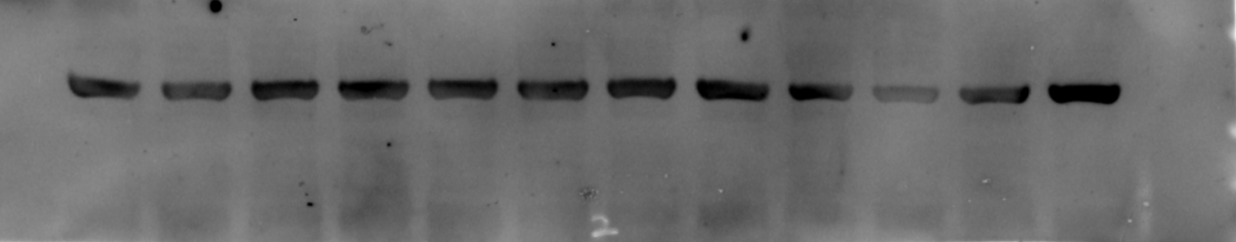
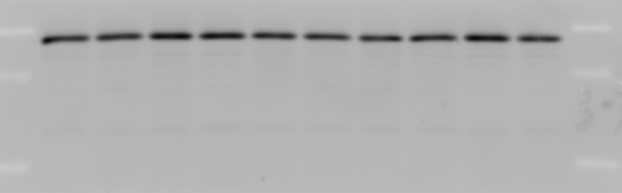
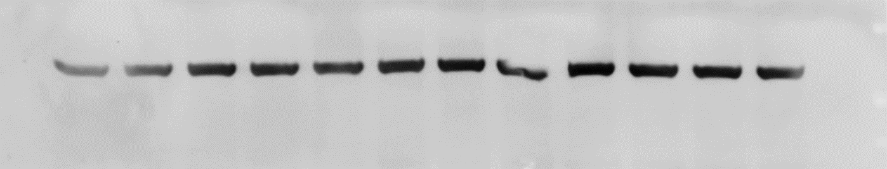
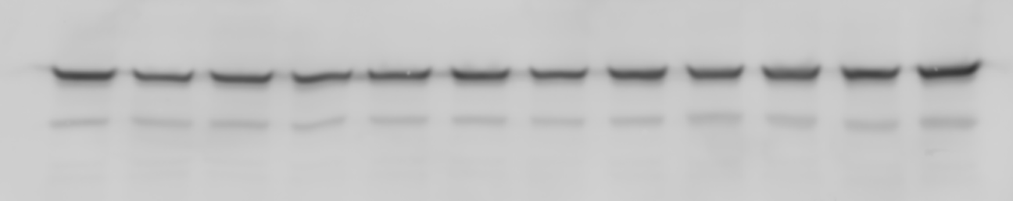
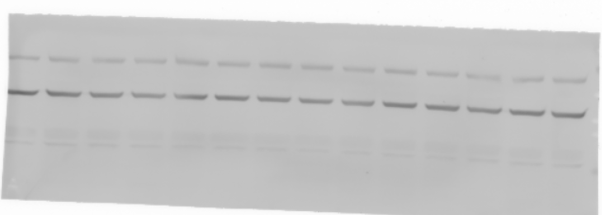
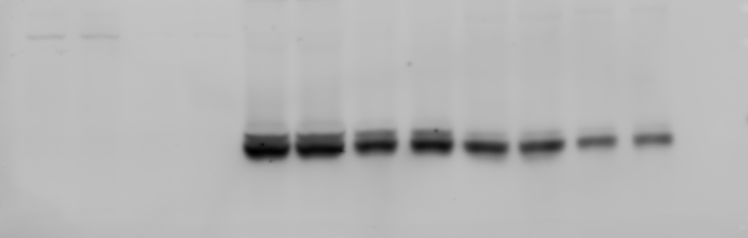
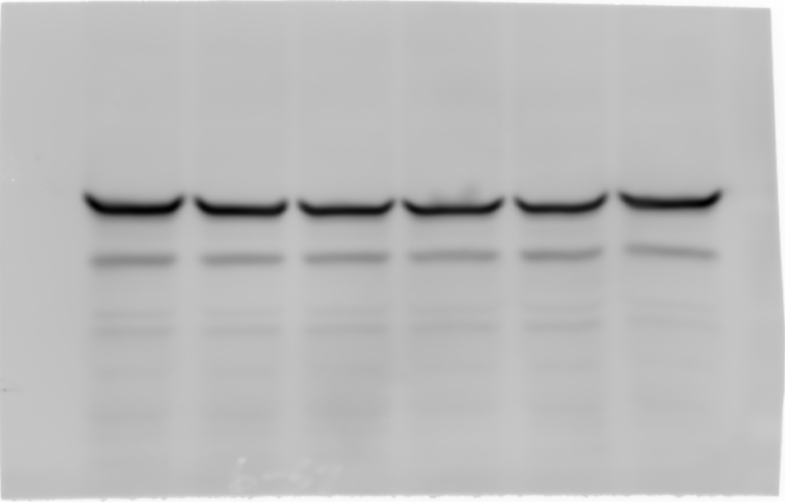
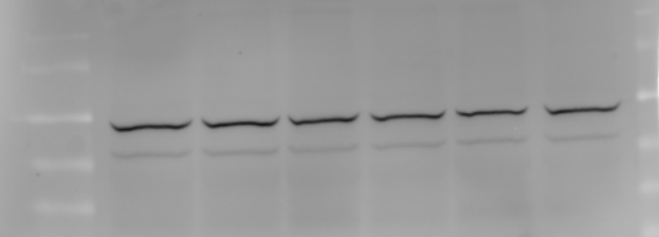











Supplementary Figure 13
Figure 1a
kDa
Figure 2c
kDa
Figure 2e
kDa
Figure 2f
kDa
40
35
40
40
15
15
IB: BDH1
IB: SMA
150
35
15
40
50
IB: Collagen I
35
IB: SCOT
150
IB: Caspase3
15
IB: Caspase3
15
IB: Actin
40
IB: Collagen III
40
40
IB: Actin
IB: Actin
Figure 2g
Figure 4a
kDa
kDa
kDa
kDa
40
IB: GFM2
100
15
70
IB: BDH1
50
25
IB: MRPL16
15
IB: PARKIN
IB: SCOT
40
IB: MRPL24
150
70
40
IB: LC3-I / LC3-II
40
IB: PINK1
IB: Actin
IB: POLRMT
IB: Actin
40
IB: TFAM
30
40
40
IB: TFB1M
Figure 4d
kDa
Figure 4h
kDa
Figure 5b
kDa
150
100
40
40
40
IB: SIRT7
25
40
40
IB: Flag
40
40
IB: SIRT7
IB: Actin
IB: Actin
40
Figure 5a
kDa
50
40
IB: HDAC2
IB: Actin
40
Supplementary Fig. 13. Uncropped and unprocessed scans of gels and blots.

Slide 14





















Continued
Figure 5g
kDa
Figure 5i
kDa
Figure 5j
kDa
15
150
150
IB: Ac
IB: CACNA1H
150
15
IB: CACNA1H
150
IB: CACNA2D2
CBB
150
40
Figure 5h
150
IB: Actin
kDa
IB: CACNA2D2
15
IB: H3K9Ac
Figure 6b
15
kDa
kDa
15
150
40
IB: H3K14Ac
IB: CACNA1H
150
IB: SIRT7
15
40
IB: CACNA2D2
IB: SMA
150
IB: Histone3.1
100
IB: Collagen I
IB: GFM2
35
150
IB: Collagen III
IB: MRPL24
40
IB: Actin
Supplementary Fig. 13. Uncropped and unprocessed scans of gels and blots.

Slide 15
Supplementary Table 1
NAME | SEQUENCE (5’-3’)
PCR, qRT-PCR
ACTB-forward (human) | TCCCTGGAGAAGAGCTACG
ACTB-reverse (human) | GTAGTTTCGTGGATGCCACA
SIRT7-forward (human) | CGCCAAATACTTGGTCGTCT
SIRT7-reverse (human) | CCCTTTCTGAAGCAGTGTCC
GFM2-forward (human) | AGTCATCAGACAATACCCAGTGT
GFM2-reverse (human) | GCCTGCATCAATATGAGCCATAA
MRPL24-forward (human) | CCATTACCGCTATGGGATGAGC
MRPL24-reverse (human) | CCACAGAACAGATACCAGTCTTC
POLRMT-forward (human) | GGACCATCGAAAGGTGTCTGG
POLRMT-reverse (human) | ATCCTTGGCATACACGTCCCT
TFB1M-forward (human) | GTTGCCCACGATTCGAGAAAT
TFB1M-reverse (human) | GCCCACTTCGTAAACATAAGCAT
TFAM-forward (human) | ATGGCGTTTCTCCGAAGCAT
TFAM-reverse (human) | TCCGCCCTATAAGCATCTTGA
ACTB-forward (rat) | CACCATGTACCCAGGCATTG
ACTB-reverse (rat) | CCTGCTTGCTGATCCACATC
SIRT7-forward (rat) | ACGGGCTTGATCTTCAAGGA
SIRT7-reverse (rat) | GAGTGAGGTAAGGCAGTGGT
GFM2-forward (rat) | AATCCAGGATGTGGCAGTGA
GFM2-reverse (rat) | GCAGGCAGTGACCATAGTTG
MRPL24-forward (rat) | GGTTGTCCTGGAGGGATTGA
MRPL24-reverse (rat) | GATCATGGTCCCTCGGTGAT
POLRMT-forward (rat) | CTTCTGGTTGCCACACAACA
POLRMT-reverse (rat) | CTCAGCGAACTCCAACAGTG
TFB1M-forward (rat) | ACCGAGGGCTTGGAATGTTA
TFB1M-reverse (rat) | AGCGTTGGATCAATGTCAGC
TFAM-forward (rat) | ATGGACTTCTGCCCACTGAA
TFAM-reverse (rat) | GATGCACGCACAGTCTTGAT
ACTB-forward (mouse) | GGCTGTATTCCCCTCCATCG
ACTB-reverse (mouse) | CCAGTTGGTAACAATGCCATGT
SIRT7-forward (mouse) | CAATCCTGTGTTTAGGGTCCAG
SIRT7-reverse (mouse) | GTTCACGATGTAGAGTTTGGGTC
GFM2-forward (mouse) | TCATTCCGTCATTAACCCTCCT
GFM2-reverse (mouse) | AATGCCCCTTTCTCGCTCTTG
MRPL24-forward (mouse) | TGAGCCGTCCAGGTTCCATA
MRPL24-reverse (mouse) | ACAGAATAGGTGCCAGTCTTCA
POLRMT-forward (mouse) | TGGGCGCAAAAGCTAGAGG
POLRMT-reverse (mouse) | GTGAAGGGTCCAGAACTCCTG
TFB1M-forward (mouse) | CGGGAGATCATTAAGTTGTTCGG
TFB1M-reverse (mouse) | GCCCAGGACCCACTTCATAAA
TFAM-forward (mouse) | ATTCCGAAGTGTTTTTCCAGCA
TFAM-reverse (mouse) | TCTGAAAGTTTTGCATCTGGGT
12.5kb-mito-forward (rat) | AGACGGGTGAGACAGCTGCACCTTTTC
12.5kb-mito-reverse (rat) | CGAGAGCATCAAGTGCAGGCATTAGAG
235bp-mito-forward (rat) | CCTCCCATTCATTATCGCCGCCCTTGC
235bp-mito-reverse (rat) | GTCTGGGTCTCCTAGTAGGTCTGGGAA
NAME | SEQUENCE (5’-3’)
Mitochondrial Mass Quantification
16S rRNA (mtDNA)-forward (human) | GCCTTCCCCCGTAAATGATA
16S rRNA (mtDNA)-reverse (human) | TTATGCGATTACCGGGCTCT
β2-microglobulin (nDNA)-forward (human) | TGCTGTCTCCATGTTTGATGTAT
β2-microglobulin (nDNA)-reverse (human) | TCTCTGCTCCCCACCTCTAAGT
ND4 (mtDNA)-forward (mouse) | GGAACCAAACTGAACGCCTA
ND4 (mtDNA)-reverse (mouse) | ATGAGGGCAATTAGCAGTGG
β2-microglobulin (nDNA)-forward (mouse) | TCATTAGGGAGGAGCCAATG
β2-microglobulin (nDNA)-reverse (mouse) | ATCCCCTTTCGTTTTTGCTT
ND4 (mtDNA)-forward (rat) | CAATCTGCCTACGCCAAACA
ND4 (mtDNA)-reverse (rat) | CGGCTGTGAATTCGTTCGTA
β2-microglobulin (nDNA)-forward (rat) | TCTGGTGCTTGTCTCTCTGG
β2-microglobulin (nDNA)-reverse (rat) | GGGTGGAACTGAGACACGTA
Chromatin IP-(qRT)-PCR
SIRT7 promoter region1-forward | TGCCCTGCGCAGTATTTATT
SIRT7 promoter region1-reverse | GCTCCCTCTGCTGCTCCT
SIRT7 promoter region2-forward | TAGGTCTAGCCAGGGGAGGT
SIRT7 promoter region2-reverse | AAGAAGCACCTGCCAGTCTC
SIRT7 promoter region3-forward | TGAGACCTCCCTGTTCTTGG
SIRT7 promoter region3-reverse | CCAGCCCCTCCTCACTTAG
SIRT7 promoter region4-forward | GAGCAGGTCGGGAGAGTAGA
SIRT7 promoter region4-reverse | CAGGAGAAGGCTTTCTGTGC
SIRT7 promoter region5-forward | ATGGTCAGGTCCCATGTTGT
SIRT7 promoter region5-reverse | TGGTACACACCCAGGACACA
SIRT7 promoter region6-forward | TTCTGACACAGCGAATCGAG
SIRT7 promoter region6-reverse | ACAACATGGGACCTGACCAT
SIRT7 promoter region7-forward | GAGTGTTCCTGTCCCCTGTC
SIRT7 promoter region7-reverse | CCTGCTGGGTATTCCTCTGA
Knock-down
SIRT7 (rat) shRNA target seq-1 | CACCTTTCTGTGAGAACGGAA
SIRT7 (rat) shRNA target seq-1 | TAGCCATTTGTCCTTGAGGAA
HDAC1 (rat) siRNA-1 | CUCAGGGCACCAAGAGGAATT
HDAC1 (rat) siRNA-2 | CGCAGACUCAGGGCACCAATT
HDAC2 (rat) siRNA-1 | GCAAGAAGAAAGUGUGCUATT
HDAC2 (rat) siRNA-2 | GCAGAUGCAGAGAUUUAAUTT
HDAC3 (rat) siRNA-1 | CCAAGAGCCUUAAUGCCUUTT
HDAC3 (rat) siRNA-2 | GGAACUUCCCUAUAGUGAATT
HDAC4 (rat) siRNA-1 | GCAGUUUCUGGAGAAGCACTT
HDAC4 (rat) siRNA-2 | GCAGCAGCACCAGCAGUUUTT
HDAC5 (rat) siRNA-1 | GGUUCUACAGAGAGCGAGATT
HDAC5 (rat) siRNA-2 | GGACGAGGAGGACUGCAUUTT
HDAC6 (rat) siRNA-1 | GCGAAAGAGUAGGCACAAUTT
HDAC6 (rat) siRNA-2 | GGGCCAGUCCUCAGAACAATT
HDAC7 (rat) siRNA-1 | GCAAGAACUUCGGCAACUUTT
HDAC7 (rat) siRNA-2 | GCACACAGCAGACUUUCUATT
HDAC8 (rat) siRNA-1 | GCUGGGAGCAGAUACCAUUTT
HDAC8 (rat) siRNA-2 | GGACUUGGAUCUACACCAUTT
NAME | SEQUENCE (5’-3’)
Plasmids Construction
SIRT7-forward (Xba I) | GCTCTAGAATGGCAGCCGGGGGTCTGAGCCGCT
SIRT7-reverse (EcoR I) | CGGAATTCCGTCACTTTCTTCCTTTTTGTGCGT
HDAC1-forward (EcoR I) | CGGAATTCATGGCGCAGACGCAGGGCACCCGGA
HDAC1-reverse (BamH I) | CGGGATCCGGCCAACTTGACCTCCTCCTTGACC
HDAC2-forward (Xho I) | CCCTCGAGATGGCGTACAGTCAAGGAGGCGGCA
HDAC2-reverse (BamH I) | CGGGATCCGGGGTTGCTGAGCTGTTCTGATTTG
HDAC3-forward (EcoR I) | CGGAATTCATGGCCAAGACCGTGGCCTATTTCT
HDAC3-reverse (BamH I) | CGGGATCCAATCTCCACATCGCTTTCCTTGTCA
HDAC4-forward (Xba I) | GCTCTAGAATGAGCTCCCAAAGCCATCCAGATG
HDAC4-reverse (EcoR I) | CGGAATTCCAGGGGCGGCTCCTCTTCCATGGGC
HDAC5-forward (Xba I) | GCTCTAGAATGAACTCTCCCAACGAGTCGGATG
HDAC5-reverse (Hind III) | CCAAGCTTCAGGGCAGGCTCCTGCTCCATGGGC
HDAC6-forward (Xba I) | GCTCTAGAATGACCTCAACCGGCCAGGATTCCA
HDAC6-reverse (Hind III) | CCAAGCTTGTGTGGGTGGGGCATATCCTCCCCA
HDAC7-forward (Xho I) | CCCTCGAGATGGACCTGCGGGTGGGCCAGCGGC
HDAC7-reverse (EcoR I) | CGGAATTCGAGATTCATAGGTTCTTCCTCCTCC
HDAC8-forward (Xho I) | CCCTCGAGATGGAGGAGCCGGAGGAACCGGCGG
HDAC8-reverse (EcoR I) | CGGAATTCGACCACATGCTTCAGATTCCCTTTG
Supplementary Table 1. Sequences of primers used for siRNA, shRNA, PCR, ChIP, and qPCR analyses used in this study.

