Slide 1
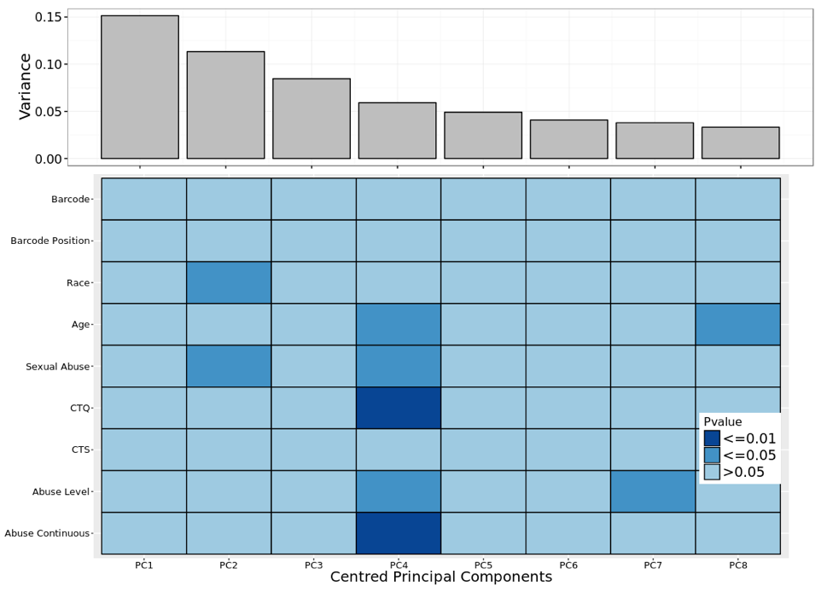
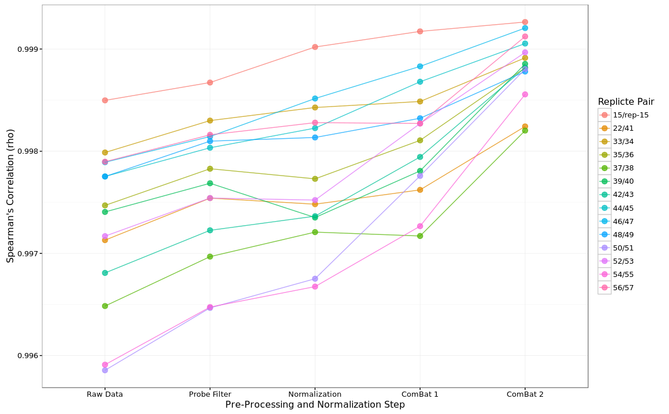
A.
B.
Figure S1. Batch effects were removed and correlations between replicate samples increased after normalization and pre-processing of 450K Array DNA methylation data. A. After probe filtering, quantile inter-sample normalization, SWAN intra-sample normalization and correction for batch effects using ComBat there was no significant correlation between batch variables (Barcode and Barcode Position) and variation present in DNAm data as found using principal component analysis. B. Correlation measurements between replicate samples improved throughout normalization and pre-processing steps, displaying the highest correlation values by the end of the pipeline.
Abbreviations: CTQ: Childhood Trauma Questionnaire; CTS: Conflict Tactic Scales.

Slide 2
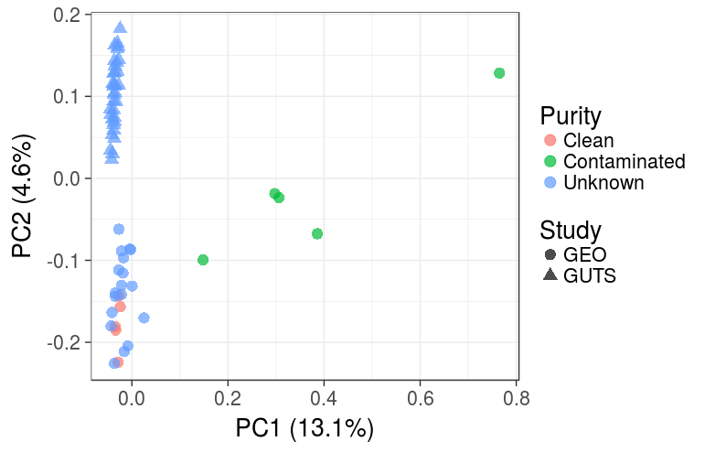
Figure S2: The DNA methylation data of GUTS samples clustered with publicly available, known purified sperm Illumina 450K DNA methylation data (GEO accession GSE108058; Jenkins et al., 2017). The GSE108058 dataset contained 5 contaminated semen samples, 5 purified semen samples and 20 semen samples of unknown purity. We merged this dataset with our own data and performed principal component analysis. The vast majority of variation in methylation is associated with tissue heterogeneity, therefore the first few PCs should be correlated with the purity of the semen samples. Plotting PC1 against PC2 (for visualization purposes), our samples cluster with the pure semen samples, providing evidence that we successfully purified the semen samples.

Slide 3
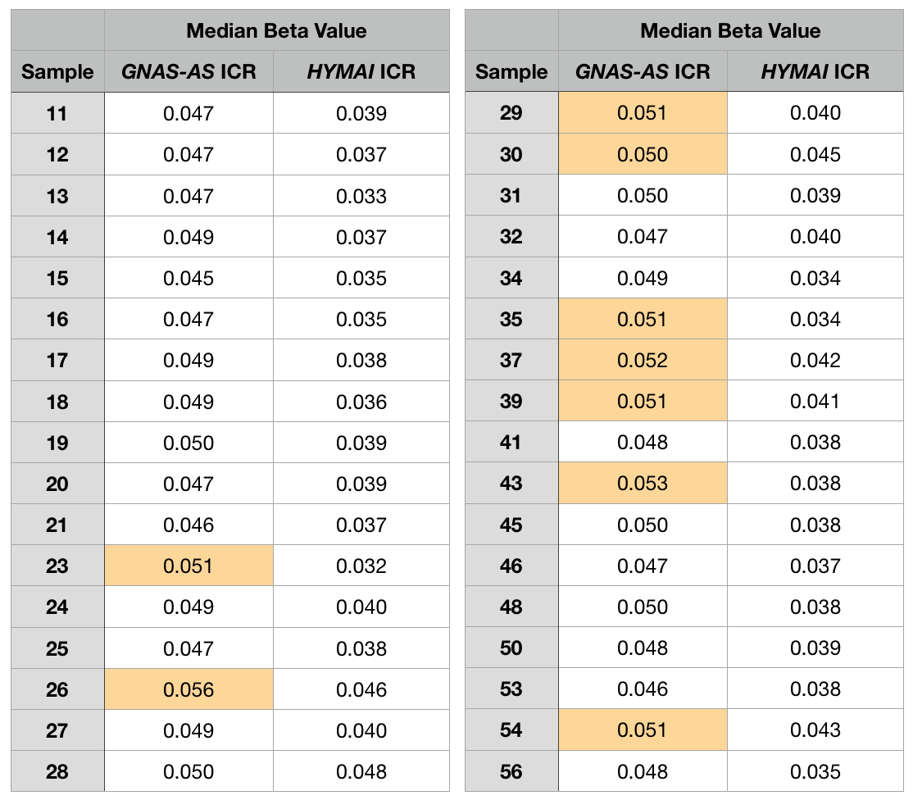
Beta value
< 5%
≥ 5%
Table S1: Methylation status of two paternally expressed imprinting control regions (ICR) (HYMAI - ICR: chr6: 144326000 – 144330000, 61 probes; GNAS-AS - ICR: chr20: 57425000 – 57429000, 69 probes) displayed values close to 0 suggesting a highly purified sperm sample. Within the listed genomic regions we examined all probes underlying the HYMAI ICR (61 probes) and the GNAS-AS ICR (69 probes) which were measured on the Illumina 450K array and calculated the median beta value for each region for each individual in our study. Both of these regions are paternally expressed, and therefore if our samples contain purified haploid male gametes, we would anticipate these regions would be fully unmethylated (as opposed to hemi-methylated in somatic tissue).

Slide 4
Figure S3: Beta value distribution of probes within two paternally expressed imprinting control regions (ICR) (HYMAI - ICR: chr6: 144326000 – 144330000; GNAS-AS - ICR: chr20: 57425000 – 57429000) shows dominant peak at 0. Within the listed genomic regions we plotted the beta values of all probes underlying the HYMAI ICR (61 probes) and the GNAS-AS ICR (69 probes) for each individual in our study. Both of these regions are paternally expressed, and therefore if our samples contain purified haploid gametes, we would anticipate these regions would be fully unmethylated (as opposed to hemi-methylated in somatic tissue).

Slide 5
 | Probes with largest PC4 scores
 | 1% | 2% | 3% | 4% | 5%
 | N
All probes | 8,794 | 17,590 | 26,384 | 35,180 | 43,974
Restricted to probes with Δβ≥5% | 1,137 | 1,443 | 1,617 | 1,718 | 1,793
Restricted to probes with Δβ≥10% | 97 | 110 | 119 | 122 | 126
Table S2. Probes with the highest loading on PC4 and meeting minimum values for differences in DNAm β values (Δβ) by childhood abuse exposure. Probes with top PC4 scores as defined by percentiles and Δβ levels. Δβ values were calculated by taking the absolute difference between the mean β for high versus no childhood abuse. Probes in the 1st percentile of positive or negative loading on PC4 and with Δβ≥5% are highlighted in blue.

Slide 6
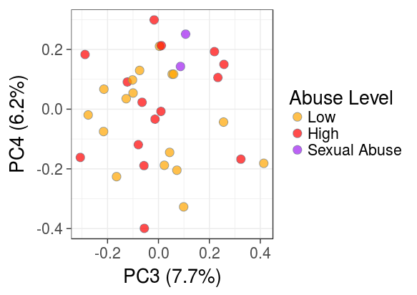
Figure S4. Scatterplot of the loading on PC4 (y-axis) versus PC3 (x-axis, for visualization) for each individual show associations with PC4 are not driven by a small subset of samples. The two men who were exposed to sexual abuse are indicated in purple. The scatterplot suggests that these men are not outliers among men who experienced abuse (shown in red).

Slide 7
Figure S5. Remaining 7of 12 statistically significant childhood abuse DMRs. Differentially methylated regions (DMRs) were defined as regions that differed statistically by abuse exposure at an FDR ≤ 0.05, had a mean Δβ ≥ 5% across probes, and were confirmed using replicates. Other than the PRDM16 DMR, which is located in the body of that gene, the remaining DMRs are intergenic in location and are labelled with the name of the gene whose transcription start site is closest.

Slide 8
 | Genomic Information
Cluster Name | Location | Width | Gene Association | Gene Location | Nearest TSS Gene | Max Distance to Nearest TSS (bp) | Enhancer | CpG Island
ARL17A | chr17:43578568-43578911 | 344 |  |  | AF119889 | -2056
MAPT | chr17:44060252-44061467 | 1216 | MAPT | Body | MAPT | 1236 | Yes | Yes
CLU | chr8:27467783-27470629 | 2847 | CLU | Body,1stExon,5'UTR,TSS200,TSS1500 | CLU | -1361 | Yes | Yes
LRRK1 | chr15:101641336-101641443 | 108 |  |  | LRRK1 | 48016
PRDM16 | chr1:3099233-3100497 | 1265 | PRDM16 | Body | MIR4251 | 55959 |  | Yes
CFAP46 | chr10:134795270-134796269 | 1000 |  |  | AK125849 | 17232 |  | Yes
MIR5093 | chr16:85362963-85363209 | 247 |  |  | LOC727710 | -26207 | Yes | Yes
TAF1B | chr2:9960583-9960899 | 317 |  |  | TAF1B | -22987
DLL1 | chr6:170500610-170500967 | 358 |  |  | LOC154449 | 71047
SYCE1 | chr10:135381727-135381914 | 188 | SYCE1 | 5'UTR | SYCE1 | 1149 |  | Yes
NDFUA10 | chr2:240723946-240724176 | 231 |  |  | LOC150935 | 39623
SDK1 | chr7:4242866-4244372 | 1507 | SDK1 | Body | SDK1 | -24249
Table S3. Genomic annotation of regions significantly differentially methylated by childhood abuse (DMRs). DMR information was obtained using annotation provided from Illumina for the Infinium 450K array.

Slide 9
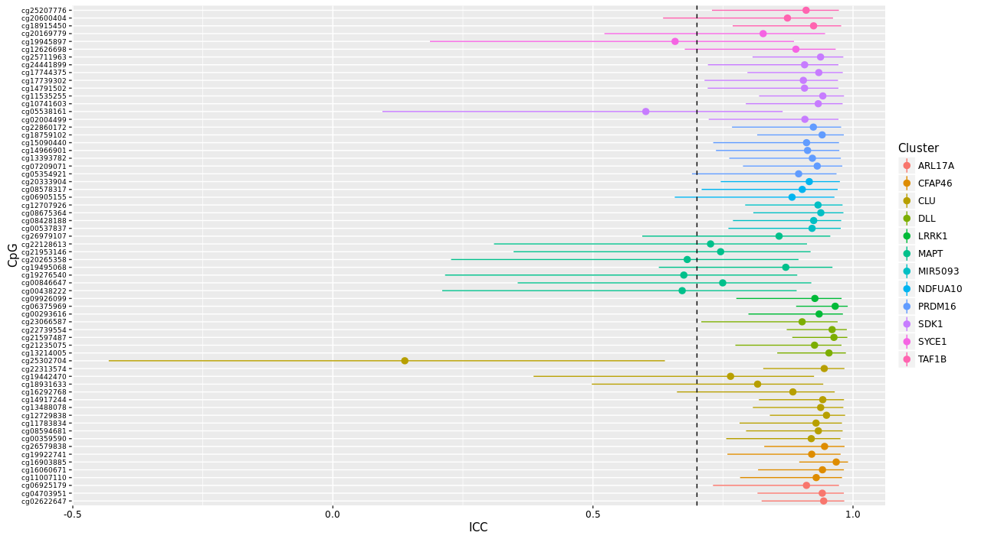
Figure S6. Probes located in DMRs have high intraclass correlation (ICC) when comparing biological replicate sample DNA methylation values. 90% of probes in significant DMRs have ICC ≥ 0.7 (dashed line). A single ICC score was obtained for each probe using 24 samples (2 biological replicates per participant). A value of 1 would indicate the biological replicates are in perfect concordance with one another. Whiskers represent 95% confidence intervals.

Slide 10
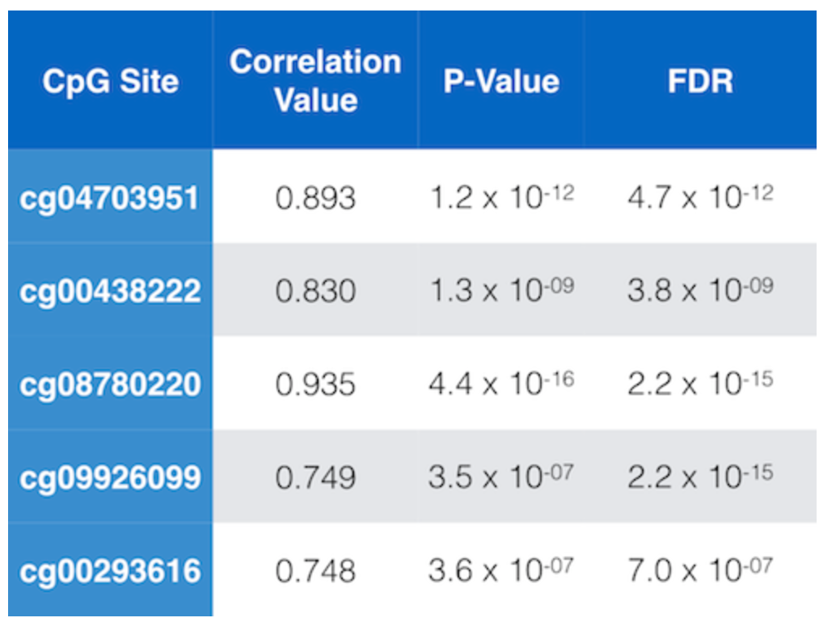
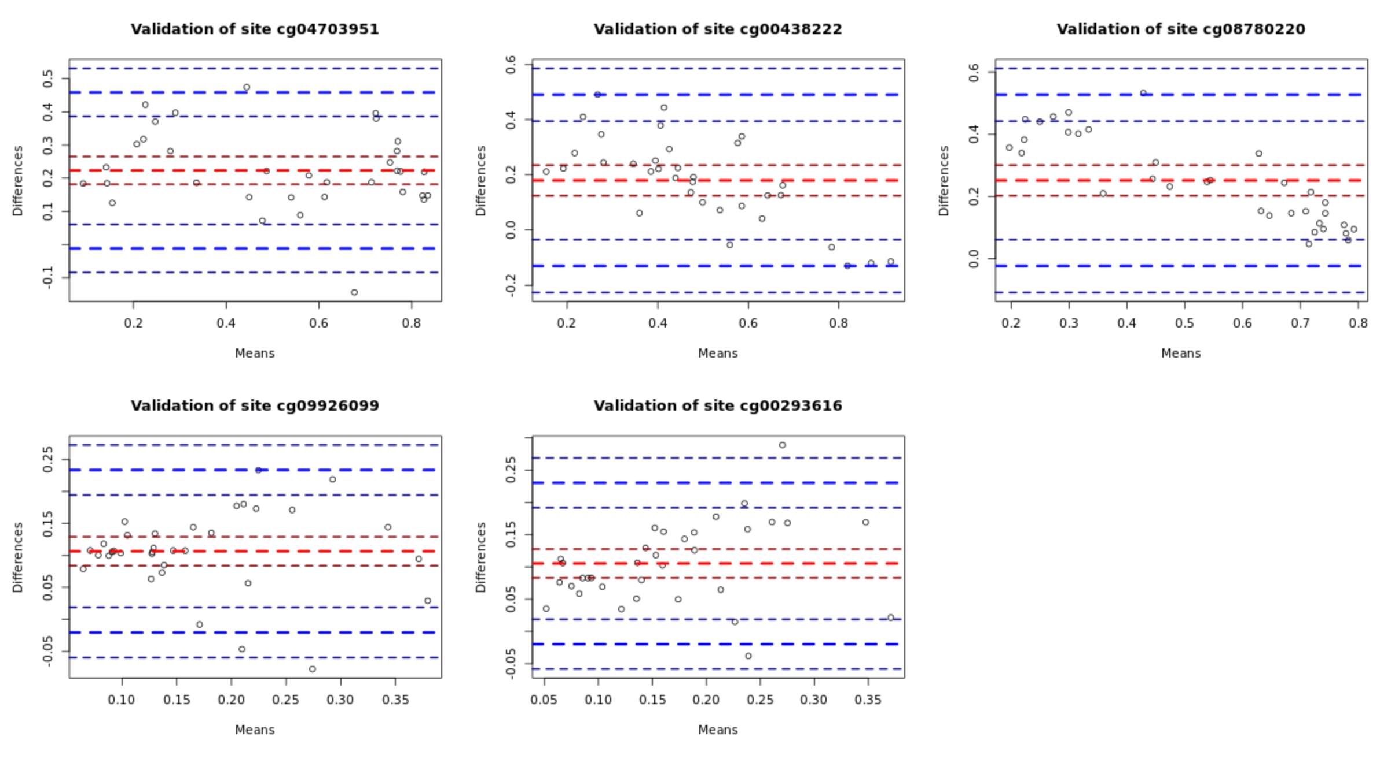
A.
B.
Figure S7. Measurements of DNAm using the 450K array and the pyrosequencing platform were highly correlated. For a certain subset of sites, pyrosequencing assays were designed to confirm DNA methylation measurements to ensure findings were not specific to the 450K array platform. A. Measurement correlations and p values obtained using Spearman’s rank method. B. Bland-Altman plots of DNA methylation sites validated in pyrosequencing made by comparing the difference in measurements by the average value between platforms.

Slide 11
Figure S8. DNA methylation measurements were confirmed at additional CpG sites measured with pyrosequencing within DMRs identified with the Illumina Infinium HumanMethylation450 BeadChip. Of the sites selected for confirmation with pyrosequencing, these are the subset of sites which were found in a subset of significant DMRs.

Slide 12
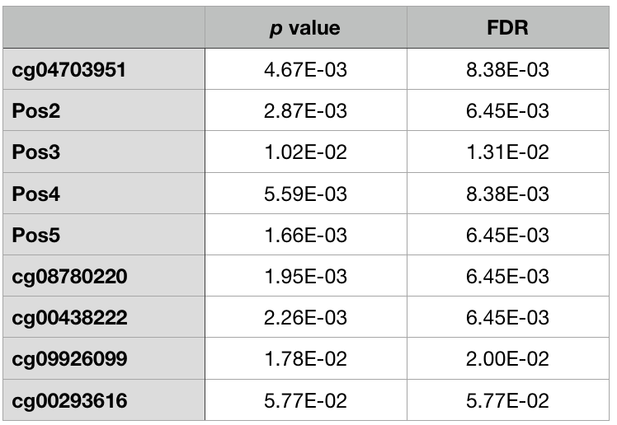
Table S4: Four additional sites detected by pyrosequencing but not measured by the 450K array within the ARL17A DMR were significantly associated with childhood abuse exposure in the same direction as original DMR sites. Linear regression for novel sites identified by pyrosequencing within the ARL17A DMR was performed and found to be significantly associated.

Slide 13
Cluster Name | Number of probes | Model 1: BMI and smoking | Model 2: Depressive and PTSD symptoms | Model 3: Lifetime Trauma
ARL17A | 3 | 5.67% | 11.23% | 16.65%
CFAP46 | 5 | -7.74% | -8.97% | -20.44%
CLU | 11 | 5.76% | 13.63% | 5.28%
DLL1 | 5 | -3.09% | 9.34% | 23.70%
LRRK1 | 3 | 0.12% | 0.79% | 2.62%
MAPT | 8 | 1.92% | -1.13% | 3.28%
MIR5093 | 4 | 1.18% | 3.72% | 5.14%
NDFUA10 | 3 | -2.35% | 5.68% | 15.80%
PRDM16 | 7 | -8.22% | -12.94% | -25.86%
SDK1 | 8 | -4.45% | -15.01% | 2.87%
SYCE1 | 3 | -2.90% | -9.23% | -14.90%
TAF1B | 3 | -8.93% | 5.29% | 14.04%
Mediation
< 10%
≥ 10%
Table S5: Mean percent mediation across probes within childhood abuse differentially methylated regions (DMR) by adulthood BMI and smoking, mental health symptoms, and lifetime trauma exposure. Percent mediation=([beta estimate_{base model}-beta estimate_{adjusted model}]/beta estimate_{base model})*100. Negative percentages indicate a stronger association of childhood abuse with DNAm in adjusted models compared to the base model.

Slide 14
Probe Name | DMR Name | Model 1: BMI and smoking | Model 2: Depressive and PTSD symptoms | Model 3: Lifetime Trauma
cg02622647 | ARL17A | 5.57% | 11.10% | 16.07%
cg04703951 | ARL17A | 4.45% | 10.62% | 15.68%
cg06925179 | ARL17A | 6.99% | 11.97% | 18.20%
cg11007110 | CFAP46 | -6.19% | -6.01% | -14.57%
cg16060671 | CFAP46 | -8.50% | -9.08% | -20.00%
cg16903885 | CFAP46 | -7.56% | -9.03% | -19.21%
cg19922741 | CFAP46 | -8.45% | -11.76% | -26.80%
cg26579838 | CFAP46 | -8.00% | -8.98% | -21.62%
cg00359590 | CLU | 4.34% | 10.94% | 4.06%
cg08594681 | CLU | 6.00% | 14.37% | 6.00%
cg11783834 | CLU | 4.92% | 13.46% | 5.62%
cg12729838 | CLU | 5.84% | 14.03% | 5.48%
cg13488078 | CLU | 5.68% | 13.68% | 4.99%
cg14917244 | CLU | 3.69% | 12.05% | 3.35%
cg16292768 | CLU | 3.55% | 13.88% | -0.24%
cg18931633 | CLU | -2.63% | 15.48% | 14.68%
cg19442470 | CLU | 5.59% | 18.00% | 4.74%
cg22313574 | CLU | 4.82% | 14.86% | 5.24%
cg25302704 | CLU | 21.63% | 9.15% | 4.17%
cg13214005 | DLL | -1.83% | 8.65% | 23.49%
cg21235075 | DLL | -4.30% | 11.68% | 26.98%
cg21597487 | DLL | -4.12% | 11.34% | 25.93%
cg22739554 | DLL | -3.23% | 4.47% | 20.08%
cg23066587 | DLL | -1.95% | 10.56% | 22.05%
cg00293616 | LRRK1 | 0.08% | 2.11% | 3.30%
cg06375969 | LRRK1 | 0.00% | -1.32% | 2.70%
cg09926099 | LRRK1 | 0.30% | 1.57% | 1.85%
cg00438222 | MAPT | 1.66% | 1.33% | 5.44%
cg00846647 | MAPT | 2.82% | 1.05% | 2.05%
cg19276540 | MAPT | 2.06% | 1.23% | 8.14%
cg19495068 | MAPT | 1.08% | -6.12% | -2.56%
Probe Name | DMR Name | Model 1: BMI and smoking | Model 2: Depressive and PTSD symptoms | Model 3: Lifetime Trauma
cg20265358 | MAPT | 1.82% | -2.35% | 1.84%
cg21953146 | MAPT | 1.74% | -0.26% | 3.79%
cg22128613 | MAPT | 1.54% | 0.38% | 5.99%
cg26979107 | MAPT | 2.61% | -4.30% | 1.55%
cg00537837 | MIR5093 | 1.45% | 4.88% | 7.08%
cg08428188 | MIR5093 | 1.08% | 3.82% | 4.36%
cg08675364 | MIR5093 | 1.09% | 2.48% | 4.11%
cg12707926 | MIR5093 | 1.10% | 3.69% | 5.01%
cg06905155 | NDFUA10 | -3.85% | 8.05% | 19.81%
cg08578317 | NDFUA10 | -2.48% | 4.59% | 16.26%
cg20333904 | NDFUA10 | -0.73% | 4.41% | 11.33%
cg05354921 | PRDM16 | -14.54% | -28.66% | -50.00%
cg07209071 | PRDM16 | -8.57% | -14.82% | -26.59%
cg13393782 | PRDM16 | -6.78% | -7.46% | -19.39%
cg14966901 | PRDM16 | -8.14% | -14.04% | -28.10%
cg15090440 | PRDM16 | -5.30% | -3.58% | -15.26%
cg18759102 | PRDM16 | -8.22% | -13.18% | -25.14%
cg22860172 | PRDM16 | -5.97% | -8.86% | -16.58%
cg02004499 | SDK1 | -5.18% | -16.56% | 2.23%
cg10741603 | SDK1 | -3.97% | -12.82% | 1.41%
cg11535255 | SDK1 | -4.58% | -13.38% | 8.50%
cg14791502 | SDK1 | -6.10% | -17.97% | 0.05%
cg17739302 | SDK1 | -4.42% | -15.93% | -0.63%
cg17744375 | SDK1 | -4.25% | -14.76% | 4.60%
cg24441899 | SDK1 | -3.11% | -13.42% | 1.27%
cg25711963 | SDK1 | -4.03% | -15.23% | 5.52%
cg12626698 | SYCE1 | -3.41% | -8.22% | -14.91%
cg19945897 | SYCE1 | -2.01% | -6.76% | -12.45%
cg20169779 | SYCE1 | -3.27% | -12.69% | -17.32%
cg18915450 | TAF1B | -9.91% | 4.93% | 15.21%
cg20600404 | TAF1B | -9.26% | 6.55% | 14.59%
cg25207776 | TAF1B | -7.64% | 4.39% | 12.32%
Table S6: Percent change in association of childhood abuse with DNAm at probes within childhood abuse differentially methylated regions (DMR) further adjusted for: adulthood BMI and smoking; mental health symptoms; and lifetime trauma exposure. Percent mediation=[beta estimate_{base model}-beta estimate_{adjusted model}]/beta estimate_{base model.} Negative percentages indicate a stronger association of childhood abuse with DNAm compared to the base model.
Mediation
< 10%
≥ 10%

Slide 15
Probe Name | DMR Name | Base Model | Model 1: BMI and smoking | Model 2: Depressive and PTSD symptoms | Model 3: Lifetime Trauma
cg02622647 | ARL17A | -1.329 | -1.255 | -1.181 | -1.115
cg04703951 | ARL17A | -1.042 | -0.995 | -0.931 | -0.878
cg06925179 | ARL17A | -0.560 | -0.521 | -0.493 | -0.458
cg11007110 | CFAP46 | -0.441 | -0.468 | -0.467 | -0.505
cg16060671 | CFAP46 | -0.510 | -0.554 | -0.557 | -0.612
cg16903885 | CFAP46 | -0.421 | -0.453 | -0.459 | -0.502
cg19922741 | CFAP46 | -0.403 | -0.437 | -0.450 | -0.511
cg26579838 | CFAP46 | -0.461 | -0.497 | -0.502 | -0.560
cg00359590 | CLU | 0.319 | 0.305 | 0.284 | 0.306
cg08594681 | CLU | 0.488 | 0.459 | 0.418 | 0.459
cg11783834 | CLU | 0.471 | 0.447 | 0.407 | 0.444
cg12729838 | CLU | 0.324 | 0.305 | 0.279 | 0.306
cg13488078 | CLU | 0.375 | 0.354 | 0.324 | 0.357
cg14917244 | CLU | 0.639 | 0.615 | 0.562 | 0.618
cg16292768 | CLU | 0.293 | 0.283 | 0.252 | 0.294
cg18931633 | CLU | 0.194 | 0.199 | 0.164 | 0.166
cg19442470 | CLU | 0.154 | 0.145 | 0.126 | 0.146
cg22313574 | CLU | 0.528 | 0.503 | 0.450 | 0.501
cg25302704 | CLU | 0.042 | 0.033 | 0.038 | 0.040
cg13214005 | DLL | 0.690 | 0.703 | 0.631 | 0.528
cg21235075 | DLL | 0.468 | 0.488 | 0.414 | 0.342
cg21597487 | DLL | 0.559 | 0.582 | 0.496 | 0.414
cg22739554 | DLL | 0.529 | 0.546 | 0.506 | 0.423
cg23066587 | DLL | 0.513 | 0.523 | 0.459 | 0.400
cg00293616 | LRRK1 | 0.636 | 0.635 | 0.622 | 0.615
cg06375969 | LRRK1 | 0.371 | 0.371 | 0.376 | 0.361
cg09926099 | LRRK1 | 0.564 | 0.562 | 0.555 | 0.553
cg00438222 | MAPT | 0.584 | 0.574 | 0.576 | 0.552
cg00846647 | MAPT | 0.458 | 0.445 | 0.453 | 0.449
cg19276540 | MAPT | 0.449 | 0.439 | 0.443 | 0.412
cg19495068 | MAPT | 0.396 | 0.392 | 0.420 | 0.406
Probe Name | DMR Name | Base Model | Model 1: BMI and smoking | Model 2: Depressive and PTSD symptoms | Model 3: Lifetime Trauma
cg20265358 | MAPT | 0.495 | 0.486 | 0.507 | 0.486
cg21953146 | MAPT | 0.399 | 0.392 | 0.400 | 0.384
cg22128613 | MAPT | 0.503 | 0.495 | 0.501 | 0.473
cg26979107 | MAPT | 0.393 | 0.383 | 0.410 | 0.387
cg00537837 | MIR5093 | 0.413 | 0.407 | 0.393 | 0.384
cg08428188 | MIR5093 | 0.373 | 0.369 | 0.359 | 0.357
cg08675364 | MIR5093 | 0.350 | 0.346 | 0.341 | 0.336
cg12707926 | MIR5093 | 0.331 | 0.327 | 0.319 | 0.314
cg06905155 | NDFUA10 | 0.381 | 0.396 | 0.350 | 0.306
cg08578317 | NDFUA10 | 0.542 | 0.555 | 0.517 | 0.454
cg20333904 | NDFUA10 | 0.581 | 0.585 | 0.555 | 0.515
cg05354921 | PRDM16 | 0.251 | 0.288 | 0.323 | 0.377
cg07209071 | PRDM16 | 0.458 | 0.497 | 0.525 | 0.579
cg13393782 | PRDM16 | 0.288 | 0.308 | 0.310 | 0.344
cg14966901 | PRDM16 | 0.336 | 0.363 | 0.383 | 0.430
cg15090440 | PRDM16 | 0.190 | 0.201 | 0.197 | 0.219
cg18759102 | PRDM16 | 0.528 | 0.571 | 0.597 | 0.660
cg22860172 | PRDM16 | 0.363 | 0.385 | 0.396 | 0.424
cg02004499 | SDK1 | -0.809 | -0.851 | -0.943 | -0.791
cg10741603 | SDK1 | -0.516 | -0.536 | -0.582 | -0.509
cg11535255 | SDK1 | -0.466 | -0.487 | -0.528 | -0.426
cg14791502 | SDK1 | -0.644 | -0.684 | -0.760 | -0.644
cg17739302 | SDK1 | -0.484 | -0.505 | -0.561 | -0.487
cg17744375 | SDK1 | -0.444 | -0.463 | -0.509 | -0.423
cg24441899 | SDK1 | -0.433 | -0.447 | -0.491 | -0.428
cg25711963 | SDK1 | -0.368 | -0.383 | -0.424 | -0.348
cg12626698 | SYCE1 | 0.472 | 0.488 | 0.511 | 0.542
cg19945897 | SYCE1 | 0.532 | 0.543 | 0.568 | 0.598
cg20169779 | SYCE1 | 0.526 | 0.543 | 0.592 | 0.617
cg18915450 | TAF1B | 0.437 | 0.481 | 0.416 | 0.371
cg20600404 | TAF1B | 0.527 | 0.576 | 0.493 | 0.450
cg25207776 | TAF1B | 0.686 | 0.738 | 0.656 | 0.602
Table S7: Beta estimates from associations of childhood abuse with DNAm at probes in differentially methylated regions (DMR), base model and further adjusted for: 1) adulthood BMI and smoking; 2) adulthood mental health symptoms; and 3) lifetime trauma exposure.

