Slide 1
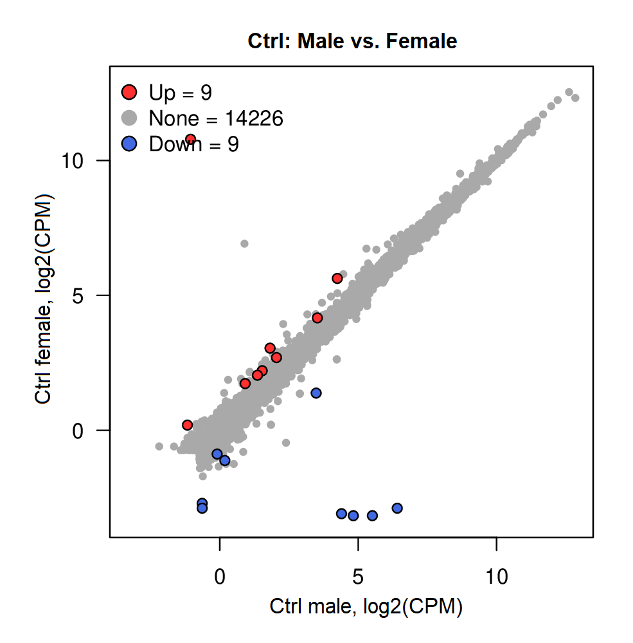
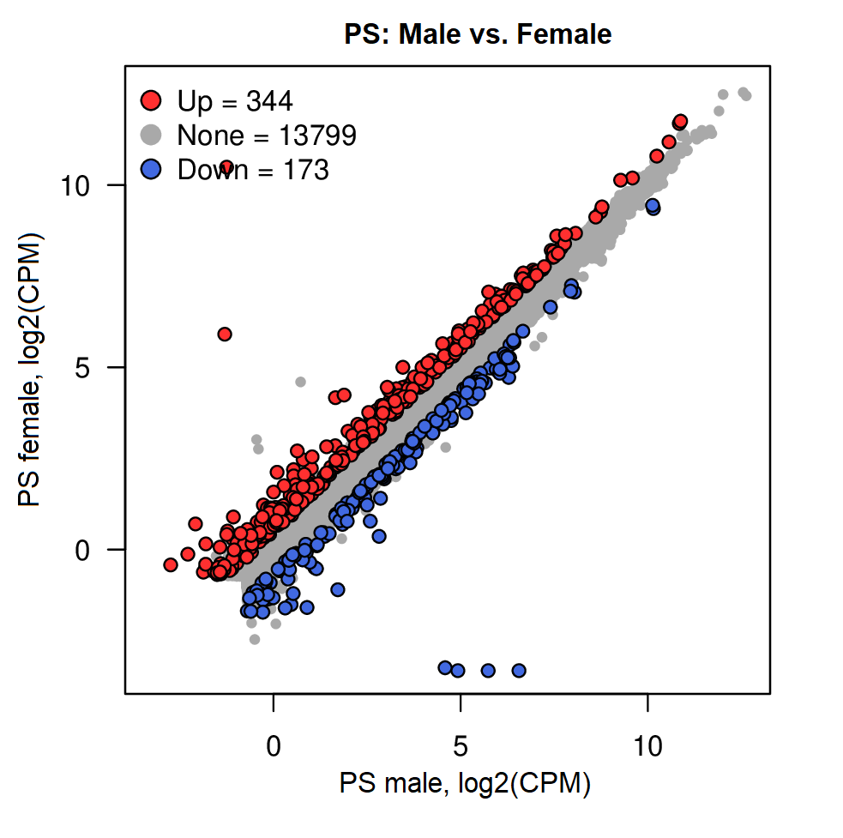
A
B
C
Gene symbol | Chromosome | Log2FC | FDR
Female-specific
Xist | X | 12.14 | 0.00E+00
Prss16 | 13 | 1.99 | 1.33E-02
Ntn5 | 7 | 1.39 | 2.45E-02
Sec1 | 7 | 1.31 | 1.87E-04
Mcmdc2 | 1 | 0.86 | 3.94E-04
Pcdhb2 | 2 | 0.71 | 2.35E-02
Col20a1 | 2 | 0.68 | 3.66E-02
Ecm2 | 13 | 0.64 | 4.68E-03
Eif2s3x | X | 0.64 | 1.19E-06
Male-specific
Eif2s3y | Y | -11.60 | 1.03E-268
Kdm5d | Y | -11.14 | 9.20E-288
Ddx3y | Y | -10.81 | 0.00E+00
Uty | Y | -9.84 | 0.00E+00
S100a9 | 3 | -3.19 | 1.19E-09
S100a8 | 3 | -2.99 | 7.58E-09
Prx | 7 | -2.28 | 5.58E-03
Gm35612 |  | -1.52 | 6.61E-06
S100a4 | 3 | -0.89 | 3.25E-02
GO Category ID | GO Category Name | Adjusted P-value | Hit in Query List
Male-specific
GOTERM_MF:0050786 | RAGE receptor binding | 1.18E-05 | S100A4; S100A9; S100A8
GOTERM_MF:0036041 | Long-chain fatty acid binding | 5.61E-03 | S100A9; S100A8
E
GO Category ID | GO Category Name | Adjusted P-value | Hit in Query List
PS female-specific
GOTERM_BP:0007268 | Synaptic transmission | 2.05E-04 | HCN4; KCNG1; CAMK2D; DOC2A; RASGRF2; DBH; SLC6A2; KCNV1; RIMS1; NPY; NPTX2; DLGAP2; CACNG3; NTSR1; GRINA3; SYT5; KCNJ4; UNC13C; KCNF1; KCNH4; KCNH5; GABRA3; SST; HAP1; CNIH3; STX1A
GOTERM_BP:0034762 | Regulation of transmembrane transport | 4.58E-04 | KCNG1; HCN4; KCNJ4; KCNF1; MEF2C; KCNH4; CAMK2D; KCNH5; RASGRF2; ATP2B4; TRDN; CACNG6; KCNV1; BPIFA1; JSRP1; GSG1L; HAP1; NOS1; CNIH3; CACNG3; CACNG5
GOTERM_BP:1900449 | Regulation of glutamate receptor signaling | 1.35E-02 | MEF2C; RASGRF2; GSG1L; CACNG3; CNIH3; CACNG5
GOTERM_CC:1902495 | Transmembrane transporter complex | 2.20E-03 | GABRQ; KCNG1; KCNJ4; KCNF1; KCNH4; CAMK2D; GABRA3; ANO2; TRDN; CACNG6; OLFM1; KCNV1; GLRA3; CNIH3; CACNG3; GRIA3; CACNG5
D

