Slide 1
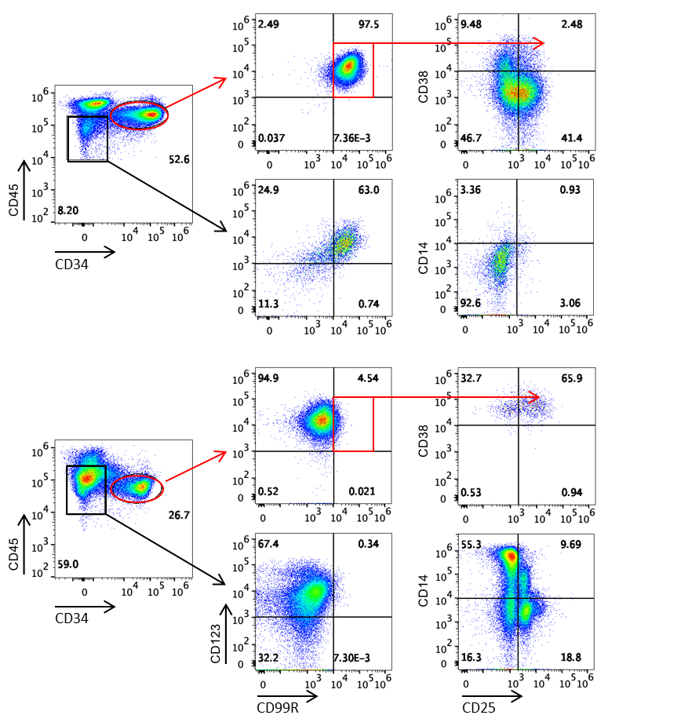
Supplementary Figure 1

Slide 2
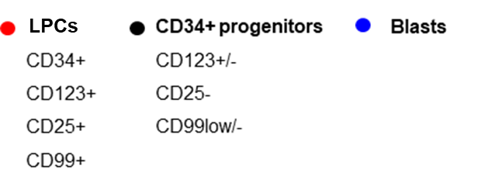
N=3
p = 0.006
FLT3-ITD and NPM1_mut AR
FLT3-ITD^{mut}
NPM1^{mut}
Supplementary Figure 2

Slide 3
UPN13
UPN14
Supplementary Figure 3

