Slide 1
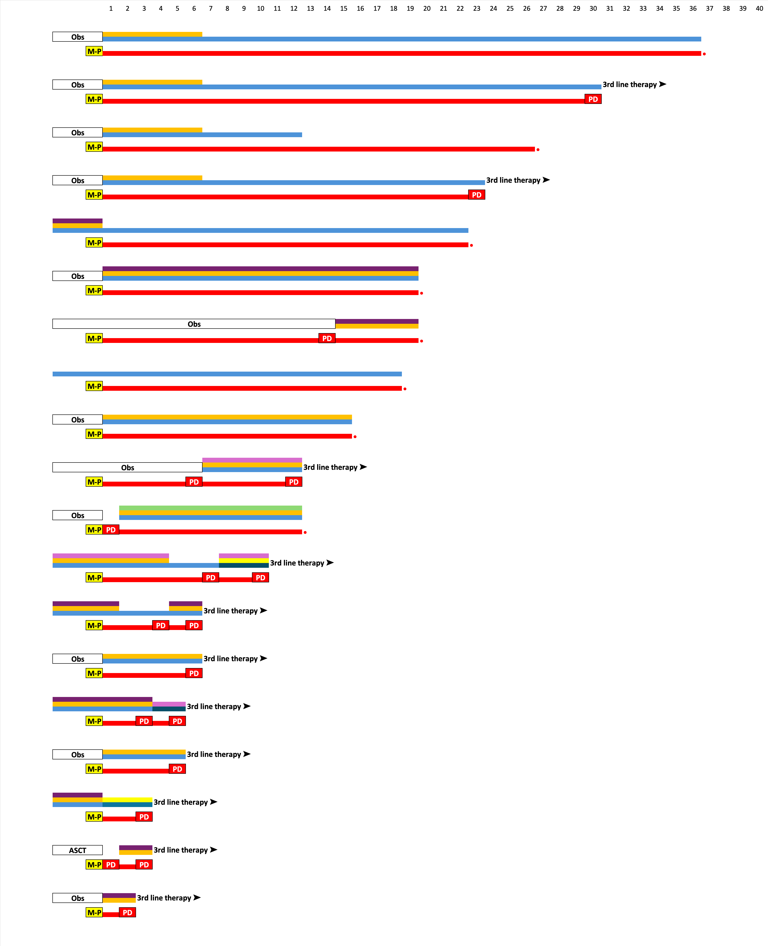

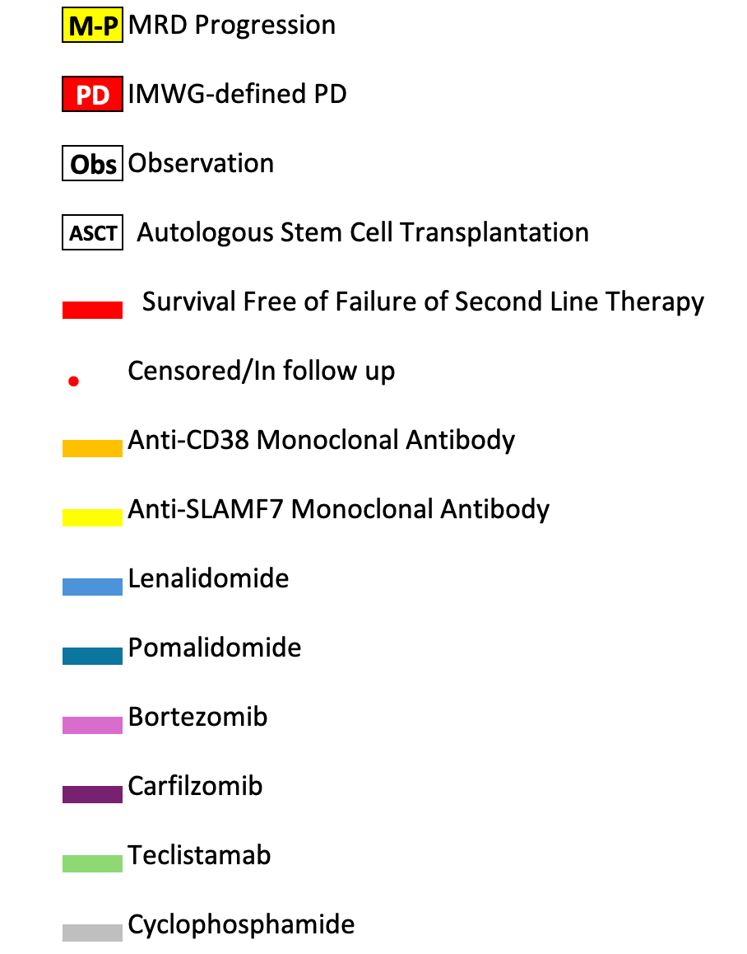
A
B
Prior Therapy
Months
Prior Therapy
Months

