Slide 1
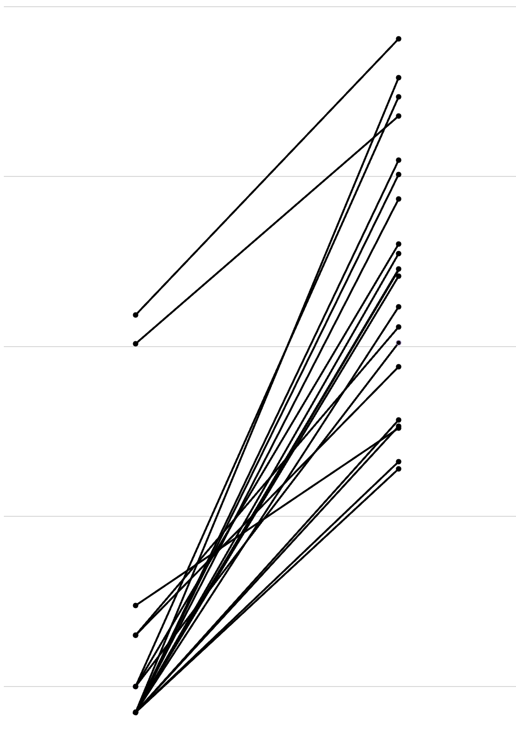
10⁻²
10⁻³
10⁻⁴
10⁻⁵
10⁻⁶
MRD prior to MRD-P
MRD at MRD-P

