Slide 1
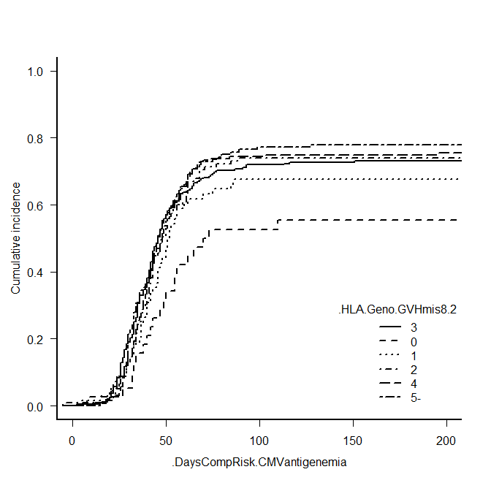
Figure showing the cumulative incidence of starting treatment for CMV reactivation for each number of HLA allele mismatches in cord blood transplantation in a population including cases with developed aGVHD. PowerPoint file (.pptx).
1.0
5 and over-allele
4-allele
0.8
2-allele
3-allele
0.6
1-allele
Cumulative incidence of CMV reactivation
8/8 match
0.4
 | n | P value (vs 3-allele)
8/8match | 39 | 0.0177
1-allele | 69 | 0.26
2-allele | 115 | 0.793
3-allele | 243 | reference
4-allele | 192 | 0.843
5-allele | 136 | 0.58
0.2
0
0
50
100
150
200
No. at risk
Days from transplantation
8/8match
1-mis
2-mis
3-mis
4-mis
5-mis
38
68
114
242
191
136
23
33
51
98
73
57
15
13
22
48
33
23
11
12
19
40
27
19
8
9
18
31
26
18
Supplementary figure 1. Cumulative incidence of starting treatment for CMV reactivation for each number of HLA allele mismatches in cord blood transplantation in a population including cases with developed aGVHD.

