Slide 1





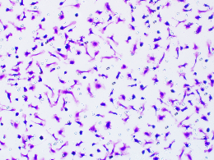
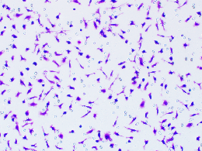
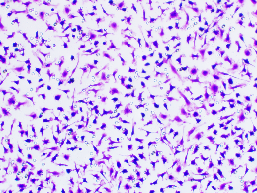
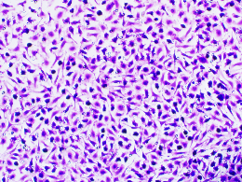
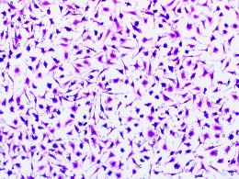
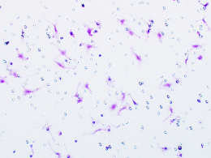
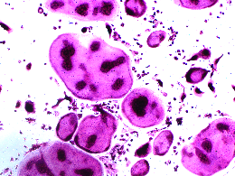
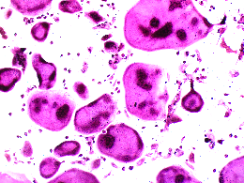
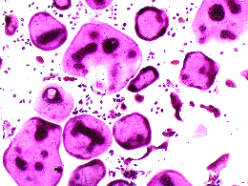
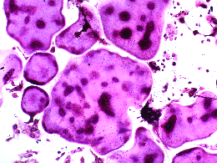
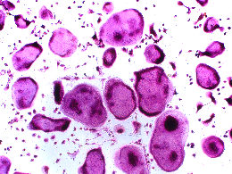
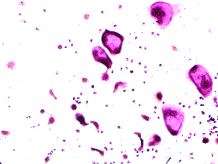
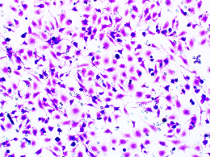
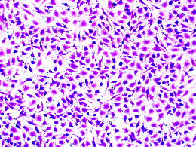
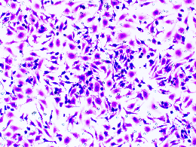
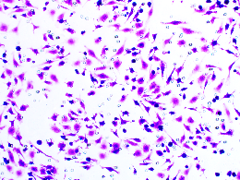
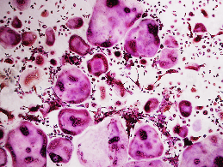
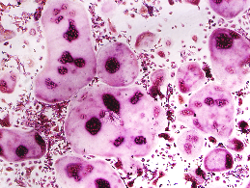
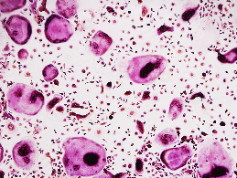
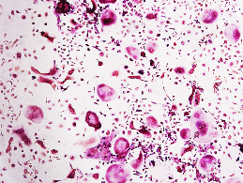
Jiang et al., Supplemental Fig. 1
D
IC₅₀ = 1.366 μM
A
Ctrl
Human Subchondral Bone of OA
O1
O2
O3
O4
O5
O7
O8
O9
O10
100
C1
C2
C3
O6
Cell Viability (% of control)
54 KD
EP2
50
0.16
3.09
1.22
0.31
2.25
1.92
2.65
1.43
0.57
0.30
EP4
53 KD
0
1
2
3
3.12
2.90
2.61
4.07
2.65
2.81
2.42
2.18
3.01
-2
-1
0
2.74
GAPDH
Log[PGE2] (μM)
37 KD
E
EP2^{WT}
EP2^{KO}
Ctrl
Human Subchondral Bone of OA
O1
O2
O3
O4
O5
O7
C1
C2
C3
O6
54 KD
EP2
54 KD
EP2
37 KD
1.00
0.00
GAPDH
0.52
0.73
0.47
0.69
0.90
0.42
0.44
EP4
EP4^{LysM}
53 KD
EP4^{fl/fl}
1.69
2.03
0.70
0.77
1.58
0.68
1.87
GAPDH
53 KD
EP4
37 KD
1.00
0.395
B
37 KD
GAPDH
PGE2
(nM)
***
0
1
10
100
1000
10000
800
ns
600
***
Migration cell numbers
400
*
200
ns
0
0
(nM)
1
10
100
1000
C
10000
PGE2
(nM)
***
0
1
10
100
1000
10000
200
ns
***
150
**
ns
TRAP positive cell numbers
100
50
F
0
0
(nM)
1
10
100
1000
PGE2
10000
EP2 antagonist
EP4 antagonist
Ctrl
Vehicle
Ctrl
Vehicle
EP2 antagonist
EP4 antagonist
500
***
***
200
***
***
***
400
**
150
**
300
TRAP positive cell numbers
Migration cell numbers
100
*
200
50
100
0
PGE2
0
PGE2

Slide 2

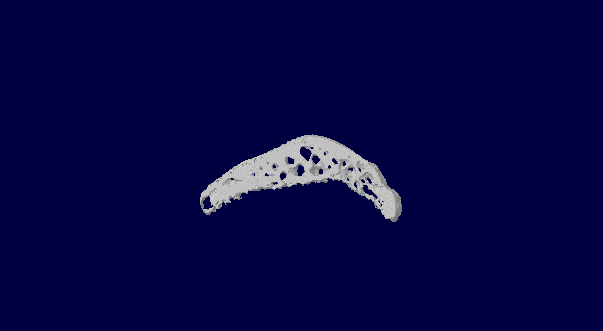
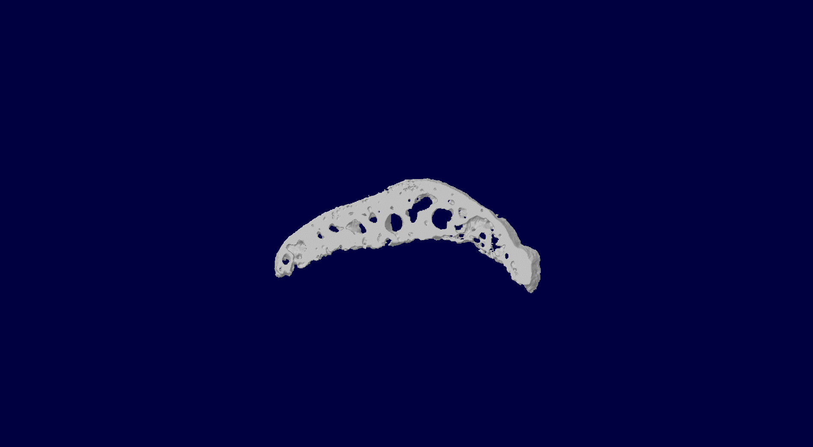
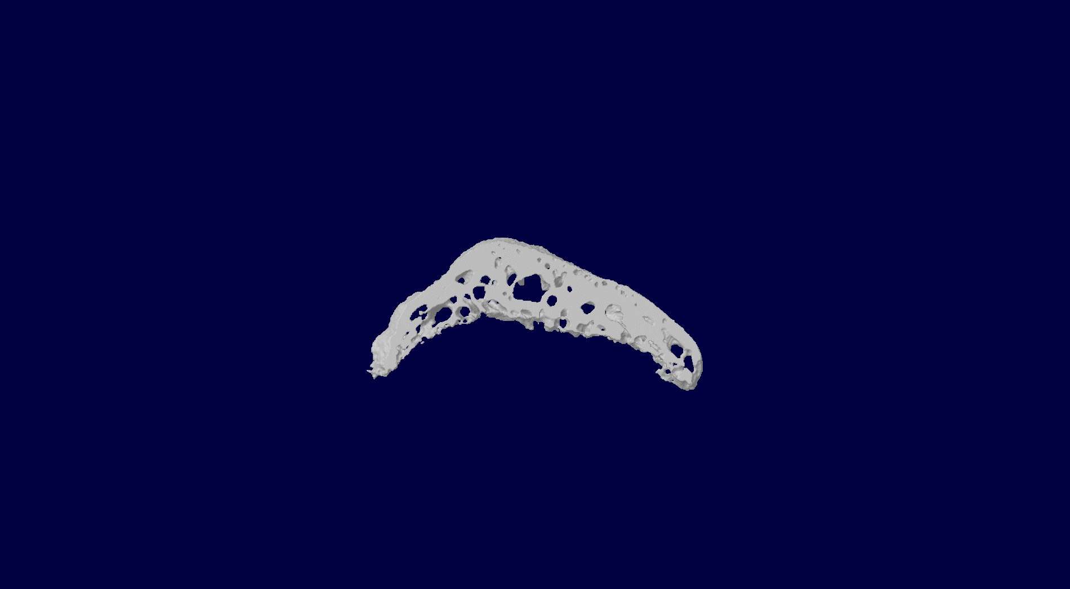
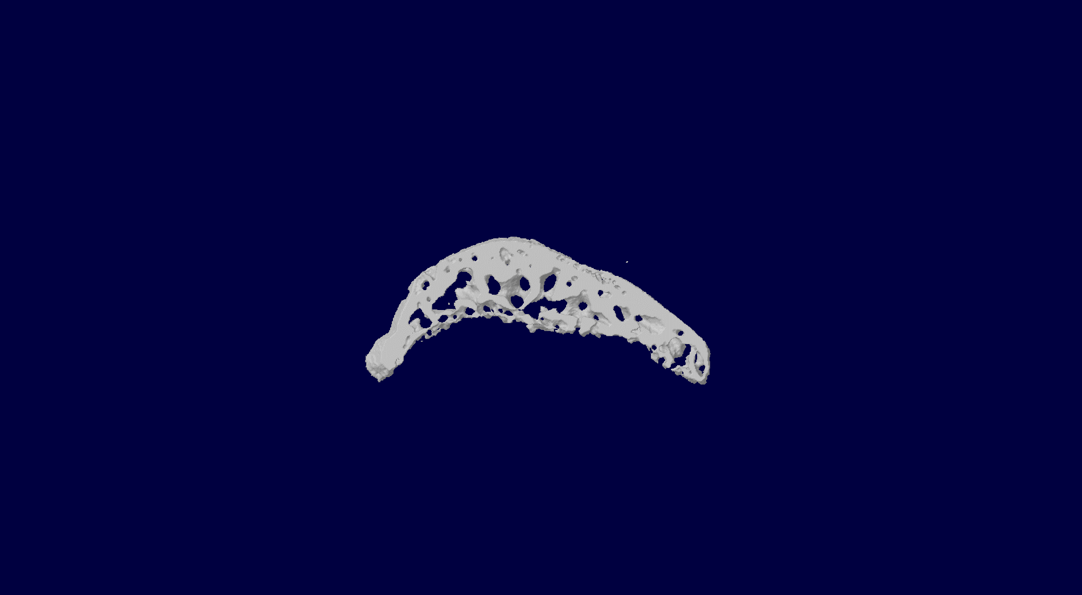
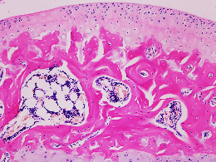
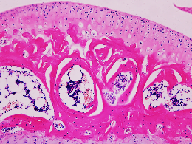
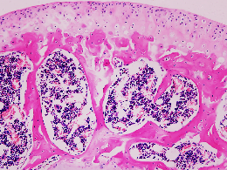
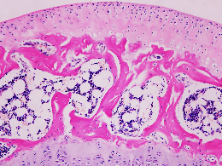
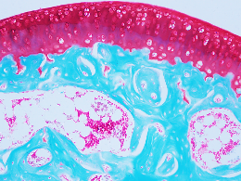
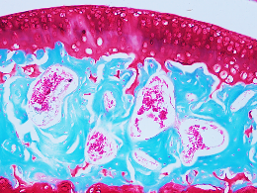
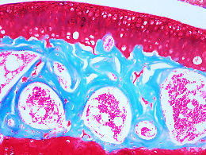
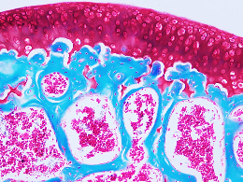
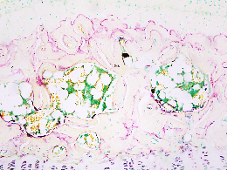
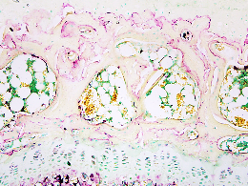
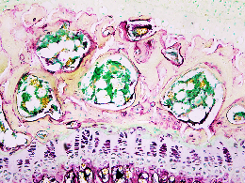
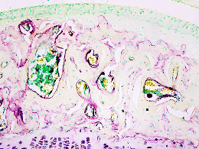
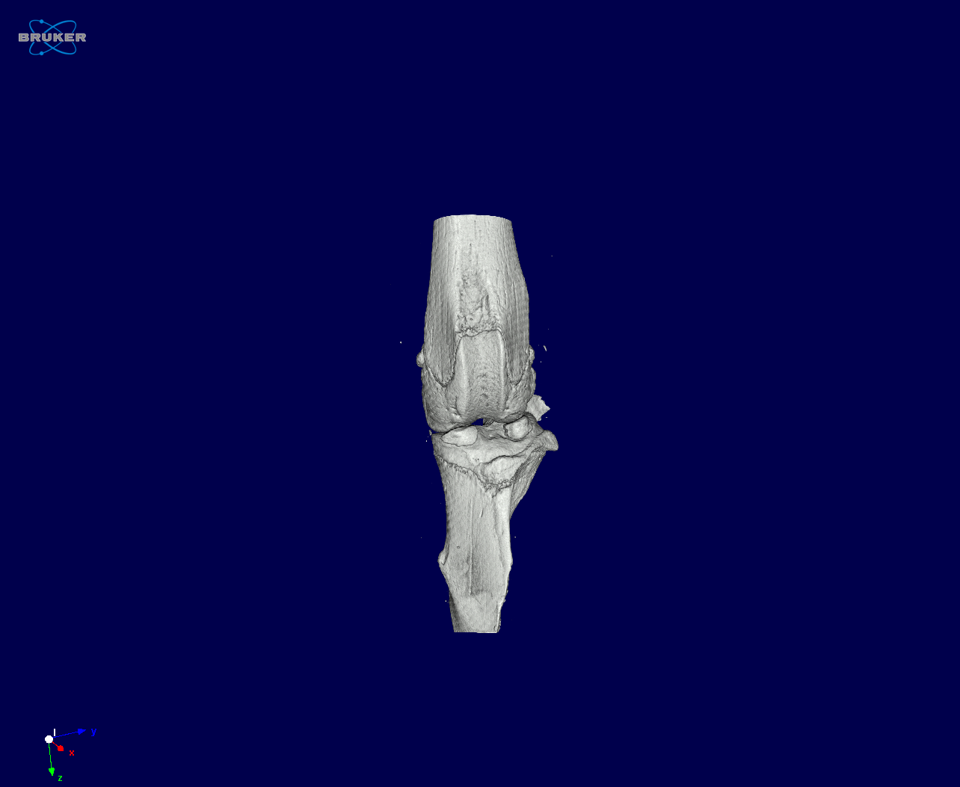
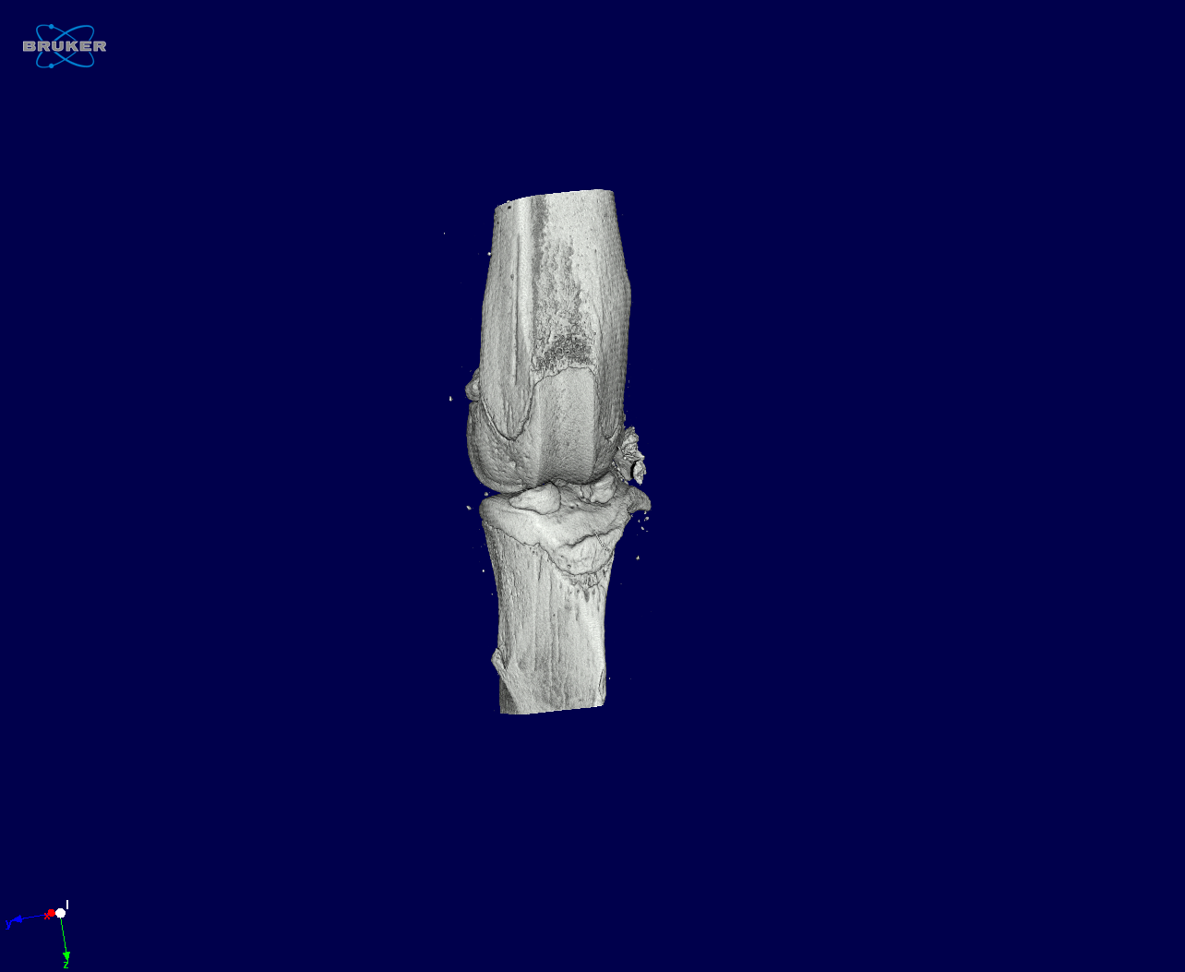
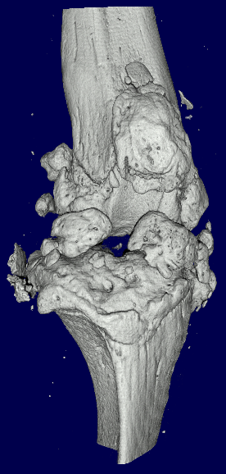
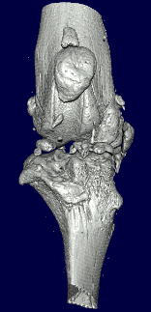
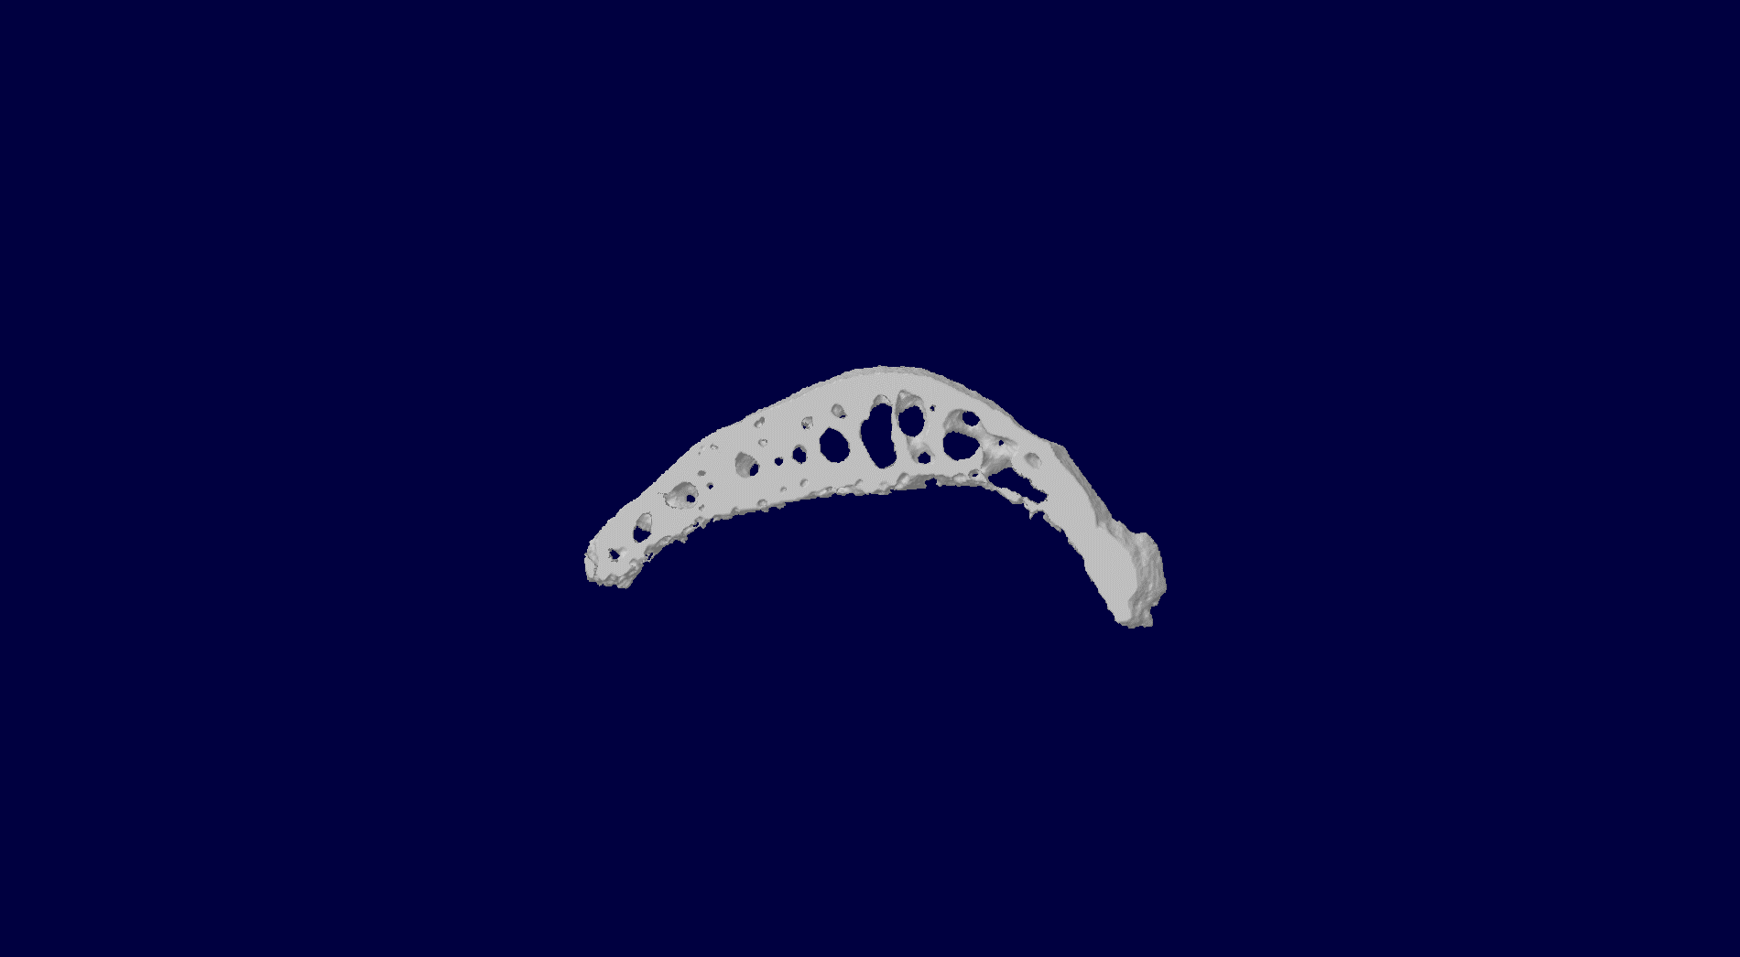
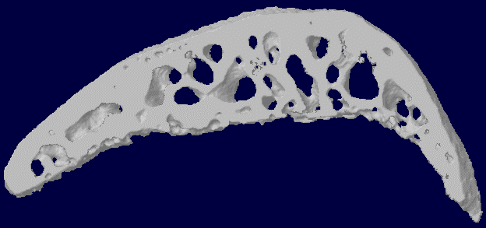
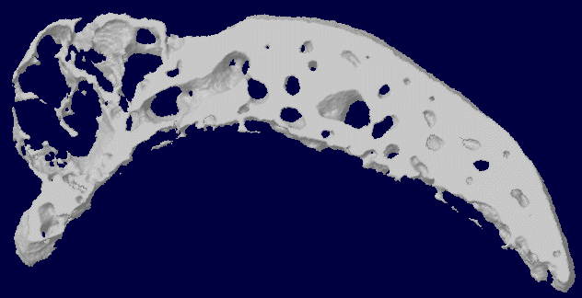
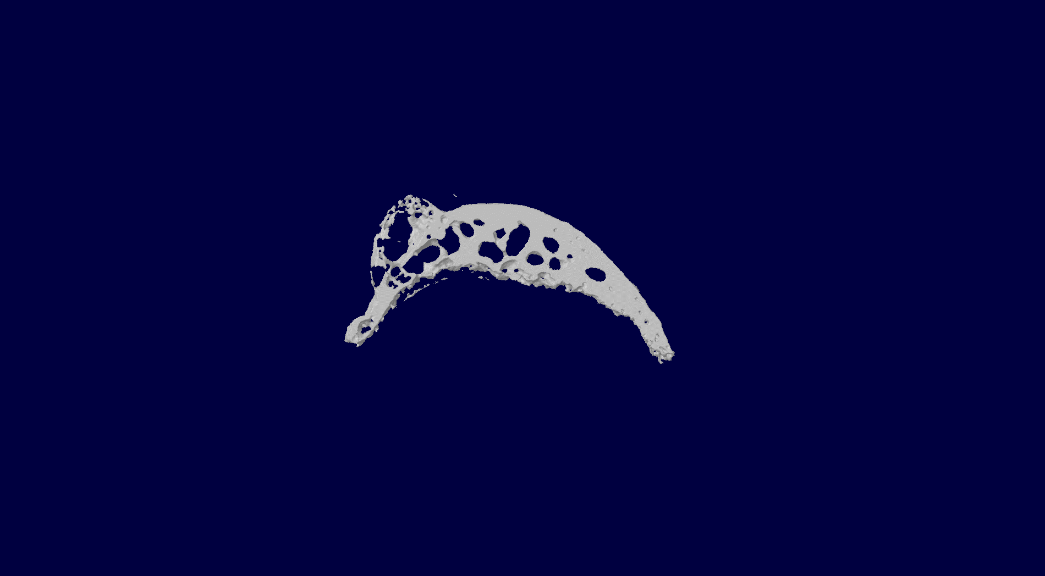
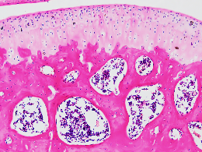
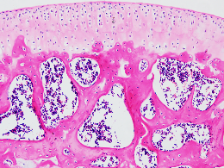
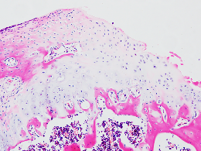
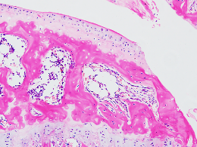
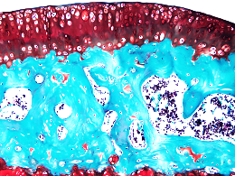
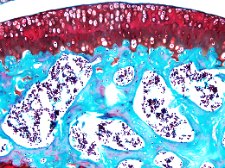


Jiang et al., Supplemental Fig. 2
A
EP2^{WT}
EP2^{HZ}
EP2^{KO}
300 bp
165 bp
EP2^{WT}
EP2^{KO}
P=0.9963
B
SHAM
ACLT
0
0.20
0.4501
EP2^{WT}
EP2^{KO}
EP2^{WT}
EP2^{KO}
-5
0.15
0.6864
0.9260
-10
Tb.Sp (mm)
microCT
Tb.Pf (mm⁻¹)
0.10
-15
0.8370
0.3422
0.05
-20
0.0293
0
H&E
-25
P=0.1641
SHAM
ACLT
SHAM
ACLT
P=0.8150
S. O.
0.0579
0.1872
P<0.0001
80
0.9941
30
<0.0001
0.2447
60
20
TRAP
BV/TV (%)
Number of TRAP⁺
/B.Pm (mm⁻¹)
40
10
0.9864
20
(2 weeks)
0
0
ACLT
SHAM
ACLT
SHAM
C
SHAM
ACLT
P=0.0308
EP2^{WT}
EP2^{KO}
EP2^{WT}
EP2^{KO}
0.0093
0
>0.9999
0.9436
-10
0.15
microCT
Tb.Pf (mm⁻¹)
0.10
Tb.Sp (mm)
-20
0.9274
0.8917
-30
0.0327
0.05
-40
P=0.0403
0
SHAM
ACLT
SHAM
ACLT
microCT
P=0.9959
0.9760
0.7065
P=0.0004
80
0.9702
20
0.9991
H&E
60
15
<0.0001
OARSI score
40
10
BV/TV (%)
0.7993
S. O.
20
5
0
0
ACLT
(8 weeks)
SHAM
ACLT
SHAM

Slide 3


















Jiang et al., Supplemental Fig. 3
A
EP4^{LysM}
EP4^{LysM}
EP4^{LysM}
EP4^{+/+}
EP4^{fl/fl}
EP4^{fl/fl}
EP4^{fl/+}
700 bp
439 bp
349 bp
B
EP4^{fl/fl}
P=0.7364
EP4^{LysM}
0.5293
SHAM
ACLT
0
80
0.9395
0.2897
EP4^{fl/fl}
EP4^{LysM}
EP4^{fl/fl}
EP4^{LysM}
-5
60
-10
microCT
Tb.Pf (mm⁻¹)
BV/TV (%)
-15
0.7337
0.0221
40
-20
0.0004
20
H&E
-25
P=0.8786
0
SHAM
ACLT
SHAM
ACLT
P=0.9984
0.20
0.6316
S. O.
0.8782
0.3098
0.15
Tb.Sp (mm)
(2 weeks)
0.10
0.05
0
ACLT
SHAM
C
SHAM
ACLT
EP4^{fl/fl}
EP4^{LysM}
EP4^{fl/fl}
EP4^{LysM}
200
P=0.2888
50
P=0.0152
COL X
0.0051
0.0102
40
0.0001
0.0067
150
30
Cartilage COL X⁺ cells
Cartilage MMP13⁺ cells
100
0.5445
20
MMP13
50
10
0.9895
0
0
ACLT
SHAM
ACLT
SHAM
(8 weeks)

Slide 4






















A
Jiang et al., Supplemental Fig. 4
200
HL-43
150
TRAP positive cell numbers
100
50
0
HL-43 (43)
41
44
48
51
59
49
52
73
78
81
85
45
50
54
79
39
58
34
43
75
77
80
82
84
86
87
Vehicle
74
76
83
Vehicle
PGE2
B
Vehicle
PGE2
10nM
30nM
100nM
IC₅₀ = 1.215 μM
100
Cell differentiated numbers
(% of control)
300nM
1μM
3μM
50
PGE2
0
1
2
3
-2
-1
0
10μM
30μM
100μM
Log[HL-43] (μM)
C
Vehicle
PGE2
10nM
30nM
100nM
IC₅₀ = 0.239 μM
100
Migration cell numbers
300nM
1μM
3μM
50
PGE2
0
-3
-2
-1
0
1
2
3
10μM
30μM
100μM
Log[HL-43] (μM)

Slide 5



















A
ACLT
Jiang et al., Supplemental Fig. 5
SHAM
Vehicle
Celecoxib
HL-43
SHAM
Celecoxib
microCT
Vehicle
HL-43
ns
ns
0
80
ns
ns
H&E
-10
60
Tb.Pf (mm⁻¹)
ns
40
BV/TV (%)
-20
***
ns
**
20
-30
0
ACLT
S. O.
ACLT
ns
ns
0.15
ns
ns
(2 weeks)
0.10
B
ACLT
Tb.Sp (mm)
SHAM
Vehicle
Celecoxib
HL-43
0.05
0
ACLT
microCT
200
***
**
150
***
Cartilage COL X⁺ cells
ns
COL X
100
50
0
ACLT
MMP13
80
***
***
60
***
C
Cartilage MMP13⁺ cells
ns
40
H&E
20
0
ACLT
D
(8 weeks)
100
100
100
100
BMM
80
BMSC
BMM
BMSC
50
60
50
50
Cell Viability (% of control)
Cell Viability (% of control)
Cell Viability (% of control)
Cell Viability (% of control)
IC₅₀ = 50.64 μM
40
IC₅₀ >300 μM
IC₅₀ >300 μM
0
20
IC₅₀ = 41.43 μM
0
0
-2
-1
0
1
2
3
0
-1
0
2
3
-2
-1
0
1
2
3
-2
-1
0
1
2
3
-2
1
Log[HL-43] (μM)
Log[HL-43] (μM)
Log[Celecoxib] (μM)
Log[Celecoxib] (μM)

Slide 6

Jiang et al., Supplemental Fig. 6

Slide 7



























Jiang et al., Supplemental Fig. 7
A
PGE2
B
PGE2
Ctrl
Vehicle
AKTi
Ctrl
Vehicle
AKTi
Transwell
44 KD
p-ERK1/2
42 KD
44 KD
ERK1/2
TRAP
42 KD
p-p38
43 KD
Ctrl
Vehicle
AKTi
40 KD
p38
54 KD
p-JNK
400
150
*
*
46 KD
300
**
*
54 KD
JNK
Migration cell numbers
100
46 KD
200
TRAP positive cell numbers
37 KD
GAPDH
100
50
0
PGE2
0
PGE2
C
PGE2
Vehicle
EKRi
JNKi
p38i
Vehicle
EKRi
JNKi
p38i
Transwell
TRAP
*
***
800
150
***
***
***
***
*
600
***
100
400
Migration cell numbers
TRAP positive cell numbers
200
50
0
p38i
0
ERKi
p38i
JNKi
ERKi
ERKi
JNKi
JNKi
p38i
ERKi
JNKi
Vehicle
Vehicle
Vehicle
Vehicle
p38i
PGE2
PGE2
D
PGE2
Vehicle
Vehicle
Neferine
14 KD
PDGF-BB
37 KD
GAPDH

Slide 8














Jiang et al., Supplemental Fig. 8
A
B
C
NETRIN-1
EP4
GAPDH
GAPDH
EP2
GAPDH
GAPDH
PDGF-BB
Full unedited gel for Figure 1B
Full unedited gel for Figure 3D
Full unedited gel for Figure 4C
D
E
Netrin-1
GAPDH
GADPH
PDGF-BB
Full unedited gel for Figure 6D
Full unedited gel for Figure 7C
F
p-AKT
AKT
GAPDH
p38
p-JNK
GAPDH
p-p38
GAPDH
p65
JNK
p-p65
p-ERK
ERK
GAPDH
GAPDH
Full unedited gel for Figure 8E

Slide 9














Jiang et al., Supplemental Fig. 8
G
EP4
EP4
GAPDH
GAPDH
EP2
EP2
GAPDH
GAPDH
Full unedited gel for Supplemental Fig. 1D
EP2
EP4
GAPDH
GAPDH
Full unedited gel for Supplemental Fig. 1E
H
I
ERK
GAPDH
GAPDH
p-p38
p-jnk
PDGF-BB
p-ERK
GAPDH
jnk
p38
GAPDH
GAPDH
Full unedited gel for Supplemental Fig. 7B
Full unedited gel for Supplemental Fig. 7D

