Slide 1
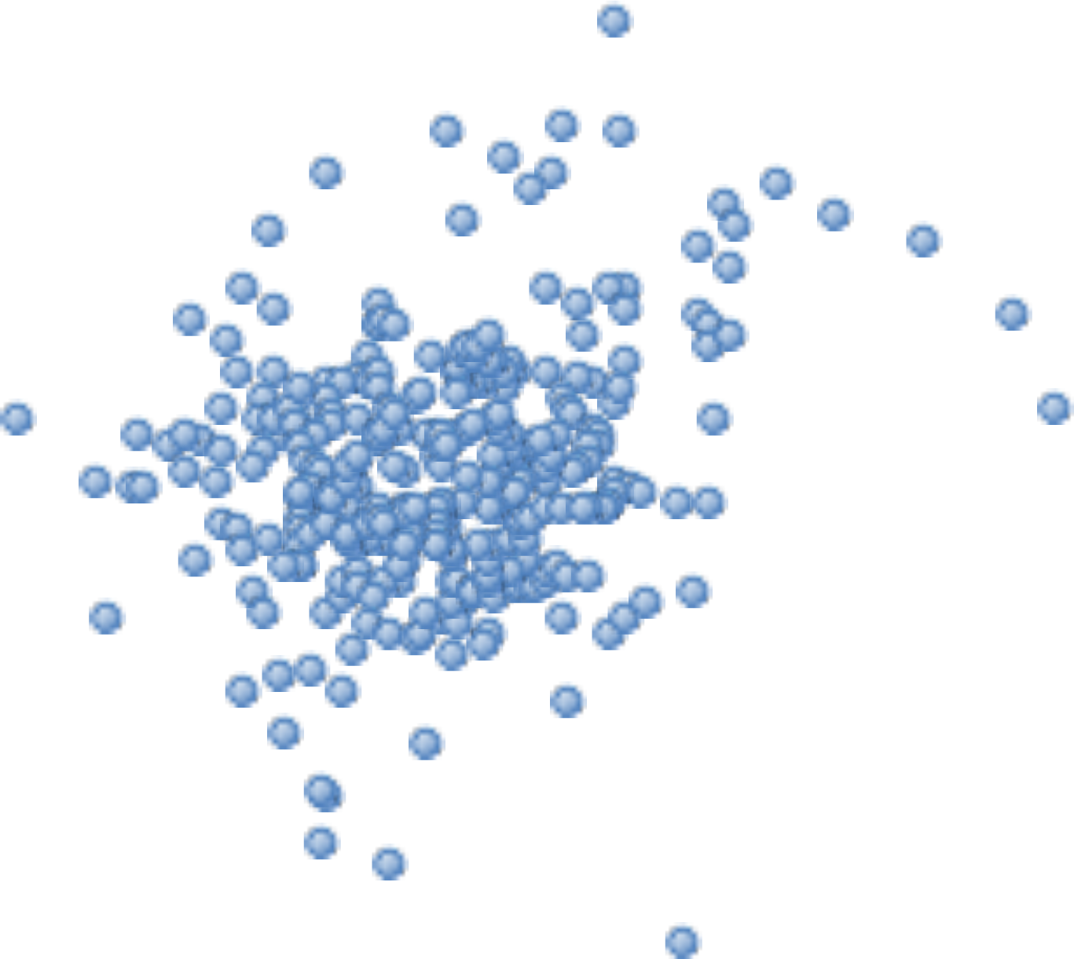
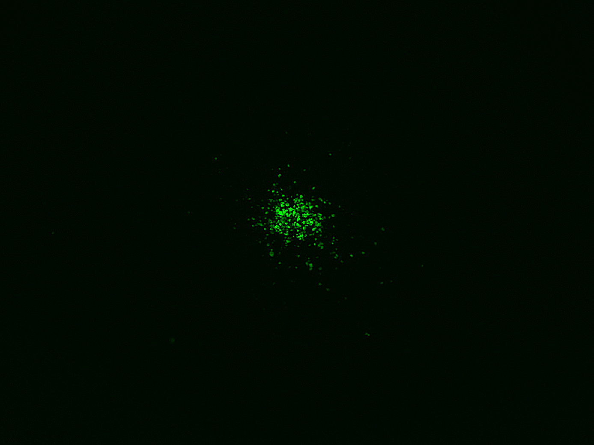
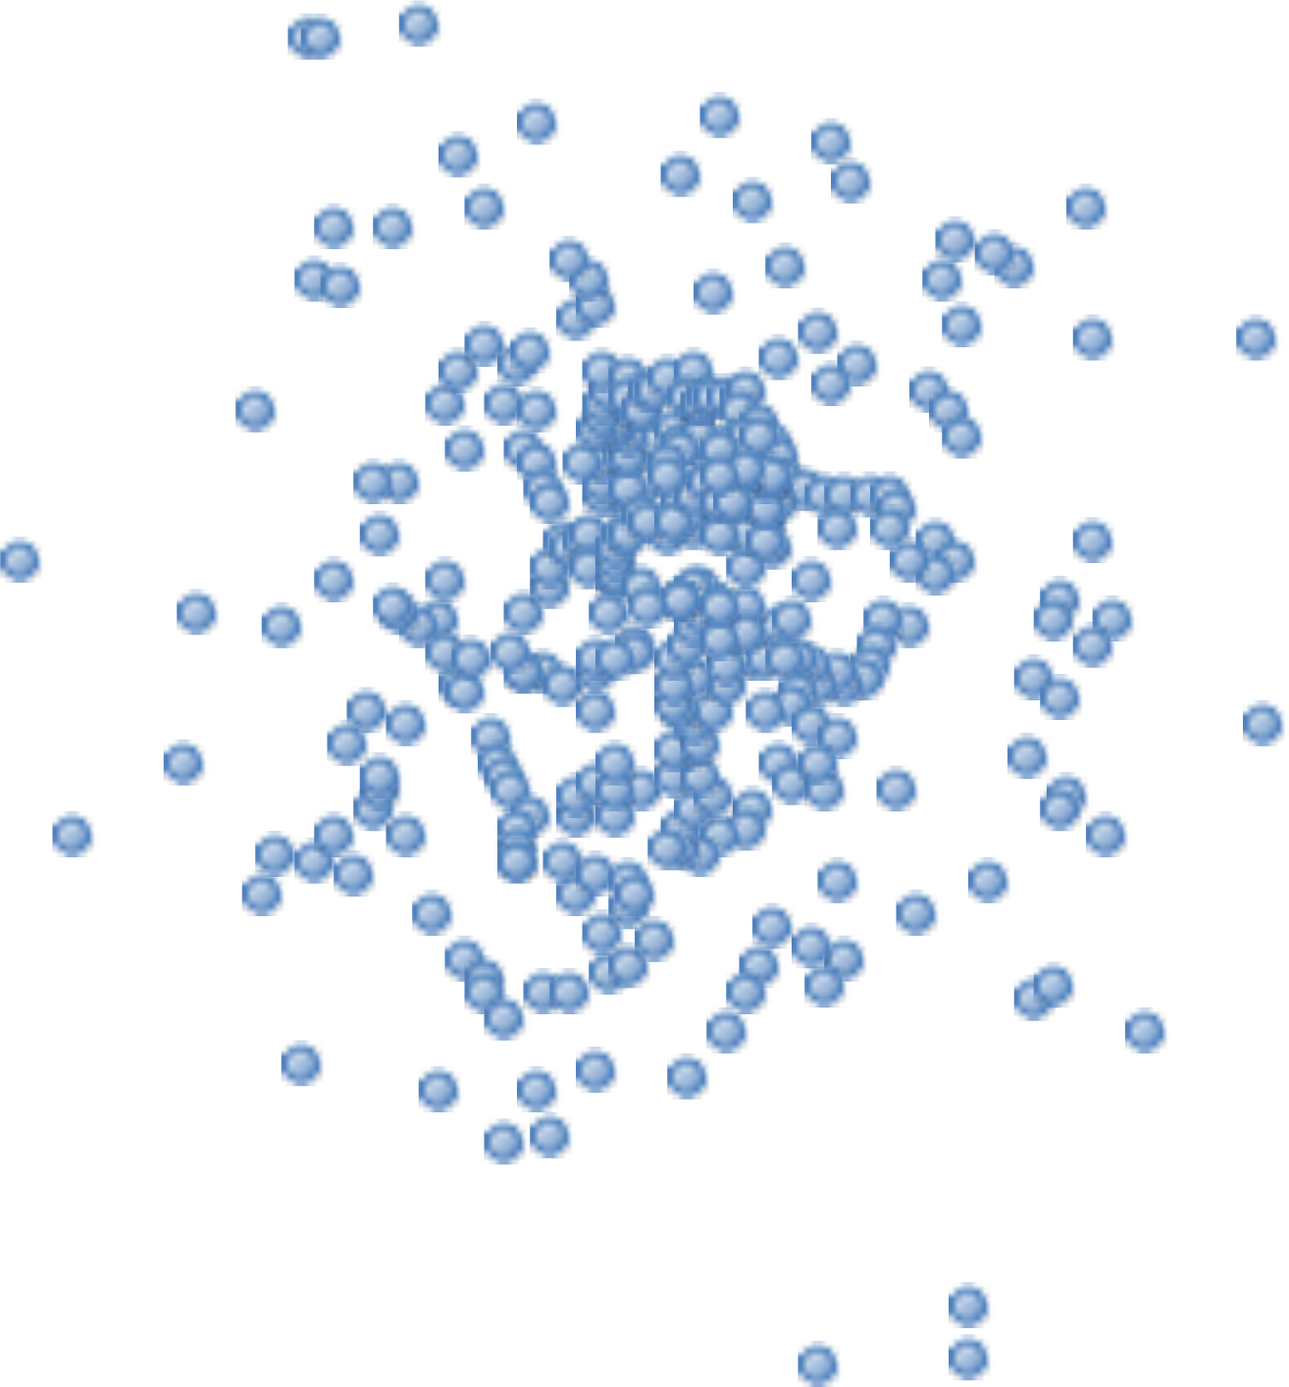
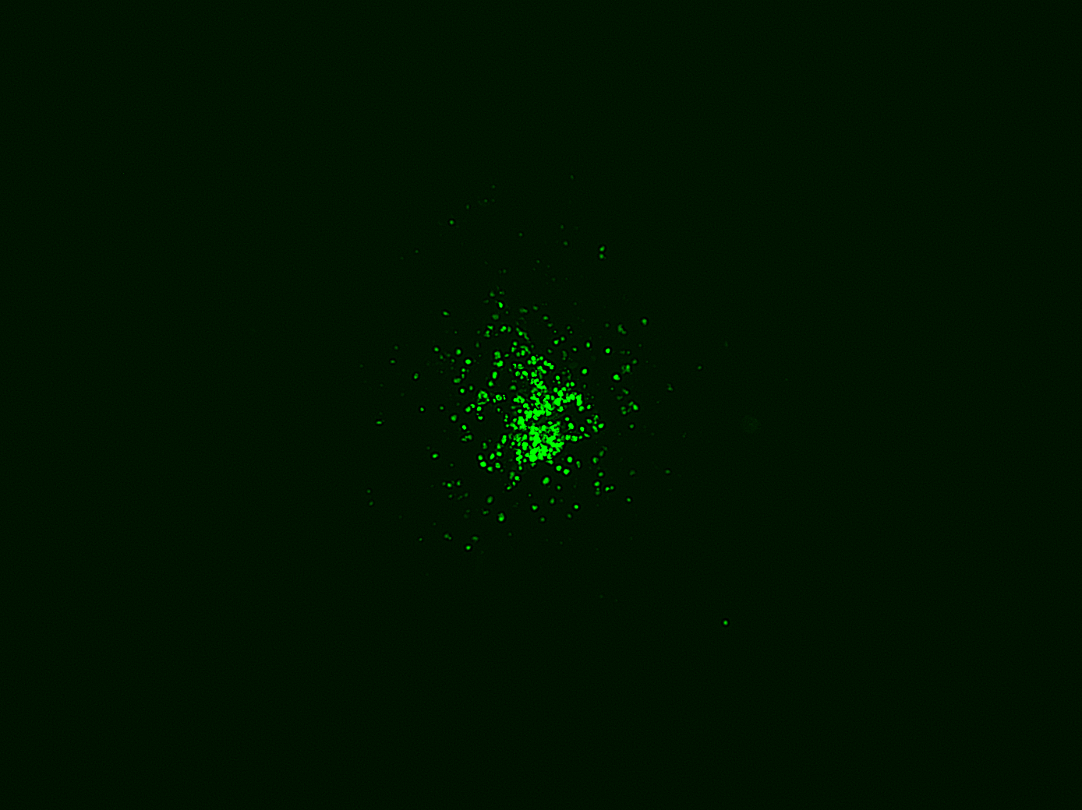
A’
(x,y)
A
A-CTL
B’
B-VEGF
Supplementary Figure S1

Slide 2
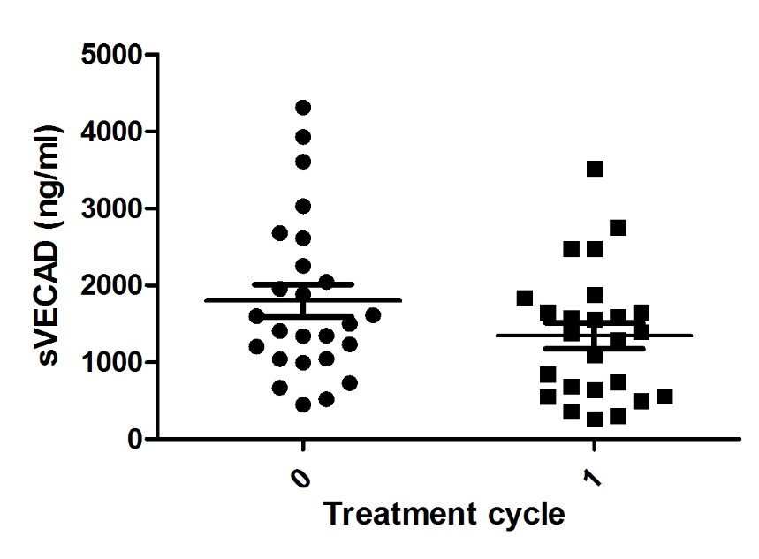
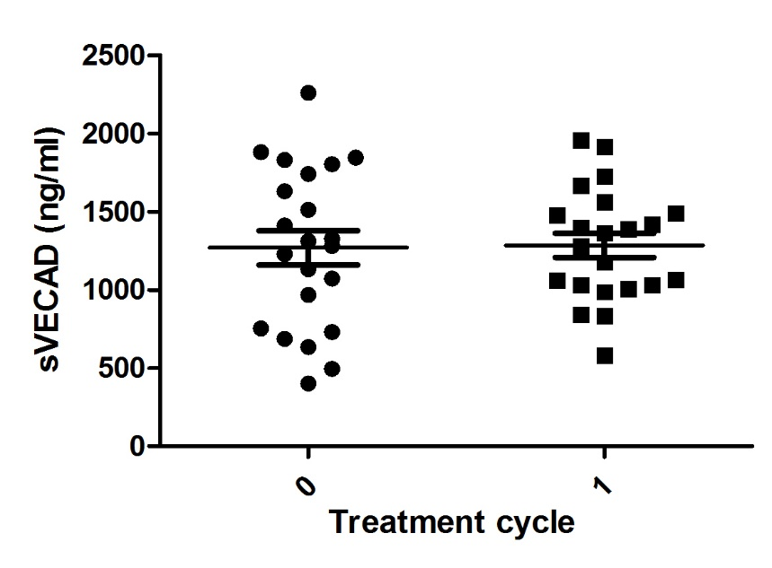
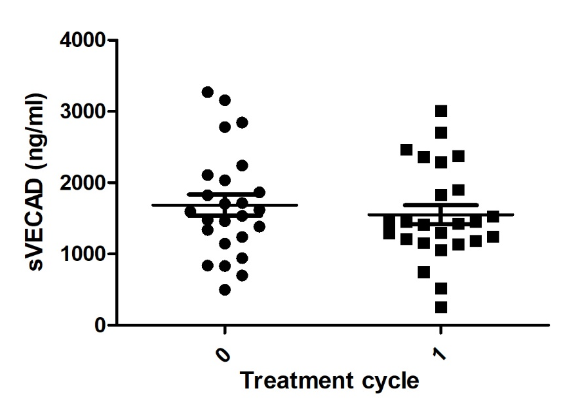
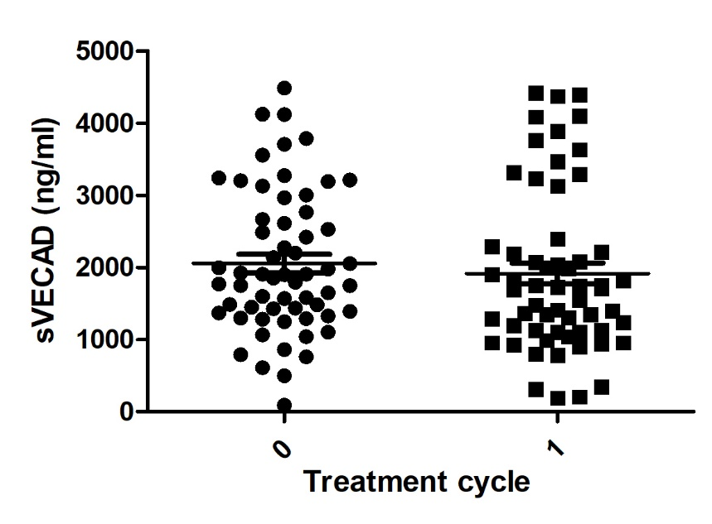
SUT group
A
Stable disease
B
Relapse
***
ns
sVE (ng/mL)
sVE (ng/mL)
BEV group
C
Stable disease
D
Relapse
ns
ns
sVE (ng/mL)
sVE (ng/mL)
Supplementary Figure S2

Slide 3
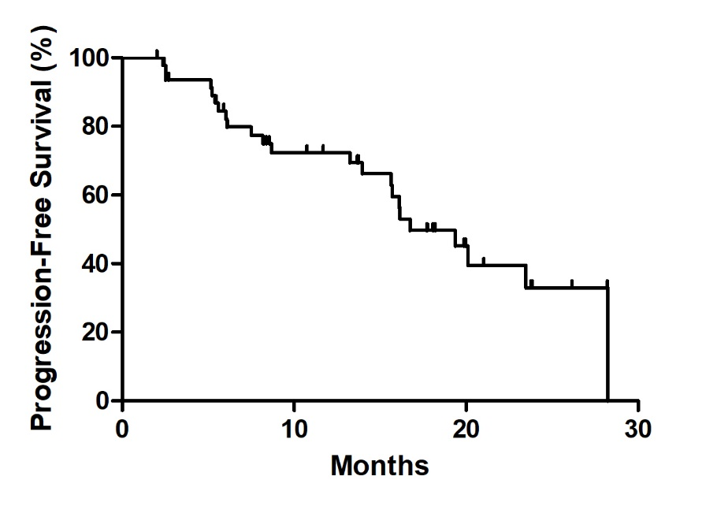
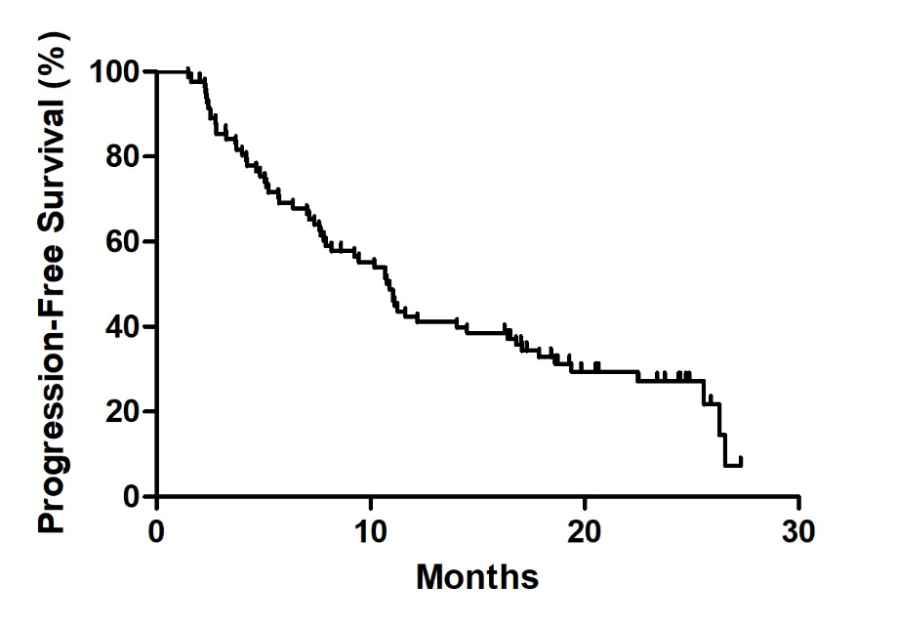
SUT group
A
Median survival
16.73 months
BEV group
B
Median survival
10.9 months
Supplementary Figure S3

Slide 4
Table 1. Characteristics of the patients included in the study.
Treatment SUT BEV
AT DIAGNOSIS
Number of patients | 48 | 83
Age at therapy initiation (yr)
Mean | 63 (34-83) | 59 (33-79)
Gender
Female | 8 (16.7%) | 21 (25.3%)
Male | 40 (83.3%) | 62 (74.7%)
Fuhrman grade
1 | 2 (4.2%) | 4 (4.8%)
2 | 10 (20.8%) | 19 (22.9%)
3 | 21 (43.8%) | 30 (36.1%)
4 | 11 (22.9%) | 15 (18.1%)
NA | 4 (8.3%) | 15 (18.1%)
Fuhrman grade (category)
1-2 | 12 (25%) | 23 (27.7%)
3-4 | 32 (66.7%) | 45 (54.2%)
NA | 4 (18.3) | 15 (18.1%)
pT
1 | 12 (25%) | 12 (14.5%)
2 | 11 (22.9%) | 19 (22.9%)
3 | 21 (43.8%) | 34 (40.9%)
NA | 4 (18.3%) | 18 (21.7%)
pN
0 | 21 (43.8%) | 32 (38.6%)
1 | 7 (14.5%) | 12 (14.4%)
NA | 20 (41.7%) | 39 (47%)
pM
0 | 27 (56.2%) | 46 (57.9%)
1 | 21 (43.8%) | 37 (42.1%)
AT BEGINNING TREATMENT
Number of metastatic sites
1 | 24 (50%) | 40 (48.2%)
2 | 14 (29.2%) | 26 (31.3%)
≥ 3 | 10 (20.8%) | 17 (20.5%)
Time from diagnosis to treatment
< 1 yr | 28 (58.3%) | 58 (69.9%)
≥ 1 yr | 20 (41.7%) | 25 (30.1%)
Mediane survival (month) | 25.6 (7.9-34.4) | 26.5 (2-29)
Best Response
Complete response | 4 (8.3%) | 2 (2.4%)
Partial response | 12 (25%) | 23 (27.7%)
Stable desease | 26 (54.2%) | 38 (45.8%)
Progression | 6 (12.5%) | 20 (24.1%)
Risk factor (MSKCC)
Good | 23 (47.9%) | 39 (47%)
Intermediate | 19 (39.6%) | 38 (45.8%)
Bad | 1 (0.2%) | 0 (0%)
NA | 5 (10.4%) | 6 (7.2%)
sVE (ng/mL)
Diagnosis (min – max) | 1631 (401-4308) | 1763 (90-4484)
After one cycle of treatment (min - max) | 1387 (366-4733) | 1532 (192-4420)
Supplementary Table 1

