Slide 1
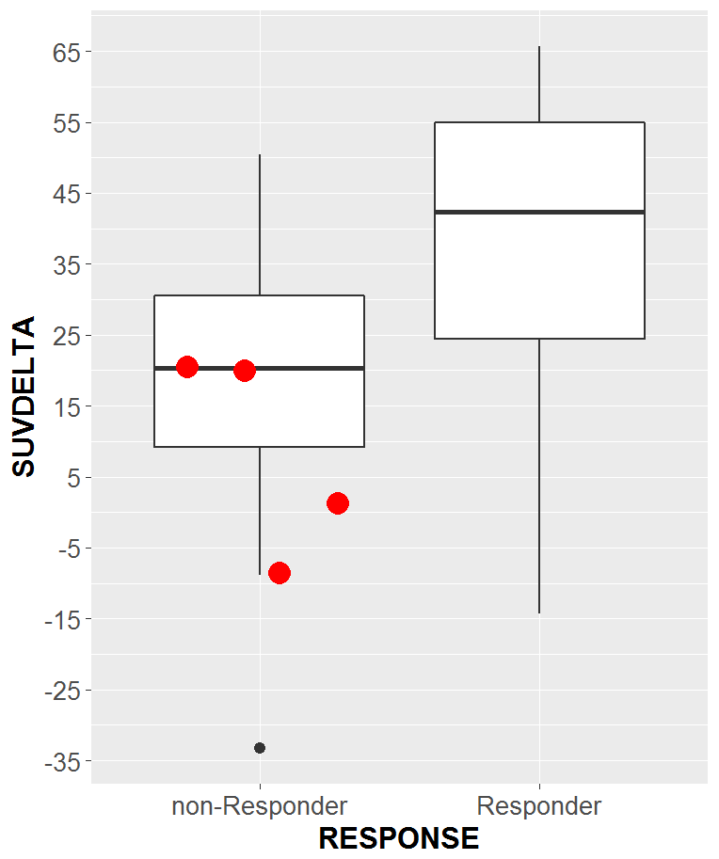
Notes:
Supplement 4: Distribution of ΔSUV by response group in the primary analysis (n=33). 4 patients whose tumors tested positive for RAS mutations post-hoc (subgroup) are highlighted in red.

