Slide 1
Supplemental Figure 1. Flow diagram of patients enrolled in the study
Patients diagnosed with locally advanced NSCLC who received
preoperative treatment followed by surgery (n=76)
Patients without sufficient specimens
before preoperative treatment (n=28)
Patients with sufficient specimens before preoperative treatment (n=48)
Patients who received
drug therapy before surgery (n=19)
Patients who received
chemo-radiotherapy before surgery (n=29)
Patients who achieved pCR after preoperative treatment (n=1)
Patients who achieved pCR after preoperative treatment (n=6)
Patients with sufficient specimens before and after
pre-operative treatment
available for immunohistochemistry
(n=18)
Patients with sufficient specimens before and after
pre-operative treatment
available for immunohistochemistry
(n=23)
NSCLC, non-small cell lung cancer; pCR, pathologic complete response

Slide 2
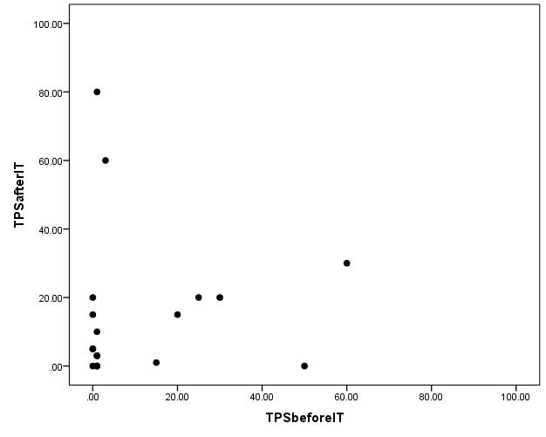
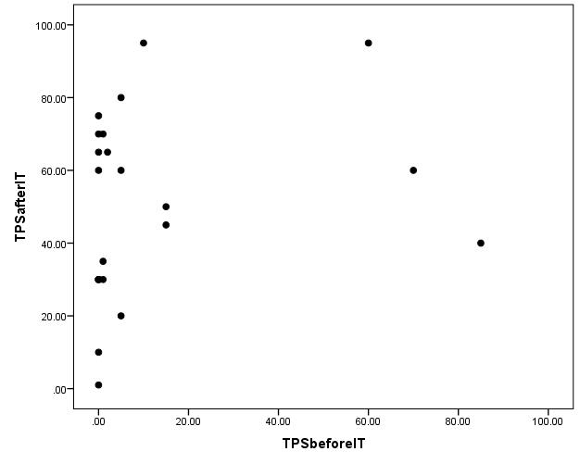
Supplemental Figure 2A. Correlation between PD-L1 expression on tumor cells before treatment and PD-L1 expression on tumor cells after treatment
Drug therapy
(n=18)
Concurrent chemo-radiotherapy
(n=23)
PD-L1 expression
(TPS)
after treatment
PD-L1 expression
(TPS)
after treatment
100
80
60
40
20
0
100
80
60
40
20
0
P=0.413; r=0.206 (Spearman)
P=0.119; r=0.334 (Spearman)
0 20 40 60 80 100
0 20 40 60 80 100
PD-L1 expression (TPS) before treatment
PD-L1 expression (TPS) before treatment
PD-L1, programmed death ligand-1; TPS, tumor proportion score

Slide 3
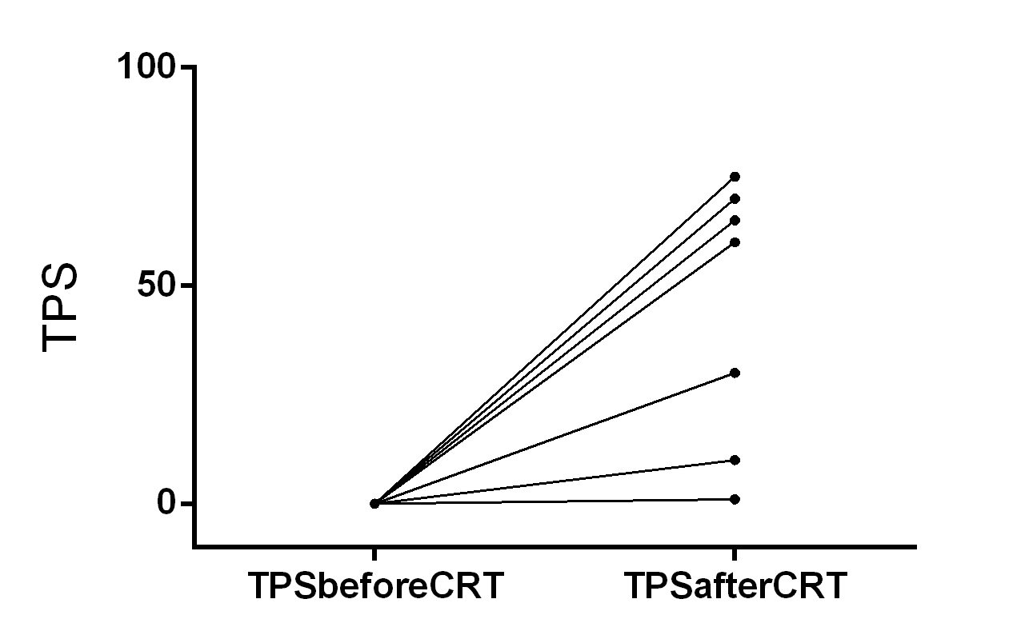
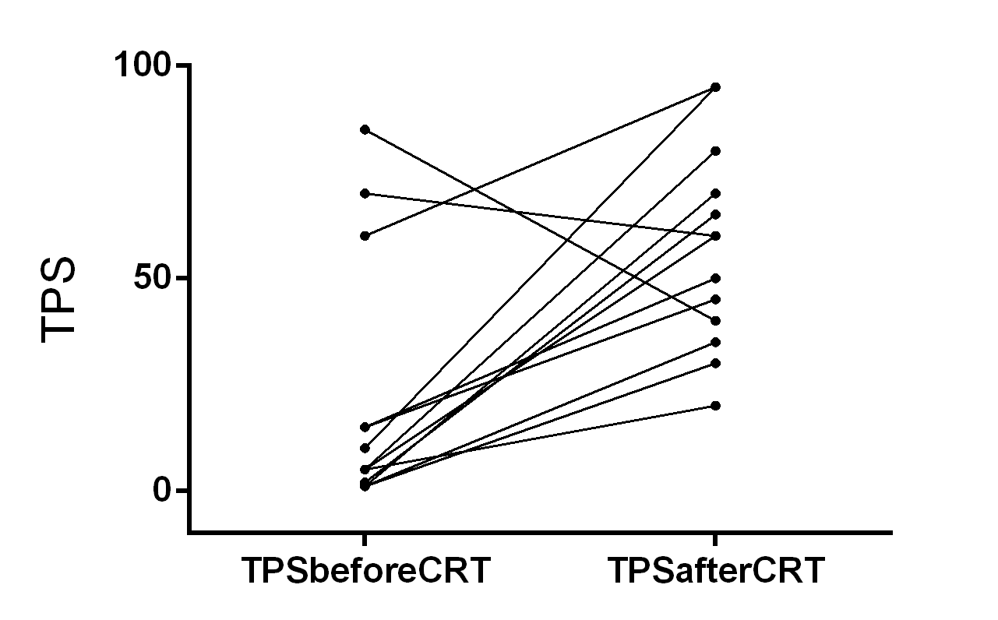
Supplemental Figure 2B. Alteration in PD-L1 expression on tumor cells after concurrent chemo-radiotherapy according to baseline PD-L1 expression on tumor cells
Baseline PD-L1 negative
(TPS begore treatment, 0)
(n=10)
Baseline PD-L1 positive
(TPS before treatment, ≥1)
(n=13)
PD-L1 expression
(TPS)
PD-L1 expression
(TPS)
100
50
0
100
50
0
TPS | Before | After
Median | 0.0 | 30.0
Mean | 0.0 | 40.1
 | P=0.001 (Wilcoxon’s signed rank)
TPS | Before | After
Median | 5.0 | 60.0
Mean | 21.2 | 57.3
 | P=0.003 (Wilcoxon’s signed rank)
PD-L1, programmed death ligand-1; TPS, tumor proportion score

Slide 4
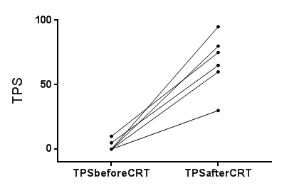
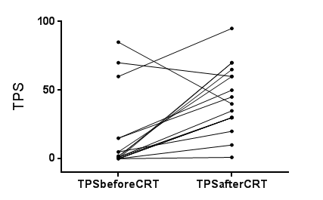
Supplemental Figure 2C. Alteration in PD-L1 expression on tumor cells after concurrent chemo-radiotherapy according to pathologic response
Pathologic response:
Therapeutic effect 1
(n=6)
Pathologic response:
Therapeutic effect 2
(n=17)
PD-L1 expression
(TPS)
PD-L1 expression
(TPS)
100
50
0
100
50
0
TPS | Before | After
Median | 0.0 | 70.0
Mean | 2.5 | 67.5
 | P=0.027 (Wilcoxon’s signed rank)
TPS | Before | After
Median | 1.0 | 40.0
Mean | 15.3 | 43.6
 | P=0.004 (Wilcoxon’s signed rank)
PD-L1, programmed death ligand-1; TPS, tumor proportion score
Pathologic response:
Therapeutic effect 1, residual viable tumor cells detected in “≥1/3” of resected tumor
Therapeutic effect 2, residual viable tumor cells detected in “<1/3” of resected tumor

Slide 5
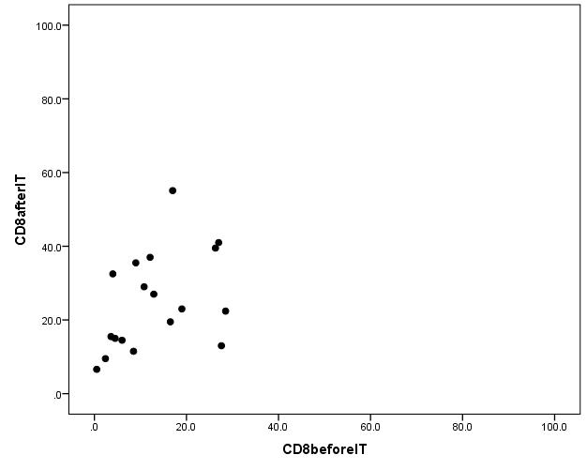
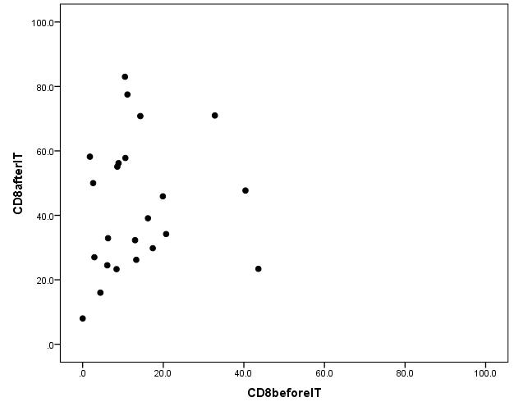
Supplemental Figure 3A. Correlation between density of stromal CD8-positive tumor infiltrating lymphocytes (CD8+TILs) before treatment and density of stromal CD8+TILs after treatment
Drug therapy
(n=18)
Concurrent chemo-radiotherapy
(n=23)
Stromal CD8+TIL density
after treatment
Stromal CD8+TIL density
after treatment
100
80
60
40
20
0
100
80
60
40
20
0
P=0.039; r=0.490 (Spearman)
P=0.378; r=0.193 (Spearman)
0 20 40 60 80 100
0 20 40 60 80 100
Stromal CD8+TIL density before treatment
Stromal CD8+TIL density before treatment
CD8+TIL, CD8-positive tumor-infiltrating lymphocyte

Slide 6
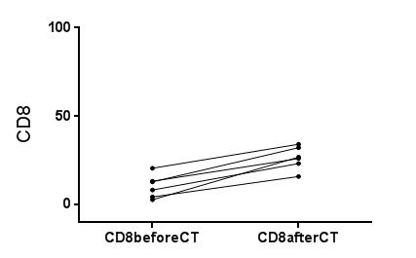
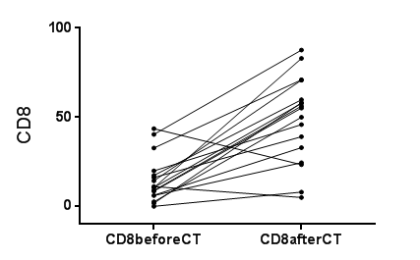
Supplemental Figure 3B. Alteration in density of stromal CD8-positive tumor infiltrating lymphocytes (CD8+TILs) after concurrent chemo-radiotherapy according to pathologic response
Pathologic response:
Therapeutic effect 1
(n=6)
Pathologic response:
Therapeutic effect 2
(n=17)
Stromal CD8+TIL
density
Stromal CD8+TIL
density
100
50
0
100
50
0
Stromal CD8+TIL density | Before | After
Median | 10.7 | 26.6
Mean | 10.5 | 26.5
 | P=0.028 (Wilcoxon’s signed rank)
Stromal CD8+TIL density | Before | After
Median | 10.6 | 55.1
Mean | 14.8 | 47.8
 | P=0.001 (Wilcoxon’s signed rank)
CD8+TIL, CD8-positive tumor-infiltrating lymphocyte
Pathologic response:
Therapeutic effect 1, residual viable tumor cells detected in “≥1/3” of resected tumor
Therapeutic effect 2, residual viable tumor cells detected in “<1/3” of resected tumor

