Slide 1
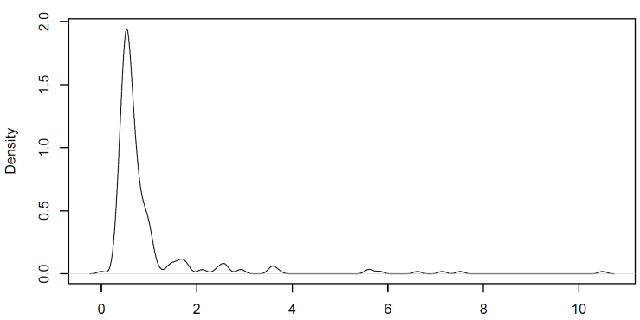
Supplementary Figure 1: Distribution of cf-miRNA at baseline (n=250)
Density
Cf-miRNA (ng/ul)
A density plot shows the distribution of cf-miRNA across the cohort

Slide 2
Supplementary Table 1: Multivariate analysis using cf-miRNA median levels
 | OVERALL SURVIVAL |  |  | PROGRESSION-FREE SURVIVAL
 | Multivariate HR | 95% CI | p-value | Multivariate HR | 95% CI | p-value
Age | 1.02 | 0.99 - 1.05 | 0.1166 | 1.01 | 0.99 - 1.04 | 0.2904
Subtype | 1.58 | 1.18 - 2.11 | 0.0019 | 1.16 | 0.94 - 1.44 | 0.1711
Stage | 2.28 | 1.56 - 3.33 | 2.14E-05 | 3.20 | 2.35 - 4.36 | 1.37E-13
Grade | 1.18 | 0.55 - 2.54 | 0.6730 | 1.07 | 0.61 - 1.89 | 0.8108
cf-miRNA median | 3.85 | 1.26 - 11.82 | 0.0183 | 4.14 | 1.92 - 8.93 | 0.0003

