Slide 1
A
B
ephrin-B2 IHC staining | Total Cases | Positive cases | Positive percentage (%)
Adjacent normal prostate tissue | 8 | 0 | 0
Normal prostate tissue | 8 | 0 | 0
Total | 16 | 0 | 0
EphB4
EFNB2
EphB1,2,3,6
Supplemental Figure 1. Induction of EphB4-ephrin-B2 in prostate cancers. (A) Immunohistochemistry (IHC) stain of ephrin-B2 one prostate cancer tissue microarray, containing 80 cases of adenocarcinoma, 8 each of adjacent normal prostate tissue and normal prostate tissue, duplicate cores per case (Biomax Inc. PR1921b). Table indicates subgroup analysis of ephrin-B2 expression level based on normal prostate tissue. (B) EPHB/EFNB gene expression levels were performed in 492 prostate cancer patients with somatic mutations based on The Cancer Genome Atlas (TCGA).

Slide 2
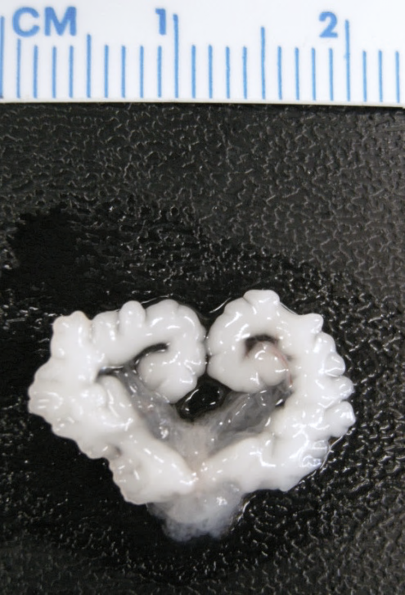
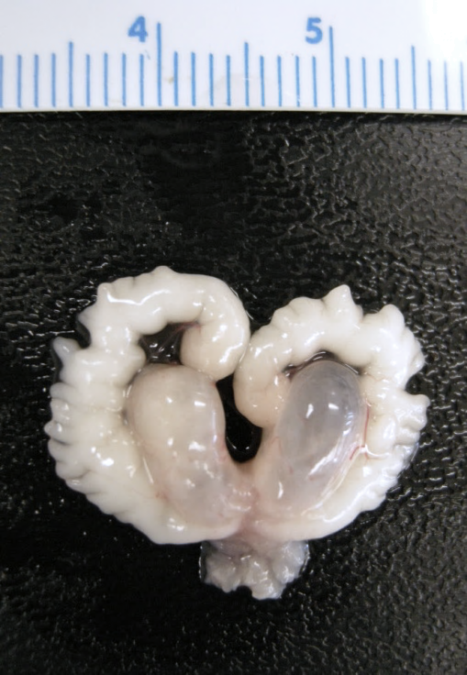
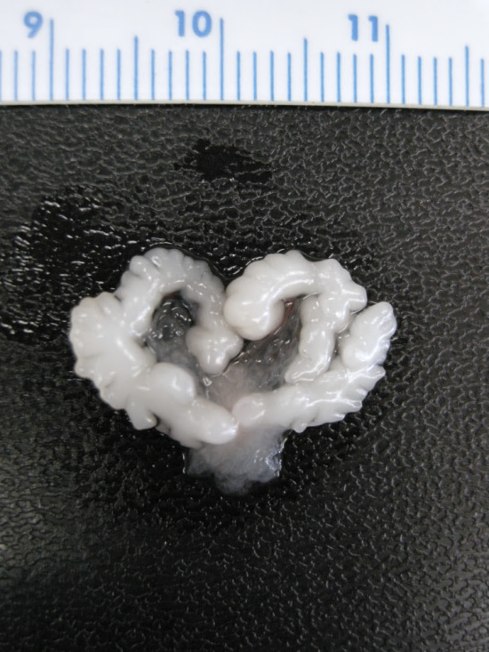
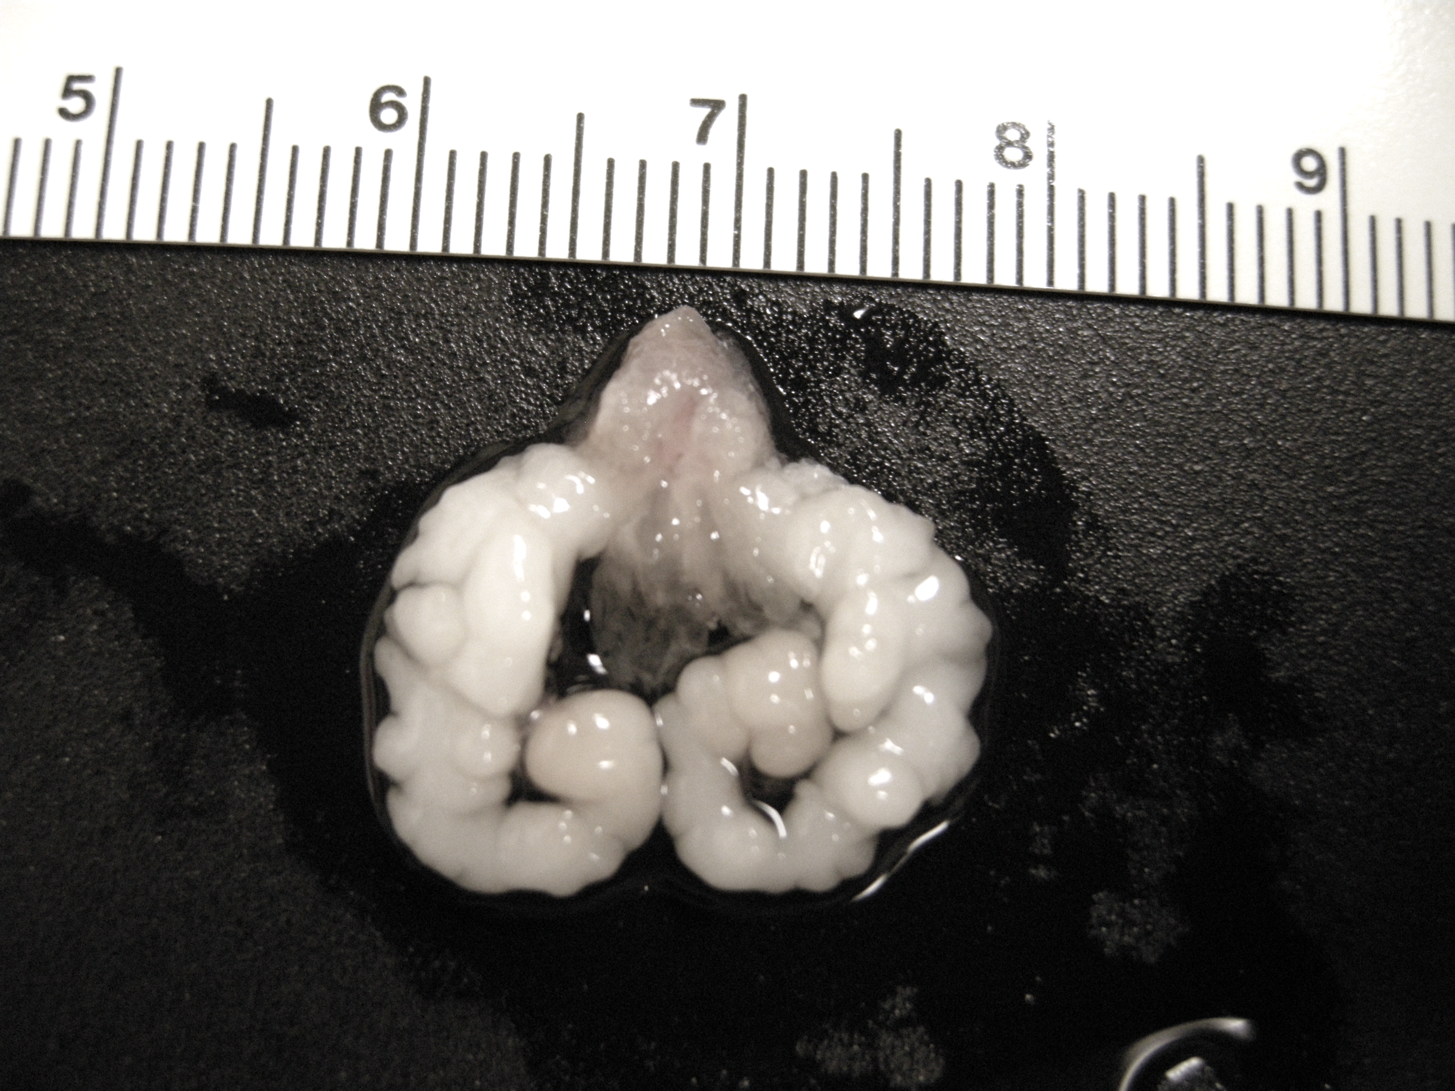
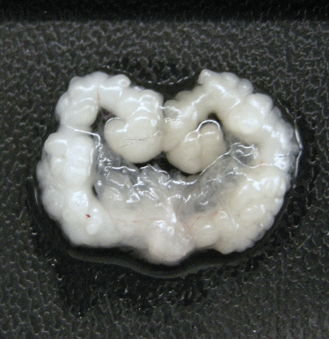
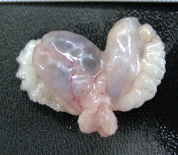
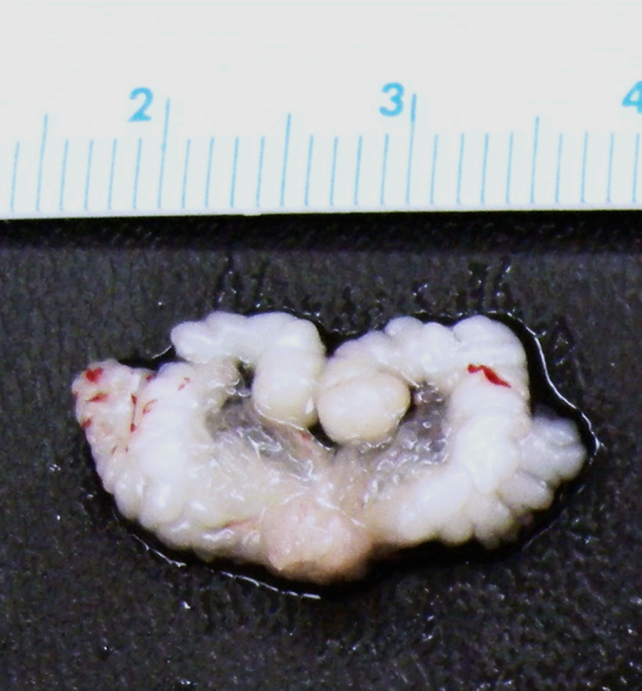
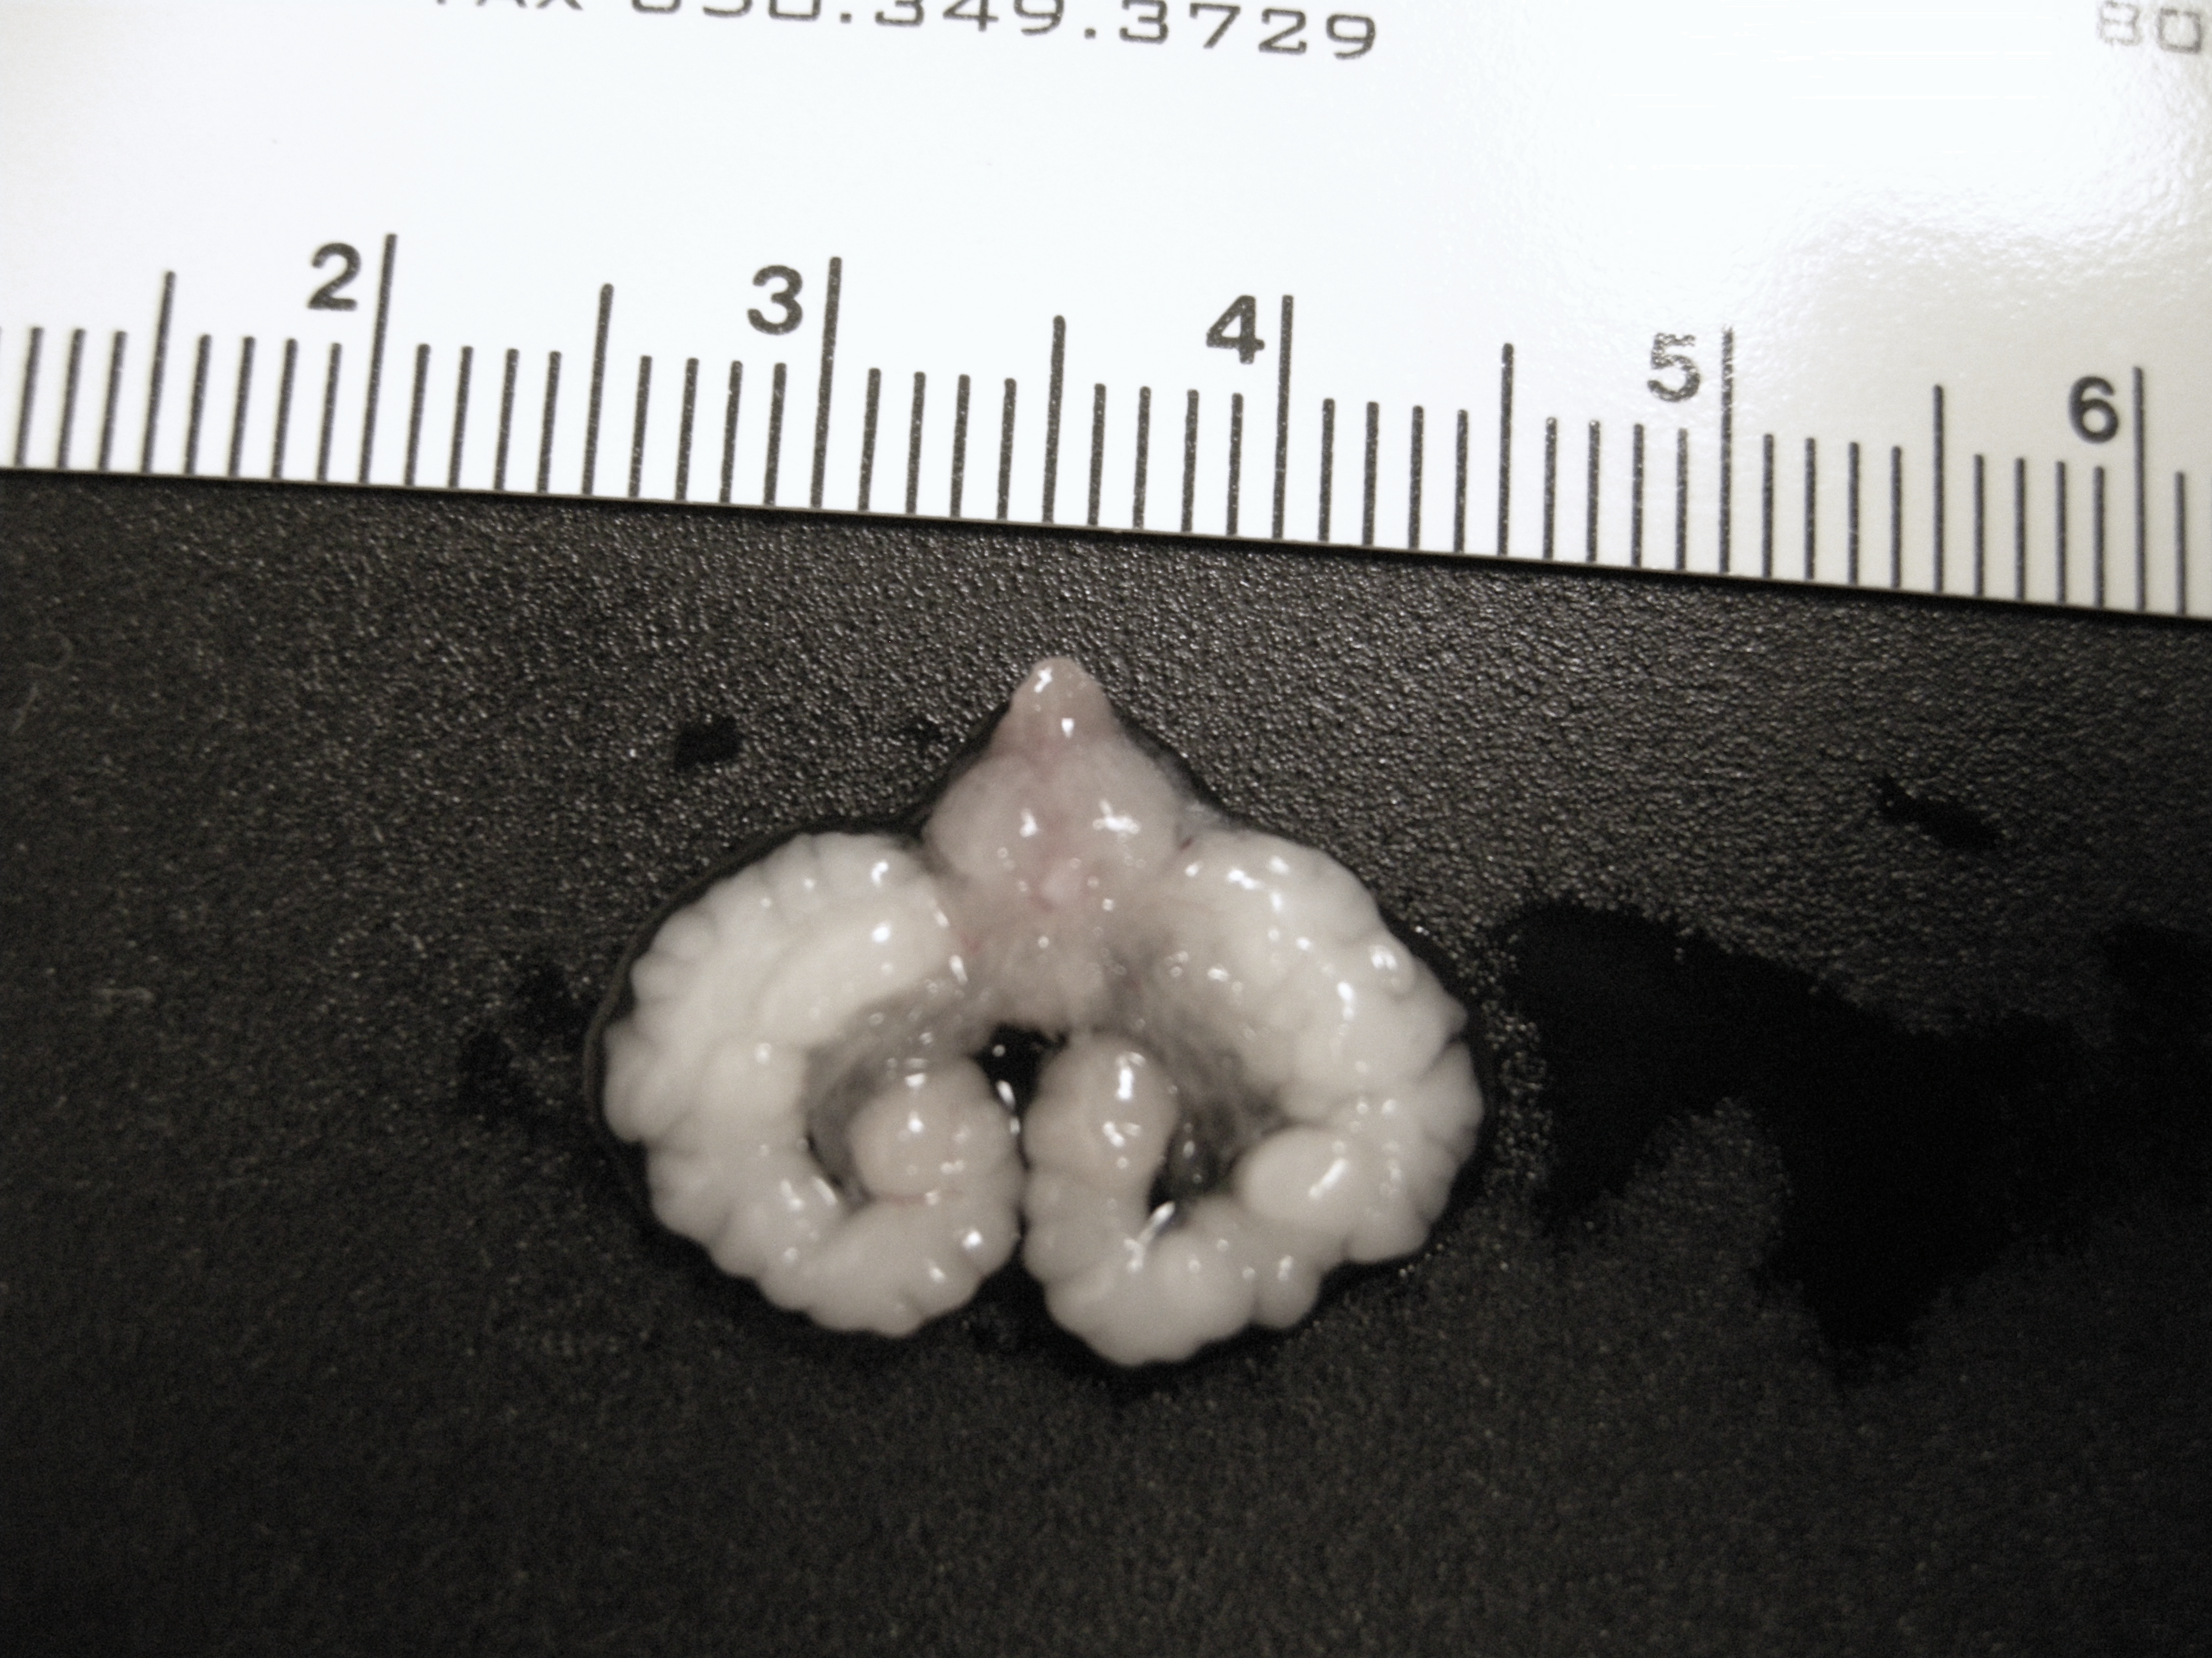
WT
EPHB4^{+/+};CPPL
EPHB4^{-/-};CPPL
EPHB4^{-/-};PTEN^{+/+}
Supplemental Figure 2. Prostate epithelium specific EPHB4 knockout (KO) prevent tumor formation in Prostate epithelium specific PTEN KO. Prostate gland from EPHB4/PTEN wild-type (WT), EPHB4 wild-type PTEN-null mice (EPHB4^{+/+};CPPL), EPHB4-homozygote PTEN-null mice (EPHB4^{-/-}; CPPL), and EphB4-homozygote PTEN wild type mice (EPHB4^{-/-};PTEN^{+/+}). Red dashed lines denote the tumor areas.
Notes:
EphB4 CWKO1 (-/-): CMV-Cre (+/-) transgenic mice:
To generate conditionally whole knock-out of EphB4 gene mice, EphB4CWKO mice which have loxp sequences flanking exon2 and exon 3 of EphB4 gene are generated and bred in our laboratory. These mice are cross-bred with CMV-Cre mice.
We analyzed 7 mices from one mom, and 3 are embryonic lethal.

Slide 3
CPPL Male Mice
Ear Tag # | 1st screen @ 2-month-old | 2nd screen @ 3-month-old | 3rd screen @ 4-month-old | 4th screen @ 5-month-old | 5th screen @ 6-month-old | 6th screen @ 7-month-old | Disposition
5758 | 2.36E+02 | 3.44E+05 | 7.87E+05 | 5.76E+06 | 2.01E+07 | 1.01E+08 | Scarified for analysis
650 | 1.02E+02 | 2.11E+05 | 6.32E+05 | 5.55E+06 | 1.02E+07 | 6.89E+07 | Scarified for analysis
575 | 1.11E+02 | 7.77E+04 | 5.35E+05 | 6.03E+06 | 5.40E+07 | 1.19E+08 | Scarified for analysis
683 | 2.21E+02 | 4.54E+05 | 1.16E+06 | Dead | - | - | Dead at 5 months age
689 | 3.23E+02 | 5.43E+05 | 2.10E+06 | 7.31E+06 | 2.09E+07 | 8.09E+07 | Scarified for analysis
690 | 8.94E+01 | 8.97E+04 | 3.66E+05 | 1.03E+06 | 7.81E+06 | 6.59E+07 | Scarified for analysis
549 | 2.44E+02 | 6.43E+05 | 5.42E+06 | 4.30E+07 | 2.11E+08 | 4.98E+08 | Scarified for analysis
742 | 9.96E+01 | 7.98E+04 | 4.98E+05 | Dead | - | - | Dead at 5 months age
306 | 3.33E+02 | 6.57E+05 | Dead | - | - | - | Dead at 4 months age
753 | 6.60E+02 | 4.59E+05 | 8.48E+05 | 2.23E+06 | 1.11E+07 | 7.02E+07 | Scarified for analysis
755 | 4.15E+02 | 9.87E+05 | 2.21E+06 | 8.99E+06 | 4.56E+07 | 1.68E+08 | Scarified for analysis
925 | 1.67E+02 | 4.74E+05 | 9.06E+05 | 4.29E+06 | Dead | - | Dead at 6 months age
987 | 1.07E+02 | 2.11E+05 | 5.01E+05 | 4.78E+06 | 2.12E+07 | 7.24E+07 | Scarified for analysis
984 | 3.33E+02 | 3.20E+05 | 4.21E+05 | 1.57E+06 | 2.40E+07 | 8.18E+07 | Scarified for analysis
Supplemental Figure 3a. BLI of luciferase expression in all CPPL live mice. Table shows the bioluminescence imaging (BLI) intensity of each screen from age 2 month to 7 month of all 14 CPPL mice and their destine.
Notes:
CPPL vs B4(F/F)CPPL
14/29
1.33E+08 vs 5.36E+05

Slide 4
EPHB4^{-/-};CPPL Male Mice
Ear Tag # | 1st screen @ 2-month-old | 2nd screen @ 3-month-old | 3rd screen @ 4-month-old | 4th screen @ 5-month-old | 5th screen @ 6-month-old | 6th screen @ 7-month-old | Disposition
316 | 9.61E+02 | 2.38E+03 | 3.23E+03 | 6.91E+04 | 2.32E+04 | 3.22E+04
463 | 1.17E+01 | 3.98E+02 | 9.66E+02 | 5.40E+03 | 7.30E+03 | 2.54E+04 | Sacrificed for analysis
652 | 8.78E+02 | 5.64E+03 | 5.49E+04 | 7.71E+05 | Dead | - | Dead at 6 months age
653 | 5.99E+02 | 8.56E+02 | 4.44E+03 | 5.56E+03 | 4.34E+04 | 4.66E+05 | Sacrificed for analysis
637 | 2.32E+02 | 5.41E+02 | 4.49E+03 | 4.92E+03 | Dead | - | Dead at 6 months age
639 | 7.47E+01 | 3.63E+02 | 5.49E+02 | 5.49E+03 | 9.49E+03 | 2.12E+05 | Sacrificed for analysis
648 | 6.46E+02 | 7.48E+02 | 2.30E+03 | Dead | - | - | Dead at 5 months age
541 | 3.33E+02 | 7.74E+03 | Dead | - | - | - | Dead at 4 months age
543 | 6.99E+02 | 5.38E+02 | 3.32E+03 | 2.46E+03 | 4.38E+04 | 3.28E+05 | Weak signal
545 | 2.88E+03 | 1.01E+04 | 2.94E+04 | 3.55E+04 | 8.54E+04 | 1.85E+05 | Weak signal
557 | 8.93E+02 | 3.41E+03 | 8.47E+04 | 2.42E+05 | 4.33E+05 | 4.47E+05 | Weak signal
564 | 7.56E+01 | 5.42E+02 | Dead | - | - | - | Dead at 4 months age
736 | 4.37E+01 | 3.28E+02 | 6.21E+02 | 3.51E+03 | 4.45E+04 | 5.56E+04 | Sacrificed for analysis
738 | 4.37E+02 | 3.45E+02 | 1.66E+03 | 5.05E+03 | 1.29E+04 | 3.28E+04 | Sacrificed for analysis
972 | 9.38E+01 | 5.34E+02 | 3.75E+03 | Dead | - | - | Dead at 5 months age
761 | 7.38E+02 | 4.55E+02 | 3.28E+03 | 2.53E+04 | 6.83E+04 | 8.81E+04 | Sacrificed for analysis
769 | 6.74E+01 | 5.84E+02 | 2.32E+03 | Dead | - | - | Dead at 5 months age
770 | 4.46E+02 | 2.09E+03 | Dead | - | - | - | Dead at 4 months age
778 | 5.49E+02 | 5.37E+03 | 8.96E+03 | 2.37E+04 | 4.94E+04 | 6.17E+04 | Sacrificed for analysis
830 | 3.99E+03 | 3.40E+03 | 4.39E+03 | 2.39E+04 | 9.38E+04 | 2.93E+05 | Sacrificed for analysis
430 | 4.13E+03 | 7.39E+03 | 4.36E+03 | 5.38E+03 | 8.44E+03 | 6.49E+04 | Sacrificed for analysis
438 | 6.39E+02 | 4.90E+03 | 2.03E+03 | 4.65E+03 | 9.37E+03 | Dead | Dead at 7 months age
403 | 4.93E+01 | 4.38E+02 | 3.38E+03 | 5.41E+03 | 7.37E+04 | 8.49E+04 | Sacrificed for analysis
404 | 8.55E+02 | 7.73E+03 | 6.37E+03 | 5.38E+04 | 2.48E+05 | 8.09E+04 | Sacrificed for analysis
499 | 5.83E+01 | 4.29E+02 | 4.54E+02 | 1.06E+03 | 3.28E+03 | 4.44E+04 | Sacrificed for analysis
2105 | 8.49E+01 | 3.20E+02 | 7.39E+03 | 8.36E+03 | 4.04E+04 | 6.18E+04 | Sacrificed for analysis
6787 | 4.81E+02 | 7.54E+02 | 4.05E+03 | 9.26E+03 | 6.39E+04 | 6.30E+04 | Sacrificed for analysis
6789 | 1.70E+03 | 3.41E+03 | 2.11E+04 | 5.56E+04 | 5.72E+04 | 3.47E+05 | Sacrificed for analysis
Supplemental Figure 3b. BLI of luciferase expression in all EPHB4-knockout CPPL live mice. The bioluminescence imaging (BLI) intensity of each screen from age 2-month to 7-month of all 29 Eph4-knockout CPPL mice (EPHB4(-/-);CPPL) and their destine.
Notes:
19/29 are alive and data analysis at 7 months age
1.33E+08 vs 5.36E+05

Slide 5
A
B
Mice # | 14 | 14 | 13 | 11 | 10 | 10
Mice # | 29 | 28 | 25 | 22 | 20 | 19
Supplemental Figure 3c: BLI intensity over time in CPPL and EPHB4-CKO/CPPL mice. BLI intensity in each mouse over time is shown. Each dot denotes individual mouse. Red bar represents the average BLI intensity of all mice at a given age. Panel A: EPHB4 wild-type CPPL mice (CPPL only). Panel B: EPHB4-knockout CPPL mice (EPHB4^{-/-};CPPL). Number of mice at each time point are shown at the bottom.

Slide 6
CPPL Male: PBS treatment group (Prevention Study)
Ear Tag # | 1st screen @ 4-month-old | 2nd screen @ 5-month-old | 3rd screen @ 6-month-old | 4th screen @ 7-month-old | 5th screen @ 8-month-old | 6th screen @ 9-month-old | Weight (gm) | Disposition
493 | 5.40E+05 | 9.39E+06 | 5.32E+07 | 2.10E+08 | 4.32E+08 | 1.38E+09 | 4.5 | Sacrificed for analysis
414 | 2.39E+05 | 3.29E+05 | 3.49E+06 | 1.30E+07 | 7.93E+07 | 1.94E+08 | 3.6 | Sacrificed for analysis
419 | 2.13E+05 | 3.45E+06 | 5.55E+06 | Dead | - | - | - | Dead at 5 months age
458 | 6.48E+04 | 2.74E+05 | 7.71E+05 | Dead | - | - | - | Dead at 5 months age
717 | 4.85E+04 | 5.31E+04 | 5.49E+05 | 8.77E+06 | 1.52E+07 | 6.58E+07 | 3.5 | Sacrificed for analysis
719 | 3.40E+06 | 6.68E+07 | 2.84E+08 | 6.59E+08 | 2.10E+09 | 9.08E+09 | 5.1 | Sacrificed for analysis
474 | 7.23E+04 | 3.93E+05 | 5.34E+05 | 2.39E+07 | 6.31E+08 | 9.32E+08 | 4.2 | Sacrificed for analysis
792 | 1.98E+05 | 3.29E+06 | 8.23E+07 | 1.59E+08 | 3.49E+09 | 6.04E+09 | 5.8 | Sacrificed for analysis
Supplemental Figure 4a. BLI in all PBS treated CPPL live mice in prevention study (early intervention). The bioluminescence imaging (BLI) intensity of each screen from age 4-month to 9-month in all 8 PBS treated CPPL mice
Notes:
PBS vs sB4 prevention
8/15
1.79E+08 vs 2.59E+03 at age 7 months old (need revise the data in the paper)
6/8 are alive and data analysis at 7 months age

Slide 7
CPPL Male: sEphB4-alb Treatment group
Ear Tag # | 1st screen @ 4-month-old | 2nd screen @ 5-month-old | 3rd screen @ 6-month-old | 4th screen @ 7-month-old | 5th screen @ 8-month-old | 6th screen @ 9-month-old | Weight (gm) | Others
743 | 8.39E+05 | 8.07E+04 | 3.39E+04 | Dead | - | - | - | Dead at 5 months age
750 | 8.90E+05 | 9.49E+04 | 4.56E+03 | 2.22E+03 | 7.04E+02 | 2.85E+02 | 1.3 | Sacrificed for analysis
985 | 4.37E+04 | 1.68E+04 | 8.85E+03 | 6.03E+02 | 8.89E+02 | 7.03E+02 | 1.8 | Sacrificed for analysis
986 | 3.37E+06 | 9.30E+05 | 3.03E+04 | 2.22E+03 | 8.30E+02 | 6.56E+02 | 1.3 | Sacrificed for analysis
987 | 6.40E+04 | 3.59E+03 | 2.48E+03 | 3.03E+03 | 8.93E+02 | 9.92E+02 | 2.0 | Sacrificed for analysis
455 | 4.93E+05 | 5.04E+03 | 4.77E+03 | 3.33E+02 | 4.03E+02 | 6.04E+02 | 1.2 | Sacrificed for analysis
742 | 9.03E+05 | 3.39E+03 | 5.31E+03 | 3.29E+02 | 5.49E+02 | 4.22E+02 | 1,1 | Sacrificed for analysis
721 | 3.12E+04 | 3.43E+03 | 9.30E+02 | 4.32E+02 | 3.93E+02 | Dead | - | Dead at 7 months age
722 | 3.73E+05 | 4.96E+04 | 8.39E+03 | 3.20E+03 | Dead | - | - | Dead at 6 months age
723 | 4.32E+05 | 7.40E+04 | 3.86E+03 | 8.83E+02 | 1.40E+03 | 2.43E+02 | 0.6 | Sacrificed for analysis
2110 | 1.20E+06 | 6.49E+05 | 8.84E+03 | 6.63E+03 | 6.74E+02 | 8.30E+02 | 1.7 | Sacrificed for analysis
2130 | 9.03E+05 | 5.40E+04 | 7.71E+03 | 5.38E+03 | 9.94E+02 | 4.31E+02 | 0.9 | Sacrificed for analysis
2170 | 4.30E+05 | 7.93E+04 | 3.33E+03 | 3.41E+02 | 9.30E+02 | 3.11E+01 | 0.5 | Sacrificed for analysis
6767 | 9.02E+04 | 3.03E+03 | 2.21E+03 | 3.23E+03 | Dead | - | - | Dead at 6 months age
6768 | 7.49E+05 | 9.93E+04 | 3.85E+04 | 7.43E+03 | 5.04E+03 | 4.58E+03 | 2.2 | Sacrificed for analysis
Supplemental Figure 4b. BLI in sEphB4-alb treated CPPL live mice in prevention study (early intervention). The bioluminescence imaging (BLI) intensity of each screen from age 4-month to 9-month in all 15 sEphB4-alb treated CPPL mice and their destine.
Notes:
1.79E+08 vs 2.59E+03 at age 7 months old (need revise the data in the paper)
11/15 are alive and data analysis at 7 months age

Slide 8
Mice # | 8 | 8 | 8 | 6 | 6 | 6
Mice # | 15 | 15 | 15 | 14 | 12 | 11
Supplemental Figure 4c. Intensity in PBS and sEph4-alb treated CPPL mice in Prevention study (early intervention). Chart summarizes the BLI intensity based on age. Each dots denotes each mouse. Red bar shows the average BLI intensity of all mice over time. Upper panel: PBS treated CPPL mice. Lower panel: sEph4-alb treated CPPL mice. The number of mice at each age group is shown on the bottom.
Mice # | 8 | 8 | 8 | 6 | 6 | 6
Mice # | 15 | 15 | 15 | 14 | 12 | 11

Slide 9
Supplemental Figure 4d. Tumor weight in PBS and sEph4-alb treated CPPL mice in Prevention study (early intervention). Data was collected during sacrificed analysis. Average tumor weight 4.45gm in PBS treated CPPL group (n=5) and 1.35gm in sEph4-alb treated CPPL group (n=11). Error bar is the standard deviation.
Mice # | 8 | 8 | 8 | 6 | 6 | 6
Mice # | 15 | 15 | 15 | 14 | 12 | 11

Slide 10
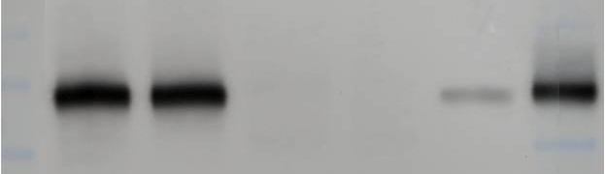

sEphB4-alb
_____________________
Positive Control
sEphB4-alb
Tumors
Tumors
Normal
Normal
0.5ng 5.0ng
180 kD
180 kD
EphB4
135 kD
135 kD
100 kD
100 kD
GAPDH
35 kD
Supplemental Figure 4e. PC3, prostate cancer cell line, were implanted in athymic mice (2x10⁶ cells/mouse) subcutaneously in the flank. When the tumors reached a volume of around 300 mm³, mice were injected with sEphB4-alb (200 µg/mouse) subcutaneously, or PBS in 100 µl volume. Tumors and normal tissue adjacent to the tumor were harvested 24 hours later. Equal amount of tumor lysates measured by total protein quantitation by Bradford method, were separated by electrophoresis, along with known amounts of recombinant sEphB4-alb. Proteins were probed with EphB4 and GAPDH antibody, respectively. GAPDH: as internal control.

Slide 11
CPPL Male: sEphB4-alb treatment group
Ear Tag # | 1st screen @ 7-month-old | 2nd screen @ 8-month-old | 3rd screen @ 9-month-old | 4th screen @ 10-month-old | Others
684 | 5.87E+08 | 4.39E+07 | 9.48E+04 | 2.11E+03 | Sacrificed for analysis
683 | 9.01E+07 | 6.41E+06 | 8.99E+03 | 2.19E+2 | Sacrificed for analysis
163 | 1.09E+08 | 6.82E+06 | 3.42E+03 | 1.09E+2 | Sacrificed for analysis
131 | 6.98E+07 | 1.76E+06 | Dead | - | Dead at 9 months age
6763 | 8.36E+07 | 4.85E+06 | 7.54E+02 | 2.18E+2 | Sacrificed for analysis
6767 | 8.40E+07 | Dead | - | - | Dead at 8 months age
621 | 2.22E+08 | 7.98E+07 | 9.89E+02 | 8.90E+1 | Sacrificed for analysis
925 | 1.02E+08 | 9.73E+06 | 5.39E+03 | 3.30E+2 | Sacrificed for analysis
Supplemental Figure 5a. BLI of all sEphB4-alb treated CPPL live mice in regression experiment (late intervention). Table shows the bioluminescence imaging (BLI) intensity of each screen from age 7-month to 10-month of all 8 sEphB4-alb treated CPPL mice (sB4;CPPL) and their destine. After the sEphB4-alb treatment, the BLI intensity was reduced significantly.
Notes:
sB4 regression:8
6/8 had regression and 2/8 died

Slide 12
Mice # | 8 | 7 | 6 | 6
Supplemental Figure 5b. Intensity of BLI of PBS treated sEph4-alb treated CPPL mice in regression experiment (late intervention). The BLI intensity over time. Each dots denotes each mouse. Red bar represents the average BLI intensity in all mice at each time point. Number of mice at each time point are shown at the bottom.

Slide 13
Castrated CPPL Male Mice with recurrent Prostate cancer: PBS treatment group
Ear Tag # | 1st screen @ 4-month-old | 2nd screen @ 5.5-month-old | 3rd screen @ 8.5-month-old | 4th screen @ 10-month-old | 5th screen @ 14.5-month-old
452 | 6,895,829 | 2,390,098 | 84,955 | 530,580 | 10,947,464
449 | 830,854 | 6,470,979 | 59,542 | 97,784 | 13,859,509
526 | 5,396,633 | 6,943,258 | 749,581 | 23,940,554 | 248,482,139
Castrated CPPL Male Mice with recurrent Prostate cancer: sEphB4-alb treatment group
229 | 3,485,930 | 3,344,896 | 667,584 | 347,320 | 2,128
987 | 445,869 | 859,963 | 879,873 | 2,137 | 438
522 | 6,559,636 | 909,534 | 129,412 | 9,807 | 121
Supplemental Figure 6. BLI in all PBS and sEphB4-alb treated castrated CPPL live mice. The bioluminescence imaging (BLI) intensity of each mouse from age 4-month to 14.5-month in PBS treated (upper panel) and sEphB4-alb treated (lower panel) CPPL castrated mouse with recurrent prostate cancer. The low signal on 3rd screen was due to setting variation.
Notes:
PBS vs sB4 castrated-resistant CPPL
3/3

Slide 14
Supplementary Figure 7. sEphB4-alb treated TRAMP-C2 xenograft. Implanted 2 X 10⁶ TRAMP-C2 cells into C57/BL6 mice. On week 20, mice were distributed into two groups: PBS (control) and sEphB4-alb (30mg/kg) treated group, n=8/group. Mice were injected IP 3 times a week from week 20-42.

Slide 15


A
B
C
Ctrl siRNA | EPHB4 siRNA
 | Vector | Wt-AKT | 𝛥-AKT
Vector | Wt-AKT | 𝛥-AKT
AKT
EPHB4
pAKT
𝛽-Actin
𝛽-Actin
Supplementary Figure 8. EphB4 regulates PI3K pathway in vitro. (A) Western blot of EphB4 confirmed EphB4 knockdown with EphB4 siRNA in all test samples. (B) Western blot of AKT and pAKT. Both overexpression of wild-type AKT (wt-AKT) and constitutionally active forms of AKT (ΔAKT) rescued AKT and pAKT levels from EphB4 siRNA. Vector: empty vector as control. β-actin was probed to ensure equal loading. (C) Cell viability (MTT) assay confirmed overexpression of either wt-AKT or ΔAKT rescued the cell death caused by EphB4 siRNA compared to control siRNA but not empty vector. Experiment was performed in triplicate.
Notes:
Figure 6A p110 western blots should be in Figure 7.

Slide 16
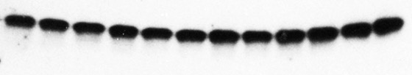
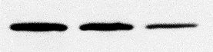
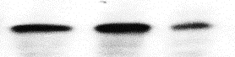

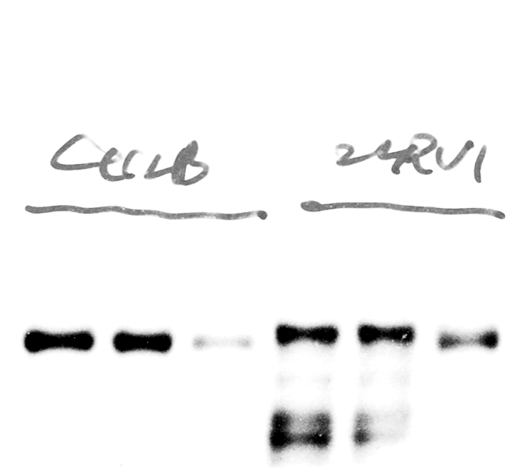

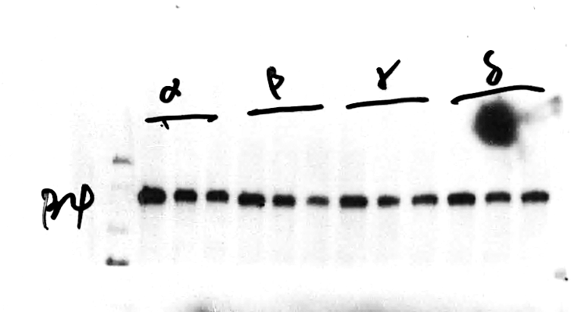
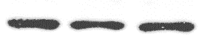
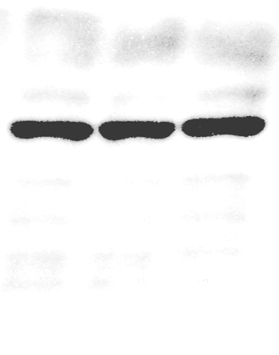
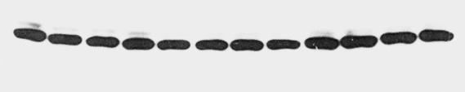
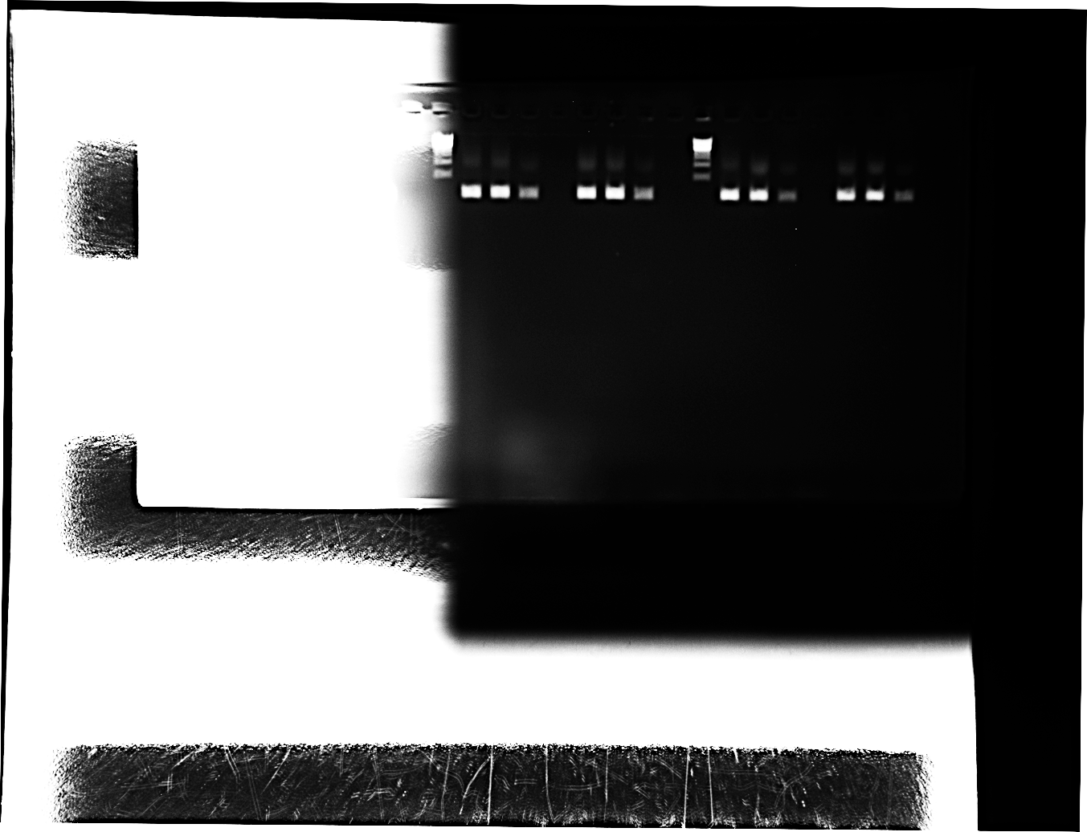
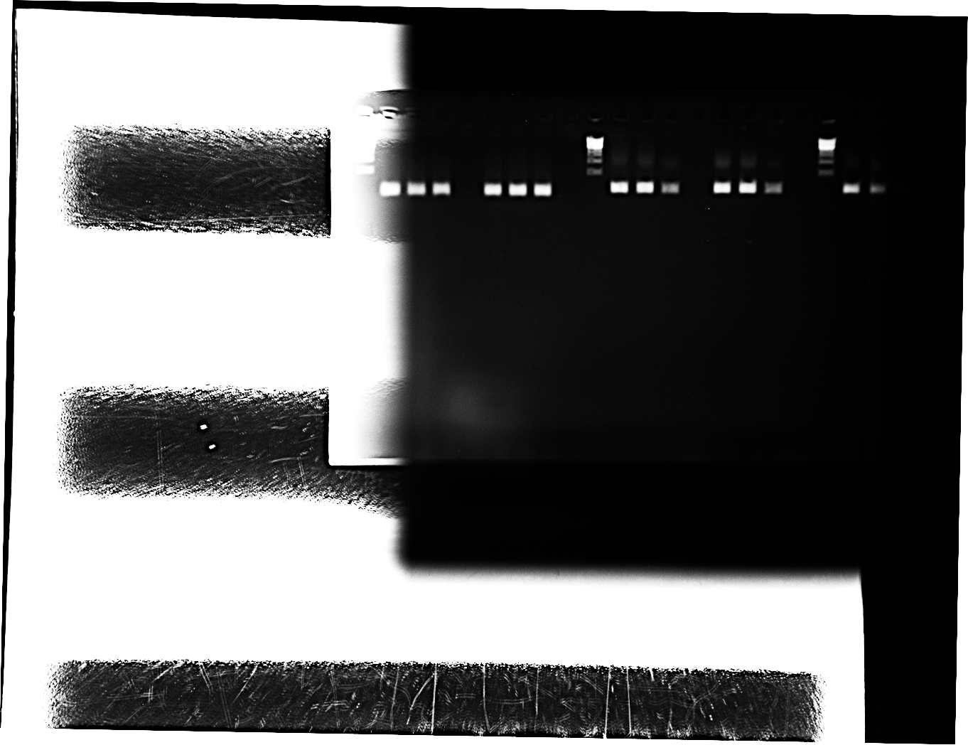
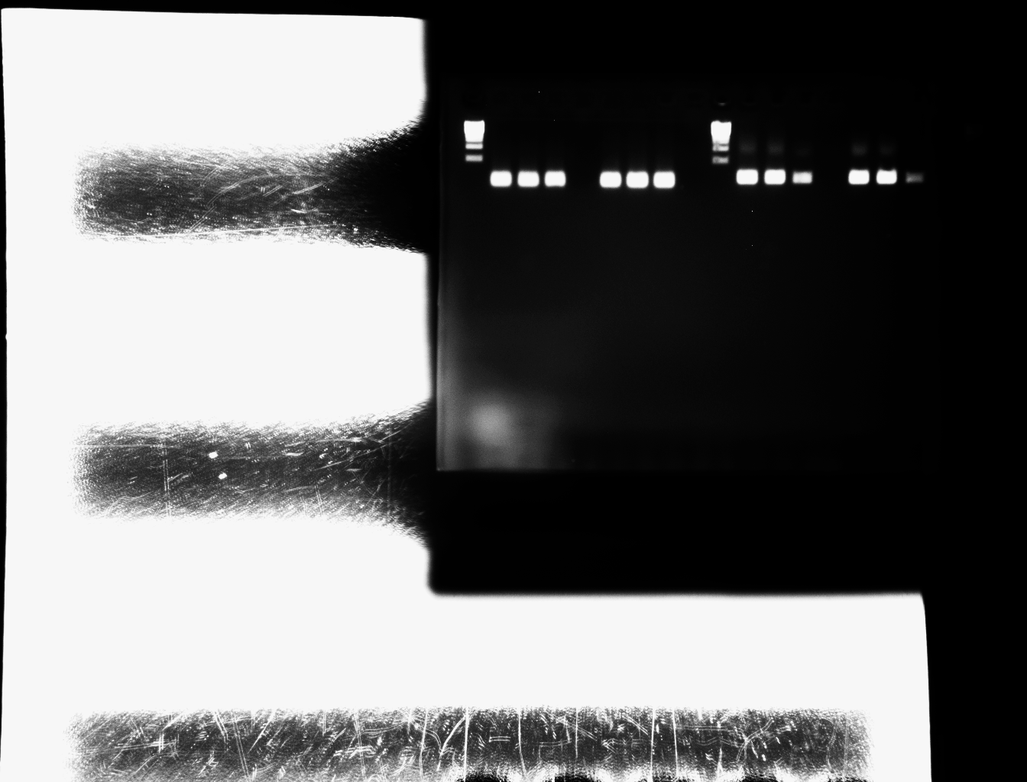
Supplementary Figure 9. PI3K p110𝛽 and EphB4 regulate AR.
A
B
P110α inhibitor BYL719, nM |  |  | P110β inhibitor GSK2636771, μM |  |  | P110γ inhibitor IPI-549, nM |  |  | P110δ inhibitor GSK2269557, nM
0 | 50 | 200 | 0 | 10 | 40 | 0 | 16 | 64 | 0 | 10 | 40
C4-2B
22Rv1
Mock
Ctrlsi
B4si
Mock
Ctrlsi
B4si
S6
29 kDa
EphB4
108 kDa
pS6
32 kDa
1.00 | 0.98 | 0.23
1.00 | 1.28 | 0.21
AR
110 kDa
EphB4
108 kDa
1.00 | 1.12 | 0.10
1.00 | 1.16 | 0.22
β-Actin
42 kDa
AR
110 kDa
β-actin
42 kDa
C
C4-2B
22Rv1
Mock
Ctrlsi
B4si
Contl
Mock
Ctrlsi
B4si
Contl
AR
146 bp
EphB4
141 bp
GAPDH
108 bp
Notes:
Figure 6. EphB4 regulates both AR and PI3K p110b. p110b regulates AR. Adding AR regulation here triggers two questions: is AR the key effector downstream of EphB4/PI3K (I.e. can AR rescue EphB4 knockdown; do you see AR level decreased in EphB4 KO mice)? Can PI3K p110b or pAKT rescue AR level in EphB4 knockdown?
Fig 4 C-D from Fig
The presence of P110 alpha, beta, gamma, delta in 22Rv1
P85: expressed in all 4 cell lines
P110a: expressed in all 4 cell lines
P110b: expressed in all 4 cell lines
P110g: weakly expressed in prostate cells and strongly expressed in k562 (erythroleumkemia) and raji (burkitt’s lymphoma)
P110d: strongly expressed in 22RV1 and hematological cell lines (K562 and raji) but low expressed in C42B cell lines.

Slide 17
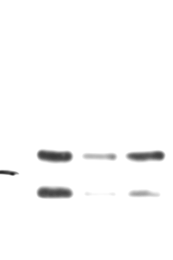
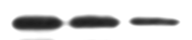
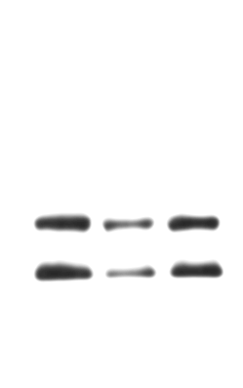
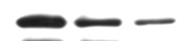
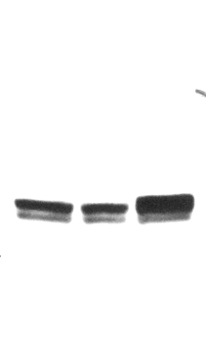
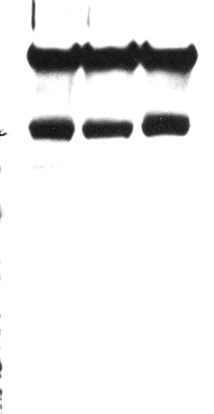

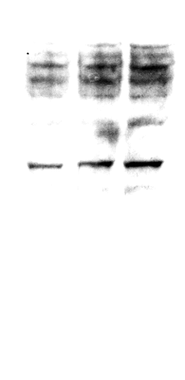

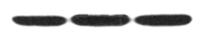

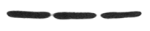
D
B4si | - | + | +
AKT | - | - | +
B4si | - | + | +
P110𝛼 | - | - | +
B4si | - | + | +
P110𝛽 | - | - | +
B4si | - | + | +
P110𝛾 | - | - | +
AR
110 kDa
AR
110 kDa
AR
110 kDa
AR
110 kDa
EphB4
108 kDa
EphB4
108 kDa
EphB4
108 kDa
EphB4
108 kDa
Akt
56 kDa
P110-a
110 kDa
P110-b
110 kDa
P110-g
110 kDa
b-Actin
42 kDa
b-Actin
42 kDa
b-Actin
42 kDa
b-Actin
42 kDa
Relative AR level
Relative AR level
Relative AR level
Relative AR level
Control
B4si
Control
B4si
Control
B4si
Control
B4si
B4si/Akt
B4si/P110𝛼
B4si/P110𝛽
B4si/P110𝛾
Supplementary Figure 9. PI3K p110𝛽 and EphB4 regulate AR. (A) Western blot of S6, pS6, EphB4, and AR in the 22Rv1 prostate cell line after treating with inhibitors of P110α (BYL719), P110β (GSK2636771), P110γ (IPI-549), and P110δ (GSK2269557) at various concentrations. Bottom panel demonstrates the quantitative analysis of relative pS6/S6 ratio, EphB4 and AR protein level was made using ImageJ (NIH). β-actin was probed to ensure equal loading. (B) Western blot of EphB4 and AR in 22Rv1 and C4-2B cells. EphB4 knockdown was achieved using EphB4siRNA (B4si) compared to control siRNA (ctrlsi) and no siRNA (mock). β-actin was probed to ensure equal loading. (C) mRNA level of AR in EphB4-knockdown 22Rv1 and C4-2B cells by Quantitative RT-PCR using EphB4siRNA compared to control siRNA and no siRNA (mock). Left panel showed the quantitative analysis of relative EphB4 and AR level. Experiment was performed in triplicate. P-value was calculated using two-tailed, unpaired Student’s t-test. NS, not significant; *P<0.05; (D) AR rescue experiments. Western blot of AR, EphB4, AKT, p110α, p110β, and p110γ in 22Rv1 cells with co-transfection of EphB4 siRNA and plasmids of EphB4, p110α, p110β, and p110γ, respectively. The quantitative analysis of relative AR level was made using ImageJ (NIH).

Slide 18
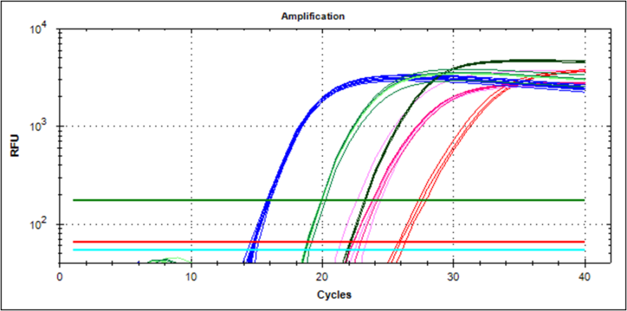
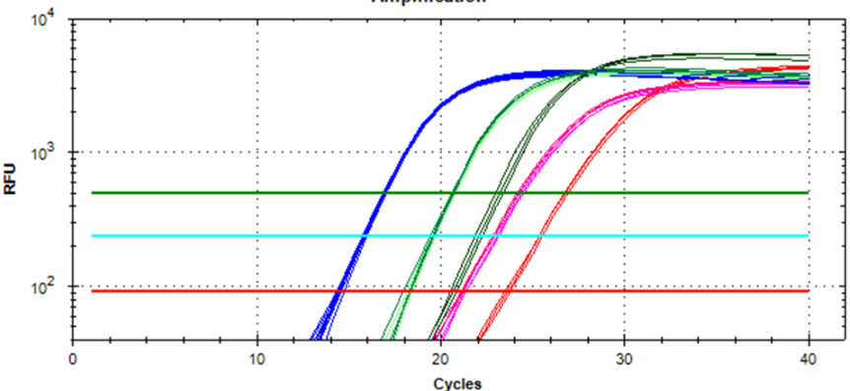
C4-2B
22Rv1
AR in Mock
AR in Mock
AR in SiCtrl
AR in SiCtrl
EphB4 in Mock
AR in SiEphB4
EphB4 in Mock
AR in SiEphB4
EphB4 in SiCtrl
EphB4 in SiCtrl
EphB4 in SiEphB4
EphB4 in SiEphB4
GAPDH in Mock/SiCtrl/SiEphB4
GAPDH in Mock/SiCtrl/SiEphB4
Supplementary Figure 10. EPHB4 knock down lowers AR in prostate cancer cell lines. QT-PCT curves indicate the gene level changes of AR, EPHB4, GADPH with EPHB4 siRNA versus control siRNA in C4-2B and 22Rv1 cell lines.

Slide 19

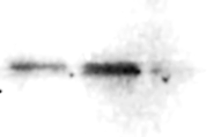

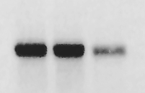


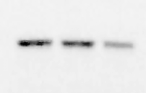


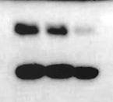








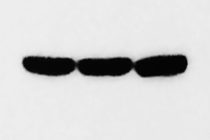


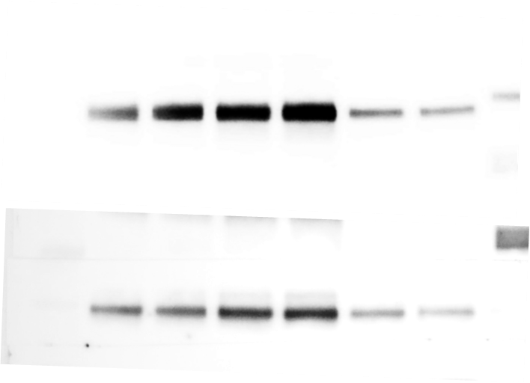
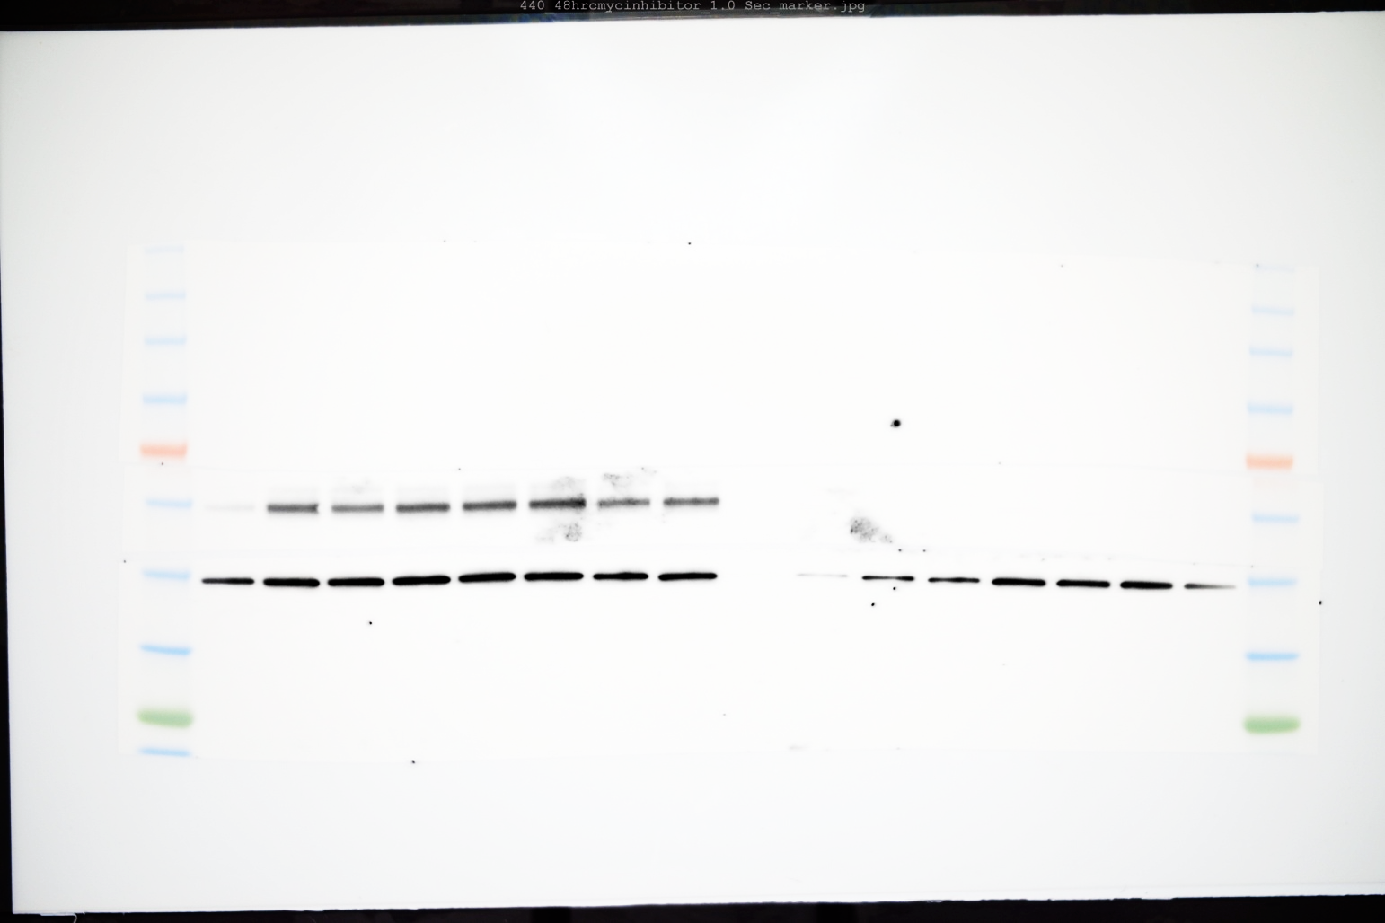

C4-2B
K562
Reh
A
siControl
siEphB4
siControl
siEphB4
siControl
siEphB4
Mock
Mock
Mock
EphB4
108 kDa
AR
110 kDa
STAT3
87 kDa
Myc
62 kDa
Supplementary Figure 11. EphB4 regulates c-Myc and AR expression in vitro. (A) Western blot of EphB4, AR, Myc, Stat3, ARL4C, SGK1 and Actin in the C4-2B cell line (prostate cancer), K562 cell line (chronic myelogenous leukemia), Reh cell line (acute lymphoblastic leukemia) after treating with control siRNA (siControl), EPHB4 siRNA (siEphB4) and PBS. β-actin was probed to ensure equal loading. (B) The quantitative analysis of EphB4, AR, Myc, Stat3, ARL4C and SGK1 protein level based on Panel A western blot was made using ImageJ (NIH). Experiment was performed in triplicate. (C) C4-2B (prostate cancer) and HT29 (human colorectal adenocarcinoma) cell lines were treated with different concentrations of Myc inhibitor 10058-F4 for 24 hrs and western blot performed for c-Myc, AR and β-Actin.
ARL4C
21 kDa
SGK1
49 kDa
Actin
42 kDa
B
Relative Expression (% Actin)
C
C4-2B
HT29
10058-F4(µM)
0 0 20 50
0 0 20 50
c-Myc
62 kDa
AR
110 kDa
β-Actin
42 kDa

Slide 20
Supplementary Figure 12. EphB4 functions in prostate cancer mechanism.
ephrin-B2
PI3K
EphB4
Myc
PI3K p110β
AR
PC Development

Slide 21
Supplementary Table 1: Real-time RT-PCR primer sequences
Gene | Forward Primer (5’-3’) | Reverse Primer (5’-3’)
mEPHB4 | GCATTCAGCCAAAGTGAGG | GCCGTTTCCAGTTTTGTGTT
mEPHB2 | GGATGTGCCCATCAAACTCT | CCTTGAAGGTTCCTGATGGA
mEPHB3 | AGCTCTACTGCAATGGCGAC | TGCTTTGCTTTGTAACTCCCA
mEFNB2 | CTGTTGGGGACTTTTGATGG | TTGTCCGGGTAGAAATTTGG
mACTb | GGCTGTATTCCCCTCCATCG | CCAGTTGGTAACAATGCCATGT
hEPHB4 | CAGTTCGAGCACCCCAATAT | ACGAGCTGGATGACTGTGAA
hAR | GCTAGAAGGCGAGAGCCTA | TTGTAGTAGTCGCGACTCTG
hGAPDH | AAGGTGAAGGTCGGAGTCAA | AATGAAGGGGTCATTGATGG

Slide 22
 | Total Cases | Positive Cases (No) | Positive Cases (%)
Stage I | 3 | 0 | 0.0%
Stage IIA | 10 | 7 | 70.0%
Stage IIB | 20 | 11 | 55.0%
Stage III | 17 | 11 | 64.7%
Stage IV | 5 | 4 | 80.0%
Total | 55 | 33 | 60.0%
 | Total Cases | Positive cases | Positive percentage (%)
Grade Group 1 (Gleason Score 3+3=6) | 6 | 3 | 50.0
Grade Group 2 (Gleason Score 3+4=7) | 14 | 8 | 57.1
Grade Group 3 (Gleason Score 4+3=7) | 5 | 4 | 80.0
Grade Group 4 (Gleason Score 8) | 23 | 11 | 47.8
Grade Group 5 (Gleason Score 9-10) | 26 | 17 | 65.4
Total | 74 | 43 | 58.1
Supplementary Table 2. ephrin-B2 and EphB4 expression in human Prostate cancer: Subgroup analysis of ephrin-B2 and ephB4 expression in prostate cancer by stage and Gleason score. There was no significant difference between stage I-IV, p=0.19 (chi-square) and Gleason scores, p=0.6 (chi-square).

