Slide 1
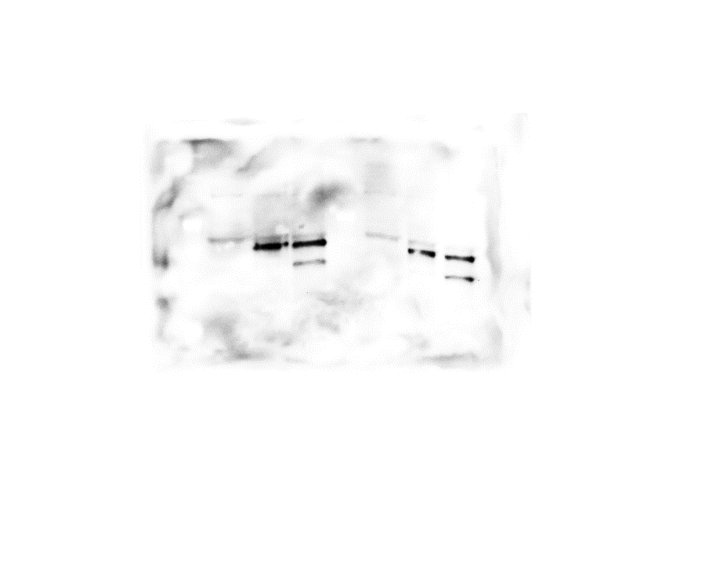
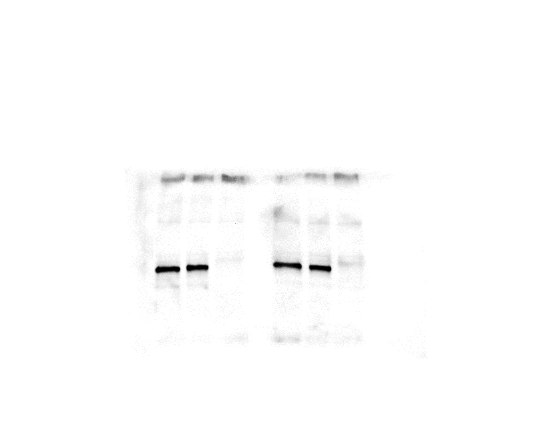
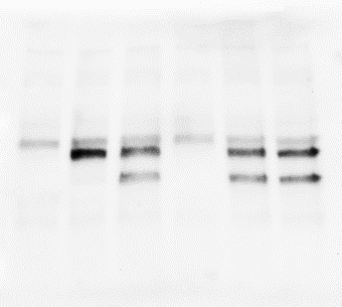
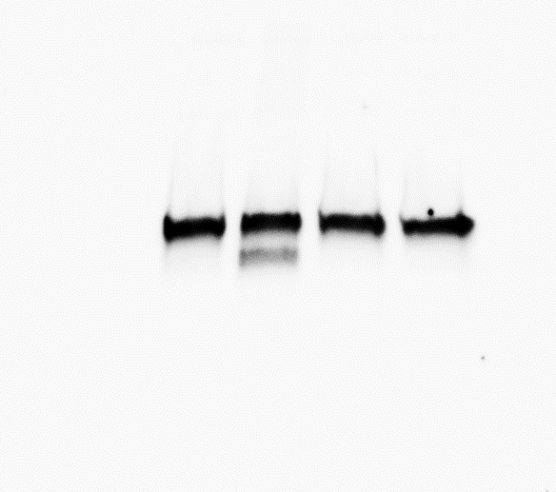
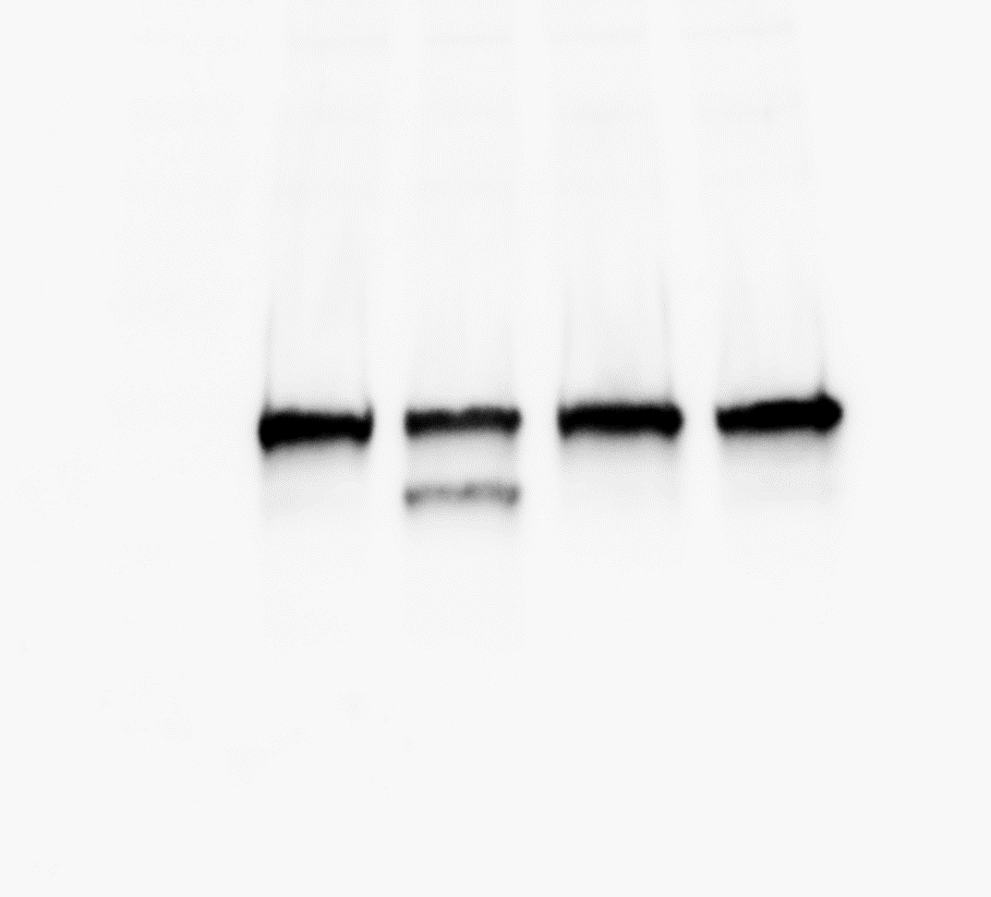
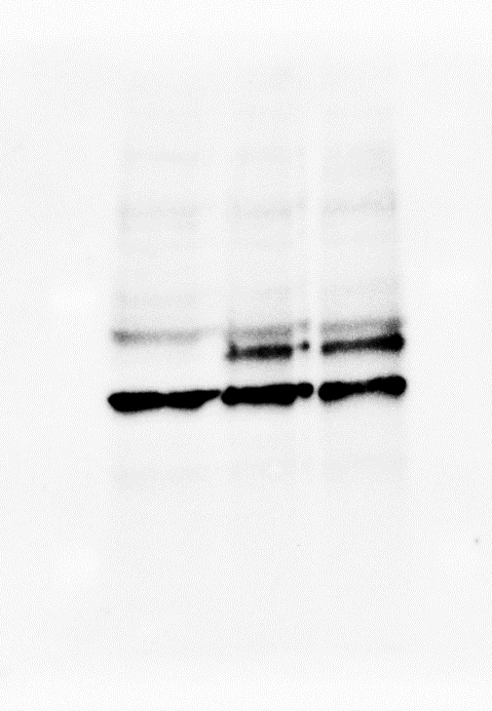
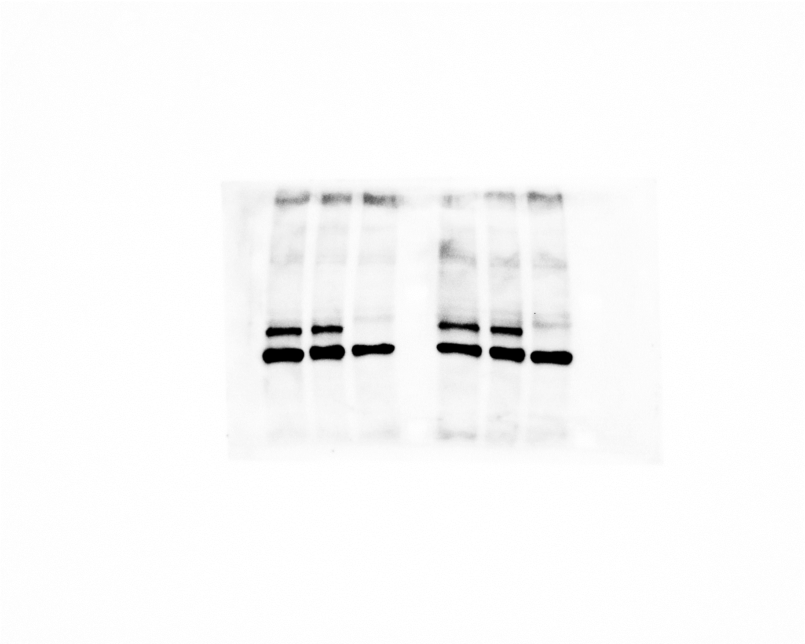
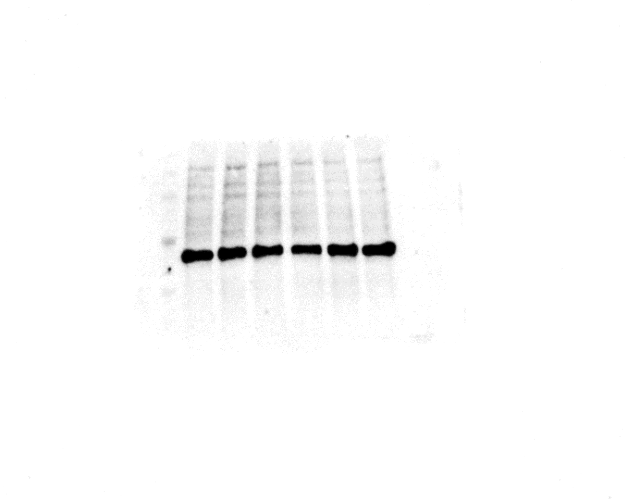
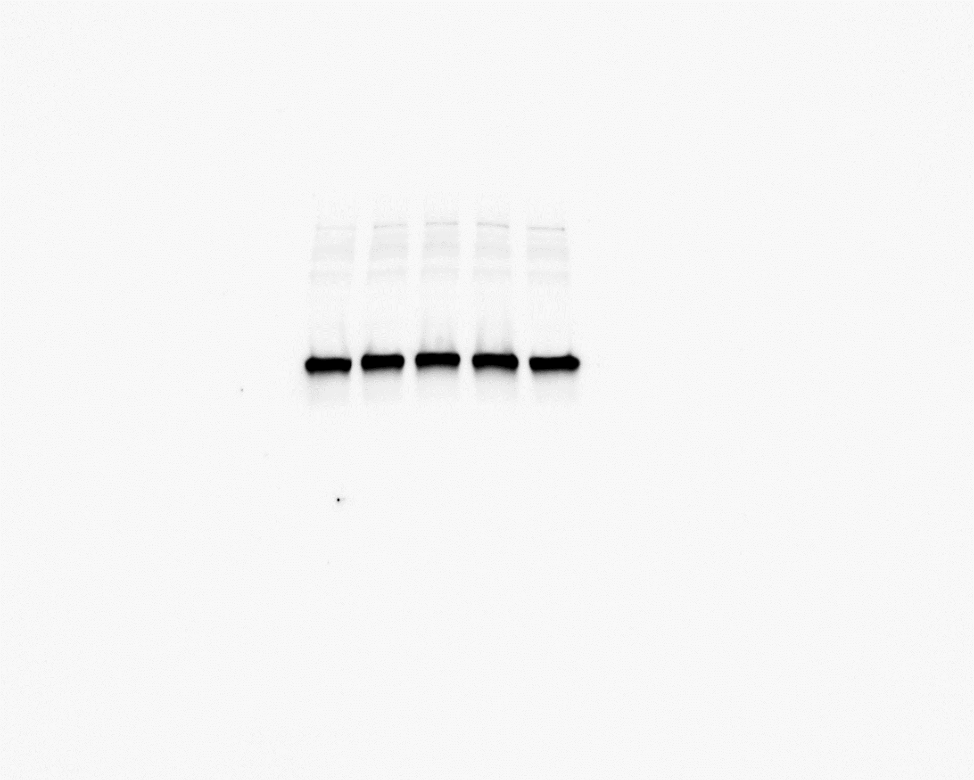
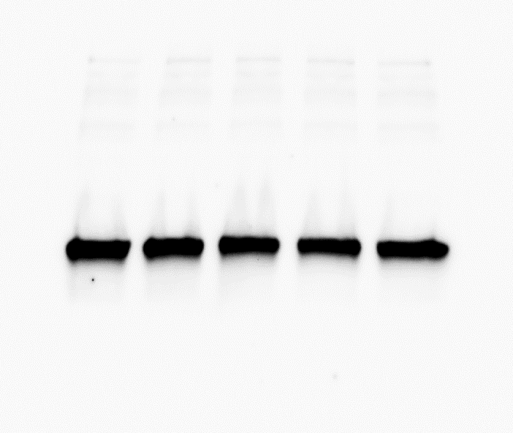
Original Western blots: cropped regions used in the Figs are marked with dashed boxes.
Fig. 1d
CASM203
Fig. 1e
Fig. 3i
Supplementary Fig. 1
p53-WT
CASM203
CASM203
CASM203
CASM203
c.G609A
NT
(c.G609T)
NT
c.G609C
p53-WT
p53-WT
p53-WT
p53-WT
NT
c.G609A
NT
c.G609A
NT
NT
c.G609C
c.G609C
p53
p53
p53
p53
p53
p47
p47
p47
p47
p47
Actin
Actin
Actin
Actin
Actin
DMSO
Thap

Slide 2
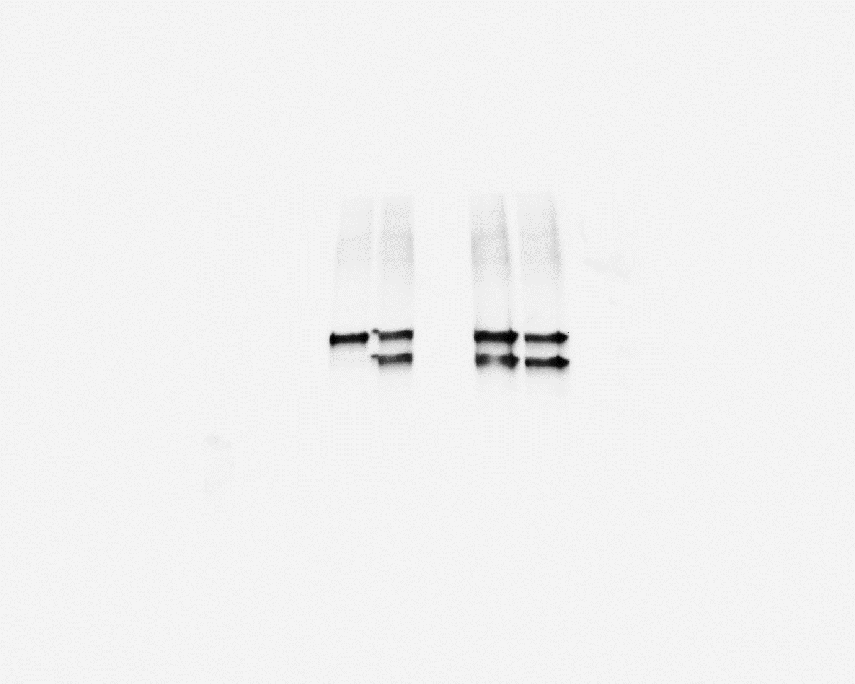
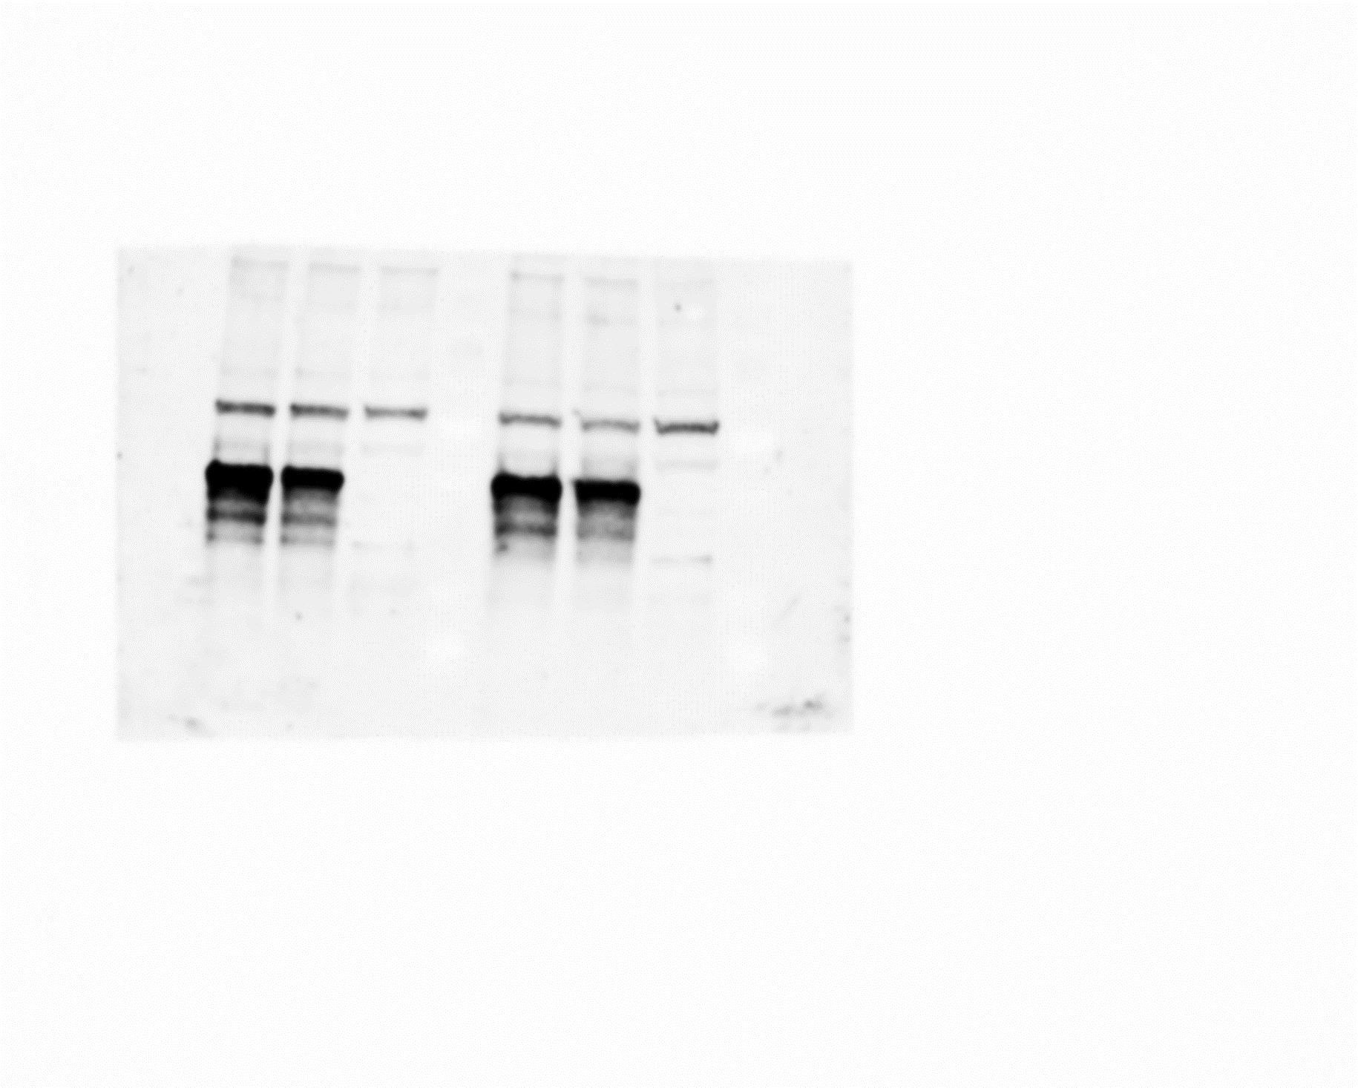
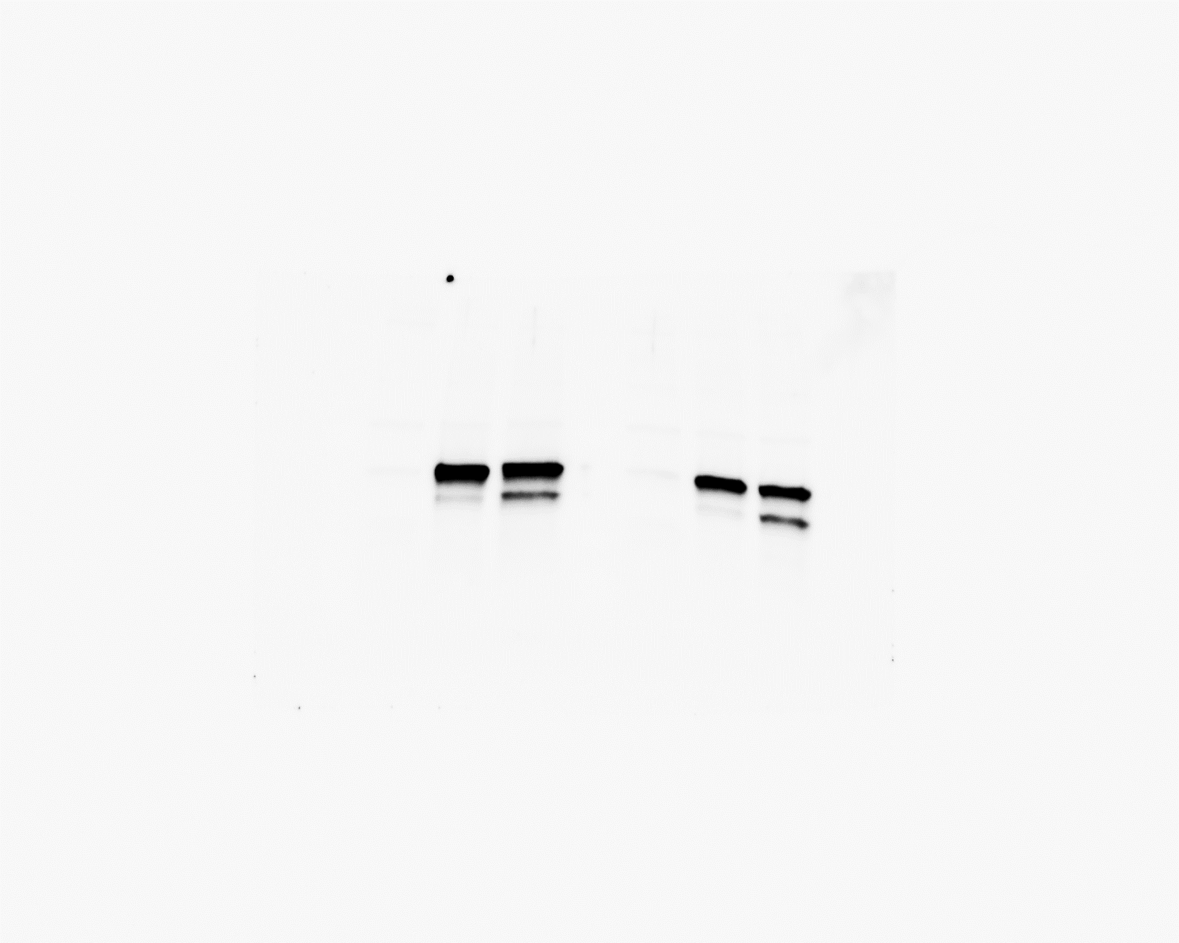
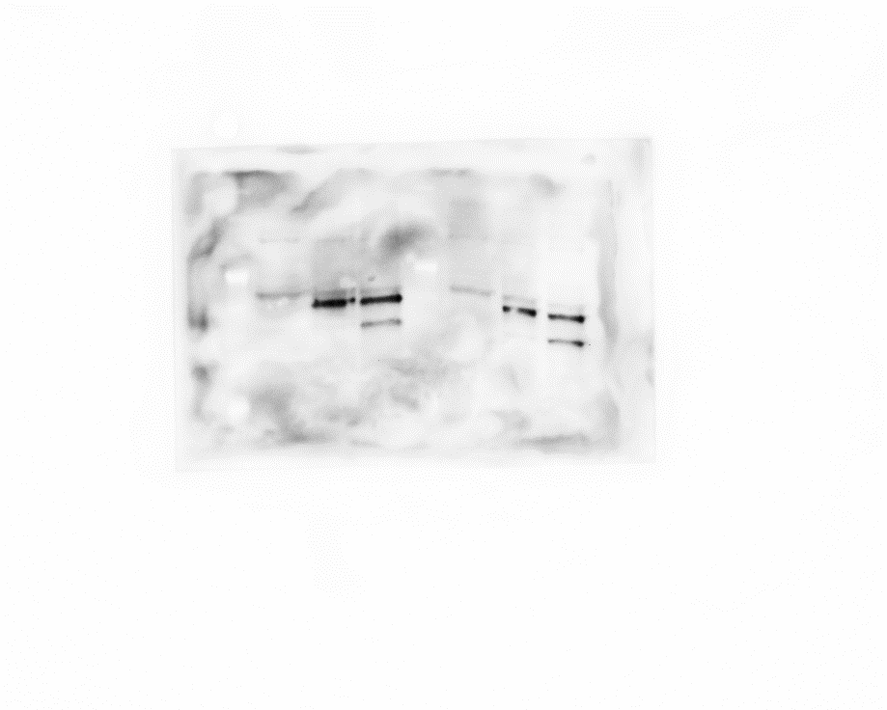

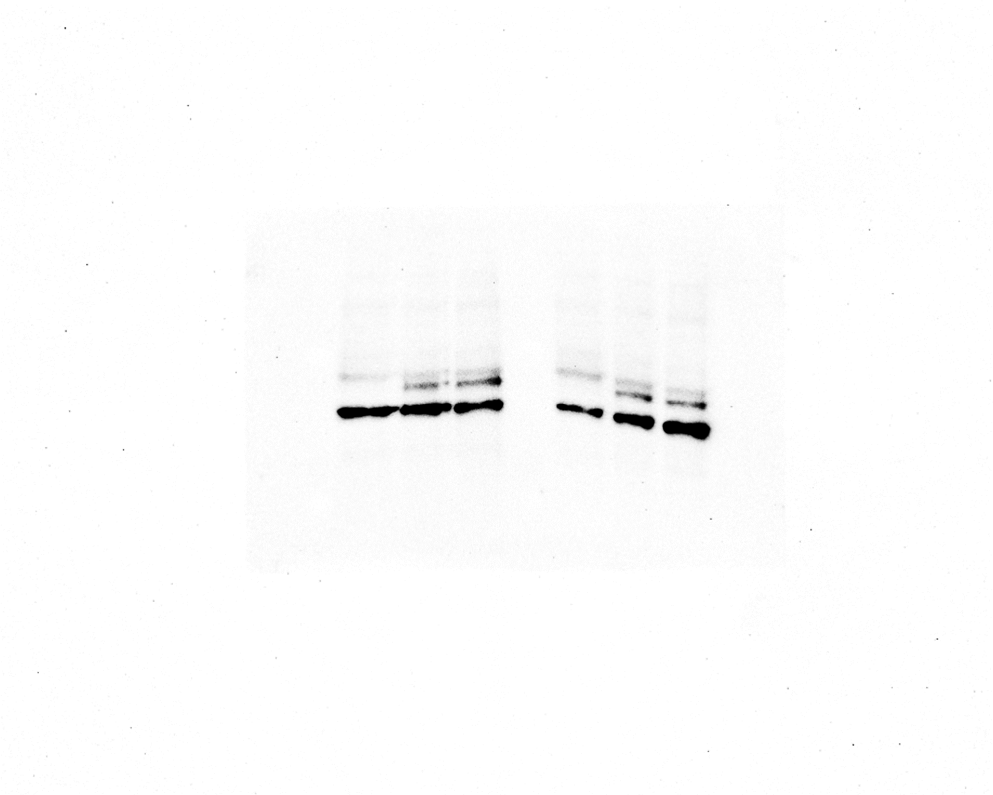

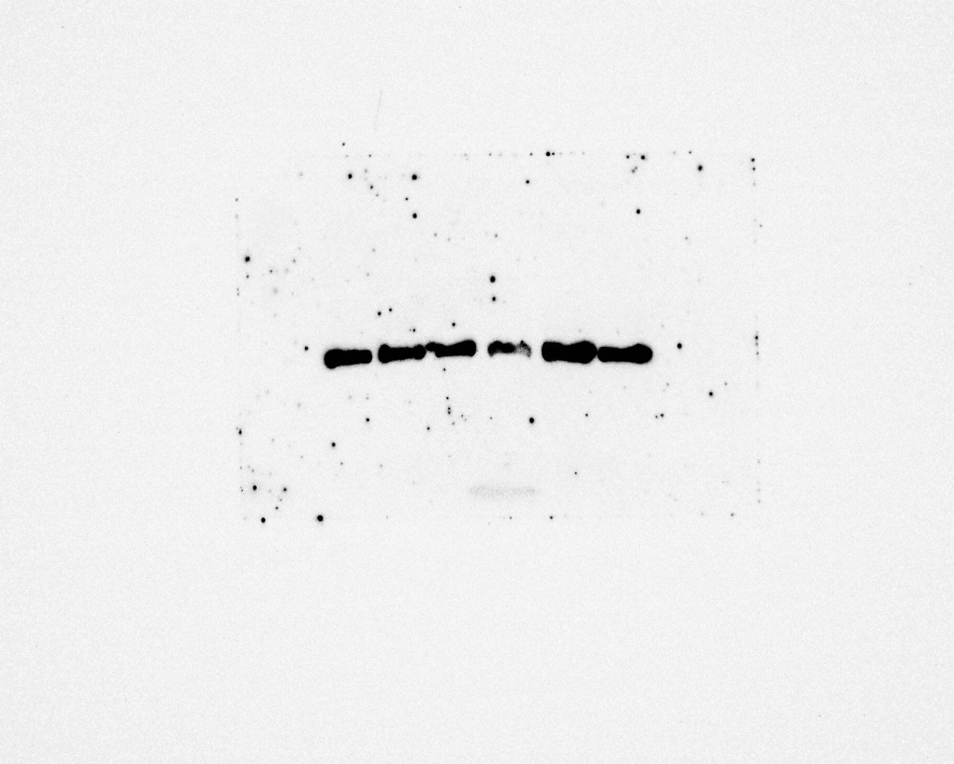
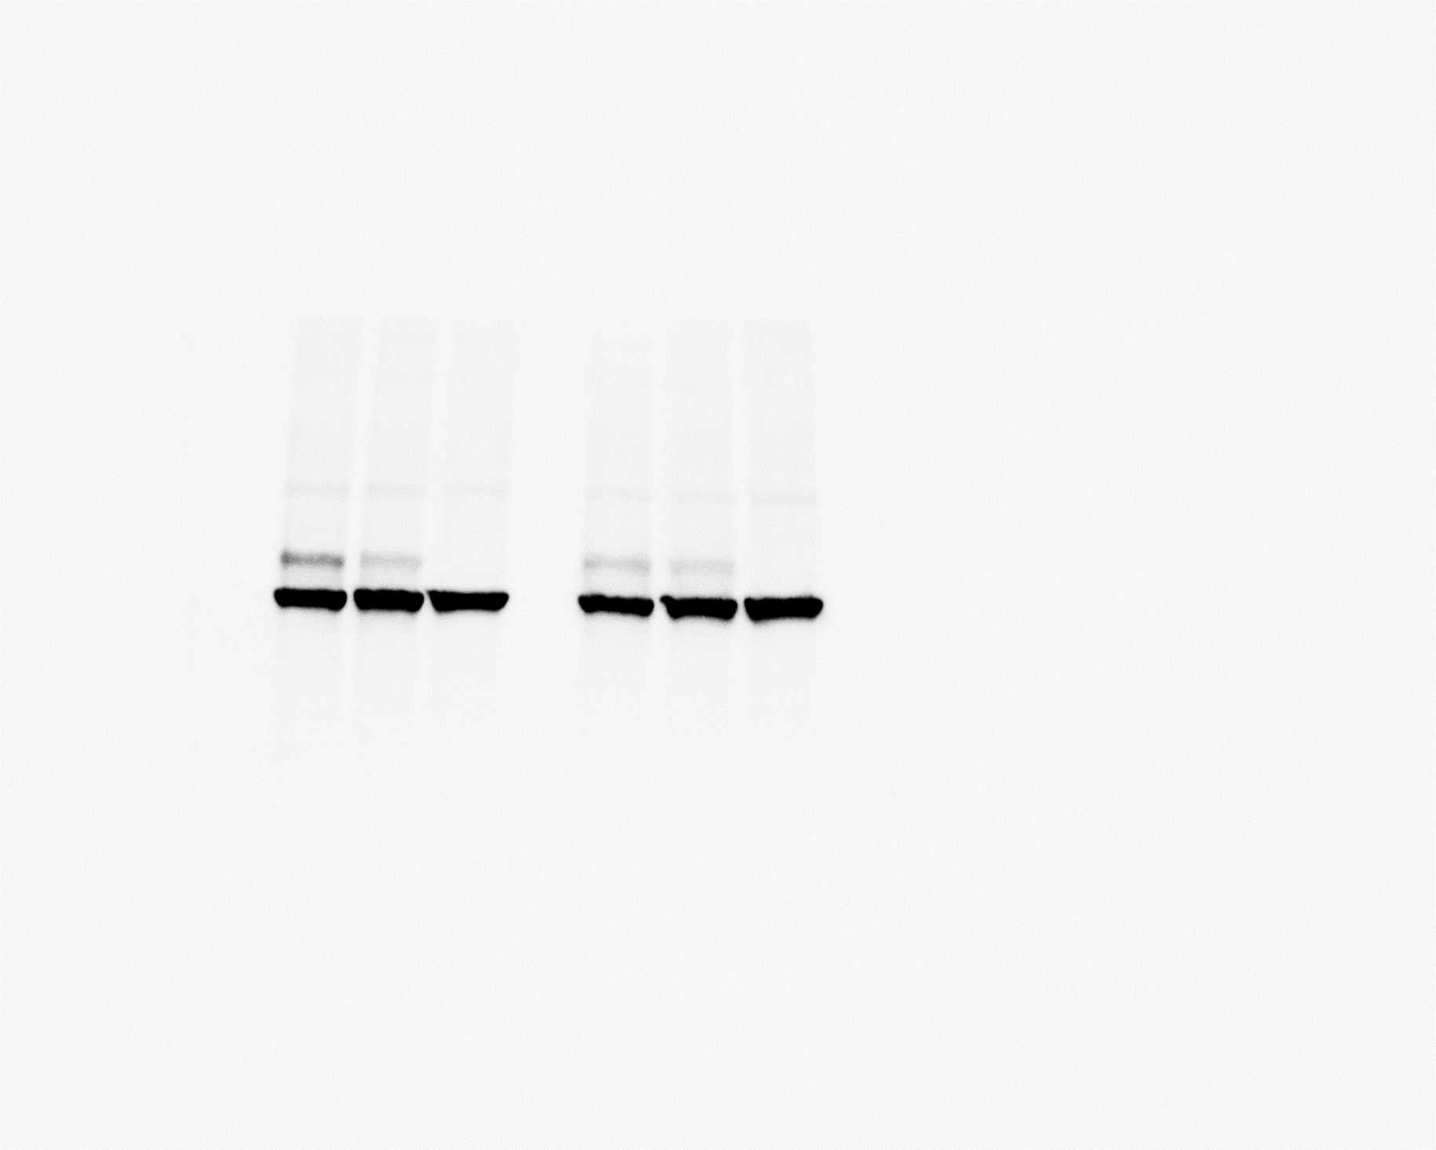
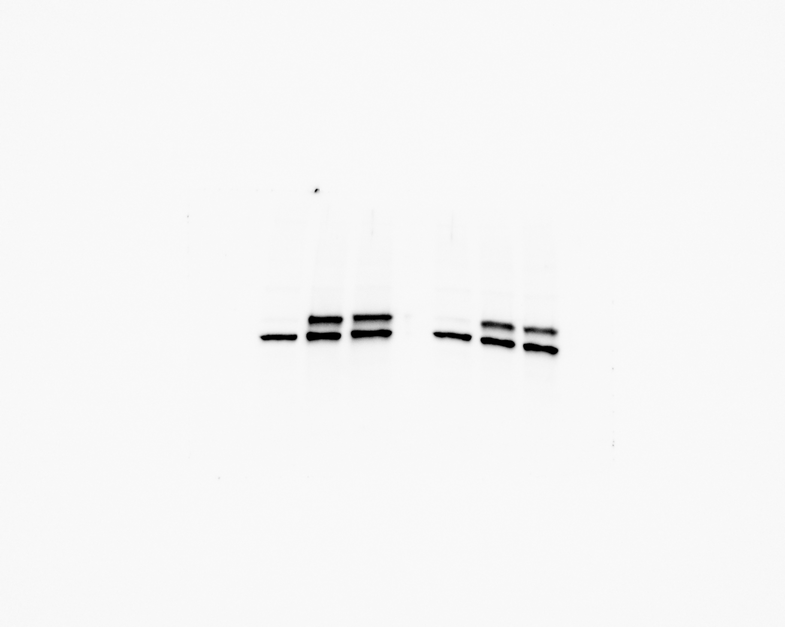
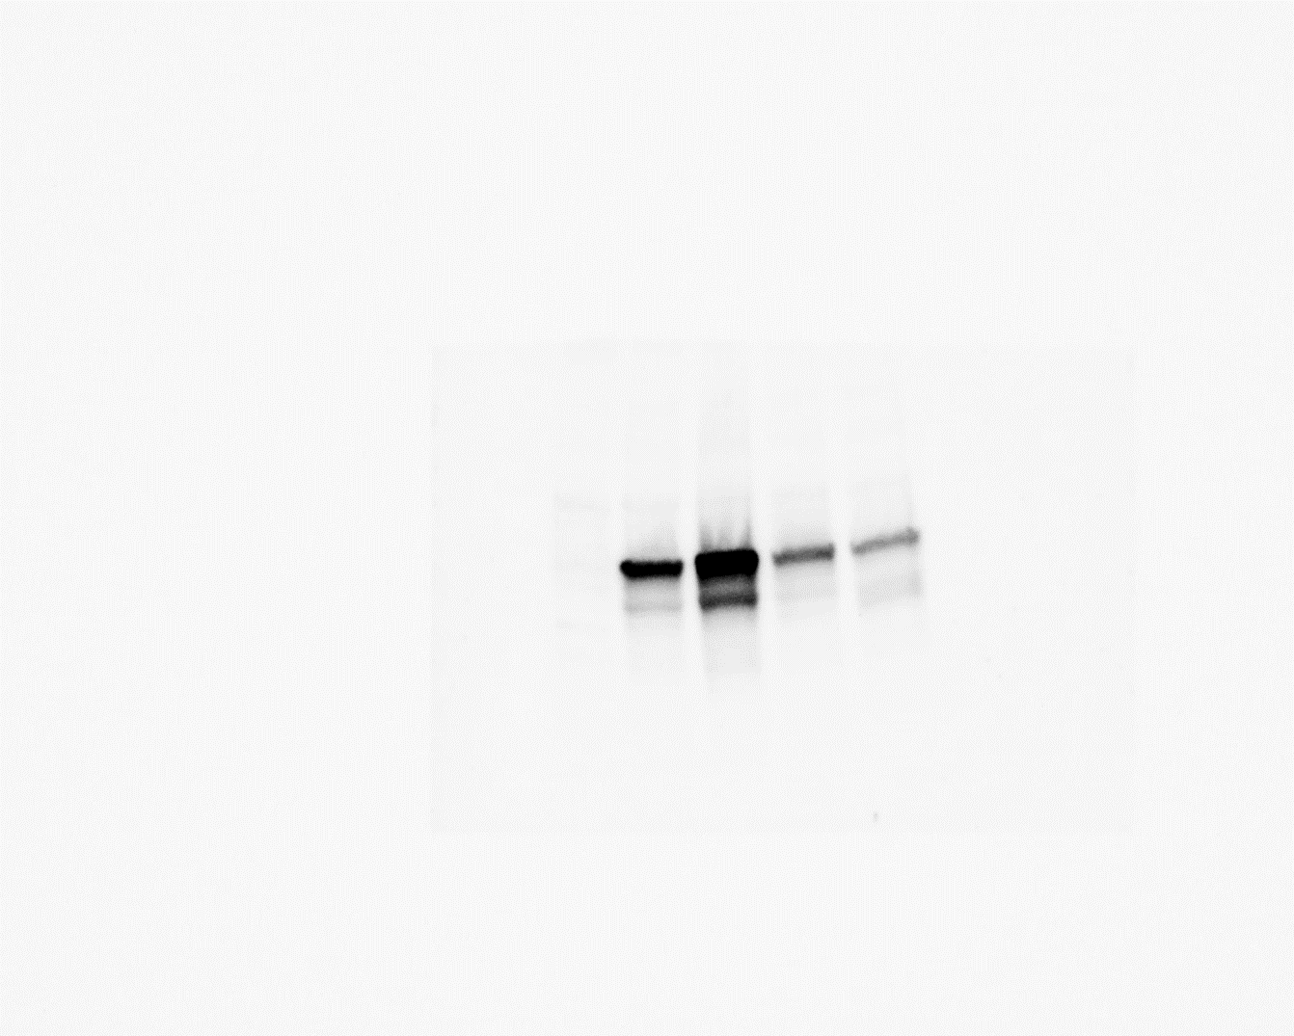
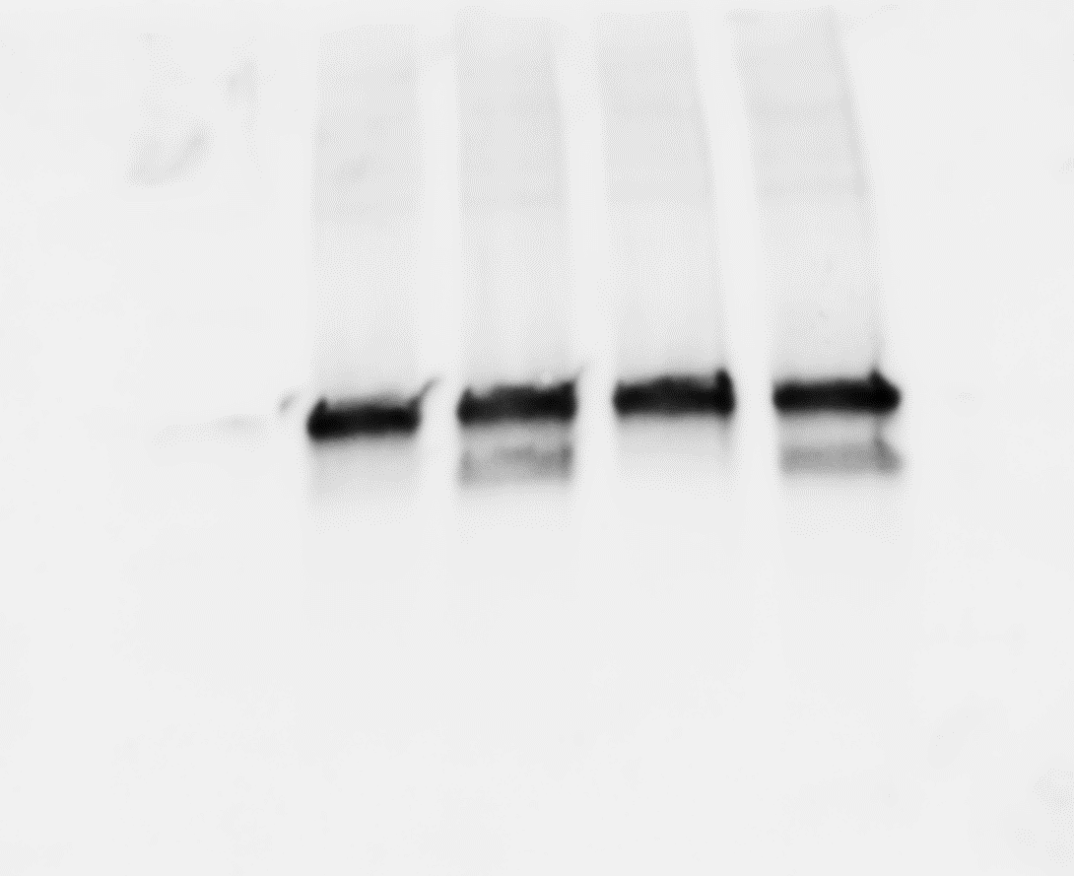
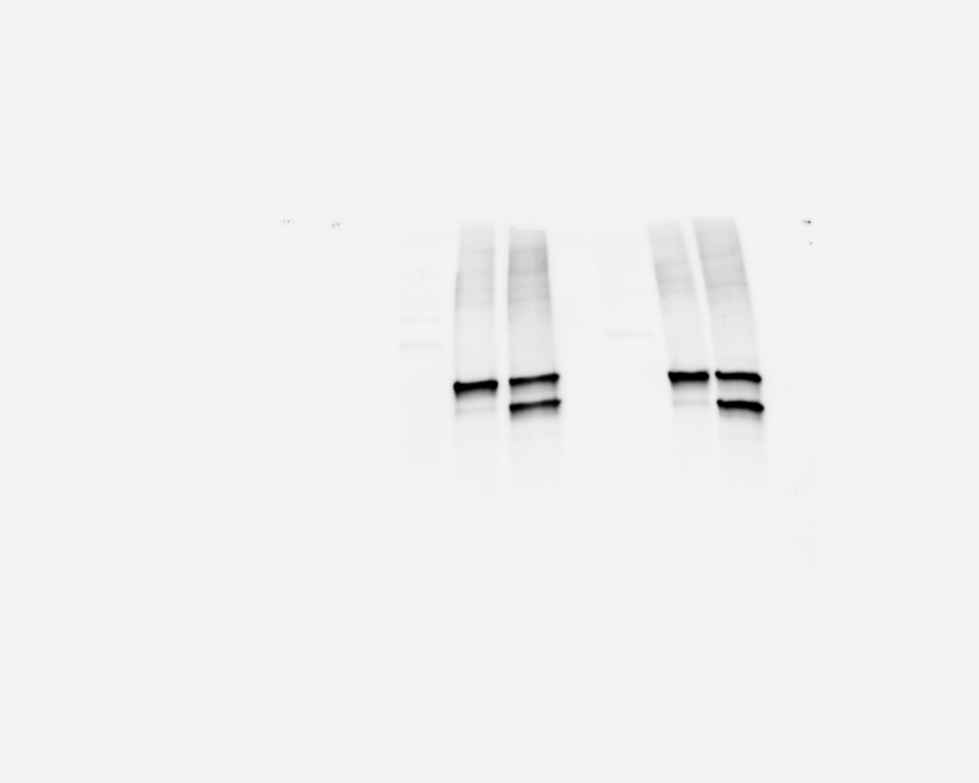
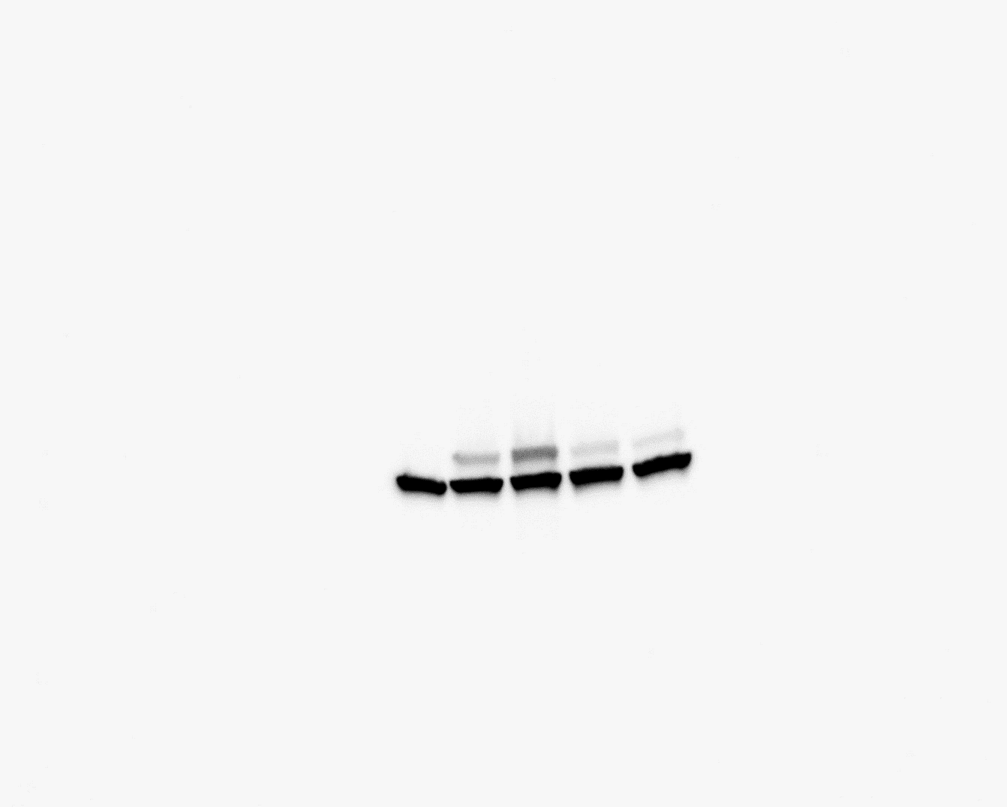
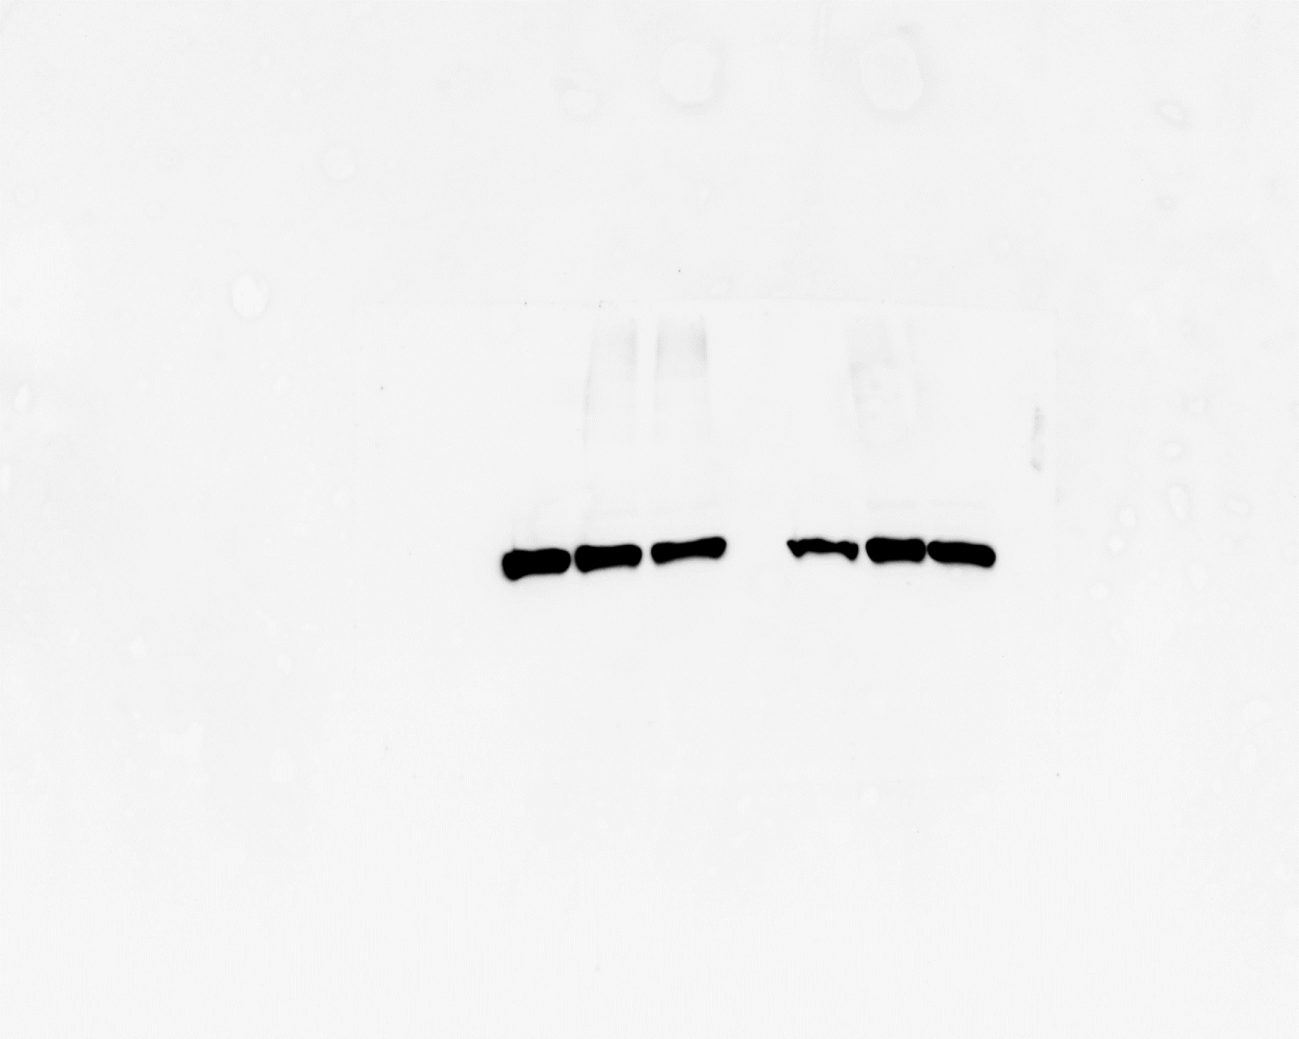
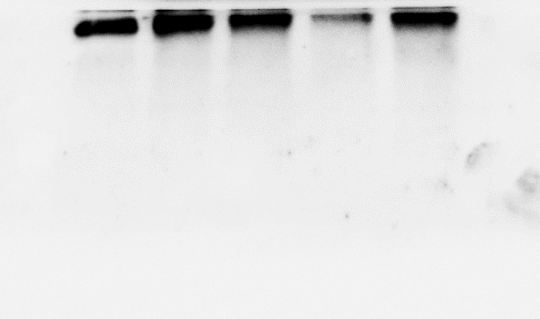
Original Western blots of replicates
A375 p53-null cells
H1299 p53-null cells
H1299 p53-null cells
CASM203
CASM203
CASM203
CASM203
CASM203
CASM203 +Thap
p53-WT
CASM203
NT
p53-WT
p53-WT
p53-WT
p53-WT
NT
NT
G609A
NT
NT
NT
NT
G609C
p53
p53
p53
p53
p53
p47
p47
p47
p53
p47
p47
Actin
Actin
Actin
Actin
Actin
Actin
DMSO
Thap
H1299 p53-null cells
A375 p53-null cells
HCT116 p53-null cells
CASM203
CASM203
CASM203
CASM203
CASM203
p53-WT
p53-WT
p53-WT
p53-WT
p53-WT
NT
NT
NT
NT
p53
p53
p53
p47
p53
p47
p47
p47
Actin
Actin
Actin
Actin

