Slide 1
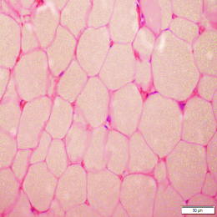
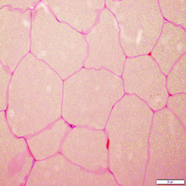
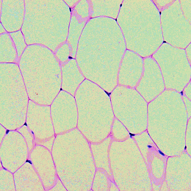
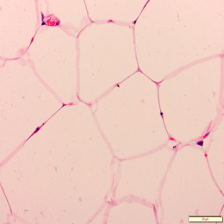
A
Lean Obesity
B
Chow HFD
Humans
Mice
Figure S1

Slide 2
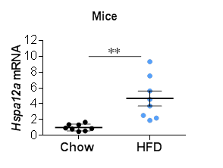
Figure S2

Slide 3
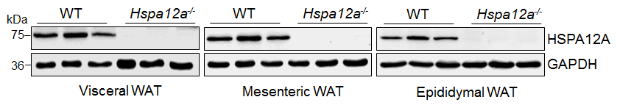
Figure S3

Slide 4
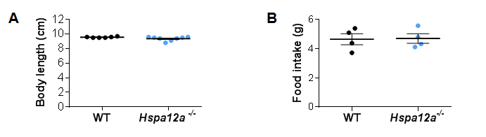
Figure S4

Slide 5
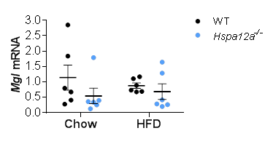
Figure S5

Slide 6
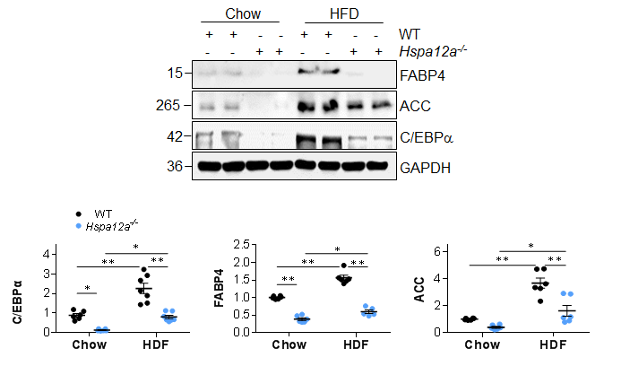
Figure S6

Slide 7
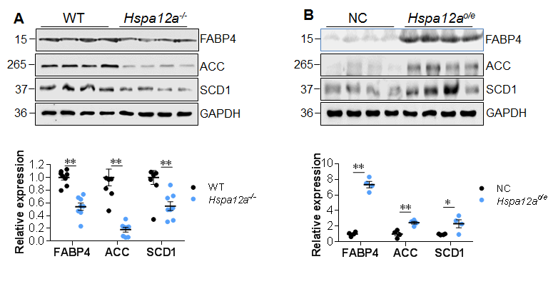
Figure S7

Slide 8
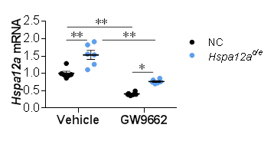
Figure S8

Slide 9
kDa
Undifferentiated Differentiated
IgG Input
75
HSPA12A
57
PPARγ2
53
PPARγ1
Non-specific bands
IgG heavy chain
Figure S9

Slide 10
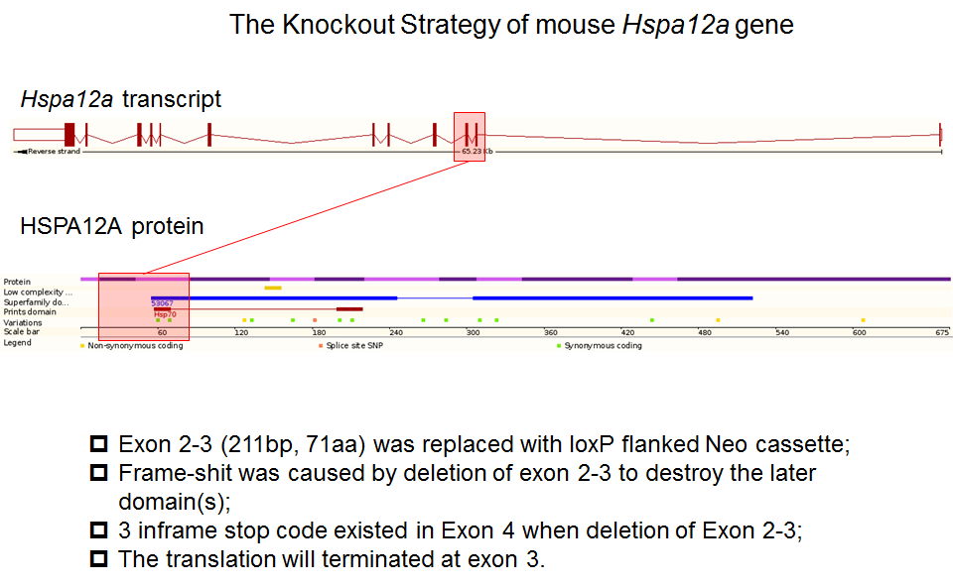
Figure S10

Slide 11
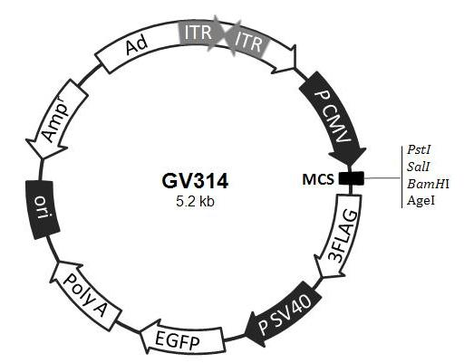
Hspa12a cds
Figure S11

