Slide 1
Figure 2 A: TOM20 SK-MEL-28 i M16 proliferating and senescence-P

Slide 2
Figure 2 A: Tubulin SK-MEL-28 i M16 proliferating and senescence-P

Slide 3
Figure 2 C: BAX SK-MEL-28 i M16 proliferating and senescence-P

Slide 4
Figure 2 C: BAK SK-MEL-28 i M16 proliferating and senescence-P

Slide 5
Figure 2 C: BIM SK-MEL-28 i M16 proliferating and senescence-P

Slide 6
Figure 2 C: Tubulin SK-MEL-28 i M16 proliferating and senescence-P

Slide 7
Figure 2 C: BIM SK-MEL-103 proliferating and senescence-P

Slide 8
Figure 2 C: tubulin SK-MEL-103 proliferating and senescence-P

Slide 9
Figure 2 C: BAX SK-MEL-103 proliferating and senescence-P

Slide 10
Figure 2 C: BAK SK-MEL-103 proliferating and senescence-P

Slide 11
Figure 2 D: BAK SK-MEL-103 xenografts

Slide 12
Figure 2 D: BAX SK-MEL-103 xenografts

Slide 13
Figure 2 D: BIM SK-MEL-103 xenografts

Slide 14
Figure 2 D: Tubulin SK-MEL-103 xenografts

Slide 15
Supplementary Figure 2: p16 SK-MEL-103 xenografts

Slide 16
Supplementary Figure 2: tubulin SK-MEL-103 xenografts

Slide 17
Supplementary Figure 2: p21 SK-MEL-103 xenografts

Slide 18
Supplementary Figure 2: tubulin SK-MEL-103 xenografts

Slide 19
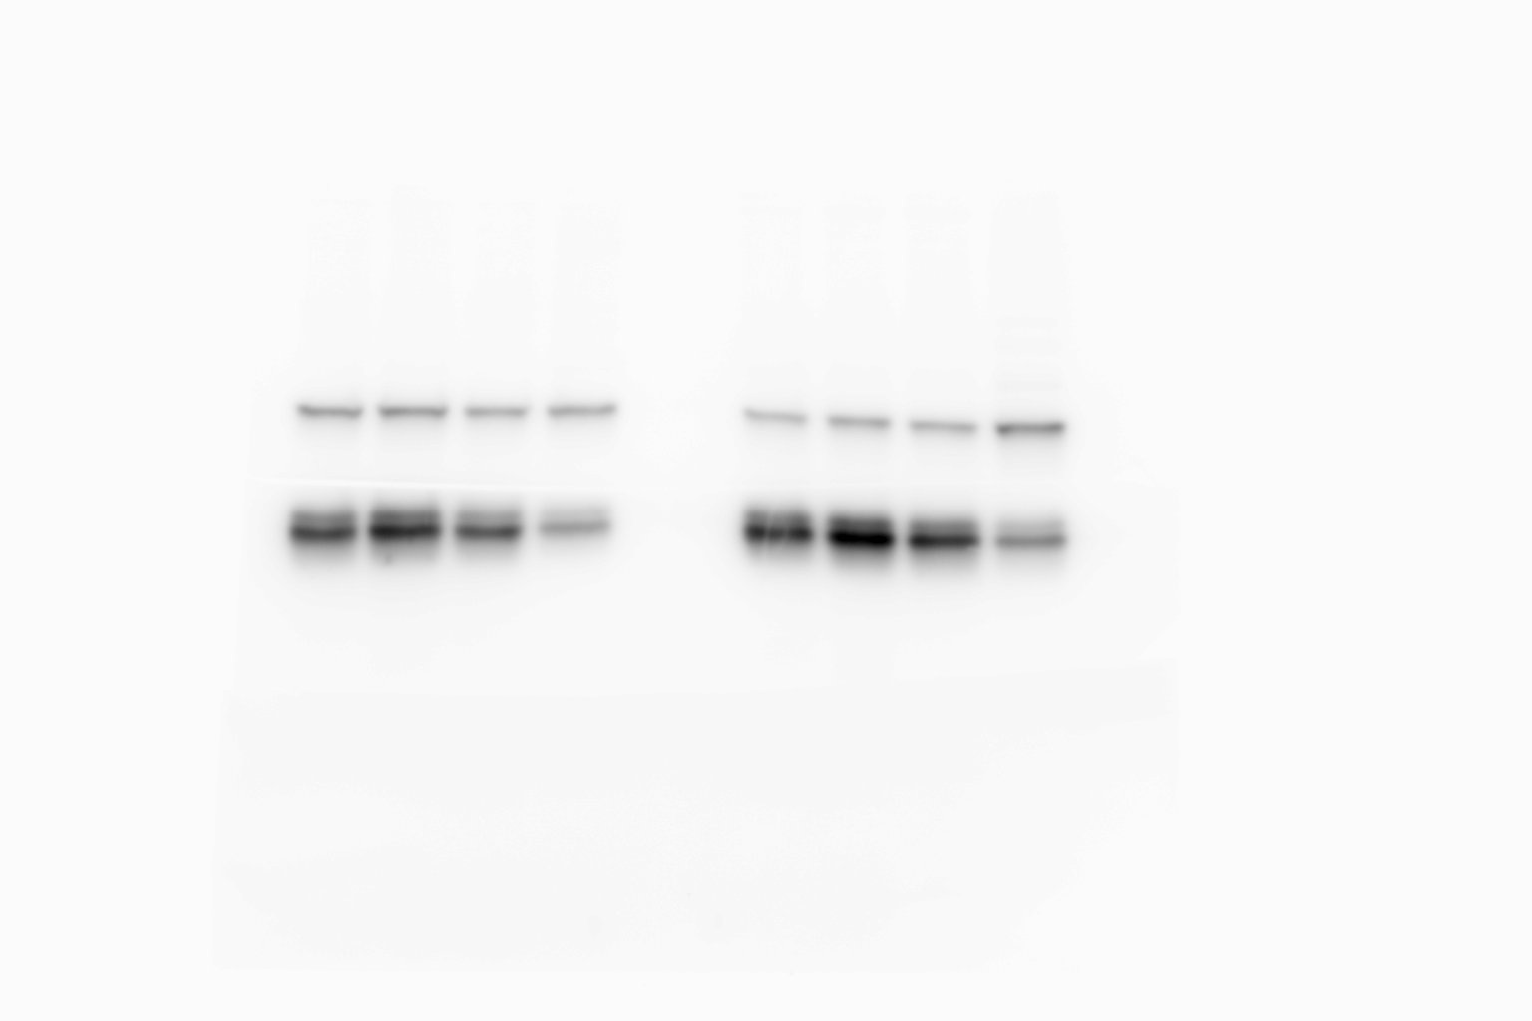
Figure 4 A: BCL-xL SK-MEL-103 proliferating, senescence-P and senescence-IR

Slide 20
Figure 4 A: HRK SK-MEL-103 proliferating and senescence-P

Slide 21
Figure 4 A: Tubulin SK-MEL-103 proliferating and senescence-P

Slide 22
Figure 4 B: BCLxL SK-MEL-28 proliferating, senescence-P and senescence-IR

Slide 23
Figure 4 B: HRK SK-MEL-28 proliferating, senescence-P and senescence-IR

Slide 24
Figure 4 B: tubulin SK-MEL-28 proliferating, senescence-P and senescence-IR

Slide 25
Figure 4 C: BCL-xL M16 proliferating and senescence-P

Slide 26
Figure 4 C: HRK M16 proliferating and senescence-P

Slide 27
Figure 4 C: tubulin M16 proliferating and senescence-P

Slide 28
Figure 4 E: BCL-xL SK-MEL-103 xenografts

Slide 29
Figure 4 E: HRK SK-MEL-103 xenografts

Slide 30
Figure 4 E: tubulin SK-MEL-103 xenografts

Slide 31
Figure 5 A: BCL-xL SK-Mel-103 unbound fraction

Slide 32
Figure 5 A: tubulin SK-Mel-103 unbound fraction

Slide 33
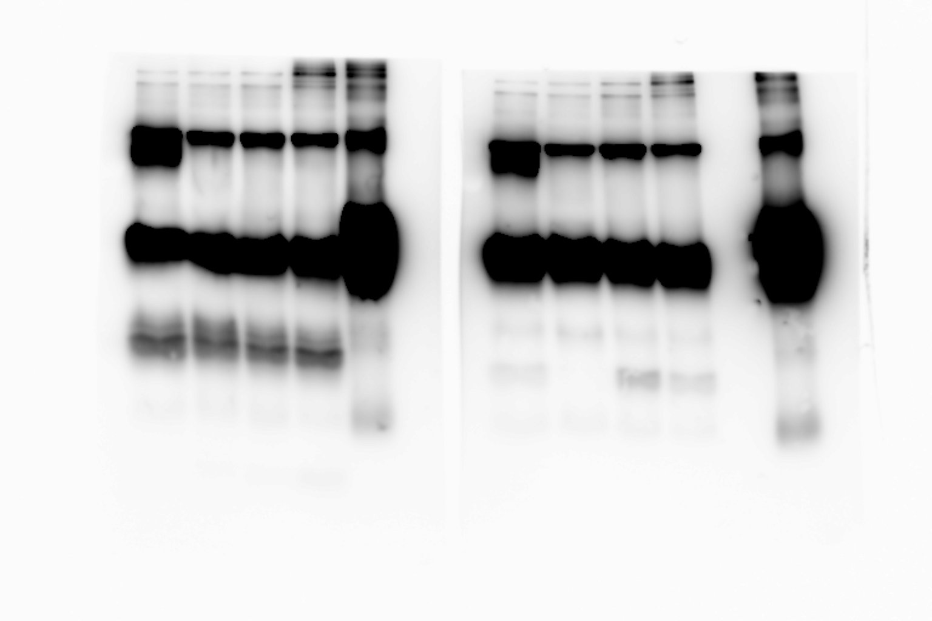
Figure 5 B: BCL-xL SK-MEL-28 and SK-MEL-103

Slide 34
Figure 5 B: BIM SK-MEL-28 and SK-MEL-103

Slide 35
Figure 5 B: BAX SK-MEL-28 and SK-MEL-103

Slide 36
Figure 5 B: BAK SK-MEL-28 and SK-MEL-103

