Slide 1
Figure 1 B and Suppl. Figure 1 A
100 kDa
MDM2
70 kDa
100 kDa
MDM2
70 kDa
70 kDa
55 kDa
p53
70 kDa
p53
55 kDa
25 kDa
p21
25 kDa
p21
40 kDa
GAPDH
35 kDa
40 kDa
GAPDH
35 kDa
Note that in each case, two distinct membranes were exposed to the camera simultaneously.

Slide 2
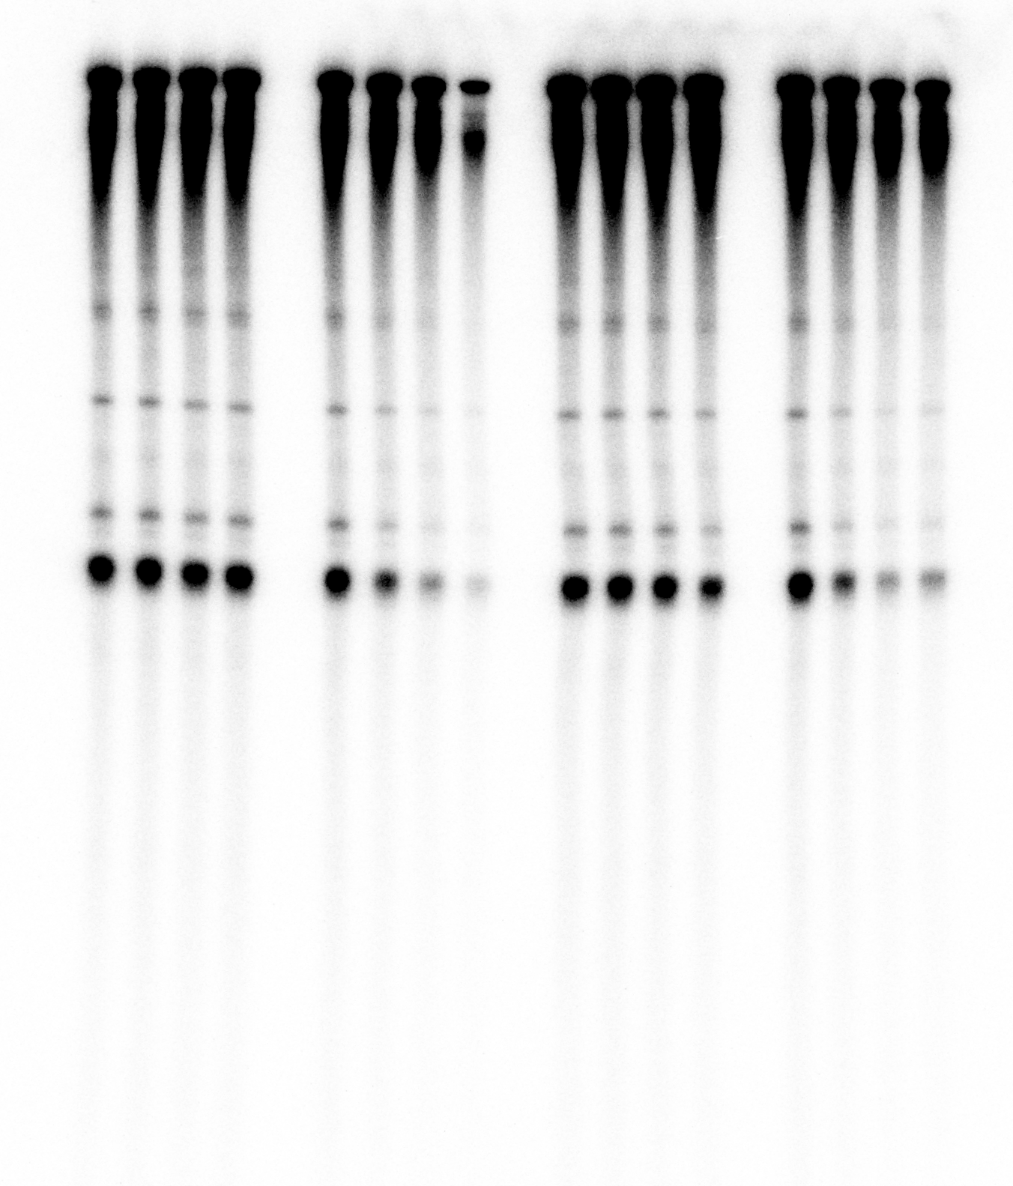
Figure 1 D

Slide 3
Quantification in Figure 1 G

Slide 4
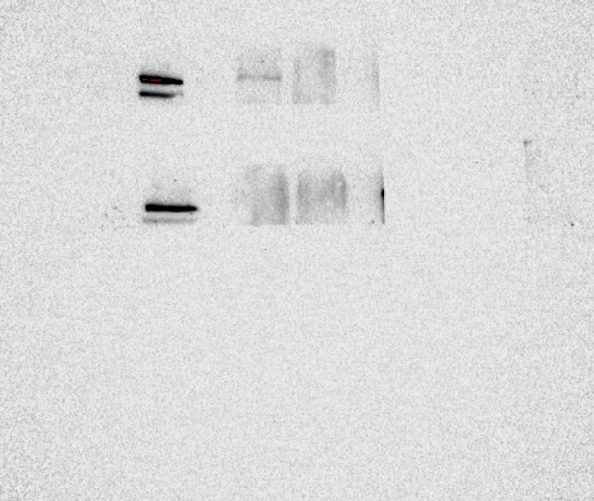
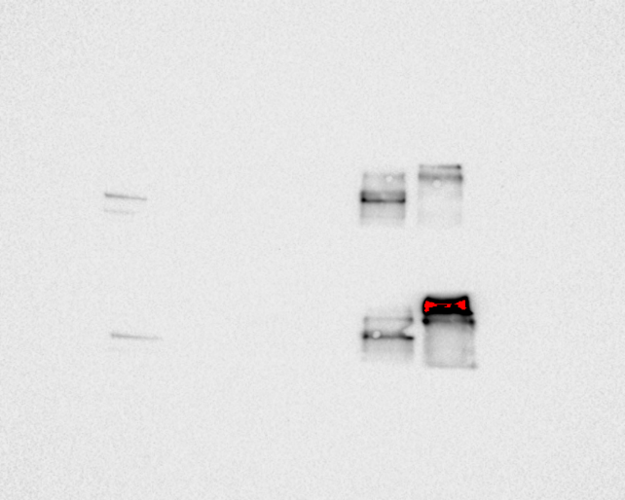
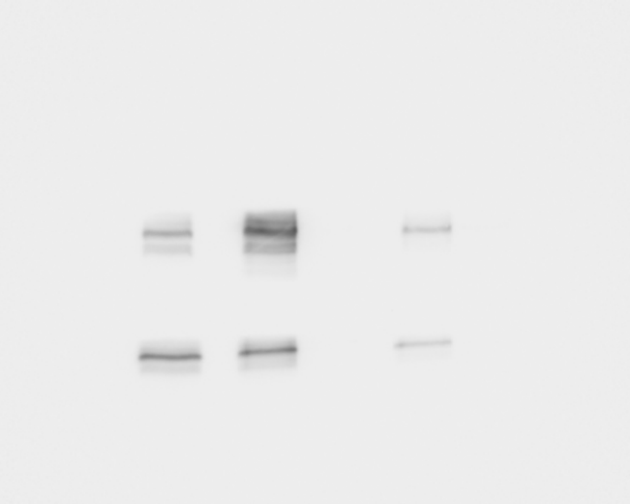
Figure 2 B
180 kDa
POLR3A
130 kDa
180 kDa
POLR3A
The left side was covered
as signal was strong
130 kDa
180 kDa
POLR3A
130 kDa
180 kDa
POLR3A
130 kDa
100 kDa
MDM2
70 kDa
100 kDa
MDM2
70 kDa
Note that in each case, two distinct membranes were exposed to the camera simultaneously.

Slide 5
Figure 2 C (same as 3B)
input
180 kDa
POLR3A
130 kDa
100 kDa
MDM2 wt
70 kDa
MDM2 Δ222-325
55 kDa
40 kDa
35 kDa
25 kDa
α-β-Gal
180 kDa
130 kDa
100 kDa
70 kDa
55 kDa
40 kDa
35 kDa
25 kDa

Slide 6
Figure 2 C (same as 3B)
α-MDM2
180 kDa
POLR3A
130 kDa
100 kDa
MDM2 wt
70 kDa
MDM2 Δ222-325
55 kDa
Heavy chain
40 kDa
35 kDa
25 kDa
α-Flag
180 kDa
POLR3A
130 kDa
100 kDa
MDM2 wt
70 kDa
MDM2 Δ222-325
55 kDa
40 kDa
35 kDa
25 kDa

Slide 7
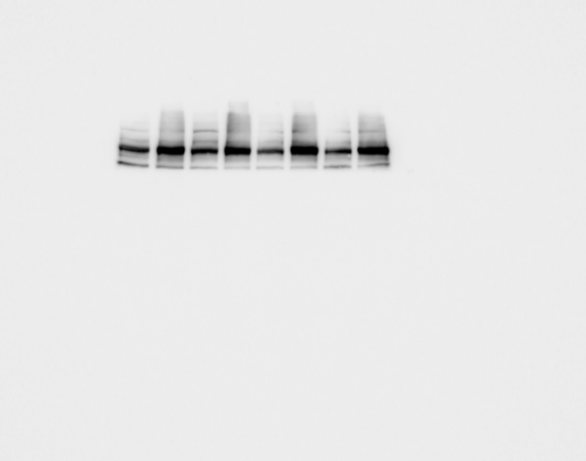
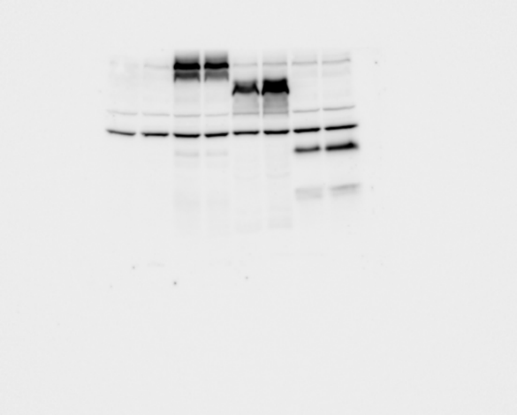

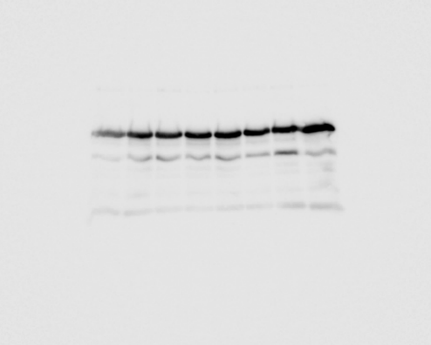
Figure 3 A
input
180 kDa
POLR3A
130 kDa
100 kDa
MDM2 wt
70 kDa
MDM2 1-400
55 kDa
Heavy chain
40 kDa
MDM2 298-491
35 kDa
25 kDa
α-β-Gal
180 kDa
130 kDa
100 kDa
70 kDa
Heavy chain
55 kDa
40 kDa
35 kDa
Light chain
25 kDa

Slide 8
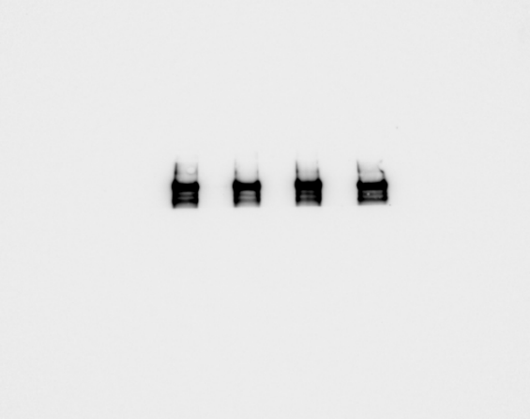
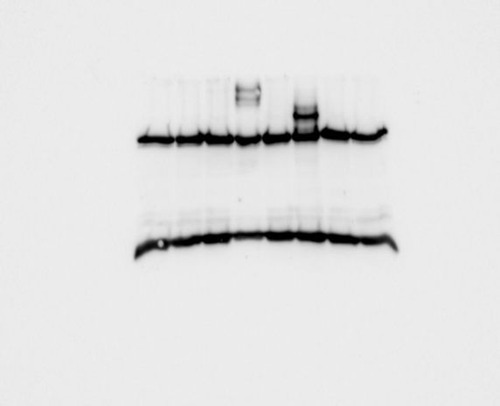
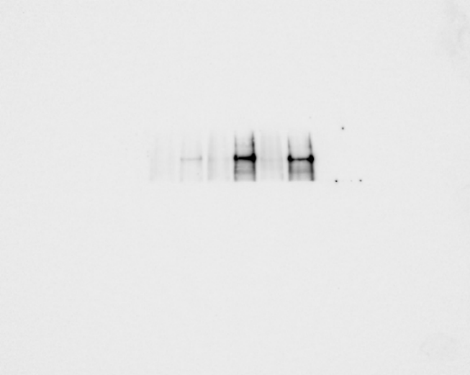
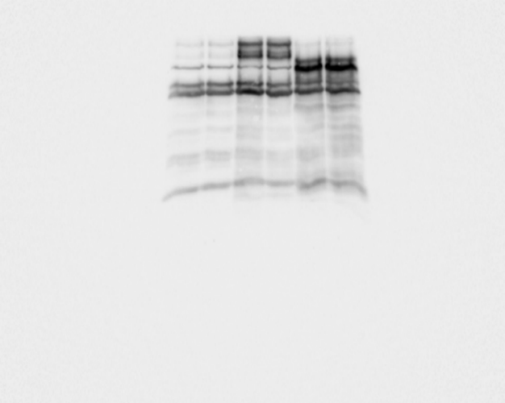
Figure 3 A
α-Flag
180 kDa
POLR3A
130 kDa
100 kDa
MDM2 wt
70 kDa
MDM2 1-400
55 kDa
Heavy chain
40 kDa
35 kDa
Light chain
25 kDa
α-MDM2 (IF2)
180 kDa
POLR3A
130 kDa
100 kDa
MDM2 wt
70 kDa
MDM2 1-400
55 kDa
Heavy chain
40 kDa
35 kDa
Light chain
25 kDa

Slide 9
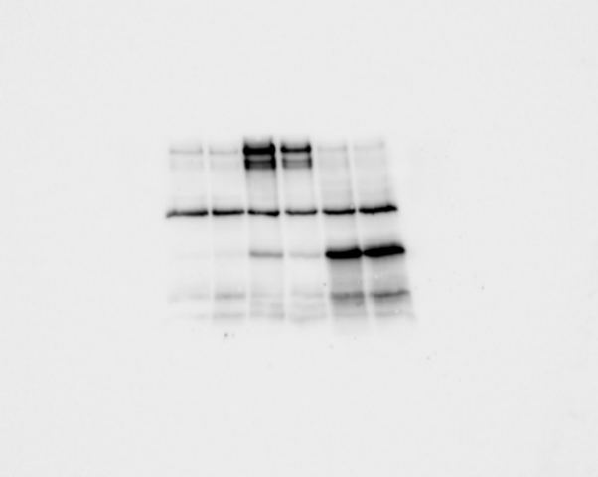
Figure 3 A
α-MDM2 (4B11)
180 kDa
POLR3A
130 kDa
100 kDa
MDM2 wt
70 kDa
Heavy chain
55 kDa
40 kDa
MDM2 298-491
35 kDa
25 kDa

Slide 10
Figure 3B (same as 2C)
input
180 kDa
POLR3A
130 kDa
100 kDa
MDM2 wt
70 kDa
MDM2 Δ222-325
55 kDa
40 kDa
35 kDa
25 kDa
α-β-Gal
180 kDa
130 kDa
100 kDa
70 kDa
55 kDa
40 kDa
35 kDa
25 kDa

Slide 11
Figure 3B (same as 2C)
α-Flag
180 kDa
POLR3A
130 kDa
100 kDa
MDM2 wt
70 kDa
MDM2 Δ222-325
55 kDa
40 kDa
35 kDa
25 kDa
α-MDM2
180 kDa
POLR3A
130 kDa
100 kDa
MDM2 wt
70 kDa
MDM2 Δ222-325
55 kDa
Heavy chain
40 kDa
35 kDa
25 kDa

Slide 12
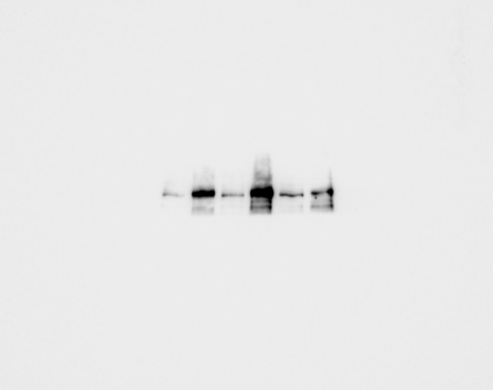
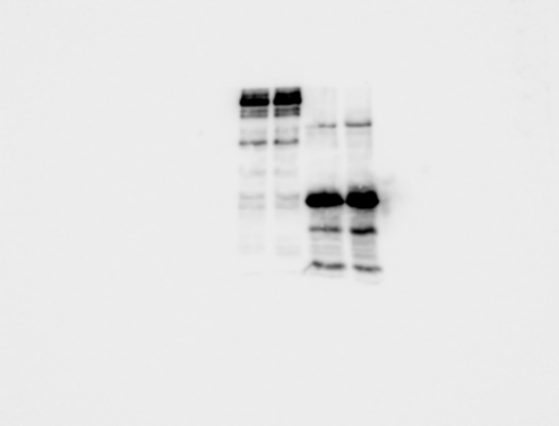

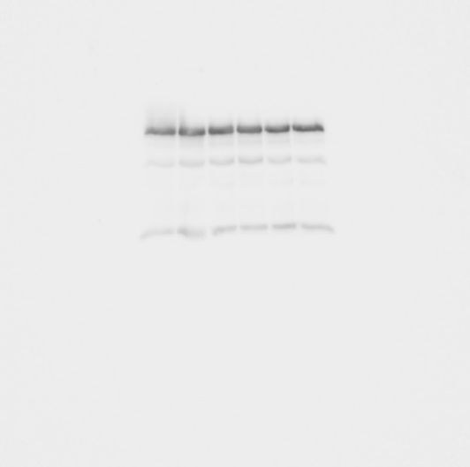
Figure 3 C
input
180 kDa
POLR3A
130 kDa
100 kDa
MDM2 wt
70 kDa
55 kDa
40 kDa
MDM2 6-200
35 kDa
25 kDa
α-β-Gal
180 kDa
130 kDa
100 kDa
70 kDa
Heavy chain
55 kDa
40 kDa
35 kDa
Light chain
25 kDa

Slide 13
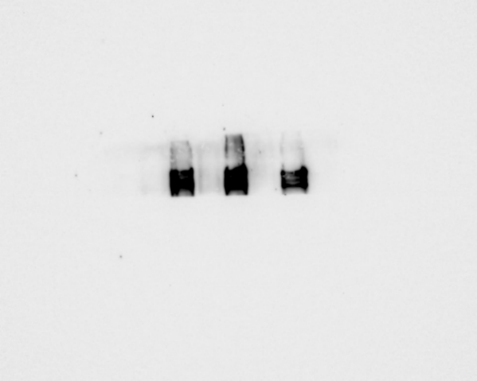
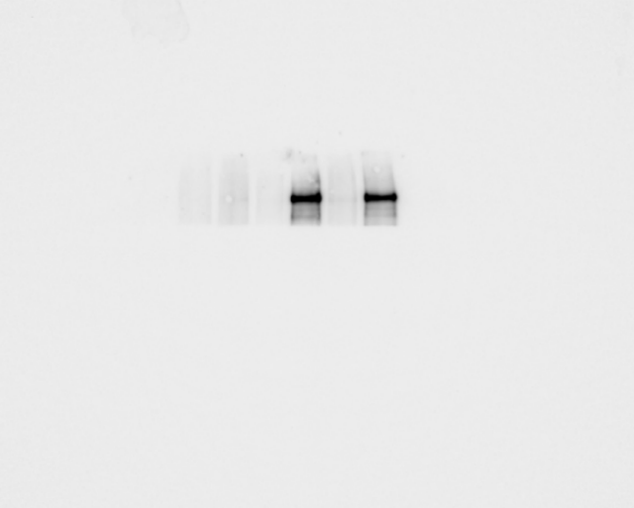
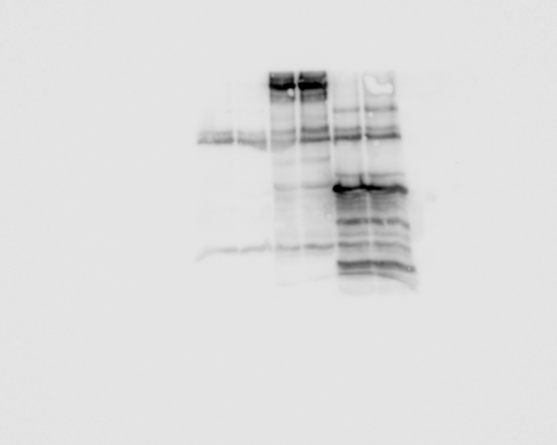
Figure 3 C
α-Flag
180 kDa
POLR3A
130 kDa
100 kDa
MDM2 wt
70 kDa
55 kDa
Heavy chain
40 kDa
35 kDa
MDM2 6-200
25 kDa
Light chain
α-MDM2 (IF2)
180 kDa
POLR3A
130 kDa
100 kDa
MDM2 wt
70 kDa
Heavy chain
55 kDa
40 kDa
MDM2 6-200
35 kDa
25 kDa
Light chain

Slide 14
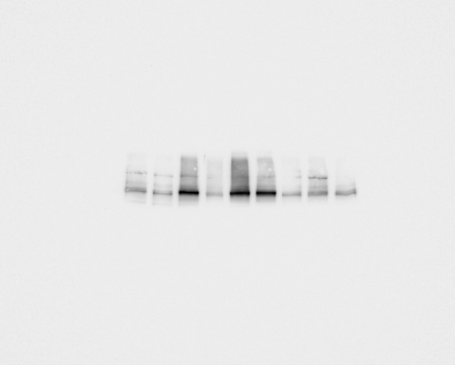
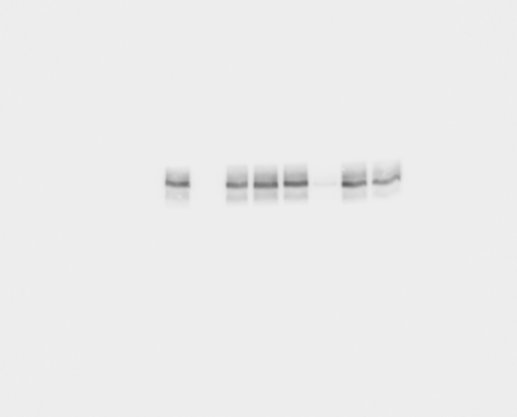
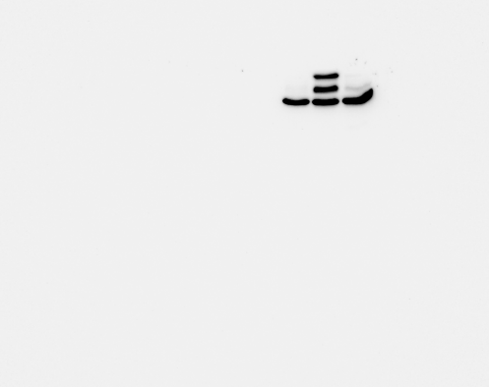
Figure 3 F
input
180 kDa
POLR3A
130 kDa
100 kDa
MDM2
70 kDa
55 kDa
p53
40 kDa
35 kDa
25 kDa

Slide 15
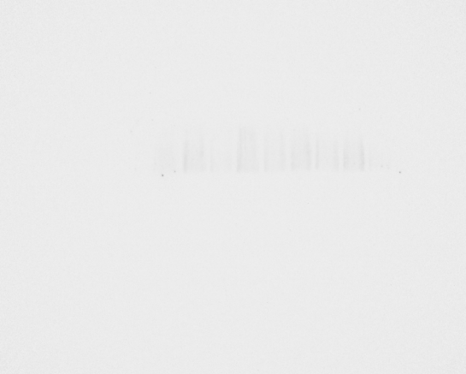


Figure 3 F
α-β-Gal
180 kDa
130 kDa
100 kDa
70 kDa
55 kDa
40 kDa
35 kDa
25 kDa

Slide 16
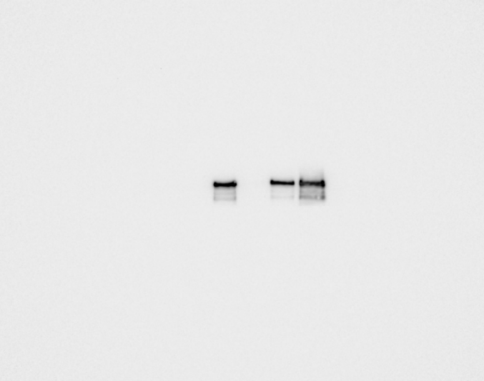
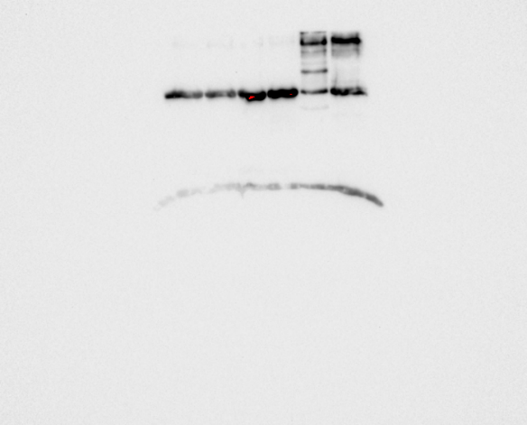
Figure 3 F
α-Flag
180 kDa
POLR3A
130 kDa
100 kDa
MDM2
70 kDa
Heavy chain
55 kDa
40 kDa
35 kDa
25 kDa
Light chain

Slide 17
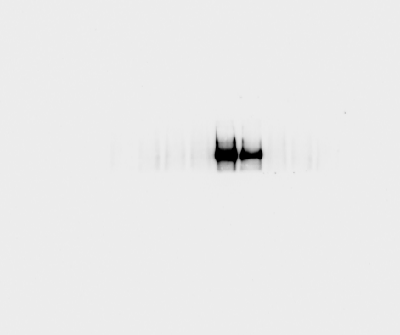
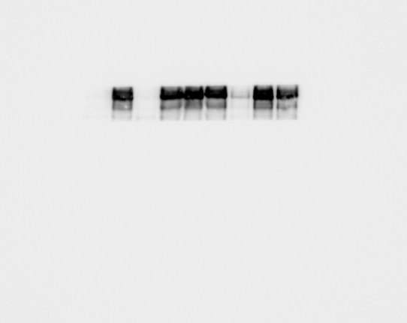
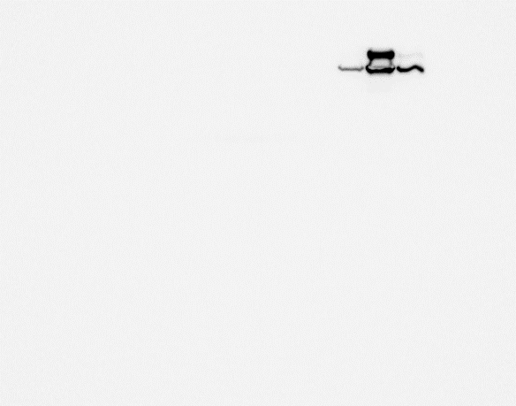
Figure 3 F
α-MDM2 (IF2)
180 kDa
POLR3A
130 kDa
100 kDa
MDM2
70 kDa
55 kDa
p53
40 kDa
35 kDa
25 kDa

Slide 18
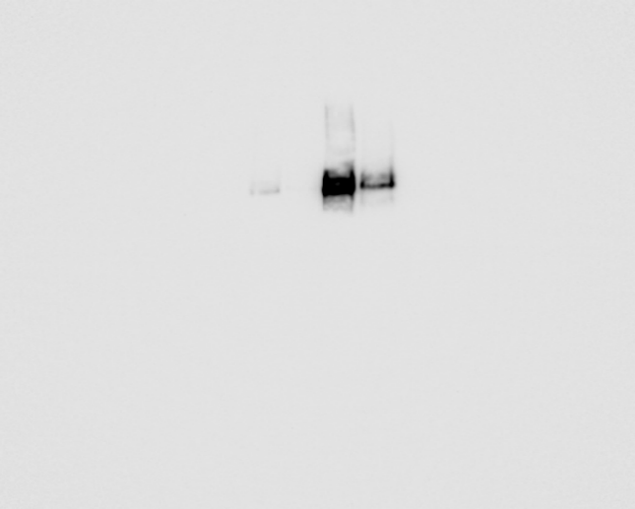
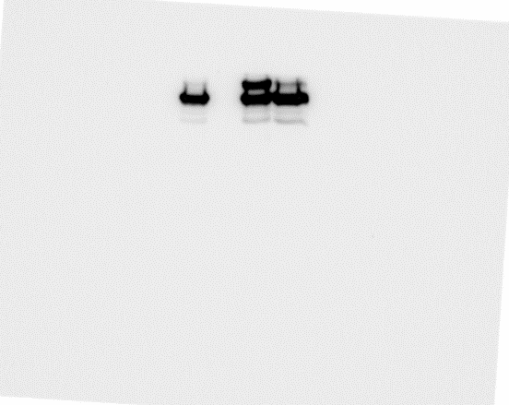
Figure 3 F
α-p53
180 kDa
130 kDa
100 kDa
MDM2
70 kDa
55 kDa
p53
40 kDa
35 kDa
25 kDa

Slide 19
Figure 4 B

Slide 20
Figure 5 B
100 kDa
MDM2
MX1 was first stained
on the membrane
70 kDa
MX1
180 kDa
130 kDa
p-TBK1
100 kDa
70 kDa
180 kDa
130 kDa
100 kDa
TBK1
70 kDa
100 kDa
MX1
70 kDa
35 kDa
GAPDH
25 kDa
15 kDa

Slide 21
Figure 6 G
180 kDa
130 kDa
Cleaved Parp-1
100 kDa
70 kDa
55 kDa
100 kDa
MDM2 wt
70 kDa
55 kDa
MDM2 6-200
40 kDa
35 kDa
Signal was covered as GAPDH was stained before
40 kDa
GAPDH
35 kDa
25 kDa
15 kDa

Slide 22
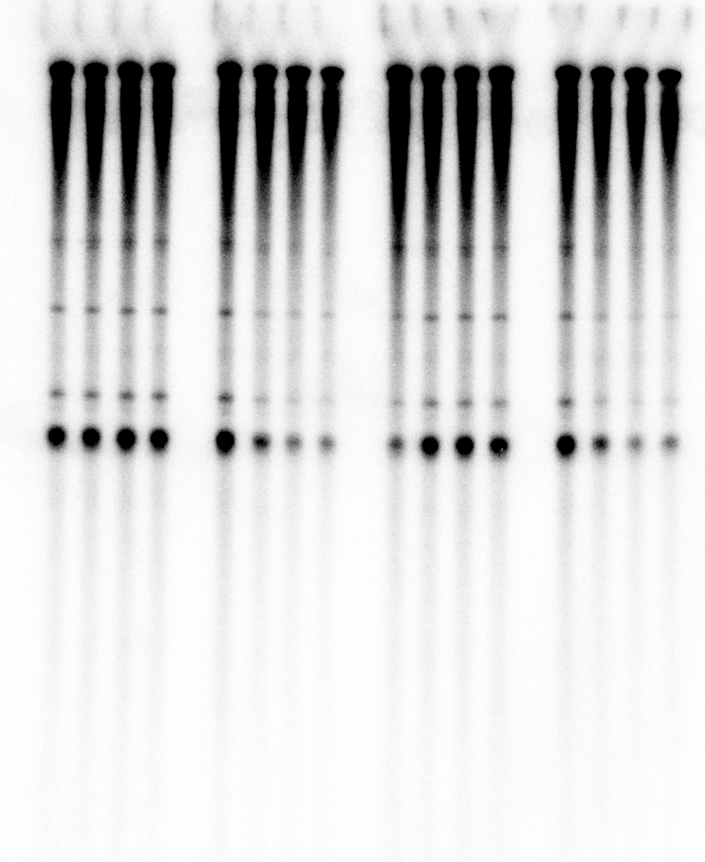
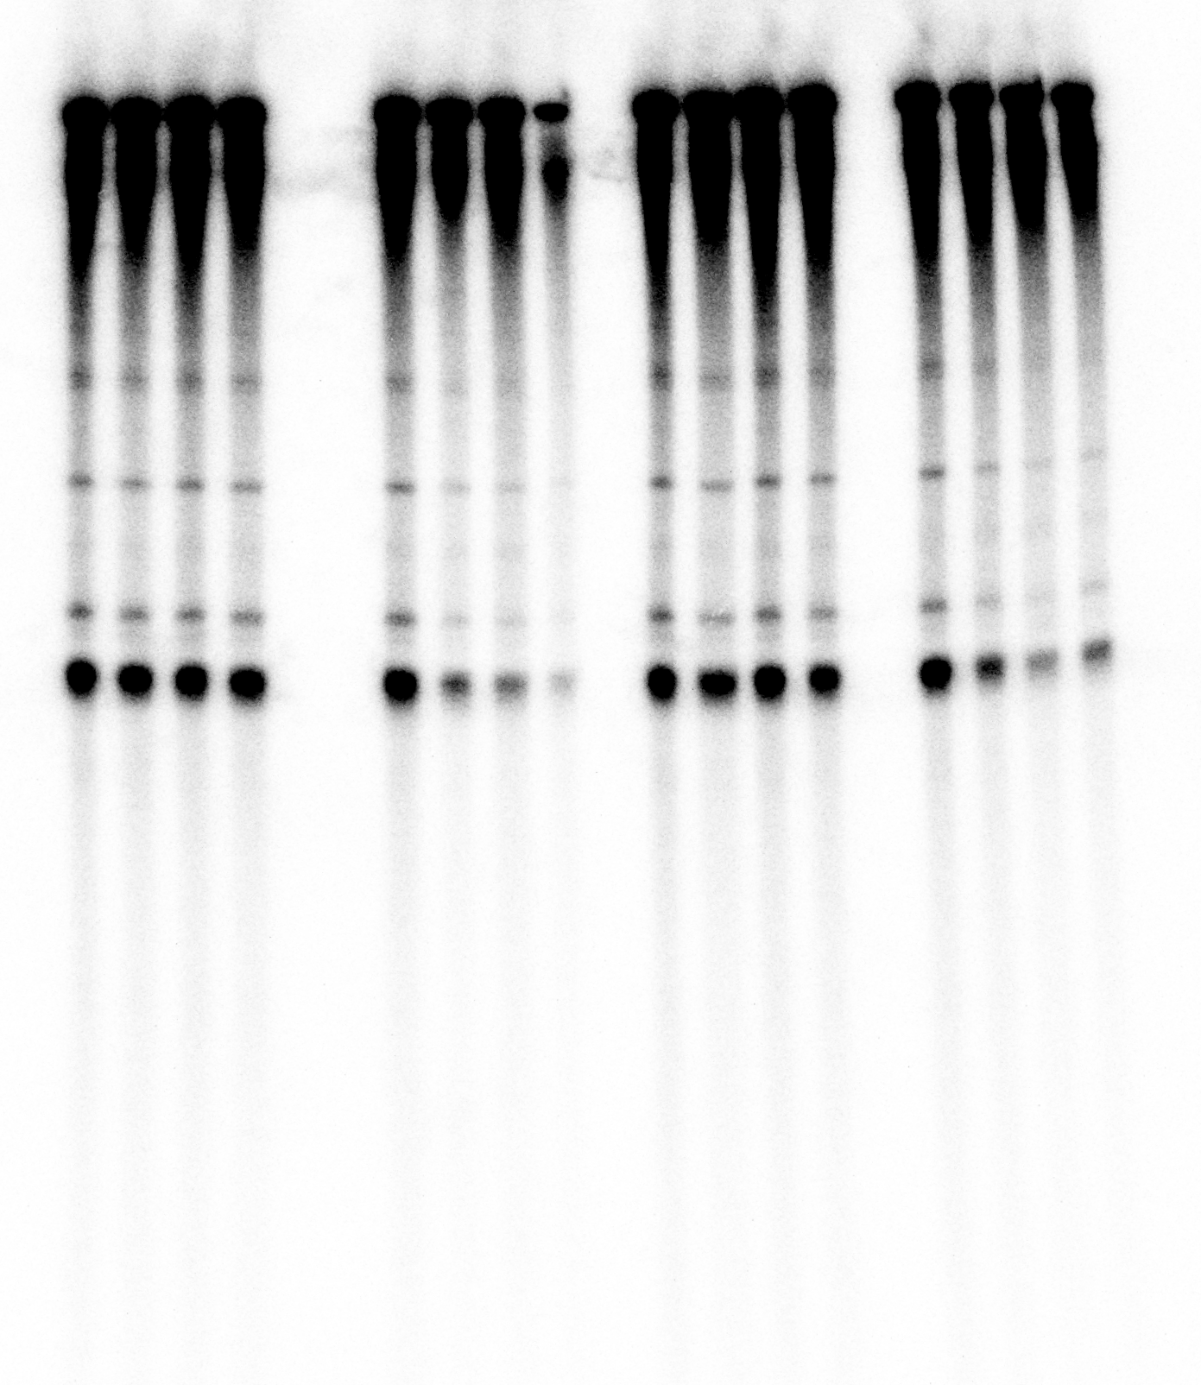
Suppl. Figure 1B

Slide 23
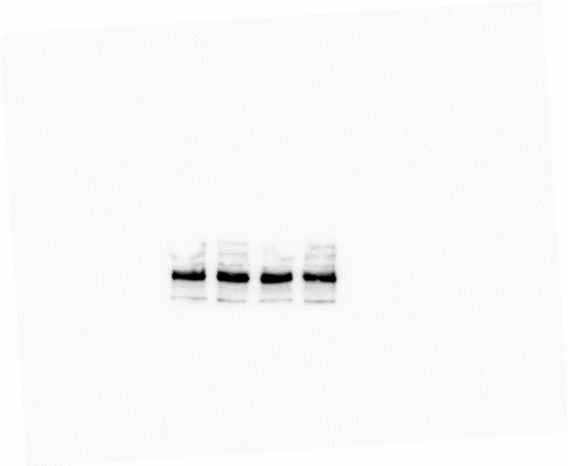
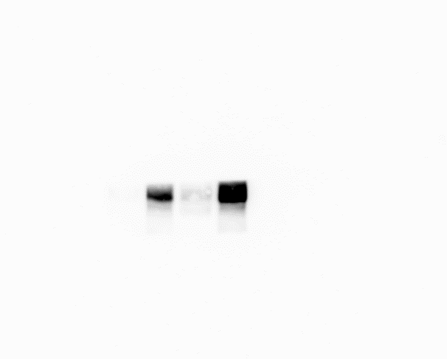
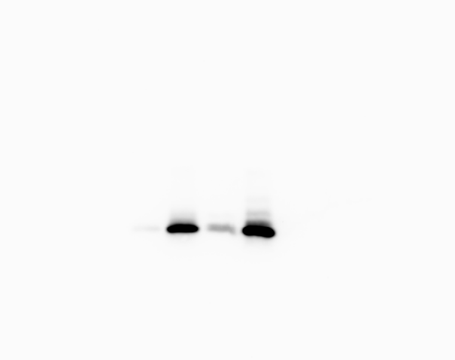

Suppl. Figure 2 B
180 kDa
POLR3A
130 kDa
100 kDa
MDM2
70 kDa
25 kDa
15 kDa
p21
35 kDa
GAPDH

Slide 24
Suppl. Figure 2 D
input
180 kDa
POLR3A
130 kDa
100 kDa
MDM2
70 kDa
Heavy chain
55 kDa
α-POLR3A /α-β-Gal
180 kDa
POLR3A
130 kDa
100 kDa
MDM2
70 kDa
Heavy chain
55 kDa

Slide 25
Suppl. Figure 4 C

Slide 26
Suppl. Figure 5 A
180 kDa
130 kDa
100 kDa
RIG-I
70 kDa
55 kDa
40 kDa
GAPDH
35 kDa
25 kDa
180 kDa
130 kDa
100 kDa
70 kDa
55 kDa
IRF3
40 kDa
GAPDH
35 kDa
25 kDa

Slide 27
Suppl. Figure 5 A
180 kDa
130 kDa
180 kDa
POLR3A
130 kDa
180 kDa
130 kDa
100 kDa
70 kDa
180 kDa
130 kDa
100 kDa
HSP70
70 kDa
Note that in each case, two distinct membranes were exposed to the camera simultaneously.

Slide 28
Suppl. Figure 5 C
180 kDa
POLR3A
130 kDa
40 kDa
GAPDH
35 kDa
25 kDa
100 kDa
MDM2
70 kDa
40 kDa
GAPDH
35 kDa
25 kDa

Slide 29
Suppl. Figure 5 E
180 kDa
POLR3A
130 kDa
100 kDa
70 kDa
55 kDa
35 kDa
GAPDH
25 kDa
15 kDa

Slide 30
Suppl. Figure 5 H
40 kDa
STING
35 kDa
25 kDa
180 kDa
130 kDa
100 kDa
HSP70
70 kDa
55 kDa

Slide 31
Suppl. Figure 5 I
180 kDa
130 kDa
RIG-I
100 kDa
70 kDa
55 kDa
40 kDa
GAPDH
35 kDa
25 kDa
40 kDa
STING
35 kDa
25 kDa
180 kDa
130 kDa
100 kDa
70 kDa
HSP70
55 kDa

Slide 32
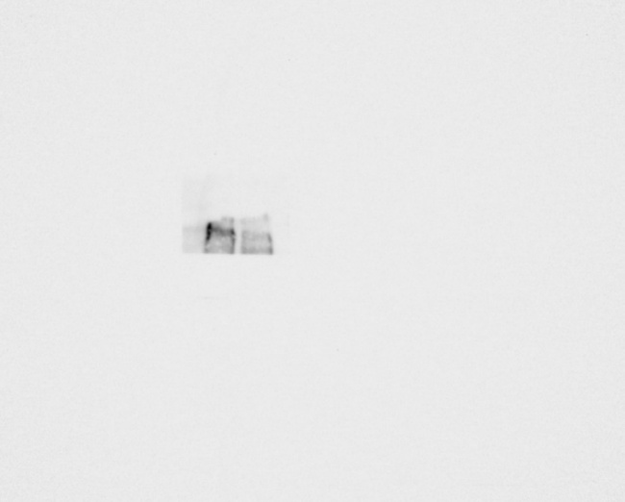
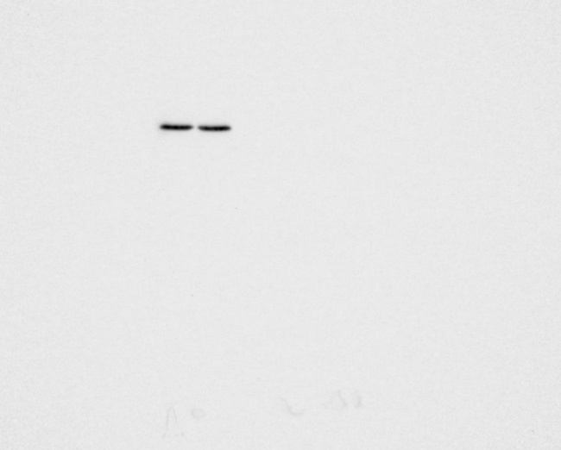
Suppl. Figure 5 J
180 kDa
POLR3A
130 kDa
100 kDa
70 kDa
40 kDa
GAPDH
35 kDa
25 kDa

Slide 33
Suppl. Figure 5 K
180 kDa
130 kDa
100 kDa
RIG-I
70 kDa
55 kDa
40 kDa
GAPDH
35 kDa
25 kDa
40 kDa
STING
35 kDa
25 kDa
180 kDa
130 kDa
100 kDa
HSP70
70 kDa
55 kDa

Slide 34
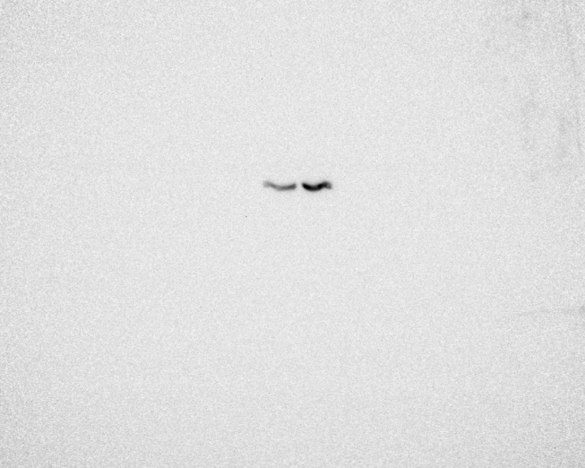
Suppl. Figure 5 L
180 kDa
POLR3A
130 kDa
100 kDa
70 kDa
40 kDa
GAPDH
35 kDa
25 kDa

Slide 35
Suppl. Figure 5 M
40 kDa
STING
35 kDa
25 kDa
180 kDa
130 kDa
HSP70
100 kDa
70 kDa
55 kDa
180 kDa
130 kDa
RIG-I
100 kDa
70 kDa
55 kDa
40 kDa
GAPDH
35 kDa
25 kDa

Slide 36
Suppl. Figure 5 N
180 kDa
130 kDa
p-TBK1
100 kDa
70 kDa
180 kDa
130 kDa
TBK1
100 kDa
70 kDa
40 kDa
GAPDH
35 kDa
25 kDa

Slide 37
Suppl. Figure 5 N
180 kDa
130 kDa
100 kDa
p-TBK1
180 kDa
130 kDa
100 kDa
TBK1
70 kDa
HSP70
55 kDa
IRF3
40 kDa
IRF3 was first stained
on the membrane

Slide 38
Suppl. Figure 5 N
180 kDa
130 kDa
p-TBK1
100 kDa
70 kDa
180 kDa
130 kDa
100 kDa
TBK1
70 kDa
40 kDa
GAPDH
35 kDa
25 kDa
Note that for GAPDH, two distinct membranes were exposed to the camera simultaneously.

Slide 39
Suppl. Figure 6 B
100 kDa
MDM2 wt
70 kDa
55 kDa
MDM2 6-200
40 kDa
GAPDH
35 kDa
GAPDH was first stained
on the membrane
100 kDa
MX1
70 kDa
40 kDa
GAPDH
35 kDa
25 kDa

Slide 40
Suppl. Figure 6 B
100 kDa
MDM2 wt
70 kDa
55 kDa
MDM2 6-200
40 kDa
35 kDa
Signal was covered as GAPDH was stained before
100 kDa
MX1
70 kDa
40 kDa
GAPDH
35 kDa
25 kDa

Slide 41
Suppl. Figure 6 B
100 kDa
MDM2 wt
70 kDa
55 kDa
MDM2 6-200
40 kDa
35 kDa
GAPDH
GAPDH was first stained
on the membrane
100 kDa
MX1
70 kDa
40 kDa
GAPDH
35 kDa
25 kDa

Slide 42
Suppl. Figure 6 C
180 kDa
130 kDa
RIG-I
100 kDa
70 kDa
55 kDa
40 kDa
GAPDH
35 kDa
25 kDa

Slide 43
Suppl. Figure 6 G
180 kDa
130 kDa
RIG-I
100 kDa
70 kDa
55 kDa
180 kDa
130 kDa
Cleaved Parp-1
100 kDa
70 kDa
55 kDa
40 kDa
GAPDH
35 kDa
25 kDa

Slide 44
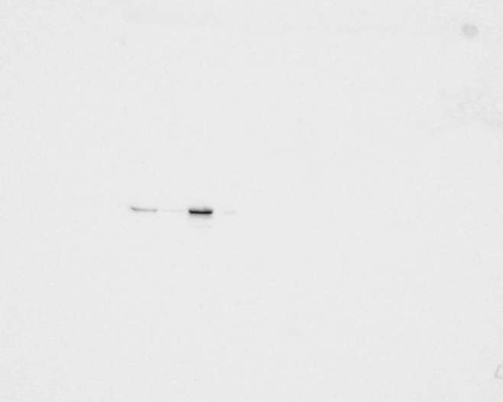
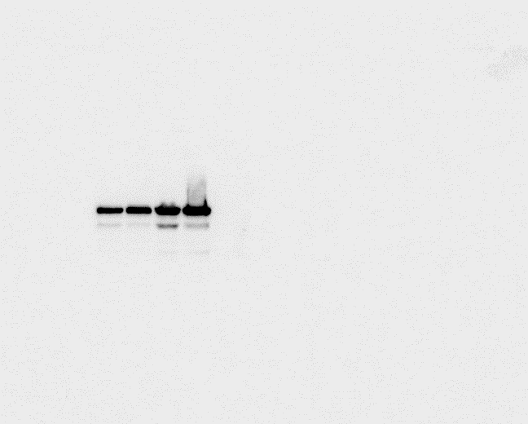
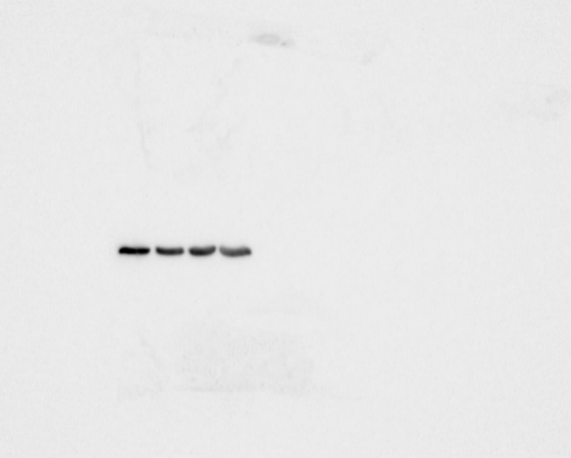
Suppl. Figure 6 G
180 kDa
130 kDa
RIG-I
100 kDa
70 kDa
55 kDa
180 kDa
130 kDa
Cleaved Parp-1
100 kDa
70 kDa
55 kDa
40 kDa
GAPDH
35 kDa
25 kDa

