Slide 1
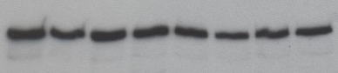
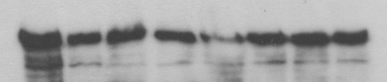
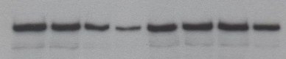
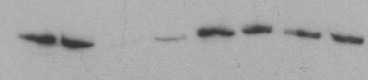
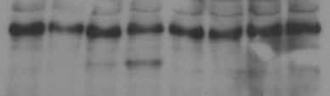


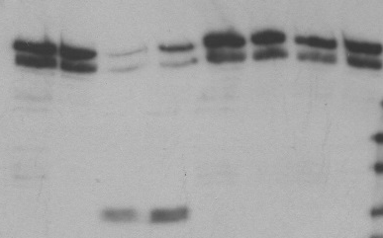
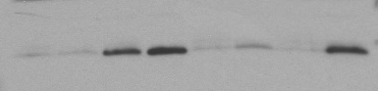
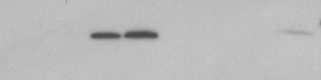


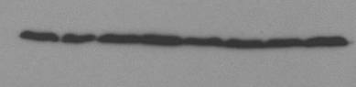
Figure S2
a
b
BxPc-3
MIA-PaCa-2
100 μM Gemcitabine - + - + - + - +
100 ng/ml TRAIL - - + + - - + +
10μM Z-VAD-FMK - - - - + + + +
100 μM Gemcitabine - + - + - + - +
100 ng/ml TRAIL - - + + - - + +
10μM Z-VAD-FMK - - - - + + + +
mTOR total
mTOR total
mTOR Ser 2448
mTOR Ser 2448
Raptor
Raptor
Δ Raptor
Δ Raptor
Rictor
Rictor
Δ Rictor
Δ Rictor
Total 4E-BP1
Total 4E-BP1
4E-BP1 Ser 65
4E-BP1 Ser 65
GAPDH
GAPDH

