Slide 1
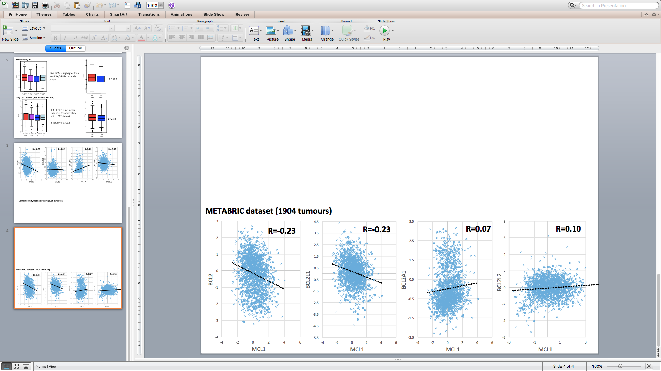
Supplementary Figure S1.
Campbell et al., MCL-1 in breast cancer

Slide 2
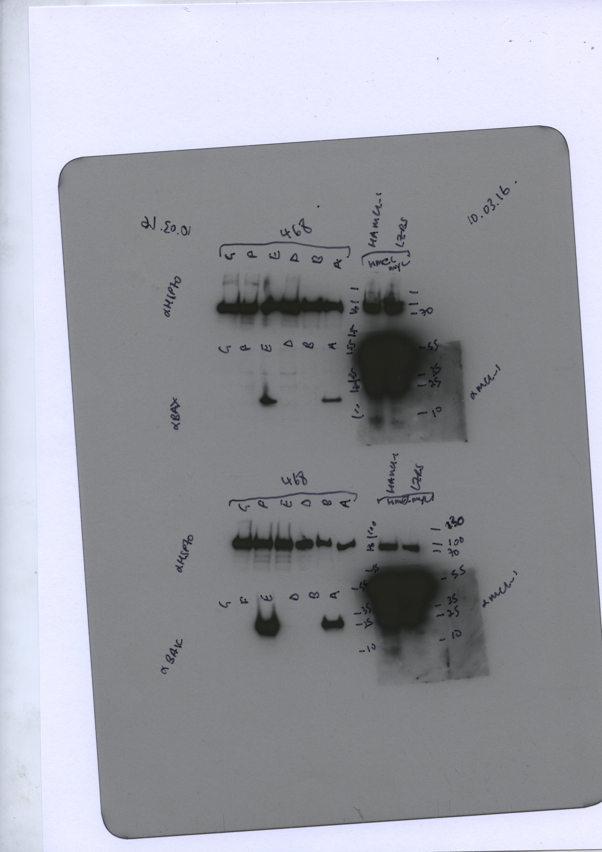
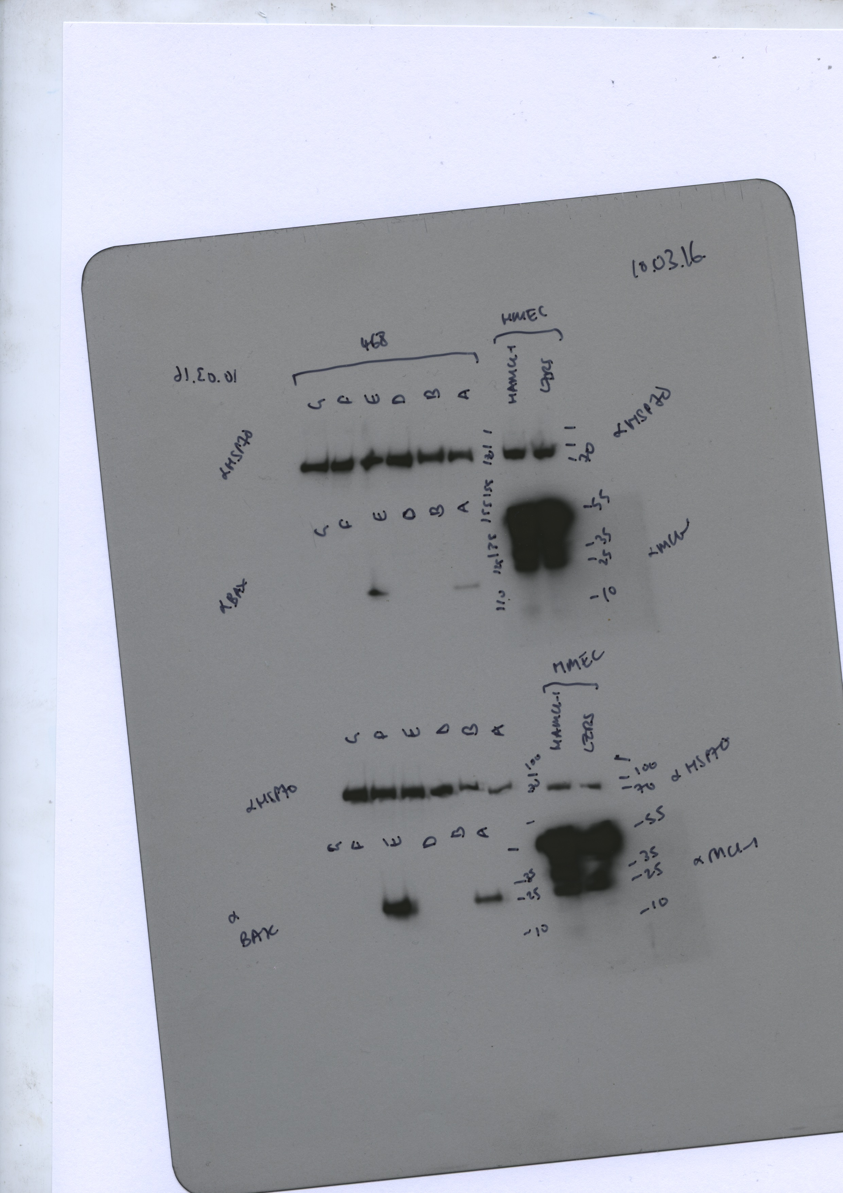
Supplementary Figure S2.
Campbell et al., MCL-1 in breast cancer
A
MCF7
UMI-77 (μM)
B
CRISPR BAX/BAK
CRISPR Control
36
BAK
28
28
BAX
17
130
95
HSP70
72

Slide 3
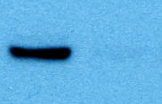
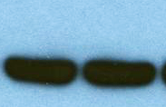


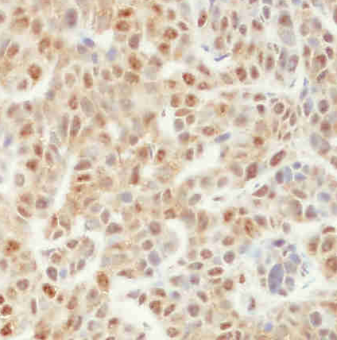
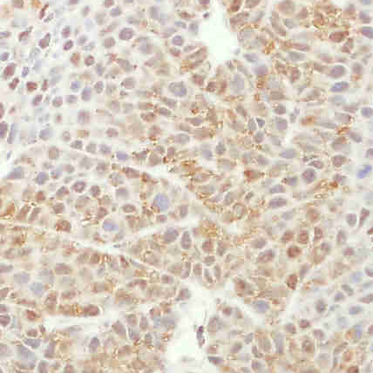
Supplementary Figure S3.
Targeting MCL-1 restricts triple negative breast cancer cell growth in vivo.
Campbell et al., MCL-1 in breast cancer
A
MDA-MB-468 xenograft final weights
B
MDA-MB-468 cells
72h siRNA treatment
siControl
siMCL1
Tumour weight (mg)
52
MCL-1
38
52
ACTIN
38
C
siControl
at endpoint
siMCL1
at endpoint
55
36
MCL-1
55
ACTIN
D
siControl tumour at endpoint
siMCL1 tumour at endpoint

Slide 4
Supplementary Figure S4.
Requirement for Mcl1 in mammary tumourigenesis in vivo
Campbell et al., MCL-1 in breast cancer
A
WT n=36
MMTV-PyMT;MMTV-cre;Mcl1^{+/+} n=8
MMTV-PyMT;MMTV-cre;Mcl1^{+/+}; ROSA-tdRFP n=9
MMTV-PyMT;Mcl1^{+/+}; ROSA-tdRFP n=4
MMTV-PyMT;Mcl1^{+/+} n=7
MMTV-PyMT;Mcl1^{fl/+} n=4
MMTV-PyMT;Mcl1^{fl/+};ROSA-tdRFP n=1
MMTV-PyMT;Mcl1^{fl/fl} n=3
HET n=28
MMTV-PyMT;MMTV-cre;Mcl1^{fl/+} n=16
MMTV-PyMT;MMTV-cre;Mcl1^{fl/+}; ROSA-tdRFP n=12
HOM n=18
MMTV-PyMT;MMTV-cre;Mcl1^{fl/fl} n=10
MMTV-PyMT;MMTV-cre;Mcl1^{fl/fl}; ROSA-tdRFP n=8
B
Time until tumour emergence
C
Time for tumour progression to end point
Days until tumour onset
D
Number of tumour burdened glands
E
Total tumour weight
Number of glands with tumour

