Slide 1
Supplementary Fig.1

Slide 2
Supplementary Fig.2

Slide 3
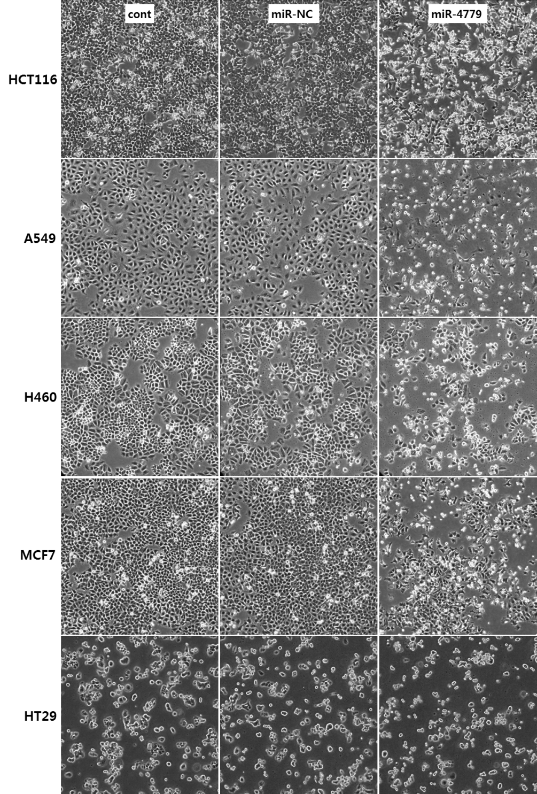
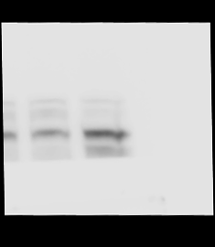
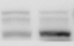
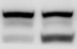
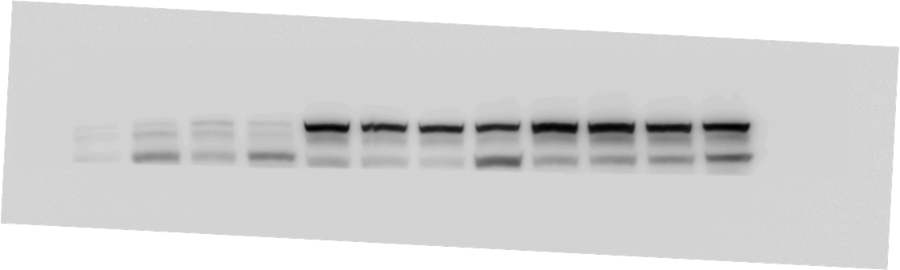
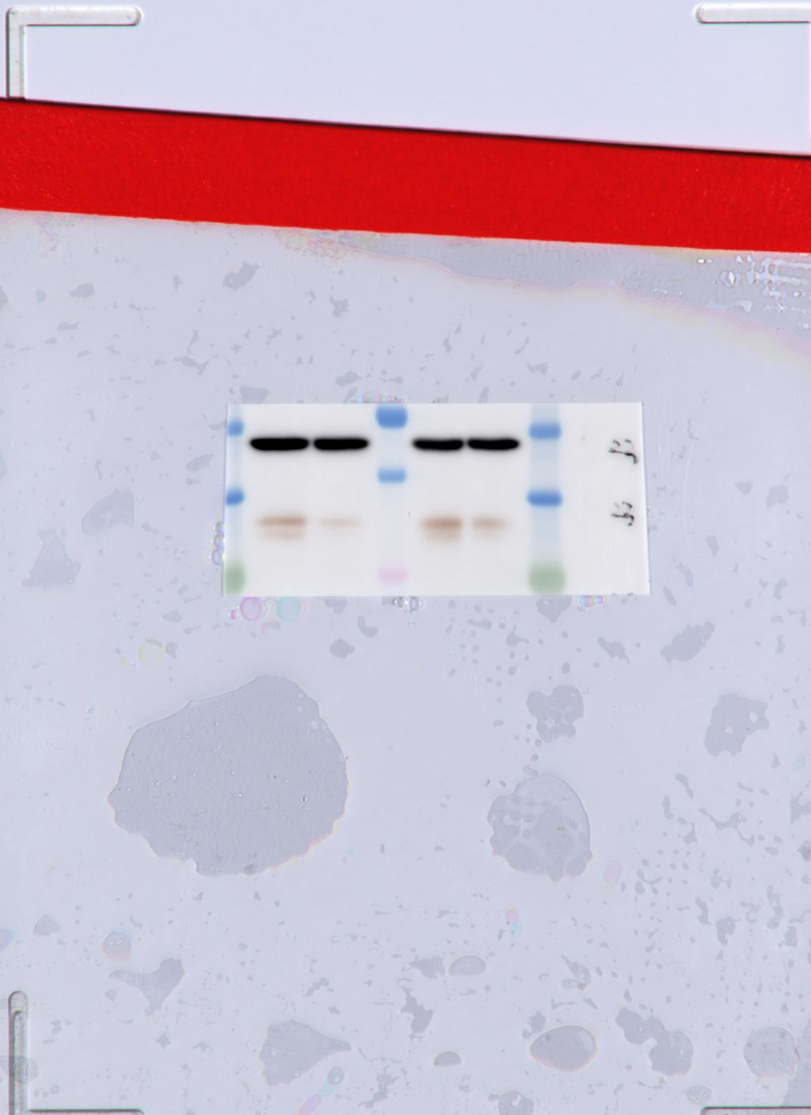
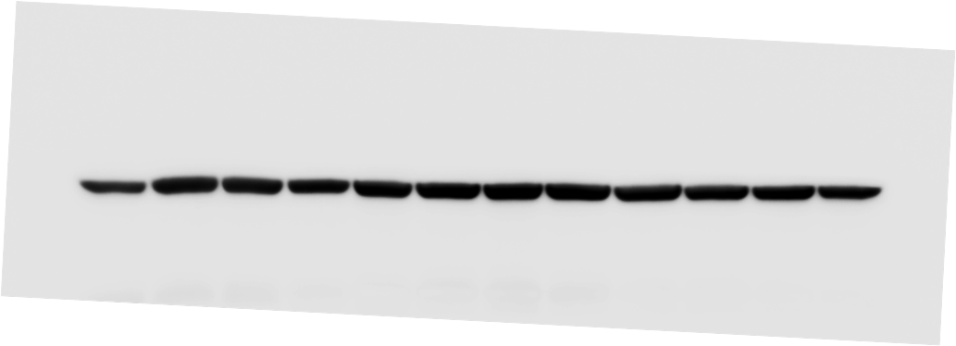
Supplementary Fig.3
A
B
A549
H460
MCF7
HT-29
miR-4779
miR-4779
miR-4779
miR-4779
miR-NC
miR-NC
miR-NC
miR-NC
Mw
110
Cleaved PARP
89
42
β-actin

Slide 4
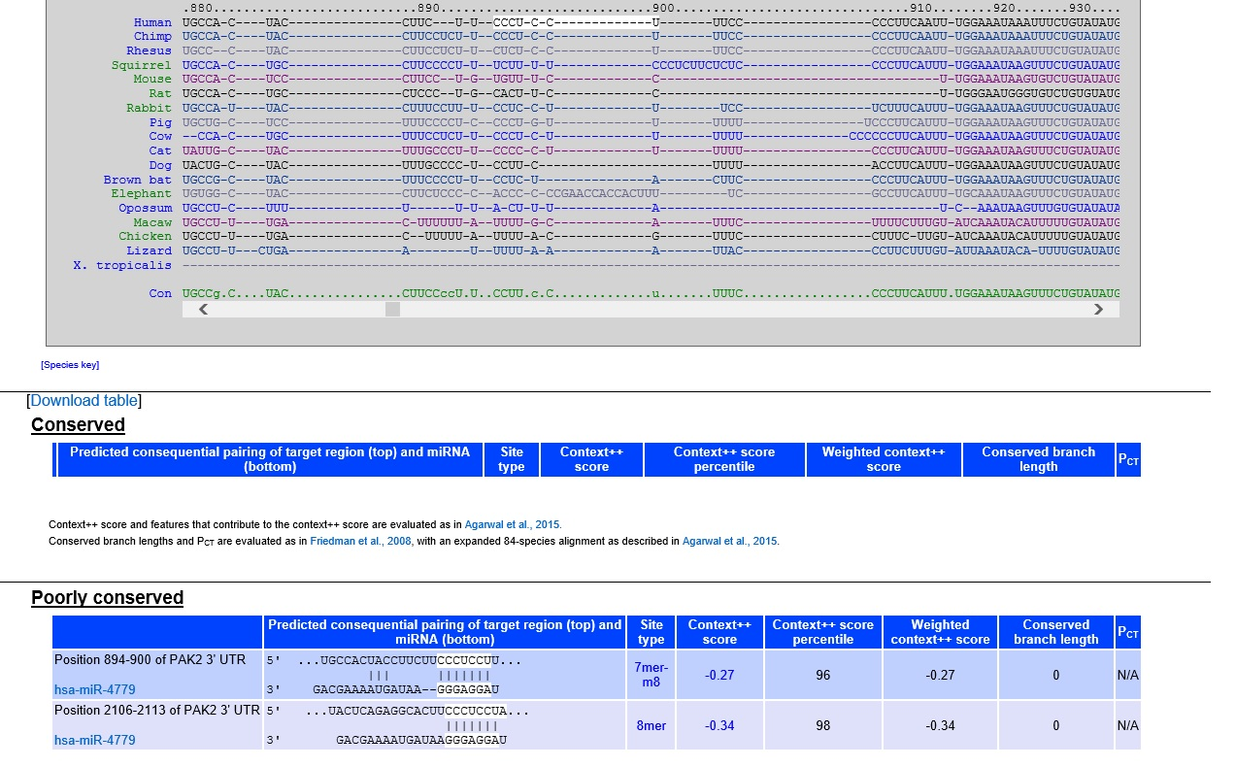
Supplementary Fig.4
A
Position 894-900 of PAK2 3´UTR:
5´···UGCCACUACCUUCUUCCCUCCUU··
hsa-miR-477 :
3´ GACGAAAAUGAUAAGGGAGGAU
Position 2106-2113 of PAK2 3´UTR:
5´···UACUCAGAGGCACUUCCCUCCUA··
hsa-miR-4779 :
3´ GACGAAAAUGAUAAGGGAGGAU
B
Position 795-801 of CCND3 3´UTR:
5´···UGGGGUGGGGUCAUGCCCUCCUC··
hsa-miR-4779 :
3´ GACGAAAAUGAUAAGGGAGGAU

Slide 5
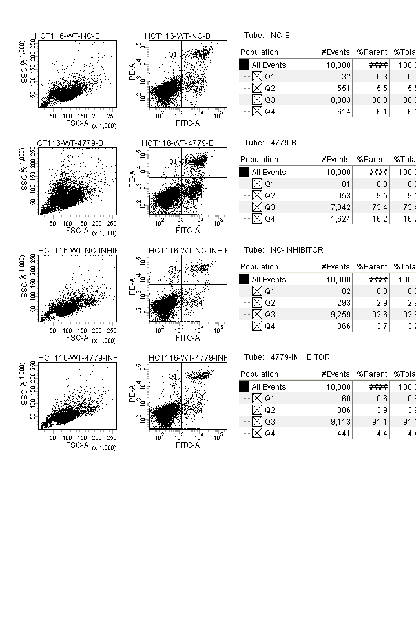
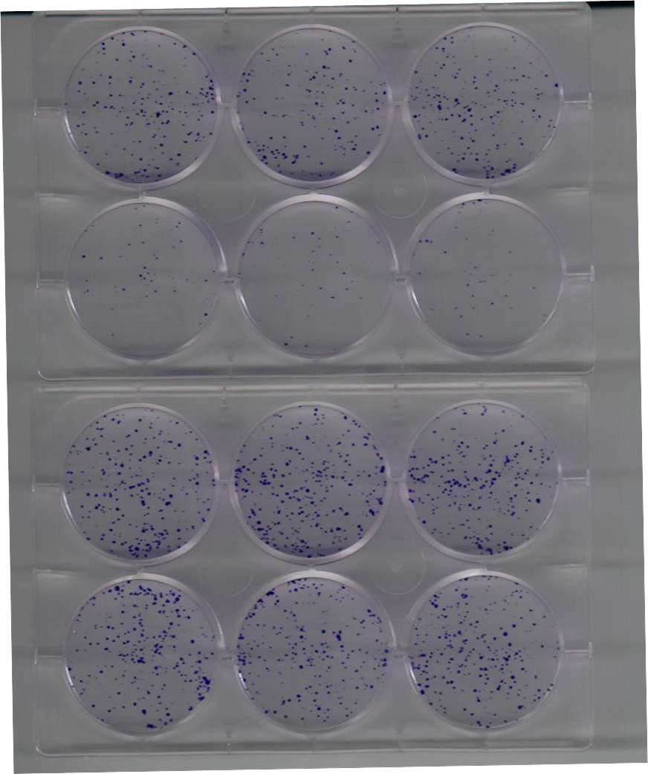
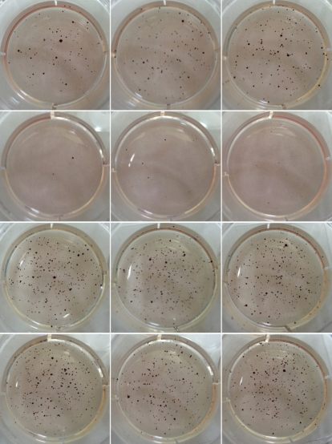
Supplementary Fig.5
A
miR-NC
miR-4779
**
***
PI
5.51
9.53
mimic
6.14
16.2
2.93
3.86
PI
inhibitor
3.66
4.41
mimic
inhibitor
Annexin V-FITC
Annexin V-FITC
B
C
miR-NC
miR-NC
mimic
mimic
miR-4779
miR-4779
miR-NC
miR-NC
inhibitor
inhibitor
miR-4779
miR-4779

Slide 6
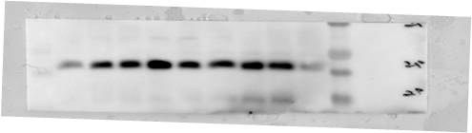

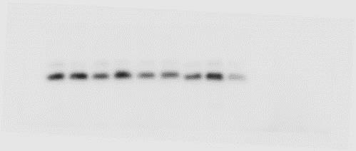
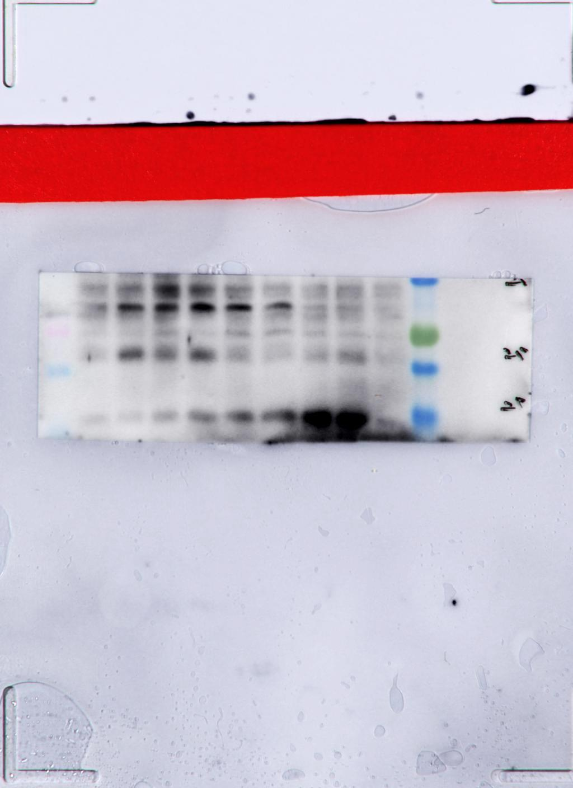
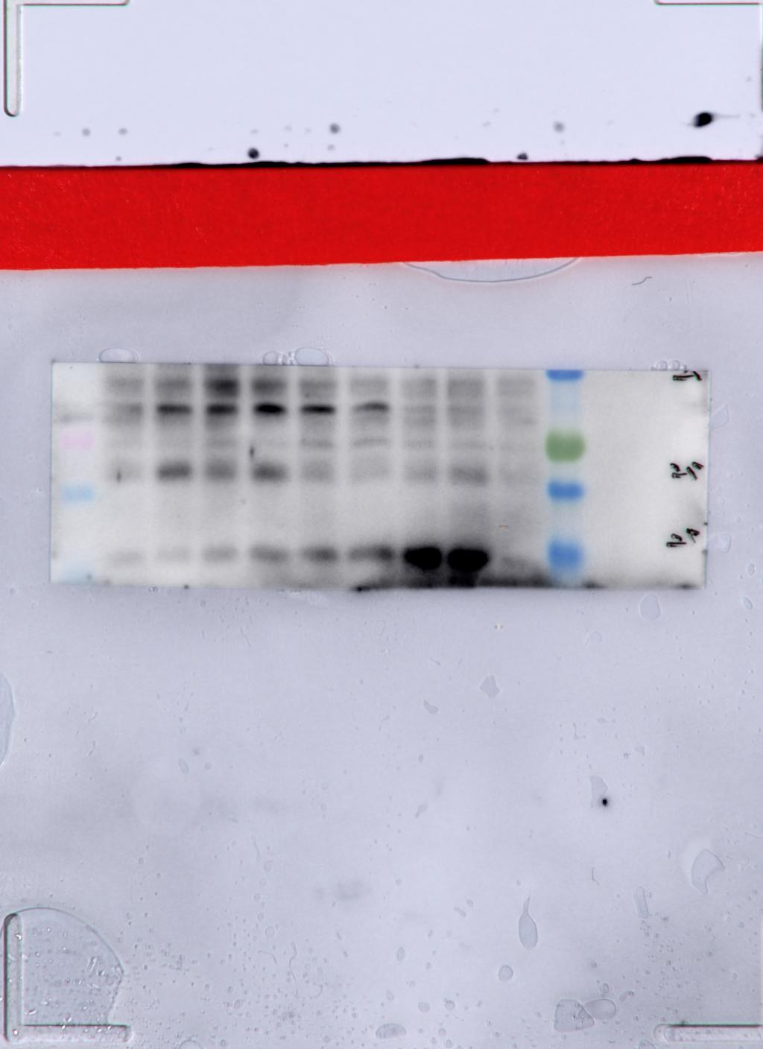

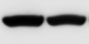
Supplementary Fig.6
miR-NC
miR-4779
si-NC
si-PAK2
Mw
23
Bad
23
p-Bad (S112)
23
p-Bad (S136)
42
β-actin

Slide 7
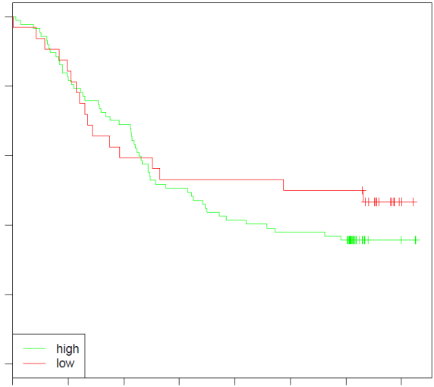
Supplementary Fig.7
miR-4779
1.0
0.8
0.6
Overall Survival
0.4
0.2
0.0
0
10
20
30
40
50
60
70
Time in (months)

Slide 8
Supplementary Fig.8
A
B
Pearson r = -0.1495
P value = 0.5294
Pearson r = -0.03278
P value = 0.8909
R²=0.02234
R²=0.00107

Slide 9
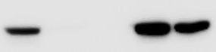
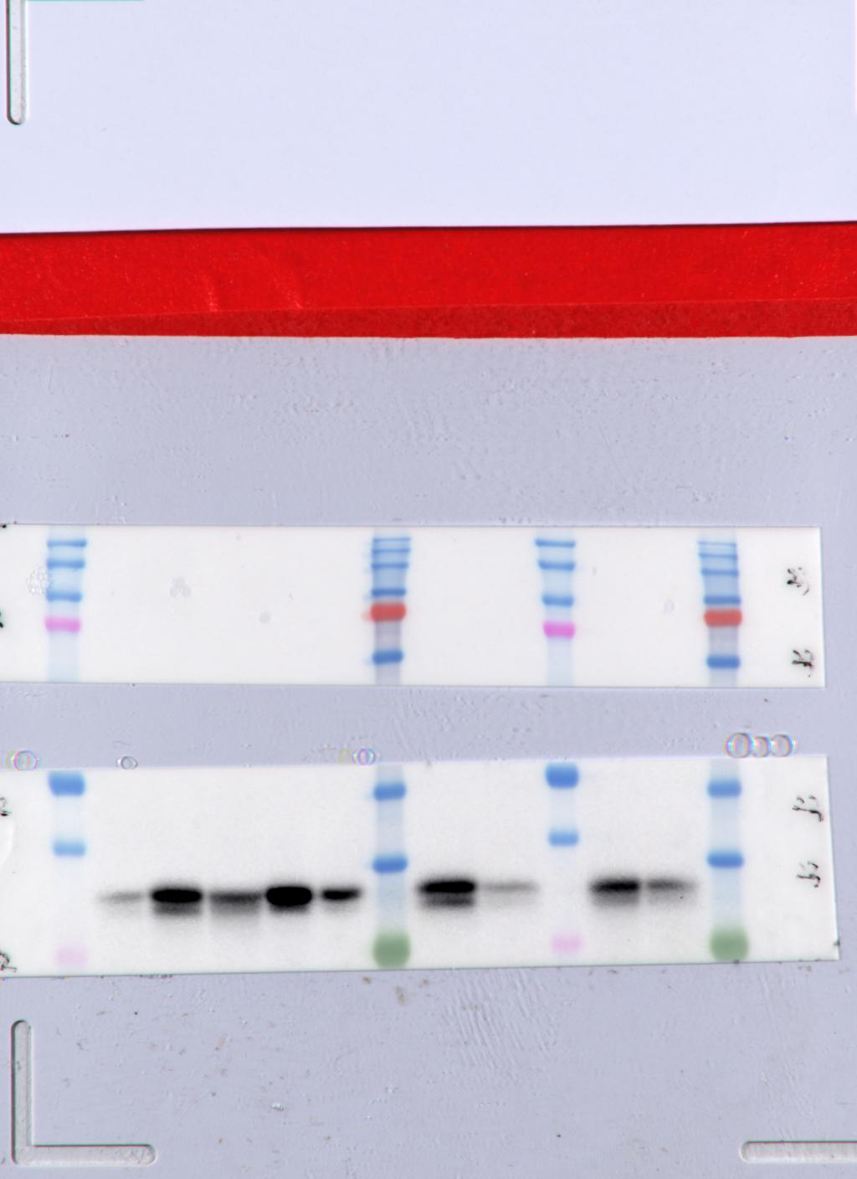
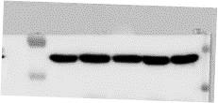

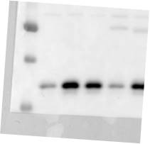

Supplementary Fig.9
A
B
HCT116
A549
H460
MCF7
HT29
Mw
61
PAK2
31
CyclinD3
42
β-actin
C
D
CCD-18Co
HCT116
BEAS-2B
A549
Mw
61
PAK2
31
CyclinD3
42
β-actin

