Slide 1
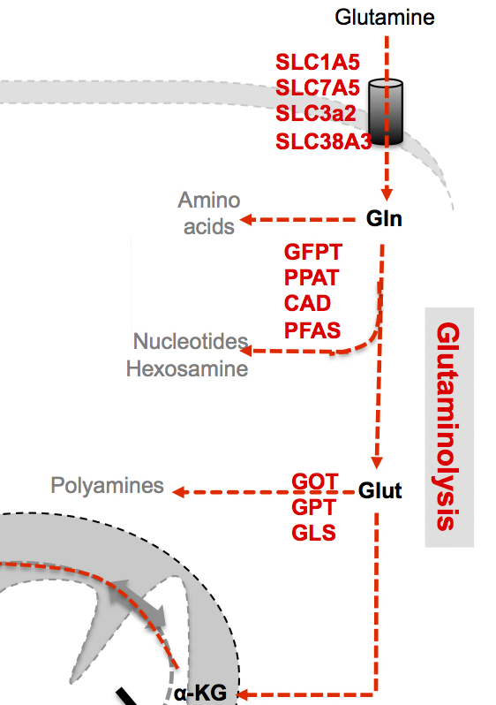
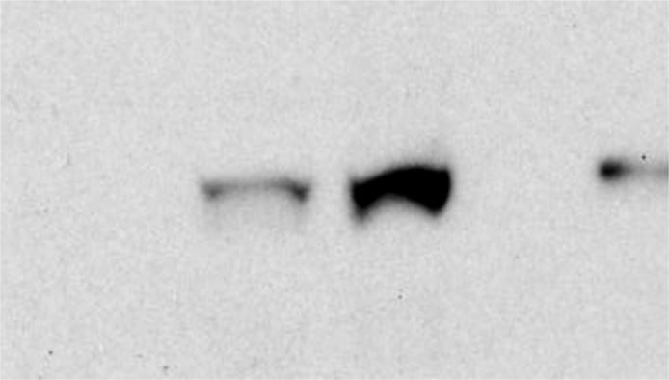
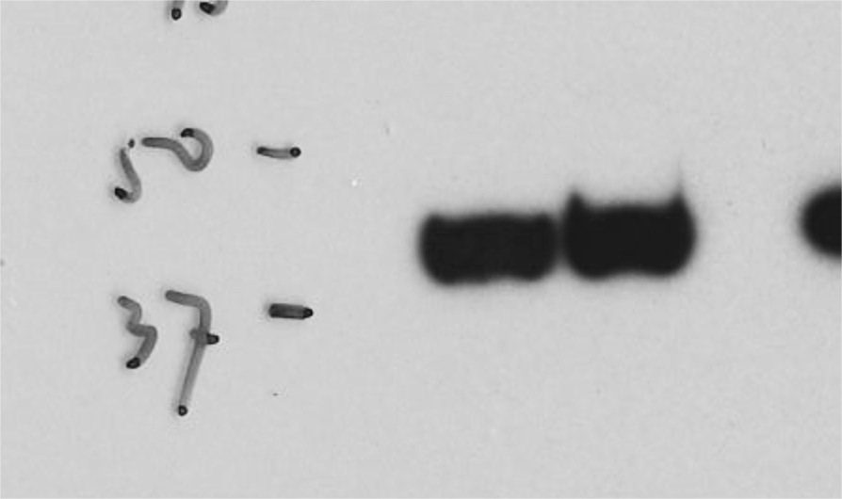
A
B
ns
*
*
*
**
**
*
**
**
**
**
***
D
E
JoMa
*
ns
**
C
ns
*
F
G
***
MycN3
kDa
Dox
ns
MycN
50
37
Actin
Figure S1. MYCN is required for driving glutaminolysis in neuroblastoma.

