Slide 1
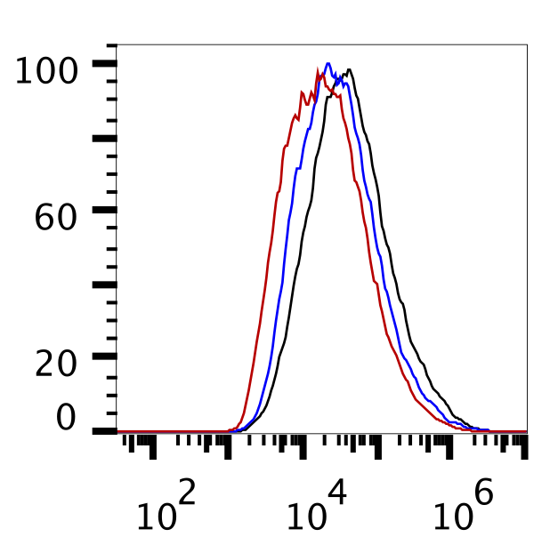
A
B
NB-1643
NB-1643
ns
**
**
***
C
Q+
Q-
JoMa
Q/Don
*
*
Events(% of max)
H₂DCF-DA
Figure S2. Glutaminolysis elevates intracellular ROS and confers sensitivity of NBL cells to ROS augmentation

