Slide 1
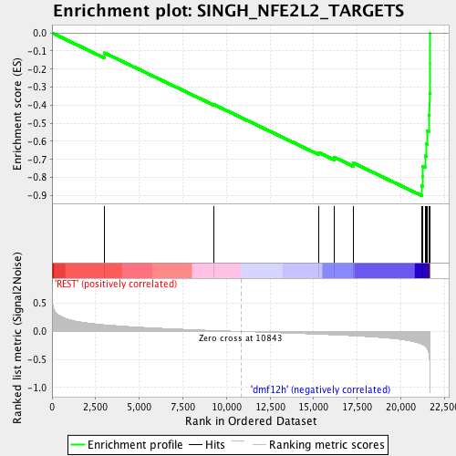
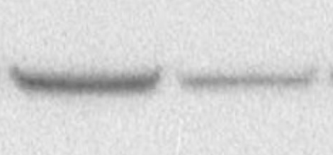
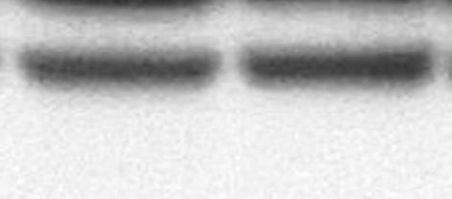
A
B
DMF
(100μM)
DMF
(100μM)
C
*
D
NB-1643
NB-1643
ns
**
*
***
***
***
***
***
E
NB-EBC1
NB-EBC1
Ctrl si
***
kDa
FH si
***
50
FH
37
Actin
Figure S3. Dimethyl fumarate suppresses NBL cell growth.

