Slide 1
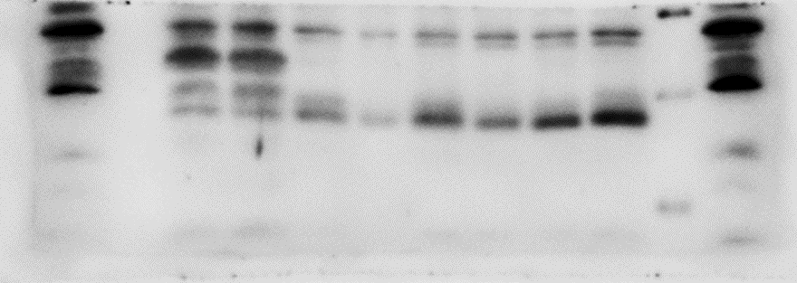
A
Positive control treated with TM
Positive control treated with TM
9 mon BMNCs
magic marker
kDa
NDM
DM
40
ATF6
30
20
db/db
db/db
magic marker
B
EOCs
db/+
db/+
TM
GRP78
78KDa
80KDa
ATF6
36KDa
40KDa
Suppl. Figure 1. (A) Protein levels of ER stress markers in BMNCs measured by western blot analysis (B) EOCs from db/+ and db/db mice were cultured along with a positive control treated with tunicamycin (TM). Protein levels of ER stress markers GRP78 and ATF6 were determined by Western blot analysis.

