Slide 1
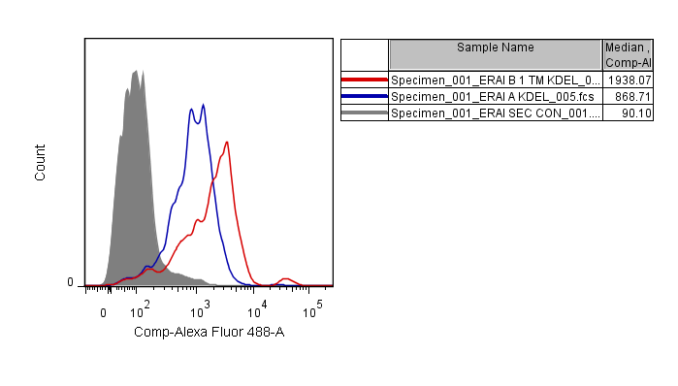
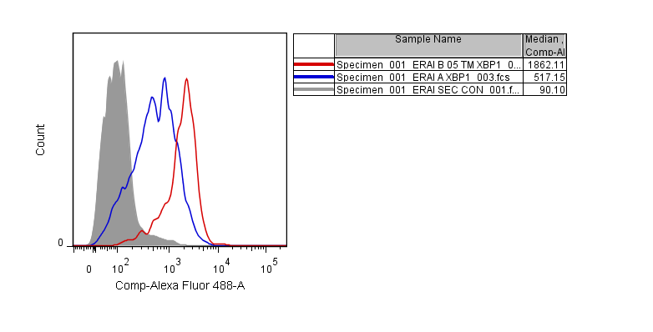
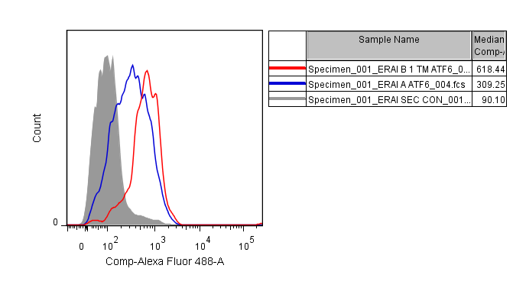
A
GRP78
XBP1
ATF6
# c-Kit+ cells
B
GRP78
XBP1
ATF6
Suppl. Figure 2. (A) Flow cytometric analysis of ER stress in c-Kit expressing BM cells treated with TM (1µg/ml) for 16 hours. This cell population represents the hematopoietic progenitor cell fraction. (B) Quantification of quantified Median Fluorescence intensity (MFI)

