Slide 1
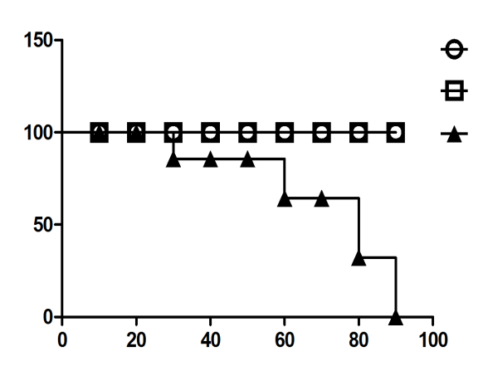
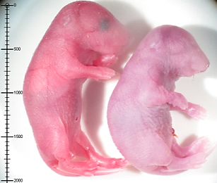


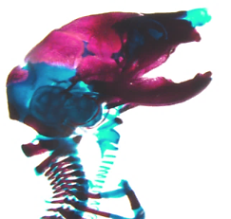
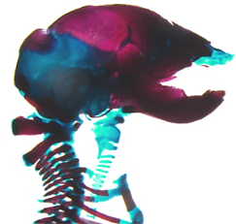
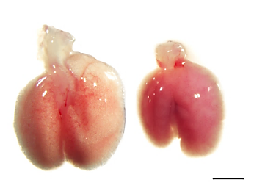
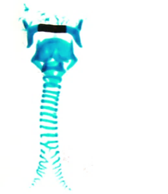
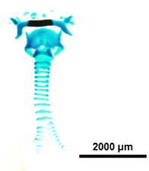
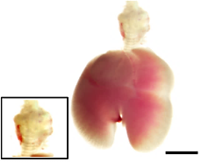
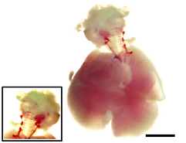
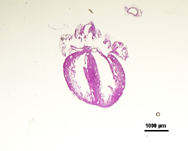
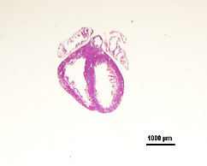
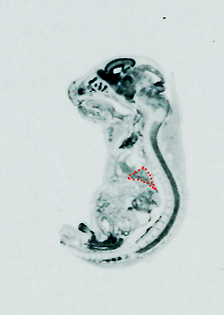
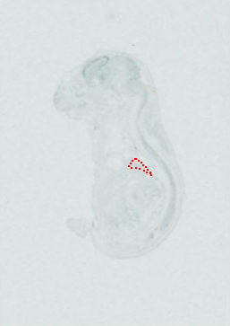
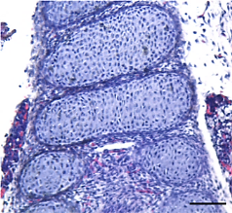
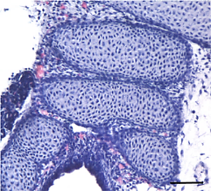
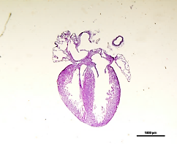
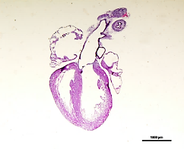


Moon_Figure S1
a
b
c
d
WT Asxl1^{-/-}
#1
#2
Survival rate at P0
WT
Fold mRNA expression
Asxl1^{+/-}
WT Asxl1^{-/-}
WT Asxl1^{-/-}
Survival rate (%)
Asxl1^{-/-}
α-Asxl1
170kDa
*
**
α-β-actin
***
Survival time (min)
e
f
g
WT Asxl1^{-/-}
Body
Lung
Lung/Body
WT Asxl1^{-/-}
Lung weight (g)
Lung/Body weight
Body weight (g)
***
*
**
P0 Asxl1^{-/-} Trachea
WT +/- -/-
WT +/- -/-
WT +/- -/-
h
WT Asxl1^{-/-}
i
WT Asxl1^{-/-}
j
E18.5 WT E18.5 Asxl1^{-/-}
E18.5 Asxl1^{-/-} Trachea
E18.5 Asxl1^{-/-} Heart

Slide 2
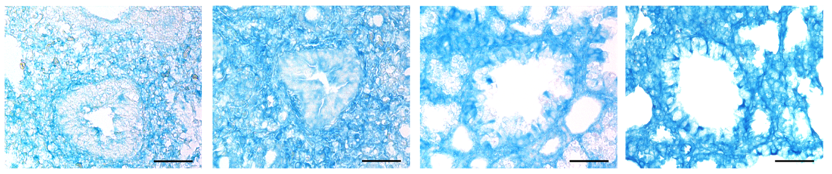
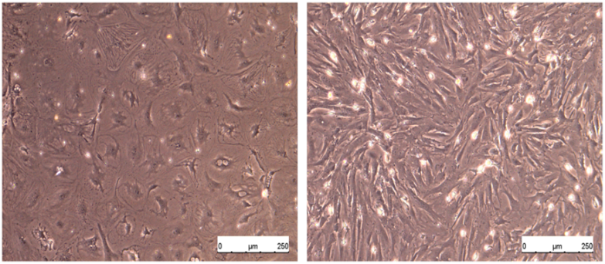
Moon_Figure S1
k
E14.5 E16.5 E18.5 P0
Asxl1^{-/-}
l
m
Asxl1
Ccsp
Vimentin
Epithelium
Mesenchyme
Normalized mRNA expression
**
**
E18.5 WT
Epithelium
Mesenchyme

Slide 3
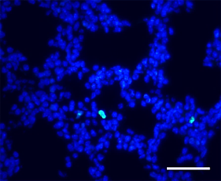
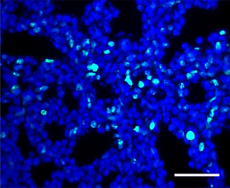
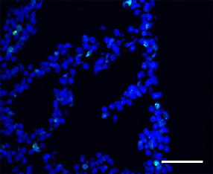
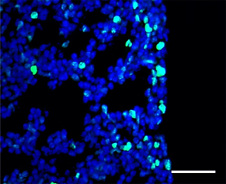
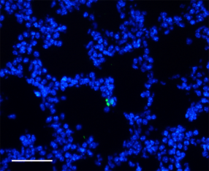
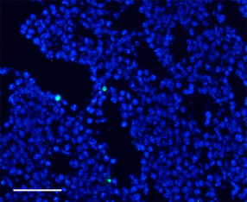
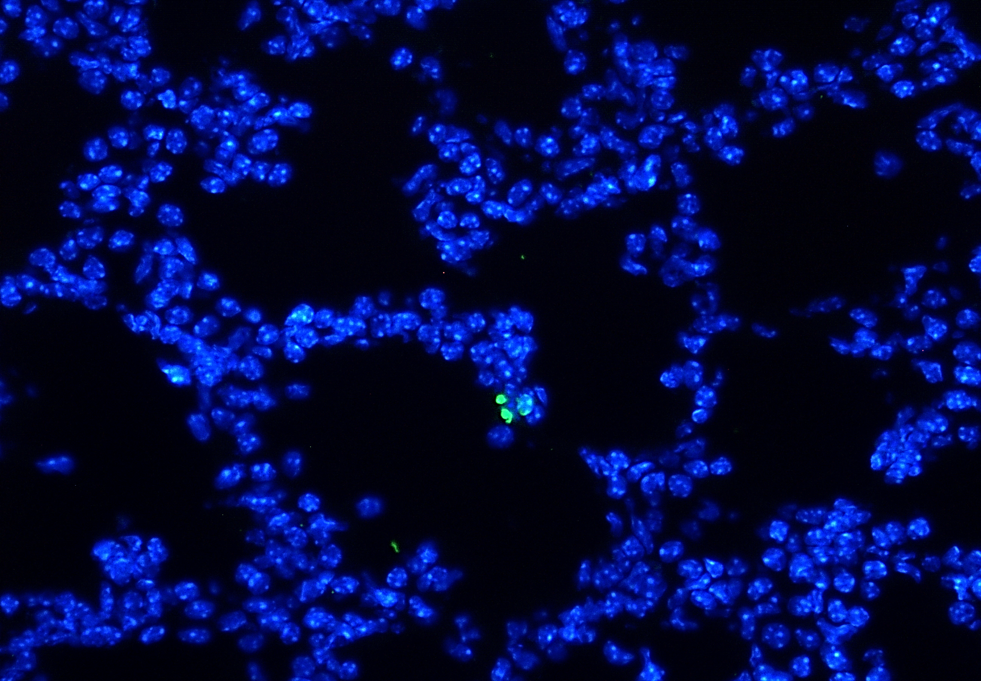
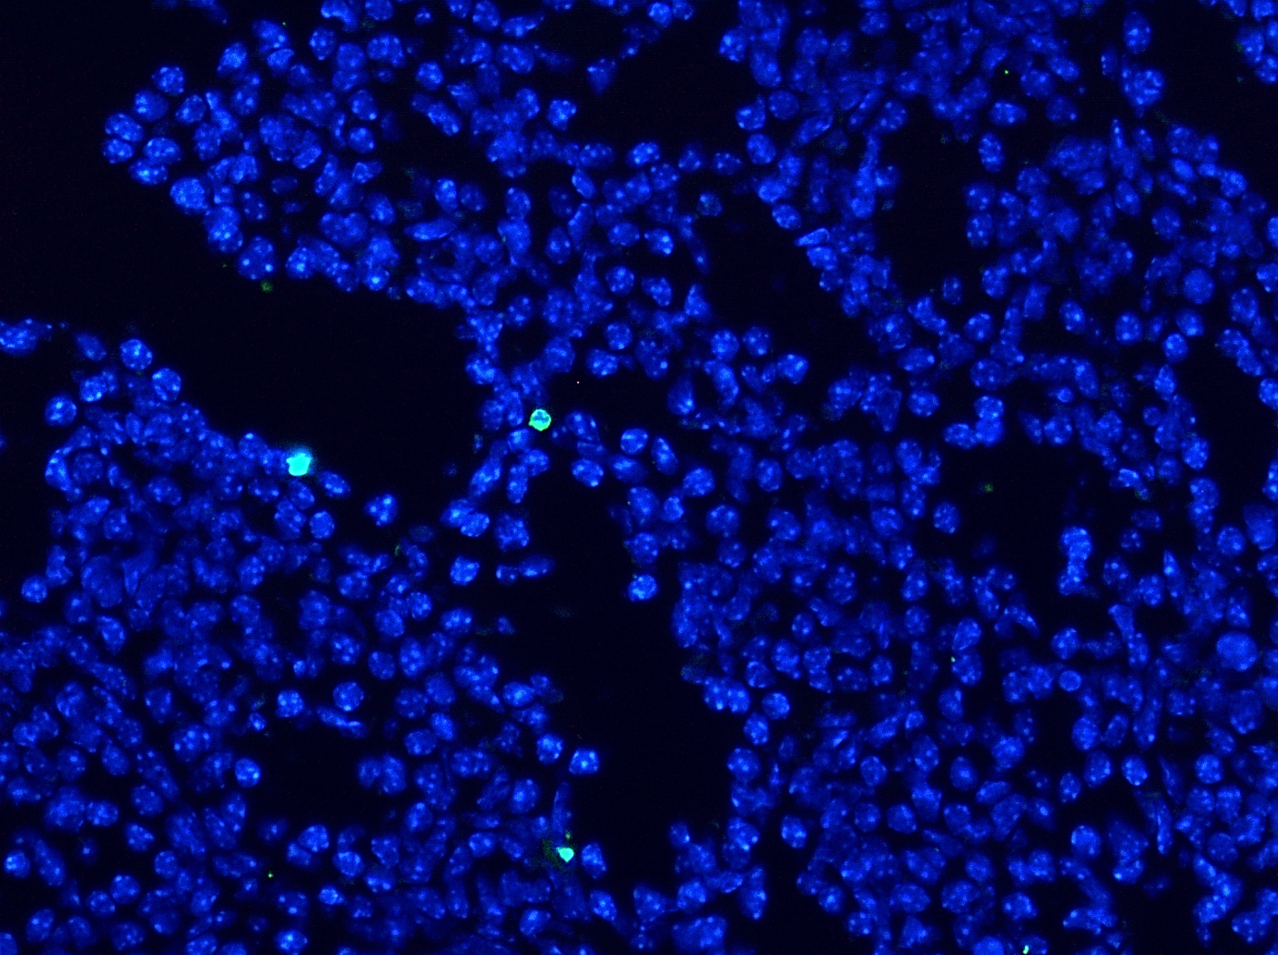
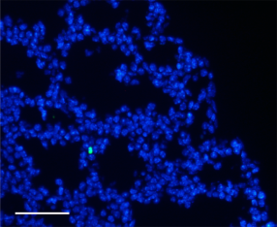
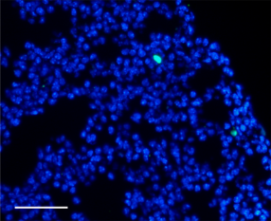
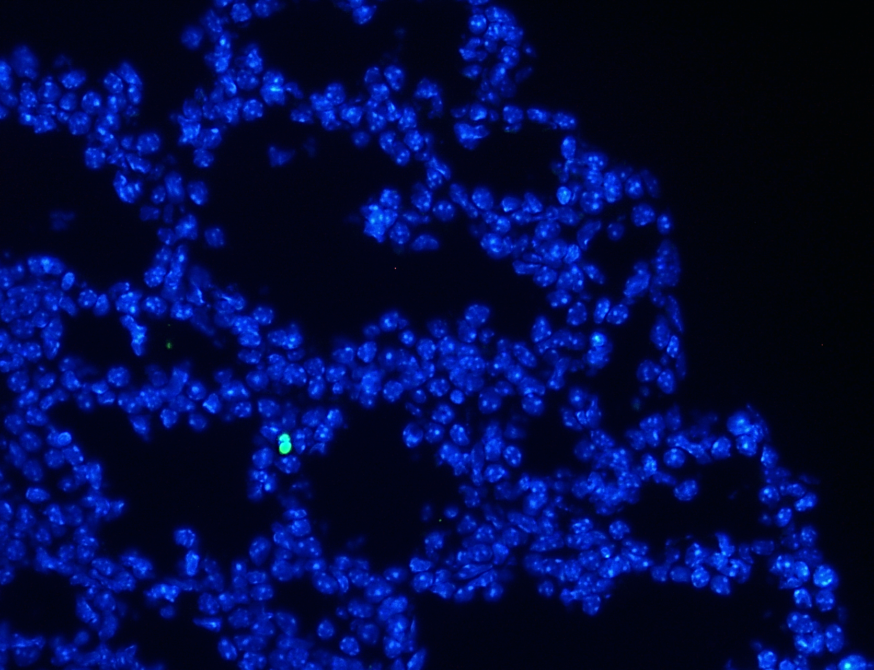
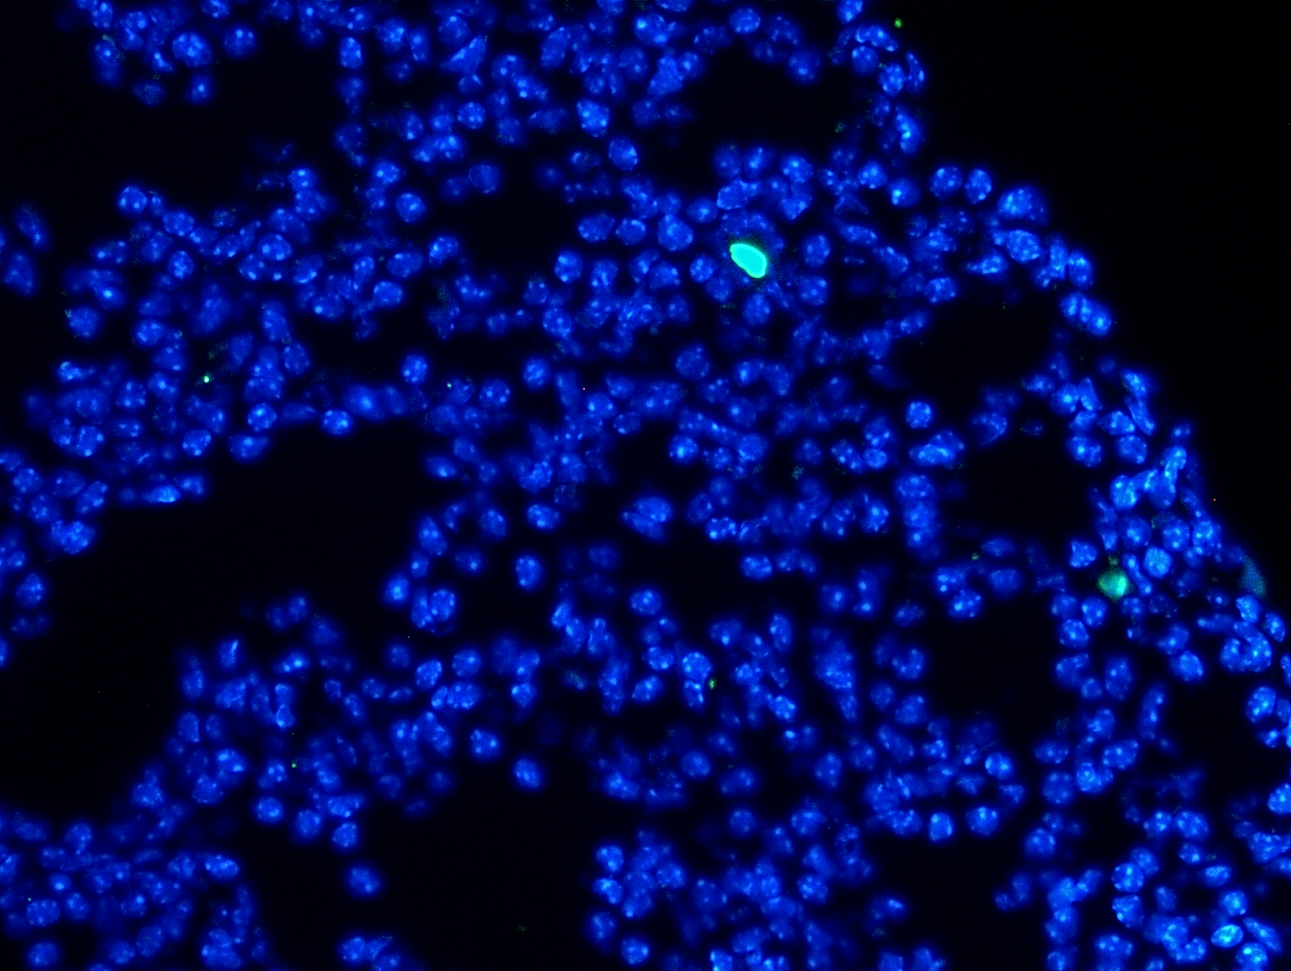
Moon_Figure S2
a
b
E18.5 WT E18.5 Asxl1^{-/-}
Proximal Distal
Ki-67 positive cell (%)
*
*
Distal Proximal
Ki-67 staining
WT Asxl1^{-/-}
WT Asxl1^{-/-}
c
d
E18.5 WT E18.5 Asxl1^{-/-}
Proximal Distal
TUNEL positive cell (%)
Distal Proximal
TUNEL staining
WT Asxl1^{-/-}
WT Asxl1^{-/-}

Slide 4
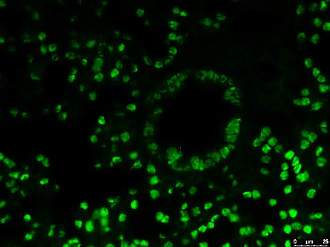
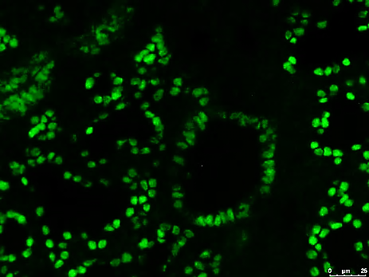
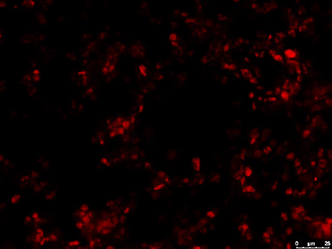
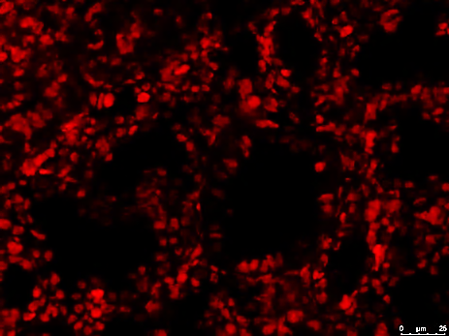
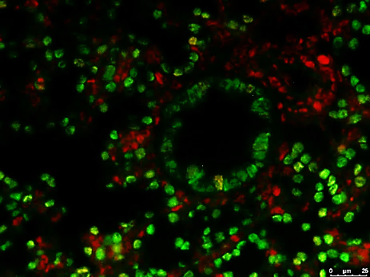
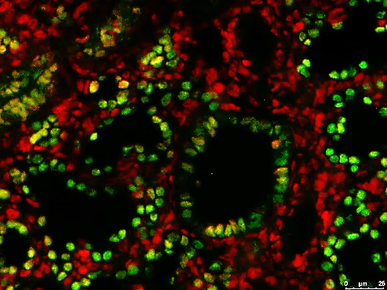
Moon_Figure S2
e
E18.5 WT
E18.5 Asxl1^{-/-}
f
Ccsp mRNA expression at P0
(normalized to GAPDH)
Nkx2.1
*
PCNA
WT Asxl1^{-/-}
Merge

Slide 5
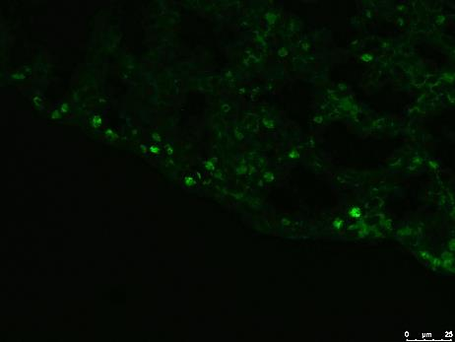
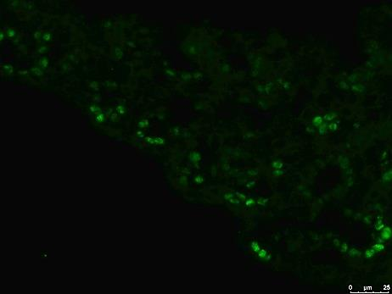
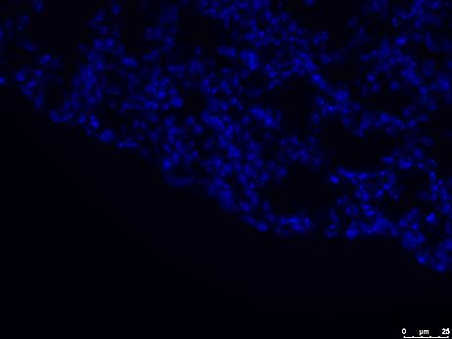
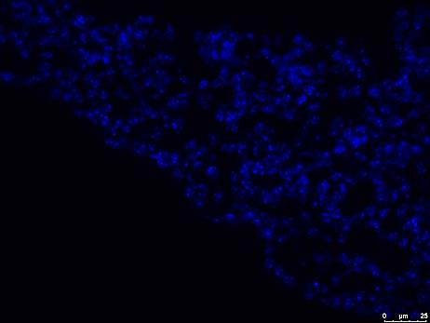
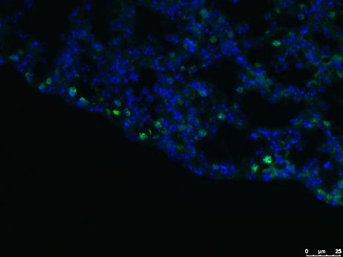
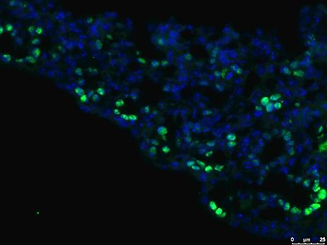
Moon_Figure S2
g
h
E18.5 WT
E18.5 Asxl1^{-/-}
Sox9 mRNA expression at E18.5
(normalized to GAPDH)
*
Sox9
Hoechst
WT Asxl1^{-/-}
Merge

Slide 6
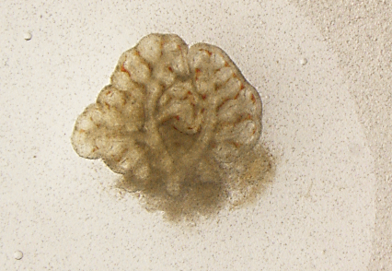
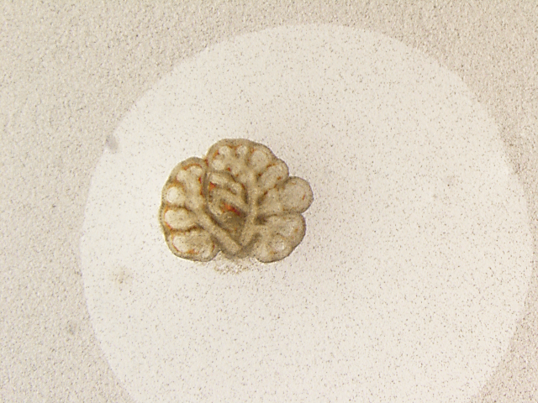
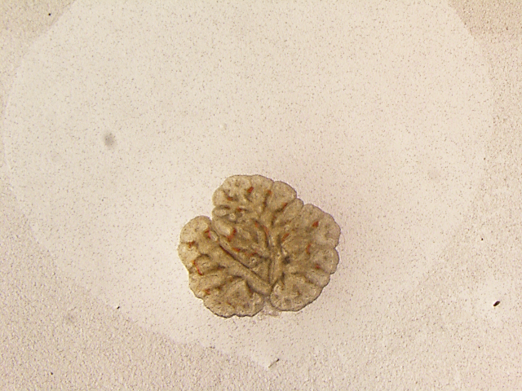
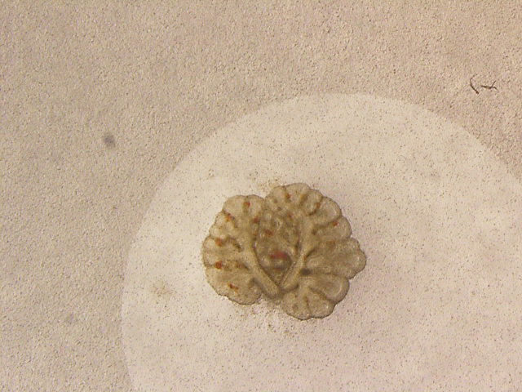
Moon_Figure S2
i
j
Lung organ culture at E10.5
Lung organ culture at E12.5
+/-
-/-
WT
Asxl1^{-/-}
0h
0h
+/-
+/-
24h
+/-
-/-
24h
+/-
+/-

Slide 7
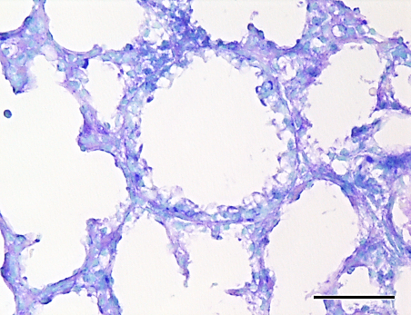
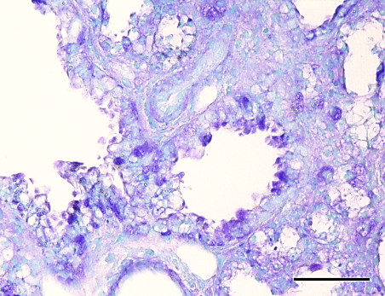
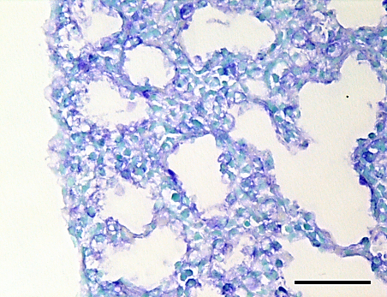

Moon_Figure S3
a
E18.5 WT E18.5 Asxl1^{-/-}
Proximal
400x
Distal
400x
b
Proximal Distal
PAS positive cell (%)
**
*
WT Asxl1^{-/-}
WT Asxl1^{-/-}

Slide 8



Moon_Figure S4
a
b
c
% of Total Significant
Nominal p-value 0.0052
FDR q-value 0.229
Nominal p-value 0.0
FDR q-value 0.0
d
e
A549
f
A549
g
Fold mRNA expression
*
Fold mRNA expression
***
Fold mRNA expression
Nominal p-value 0.0
FDR q-value 0.06527056
*
*
*
*
*
*
*
**
**
**
**
**
**
Cdca3
Cdk7
Ccnb1
ASXL1
E2F1
NMYC
NMYC
CDC6
CDK7
Cdc45
Cdc25c
CCNA2
CCNA2
CCNE1
CDCA3
CDC25A
CDC25A

Slide 9
Moon_Figure S4
h
Sftpa
Sftpb
Sftpc
***
***
***
mRNA expression
(Normalized to GAPDH)
**
***
***
E14.5 E16.5 E18.5
E14.5 E16.5 E18.5
E14.5 E16.5 E18.5

Slide 10
Moon_Figure S5
a
b
E2F1 site
E2F1 site
F/L
-3.2 Kb
LUC
**
-753 bp
LUC
(D6 WT)
**
Fold Luc activity
-753 bp
LUC
(D6 MT)
**
AAATGGCTTTTGGCGCGAAAGGC
AAATGGCTTTTGTCGAGAAAGGC
mAsxl1 -
c
A549
d
H460
***
**
**
% of Input
% of Input
**
**
**
CDC6
CCNA2
CDC25A
CDC6
CCNA2
CDC25A

Slide 11










Moon_Figure S6
a
IP
IgG α-Asxl1
b
IP
IgG α-ASXL1
Input
(8%)
Input
(8%)
WB:
α-Asxl1
WB:
α-ASXL1
170kDa
170kDa
α-HCF-1
170kDa
α-HCF-1
170kDa
130kDa
130kDa
95kDa
95kDa
E18.5 lung
A549 cells
c
d
ASXN ASXM NR box PHD
Cleavage sits
Kelch Basic Acidic Fn3Rep
mAsxl1
hHCF-1
1 86 250 361 520 648 1082 1087 1481 1514
1 380 478 875 1530 1735/1800 2035
(1-370)
(1-434)
(371-655)
(435-1011)
GFP fusions
(656-1192)
Myc fusions
(1436-2035)
(1193-1514)
e
Input (1%)
IP : Flag
GFP-Asxl1(1193-1514)
GFP-Asxl1(1193-1514)
GFP-Asxl1(656-1192)
GFP-Asxl1(656-1192)
GFP-Asxl1(371-655)
GFP-Asxl1(371-655)
GFP-Asxl(1-370)
GFP-Asxl1(1-370)
WB:
α-GFP
GFP
GFP
130kDa
95kDa
*
70kDa
α-Flag
56kDa
*

Slide 12
Moon_Figure S6
f
g
H460
A549
**
***
**
**
% of Input
**
% of Input
CDC25A
CCNA2
CDC6
Flag-: Mock HCF-1
(1-434)
Flag-: Mock HCF-1
(1-434)

Slide 13


Moon_Figure S7
a
c
GSE3141
GSE31210
High ASXL1
Nominal p-value 0.0
FDR q-value 0.0
Low ASXL1
Survival rate
High ASXL1
Survival rate
Low ASXL1
P<0.00585
P<0.0278
Month
Month
b
d
High ASXL1 (GSE3141)
High ASXL1 (GSE31210)
Low NMYC
Nominal p-value 0.0
FDR q-value 0.002435
Low NMYC
High NMYC
Survival rate
High NMYC
Survival rate
P<0.00583
P<0.000359
Month
Month

