Slide 1
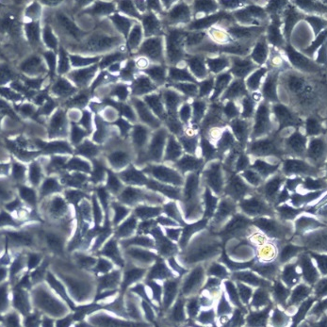
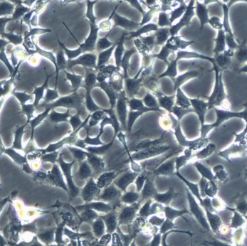
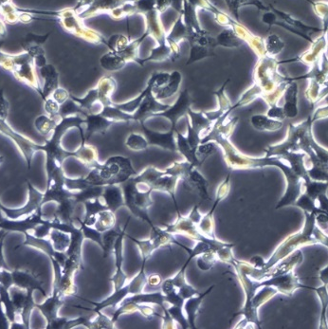
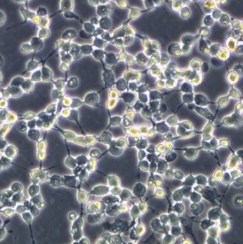
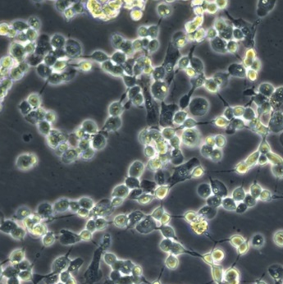

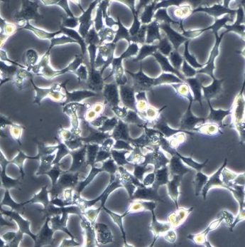
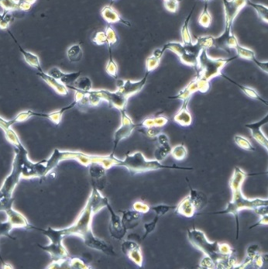
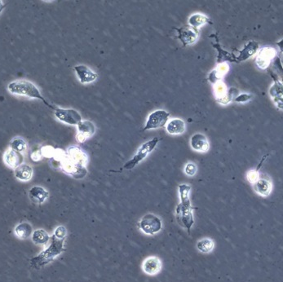
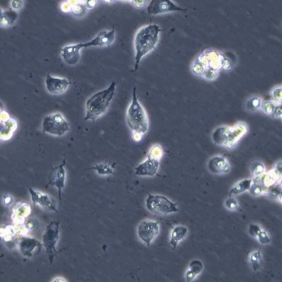
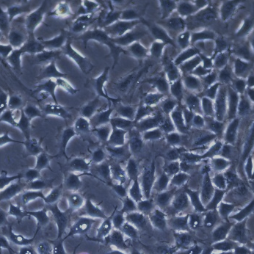
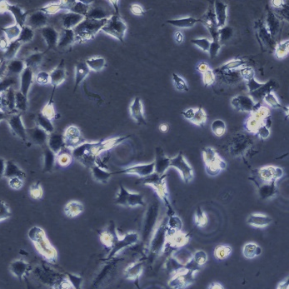
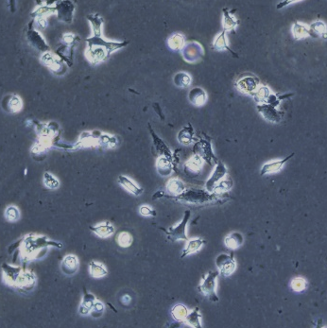
Supplementary Figure 1.
a
H9c2, RSL3
Untreated
0.5 μM
1 μM
5 μM
10 μM
3h
5h
b
H9c2, DMEM (-Cys)
0 h
36 h
48h

Slide 2
Supplementary Figure 2.
a
b
Non
DMM
siNTpool
*
siACSL4pool
***
**
*
RSL3 (μM)
RSL3 (uM)

Slide 3
Supplementary Figure 3.
a
b
c
RSL3 (μM)
RSL3 (μM)

