Slide 1
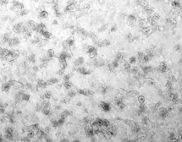
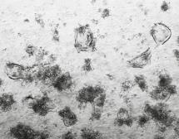
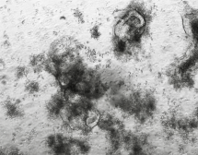
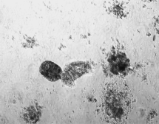
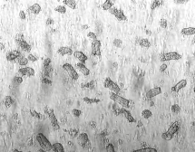
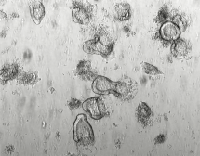
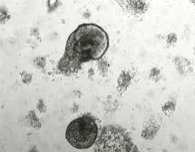
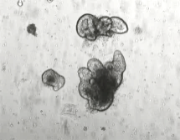
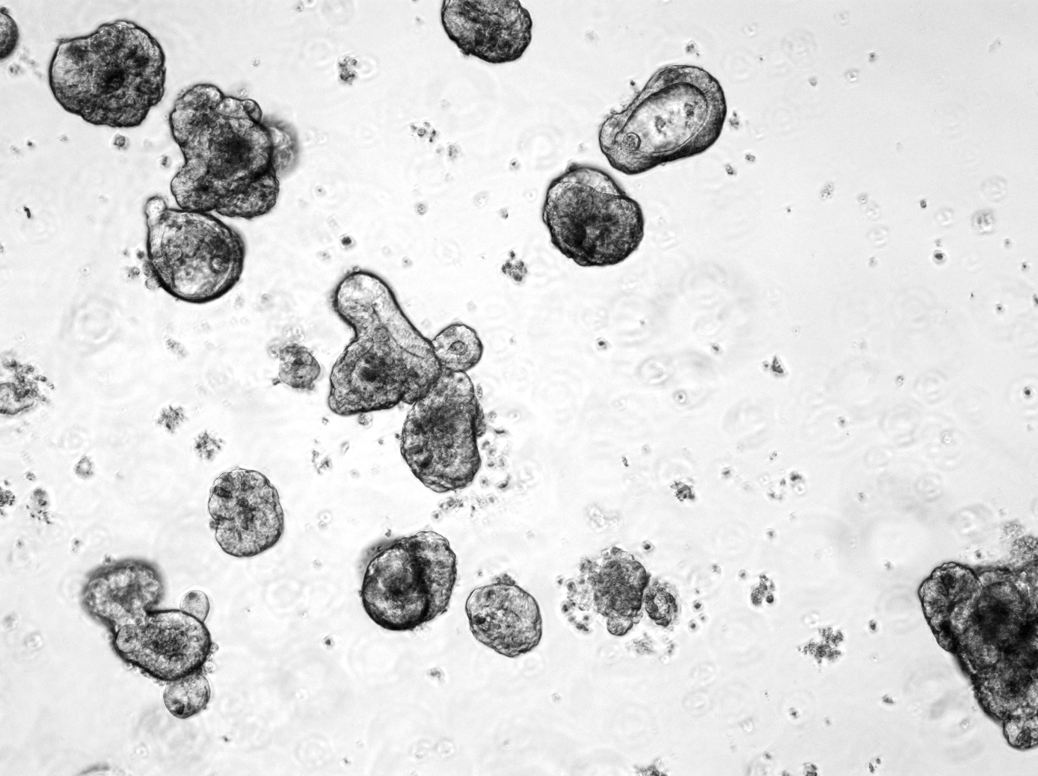
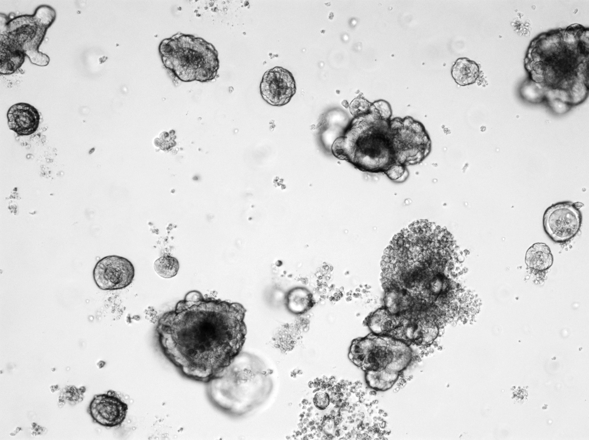
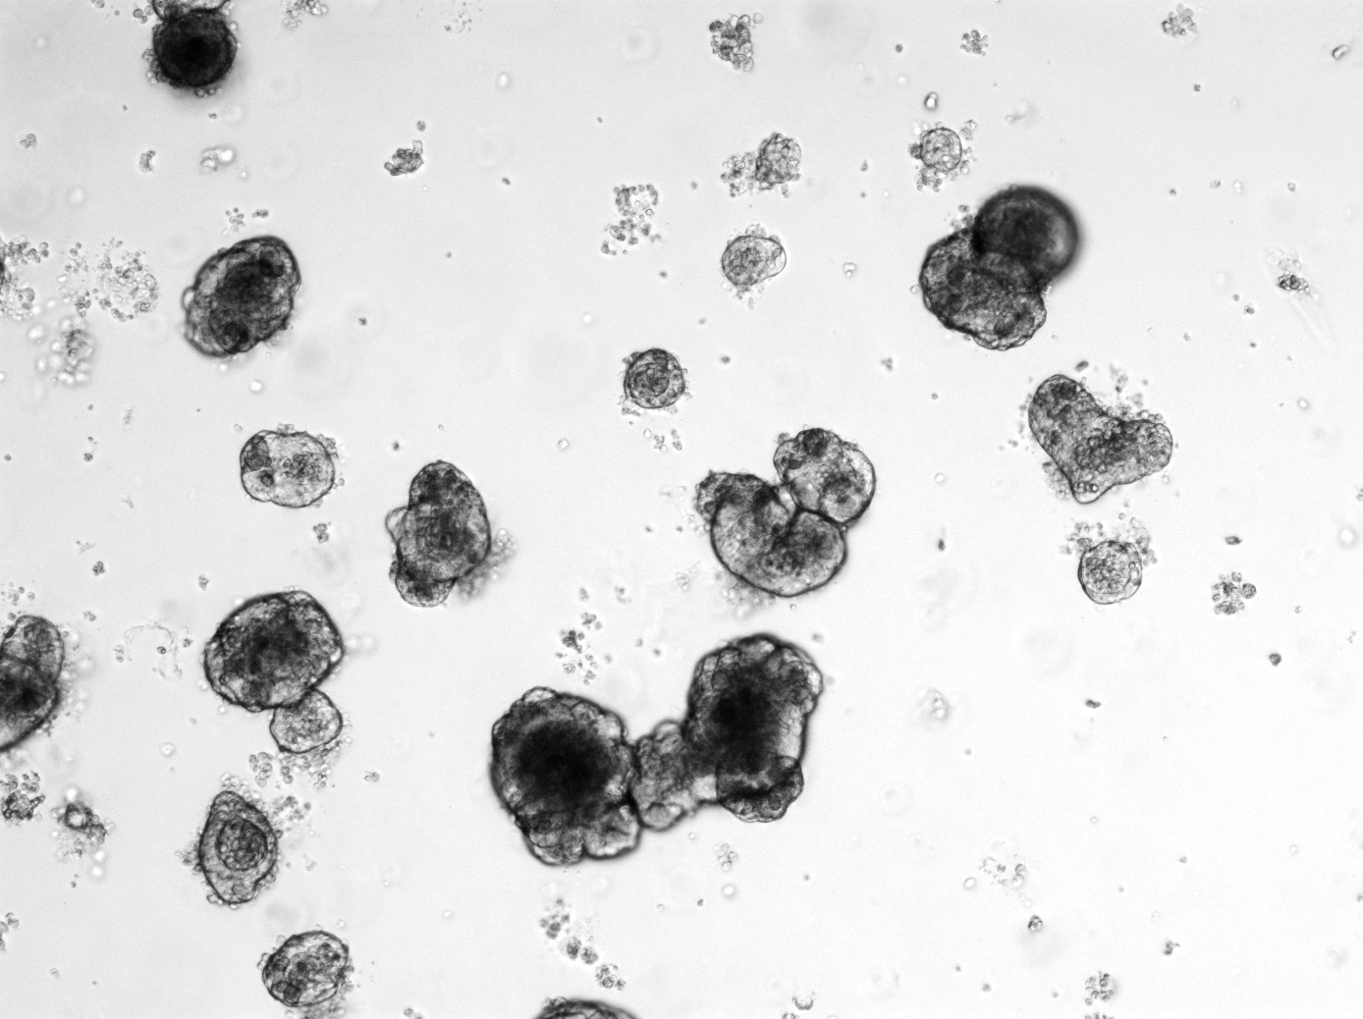


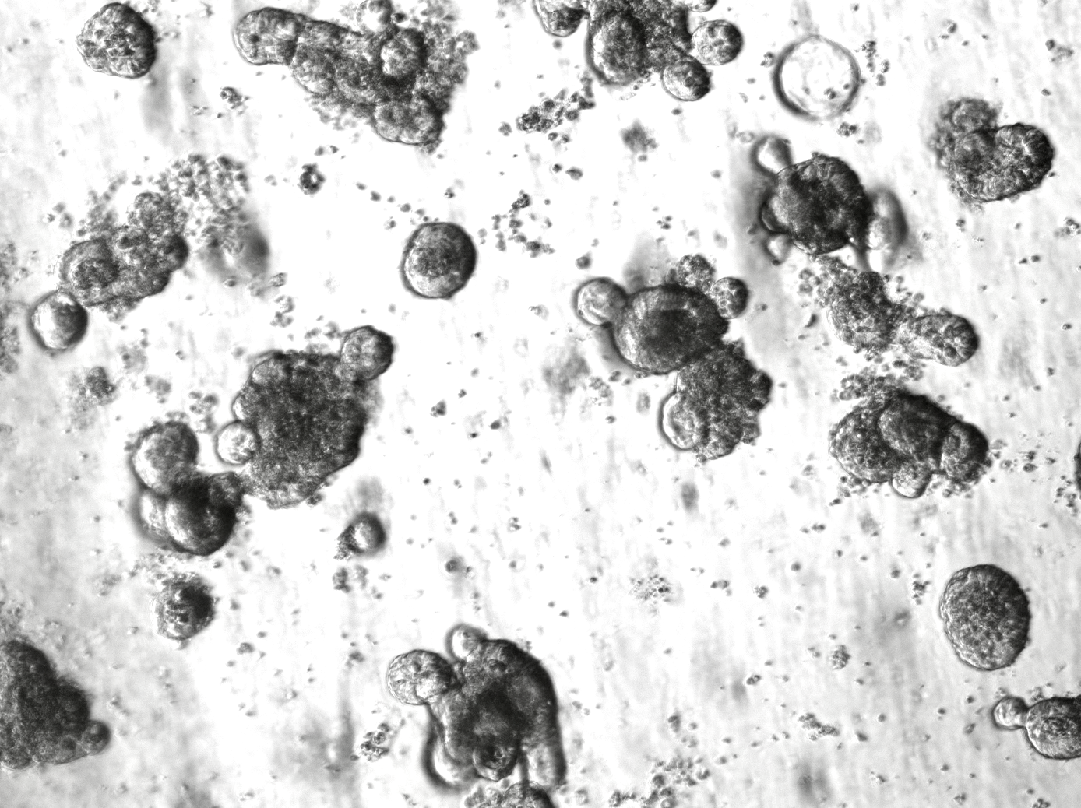
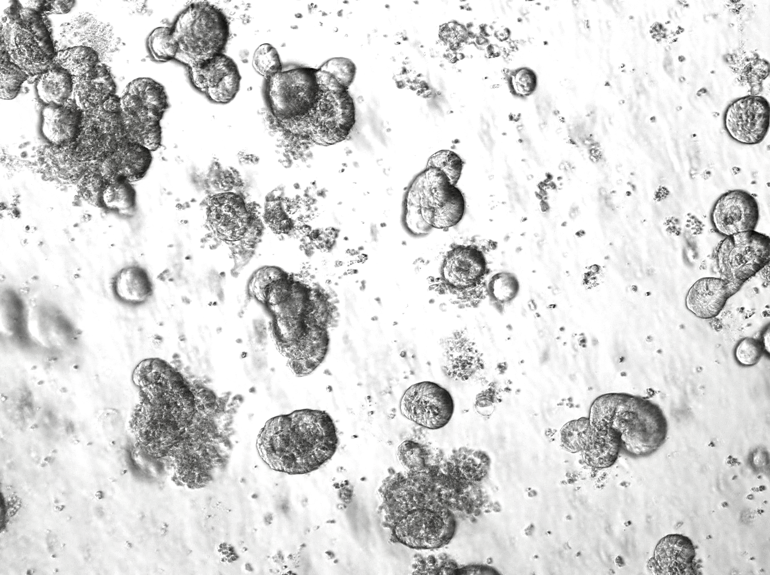
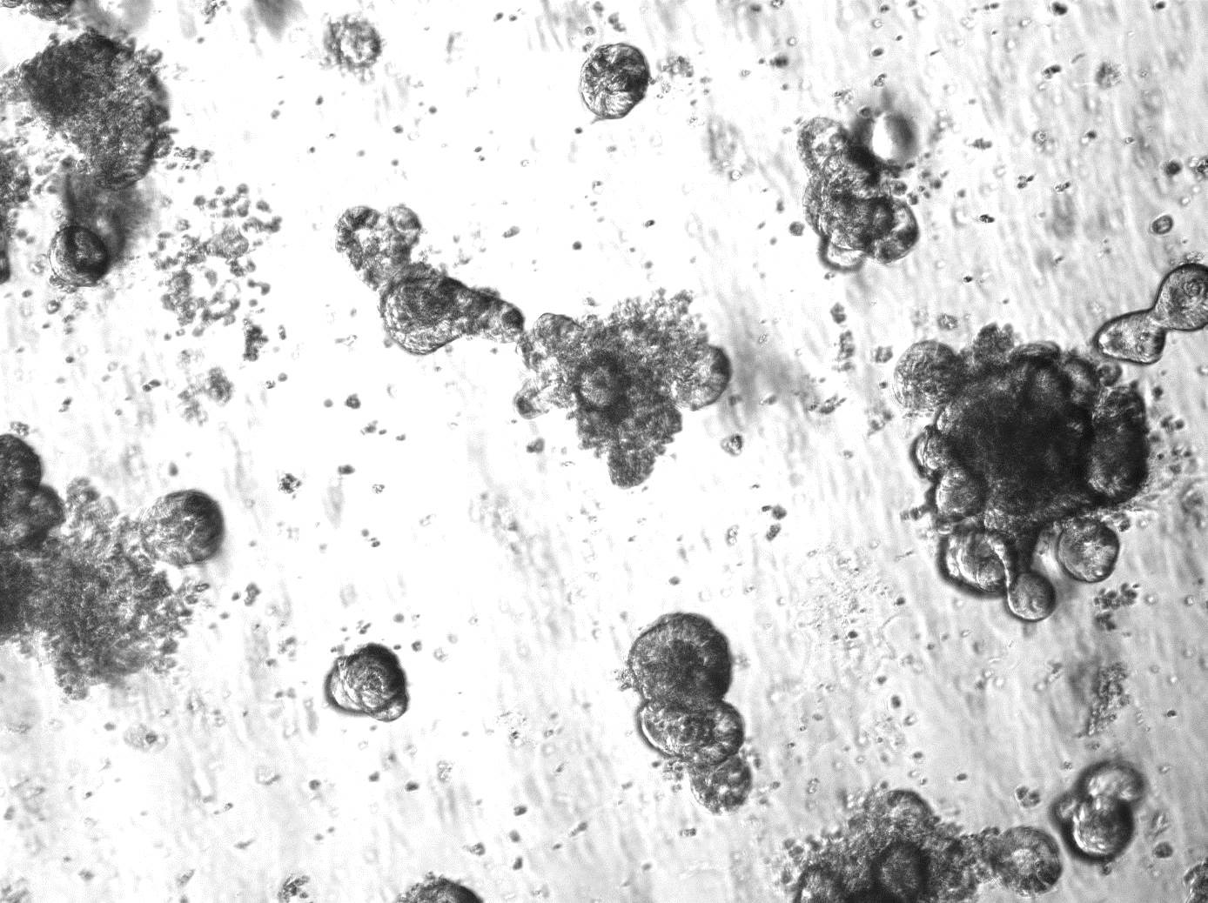






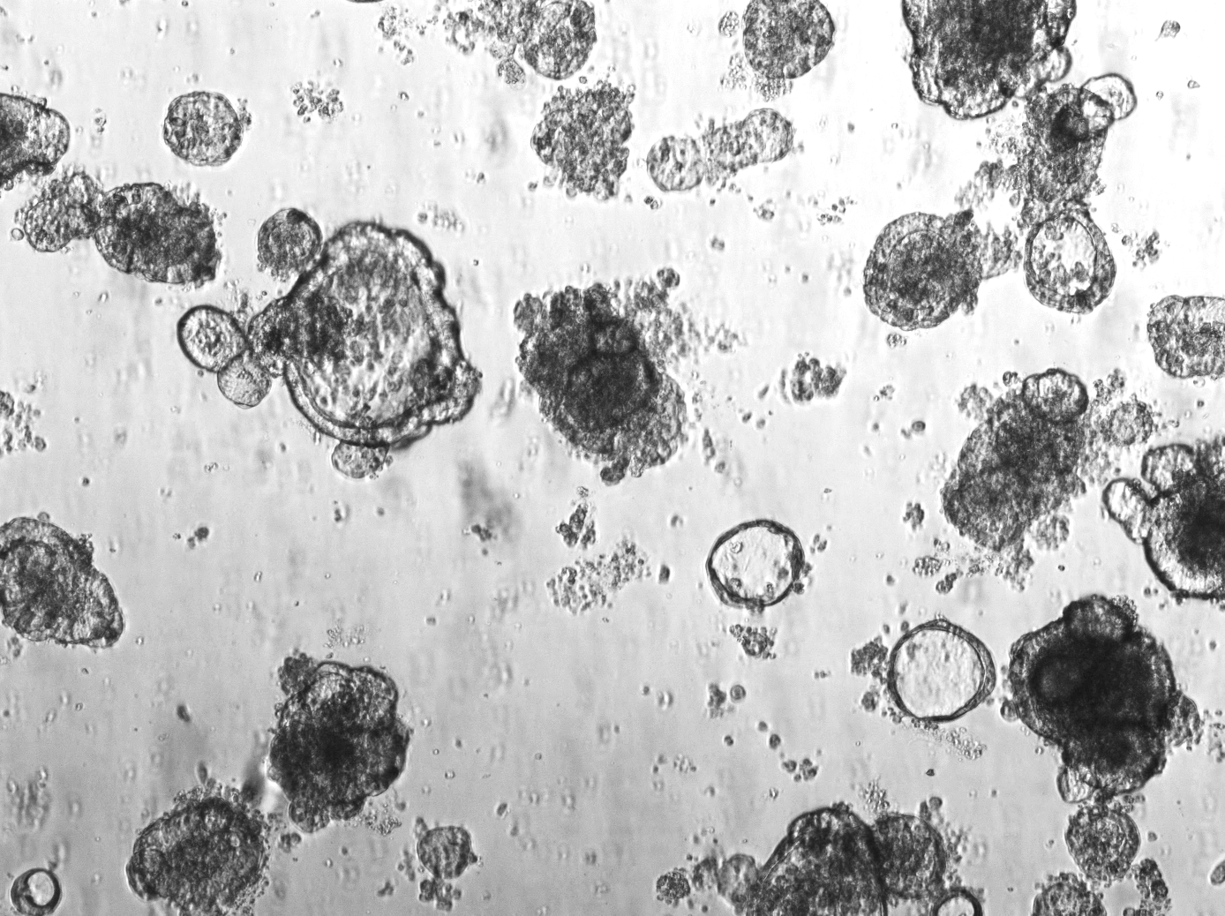
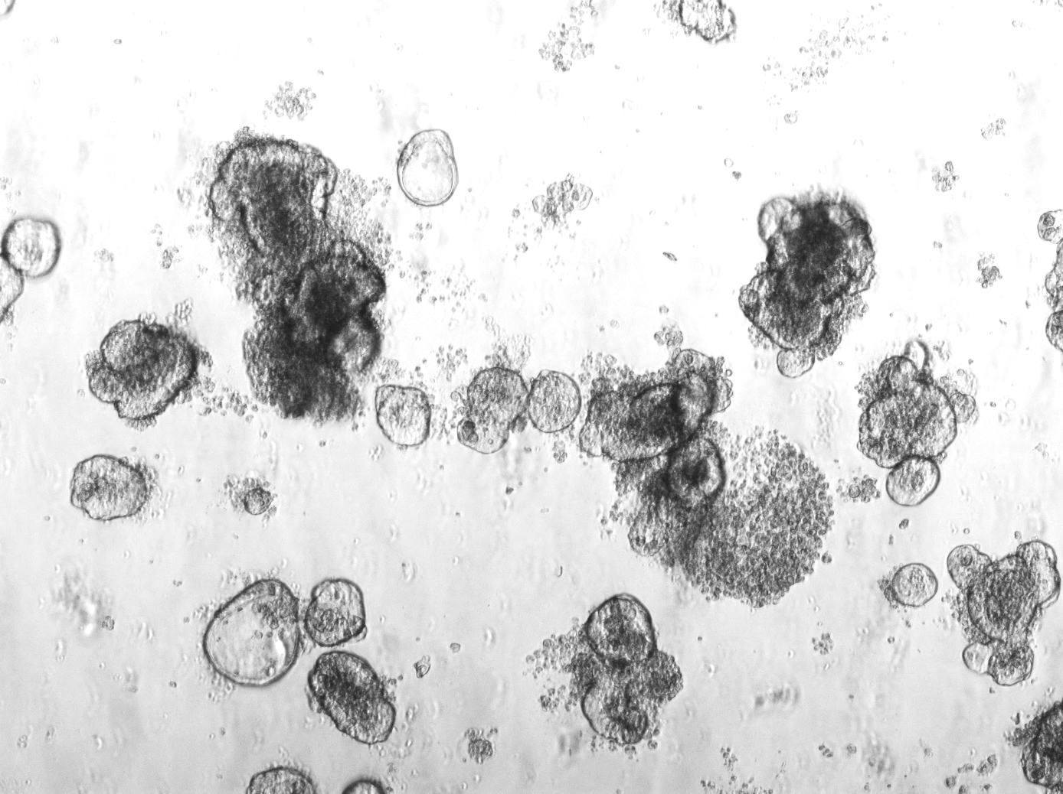
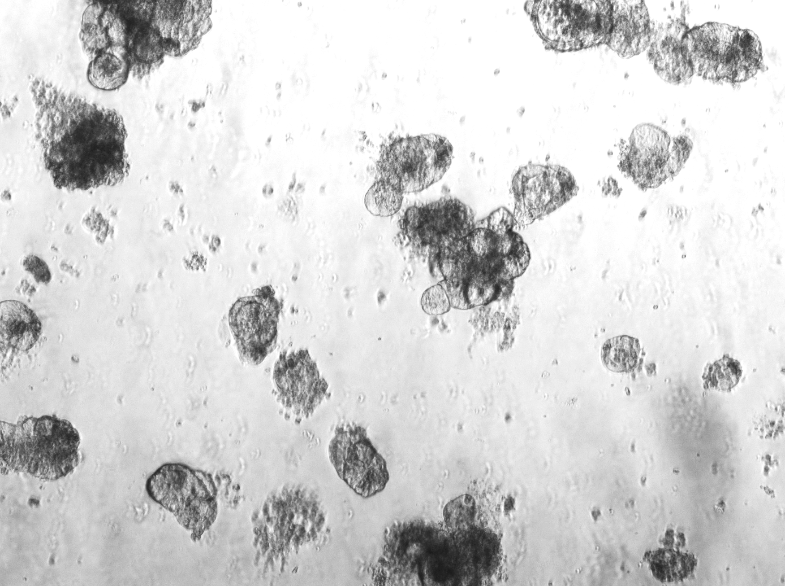
A
d 0
after preparation (p 0)
after splitting (p 1)
d 2
d 6
d 3
129S1/SvImJ
C57BL/6
B
murine small intestine
C
17AAG
murine small intestine
con
250 nM 17AAG
500 nM 17AAG
17AAG
ns
250 nM
**
con
500 nM
dead organoids [%]
kDa
12
Mif
con
42
Actin
500 nM
250 nM
con
30 nM Ganet
60 nM Ganet
Ganetespib
Ganetespib
30 nM
ns
con
60 nM
ns
kDa
Mif
dead organoids [%]
12
90
Stat3
con
42
Actin
60 nM
30 nM
Mif/Actin
1 0.9 0.7
con
200 nM Onalespib
400 nM Onalespib
Onalespib
ns
dead organoids [%]
ns
con
200 nM
400 nM
Supp Figure 5
Notes:
Figure S6: Related to Figure 7. MIF is an actionable and selective therapeutic target by HSP90 inhibition in colorectal cancer-derived organoids.
Representative images to evaluate growth and development of normal colonic organoids from two different mouse strains (129S1/SvImJ and C57Bl/6). Images were taken at day of organoid preparation (d 0) as well as two (d 2) and six (d 6) days after preparation (p 0=passage 0). Additional image taken three (d 3) days after splitting (p 1=passage 1). Scale bars, 200µm.

