Slide 1
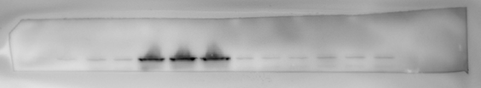
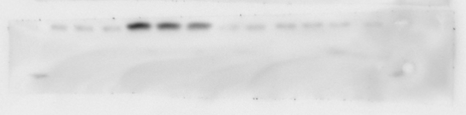
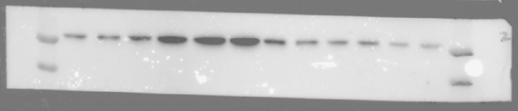





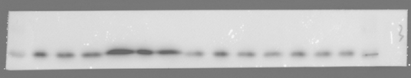
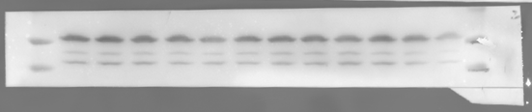

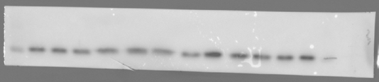
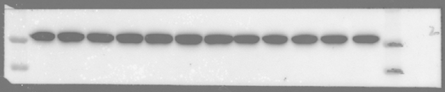
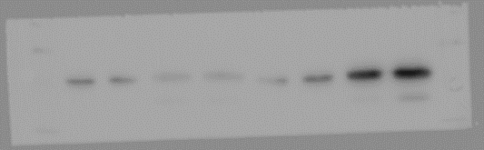

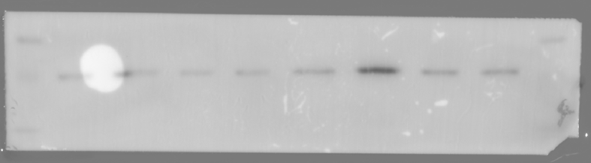

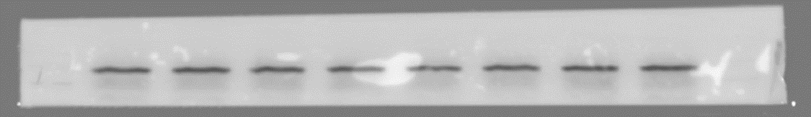

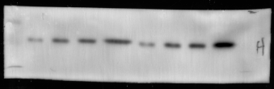
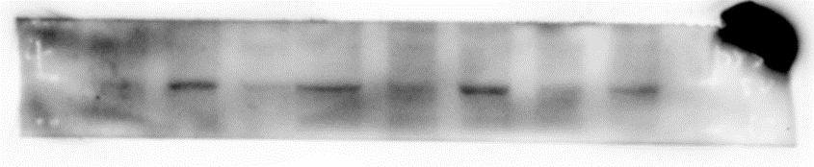




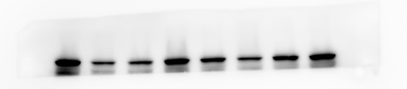


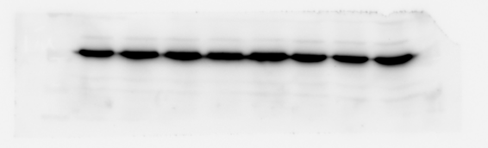

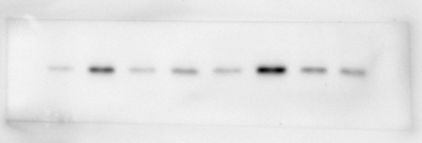
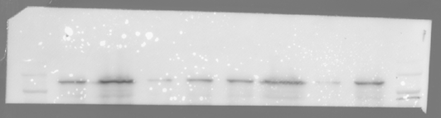




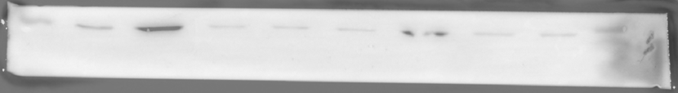
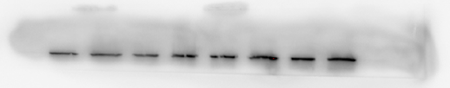



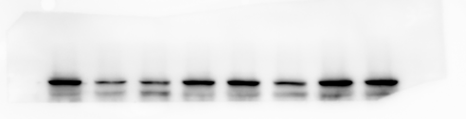
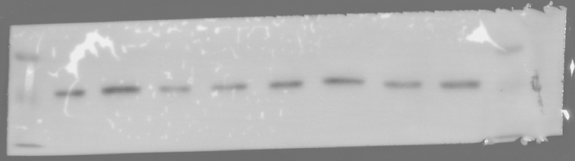
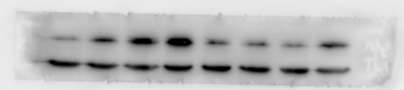
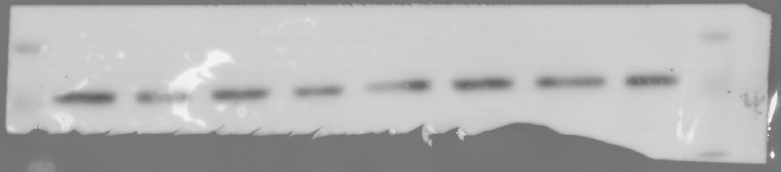

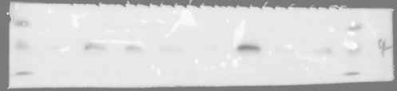
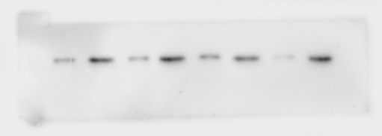

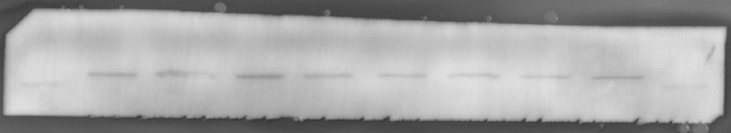


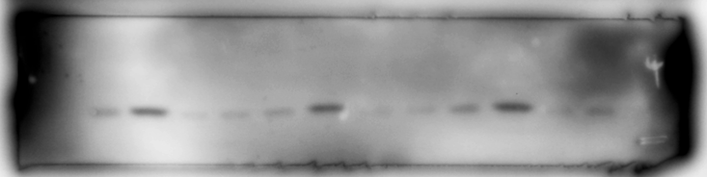

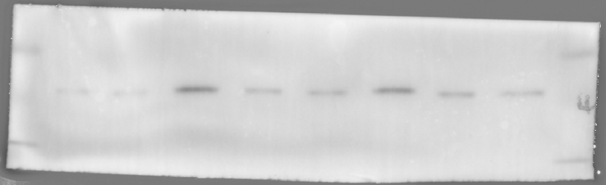
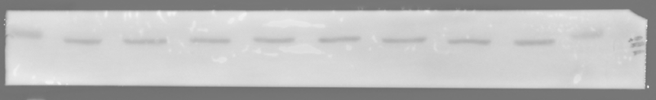
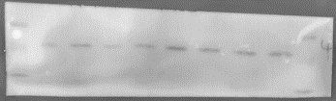

Figure 1E
Figure 2D
Figure 2G
MLL1
-150
NGAL
-25
p-p53
-50
WDR5
-37
p53
-75
GAPDH
-37
C-cas3
-15
GAPDH
-37
H3K4me3
-15
GAPDH
-37
Histone H3
E-cadherin
-100
-15
α-tubulin
-50
Figure 3A
Figure 3E
Figure 3L
-20
MLL1
-150
C-cas3
-20
C-cas3
WDR5
-37
p-p53
-50
-20
β-actin
-37
p53
-50
H3K4me3
p-p53
-50
E-cadherin
-100
Histone H3
-20
p53
-50
α-tubulin
-50
E-cadherin
-100
α-tubulin
-50
α-tubulin
-50
Figure 3P
Figure 4D
Figure 4F
MLL1
-150
C-cas3
-15
MLL1
-150
α-tubulin
-50
WDR5
-37
WDR5
-37
H3K4me3
-15
p-p53
-50
Histone H3
-20
p53
-50
α-tubulin
-50
α-tubulin
-50
H3K4me3
-20
E-cadherin
-100
α-tubulin
Histone H3
-20
-50
Figure 4H
Figure 4J
α-tubulin
-50
C-cas3
-15
MLL1
-150
p-p53
-50
β-actin
p53
-50
-37
β-actin
-37
WDR5
-25
E-cadherin
-100
-20
GAPDH
-37
H3K4me3
Histone H3
-20
α-tubulin
-50

Slide 2
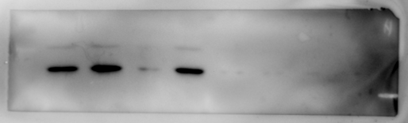
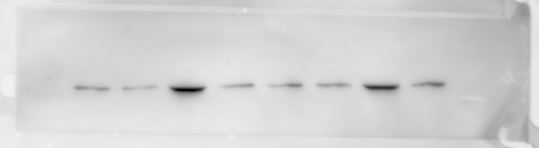
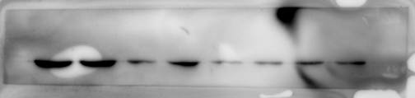


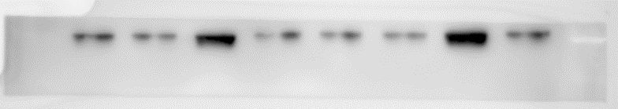

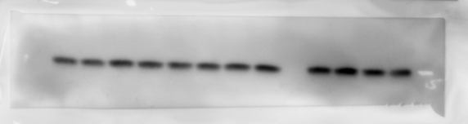
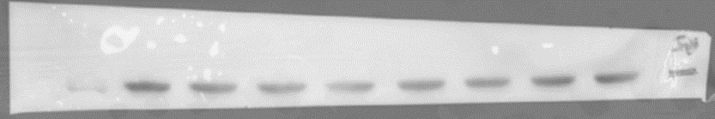
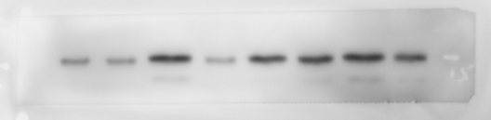
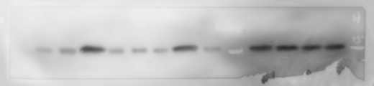


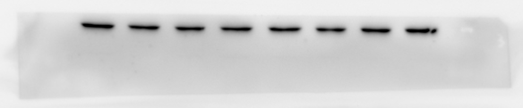

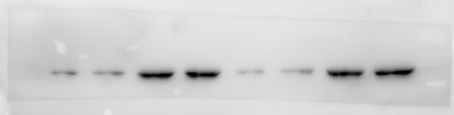
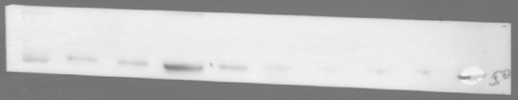
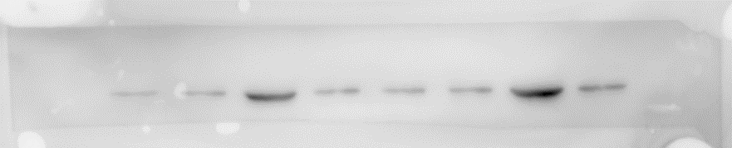
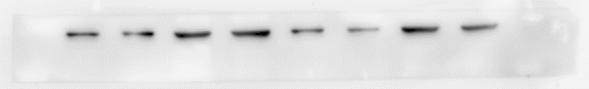
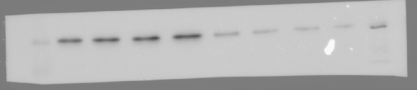
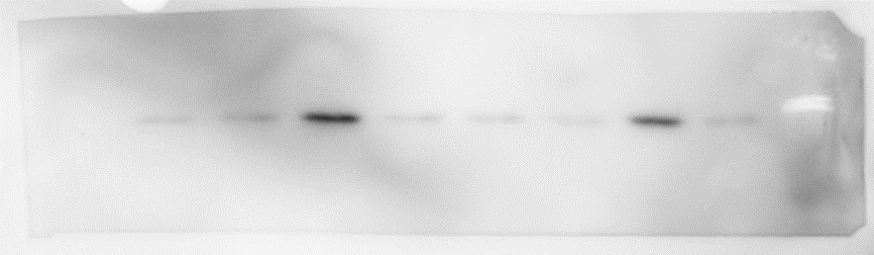

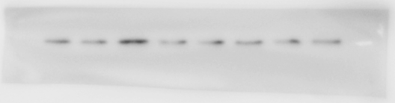

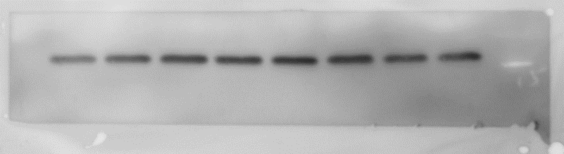

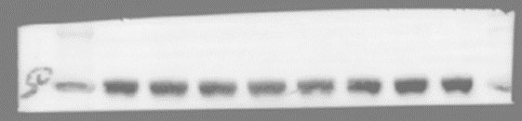
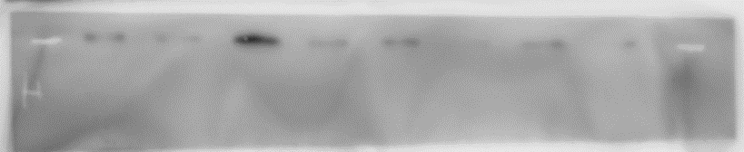
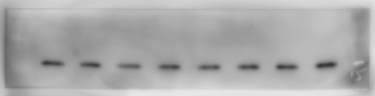


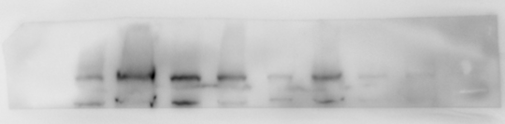
















Figure 5A
Figure 5E
Figure 5I
E-cadherin
-100
MLL1
-150
E-cadherin
-100
p-p53
-50
WDR5
-37
p-p53
-50
p53
-50
H3K4me3
-15
p53
-50
C-cas3
-15
C-cas3
-15
α-tubulin
-50
Histone H3
-15
GAPDH
-37
GAPDH
-37
Figure 5M
Figure 6A
Figure 6H
MLL1
-150
p-p53
-50
MLL1
-180
WDR5
-37
p53
-50
WDR5
-34
H3K4me3
-15
p21
-21
H3K4me3
-15
Histone H3
-15
E-cadherin
-100
α-tubulin
-50
C-cas3
-15
Histone H3
-15
GAPDH
-37
GAPDH
-37
Figure 7A
Figure 7C
Figure 7E, I
p-ATR
-250
p-Chk1
-50
p-ATR
-250
ATR
Chk1
-50
ATR
-250
-250
α-tubulin
-50
β-actin
-37
GAPDH
-37
p-Chk2
p-ATM
-250
p-ATM
-250
-50
ATM
-250
ATM
Chk2
-62
α-tubulin
-250
α-tubulin
-50
-50
α-tubulin
-50

Slide 3































Figure 7G, K
Figure 7M
Figure 7P
p-Chk1
-50
p-ATR
-250
p-Chk1
-50
ATR
-250
Chk1
-50
Chk1
-50
GAPDH
-37
β-actin
-37
GAPDH
-37
p-ATM
-250
p-Chk2
-50
p-Chk2
-50
ATM
-250
Chk2
Chk2
-50
β-actin
-50
-50
β-actin
-37
β-actin
-37
p-Chk2
-50
Chk2
-50
α-tubulin
-50
Figure 8A
Figure 8D
Figure 8G
p21
-20
p21
-20
p21
-20
p-H3(ser10)
-15
p-H3(ser10)
-15
α-tubulin
-15
Histone H3
-20
Histone H3
-15
p-H3(ser10)
-15
α-tubulin
-37
Histone H3
-20
α-tubulin
-37
β-actin
-37

Slide 4































Figure 8J
supplemental Figure 1
supplemental Figure 4A
p21
-20
C-Cas3
-15
p-p53
-50
p-H3(ser10)
-15
α-tubulin
-50
p53
-50
p21
-20
Histone H3
-15
supplemental Figure 2
-20
MLL1
-150
C-cas3
-15
β-actin
-37
MLL1
-150
E-cadherin
-100
WDR5
-30
α-tubulin
-50
supplemental Figure 4E
supplemental Figure 5A
MLL1
-150
γ-H2AX
-20
supplemental Figure 5G
WDR5
-30
-15
γ-H2AX
-20
H3K4me3
-15
H2AX
H2AX
-15
-20
α-tubulin
-50
β-actin
-37
Histone H3
-15
supplemental Figure 5D
supplemental Figure 5J
α-tubulin
-50
γ-H2AX
-20
γ-H2AX
-15
H2AX
-20
H2AX
-15
α-tubulin
-50
α-tubulin
-50

