Slide 1
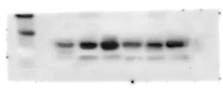
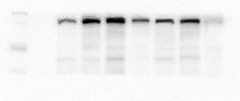
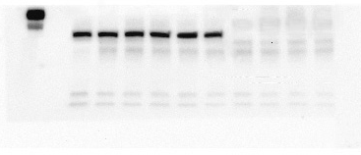
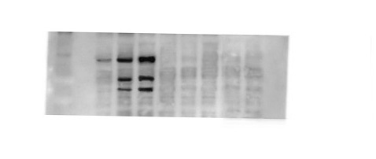
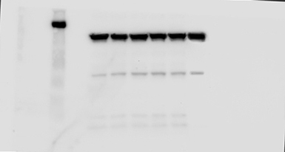
Figure 1G α-SMA
Antibody: Anti-α-SMA (A5228, Sigma-Aldrich)(1:1000)
Horseradish peroxidase-labeled secondary antibody(1:5000)
Figure 1G Col I
Antibody: anti-collagen I (ab34710, Abcam)(1:1000)
Horseradish peroxidase-labeled secondary antibody(1:5000)
Figure 1G GAPDH
Antibody: anti-GAPDH (3781, ProSci)(1:1000)
Horseradish peroxidase-labeled secondary antibody(1:5000)
Figure 1H GSDMD and its cleaved fragment
Antibody: anti-GSDMD antibody (ab219800, Abcam)(1:1000)
Horseradish peroxidase-labeled secondary antibody(1:5000)
Figure 1H GAPDH
Antibody: anti-GAPDH (3781, ProSci)(1:1000)
Horseradish peroxidase-labeled secondary antibody(1:5000)
Figure 1 original WB gels

Slide 2
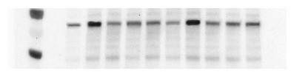
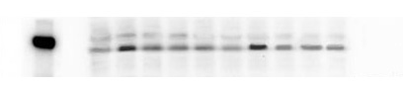
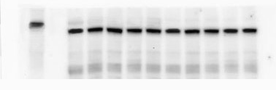
Figure 7E α-SMA
Antibody: Anti-α-SMA (A5228, Sigma-Aldrich)(1:1000)
Horseradish peroxidase-labeled secondary antibody(1:5000)
Figure 7E pSmad3
Antibody: anti-pSmad3 antibody (ab52903)(1:1000)
Horseradish peroxidase-labeled secondary antibody(1:5000)
Figure 7E GAPDH
Antibody: anti-GAPDH (3781, ProSci)(1:1000)
Horseradish peroxidase-labeled secondary antibody(1:5000)
Figure 7 original WB gels

Slide 3
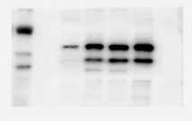
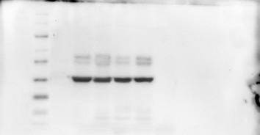
Figure 8A Caspase11
Antibody: anti-Caspase11 antibody (14340, Cell Signaling)(1:1000)
Horseradish peroxidase-labeled secondary antibody(1:5000)
Figure 8A GAPDH
Antibody: anti-GAPDH (3781, ProSci)(1:1000)
Horseradish peroxidase-labeled secondary antibody(1:5000)
Figure 8 original WB gels

