Slide 1
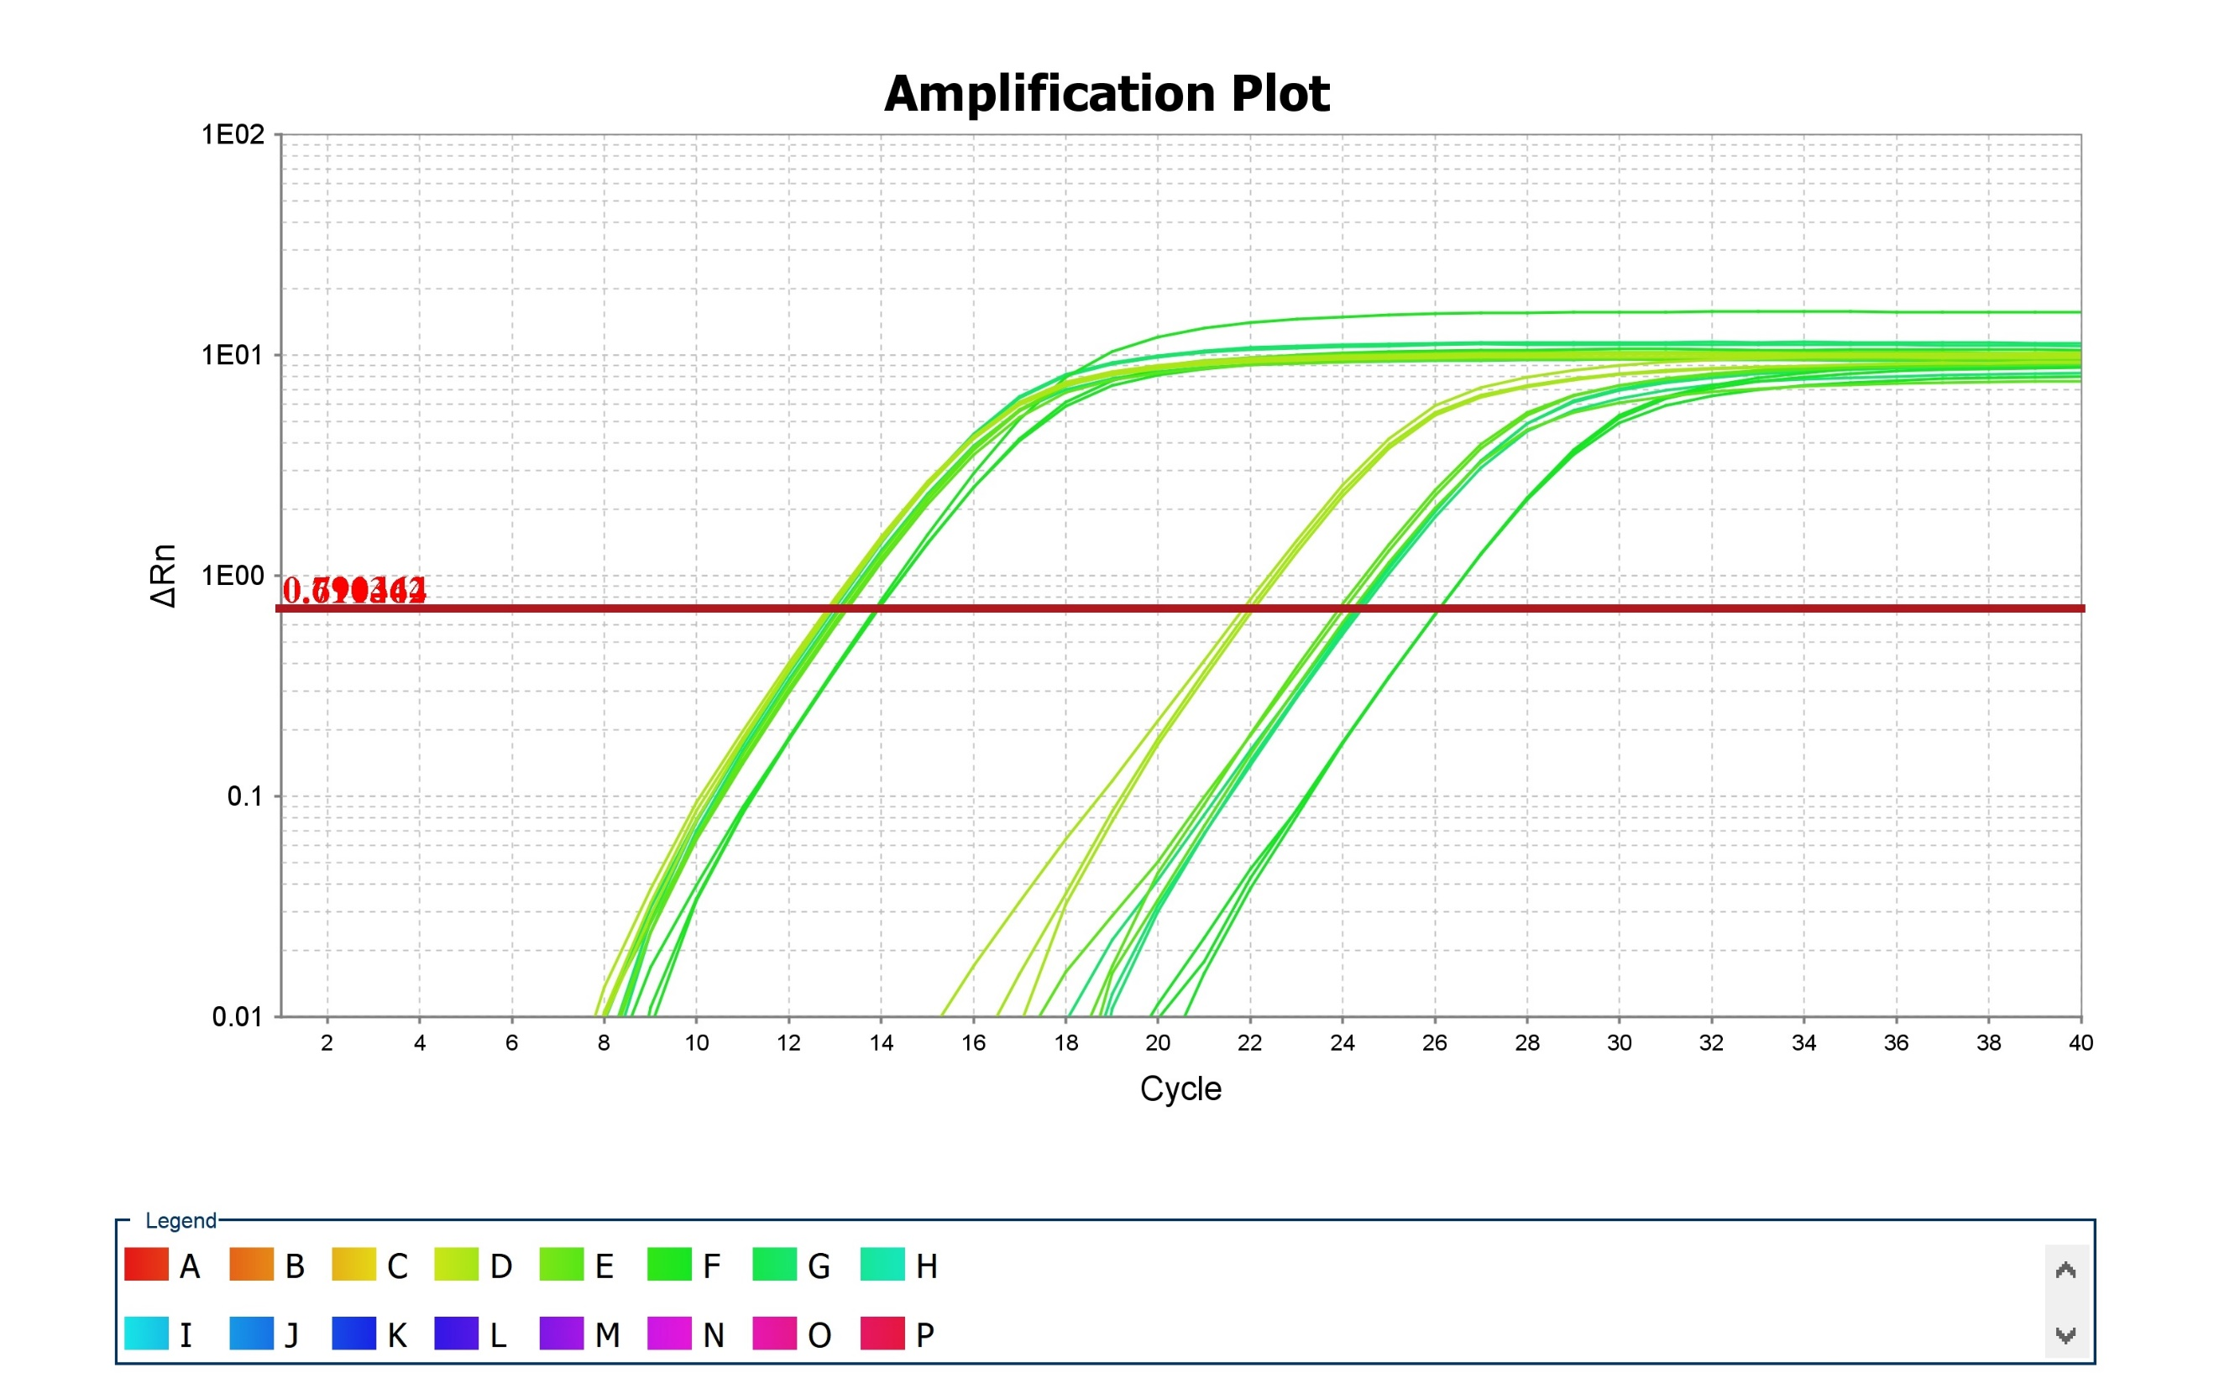
Figure 1B

Slide 2
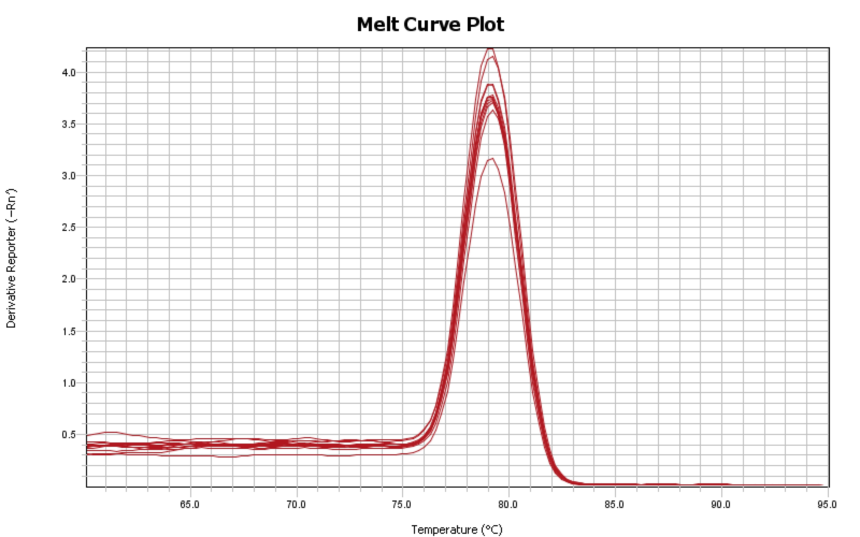
Figure 1B

Slide 3
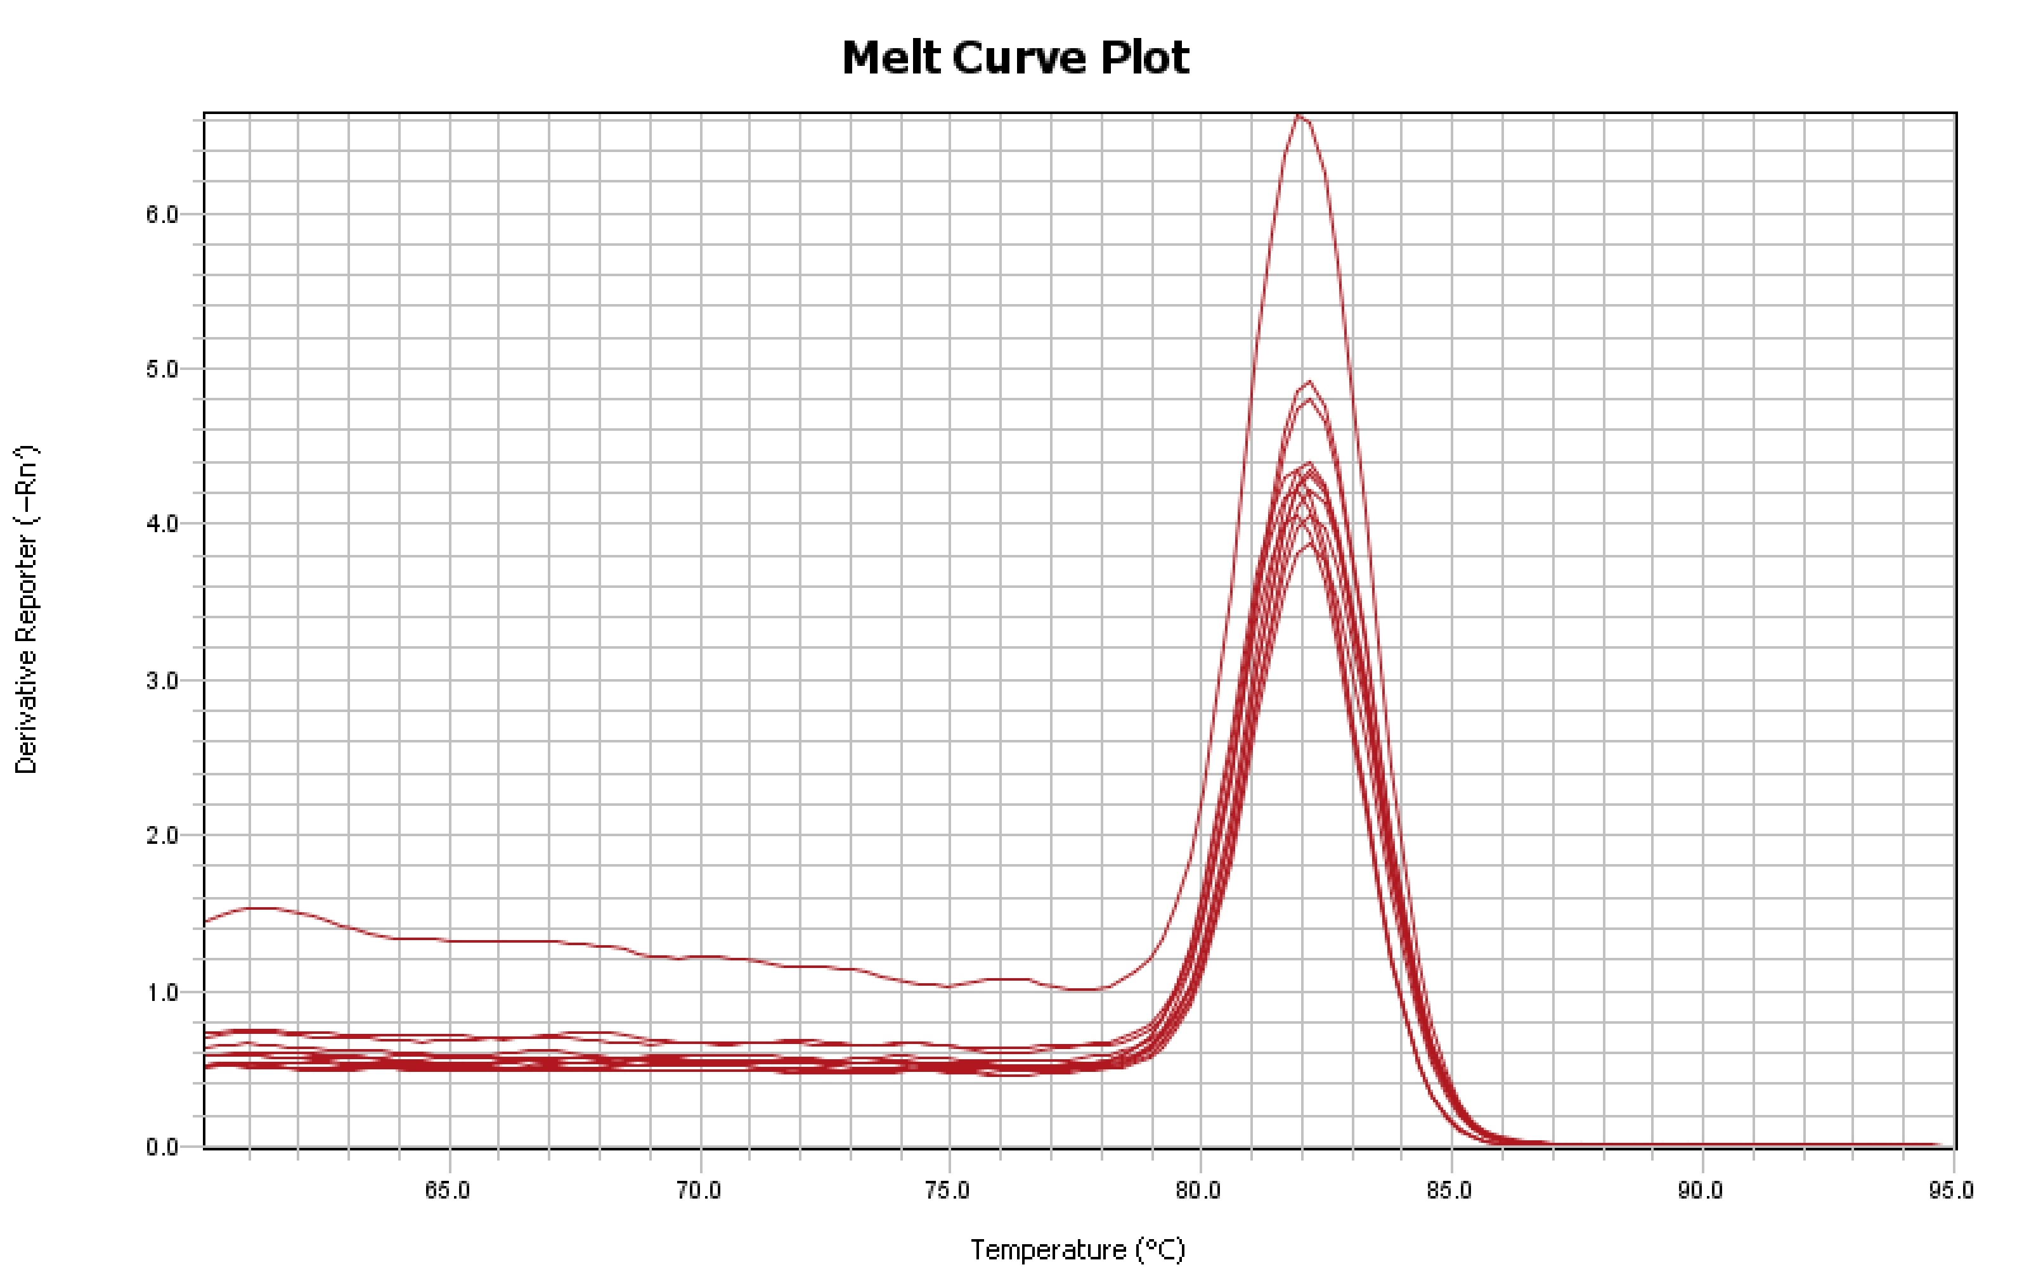
Figure 1B

Slide 4
Figure 1B

Slide 5
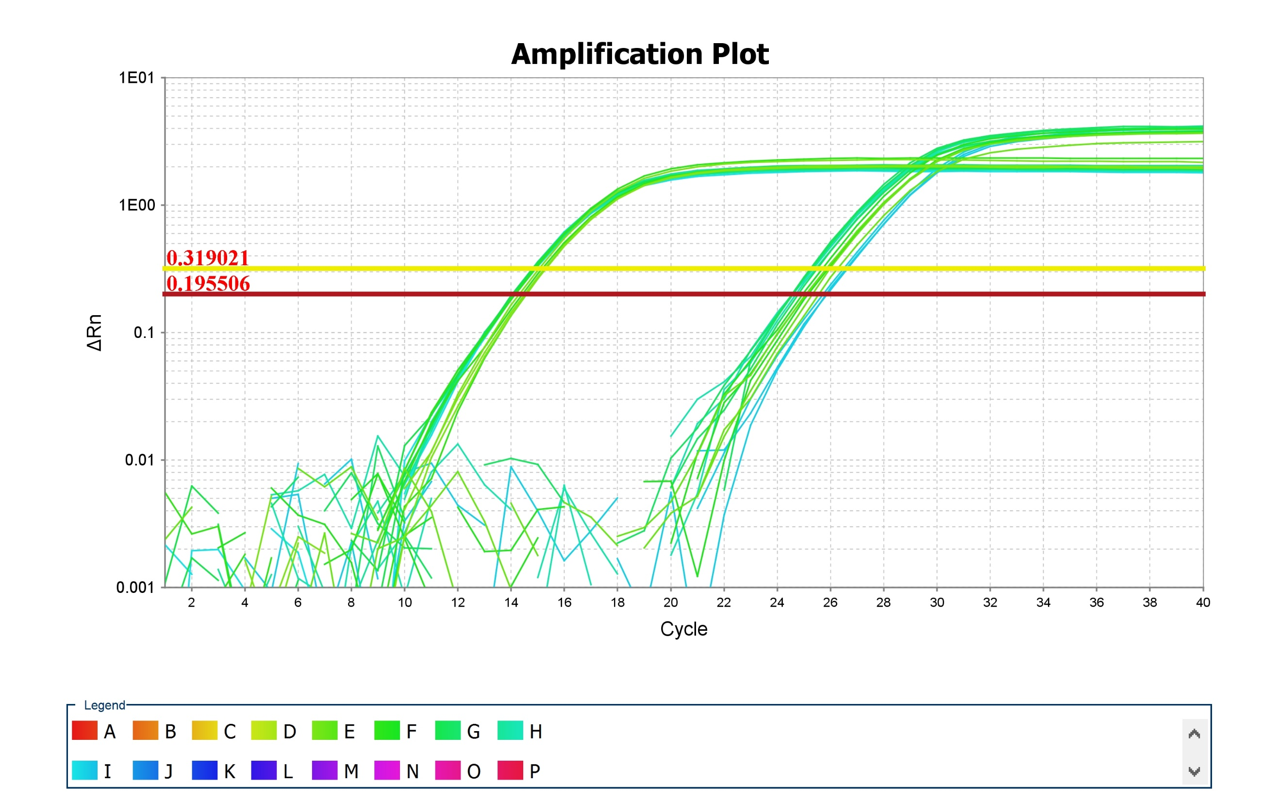
Figure 1C

Slide 6
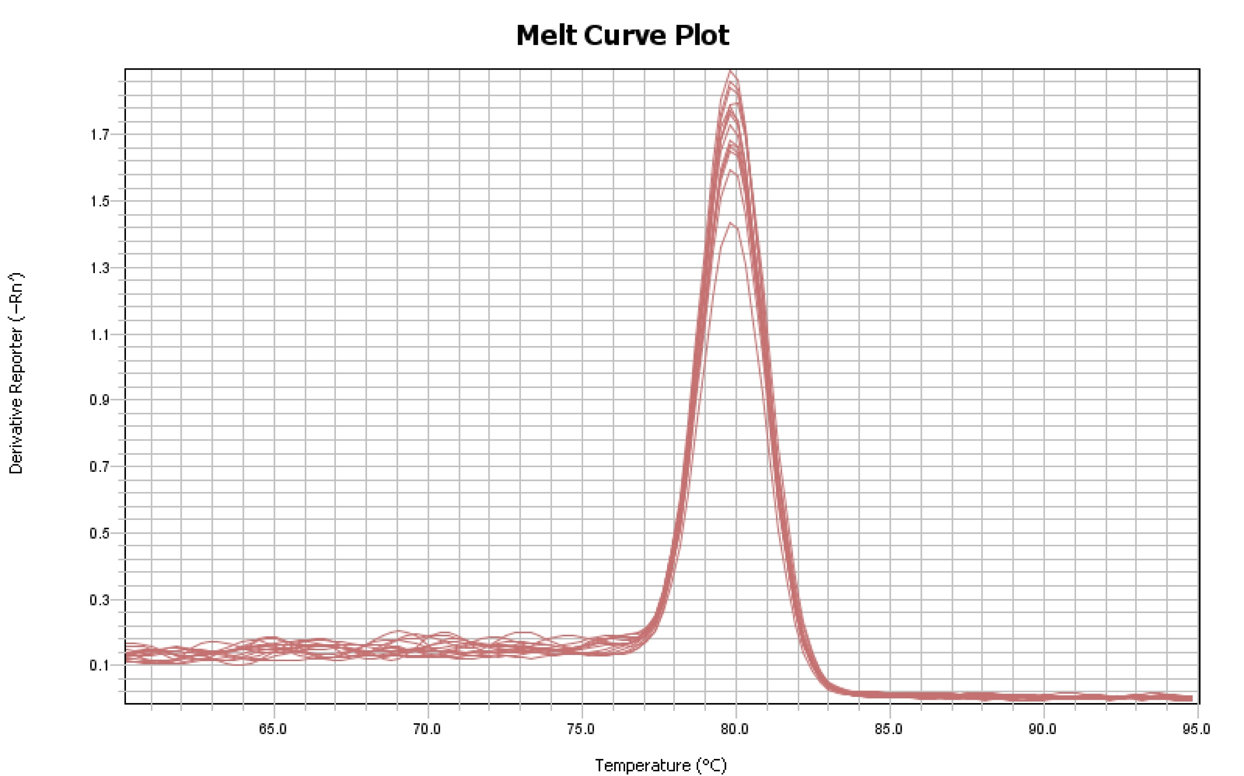
Figure 1C

Slide 7
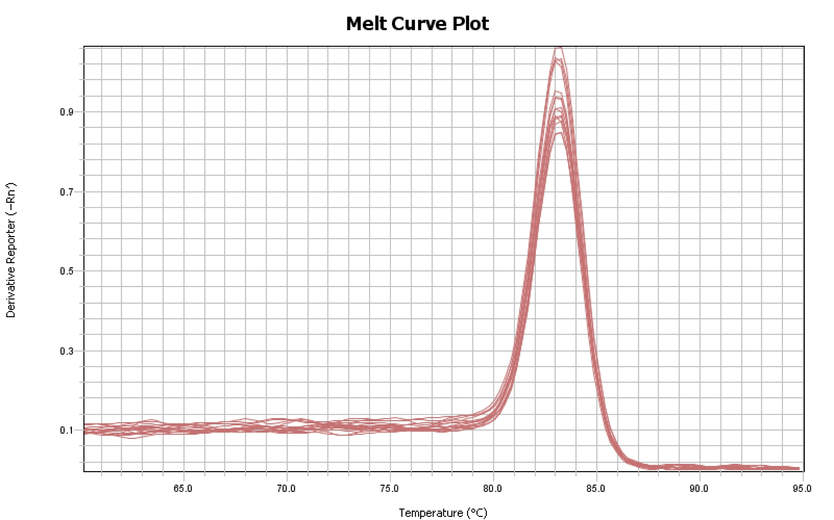
Figure 1C

Slide 8
Figure 1C

Slide 9
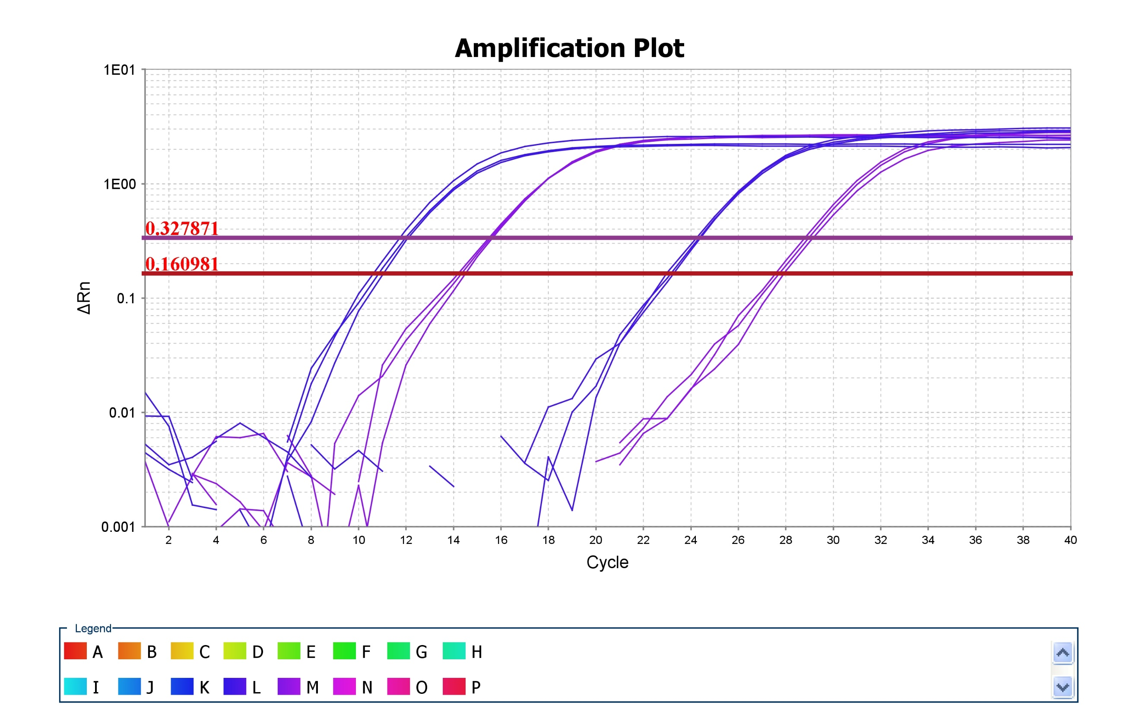
Figure 2A DU 145

Slide 10
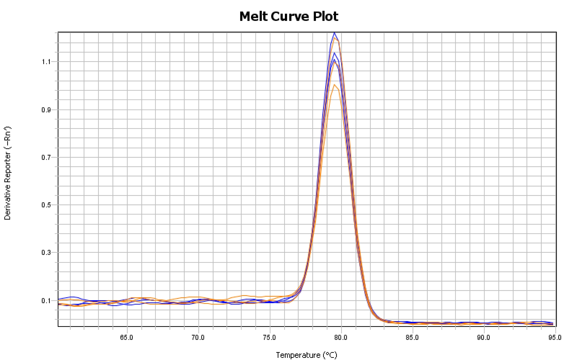
Figure 2A DU 145

Slide 11
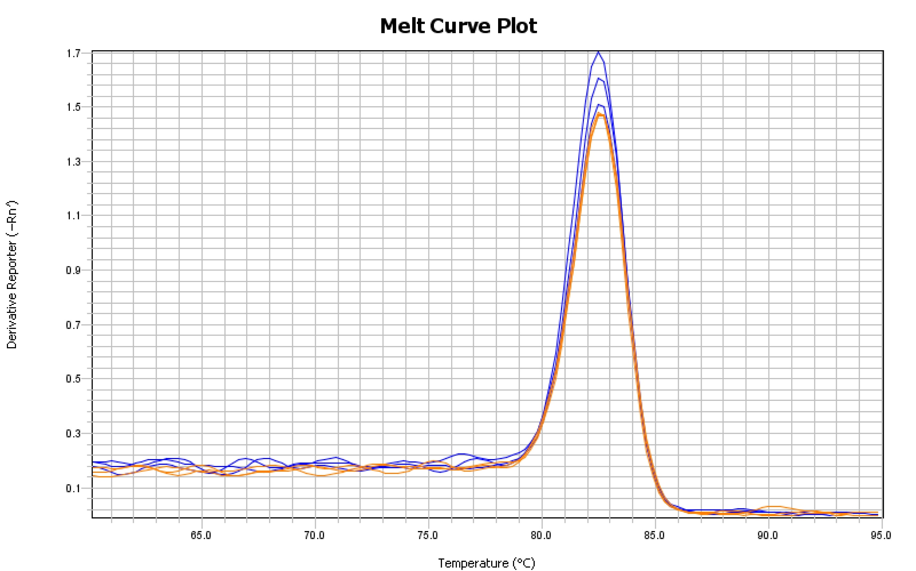
Figure 2A DU 145

Slide 12
Figure 2A DU 145

Slide 13
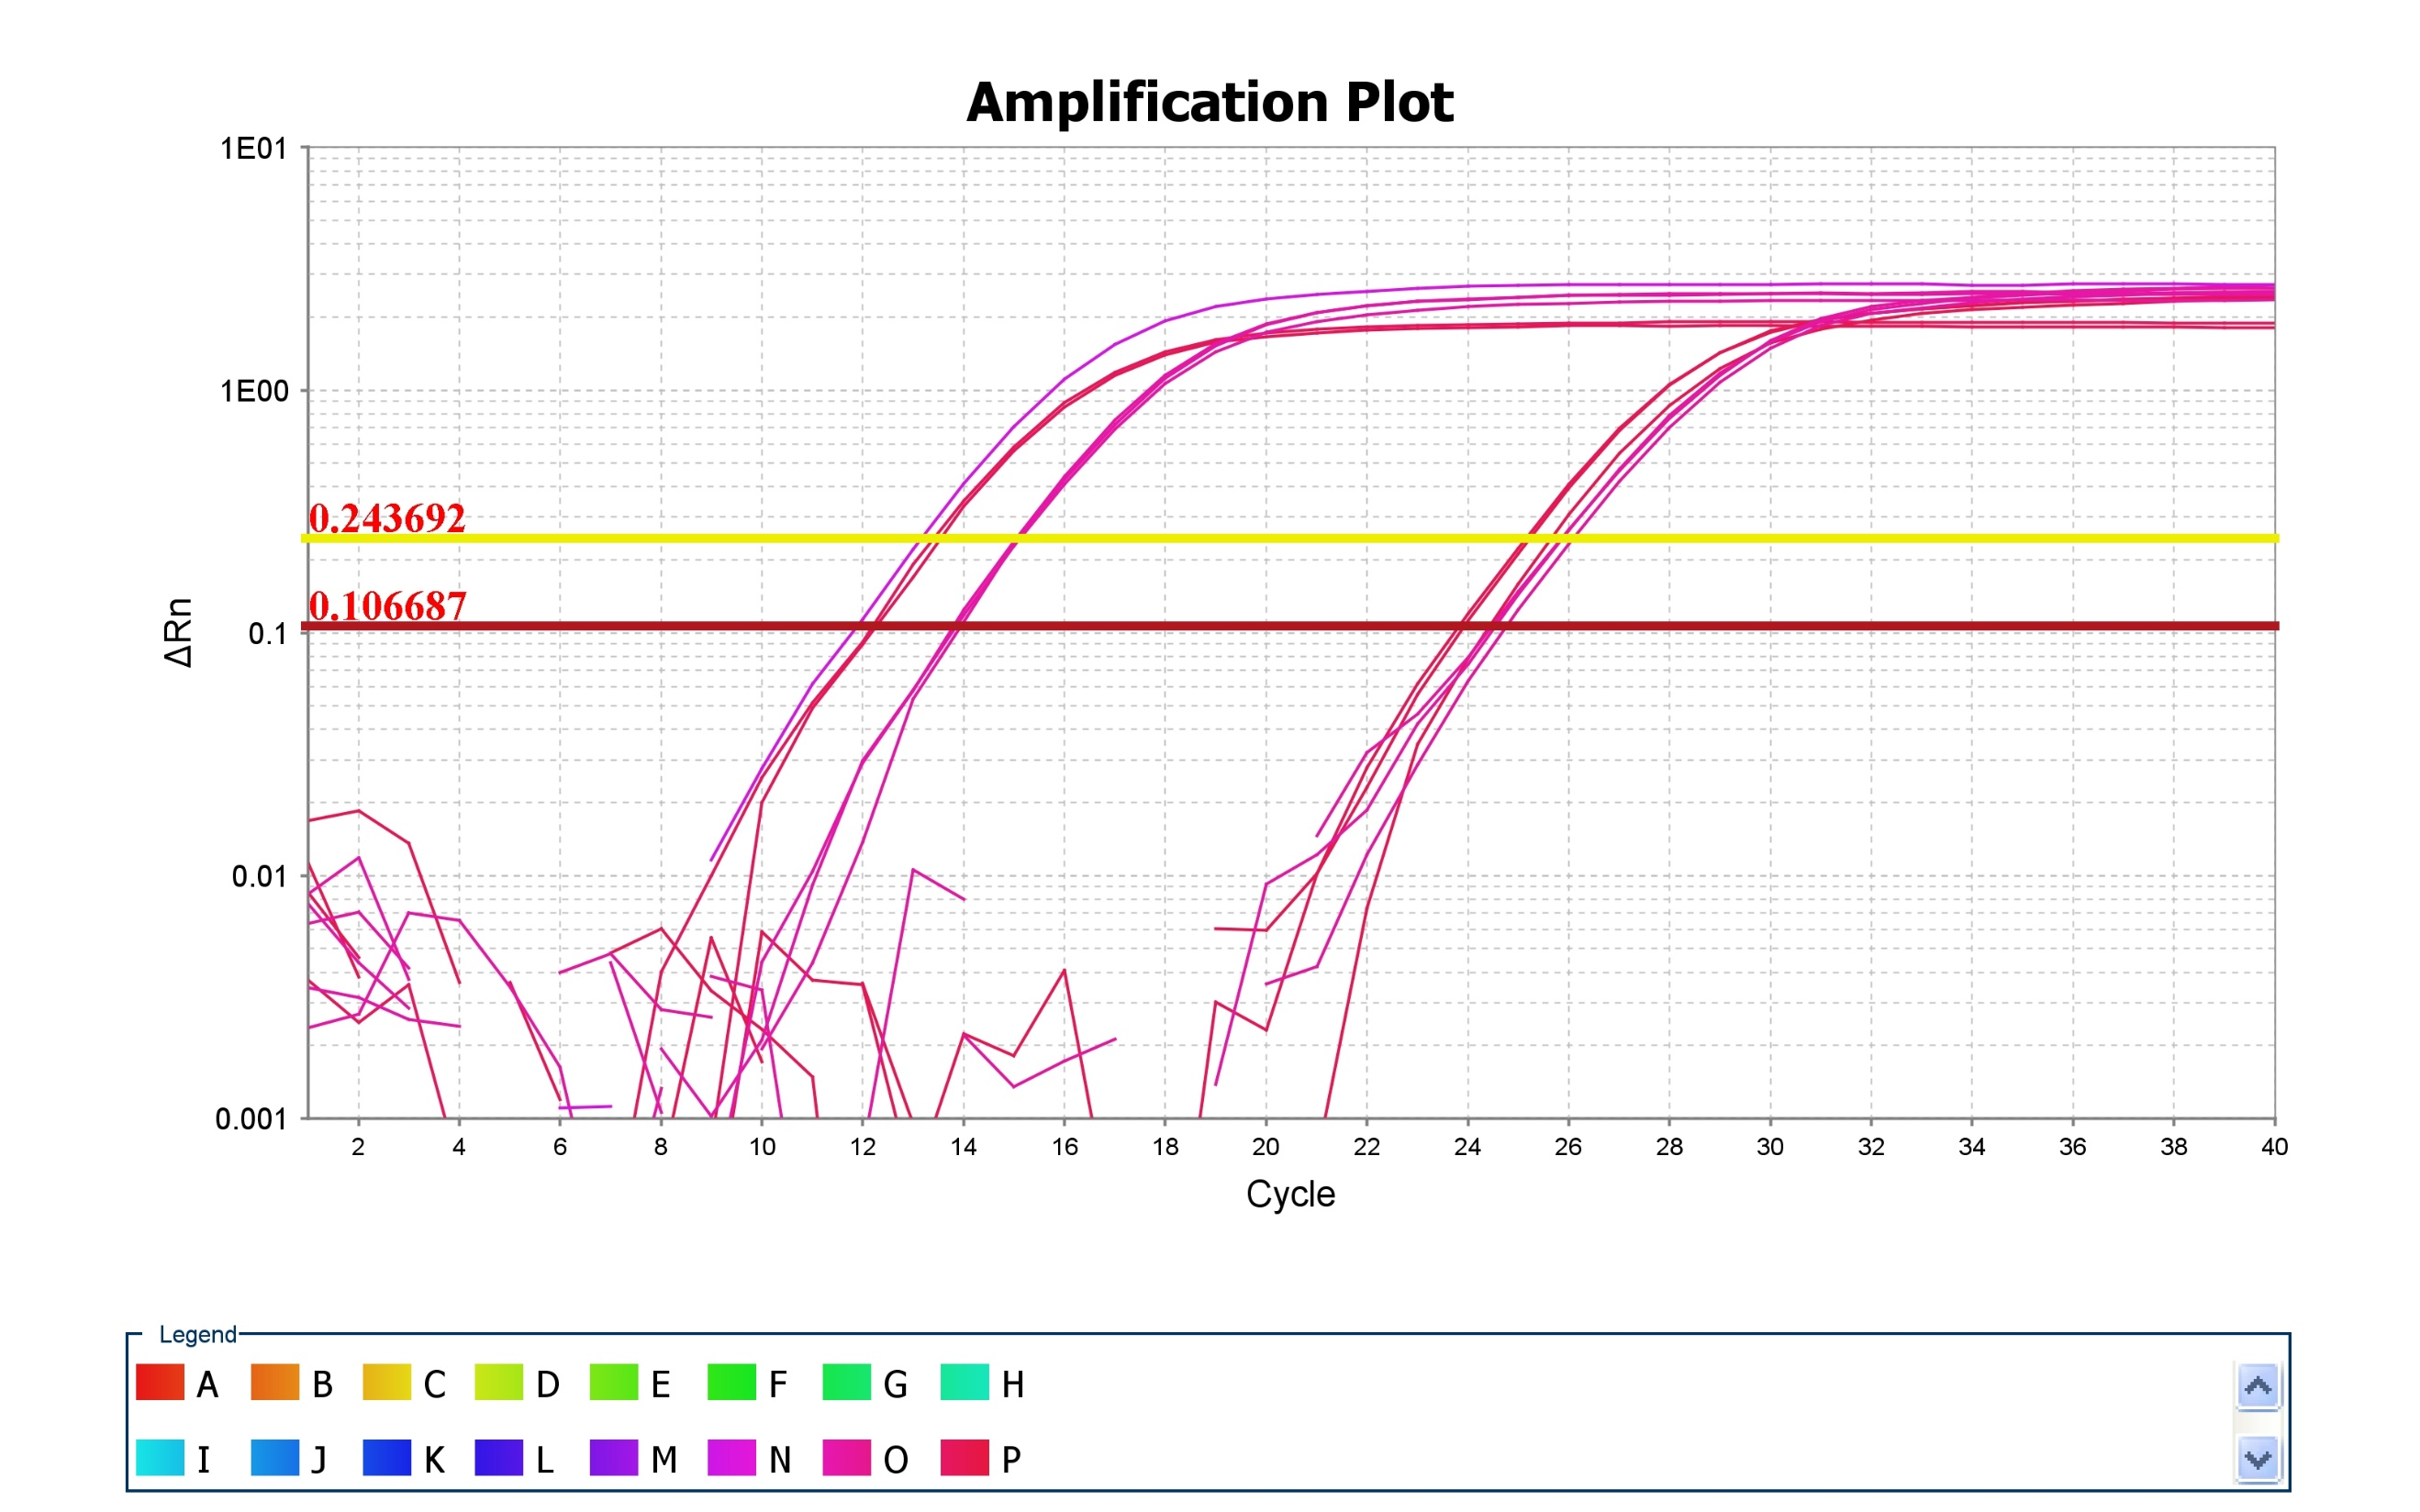
Figure 2A PC-3

Slide 14
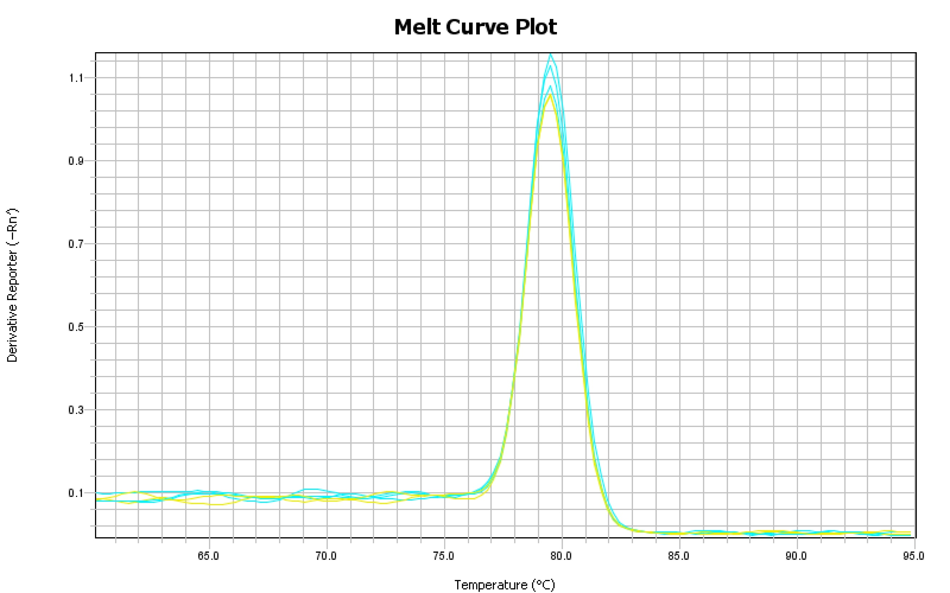
Figure 2A PC-3

Slide 15
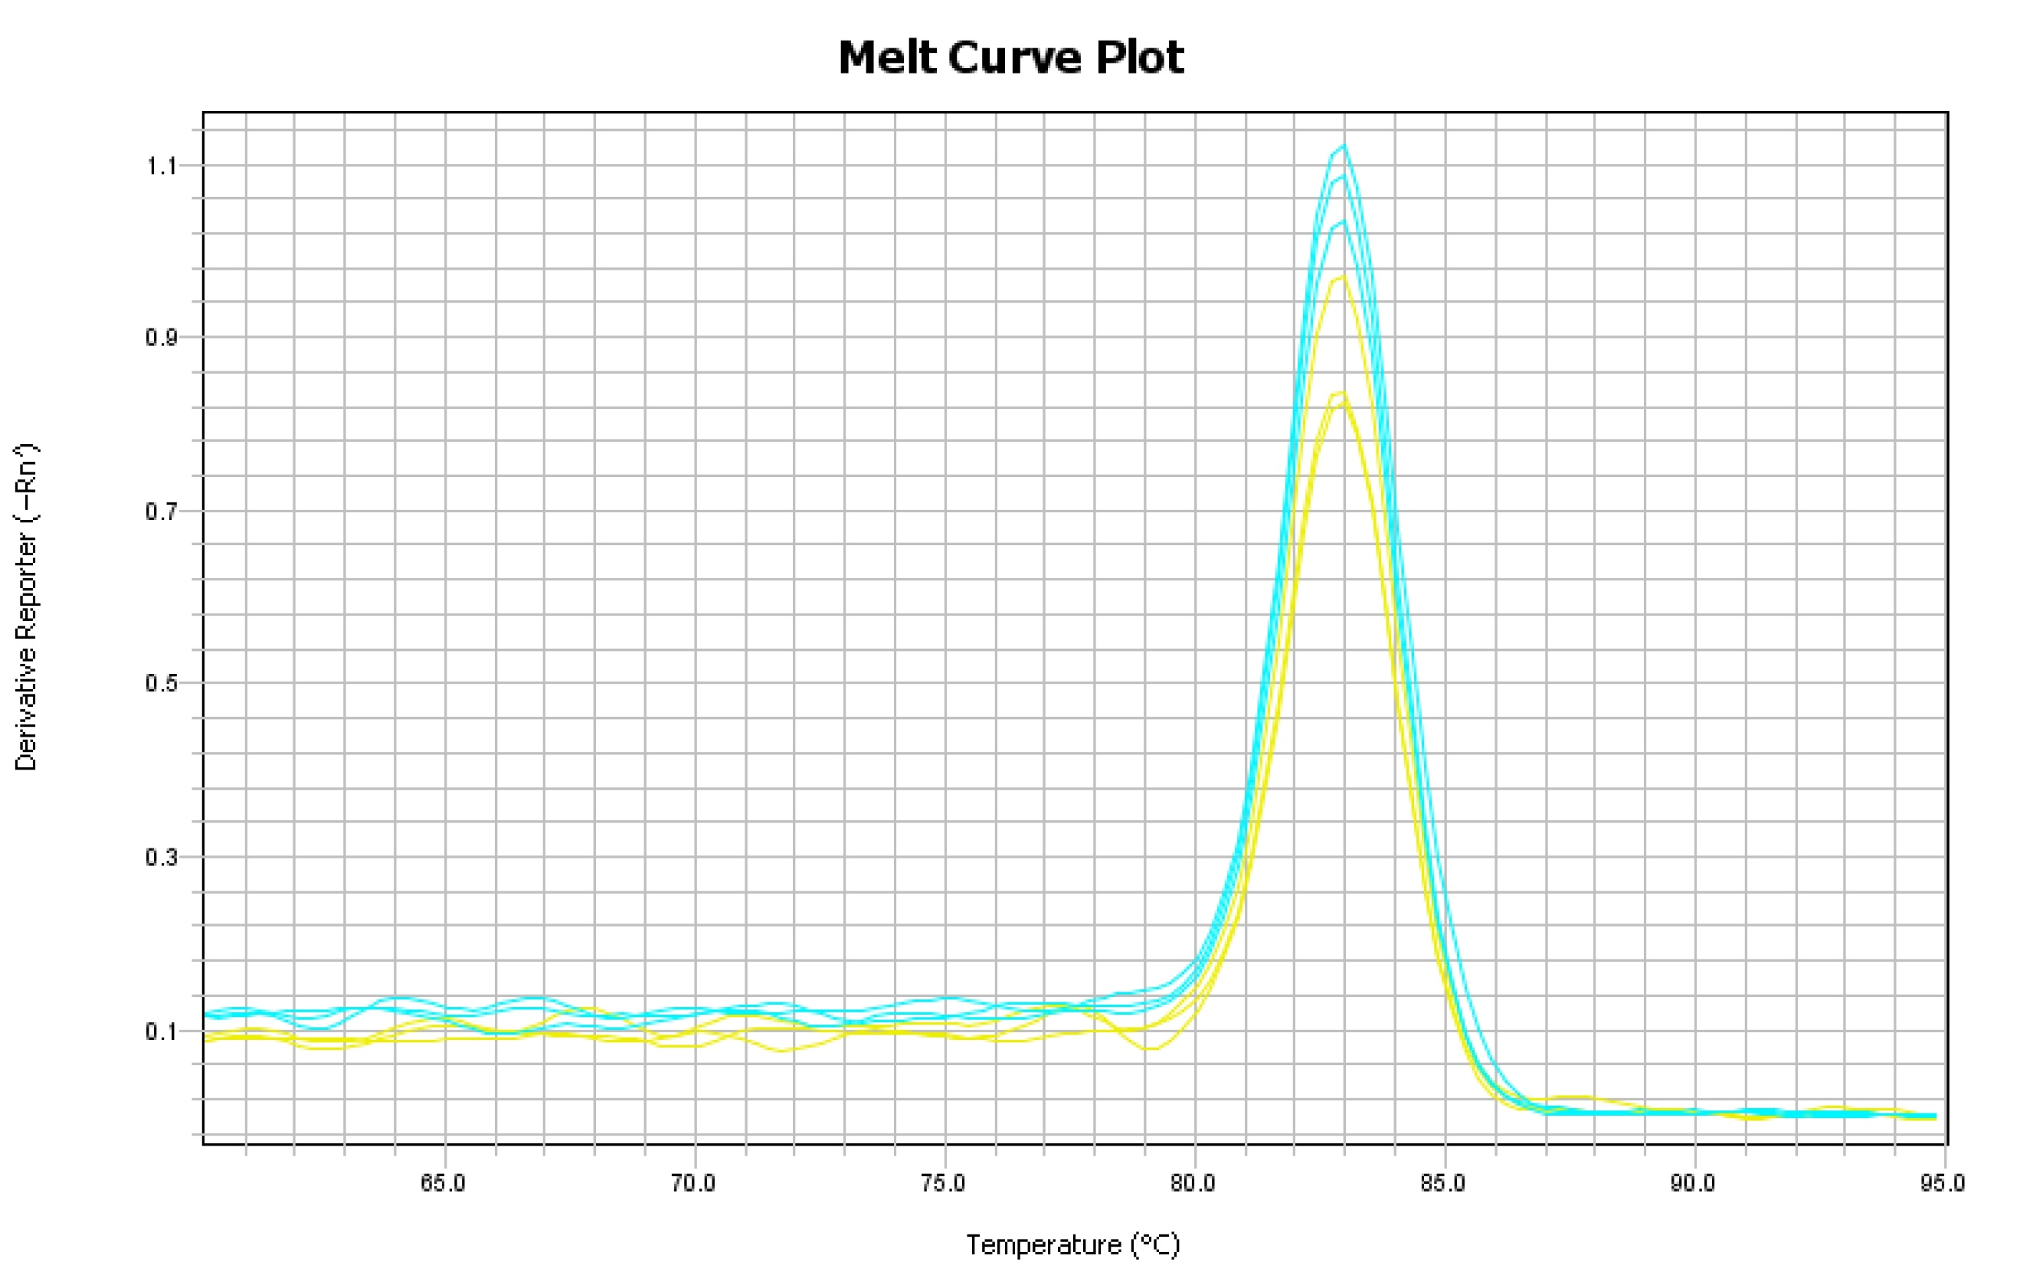
Figure 2A PC-3

Slide 16
Figure 2A PC-3

Slide 17
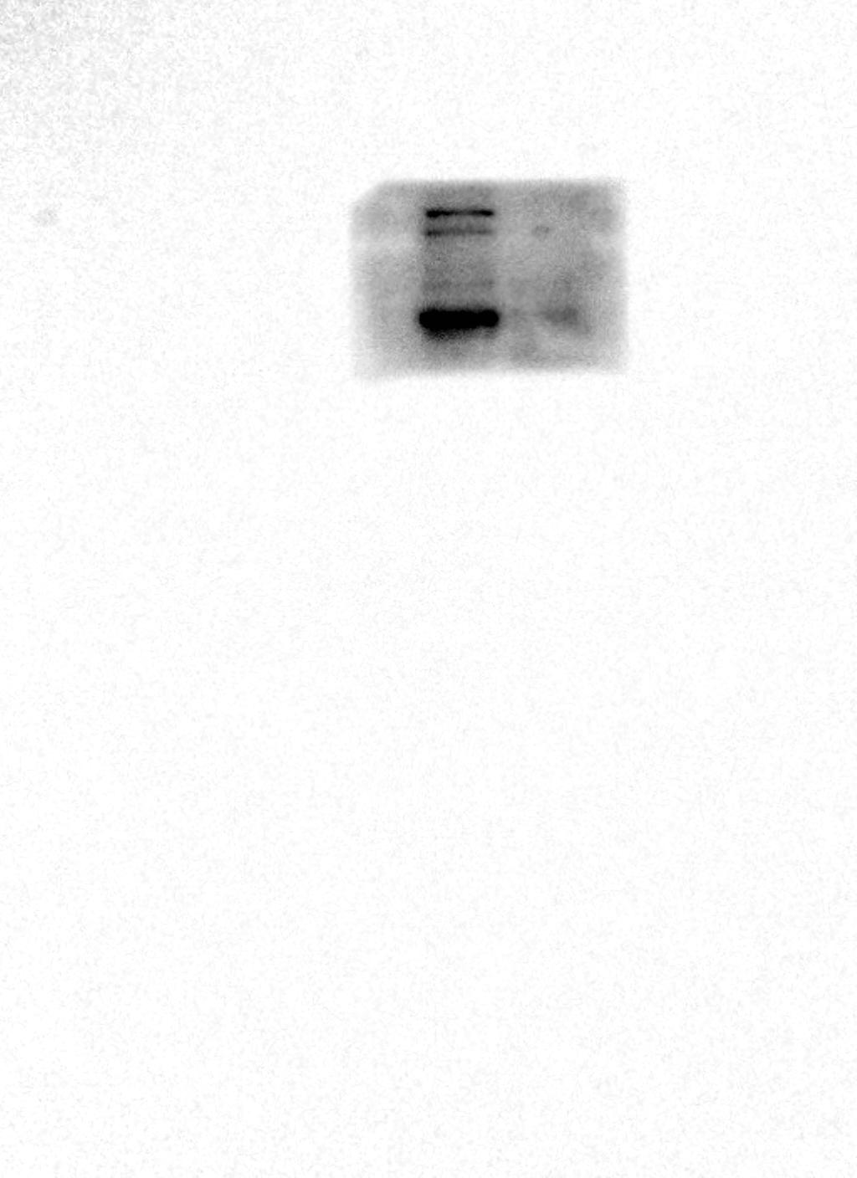
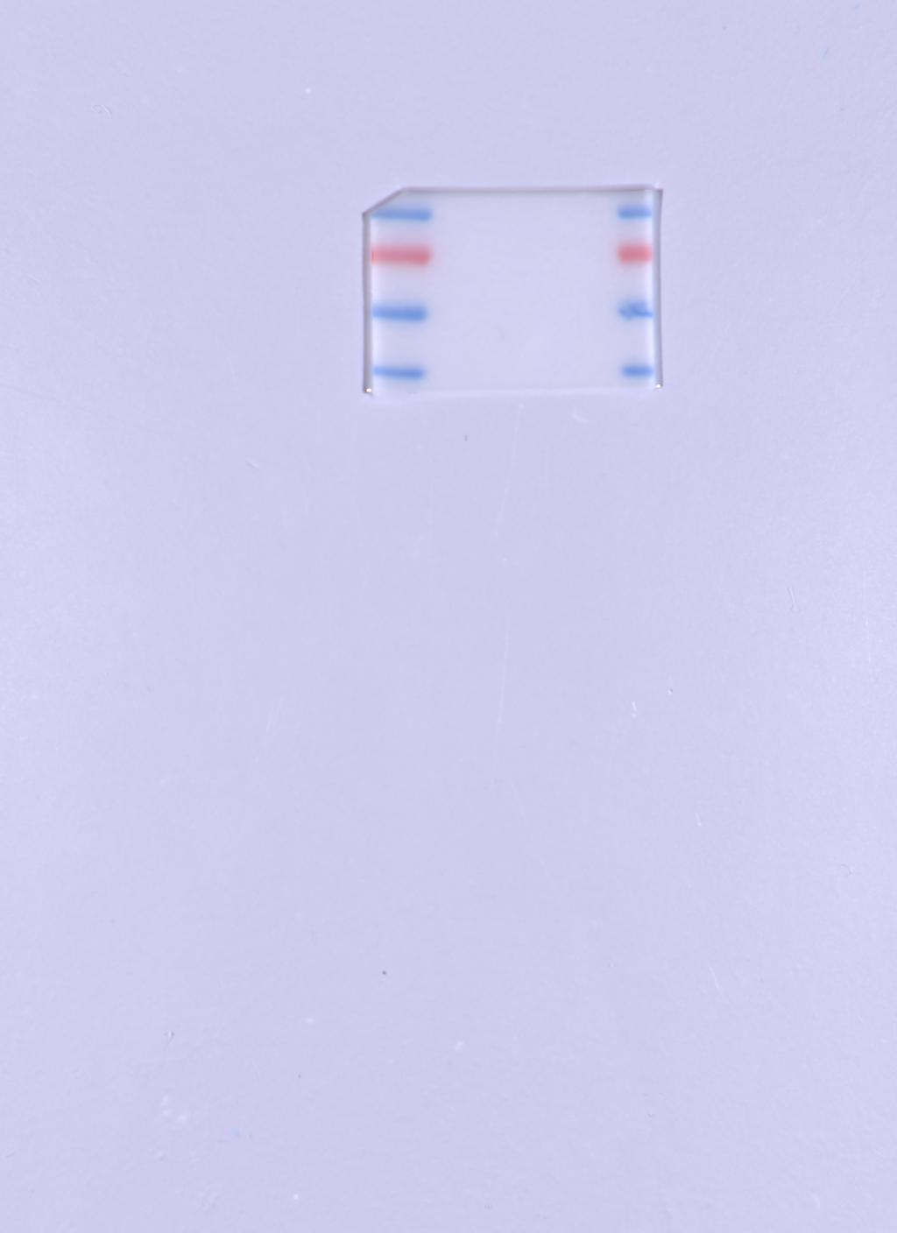

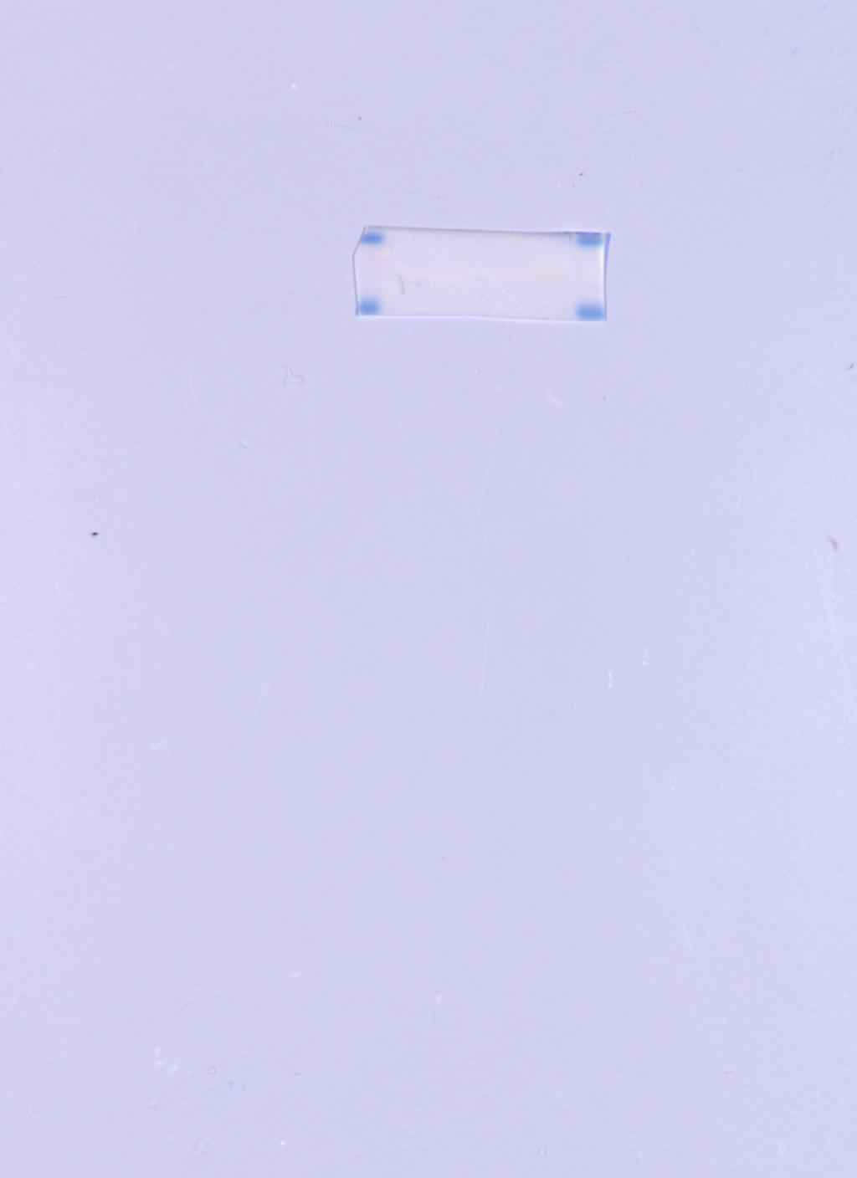
Figure 2A
DU145 CDKL3
DU145 GAPDH

Slide 18
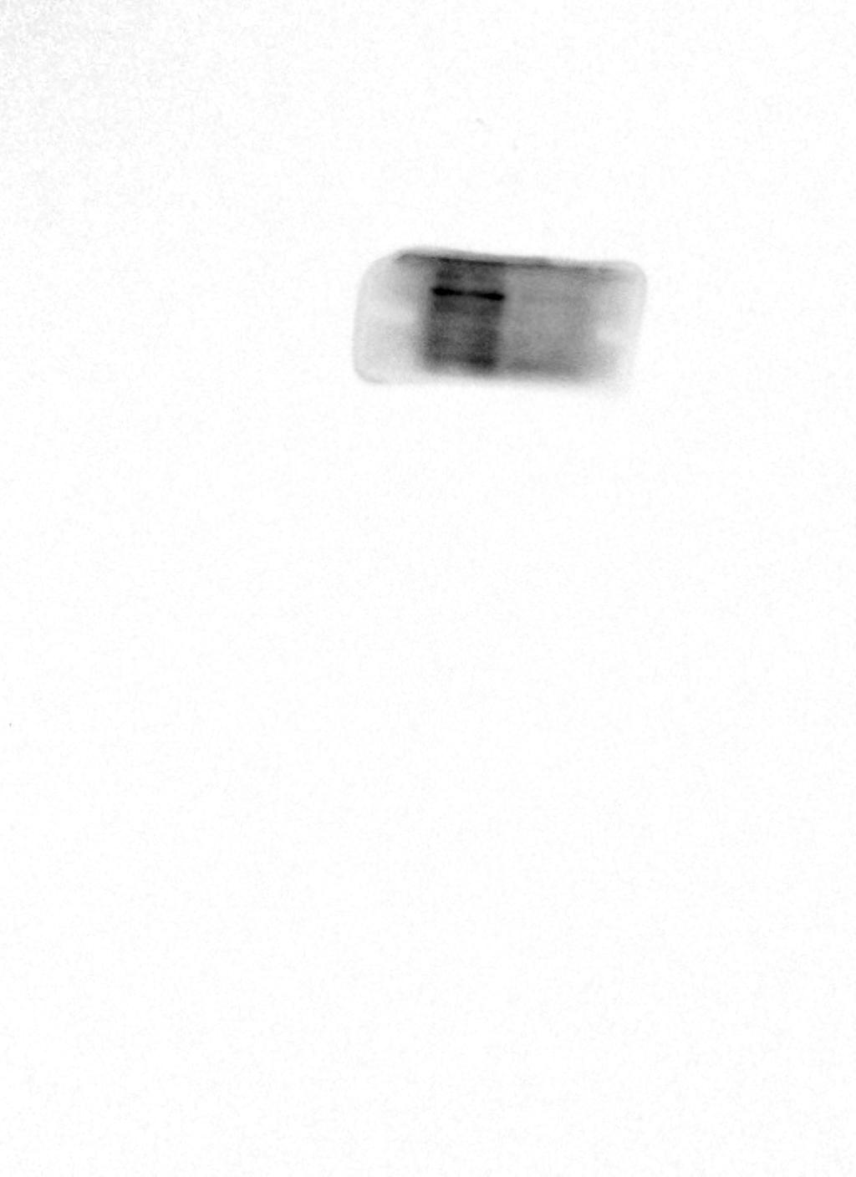
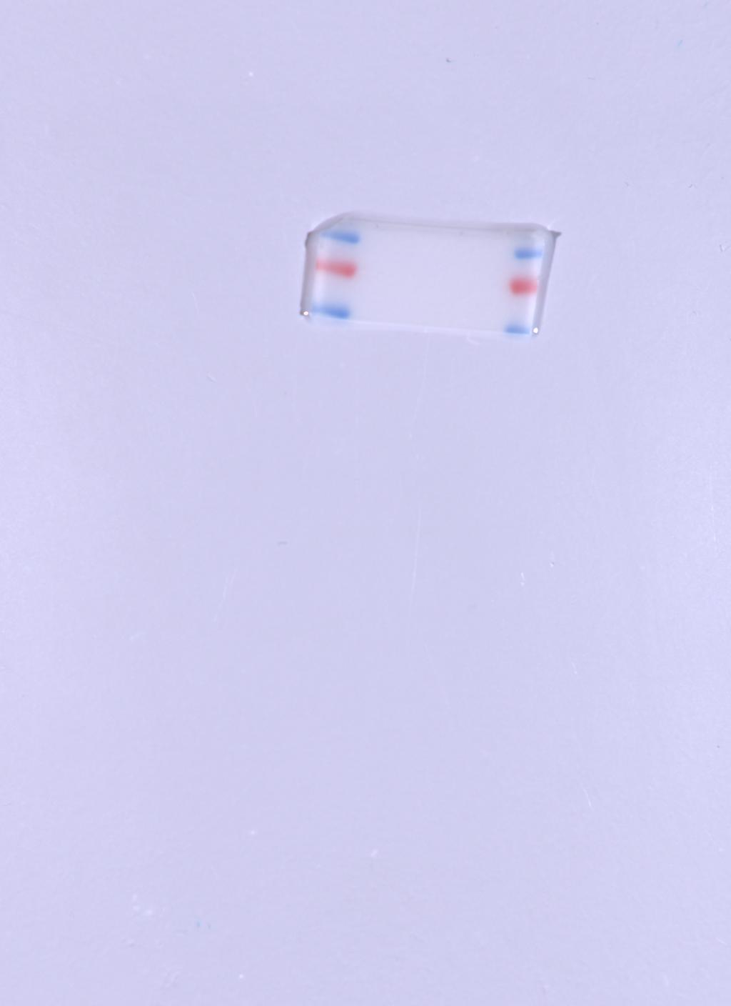
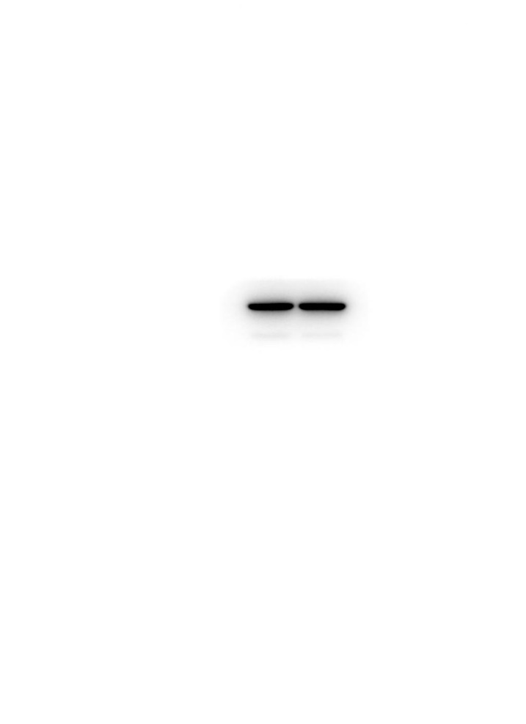
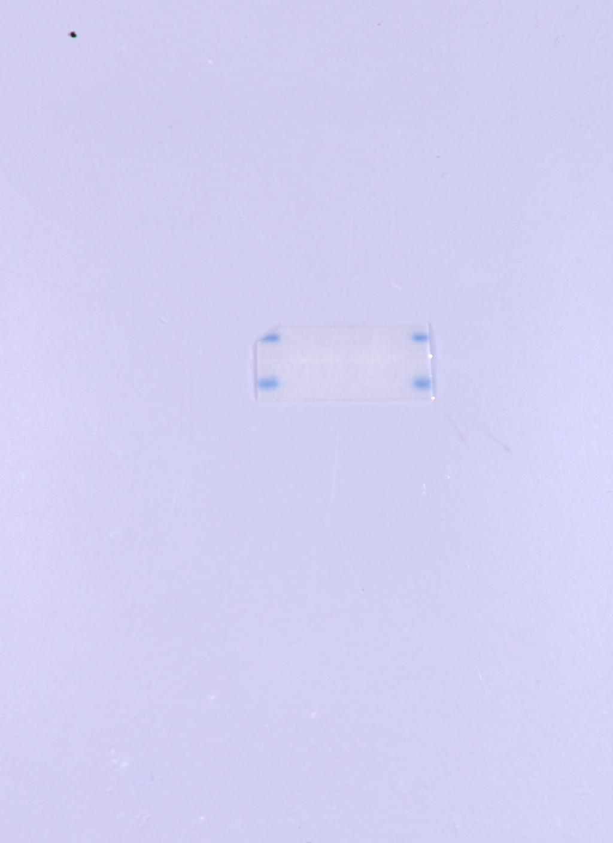
Figure 2A
PC-3 CDKL3
PC-3 GAPDH

Slide 19
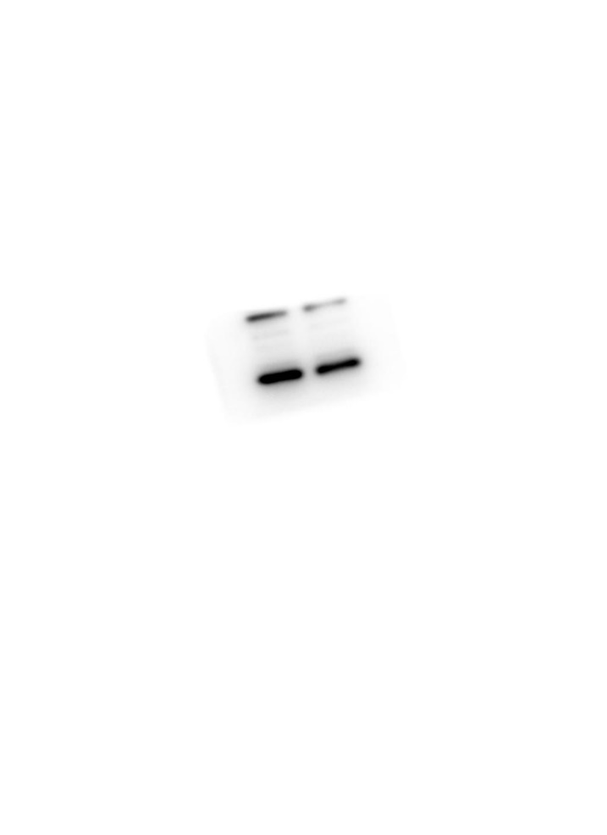
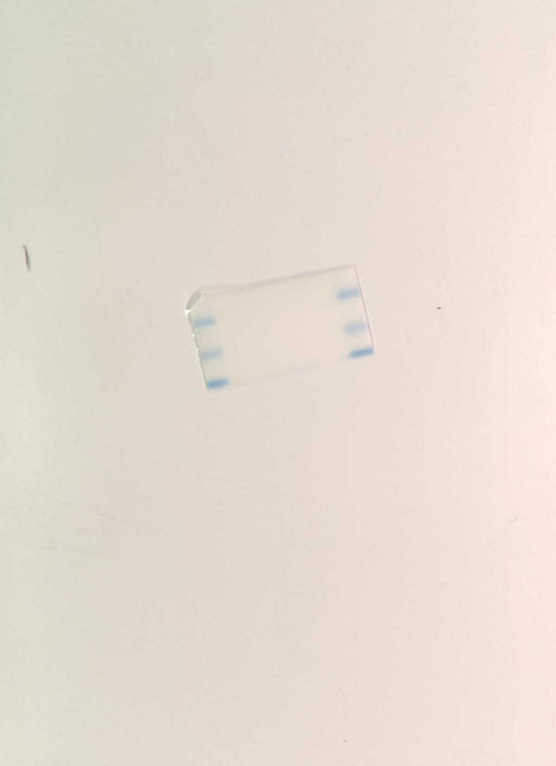

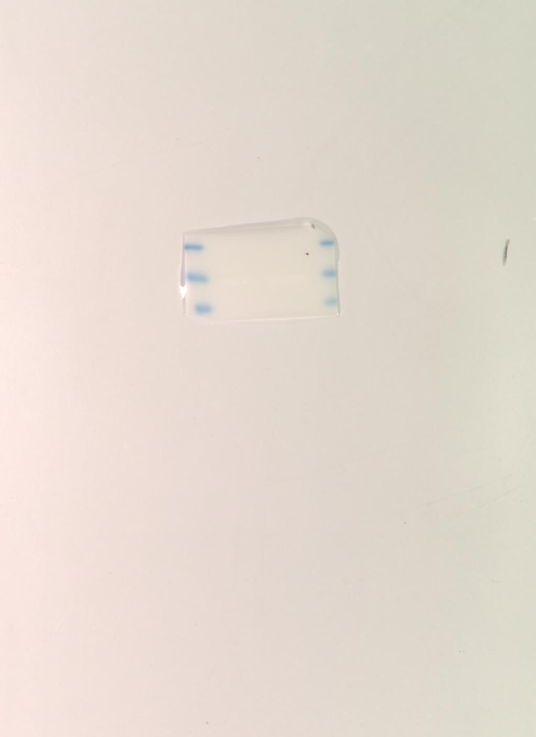
Figure 2G and S3
DU 145
Bcl-2
Caspase-3

Slide 20

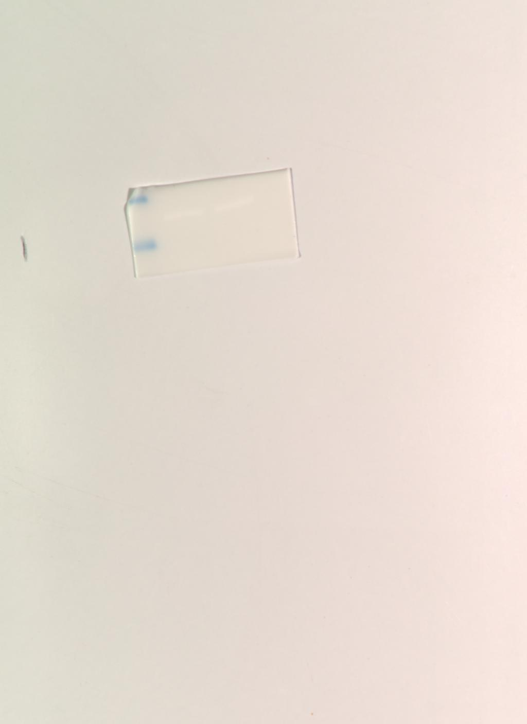
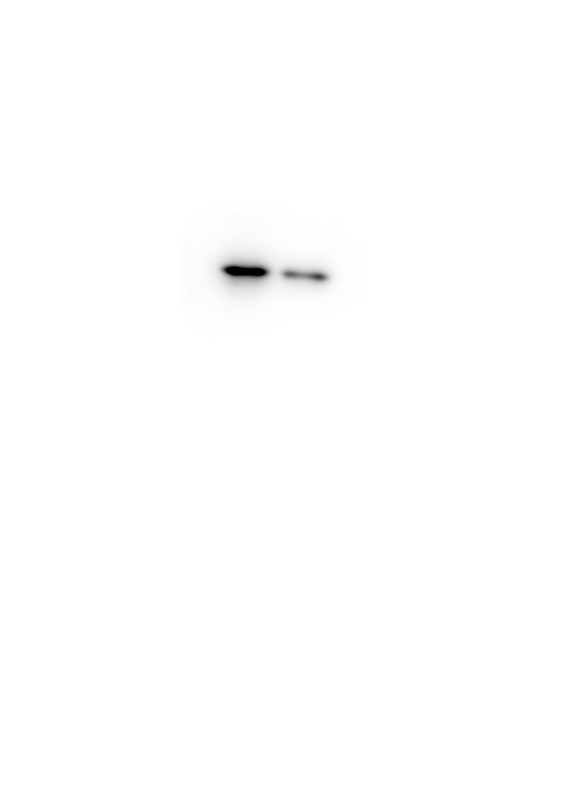
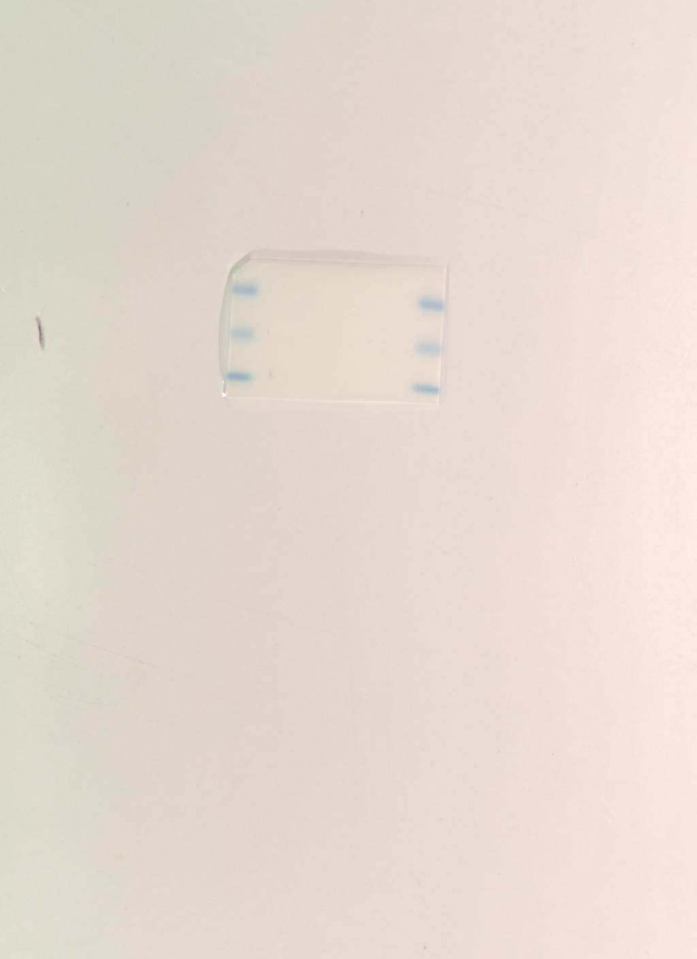
Figure 2G and S3
DU 145
GAPDH
HSP27

Slide 21
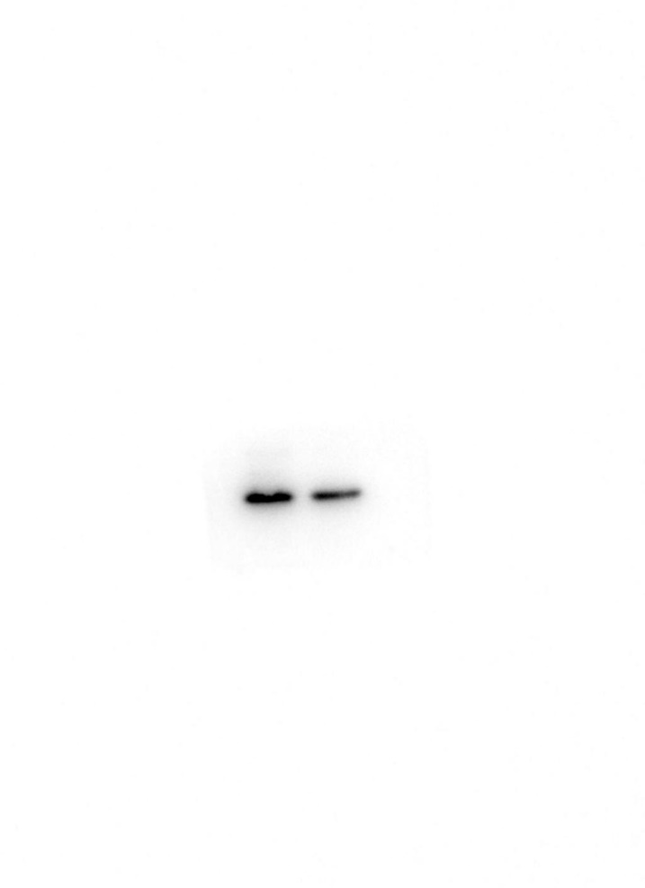
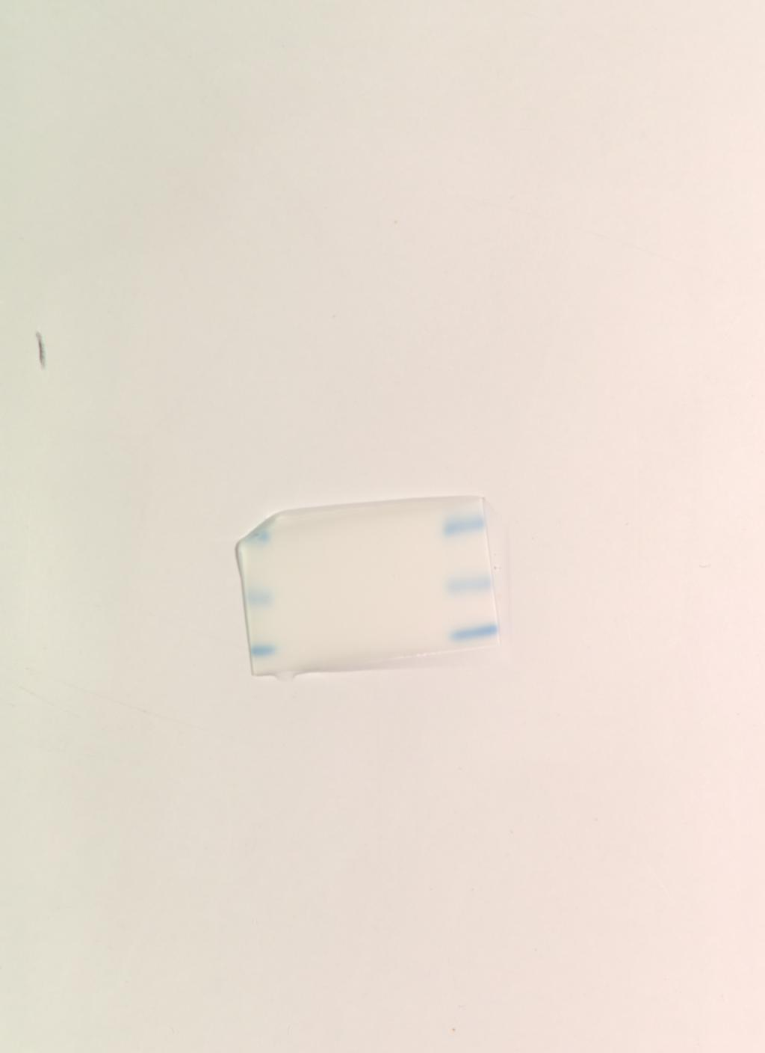
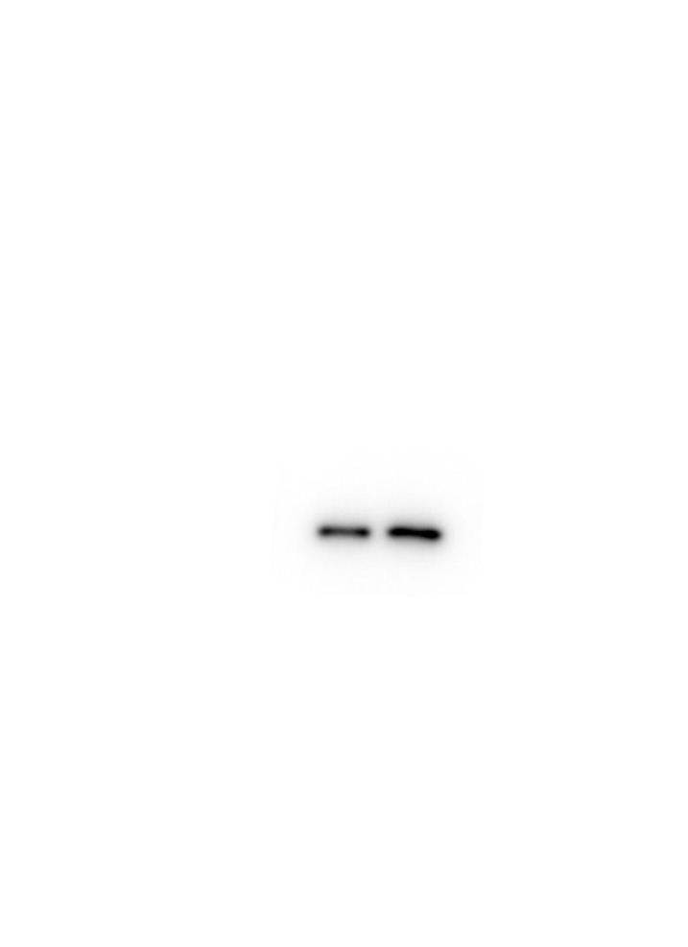
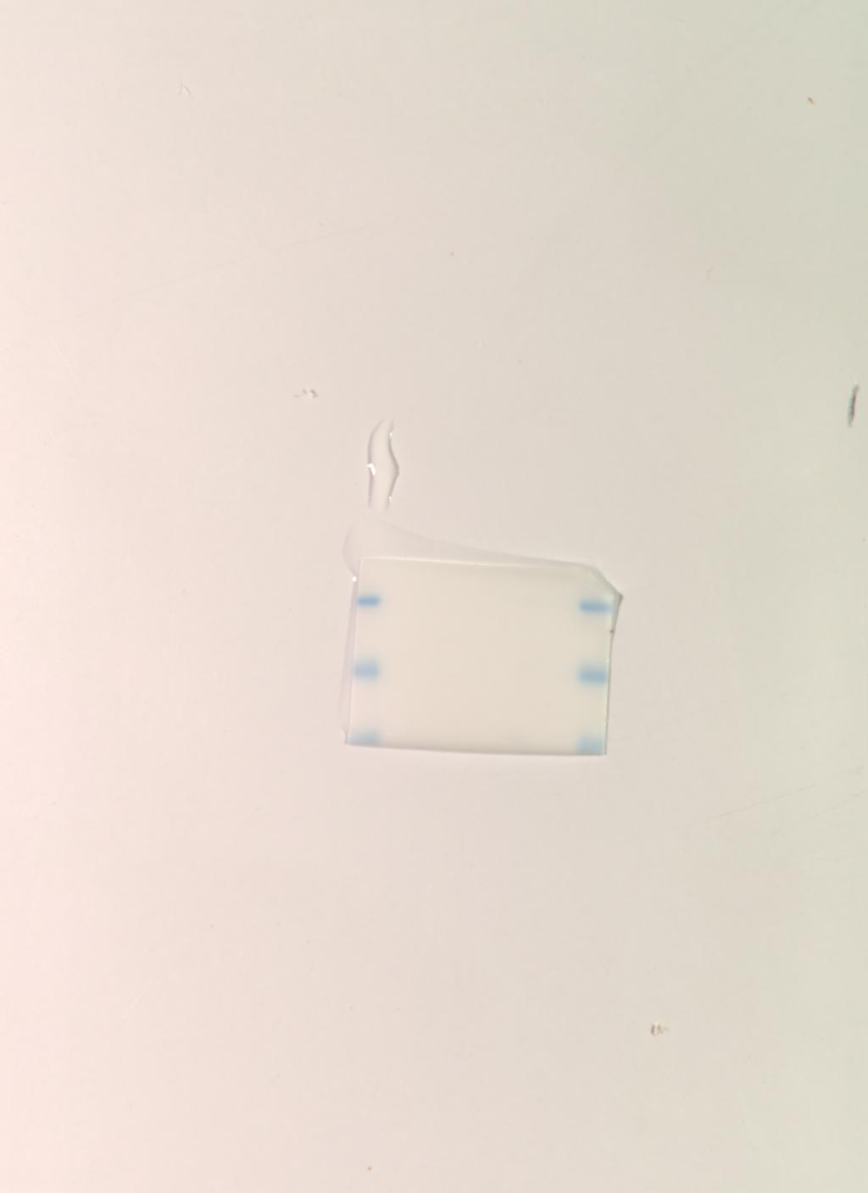
Figure 2G and S3
PC-3
Bcl-2
Caspase-3

Slide 22
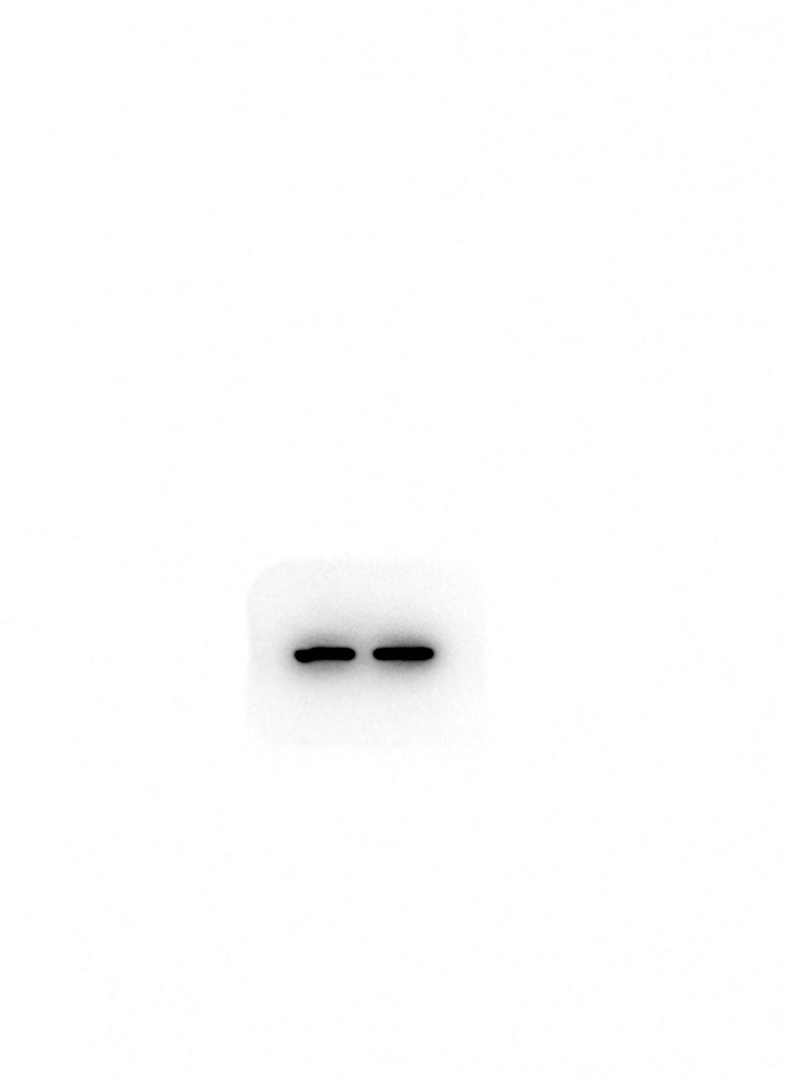
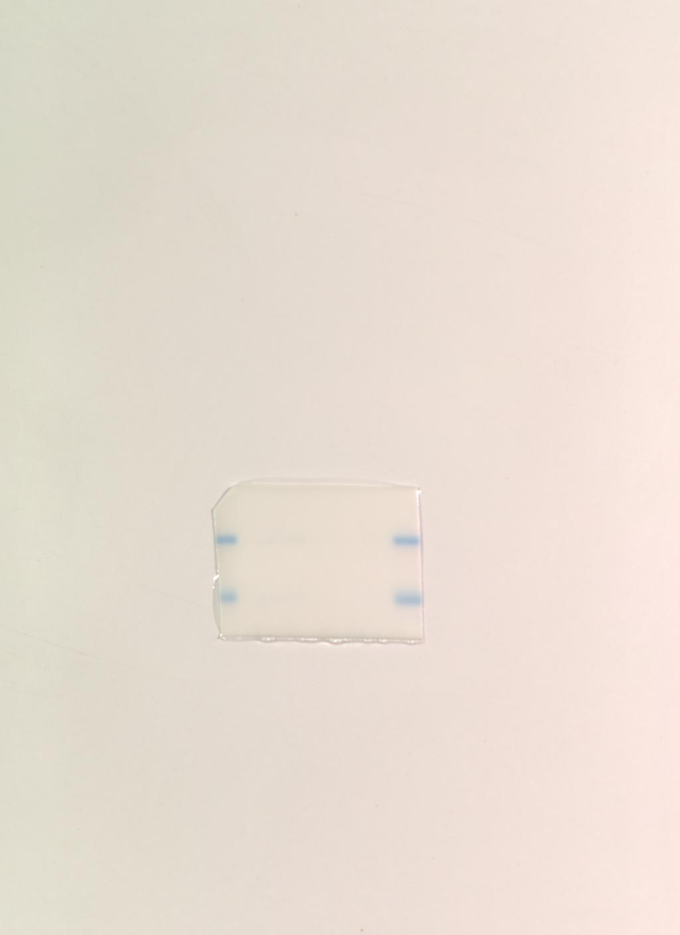
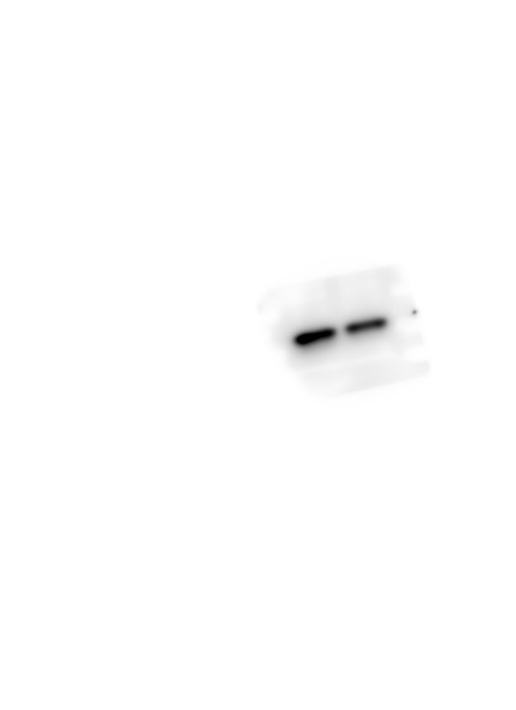
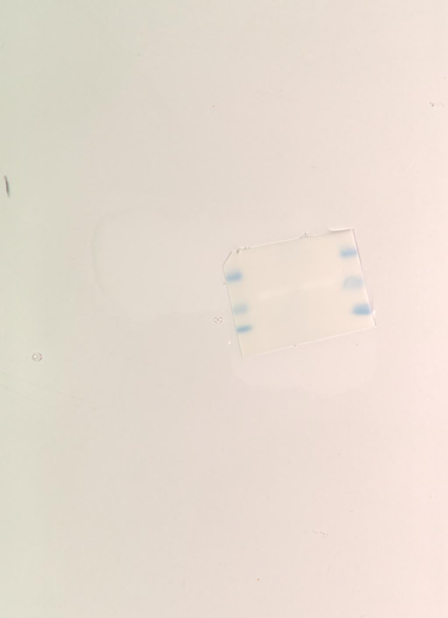
Figure 2G and S3
PC-3
GAPDH
HSP27

Slide 23
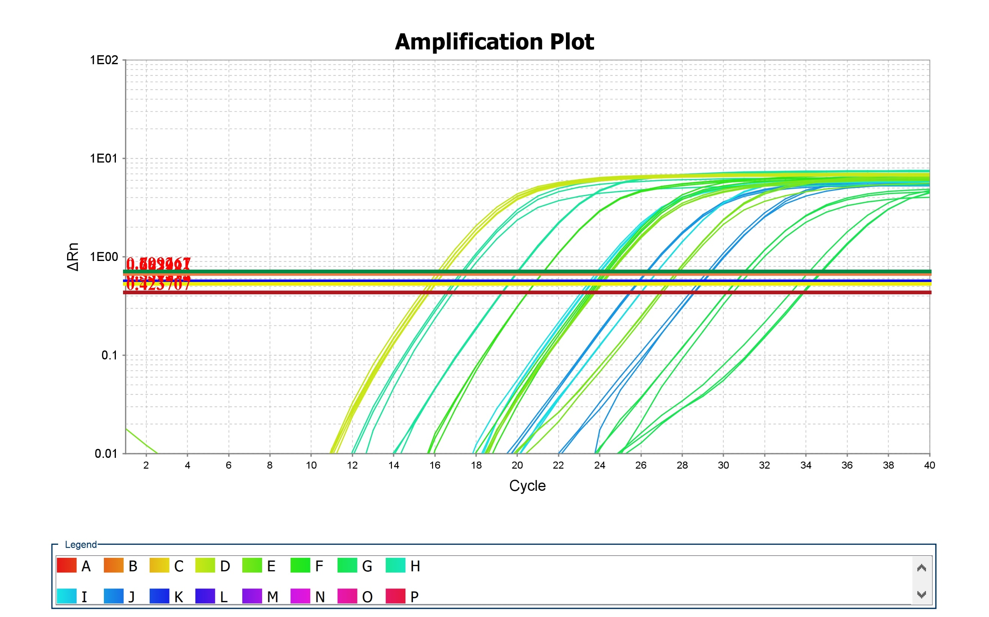
Figure 4B

Slide 24
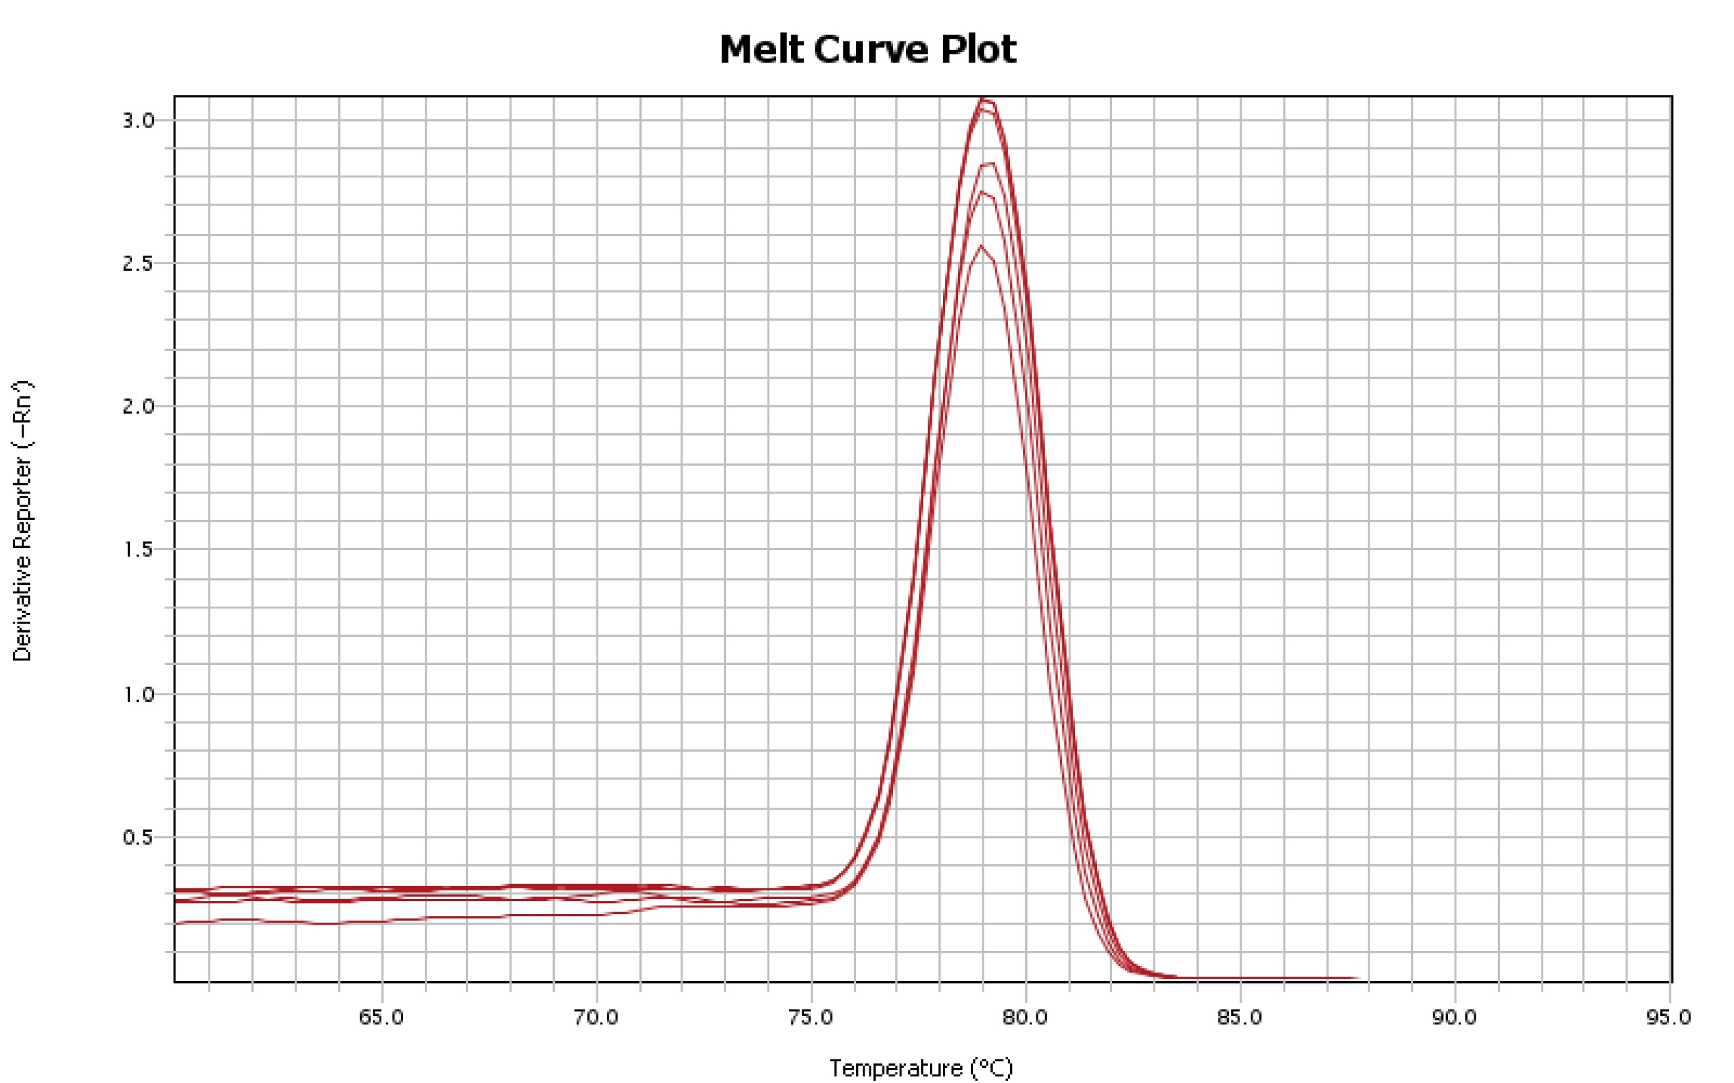
Figure 4B

Slide 25
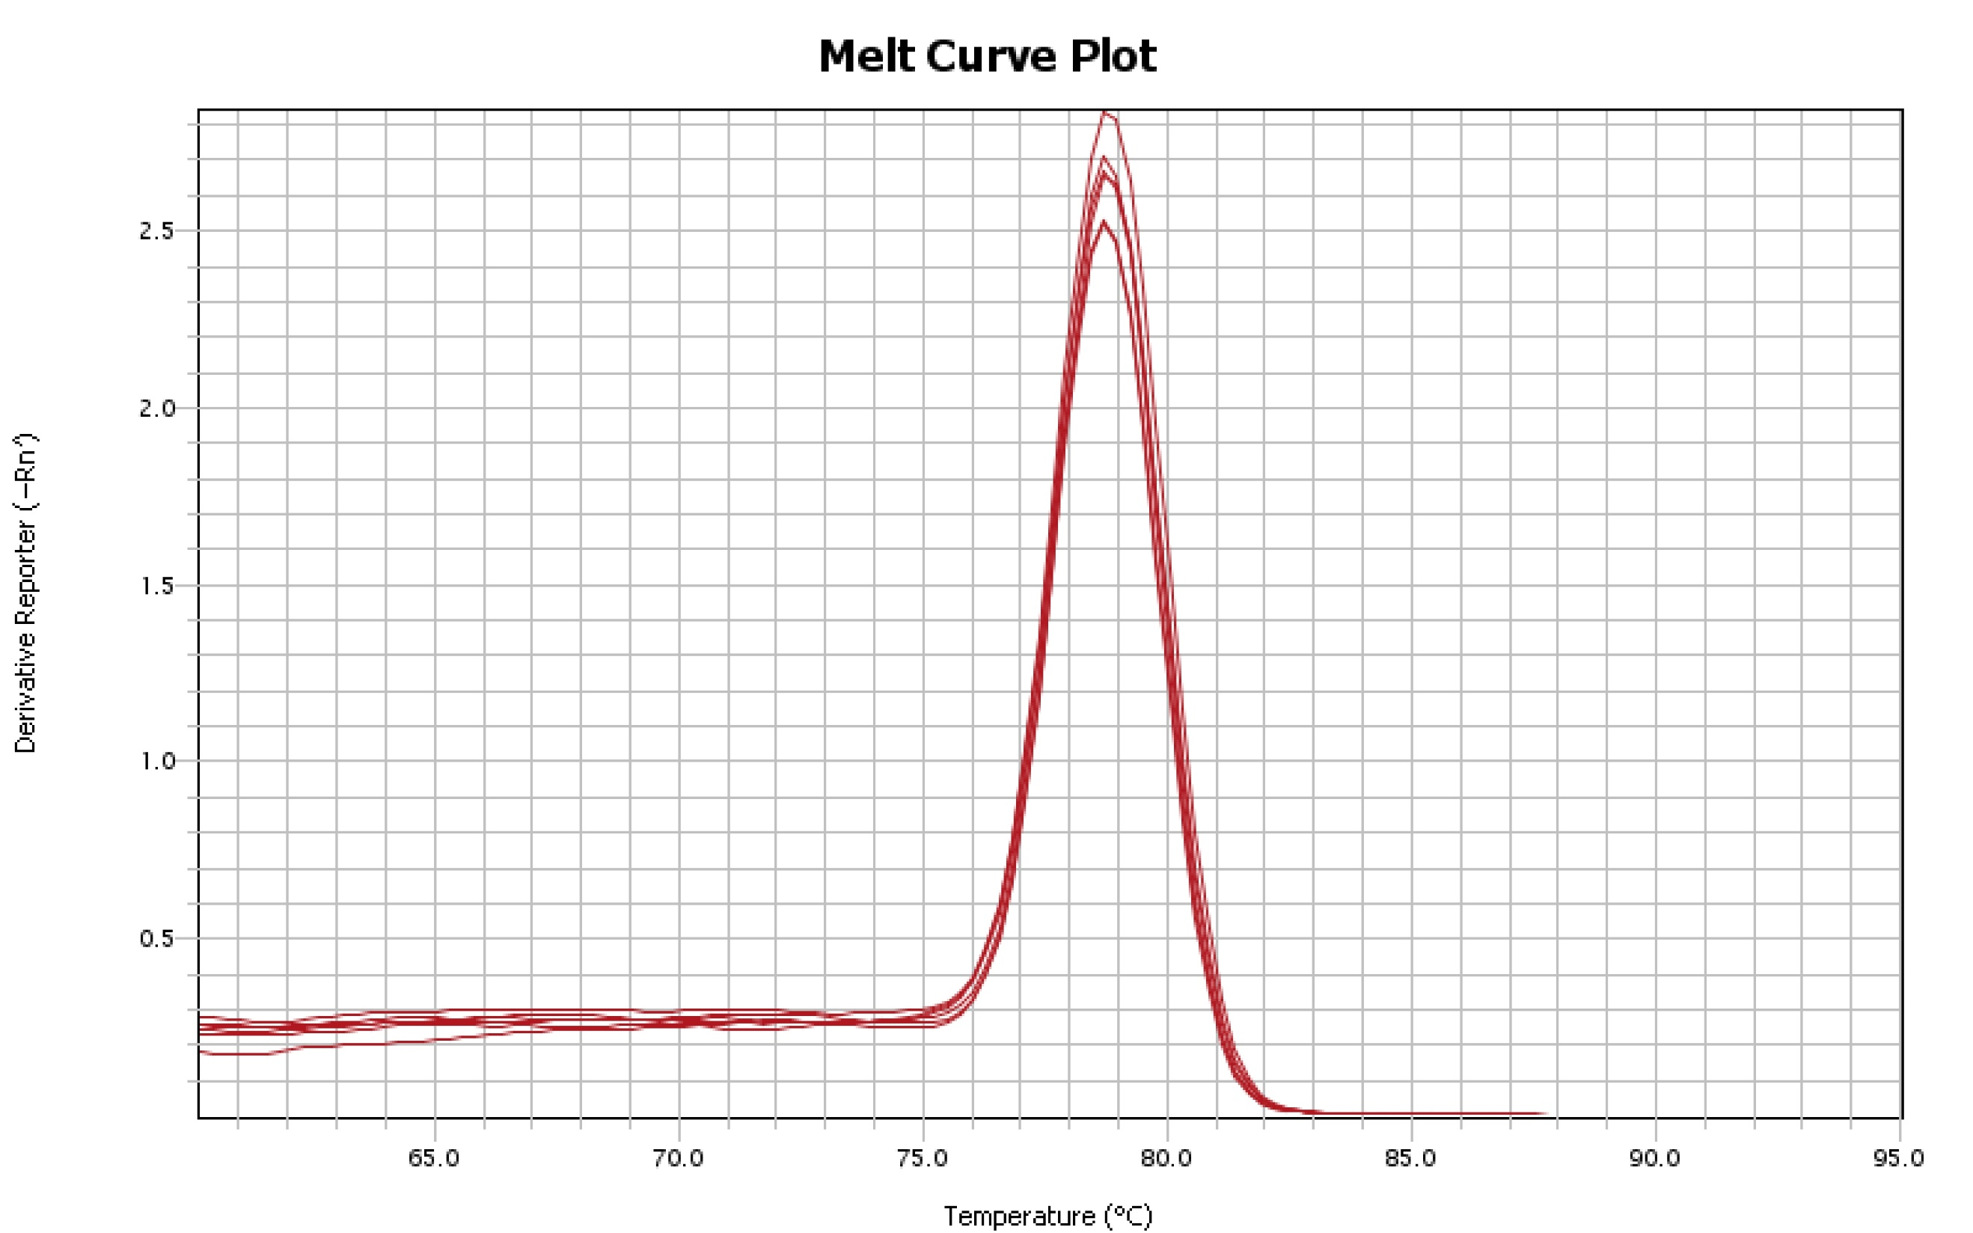
Figure 4B

Slide 26
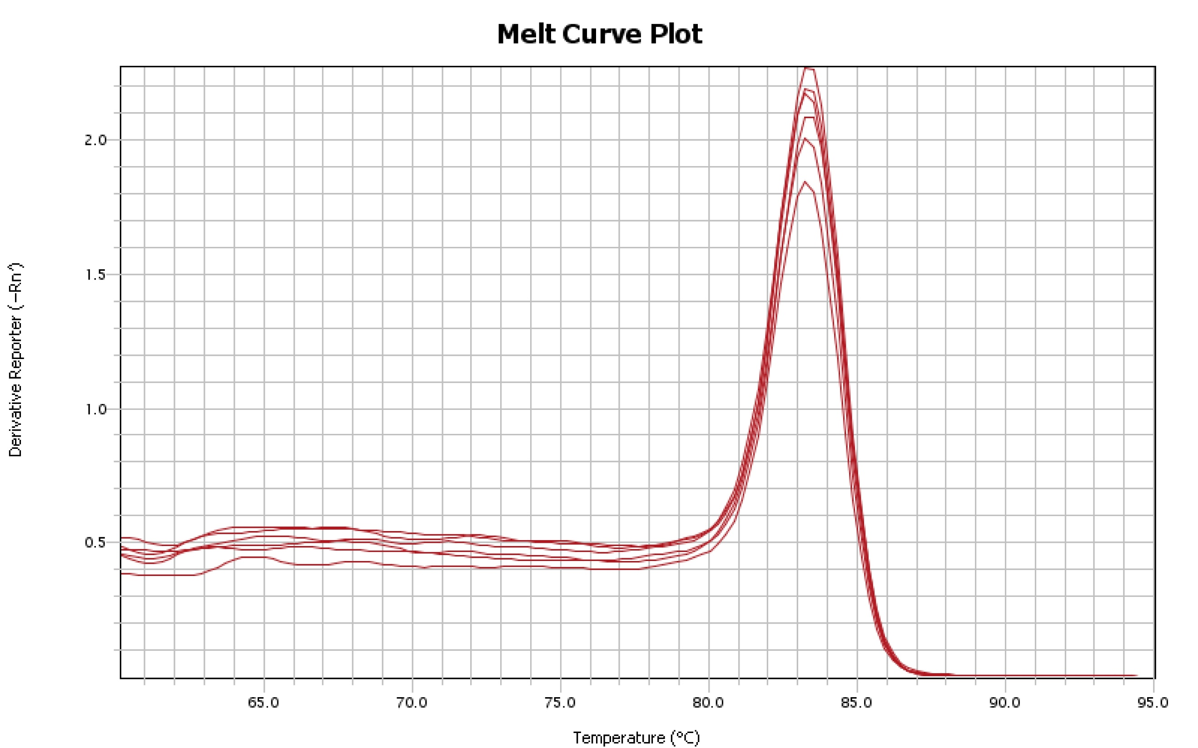
Figure 4B

Slide 27
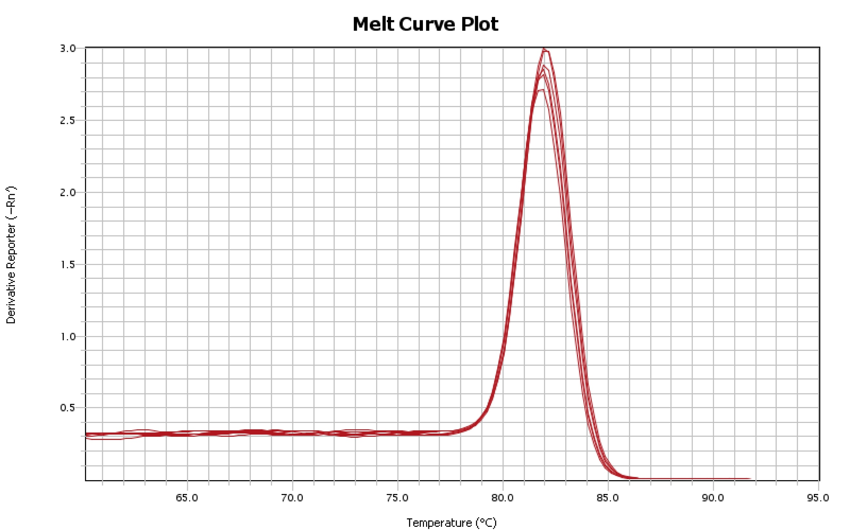
Figure 4B

Slide 28
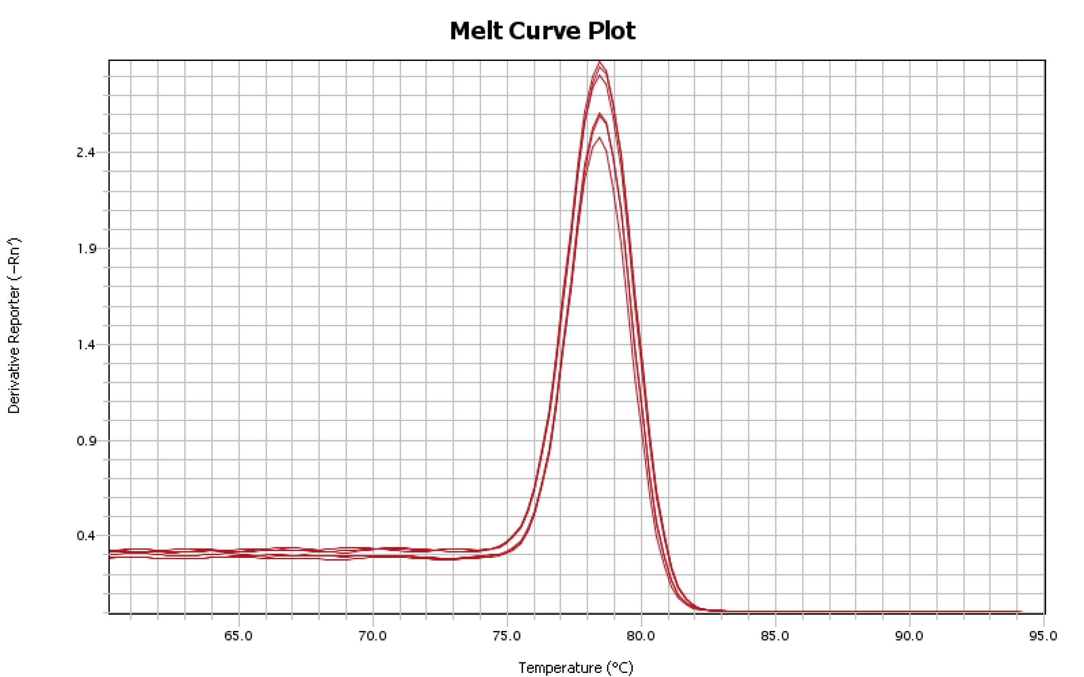
Figure 4B

Slide 29
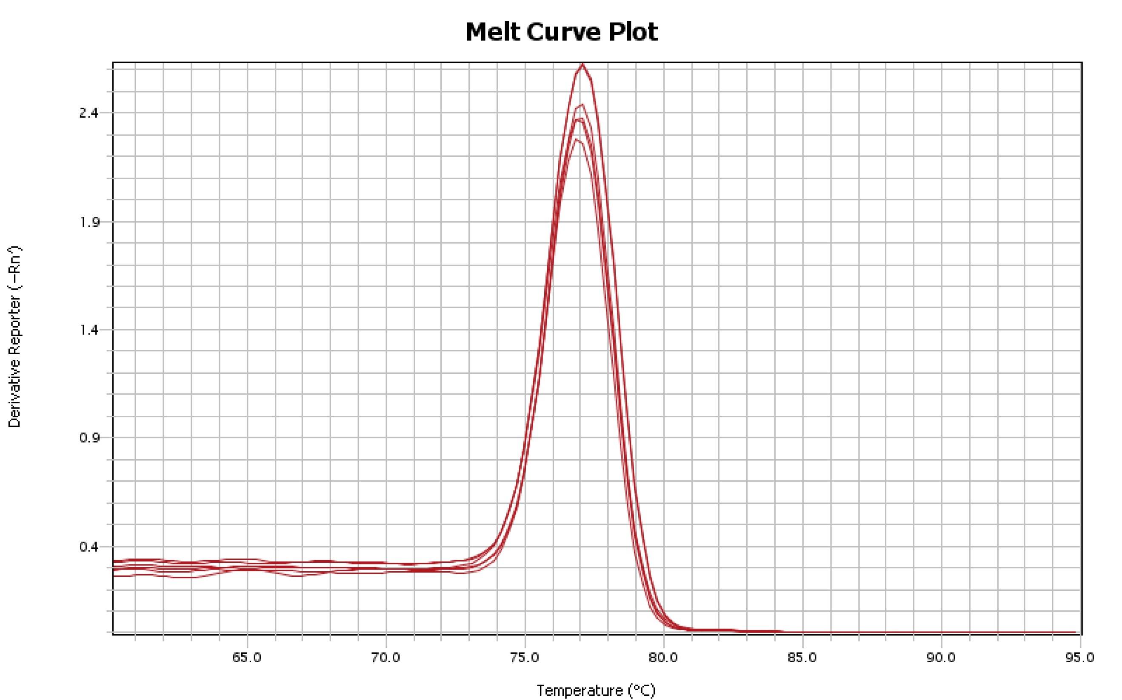
Figure 4B

Slide 30
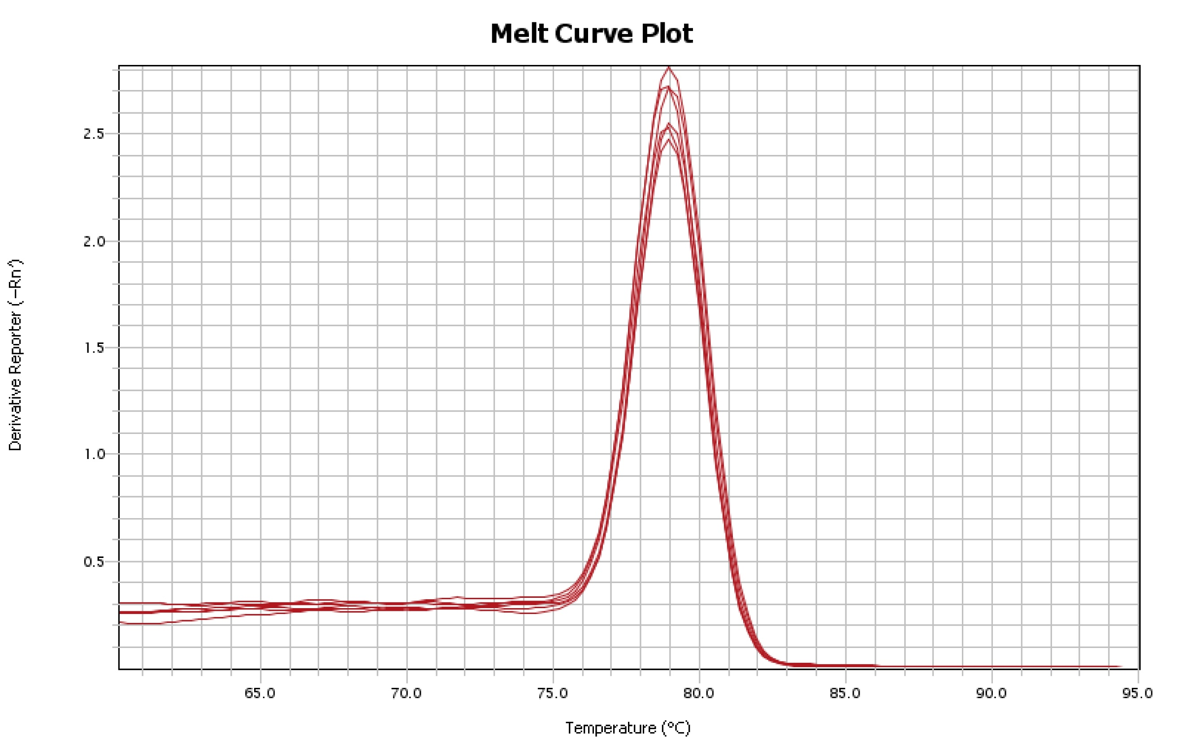
Figure 4B

Slide 31
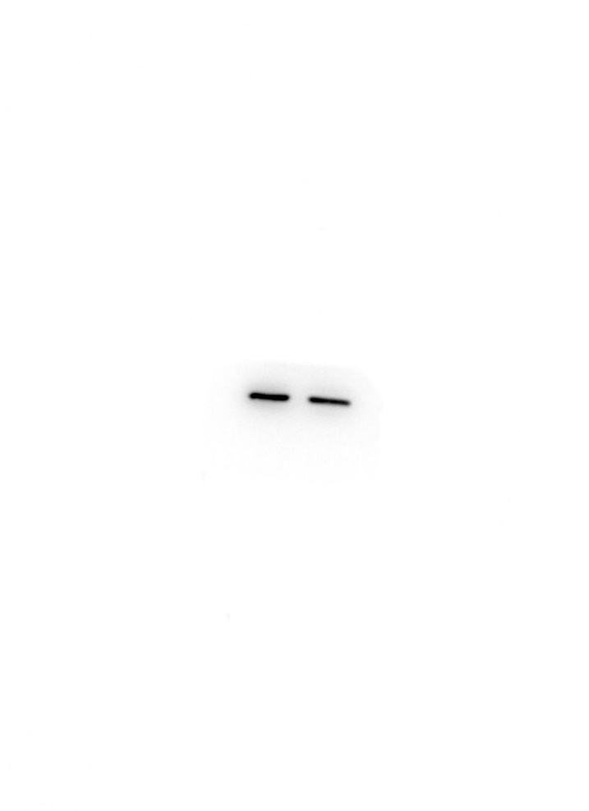
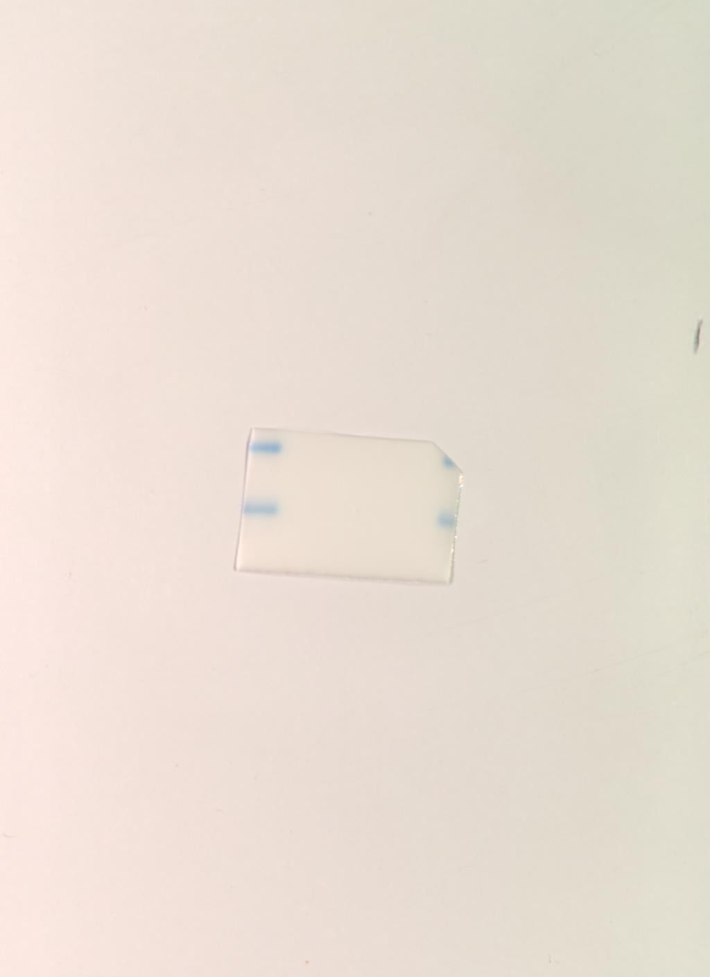

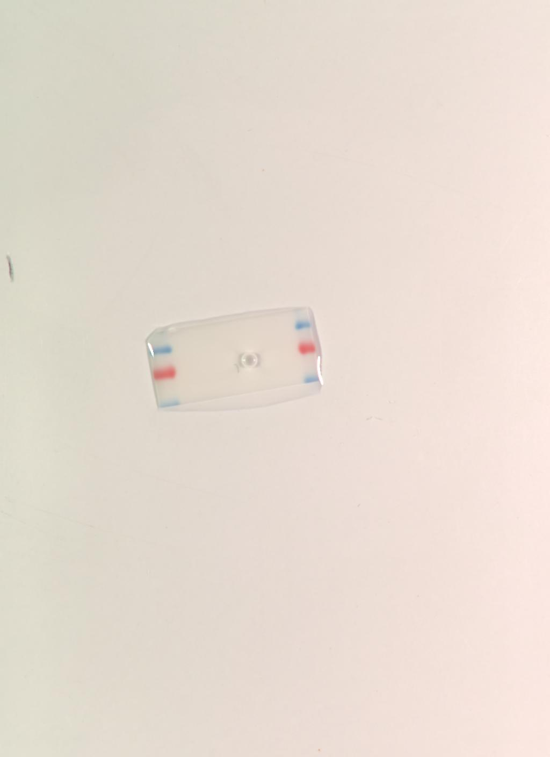
Figure 4C
ATF4
CDKL3

Slide 32
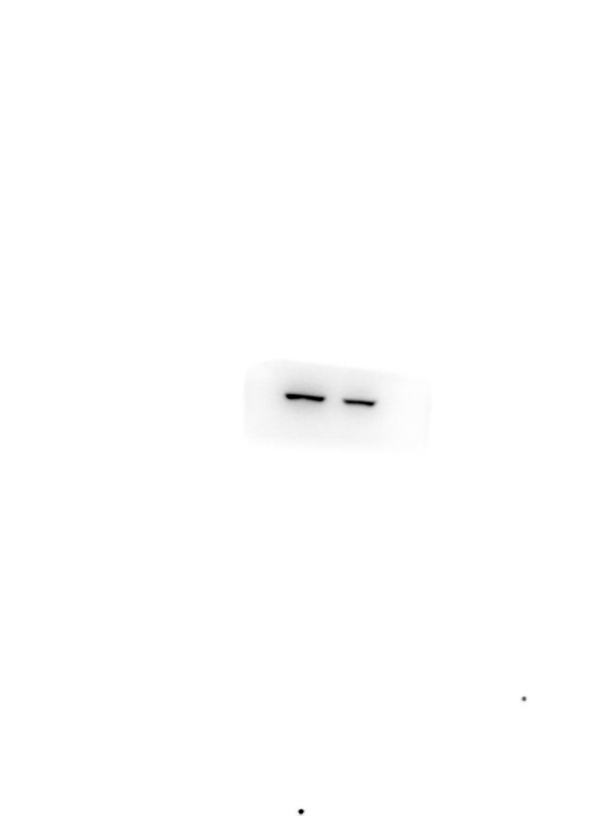
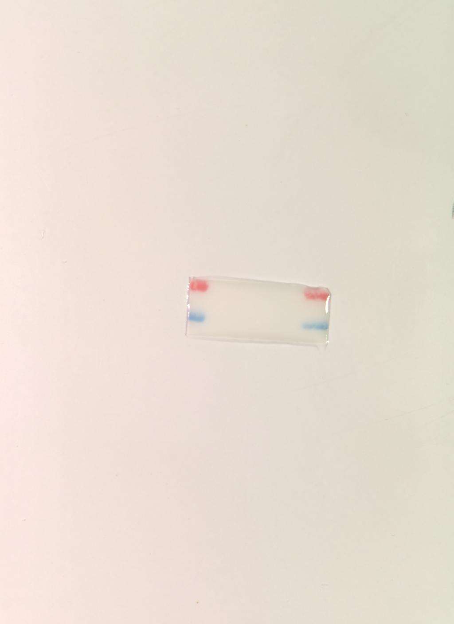
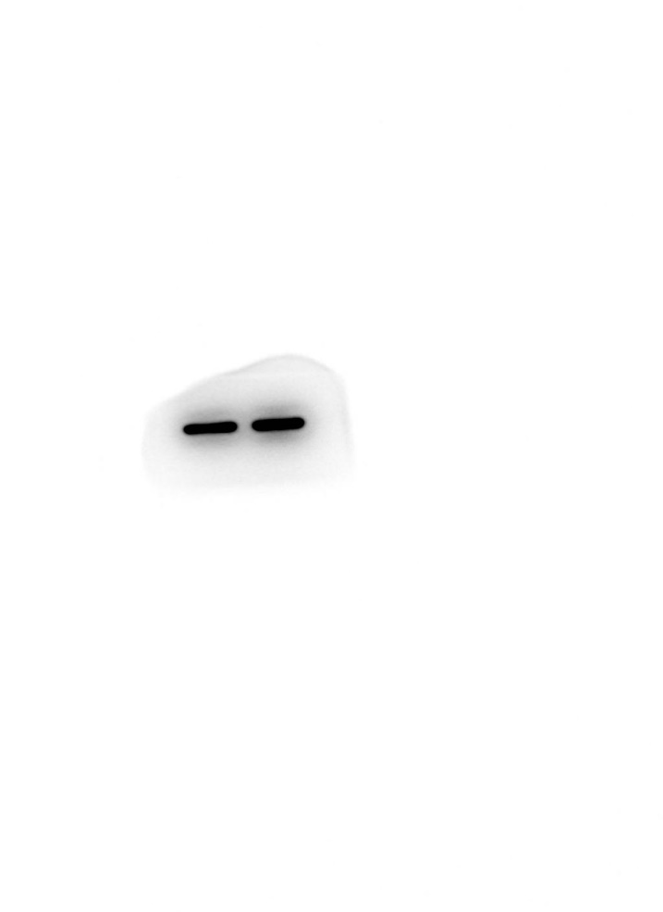
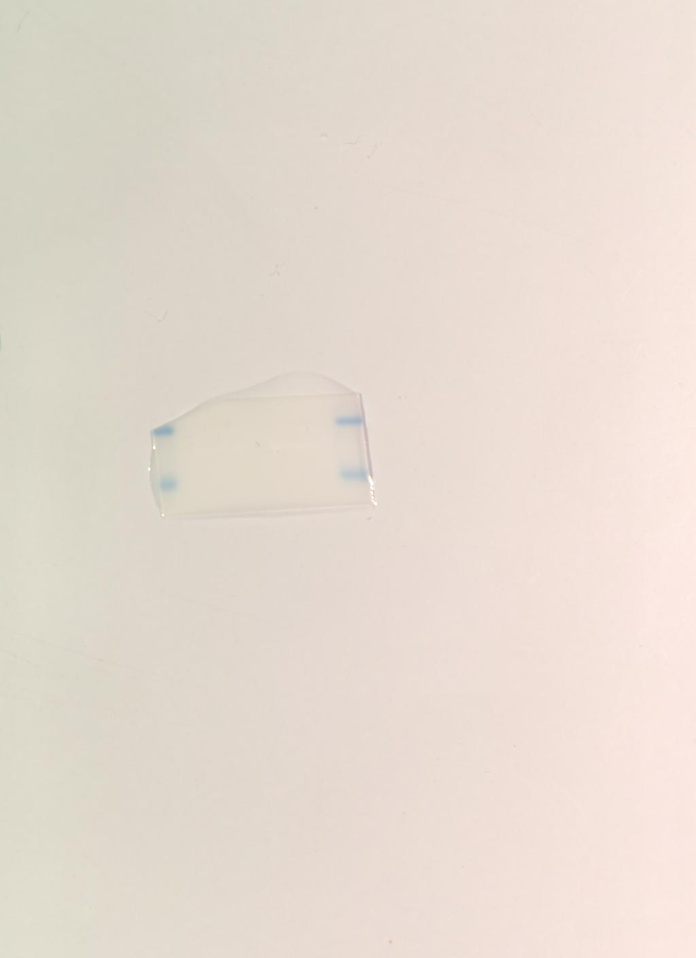
Figure 4C
FOS
GAPDH

Slide 33
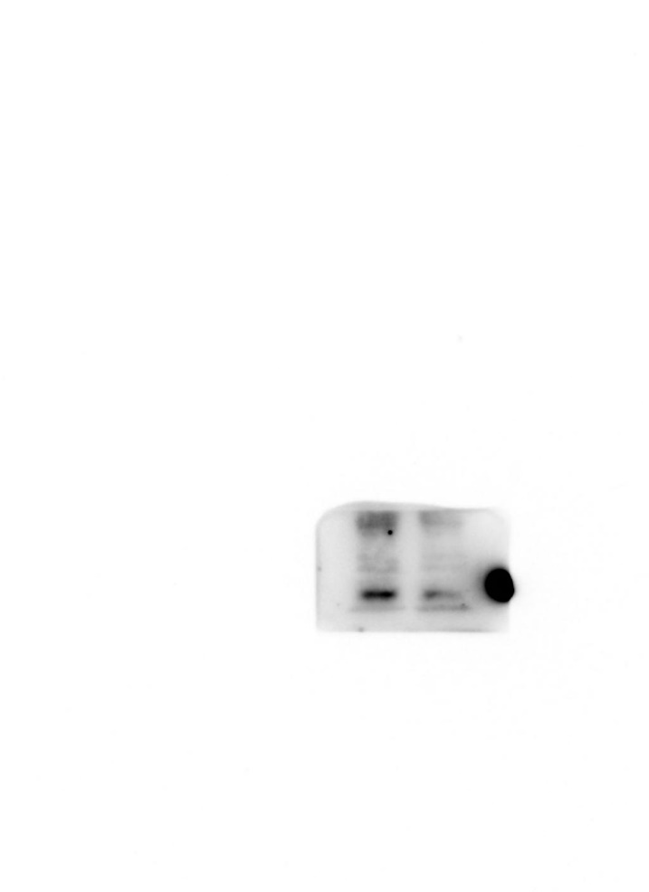
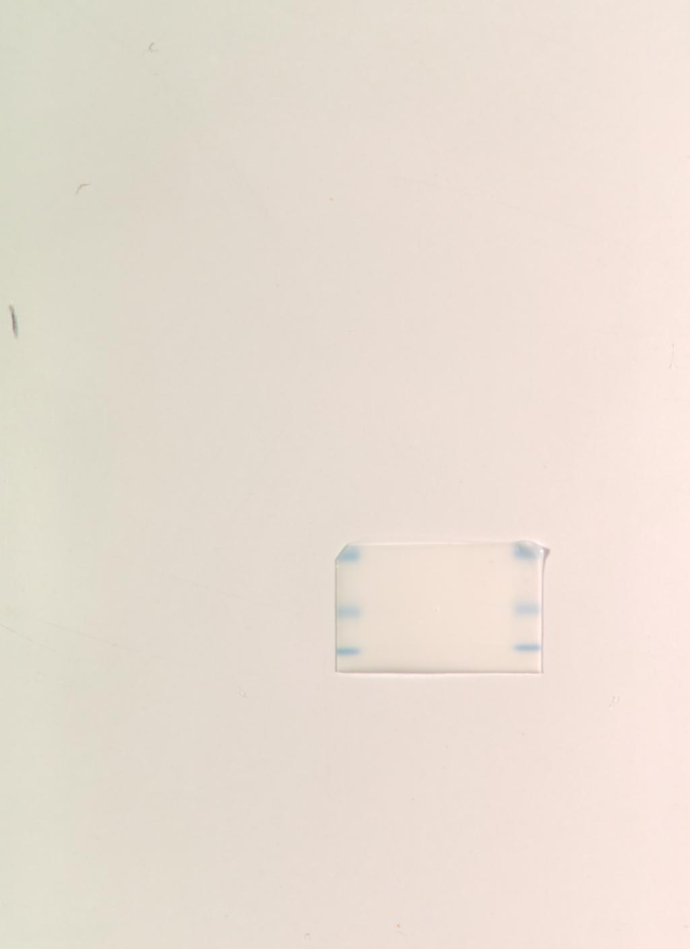


Figure 4C
NRAS
PIK3CB

Slide 34


Figure 4C
STAT1

Slide 35




Figure 4D and S6A
DU 145
CDKL3
ERK

Slide 36




Figure 4D and S6A
DU 145
GAPDH
p-ERK

Slide 37


Figure 4D and S6A
DU 145
STAT1

Slide 38




Figure 4D and S6A
PC-3
CDKL3
ERK

Slide 39




Figure 4D and S6A
PC-3
GAPDH
p-ERK

Slide 40


Figure 4D and S6A
PC-3
STAT1

Slide 41




Figure 5A-5B
GAPDH KD
GAPDH NC

Slide 42




Figure 5A-5B
STAT1 KD
STAT1 NC

Slide 43




Figure 5C
GAPDH
STAT1

Slide 44


Figure 5D
Ubiquitin

Slide 45




Figure 5F-5G
GAPDH NC
GAPDH OE

Slide 46




Figure 5F-5G
STAT1 NC
STAT1 OE

Slide 47




Figure 5H
GAPDH
STAT1

Slide 48


Figure 5I
Ubiquitin

Slide 49




Figure 5J
CBL
Figure 5J

Slide 50




Figure S4
DU 145
CDKL3
GAPDH

Slide 51




Figure S4 PC-3
CDKL3
GAPDH

Slide 52

Figure S7

Slide 53

Figure S7

Slide 54

Figure S7

Slide 55
Figure S7

Slide 56

Figure S8A-S8B

Slide 57

Figure S8A-S8B

Slide 58

Figure S8A-S8B

Slide 59

Figure S8A-S8B

Slide 60
Figure S8A-S8B

Slide 61




Figure S8C
CDKL3
GAPDH

Slide 62


Figure S8C
STAT1

