Slide 1




Figure 1F
PDE4D
100KD
70KD
GAPDH
40KD
35KD
PDE4D
100KD
70KD
GAPDH
40KD
35KD

Slide 2

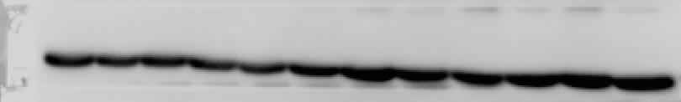
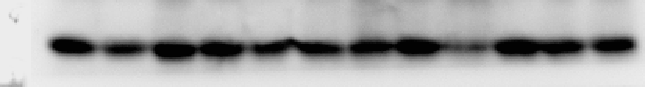

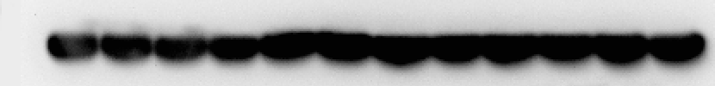
Figure 2A
PDE4D
100KD
70KD
GAPDH
40KD
35KD
PDE4D
100KD
70KD
GAPDH
40KD
35KD
PDE4D
100KD
70KD
GAPDH
40KD
35KD

Slide 3


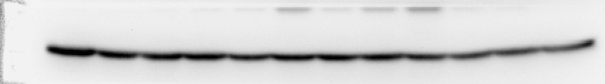

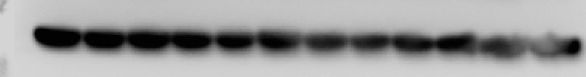
Figure 2H
P-AKT
70KD
55KD
AKT
70KD
55KD
GAPDH
40KD
35KD
P-AKT
70KD
55KD
70KD
AKT
55KD
GAPDH
40KD
35KD
P-AKT
70KD
55KD
70KD
AKT
55KD
GAPDH
40KD
35KD

Slide 4
Figure 3B
PDE4D
100KD
70KD
GAPDH
40KD
35KD
Figure 3C
P-AKT
70KD
55KD
AKT
70KD
55KD
GAPDH
40KD
35KD

Slide 5







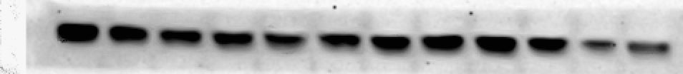
Figure 4D
70KD
p-AKT
55KD
70KD
AKT
55KD
p-AKT
70KD
55KD
70KD
AKT
55KD
70KD
p-AKT
55KD
70KD
AKT
55KD
Figure 4E
PDE4D
100KD
70KD
GAPDH
40KD
35KD
p-AKT
70KD
55KD
AKT
70KD
55KD

Slide 6
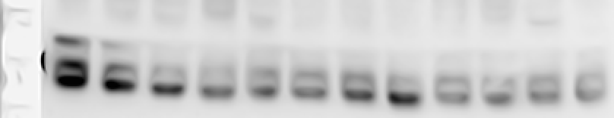


Figure 5A
TGF-β1
25KD
40KD
GAPDH
35KD
70KD
CD36
55KD
40KD
GAPDH
35KD

Slide 7
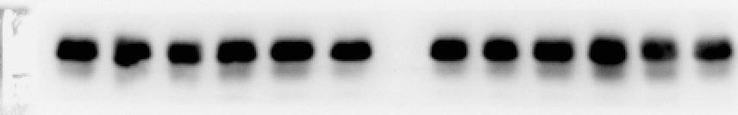

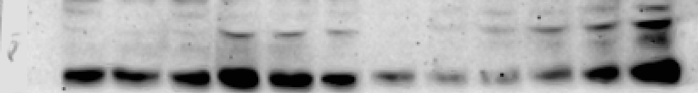


Figure5B
TGF-β1
25KD
GAPDH
40KD
35KD
P-SMAD2
55KD
SMAD2
55KD
Figure5D
TGF-β1
25KD
40KD
GAPDH
35KD
P-SMAD2
55KD
SMAD2
55KD

Slide 8



Figure5F
TGFβ1
25KD
Collagen1
140KD
GAPDH
40KD
35KD

Slide 9




Figure 6E
PDE4D
100KD
70KD
GAPDH
40KD
35KD
Figure 6F
TGF-β1
25KD
GAPDH
40KD
35KD
P-SMAD2
55KD
SMAD2
55KD

Slide 10






FigureS2A
70KD
p-AKT
55KD
AKT
70KD
55KD
FigureS2B
70KD
p-AKT
55KD
AKT
70KD
55KD
FigureS2C
p-AKT
70KD
55KD
70KD
AKT
55KD

