Slide 1
Mesothelioma paper
Blots- all figures

Slide 2

1E.
FN
Meso 8 to 27
Meso 33 and 55
Meso 60 and 70, Met-5A

Slide 3

1E.
FAP
Meso 8 to 27
Meso 33 and 55
Meso 60 and 70, Met-5A

Slide 4

1E.
αSMA
Meso 8 to 27
Meso 33 and 55
Meso 60 and 70, Met-5A

Slide 5

1E.
Actin β
Meso 8 to 27
Meso 33 and 55
Meso 60 and 70, Met-5A

Slide 6
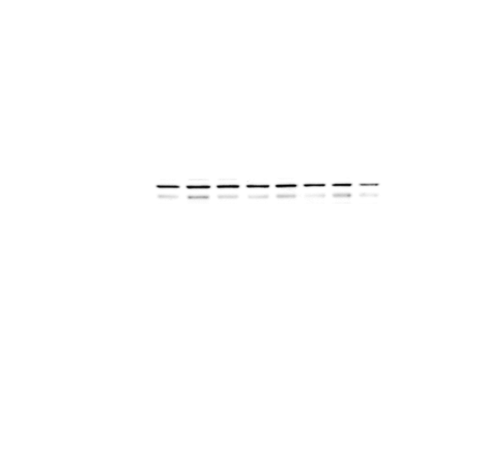
2B.
ENG

Slide 7

2B.
ANGPT-2

Slide 8

2B.
MIC-1

Slide 9
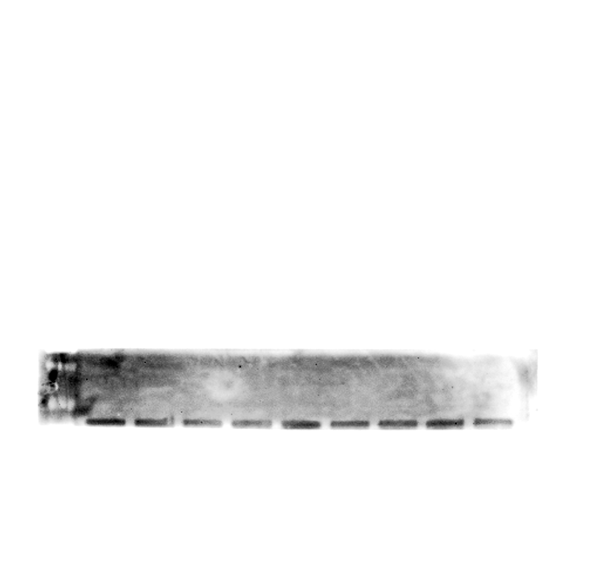
2B.
IL-8

Slide 10
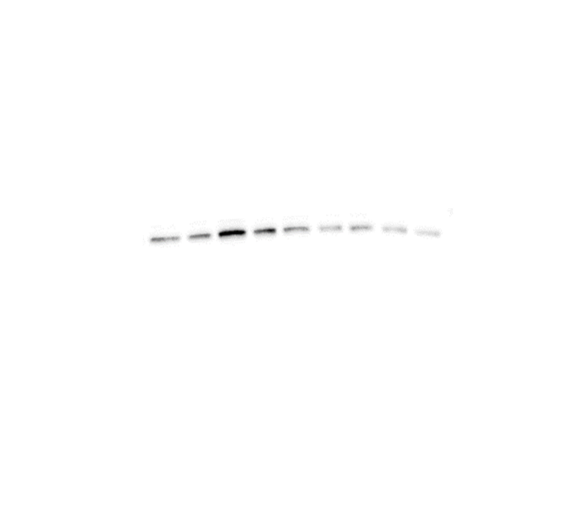
2B.
IL-1A

Slide 11

2B.
IL-17A

Slide 12

2B.
IL-6

Slide 13
2B.
MIF

Slide 14

2B.
Actin B

Slide 15
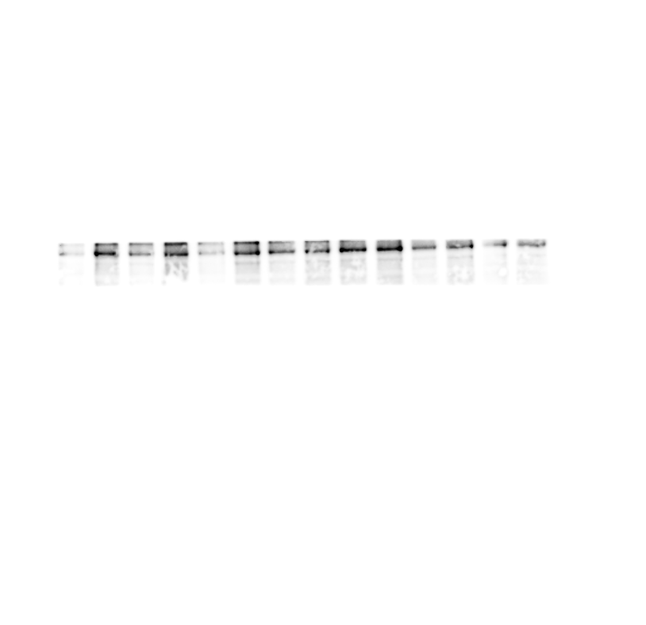
3B.
FN

Slide 16
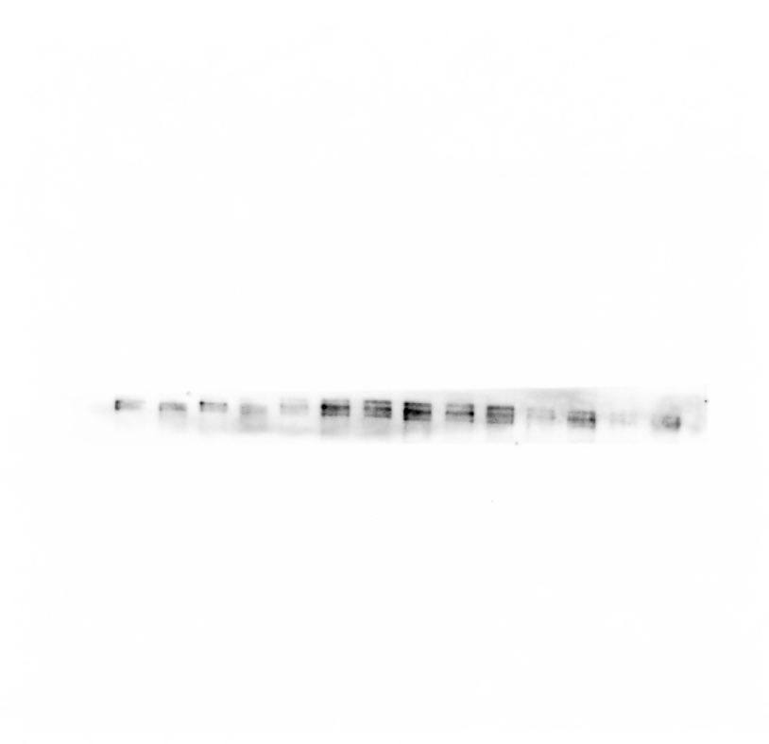
3B.
FBN2

Slide 17
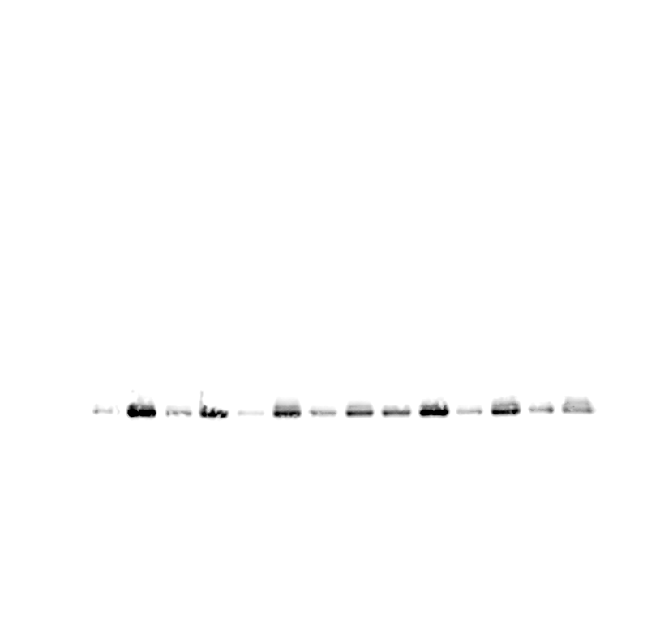
3B.
FAP

Slide 18

3B.
aSMA

Slide 19

3B.
Actin β

Slide 20
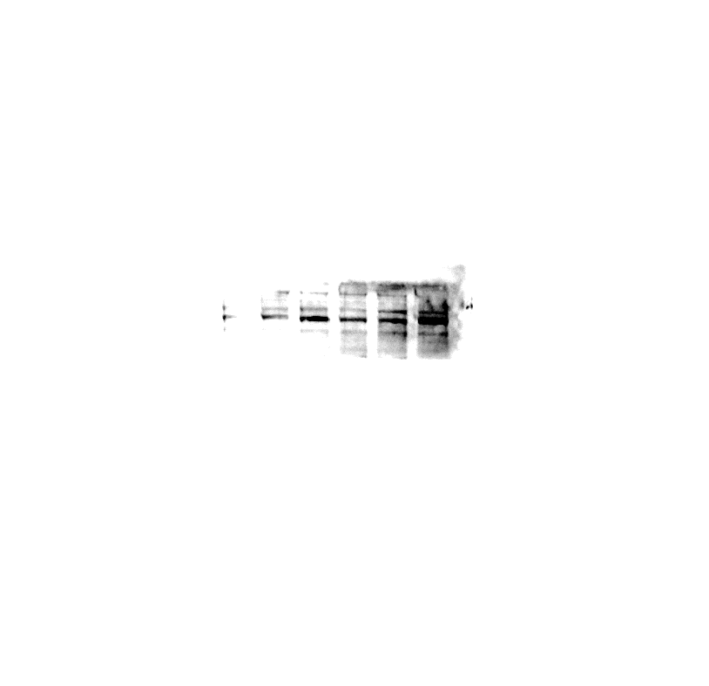







Complete blot of figure 4C – condition NF (rpmi) ECM was excluded in the final figure
4C.
CAF
8
ECM
CAF
12
ECM
CAF
33
ECM
CAF
70
ECM
NF
(Met)
ECM
NF
(rpmi)
ECM
COL IV
250
FN
250
FBN2
240
FAP
95
αSMA
50
Bcl-xL
30
Bcl-2
28
Actin β
48

Slide 21
4C.
COL IV

Slide 22
4C.
FN

Slide 23
4C.
FBN2

Slide 24
4C.
FAP

Slide 25
4C.
αSMA

Slide 26
4C.
Bcl-xL

Slide 27
4C.
Bcl-2

Slide 28
4C.
Actin β

Slide 29
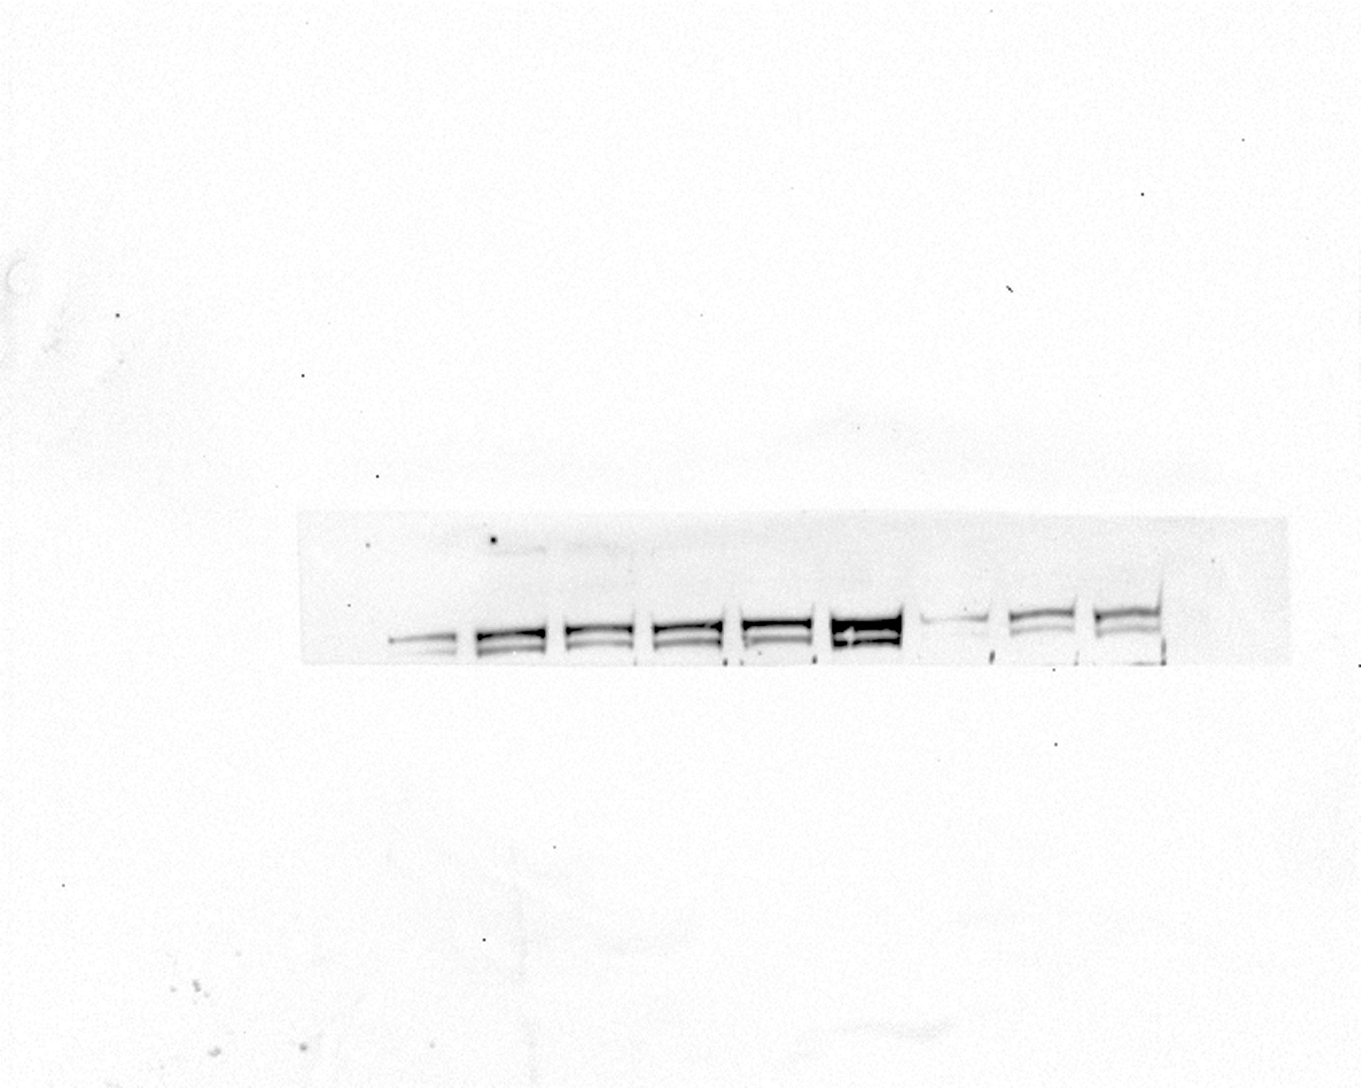
5C.
pmTOR

Slide 30
5C.
mTOR

Slide 31
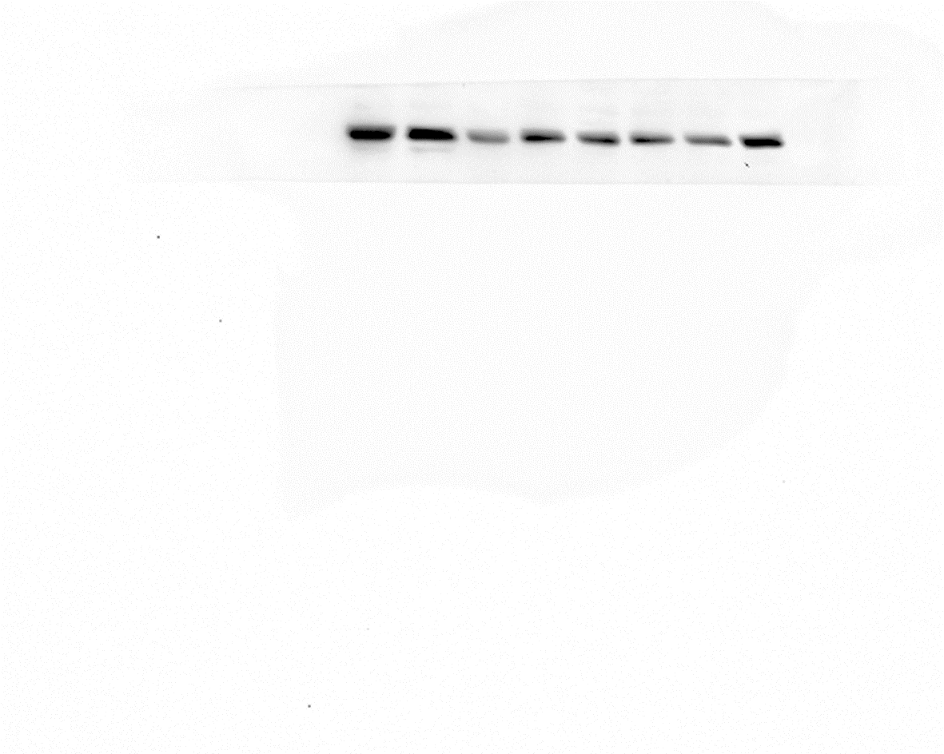
5C.
pPDGFRB

Slide 32
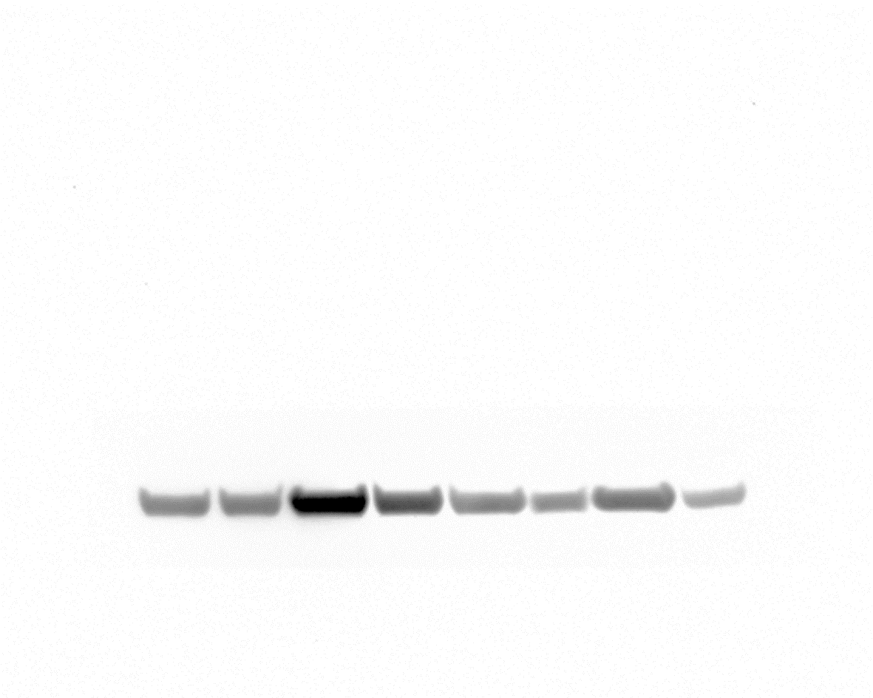
5C.
PDGFRA

Slide 33
5C.
PDGFRA

Slide 34

5C.
PRKACA

Slide 35
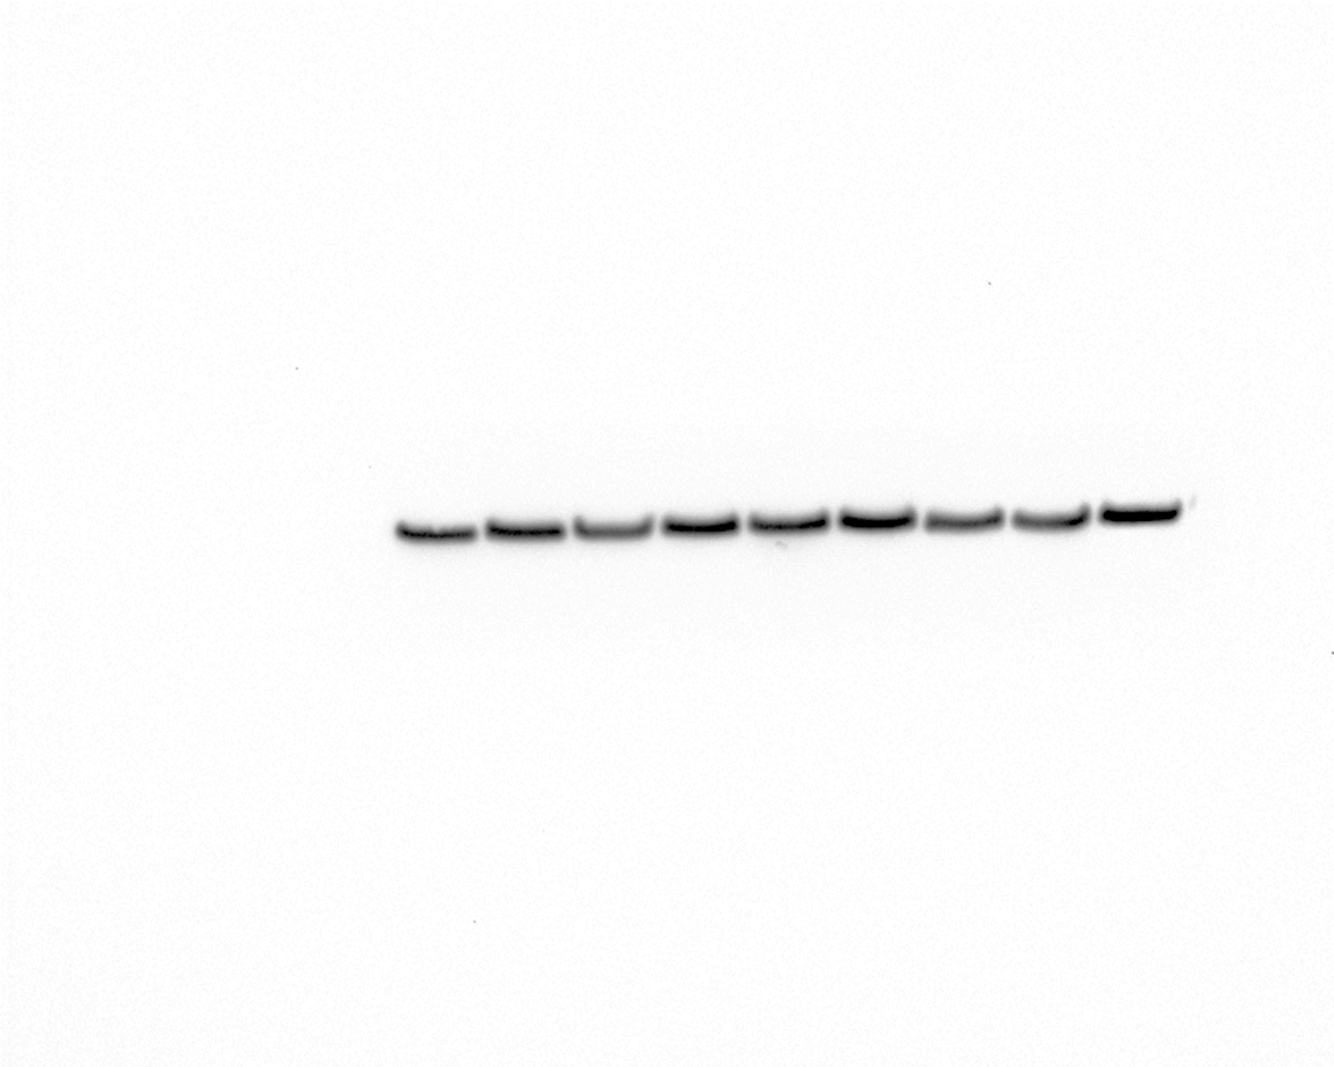
5C.
pSRC

Slide 36

5C.
SRC

Slide 37
5C.
pAKT1

Slide 38
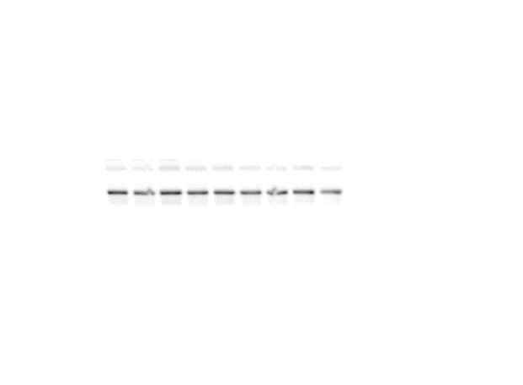
5C.
AKT1

Slide 39

5C.
BCL-2

Slide 40

5C.
VCL

Slide 41

5D.
pmTOR

Slide 42
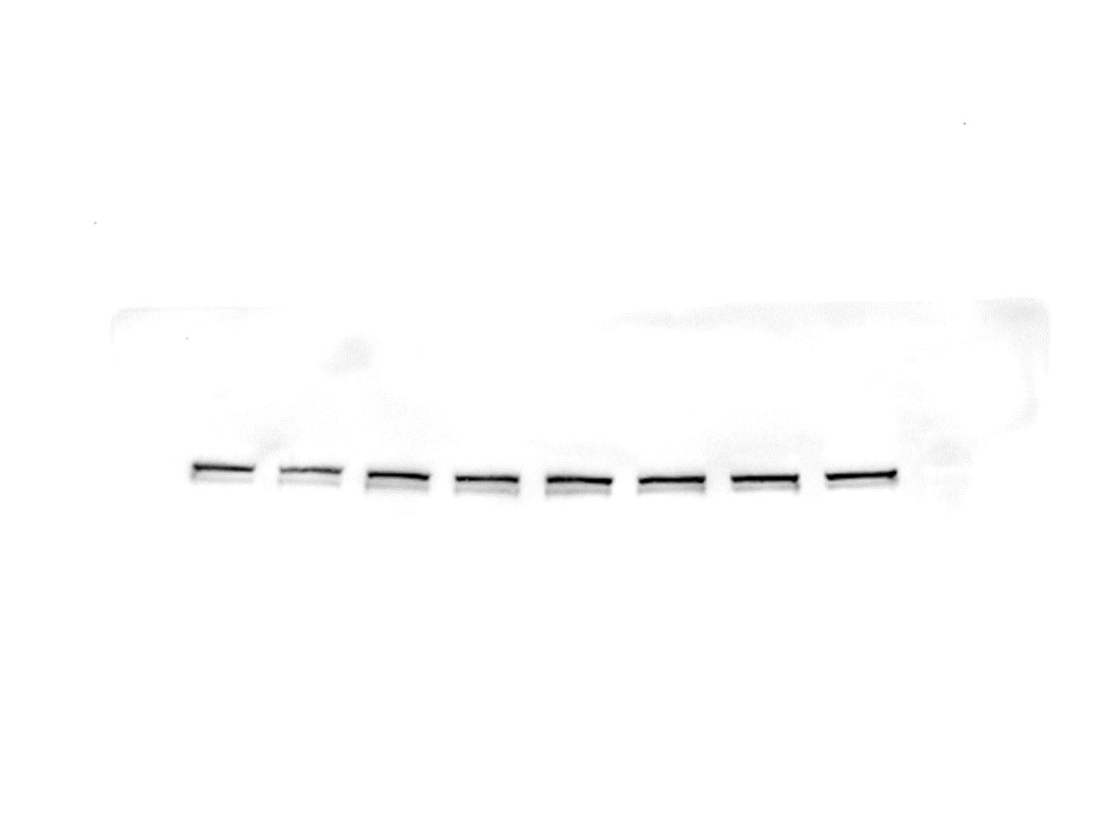
5D.
mTOR

Slide 43
5D.
pPDGFRB

Slide 44
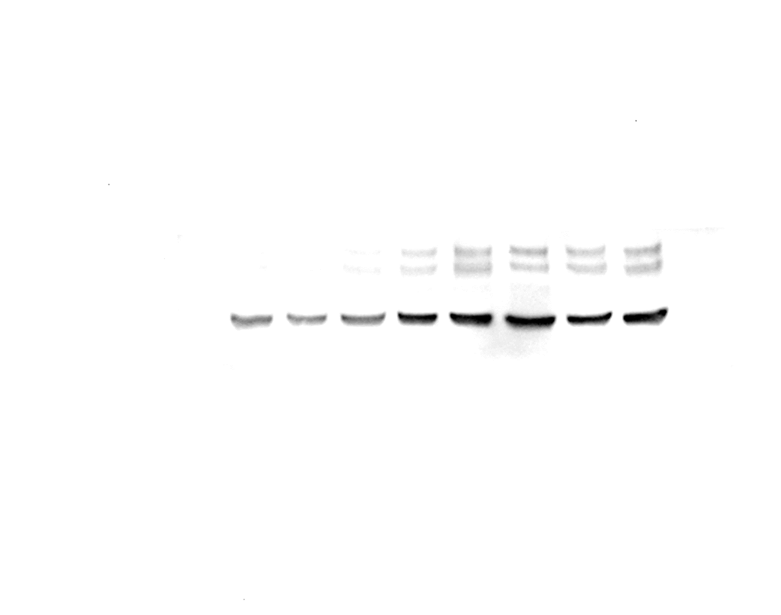
5D.
PDGFRA

Slide 45

5D.
PRKACA

Slide 46

5D.
pAKT

Slide 47

5D.
AKT

Slide 48

5D.
pSRC

Slide 49
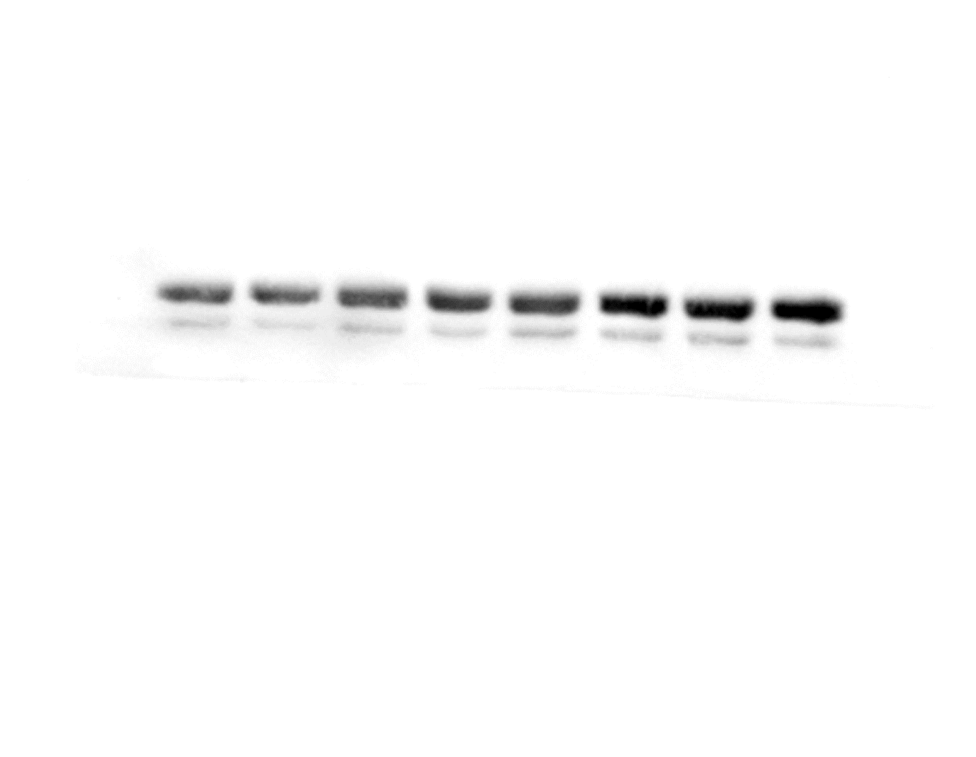
5D.
SRC

Slide 50

5D.
ACTIN β

Slide 51

Supp 2D
FN

Slide 52

Supp 2D
FAP

Slide 53

Supp 2D
α-SMA

Slide 54

Supp 2D
ACTIN β

Slide 55

Supp 2E
COL IV

Slide 56

Supp 2E
FN

Slide 57

Supp 2E
FAP

Slide 58

Supp 2E
αSMA

Slide 59

Supp 2E
ACTIN β

Slide 60
Supp 3D
XIAP

Slide 61
Supp 3D
BCL2

Slide 62
Supp 3D
S112-BAD

Slide 63
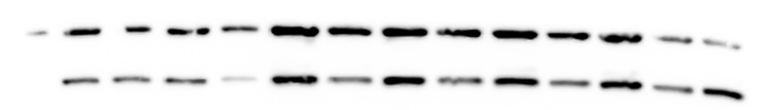
Supp 3D
CASP7

Slide 64
Supp 3D
ACTIN β

Slide 65

Supp 11C
FAP

Slide 66
Supp 11C
FN

Slide 67
Supp 11C
S2481- mTOR

Slide 68
Supp 11C
mTOR

Slide 69
Supp 11C
T389- p70S6K

Slide 70
Supp 11C
PKCα

Slide 71
Supp 11C
S473-AKT

Slide 72
Supp 11C
AKT

Slide 73

Supp 11C
Actin β

Slide 74
Supp 11D
FN

Slide 75

Supp 11D
ENG

Slide 76
Supp 11D
pSRC

Slide 77
Supp 11D
SRC

Slide 78
Supp 11D
Bcl2

Slide 79
Supp 11D
Actin β

