Slide 1






Figure 1G
N | T | N | T | N | T | N | T
ALDH9A1
55kDa
40kDa
GAPDH
35kDa
N | T | N | T | N | T | N | T
ALDH9A1
55kDa
GAPDH
40kDa
35kDa
N | T | N | T | N | T | N | T
ALDH9A1
55kDa
40kDa
GAPDH
35kDa

Slide 2




Figure 1H
55kDa
ALDH9A1
GAPDH
40kDa
35kDa

Slide 3








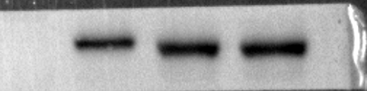


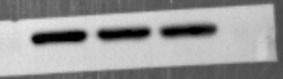
Figure 4C
OE-FTO | - | +
70kDa
FTO
55kDa
ALDH9A1
40kDa
GAPDH
35kDa
siFTO | - | + | +
70kDa
FTO
55kDa
55kDa
ALDH9A1
GAPDH
35kDa

Slide 4
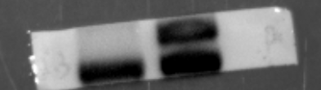

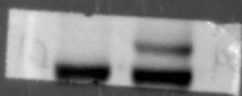








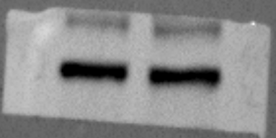



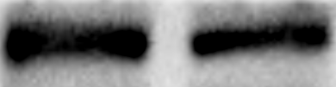




















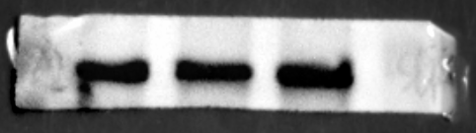

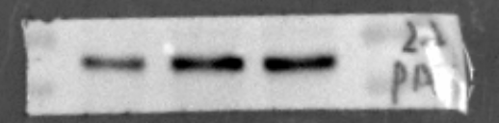

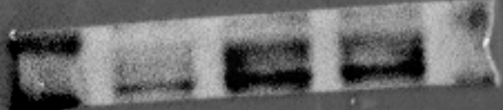

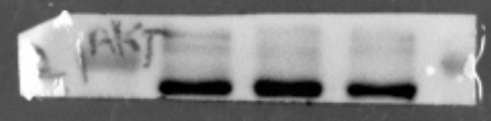




Figure 5C and 5D
OE-ALDH | - | +
OE-ALDH | - | +
55kDa
ALDH9A1
55kDa
ALDH9A1
70kDa
P AKT
70kDa
P AKT
55kDa
55kDa
70kDa
AKT
70kDa
AKT
55kDa
55kDa
70kDa
S6K
70kDa
PS6K
55kDa
55kDa
55kDa
PS6K
70kDa
S6K
55kDa
55kDa
GAPDH
55kDa
GAPDH
35kDa
35kDa
siALDH | - | + | +
siALDH | - | + | +
ALDH9A1
55kDa
ALDH9A1
55kDa
P AKT
70kDa
P AKT
70kDa
55kDa
55kDa
AKT
70kDa
AKT
70kDa
55kDa
55kDa
S6K
70kDa
PS6K
70kDa
11-5
55kDa
55kDa
PS6K
70kDa
S6K
70kDa
11-5
55kDa
GAPDH
35kDa
GAPDH
35kDa

Slide 5


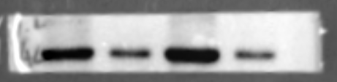






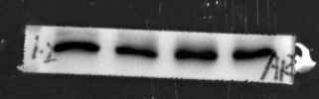





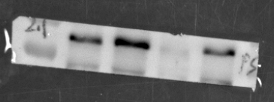








Figure 5E
siALDH9A1 | - | + | - | +
siALDH9A1 | - | + | - | +
LY294002 | - | - | + | +
LY294002 | - | - | + | +
55kDa
ALDH9A1
55kDa
ALDH9A1
P AKT
70kDa
55kDa
P-AKT
70kDa
55kDa
AKT
70kDa
70kDa
55kDa
AKT
55kDa
PS6K
70kDa
55kDa
P-S6K
70kDa
55kDa
S6K
70kDa
S6K
70kDa
55kDa
GAPDH
GAPDH
35kDa
35kDa

Slide 6



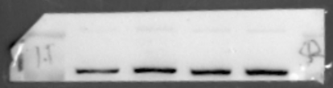

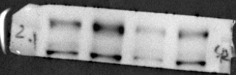




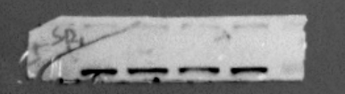





Figure 5E
siALDH9A1 | - | + | - | +
LY294002 | - | - | + | +
ALDH9A1
55 kDa
SREBP1（p）
130 kDa
SREBP1（m）
70 kDa for understrip
GAPDH
35 kDa
siALDH9A1 | - | + | - | +
LY294002 | - | - | + | +
ALDH9A1
55 kDa
SREBP1（p）
130 kDa
SREBP1（m）
70 kDa
GAPDH
35 kDa

Slide 7





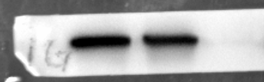






Figure 6E
OE-ALDH9A1 | - | +
ALDH9A1
55kDa
IQGAP2
180kDa
GAPDH
35kDa
siALDH9A1 | - | + | +
55kDa
ALDH9A1
IQGAP2
180kDa
GAPDH
35kDa

Slide 8







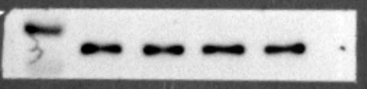

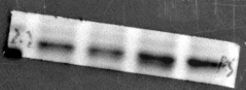




Figure 6L
ALDH9A1oe | - | + | - | +
IQGAP-kd | - | - | + | +
ALDH9A1
55kDa
IQGAP2
181kDa
P-AKT
70kDa
AKT
70kDa
55kDa
PS6K
70kDa
55kDa
S6K
70kDa
55kDa
GAPDH
35kDa

Slide 9

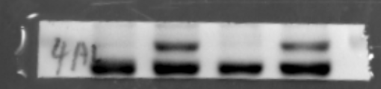

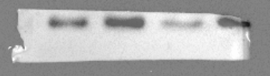

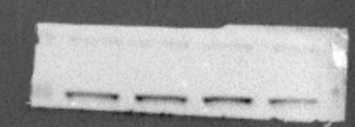






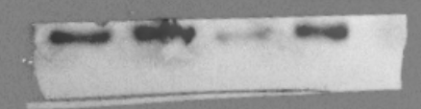







ALDH9A1oe | - | + | - | +
Figure 6M
IQGAP-kd | - | - | + | +
ALDH9A1
55 kDa
IQGAP2
180 kDa
SREBP1(p)
130 kDa
SREBP1(m)
70 kDa
GAPDH
35 kDa
ALDH9A1oe | - | + | - | +
IQGAP-kd | - | - | + | +
ALDH9A1
IQGAP2
181 kDa
SREBP1(p)
130 kDa
SREBP1 (m)
70 kDa
GAPDH
35 kDa

Slide 10

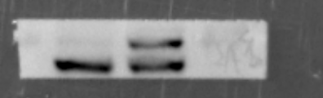
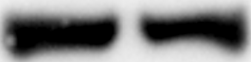

Figure 6M
293T
OE-ALDH9A1 | - | +
55 kDa
AL
G
35kDa

Slide 11











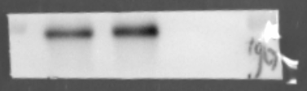
Figure 7C
293T
NPM1
40kDa
ALDH9A1
55kDa
lgG
55kDa
NPM1
40kDa
ALDH9A1
55kDa
lgG
55kDa

Slide 12

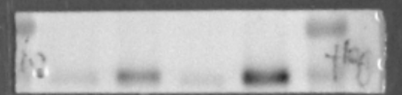







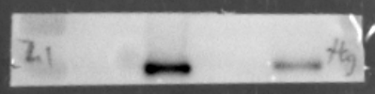

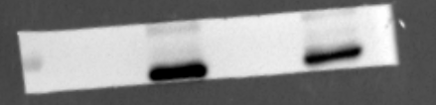








Figure 7D and 7E
70kDa
flag
70kDa
flag
55kDa
55kDa
MYC
55kDa
MYC
55kDa
40kDa
40kDa
70kDa
flag
70kDa
flag
55kDa
55kDa
55kDa
MYC
MYC
GAPDH
35kDa
GAPDH
35kDa

Slide 13
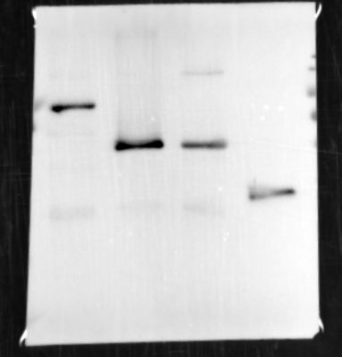
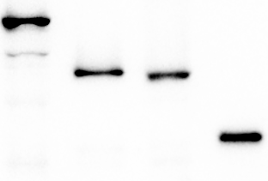
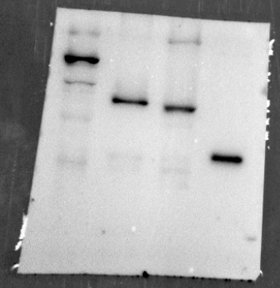
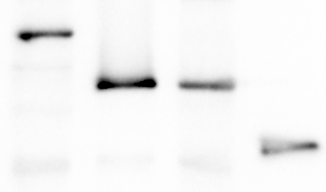
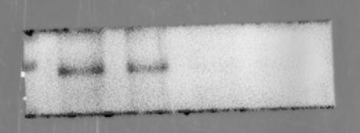

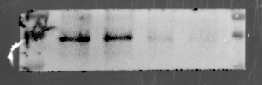

Figure 7H and 7I
40kDa
40kDa
15kDa
input
15kDa
input
5kDa
5kDa
55kDa
55kDa
ALDH9A1
ALDH9A1

Slide 14

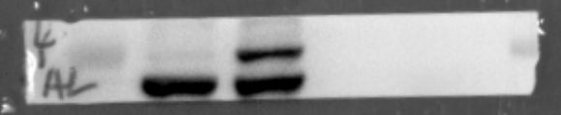



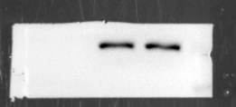










Figure 7J and 7K
ALDH OE | - | + | - | +
ALDH9A1
55kDa
40kDa
NPM1
LaminB1
70kDa
GAPDH
35kDa
ALDH si | - | + | + | - | + | +
40kDa
NPM1
ALDH9A1
55kDa
GAPDH
35kDa
LaminB1
70kDa

Slide 15









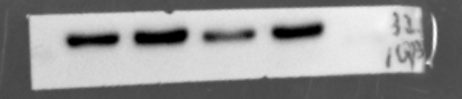



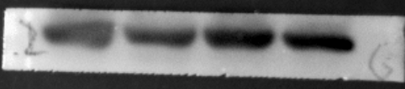
Figure 7l and 7M
ALDH-oe | - | + | - | +
NPM1-oe | - | - | + | +
NPM1-oe | - | +
55kDa
ALDH9A1
NPM1
40kDa
35kDa
NPM1
40kDa
IQGAP2
180kDa
IQGAP2
180kDa
GAPDH
35kDa
GAPDH
35kDa

Slide 16




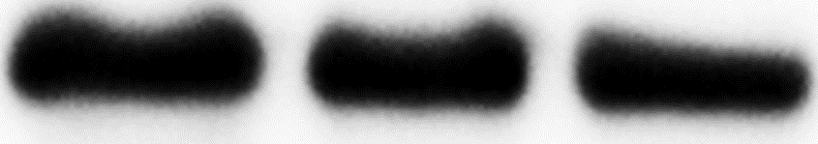
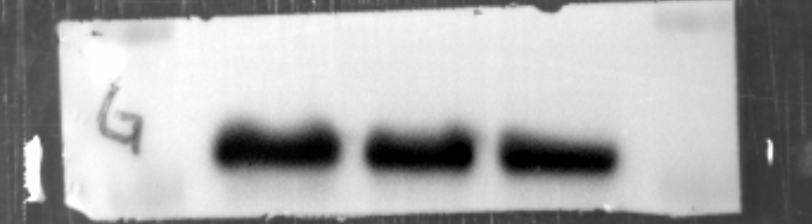



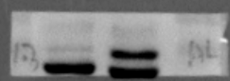

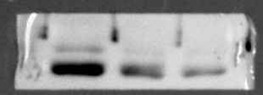




Supplementary figure 2A and 2C
ALDH9A1-oe | - | +
siALDH9A1 | - | + | +
70kDa
55kDa
ALDH9A1
55kDa
ALDH9A1
40kDa
40kDa
GAPDH
GAPDH
35kDa
35kDa
ALDH9A1-oe | - | +
siALDH9A1 | - | + | +
70kDa
55kDa
ALDH9A1
55kDa
ALDH9A1
40kDa
GAPDH
40kDa
GAPDH
35kDa
35kDa

Slide 17





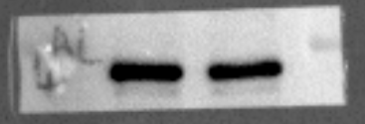

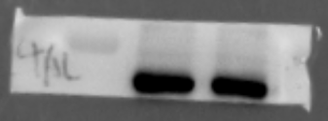





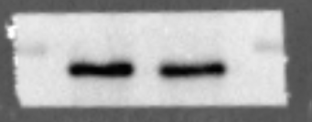

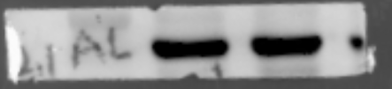


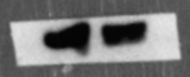

Supplementary figure 3C
5-AZA
- +
55kDa
ALDH9A1
GAPDH
35kDa
5-AZA
- +
55kDa
5-AZA
- +
ALDH9A1
55kDa
GAPDH
ALDH9A1
35kDa
GAPDH
35kDa
5-AZA
- +
55kDa
5-AZA
- +
ALDH9A1
ALDH9A1
55kDa
GAPDH
35kDa
GAPDH
35kDa

Slide 18

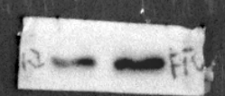

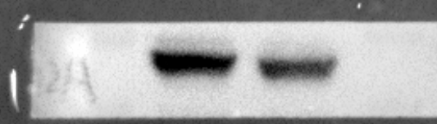








Supplementary figure 4E
OE-FTO | - | +
70kDa
FTO
55kDa
ALDH9A1
55kDa
GAPDH
35kDa
siFTO | - | + | +
FTO
70kDa
55kDa
55kDa
ALDH9A1
GAPDH
35kDa
Notes:
这里的结果联合4-5号的结果一起分析

Slide 19




















Supplementary figure 6A
LY294002 | - | +
PAKT
70kDa
LY294002 | - | +
55kDa
70kDa
AKT
70kDa
PAKT
55kDa
55kDa
AKT
70kDa
SREBP1(m)
70 kDa
55kDa
130 kDa
SREBP1(m)
70 kDa
SREBP1(p)
SREBP1(p)
130 kDa
GAPDH
35 kDa
GAPDH
35 kDa

Slide 20
































Supplementary figure 6F
ALDH9A1-oe | - | +
ALDH9A1-oe | - | +
55kDa
55kDa
ALDH9A1
ALDH9A1
SREBP1(m)
70 kDa
70 kDa
SREBP1(m)
130 kDa
130 kDa
SREBP1(p)
SREBP1(p)
GAPDH
35 kDa
GAPDH
35 kDa
siALDH9A1 | - | + | +
siALDH9A1 | - | + | +
ALDH9A1
55kDa
55kDa
ALDH9A1
SREBP1(m)
70 kDa
70 kDa
SREBP1(m)
SREBP1(p)
130 kDa
130 kDa
SREBP1(p)
GAPDH
35 kDa
GAPDH
35 kDa

Slide 21












Supplementary figure 8E
OE-ALDH9A1 | - | +
ALDH9A1
55kDa
IQGAP2
180kDa
GAPDH
35kDa
siALDH9A1 | - | + | +
55kDa
ALDH9A1
IQGAP2
180kDa
GAPDH
35kDa

Slide 22
































Supplementary figure 10B
OE-IQGAP2 | - | +
OE-IQGAP2 | - | +
IQ
180kDA
IQ
180kDA
70kDa
PAKT
70kDa
PAKT
55kDa
55kDa
70kDa
AKT
70kDa
AKT
55kDa
55kDa
PS6K
70kDa
70kDa
55kDa
PS6K
55kDa
S6K
70kDa
S6K
70kDa
SREBP1(m)
70 kDa
70 kDa
SREBP1(m)
SREBP1(p)
130 kDa
SREBP1(p)
130 kDa
GAPDH
35kDa
GAPDH
35kDa

Slide 23












Supplementary figure 11B
shIQGAP2 | - | +
IQGAP2
180kDa
ALDH9A1
55kDa
GAPDH
35kDa
shIQGAP2 | - | +
IQGAP2
180kDa
ALDH9A1
40kDa
GAPDH
35kDa

Slide 24














Supplementary figure 12D
ALDH9A1oe | - | + | - | +
IQGAP-kd | - | - | + | +
ALDH9A1
55kDa
IQGAP2
181kDa
P-AKT
70kDa
55kDa
AKT
70kDa
55kDa
P-S6K
70kDa
55kDa
S6K
55kDa
GAPDH
35kDa

Slide 25














Supplementary figure 13B
Input
IgG
IP
ALDH9A1-OE | - | + | - | + | - | +
40kDa
NPM1
CANX
55kDa
HNRNPK
55kDa
SERBP1
40kDa
IMMT
100kDa
70kDa
Flag
55kDa
lgG
70kDa
55kDa

Slide 26













Supplementary figure 13C
Input
IgG
IP
ALDH9A1-OE | - | + | - | + | - | +
npm
40kDa
CANX
40kDa
HNRNPK
55kDa
SERBP1
40kDa
IMMT
100kDa
70kDa
Flag
55kDa
lgG
70kDa
55kDa

Slide 27
























Supplementary figure 13D and 13E
498
CAKI
ALDH9A1
55kDa
ALDH9A1
55kDa
40kDa
NPM1
40kDa
NPM1
55kDa
lgG
55kDa
lgG
40kDa
40kDa
NPM1
NPM1
55kDa
55kDa
ALDH9A1
ALDH9A1
55kDa
55kDa
lgG
lgG

Slide 28




















Supplementary figure 13F and 13G
FLAG
70kDa
FLAG
55kDa
55kDa
55kDa
MYC
MYC
40kDa
40kDa
FLAG
70kDa
55kDa
FLAG
55kDa
MYC
55kDa
40kDa
MYC
55kDa
40kDa
GAPDH
35kDa
GAPDH
35kDa

Slide 29
























Supplementary figure 14A-D
OE-ALDH9A1 | - | +
OE-ALDH9A1 | - | +
ALDH9A1
ALDH9A1
NPM1
NPM1
GAPDH
GAPDH
siALDH9A1 | - | + | +
siALDH9A1 | - | + | +
ALDH9A1
ALDH9A1
NPM1
NPM1
GAPDH
GAPDH

Slide 30















Supplementary figure 14G and 14H
ALDH9A1-OE | - | + | - | +
55kDa
ALDH9A1
NPM1
40kDa
LaminB1
70kDa
GAPDH
35kDa
siALDH9A1 | - | + | + | - | + | +
ALDH9A1
55kDa
NPM1
40kDa
LaminB1
70kDa
GAPDH
35kDa

Slide 31






Supplementary figure 15C
OE-NPM1 | - | +
40kDa
NPM1
IQGAP2
180kDa
GAPDH
35kDa

Slide 32








Supplementary figure 15G
ALDH9A1-oe | - | + | - | +
NPM1-oe | - | - | + | +
ALDH9A1
55kDa
NPM1
40kDa
IQGAP2
181kDa
GAPDH
35kDa

