Slide 1
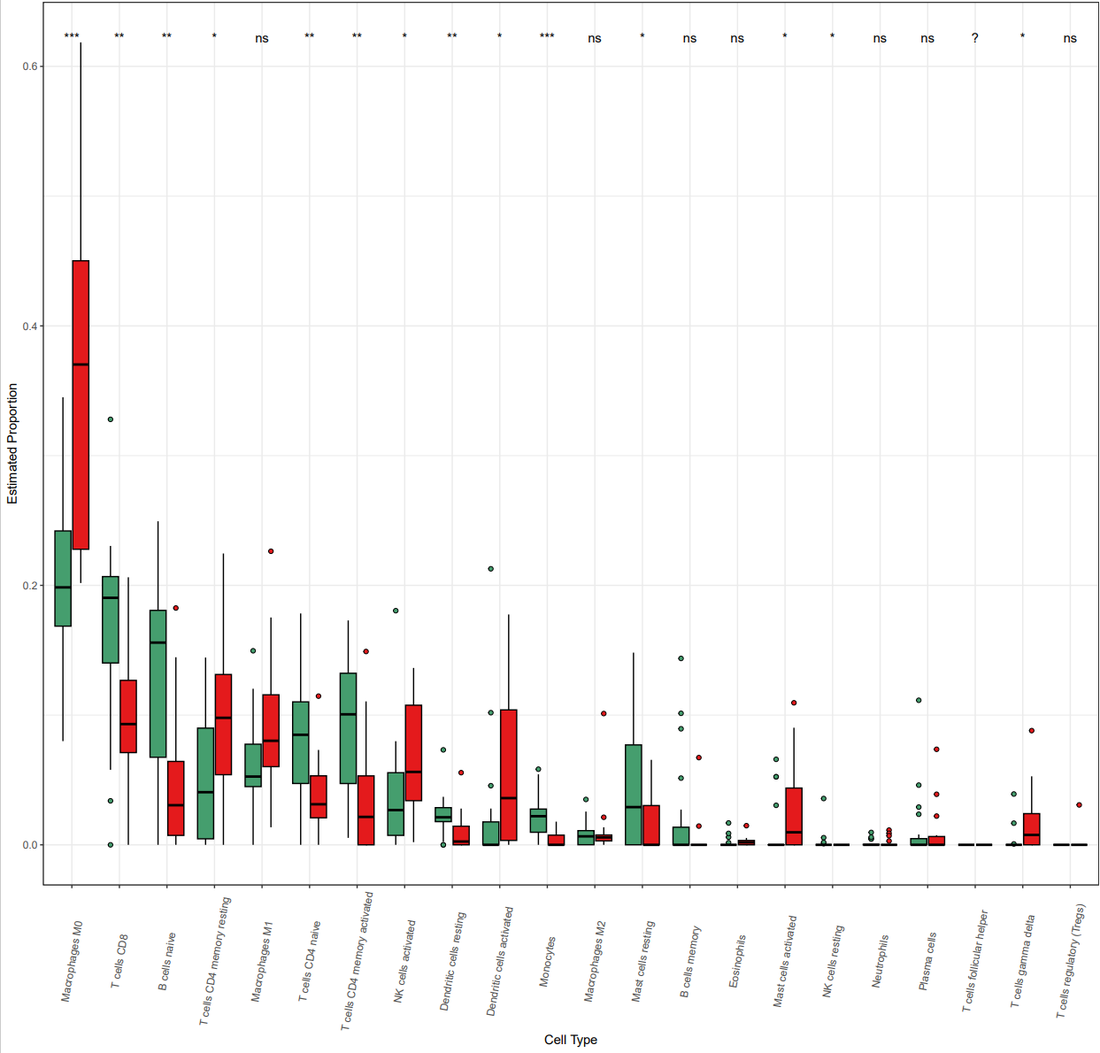

Monocytes
Eosinophils
Neutrophils
Mast cells resting
B cells memory
NK cells resting
Plasma cells
T cells CD8
Macrophages M2
Macrophages M0
B cells naive
T cells naive
Mast cells activated
T cells regulatory
(Tregs)
T cells CD4
memory resting
NK cells activated
T cells gamma delta
Macrophages M1
Dendritic cells resting
T cells follicular helper
T cells CD4
memory activated
Dendritic cells activated
Supplementary Fig. 2. Histogram of predicted immune cell infiltrate levels in the GSE53819 dataset which with higher SLC7A11 levels in NPC tissues.

