Slide 1
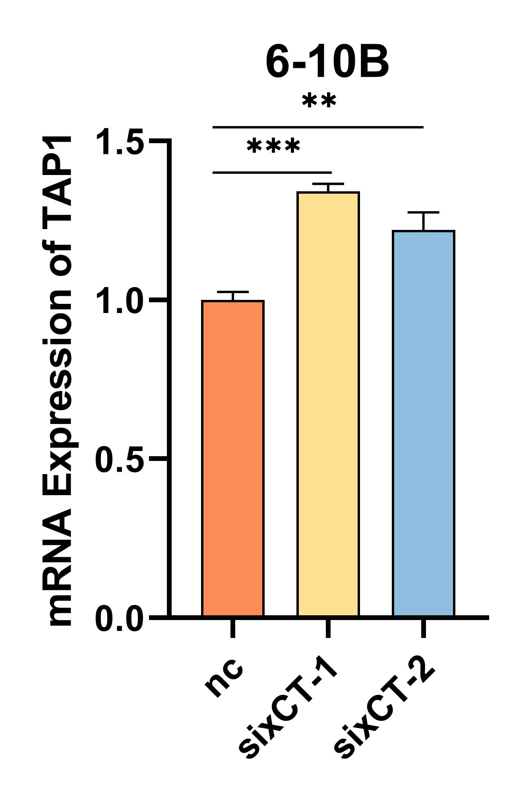

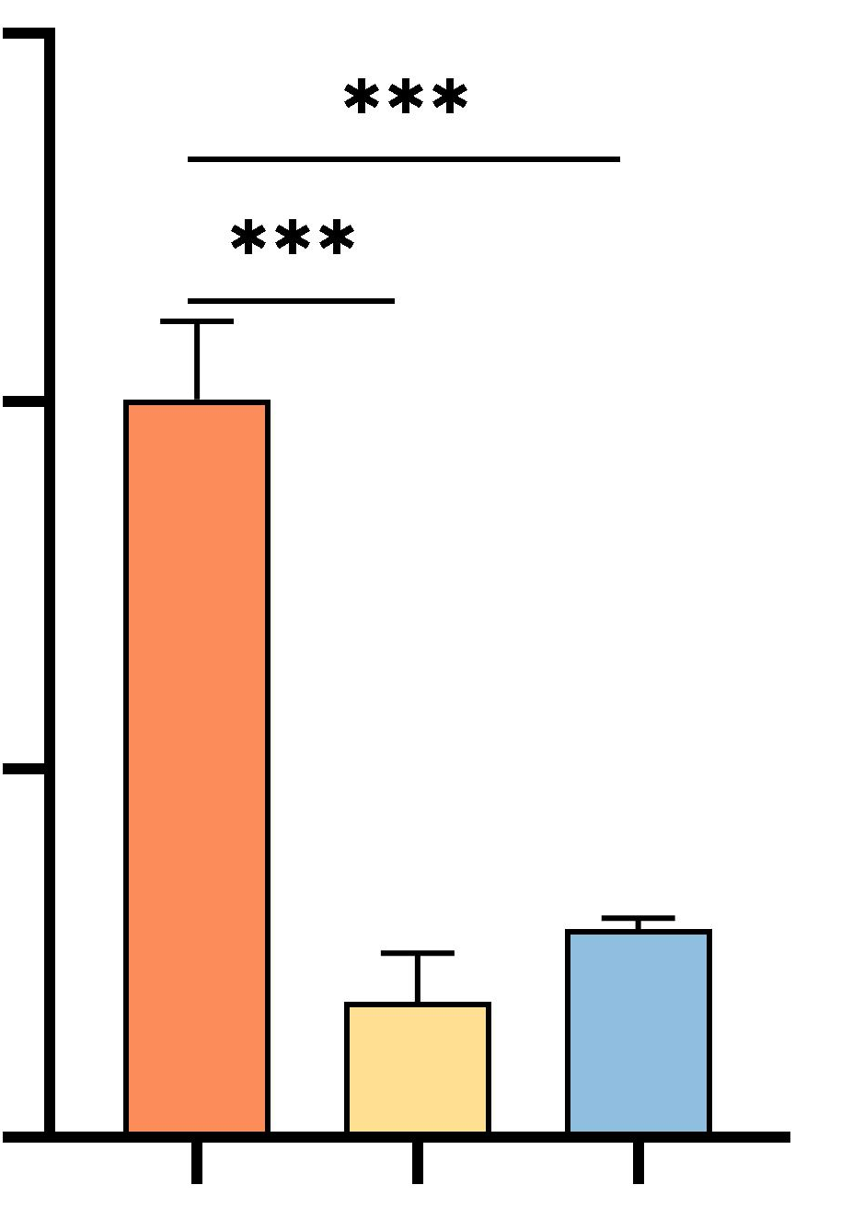







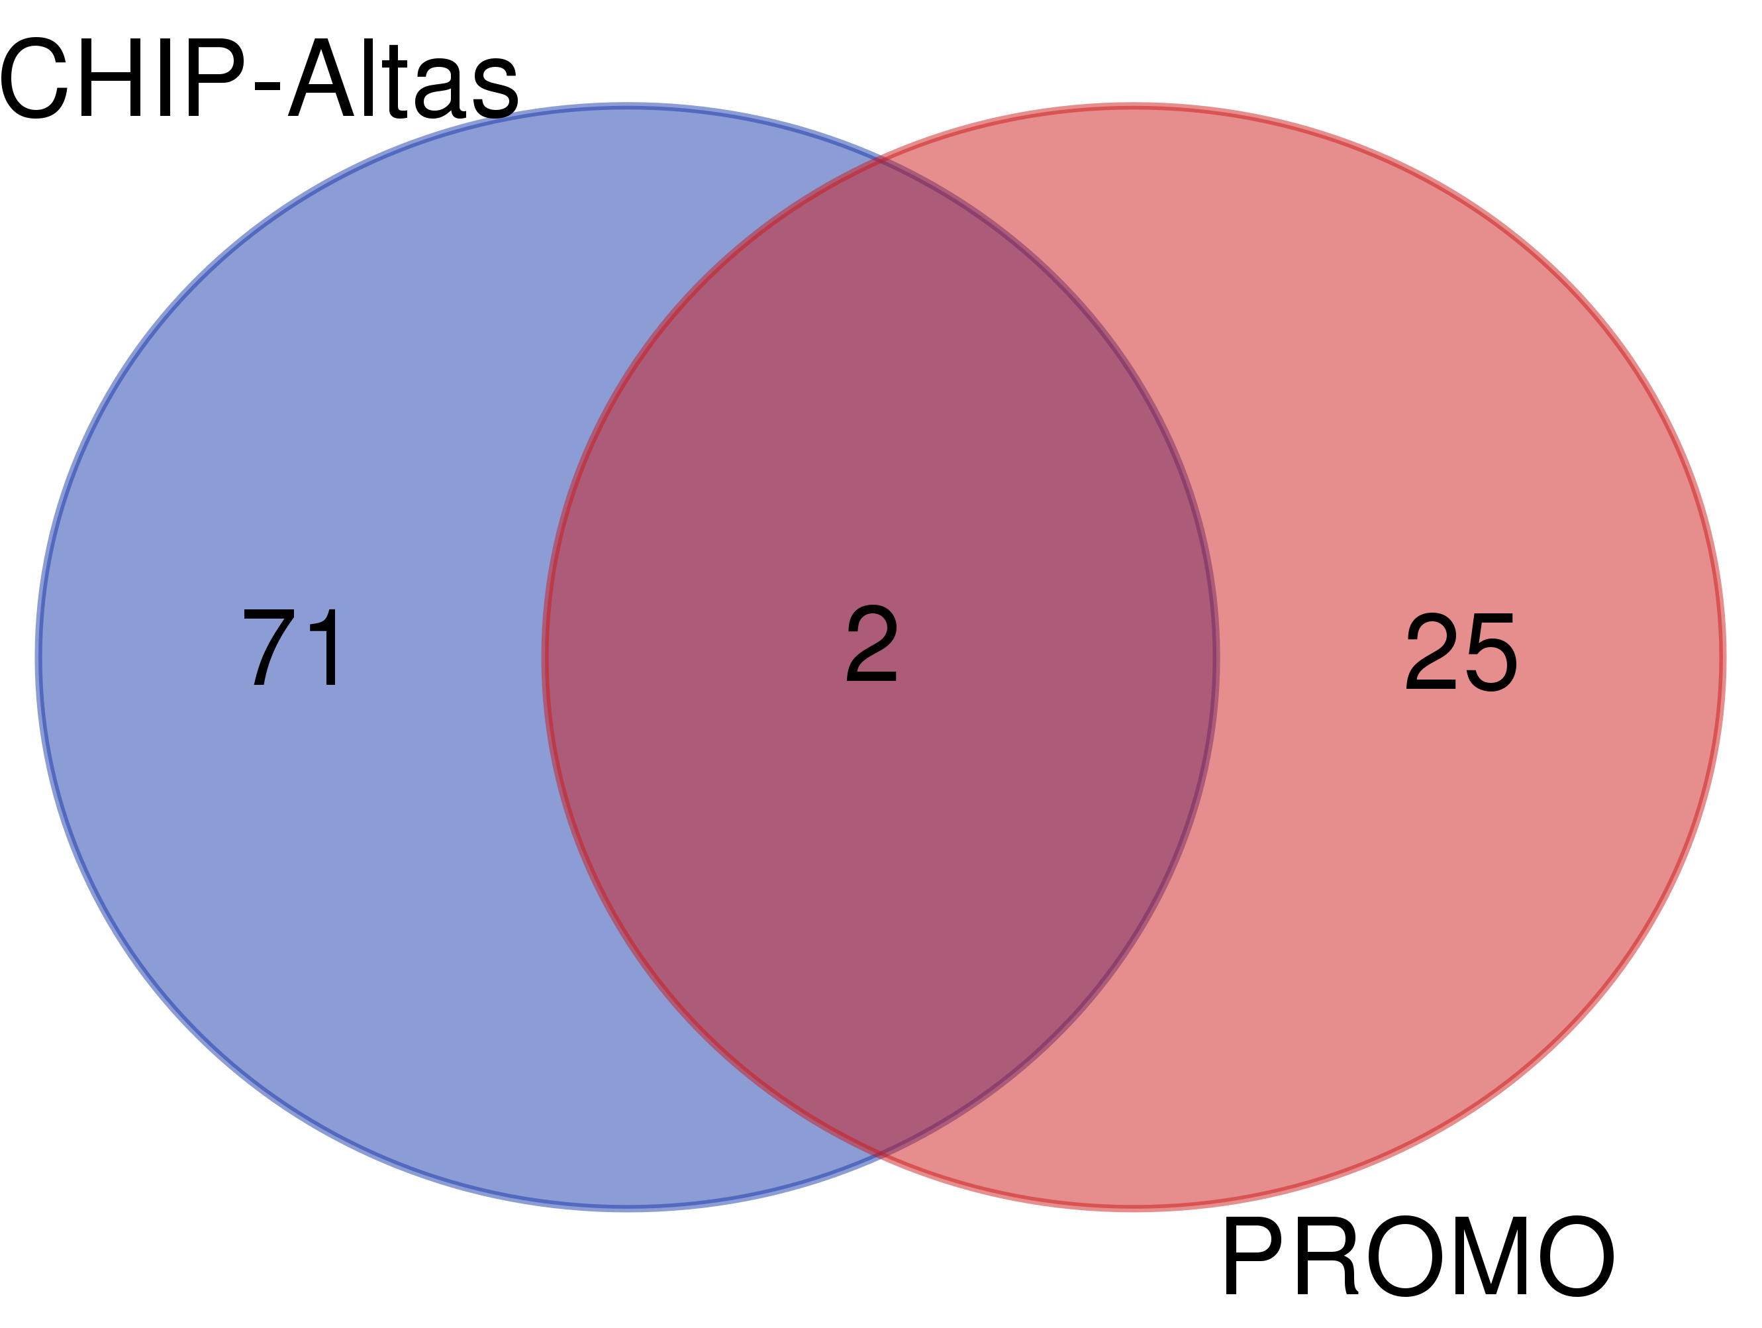

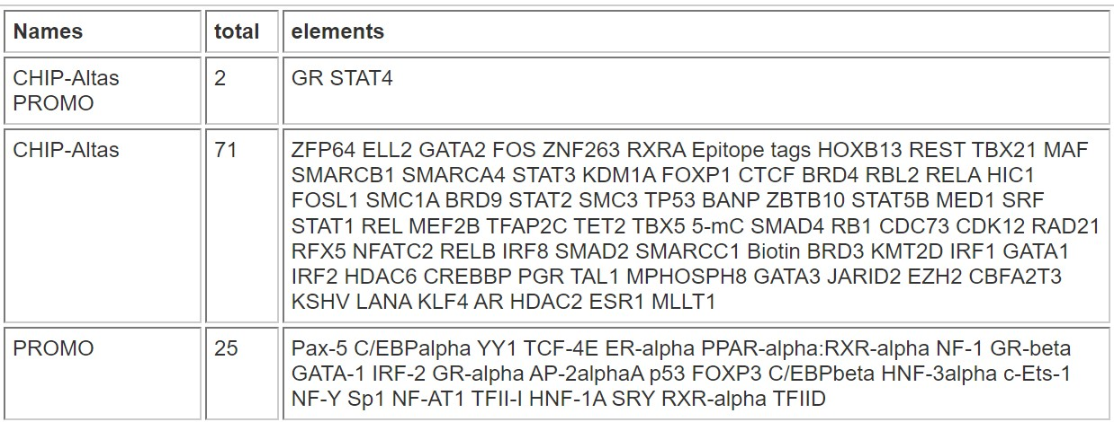



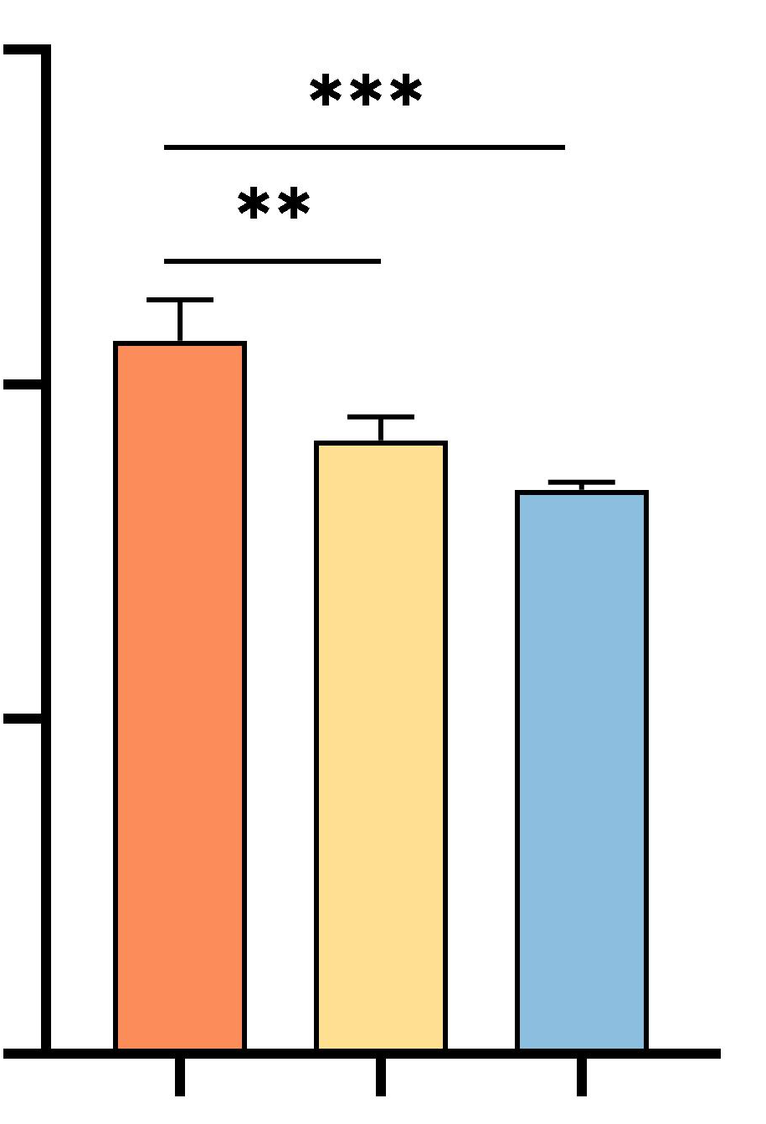









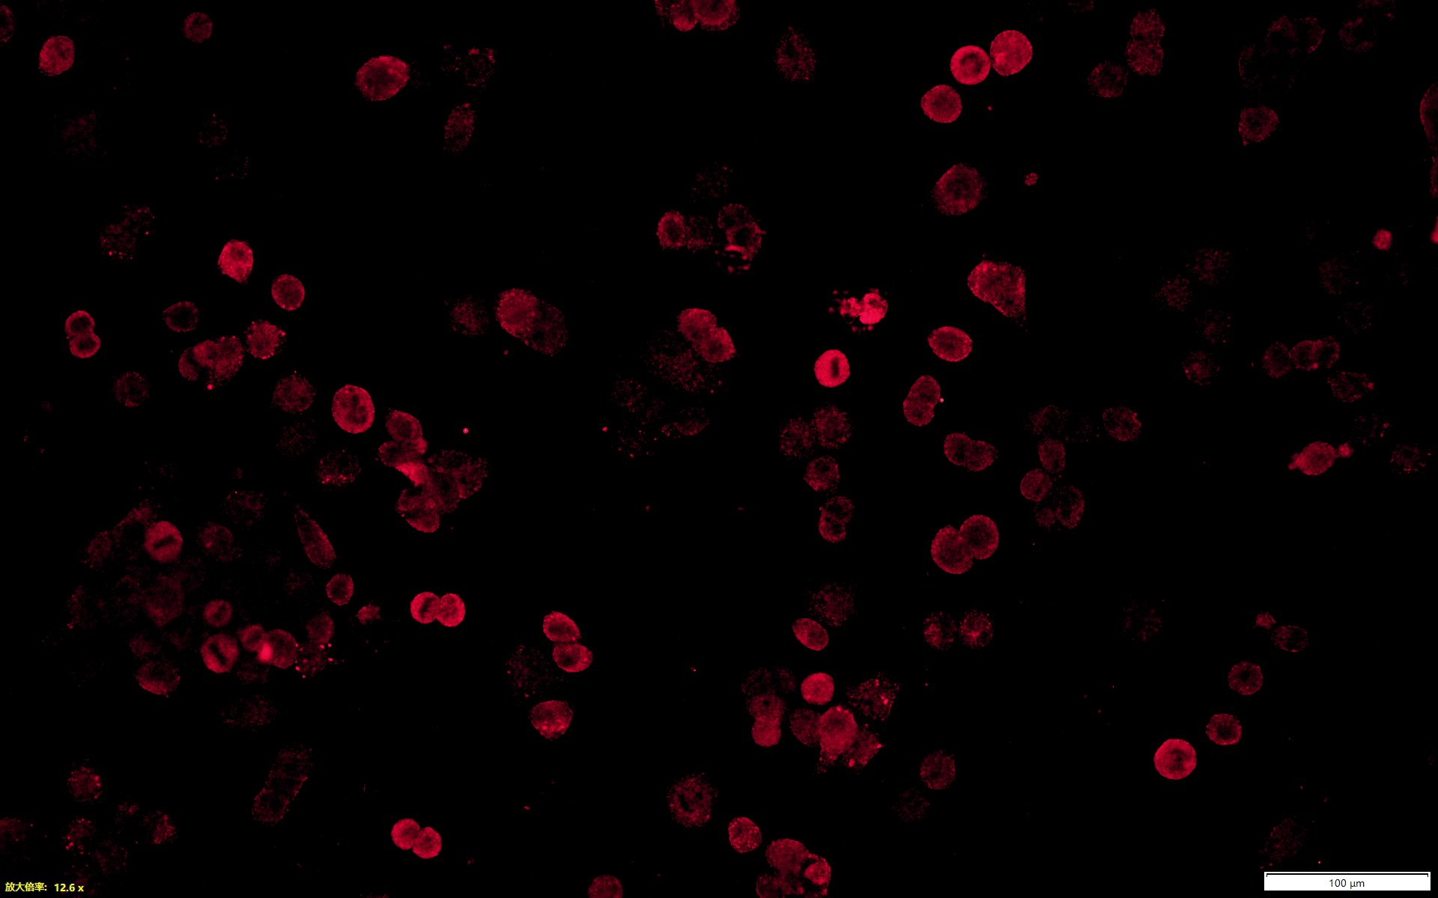
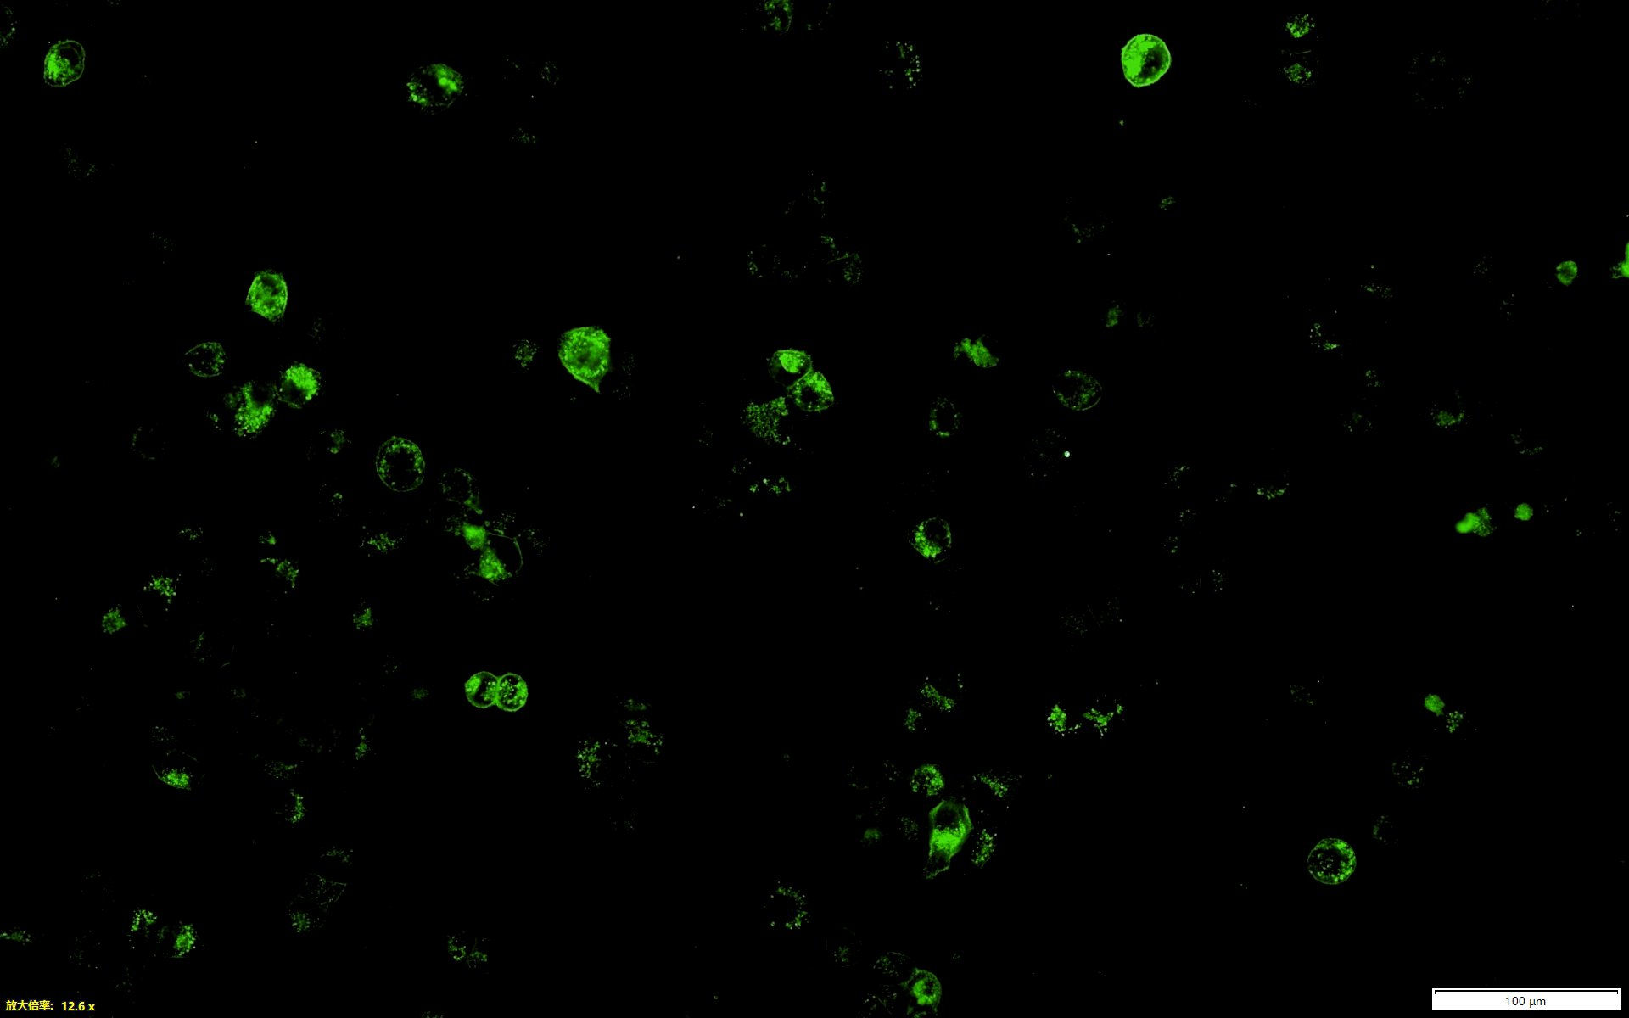
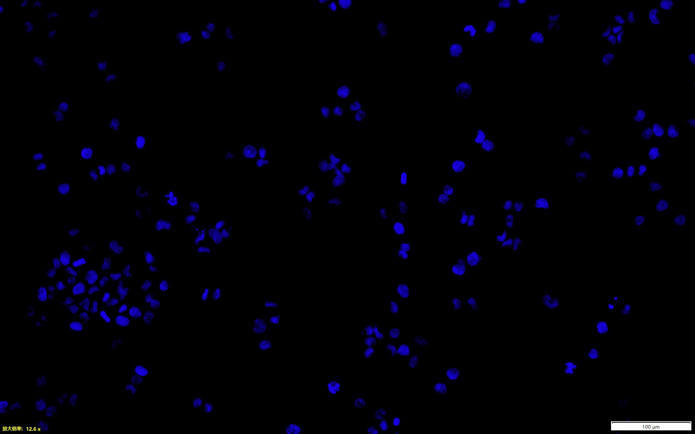
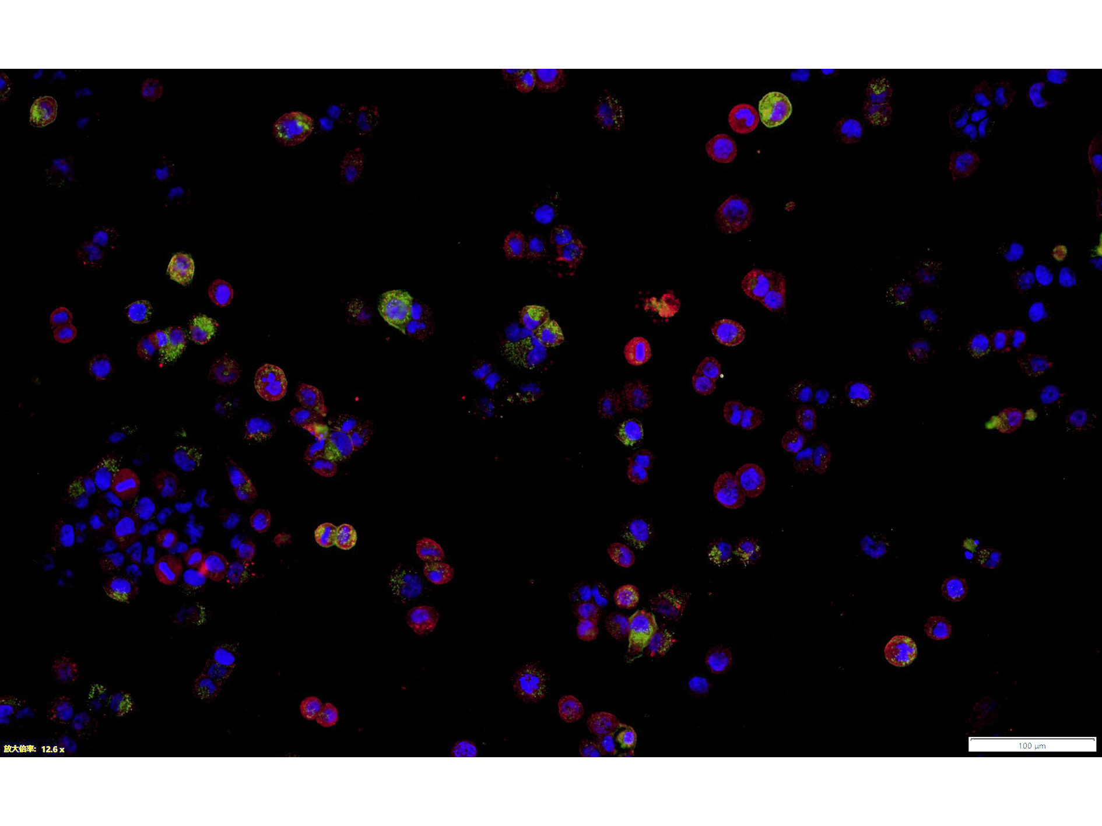
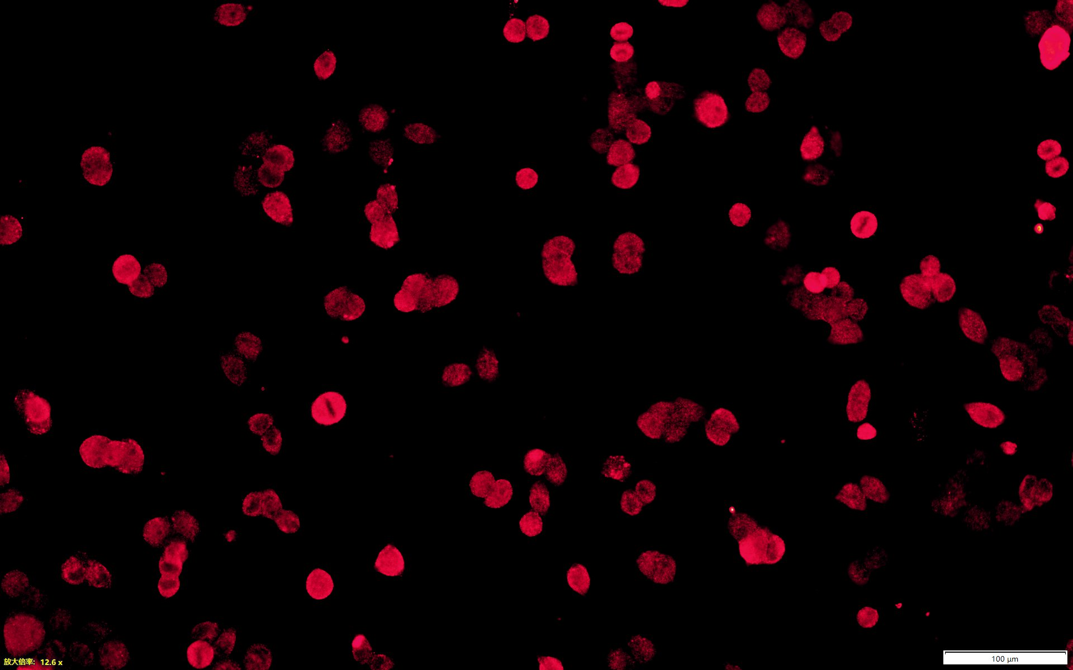
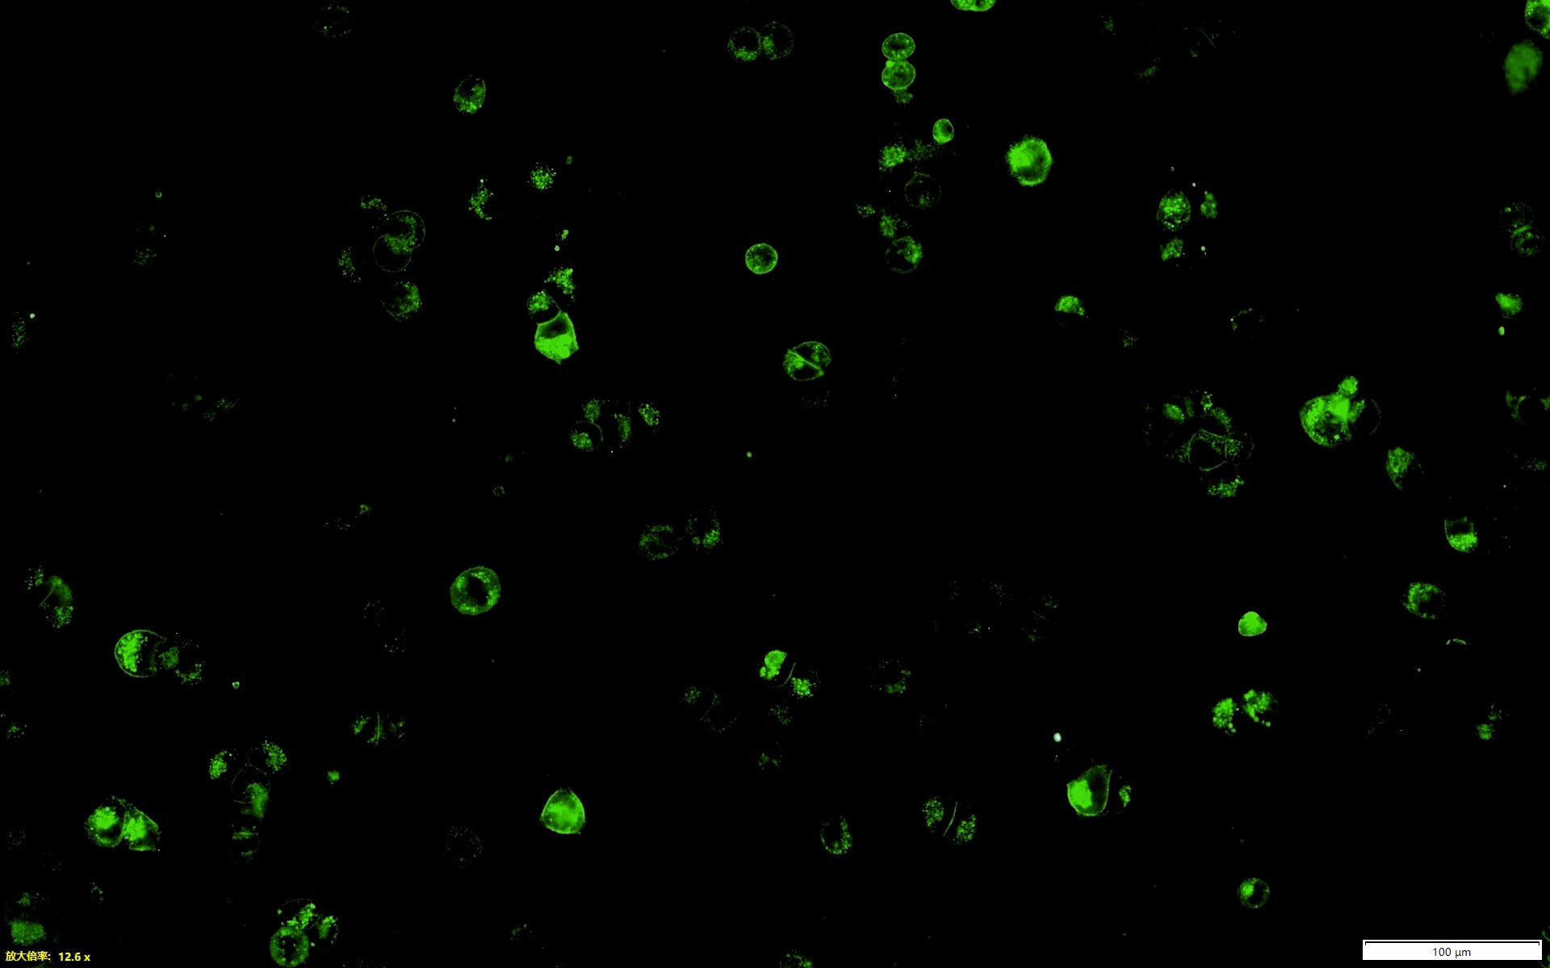
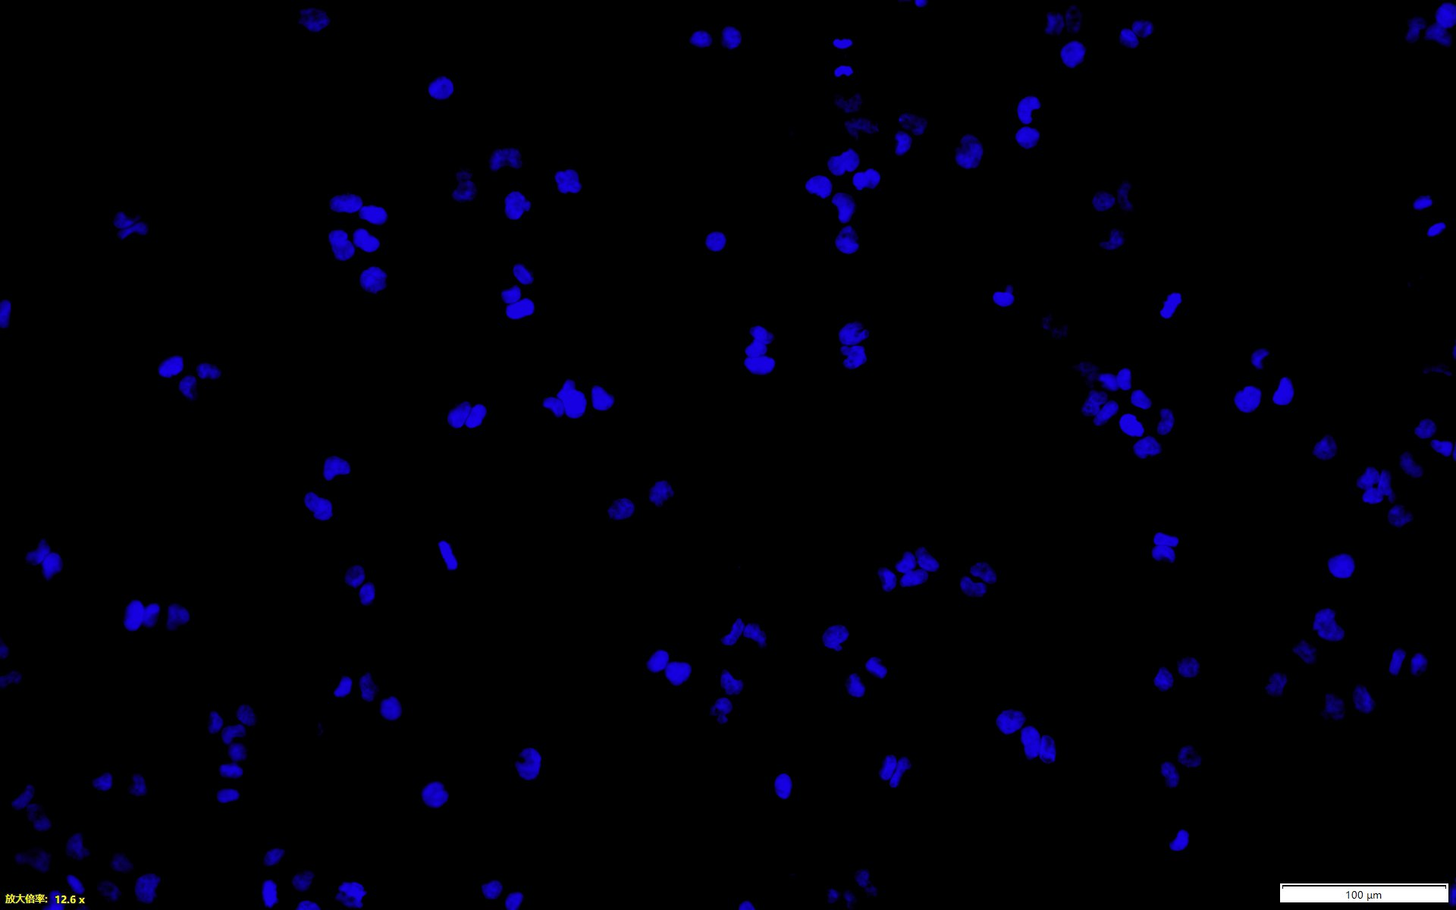
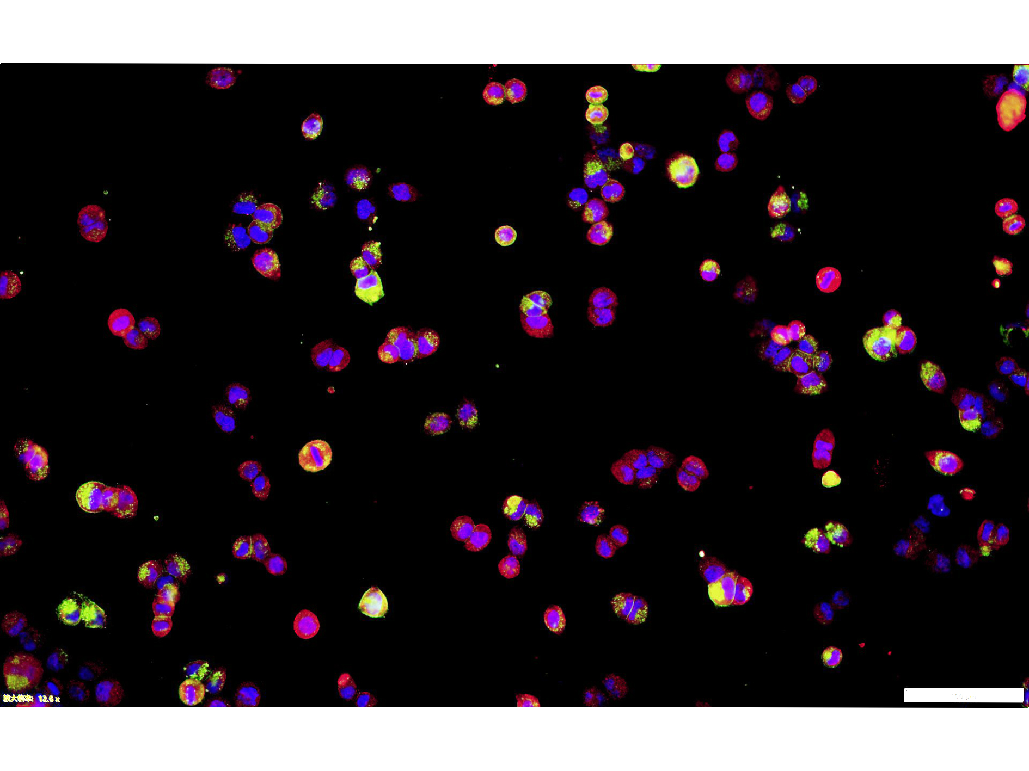
A B
C D
E
F
G H
I
6-10B
6-10B
6-10B
siSLC7A11-1
NC
siSLC7A11-2
6-10B
siTAP1-1
1.5
1.0
0.5
0
SLC7A11
1.5
1.0
0.5
0
NC
siTAP1-2
The mRNA levels of
TAP1
1 0.77 0.42
55kD
SLC7A11
1 0.94 1.01
45-55kD
TAP1
The mRNA levels of
TAP1
TAP1
70-81kD
1 1.65 1.28
70-81kD
MHC-I
1 0.28 0.49
MHC-I
1 1.19 1.40
41kD
1 0.82 0.72
41kD
NC
Tubulin
50kD
NC
Tubulin
50kD
siTAP-1
siSLC7A11-1
siTAP-2
siSLC7A11-2
6-10B
siSLC7A11+
siTAP1-1
siTAP1-1
siSLC7A11
SLC7A11
NC
45-55kD
TAP1
1 0.41 0.91 0.36
81kD
MHC-I
1 1.11 0.30 0.32
41kD
Tubulin
1 1.21 0.73 0.88
50kD
1.5
1.0
0.5
0
6-10B
48h
6-10B
96h
siGR-3
72h
siGR-2
siGR-2
siGR-3
siGR-3
The mRNA levels of
TAP1
GR
NC
NC
NC
siGR-2
94kD
MHC-I
1 0.92 0.84 1.0 0.77 0.74 0.90 0.83 0.53
41kD
NC
Tubulin
1 0.81 0.81 0.81 0.63 0.79 0.84 0.80 0.76
50kD
siGR-2
siGR-3
6-10B
6-10B
6-10B
siGR-3
cytoplam
nucleus
cytoplam
nucleus
siGR-2
NC
Glucose
(4.5g/L)
Glucose
(4.5g/L)
Glucose
(1g/L)
Glucose
(1g/L)
siSLCA11-1
siSLCA11-1
GR
94kD
GR
94kD
GR
NC
NC
94kD
TAP1
81kD
tubulin
1 0.86 1 1.10
50kD
tubulin
1 0.97 1 1.16
50kD
β-actin
1 0.90 0.56
42kD
Histone H3
17kD
Histone H3
17kD
GR MHC-I DAPI Merge
NC
siSLC7A11
Supplementary Fig. 3. Glucose-dependent properties of high SLC7A11 expression inhibit TAP1 transcription through GR, weakening MHC-I membrane expression in NPC cells
(A) Left: qPCR analysis of TAP1 mRNA post-SLC7A11 knockdown. Right: Western blot verifying effects of SLC7A11 knockdown on TAP1 and MHC-Ⅰ protein expression. β-actin and Tubulin were used as loading controls. (B) Left: qPCR confirmation of TAP1 mRNA knockdown using siTAP1-1/2. Right: The effect of TAP1 knockdown on the protein expression of SLC7A11, TAP1 and MHC-Ⅰ were verified by Western blot. Tubulin were used as loading controls. (C) Immunoblot assessment of SLC7A11, TAP1, and MHC-Ⅰ in 6-10B cells post-transfection: control, siSLC7A11, siTAP1, or combined siSLC7A11 and siTAP1. (D) Candidate transcript factors of TAP1 were identified using CHIP-Altas (https://chip-atlas.org/) and PROMO (https://alggen.lsi.upc.es/cgi-bin/promo_v3/promo/promoinit.cgi?dirDB=TF_8.3). (E) upper: qPCR analysis of TAP1 mRNA post-GR knockdown. Lower: The effect of GR knockdown on the protein expression of TAP1 was verified by Western blot. β-actin were used as loading controls. (F) Immunoblot assessment of MHC-Ⅰ protein expression in 6-10B cells at specified times post-GR knockdown. Tubulin were used as loading controls. (G) Immunoblot assessment of GR location in 6-10B cells subjected to high/low glucose concentrations at specified times. Tubulin was used as loading controls of cytoplasm. Histone H3 was used as loading controls of nucleus. (H) Immunoblot assessment of GR location in 6-10B cells at specified times post-SLC7A11 downregulation. Tubulin was used as loading controls of cytoplasm. Histone H3 was used as loading controls of nucleus. (I) Immunofluorescence assessment of GR and MHC-Ⅰ in SUNE1 cells post-SLC7A11 knockdown. Scale bars, 50 μm.

