Slide 1
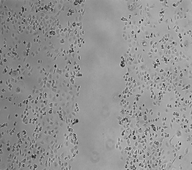
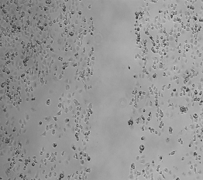
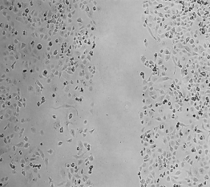
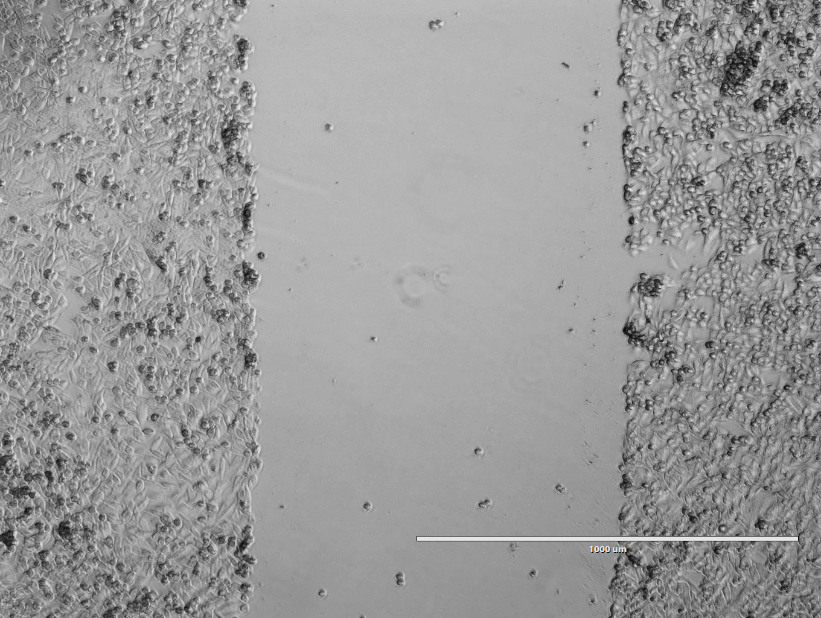
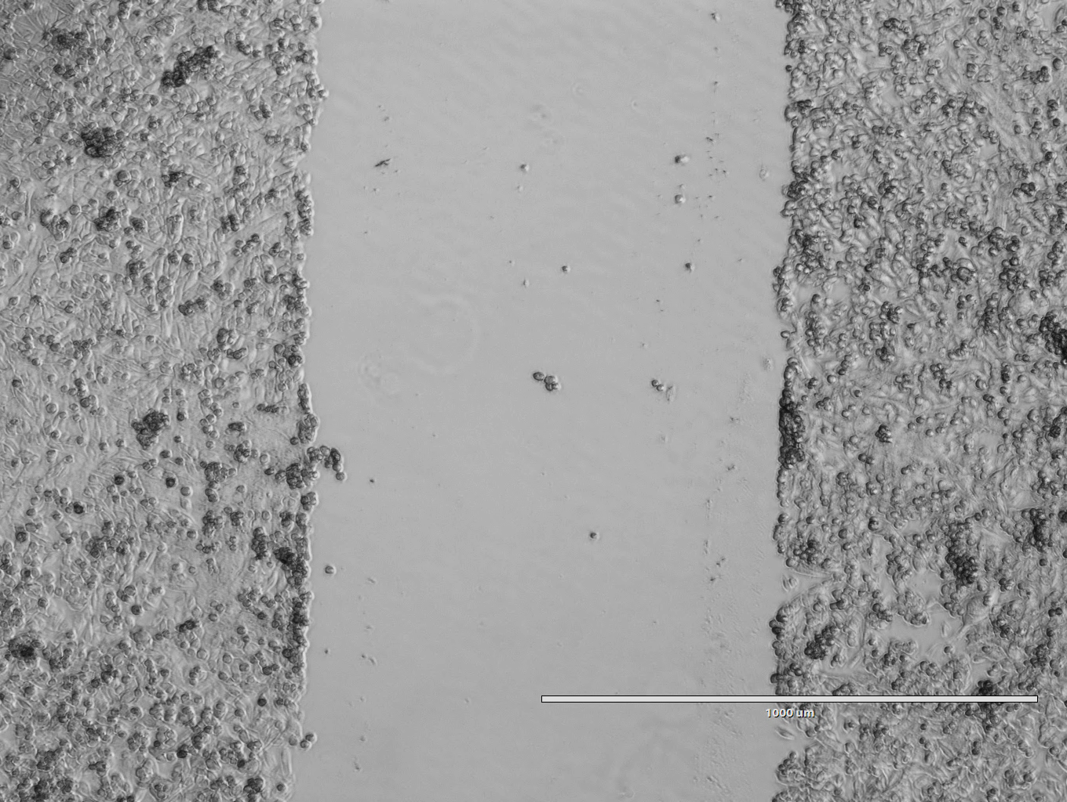
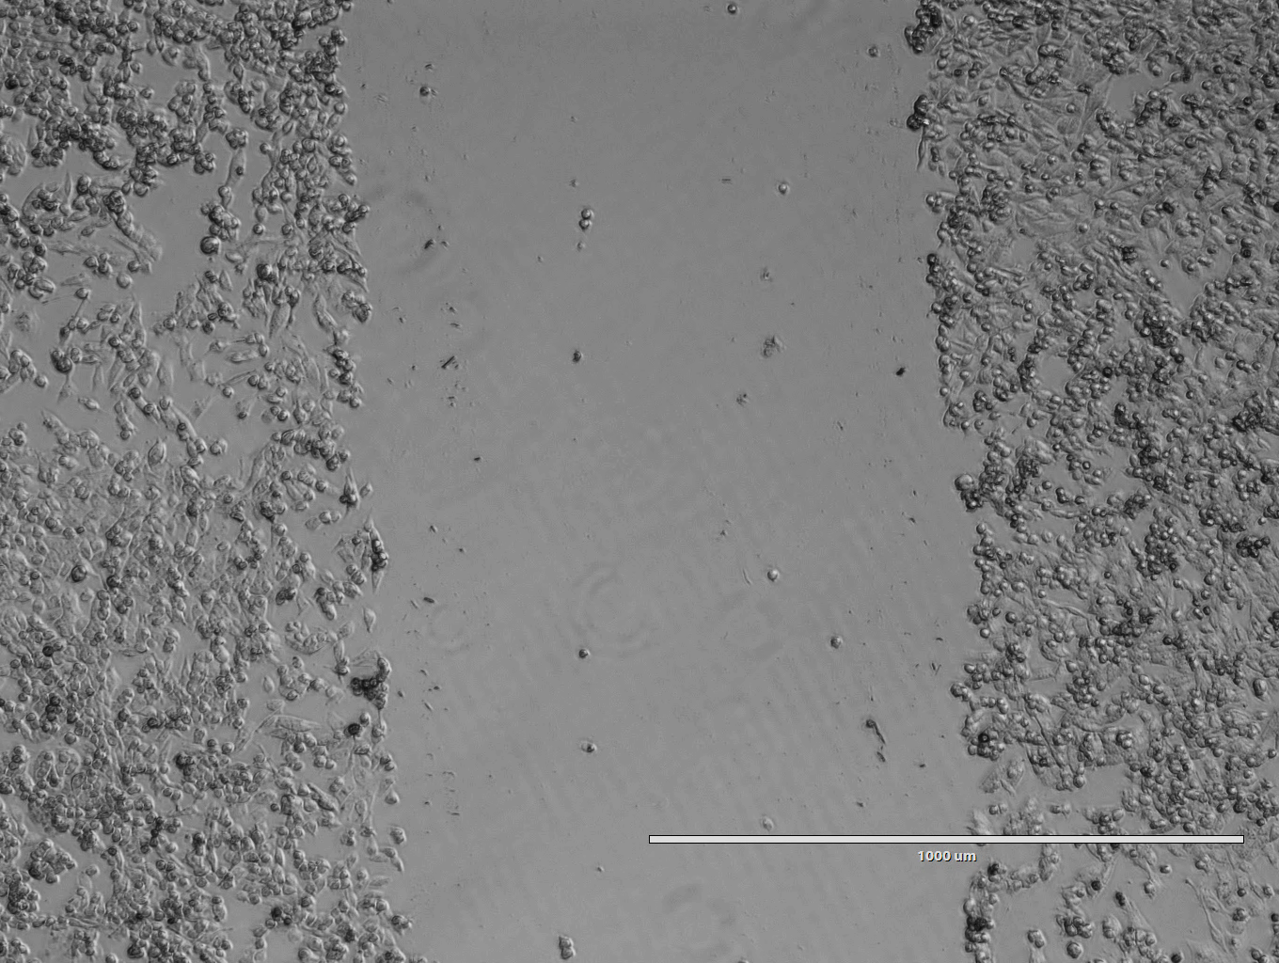
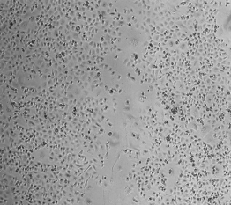
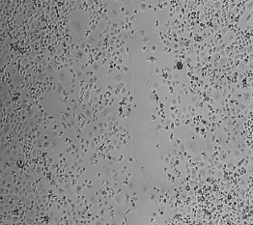
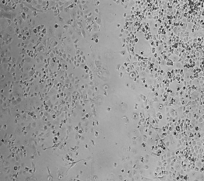
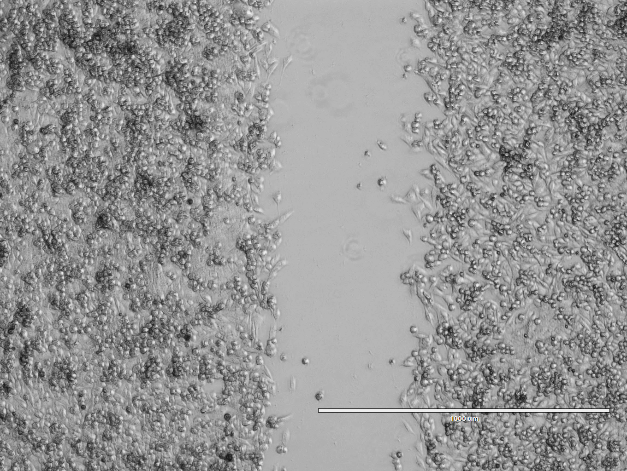
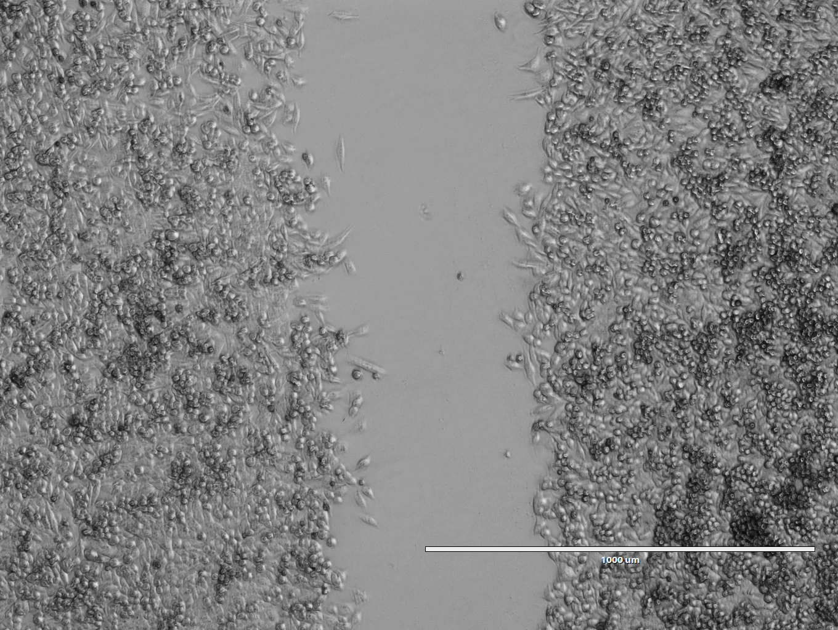
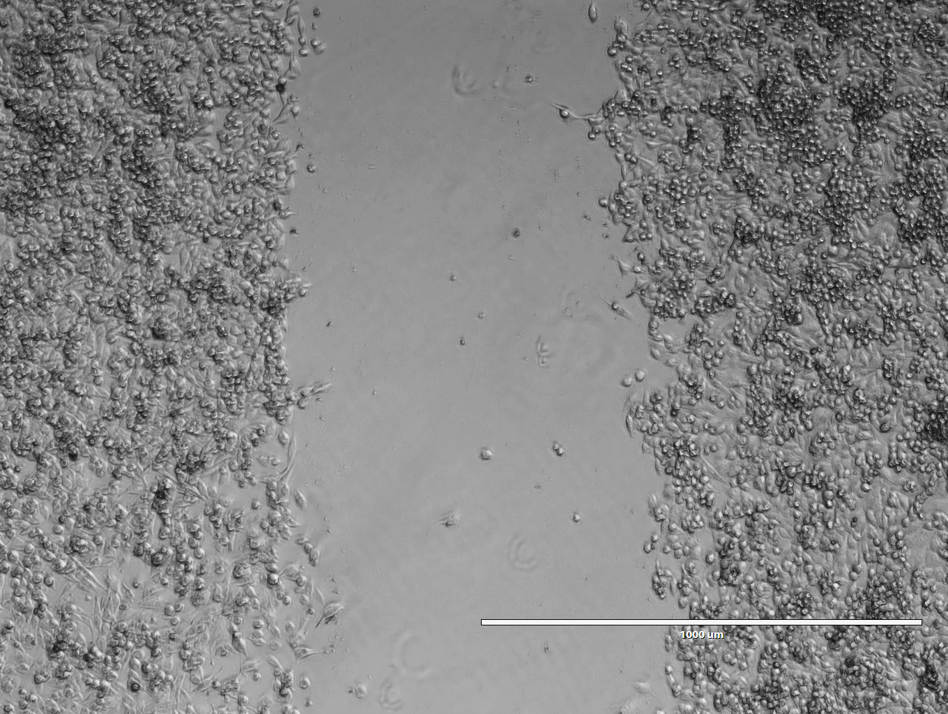
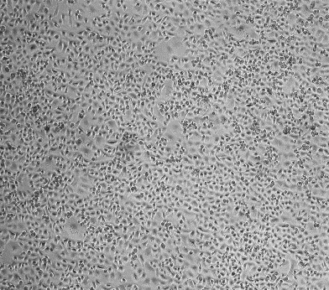
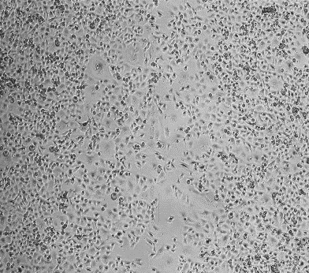
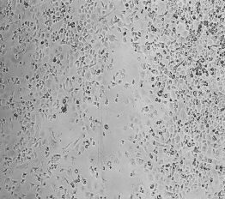
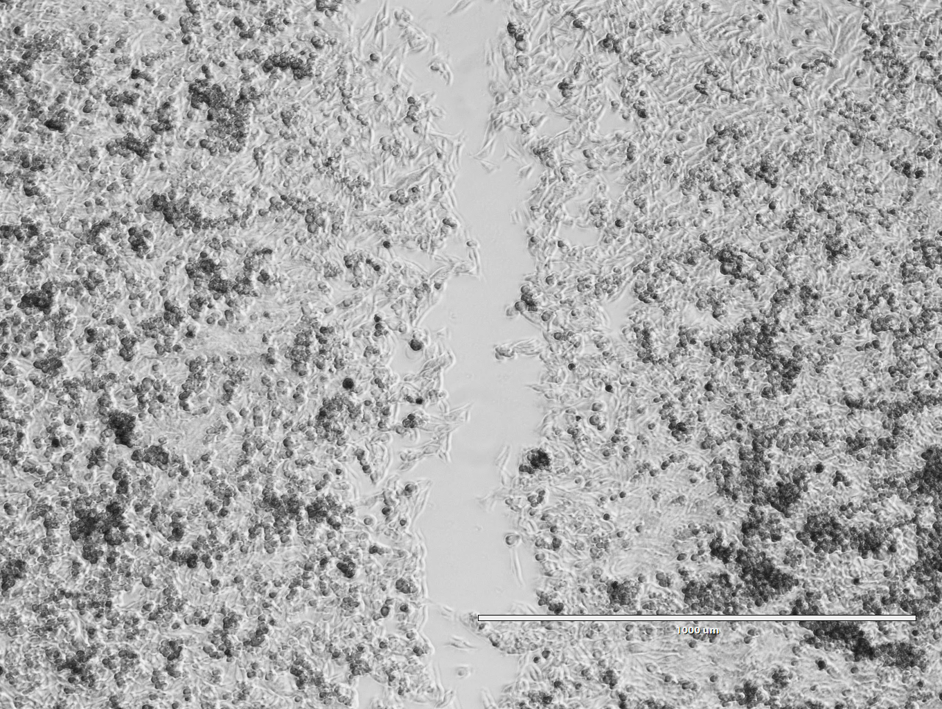
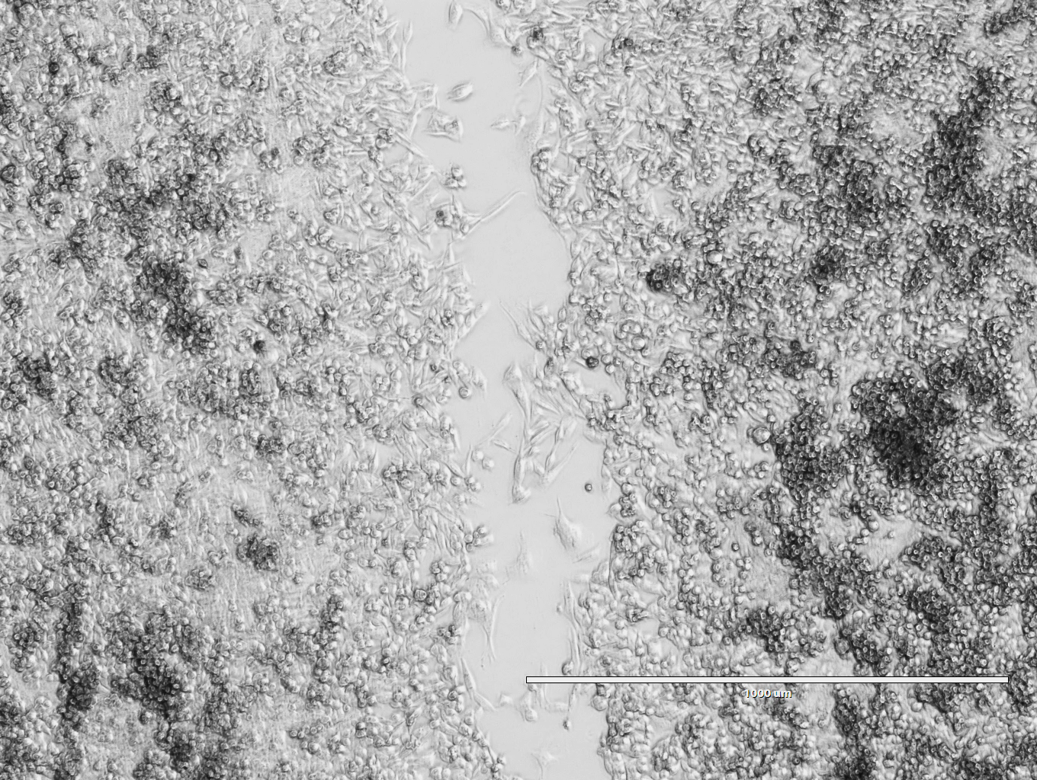
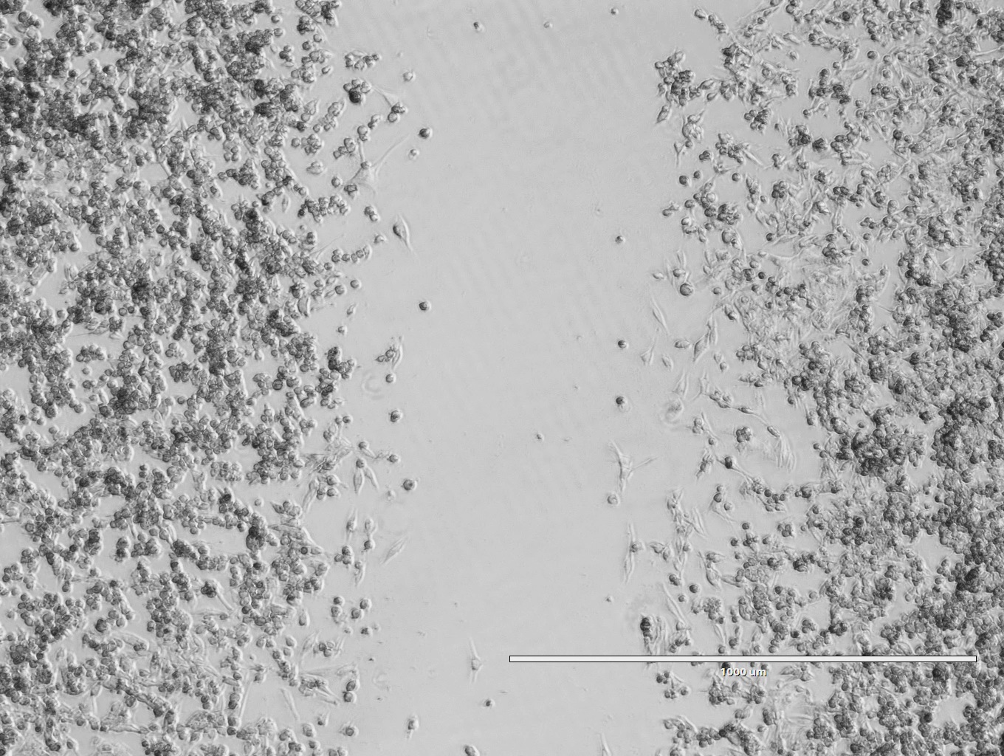
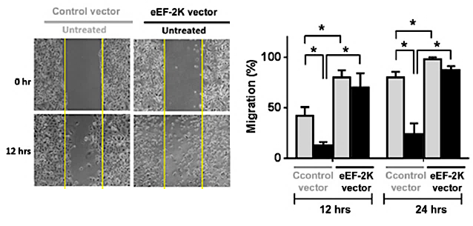
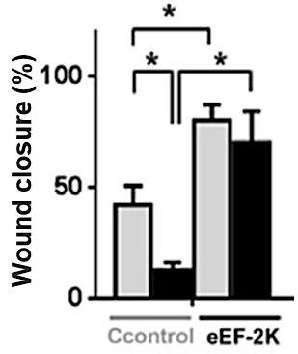
A
PANC-1
B
MiaPaCa-2
NT
Cnt siRNA
eEF2K siRNA
NT
Cnt siRNA
eEF2K siRNA
0h
0h
24h
24h
48h
48h
C
Lenti-Cnt v.
Lenti-eEF2K v.
0h
24h
Control
eEF2K
Figure S1. eEF2K expression is related to migration abilities of pancreatic cancer cells. Knockdown of eEF2K by siRNA reduces migration capabilities of (A) PANC-1 and (B) MiaPaCa-2 cells (*p<0.05, **p<0.01, and ****p<0.0001). Bar graphs represent the mean of three independent experiments. (C) Overexpression of eEF2K induced migration of PANC-1 cells. *p<0.05. Lenti-Cnt v.; lenti-Control vector.

Slide 2
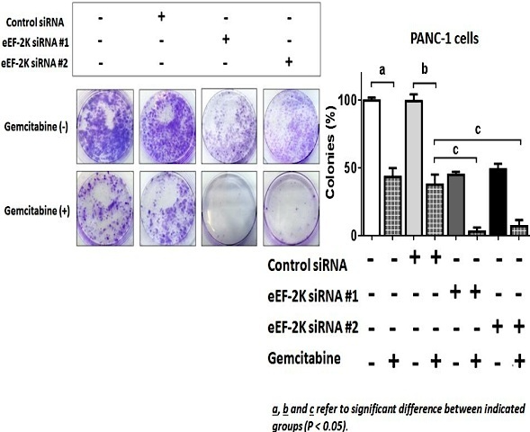
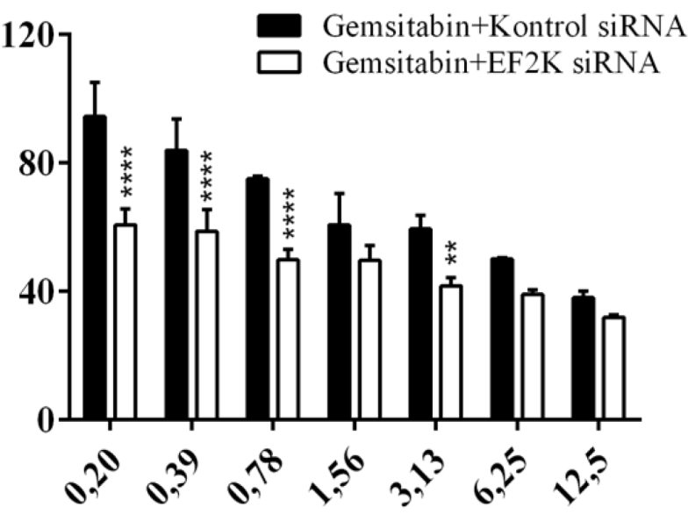
A
B
Gemc. + Cnt siRNA
Gemc. + eEF2K siRNA
Colonies (%)
Viability (%)
Cnt siRNA
-
-
+
+
-
-
-
-
eEF2K siRNA #1
-
-
-
-
+
+
-
-
0,20
0,39
0,78
1,56
3,13
6,25
12,5
eEF2K siRNA #2
-
-
-
-
-
-
+
+
Gemc.
-
+
-
+
-
+
-
+
Gemcitabine (µM)
Figure S2. Combined application of eEF2K siRNA and gemcitabine decreases the colony-forming ability and viability of PANC-1 cells. (A) The effects of eEF2K siRNA and gemcitabine on colony-forming ability of PANC-1 cells. The data are means ± SDs. a b, c refer to the significant differences between indicated groups. p<0.05. (B) MTS viability assay results of PANC-1 cells after the treatment with the combination of different concentrations of gemcitabine (0-12.5 µM) and 50 nM control or eEF2K siRNA (**p<0.01, ****p<0.0001). Gemc.; gemcitabine.
Notes:
A, b, c refer to significant difference between indicated groups (p<0.05)

Slide 3
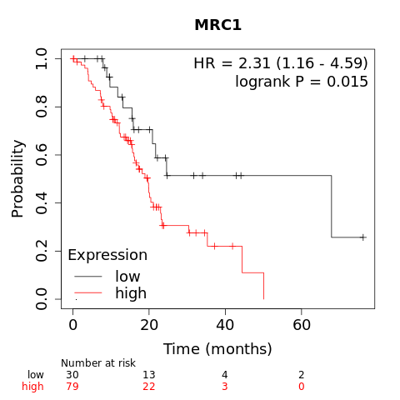
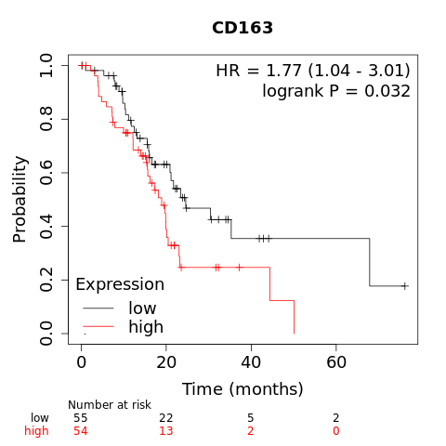
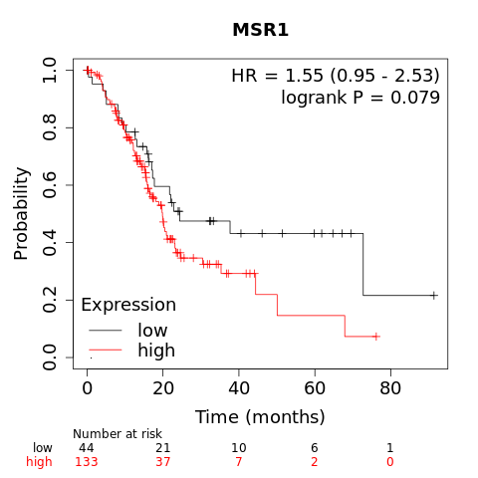
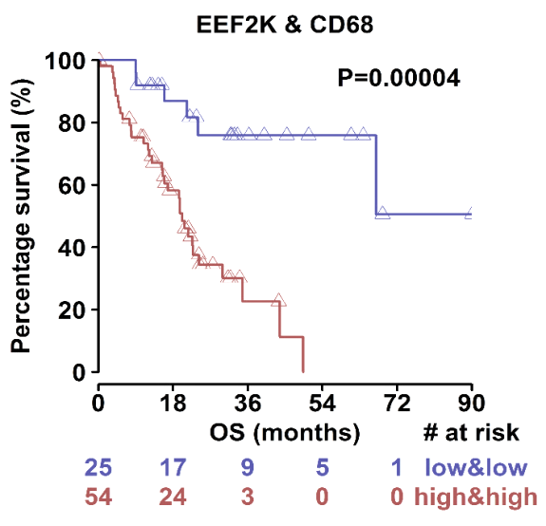
A
CD206
B
CD163
C
CD204
D
eEF2K+CD68
HR=2.67 (1.35-5.28)
P=0.00004
Figure S3. Macrophage markers along with eEF2K expression are associated with poor overall survival in PDAC patients. (A-D) Kaplan-Meier survival analysis of the TCGA pancreatic cancer database showed the overall survival rates of PDAC patients with high and low expression of eEF2K+CD68, CD206, CD163 and CD204.

Slide 4
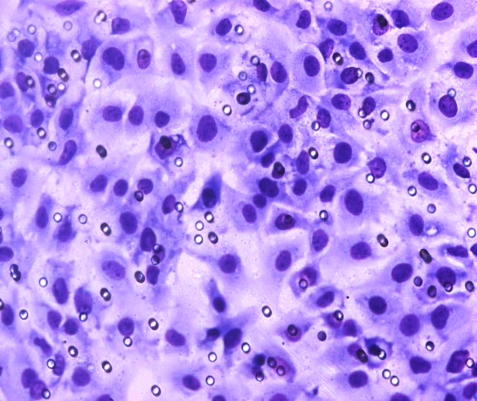
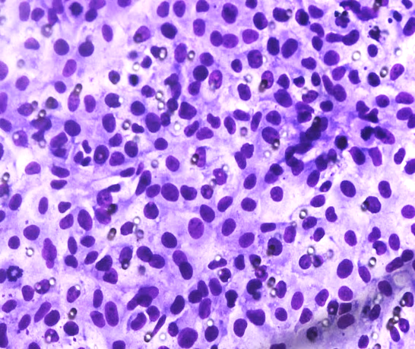
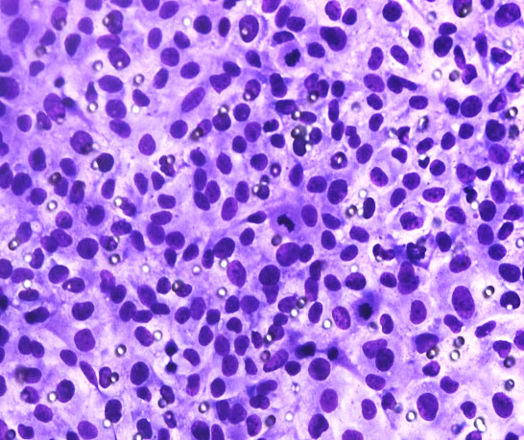
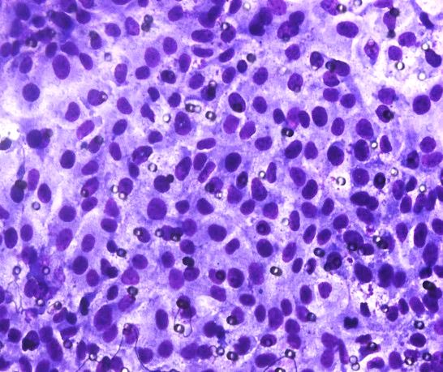
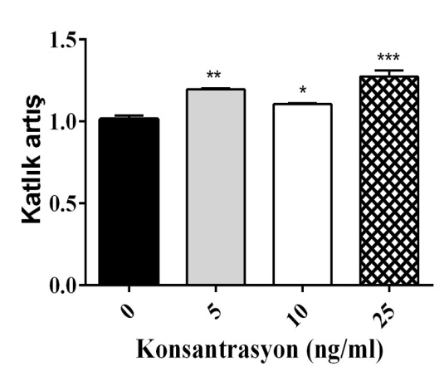
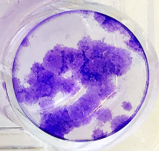
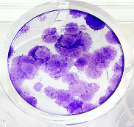
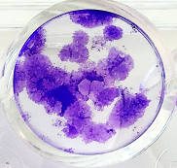
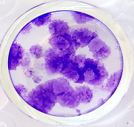
A
PSC, CM
PSC, Co-culture
PSC, Exosomes
+M0
+THP-1
+M2
+THP-1
+THP-1
+M2
+M0
+M0
NT
NT
+M2
NT
eEF2K
eEF2K
eEF2K
GAPDH
GAPDH
GAPDH
B
MiaPaCa-2, Exosomes
+THP-1
+M2
NT
+M0
eEF2K
GAPDH
C
PSC, Exosomes
NT
+THP-1
+M0
+M2
D
PANC-1 cells
MCP-1 (ng/ml)
1.5
NT
5
10
25
1.0
Fold change
0.5
0
0
5
10
25
MCP-1 (ng/ml)
Figure S4. The presence of macrophages induces eEF2K expression in PSCs and MiaPaCa-2 cells (A) The changes in eEF2K expression levels in PSCs either co-cultured with monocytes/macrophages or treated with conditioned media or exosomes (n=2, *p<0.05). (B) eEF2K expression levels of MiaPaCa-2 cells after treatment with exosomes of monocytes/macrophages (n=2). (C) Representative images of invasive PSCs cells and the quantified data after 48 hours of exosome exposure (*p<0.05; ***p<0.001, relative to NT). (D) PANC-1 cells were treated with three different concentrations of MCP-1 and then the changes in the colony-forming ability were evaluated. The upper panel shows representative images of colonies, and the lower panel represents the fold changes between non-treated and treated groups. (*p<0.05, **p<0.01; ***p<0.001, relative to 0 ng/ml MCP-1). CM; conditioned media.

Slide 5
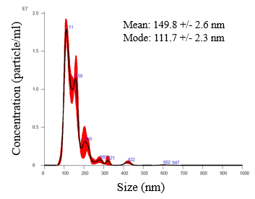
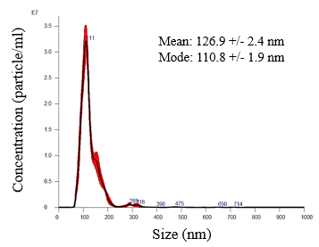
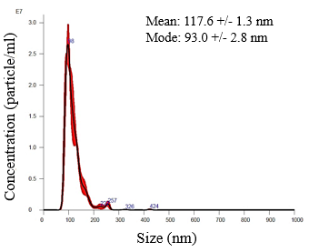
A
B
C
Figure S5. The size and particle analyses of exosomes. Exosomes were isolated from cell culture media of THP-1 cells, M0- and M2-type macrophages. Particle size distributions and concentration of isolated exosomes were analyzed by NanoSight NS300. Representative NTA of exosomes isolated from (A) THP-1 monocytes, (B) M0 macrophages, and (C) M2 macrophages. NTA; nanoparticle tracking analysis.

Slide 6
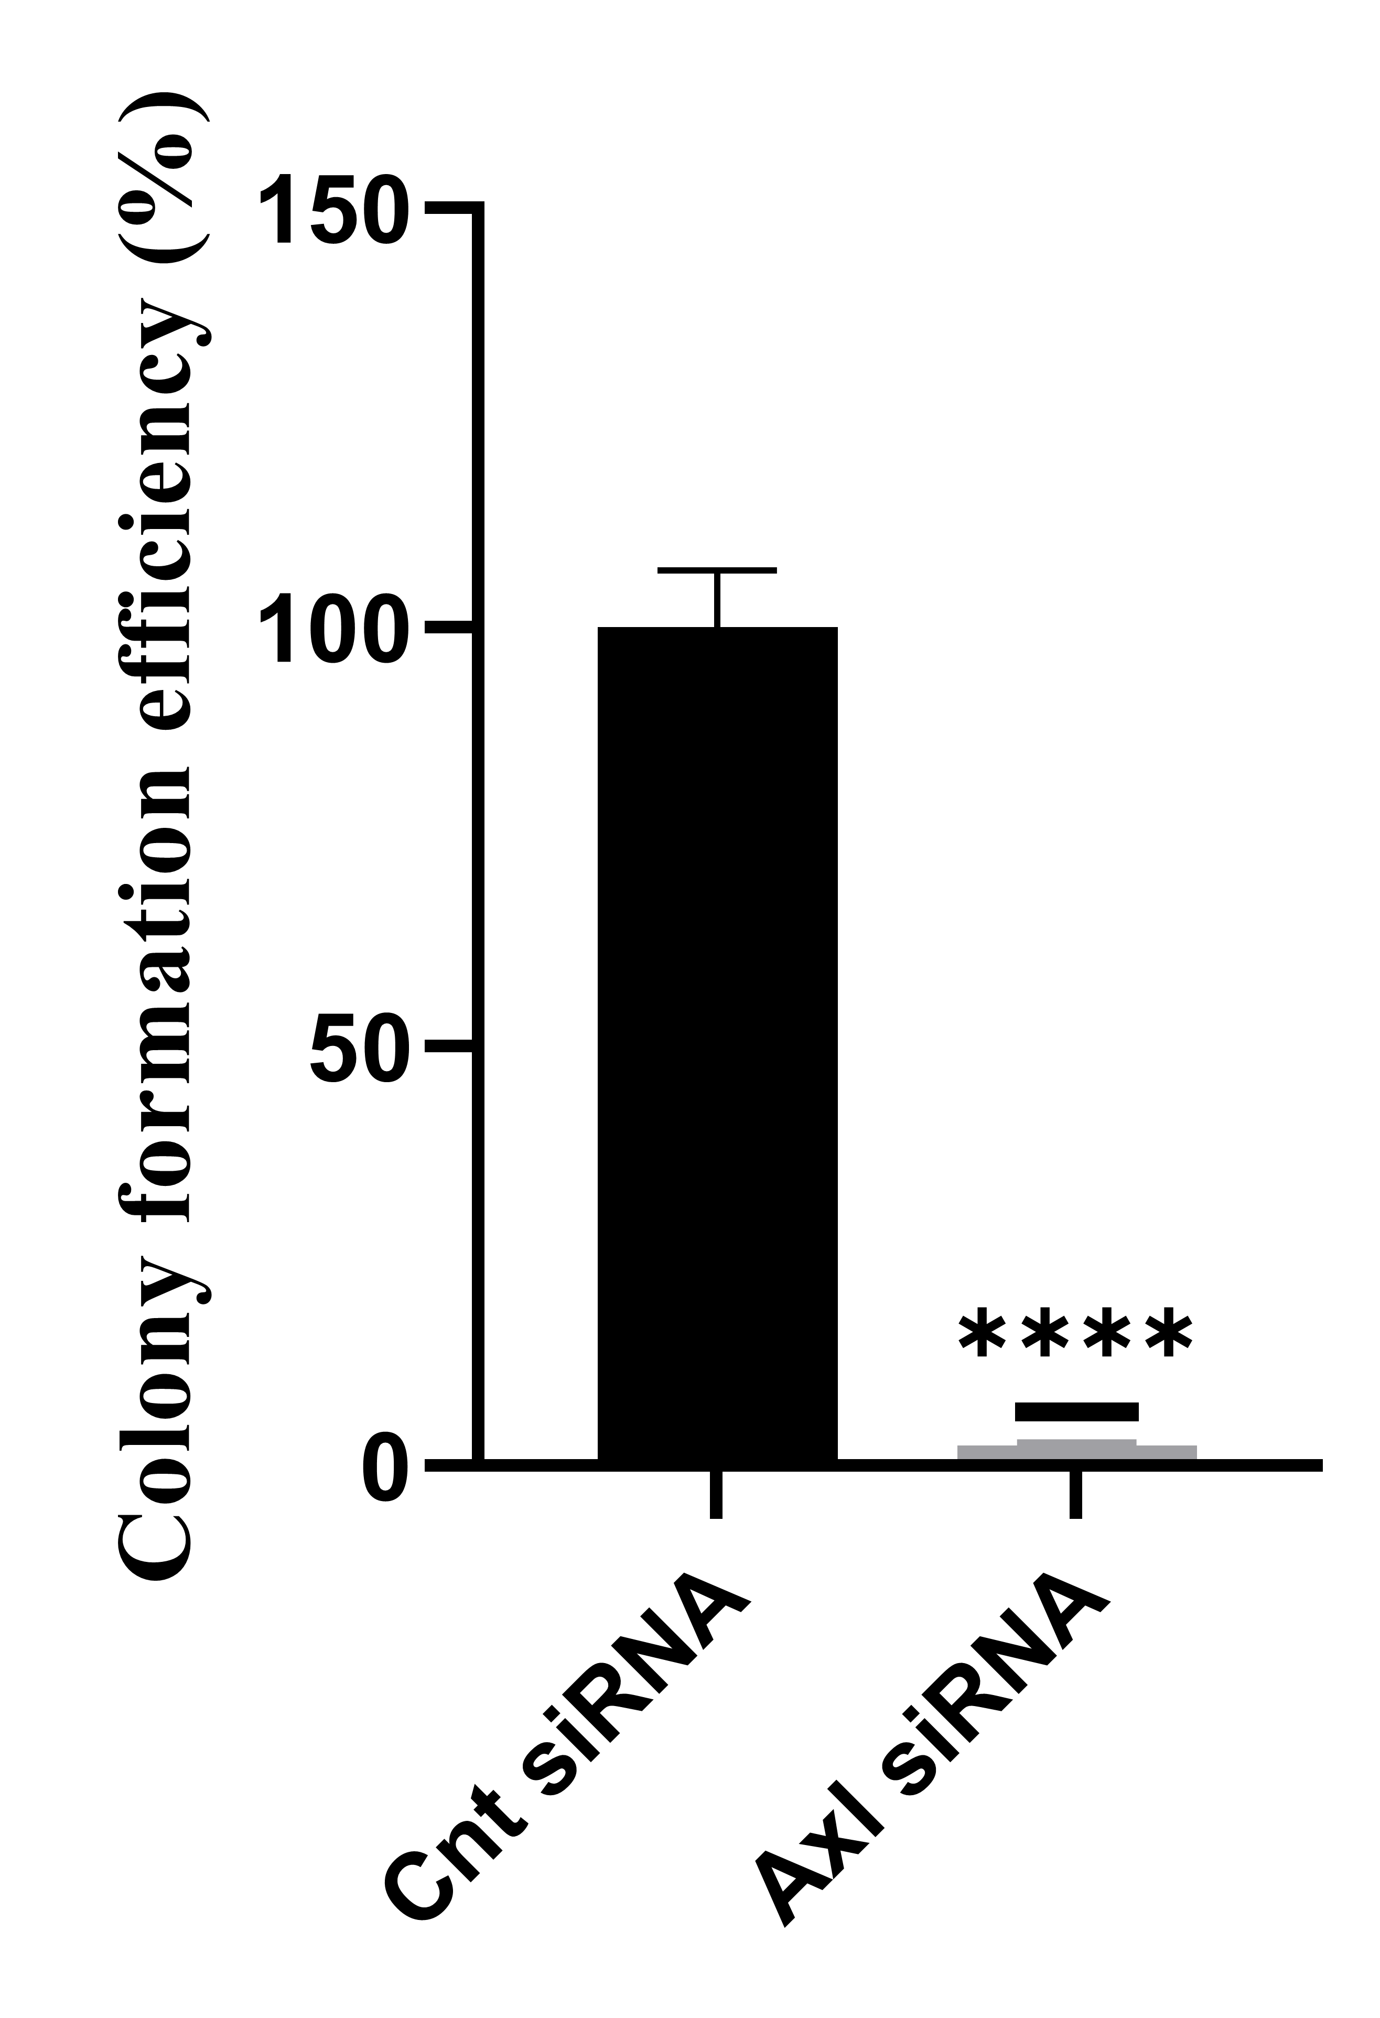
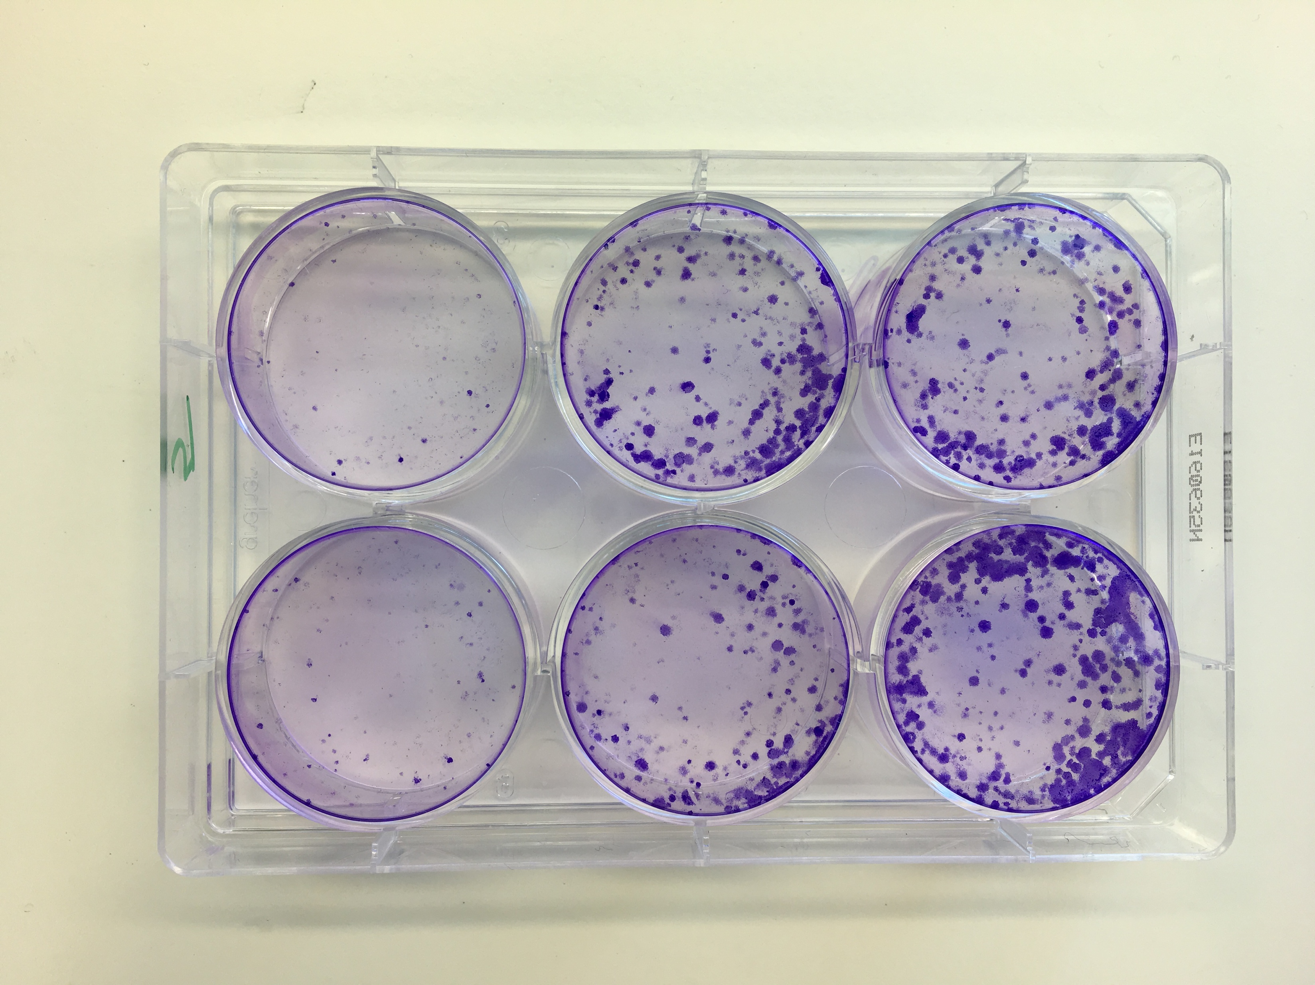
A
MiaPaCa-2 cells
Cnt siRNA
AXL siRNA
Colony formation efficiency (%)
B
MiaPaCa-2 cells
C
MiaPaCa-2 cells
Cnt siRNA
AXL siRNA
Invasion (%)
Figure S6. AXL silencing decreases colony formation, migration, and invasion in MiaPaCa-2 cells. The changes in (A) colony formation, (B) migration, and (C) invasion abilities of MiaPaCa-2 cells following AXL siRNA treatment.

Slide 7





A
B
TAM-M2 cells
M0+
MCP1
siRNAs
M0
M2
NT
Cnt
eEF2K
AXL
CD206
eEF2K
eEF2K
1
0,95
0,12
1,14
CCR2
β-actin
1
0,96
0,32
0,79
Gas6
1
0,72
0,33
1,60
GAPDH
Figure S7. MCP-1 treatment stimulates macrophage polarization towards pro-tumorigenic M2-type. (A) The effect of MCP-1 application on the polarization of macrophages and eEF2K expression was evaluated by the increased CD206 and eEF2K levels, respectively. (B) The effect of eEF2K knockdown on CCR2 (receptor of MCP-1) and Gas6 protein expression in M2-macrophages was evaluated by measured by Western blot. β-actin and GAPDH were used as loading control.

Slide 8
WB membranes

Slide 9
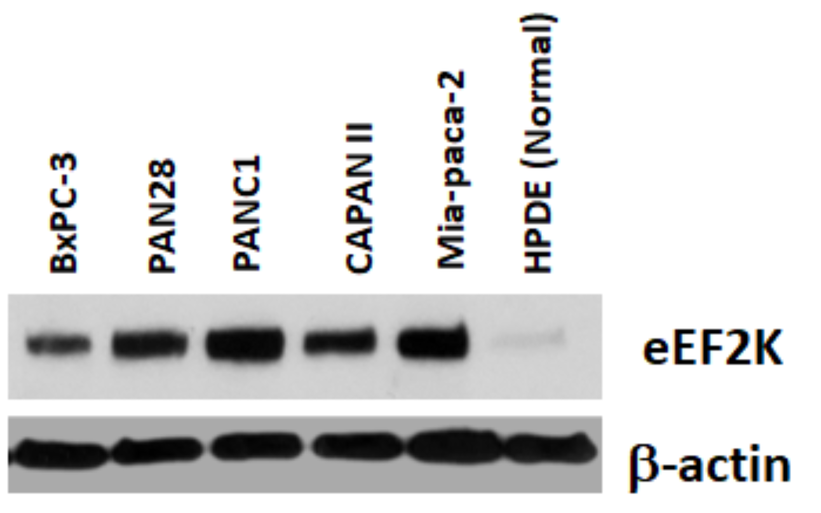
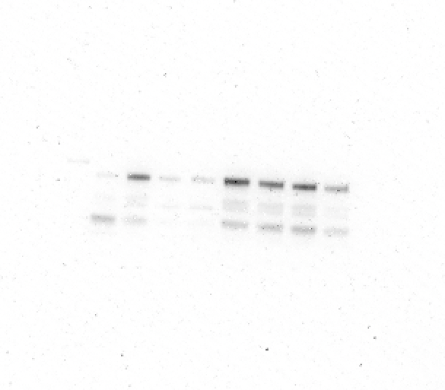

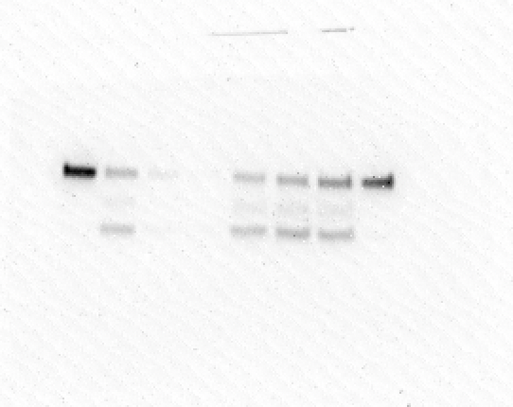
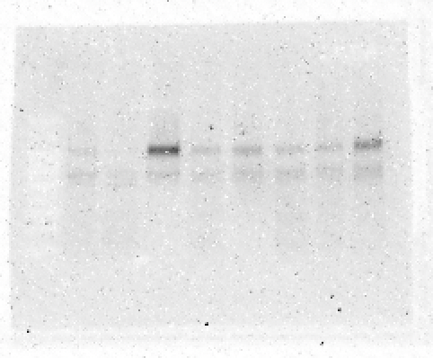
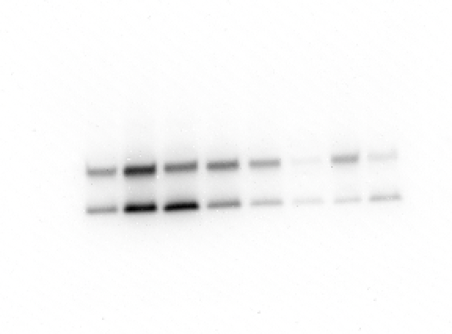
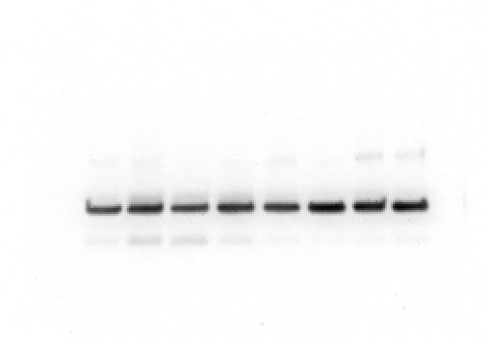
Figure 1B
eEF2K
β-actin
105 kDa
45 kDa
Figure 1D
eEF2K
β-actin
105 kDa
45 kDa
Figure 1E
eEF2K
β-actin
105 kDa
45 kDa
Figure 2E
eEF2K
MCP-1
β-actin
105 kDa
15 kDa
45 kDa

Slide 10





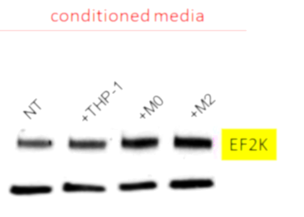
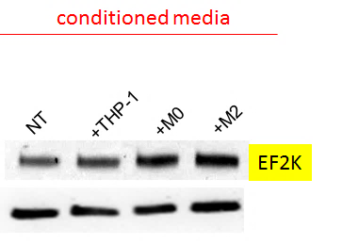
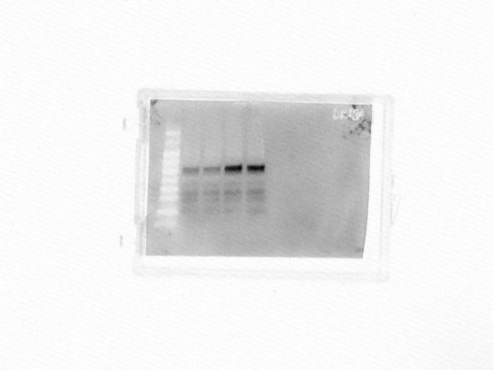
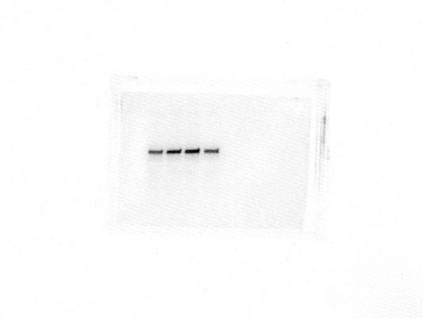


Figure 3B
CD68
CD163
GAPDH
70-80kDa
160-170 kDa
38 kDa
CD206
GAPDH
190-250 kDa
38 kDa
Figure 3E
eEF2K
GAPDH
105 kDa
38 kDa
eEF2K
GAPDH
105 kDa
38 kDa
Figure 3F
eEF2K
GAPDH
105 kDa
38 kDa
Figure 3J
p-Src^{(Tyr416)}
Src
60 kDa
60 kDa
Snail
β-actin
29 kDa
45 kDa
Figure 4B
eEF2K
GAPDH
105 kDa
38 kDa

Slide 11






Figure 5A
eEF2K
MCP-1
Gas6
GAPDH
105 kDa
15 kDa
78 kDa
38 kDa
Figure 5C
MCP-1
GAPDH
15 kDa
38 kDa
Figure 5D
eEF2K
GAPDH
105 kDa
38 kDa
Figure 5E
eEF2K
p-Axl ^{(Tyr702)}
p-Src ^{(Tyr416)}
105 kDa
138 kDa
60 kDa
VEGF
β-actin
16-26 kDa
45 kDa

Slide 12








Figure 5F
eEF2K
p-Axl ^{(Tyr702)}
105 kDa
138 kDa
t-Axl
β-actin
138 kDa
45 kDa
Snail
β-actin
29 kDa
45 kDa
MMP2
GAPDH
64, 72 kDa
38 kDa
Figure 5G
eEF2K
Gas6
MCP-1
15
kDa
p-Axl^{(Tyr702)}
138
kDa
105 kDa
78 kDa
t-Axl
p-Src^{(Tyr416)}
t-Src
β-actin
138 kDa
60 kDa
60 kDa
45 kDa

Slide 13






Figure 5H
eEF2K
Gas6
105 kDa
78 kDa
MCP-1
GAPDH
15 kDa
38 kDa
p-Axl^{(Tyr702)}
t-Axl
p-Src ^{(Tyr416)}
GAPDH
138
kDa
138
kDa
60
kDa
38
kDa
Figure S4
eEF2K
GAPDH
105 kDa
38 kDa
eEF2K
GAPDH
105 kDa
38 kDa
eEF2K
GAPDH
105 kDa
38 kDa
eEF2K
GAPDH
105 kDa
38 kDa

Slide 14



Figure S7A
CD206
eEF2K
β-actin
250 kDa
105 kDa
45 kDa
Figure S7B
eEF2K
CCR2
42
kDa
Gas6
GAPDH
105
kDa
78
kDa
38
kDa

