Slide 1
BCL-X_{L} Dependence is a Subtype Agnostic Actionable Feature of Difficult-to-Treat Kidney Cancers
Cell Death and Disease, 2026
Source File

Slide 2
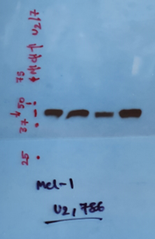
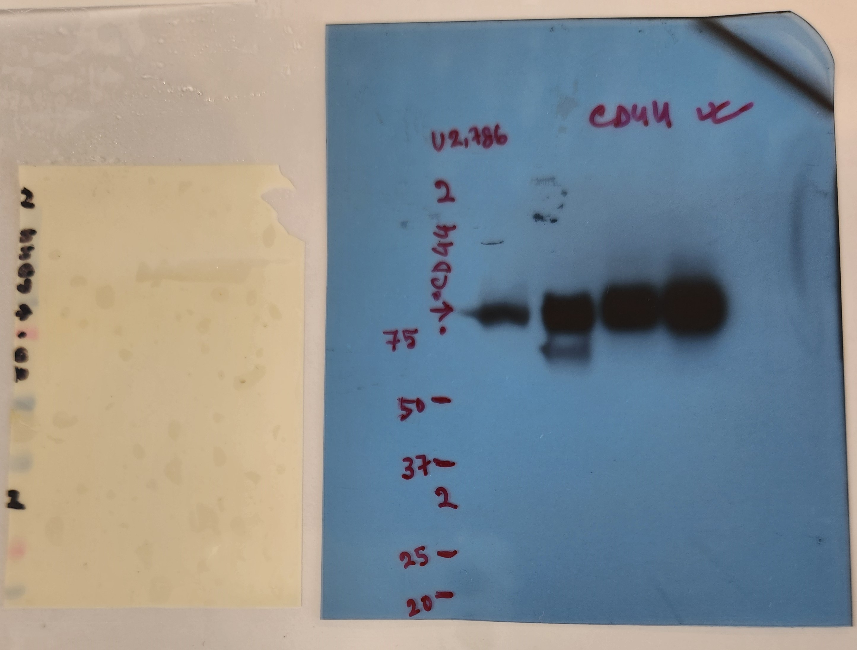
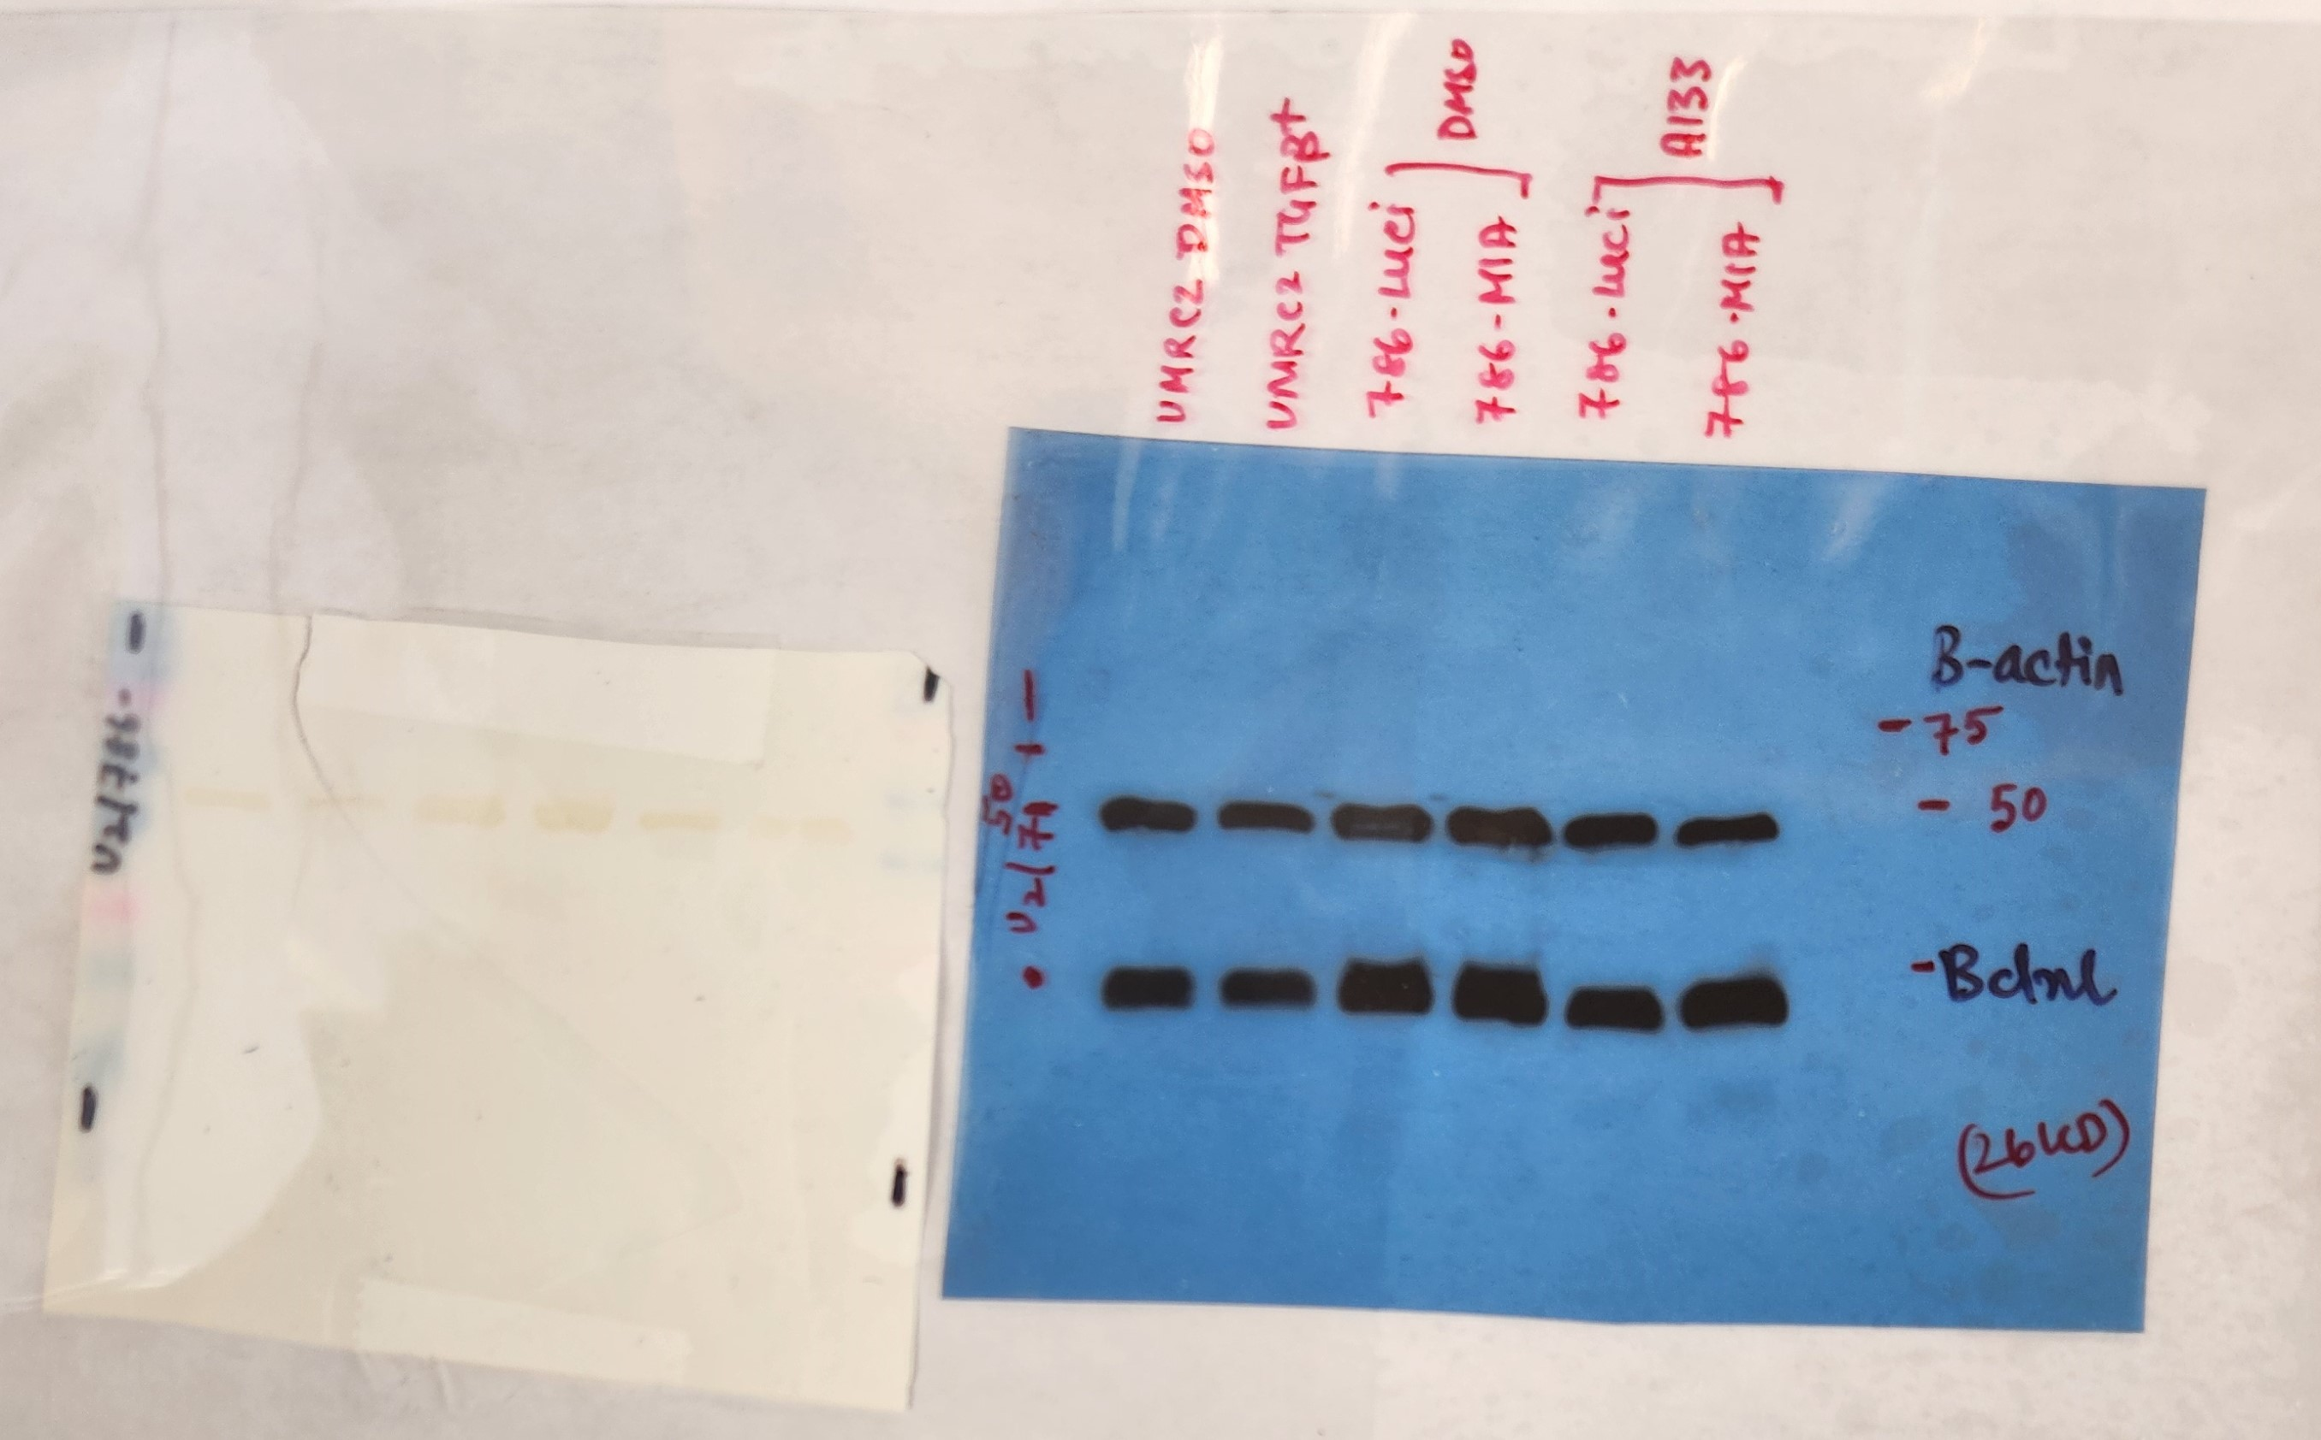
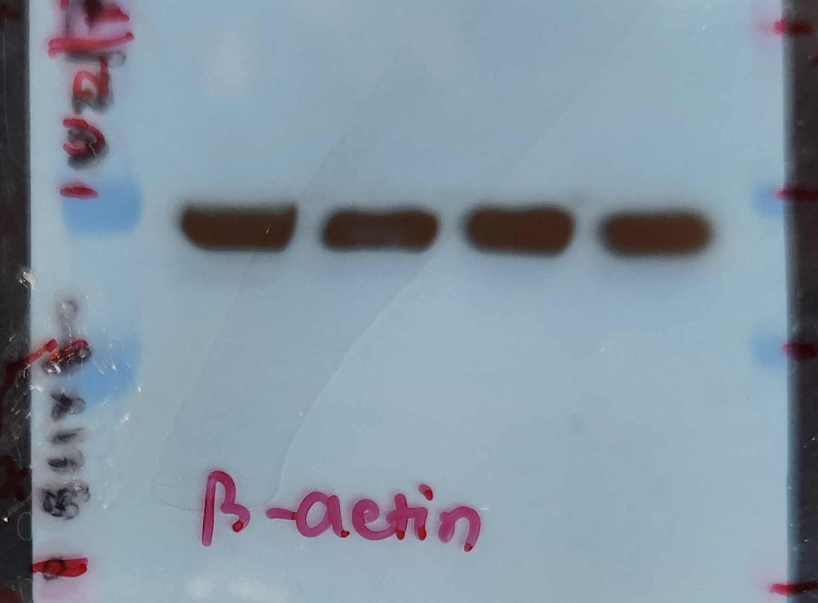
Figure 1A
TGFβ - +
MCL1
CD44
BCL-X_{L}
β-actin

Slide 3
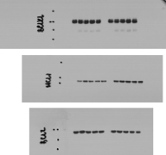

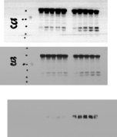
Figure 1D
Caspase 3
Contrast adjusted
Vinculin
BCL-X_{L}
Cleaved caspase 3
Caspase 3
Original image
MCL1
Cleaved caspase 3
CD44
BCL2

Slide 4

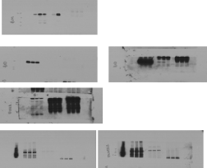
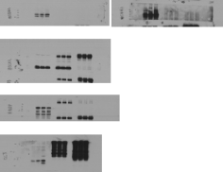
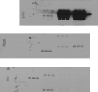
Figure 1H
BIM
ZFC3H1
Low exposure
ZFC3H1
High exposure
BUB3
BID
Low exposure
BID
High exposure
PUMA
GAPDH
BCL-X_{L}
Vinculin
MTREX
Low exposure
MTREX
High exposure
Caspase 3
Cleaved Caspase 3

Slide 5

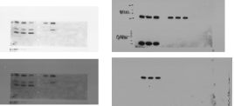
Figure 1I
Contrast adjusted
BCL-X_{L}
BIM-EL
BIM-L
Original image
BIM-EL
GAPDH
BIM-L

Slide 6
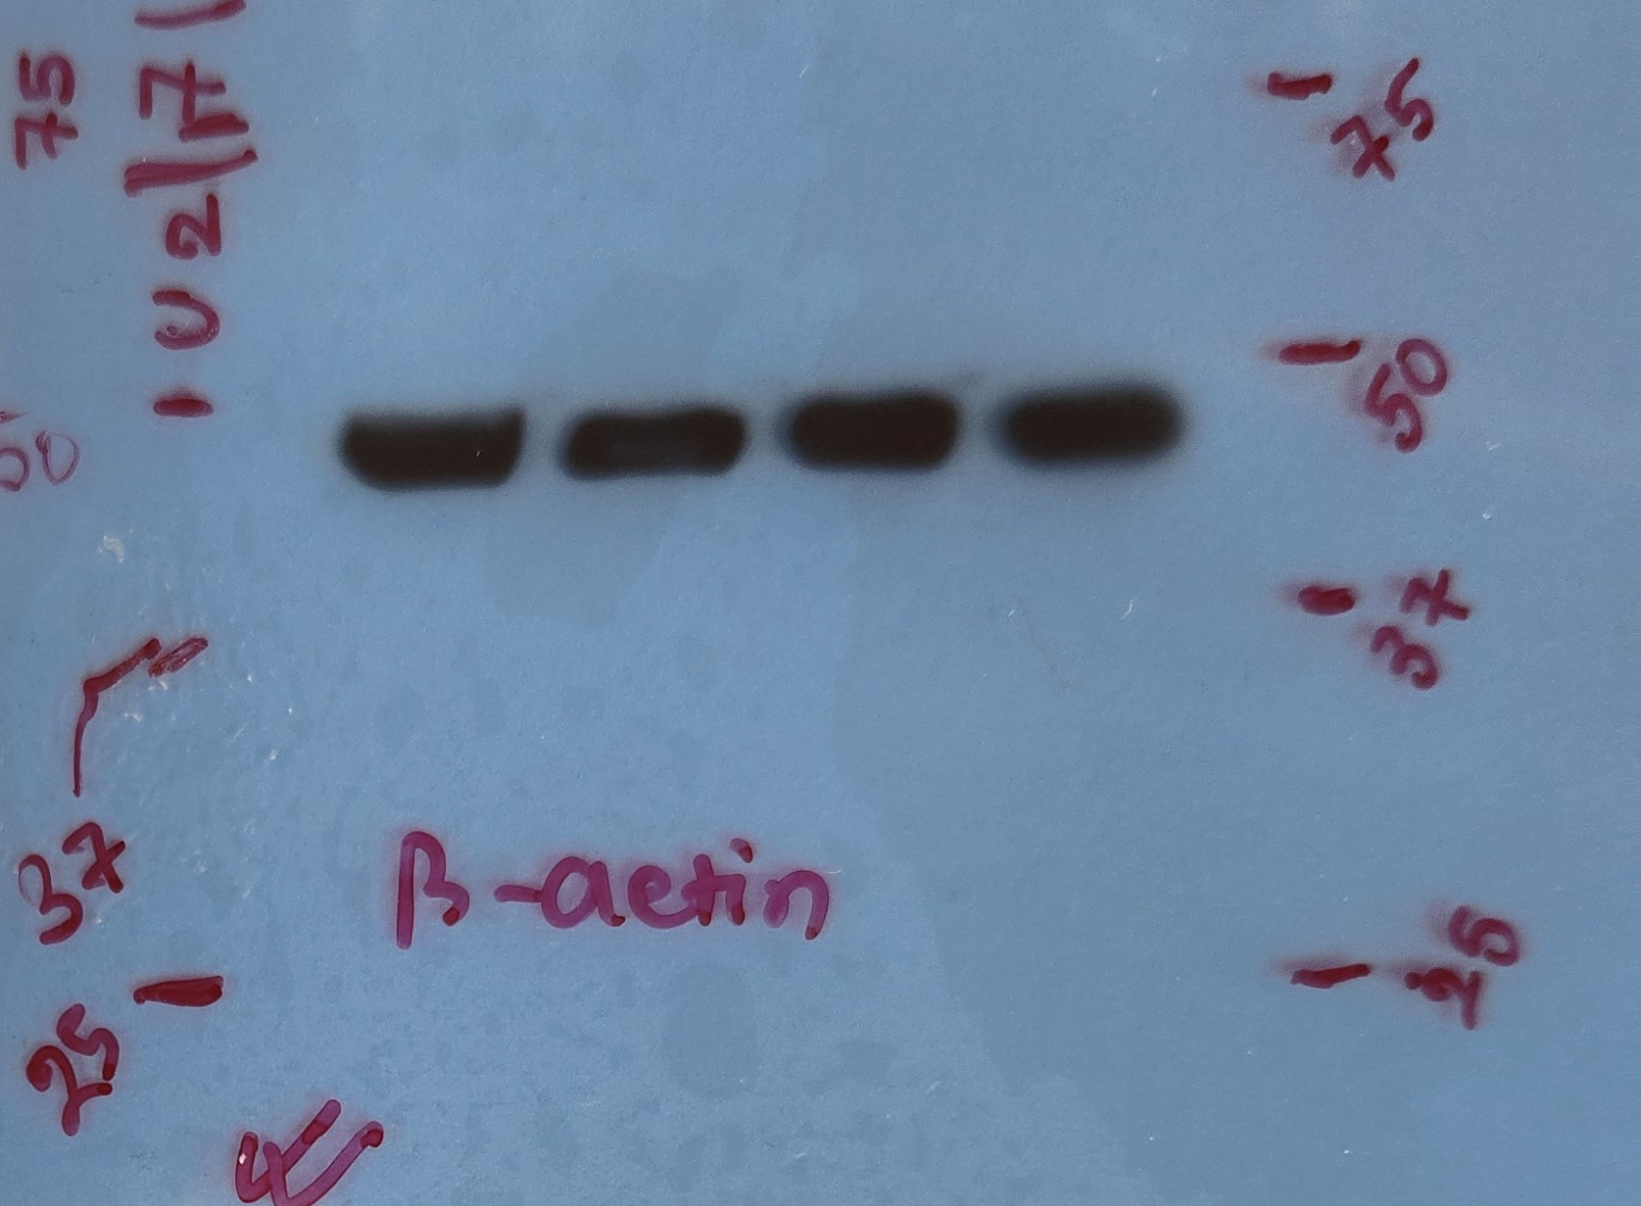
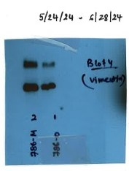
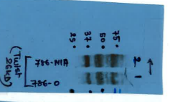
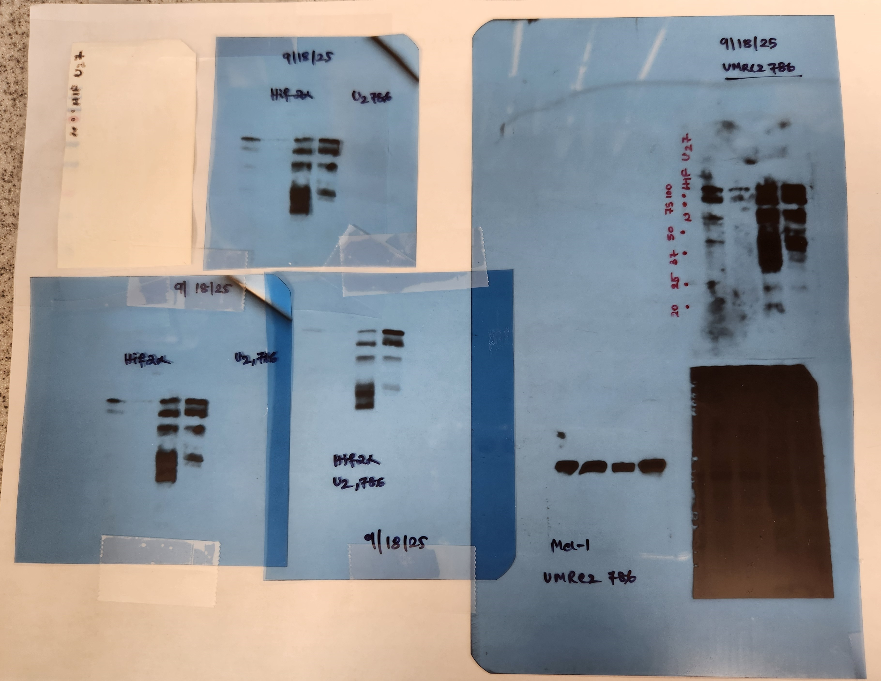
Figure 3A
7860 786M1
β-actin
Vimentin
BCL-X_{L}
CD44
Twist
HIF2⍺
MCL1

Slide 7




Figure 3D
BCL-X_{L}
BCL2
Cleaved caspase 3
Vinculin
MCL1
Vinculin

Slide 8

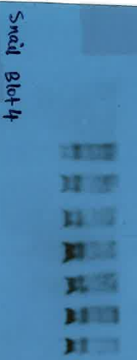
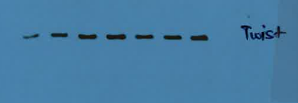

Figure 4A
TK10 : FH KO
NT1 NT2 Fh1 Fh2 Fh3 Fh4 Fh5
Fumarate Hydratase
Snail
Twist
β-actin

Slide 9

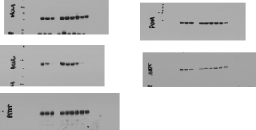
Figure 4H
MCL1
Fumarate Hydratase
BCL2
Vinculin
BCL-X_{L}

Slide 10
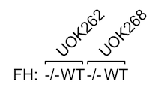
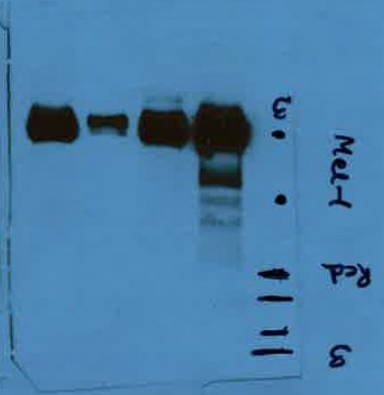
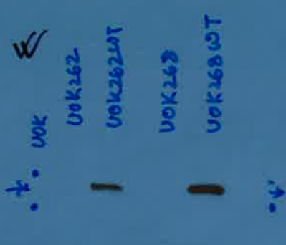
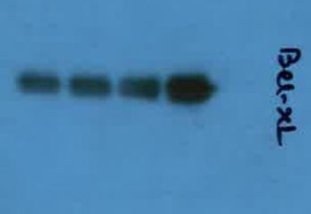

Figure 4K
Fumarate Hydratase
MCL1
BCL-X_{L}
β-actin

Slide 11
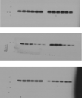



Figure 4N
BCL-X_{L}
BCL2
MCL1
Cleaved caspase 3
Fumarate Hydratase
Vinculin

Slide 12

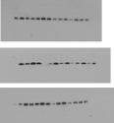


Figure 5E
BCL-X_{L}
MCL1
B-actin
GAPDH
NOXA
BCL2
Vinculin
BIM

Slide 13

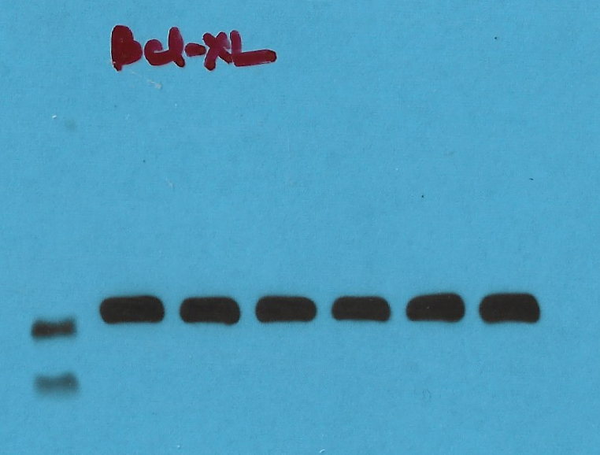
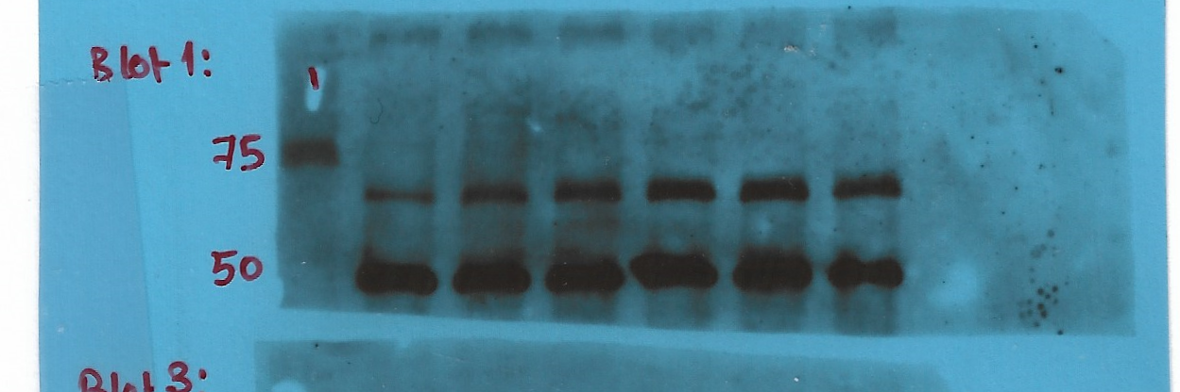
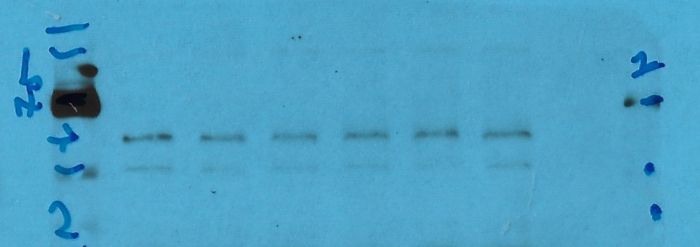
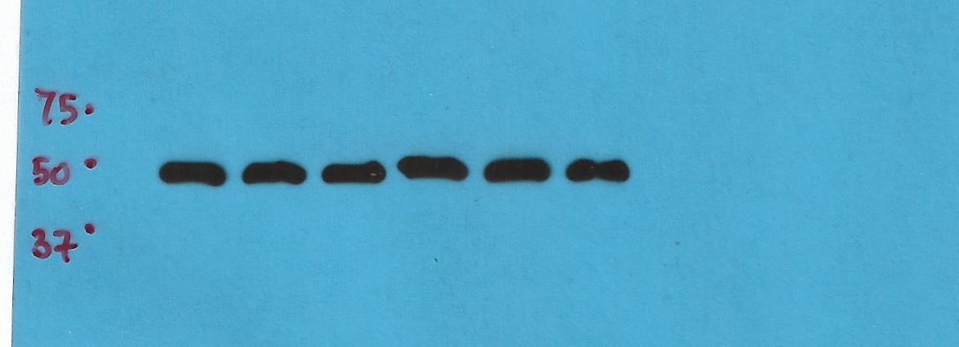
Figure 6D
pAMPK
Bcl-xL
AMPK
β actin

Slide 14
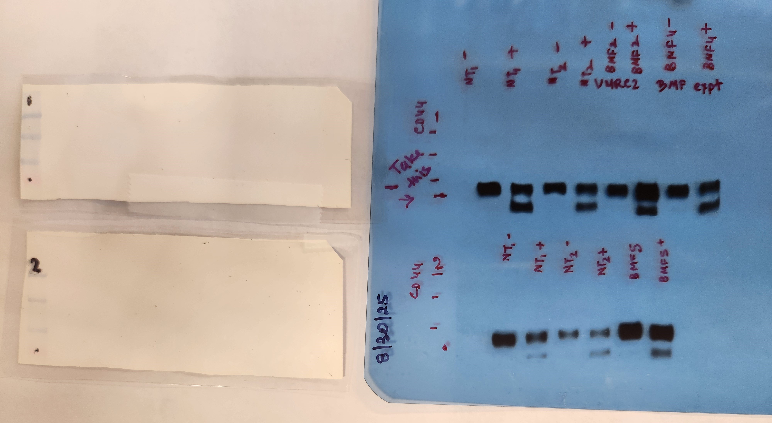
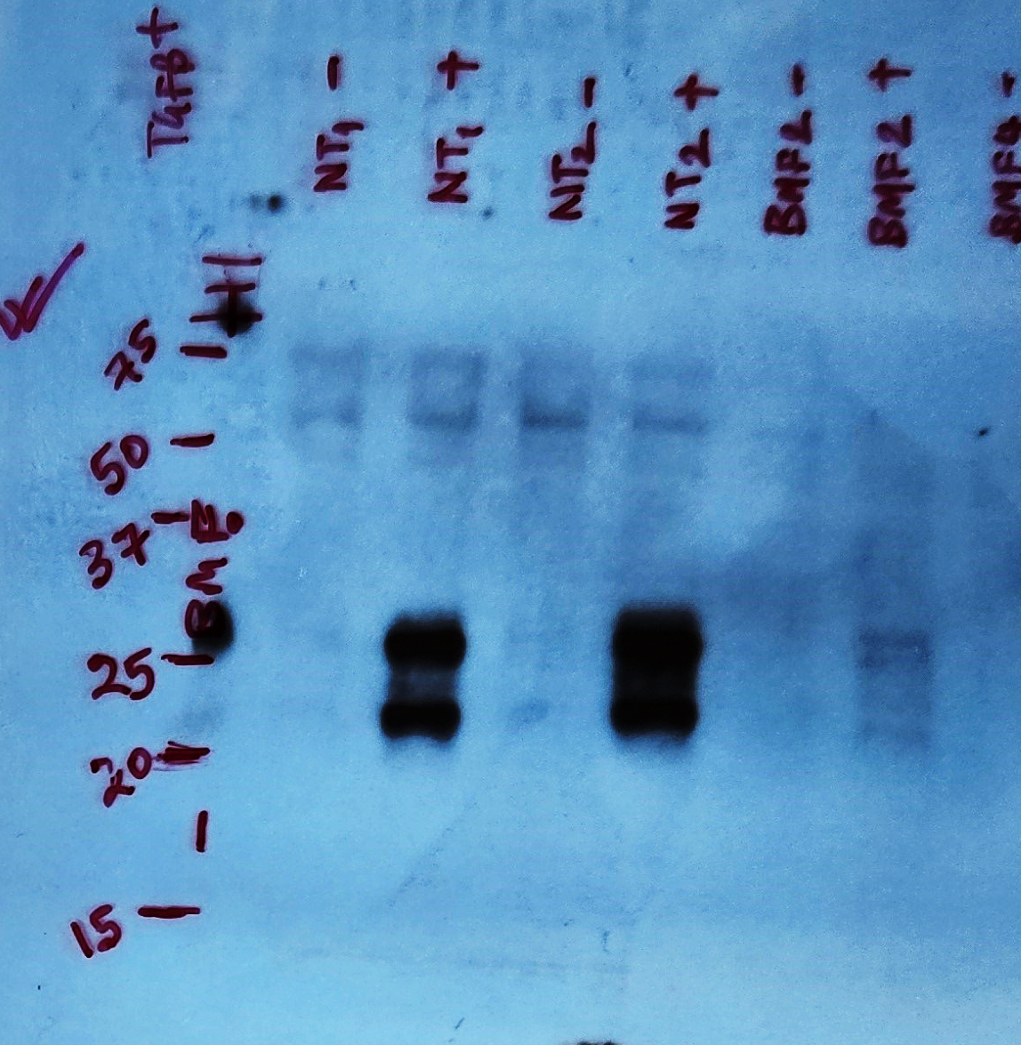
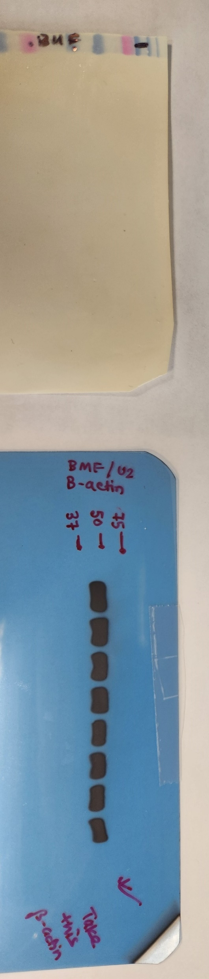
Supplementary Figure S1A
NT1 NT2 BMFsg2
Tgfβ - + - + - +
CD44
BMF
β-actin

Slide 15
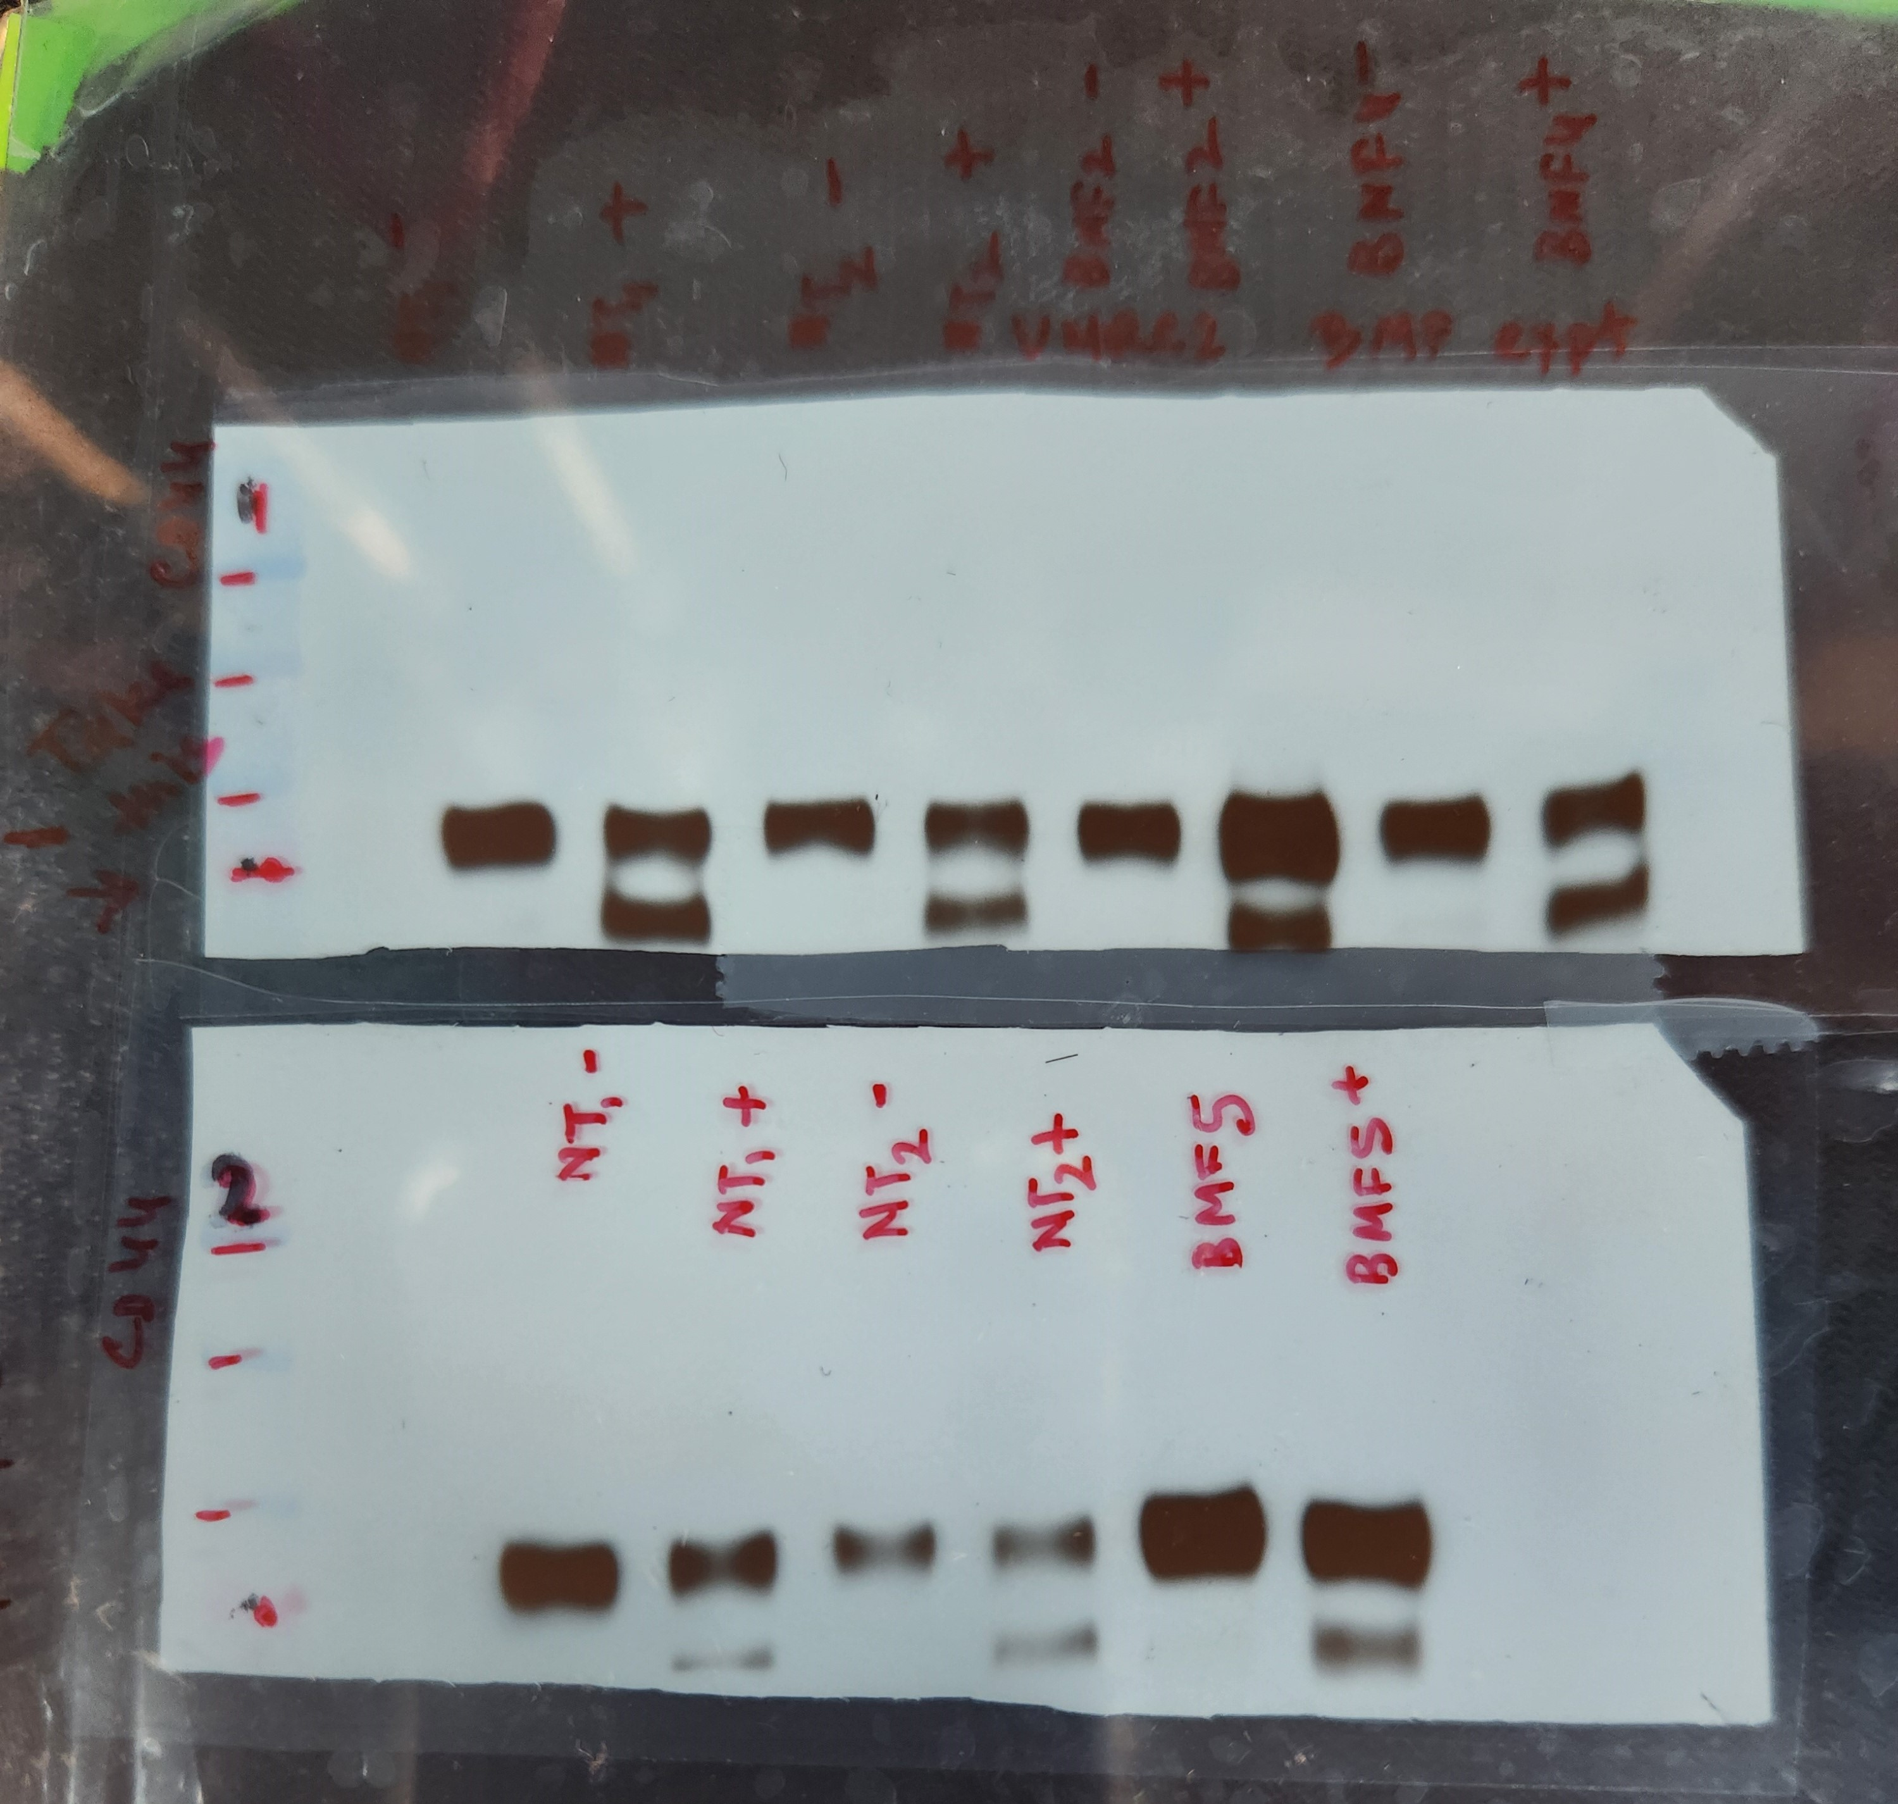
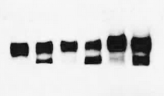
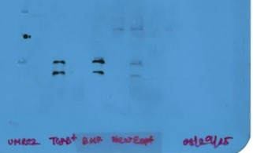
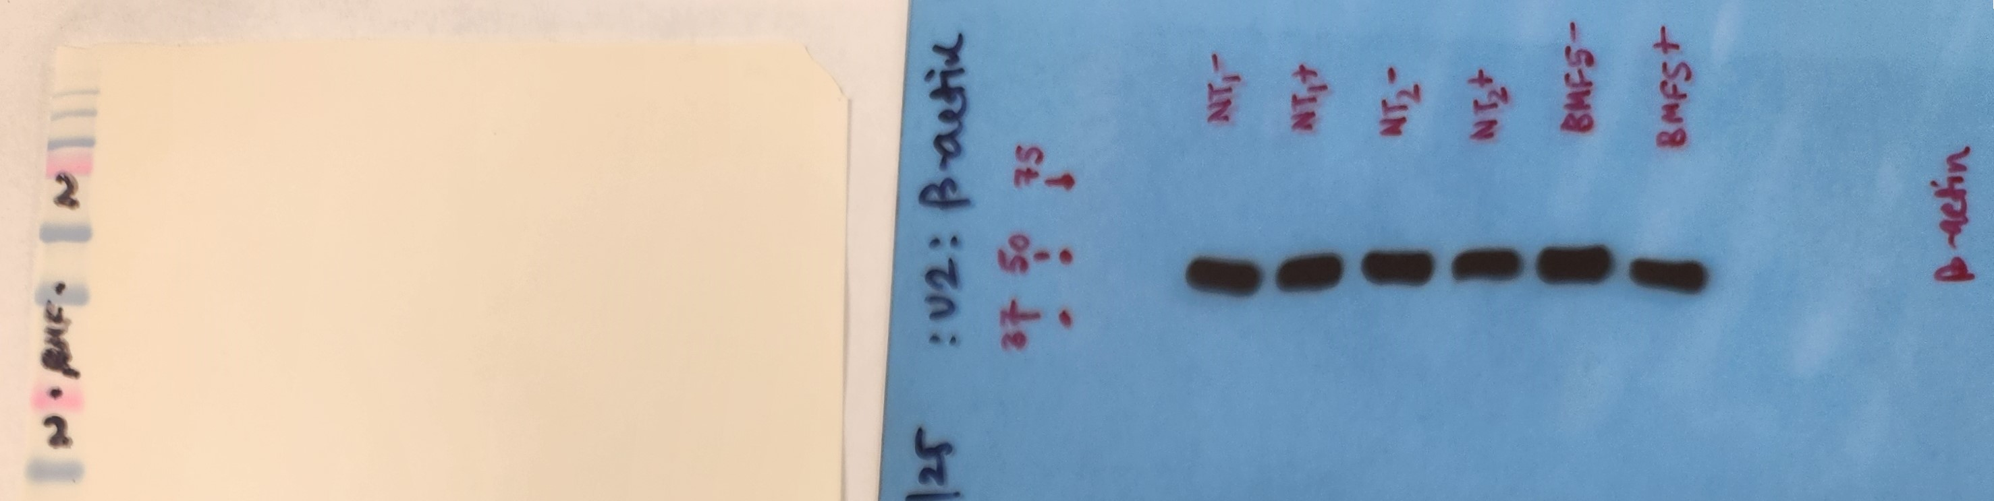
Supplementary Figure S1B
Nt1 Nt2 Bmf5
Tgfβ - + - + - +
BMF
CD44
β-actin

Slide 16

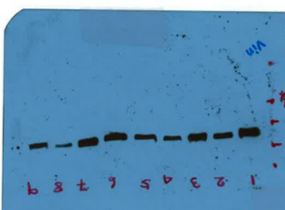
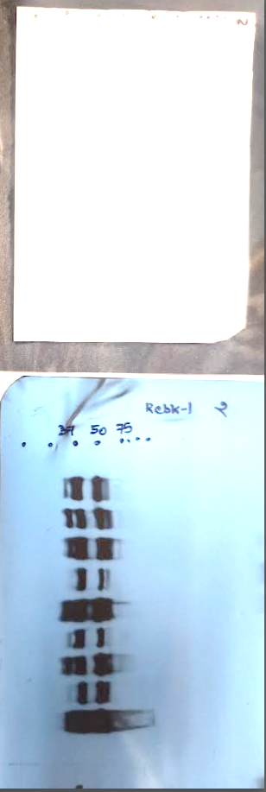
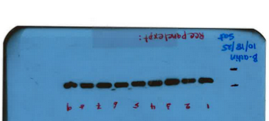
Supplementary Figure S5E
GTF2IRD1
Vinculin
β-actin
Rbck-1
Cleaved Rbck-1

Slide 17
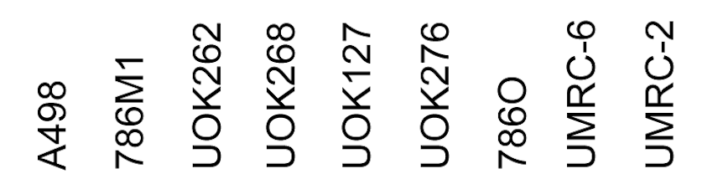
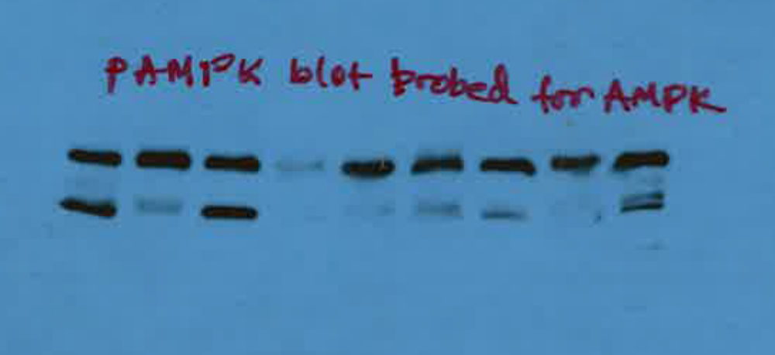
Supplementary Figure S6D
AMPK
β- actin

