Slide 1
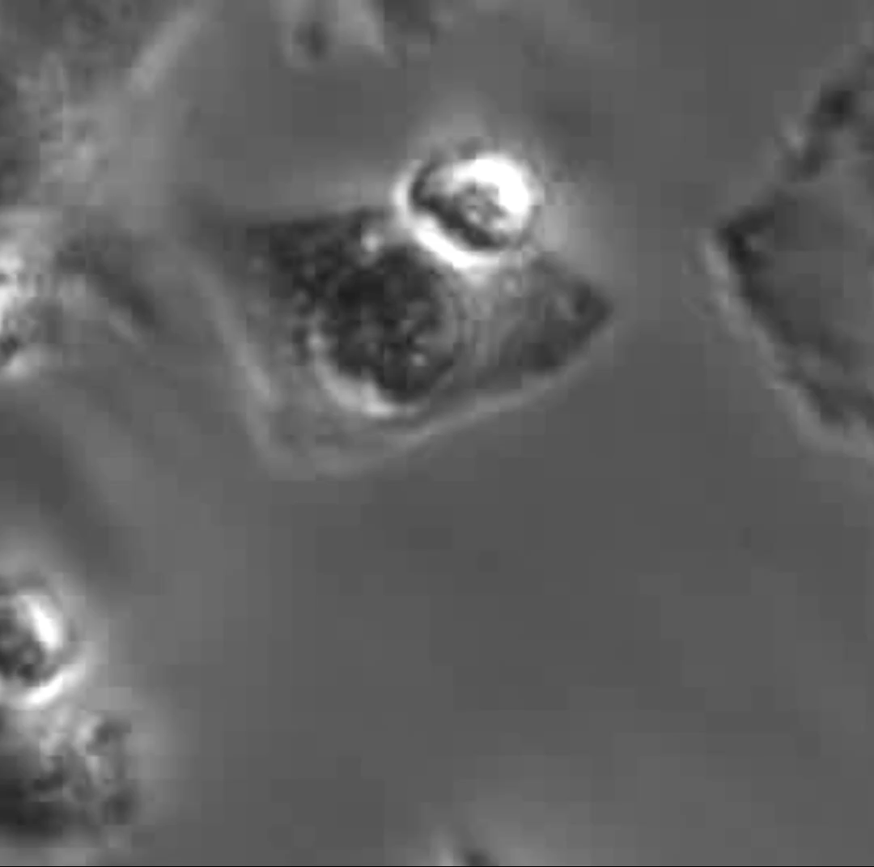
Sample video showing T-cell mediated tumor killing
Suppl 1A
T Cell
Tumor Cell
T-cell co-culture with tumor cells for 8 hrs in the presence of 1 µM EthD-1
Notes:
Supplementary Video 1. High MDM2 tumor cells are resistant to T-cell mediated killing
(1A) Showing example of T-cell mediated tumor killing video. The cell-impermeant viability indicator red fluorescence ethdium homodimer-1 (EthD-1) was used to detect dead cells.
Tumor cells were cultured overnight in slide chamber and T cells (in suspension) were added to the media with effector:target (E:T) 2:1 ratio in the presence of 1 µM ethdium homodimer-1 (EthD-1) for 8 or 12 hours. Pictures were captured every 10 or 15 minutes with video microscopy for final video (red arrow showing T cell, green arrow showing tumor cell).

Slide 2
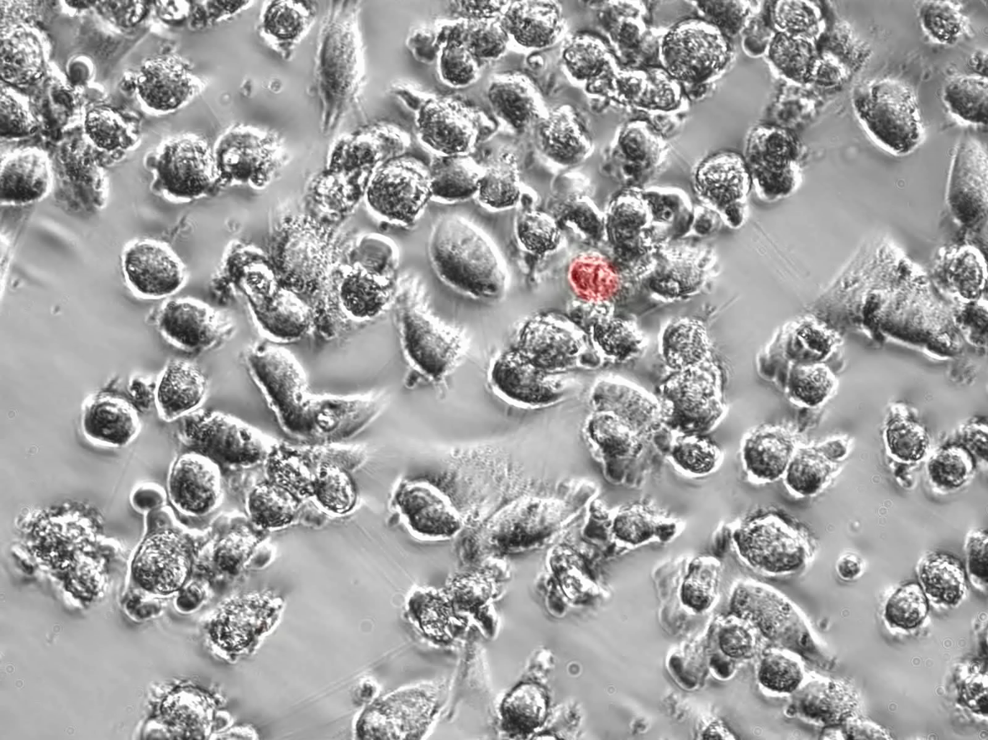
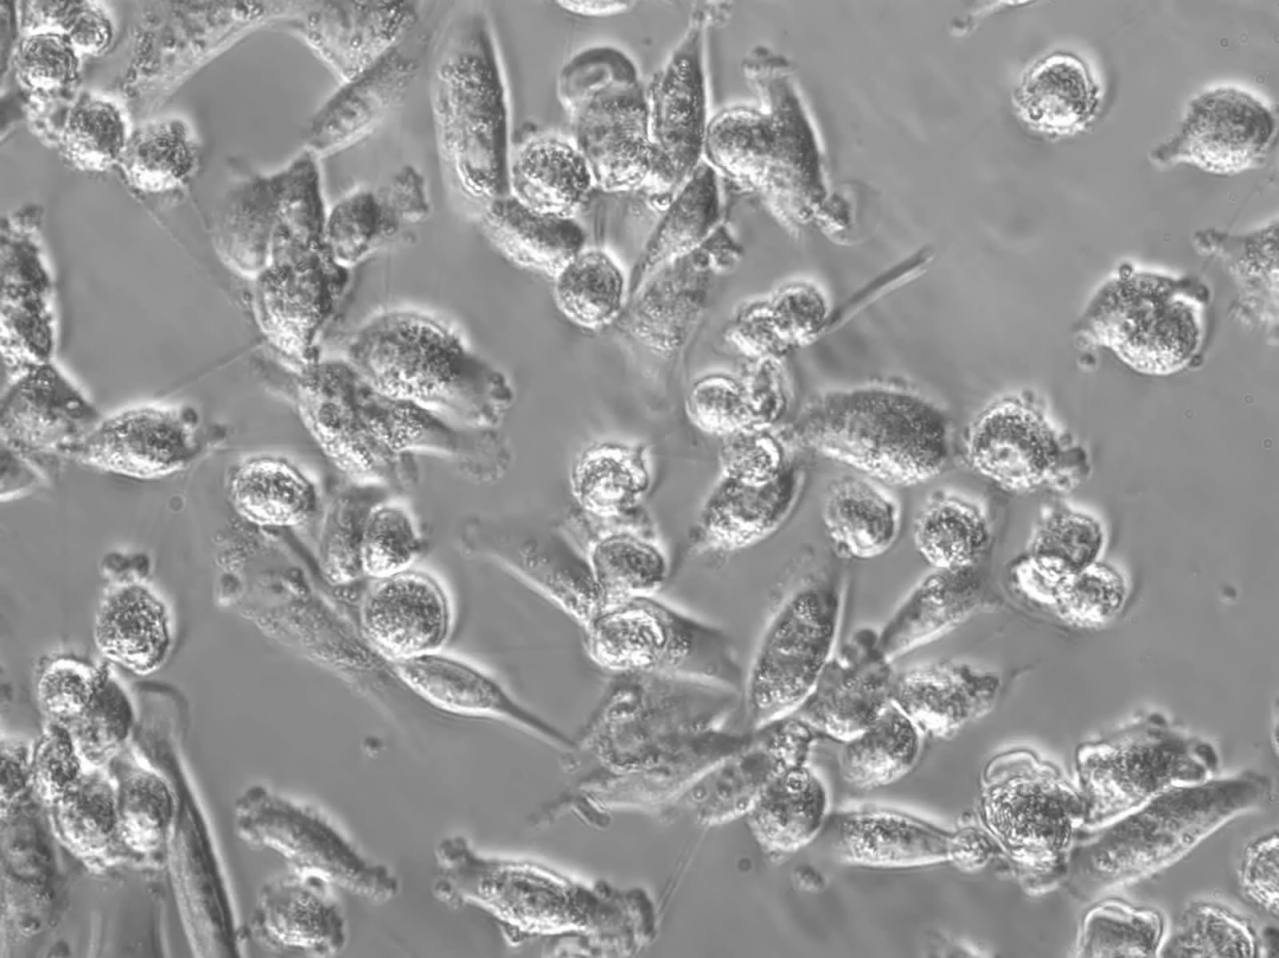
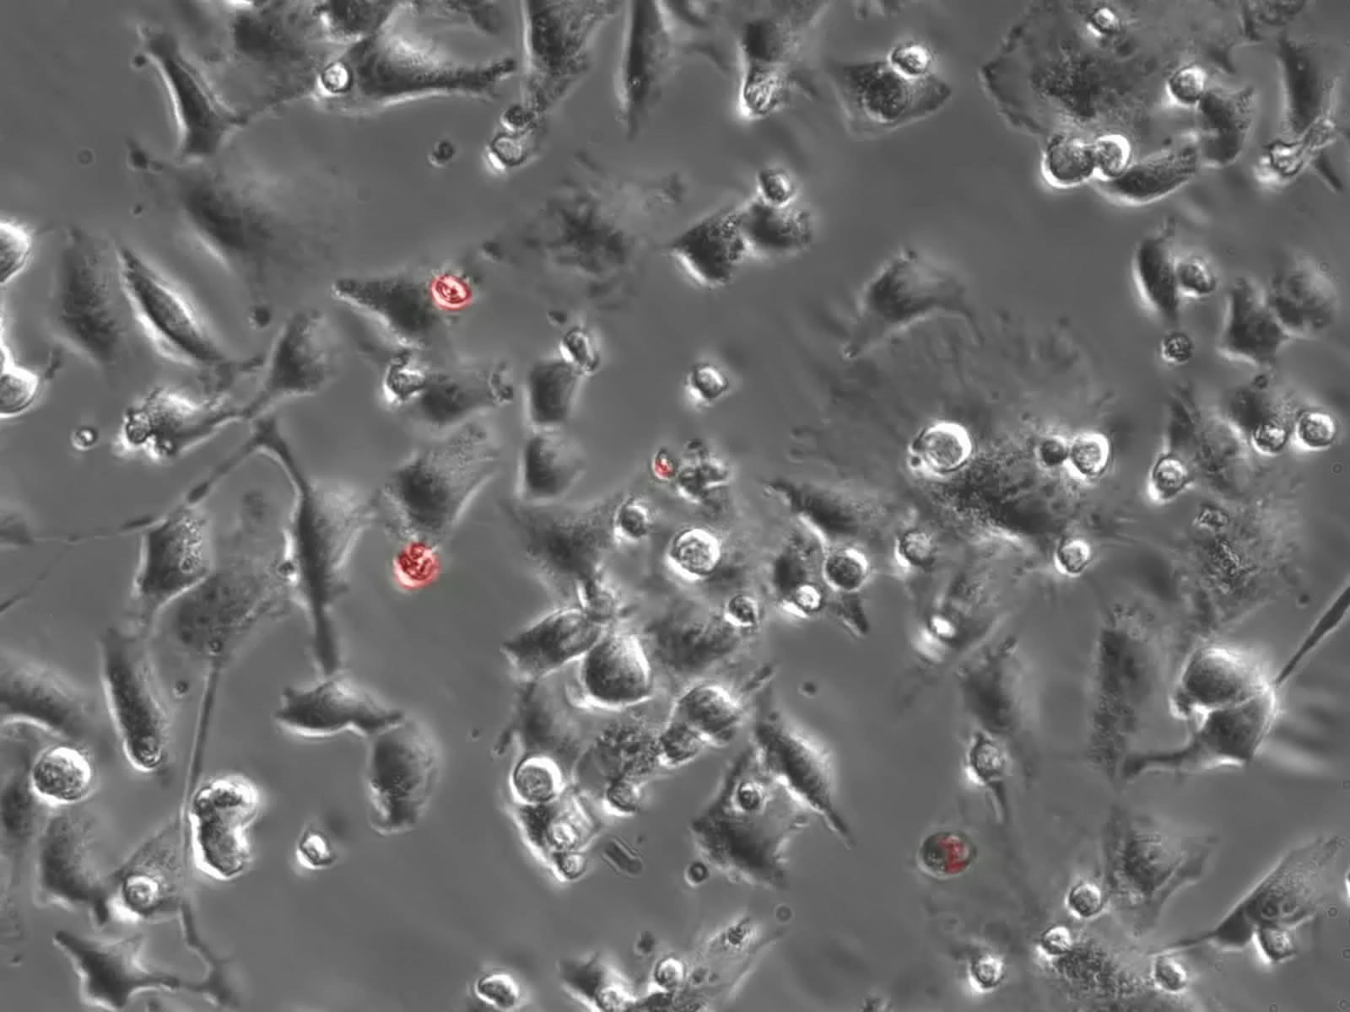
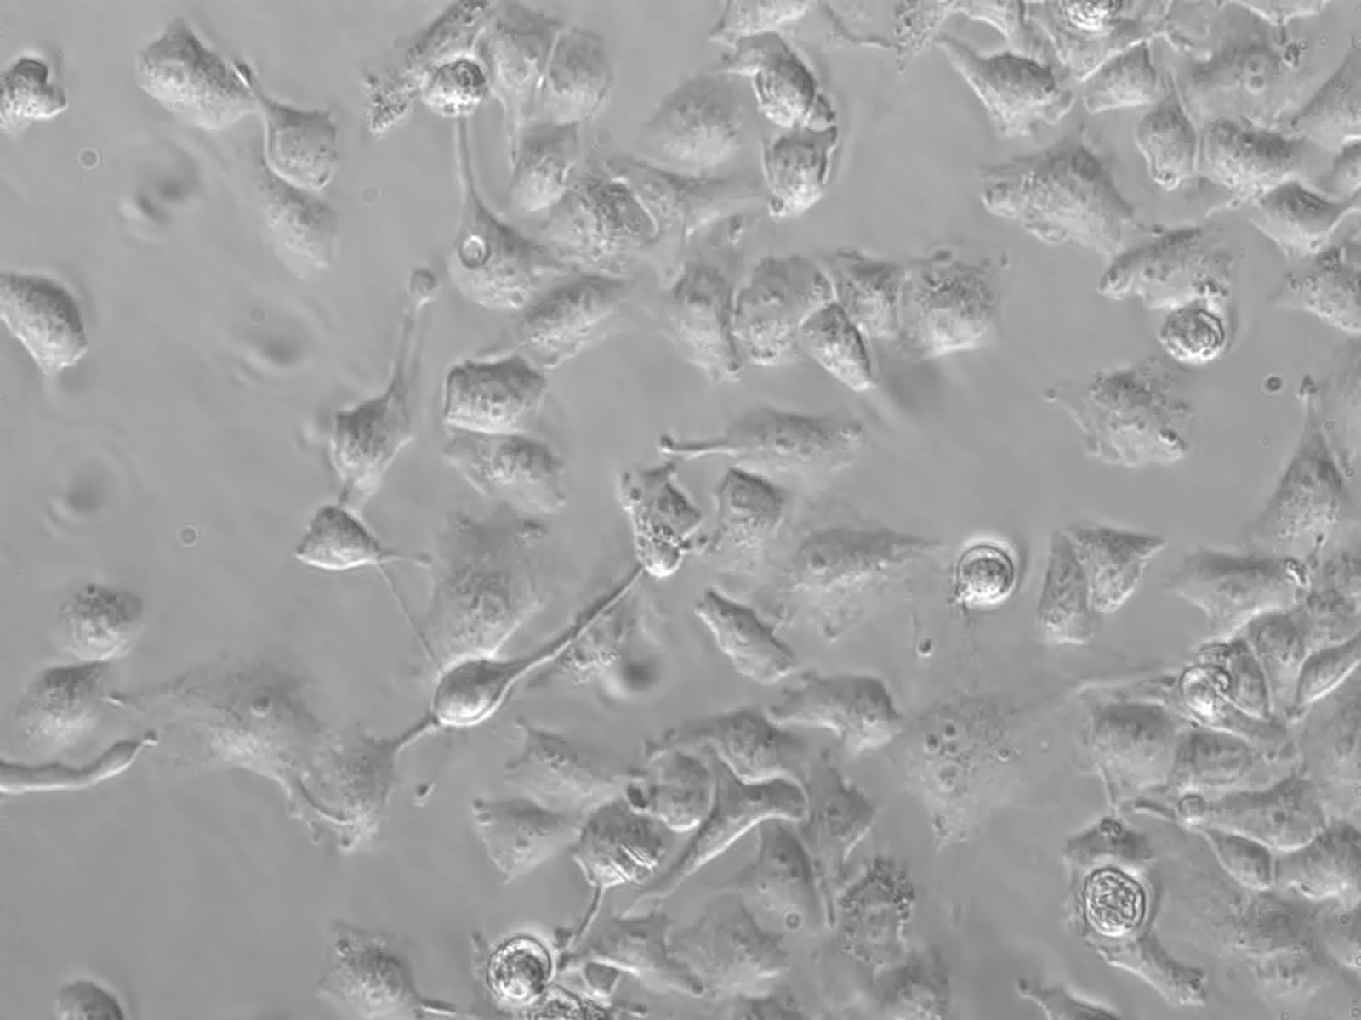
Co-culture
Cells Alone 8 hours
Suppl 1B
OVTOKO
32x
32x
TOV-21G
32x
32x
Notes:
1B) Under high magnification (32X), OVTOKO (high MDM2) and TOV-21G were cultured overnight and co-cultured with and without T cells (TALL-104) with E:T 2:1 ratio in the presence of EthD-1 for 8 hours.

Slide 3
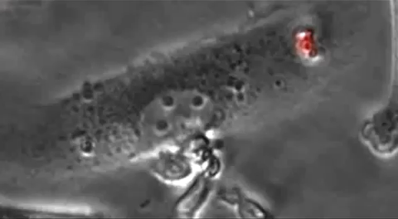
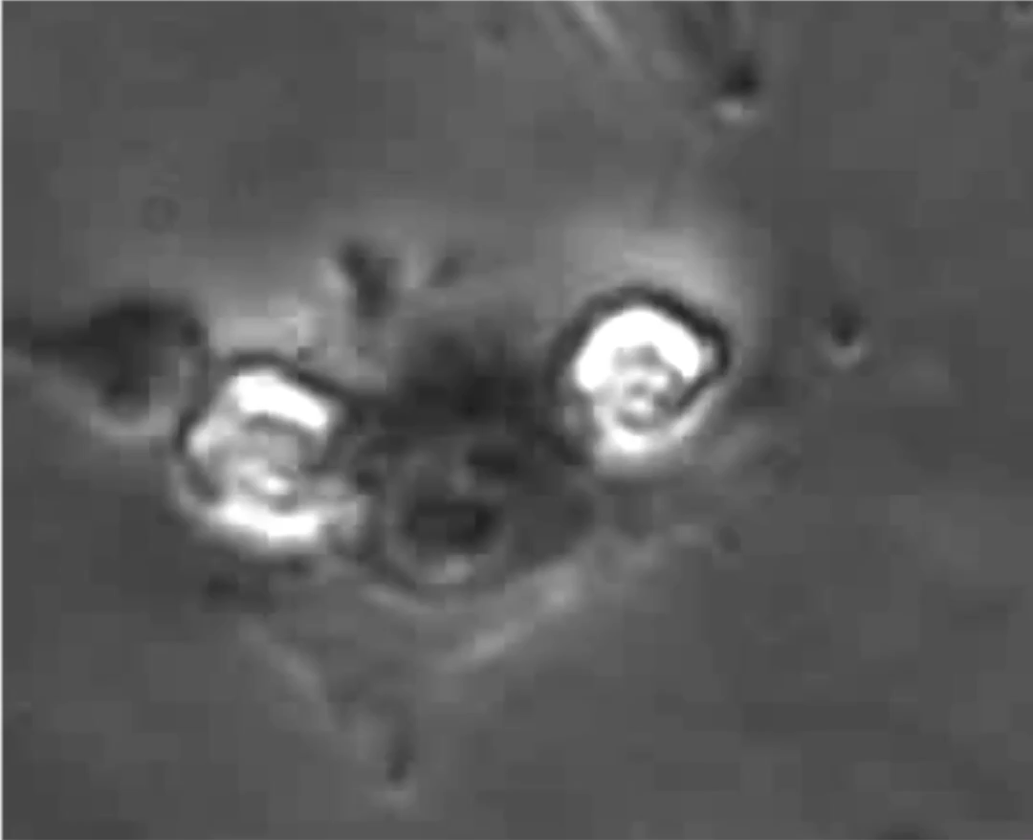
Suppl 1C
OVTOKO (High MDM2)
Tumor Cells
T Cells
TOV-21G
Notes:
1C) Single tumor cell video of OVTOKO and TOV-21G showing tumor cell interaction with T-cells.

