Slide 1
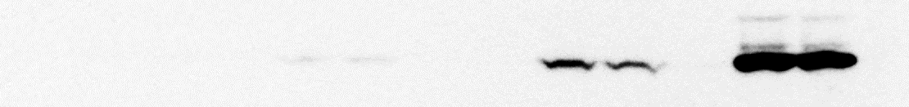

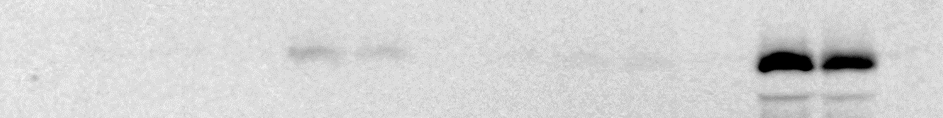
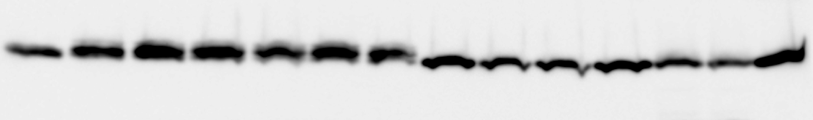
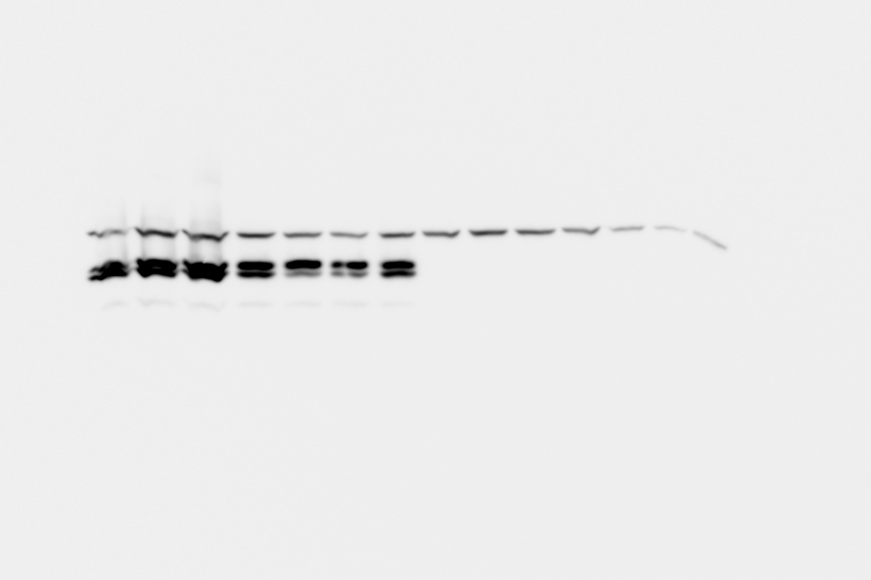
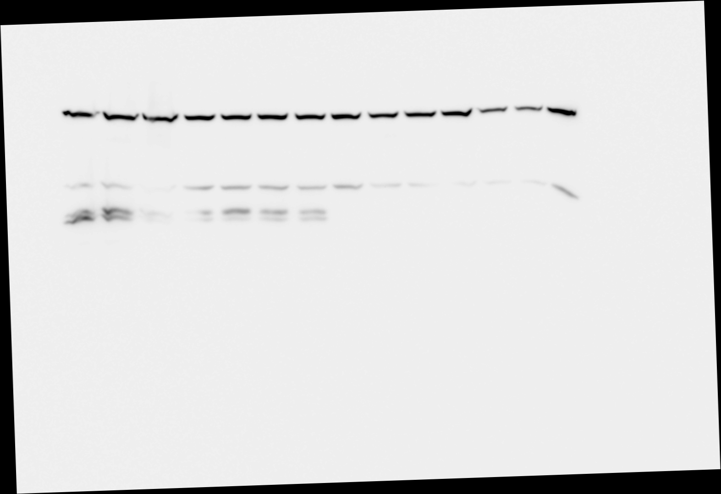
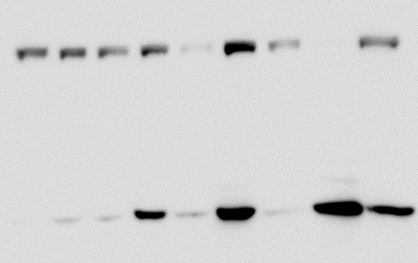
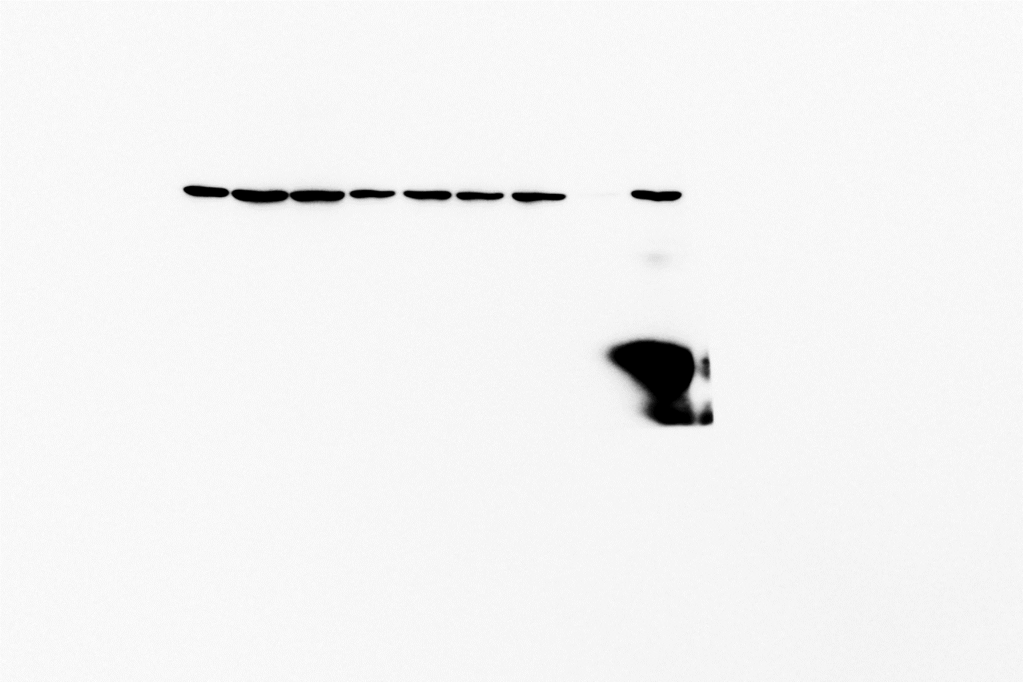
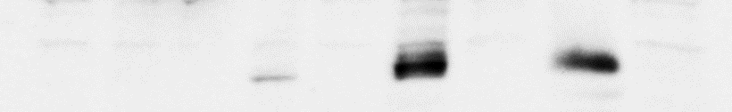
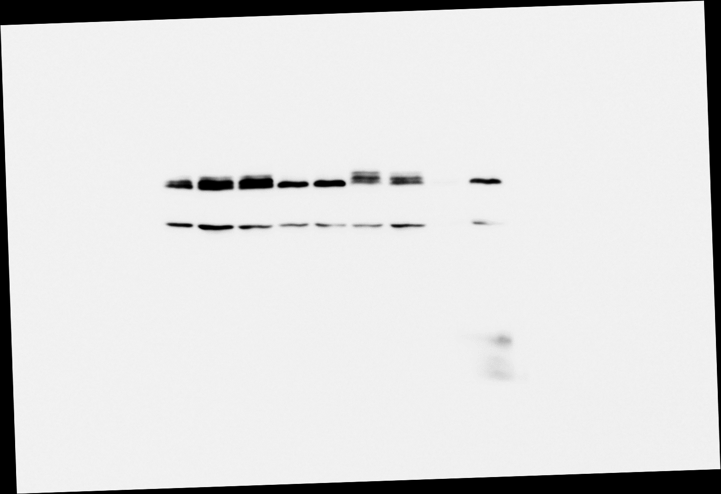
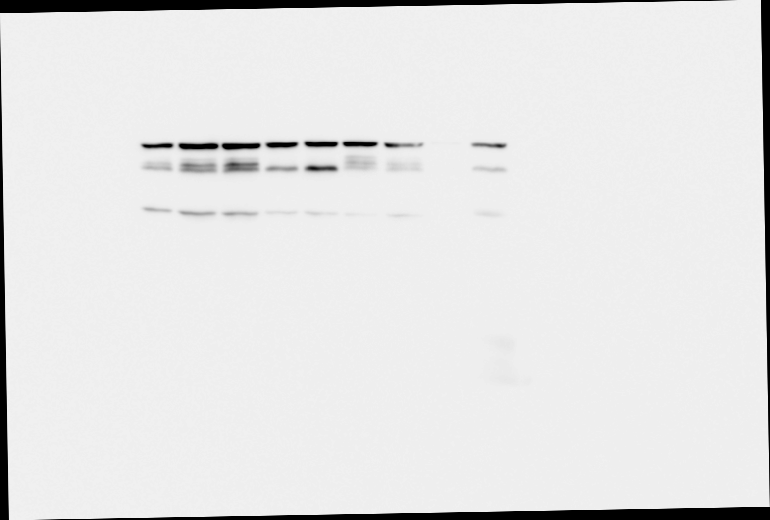
Supplementary Figure S1
A
MK2KO+ MK2
MK2KO+ vector
TNF
SM
zVAD
Nec-1
-
-
-
-
60‘
+
-
-
90‘
+
-
-
90‘
+
-
+
60‘
+
+
-
90‘
+
+
-
90‘
+
+
+
-
-
-
-
60‘
+
-
-
90‘
+
-
-
90‘
+
-
+
60‘
+
+
-
90‘
+
+
-
90‘
+
+
+
pS³⁴⁵-MLKL
48
MLKL
48
pS¹⁶⁶-RIPK1
75
RIPK1
75
MK2
48
EF2
100
B
WT-MEFs
TNF (2.5h)
SM
Nec-1
PF3644022
zVAD
-
-
-
-
-
+
+
-
-
-
+
+
+
-
-
+
+
-
+
-
+
+
+
+
-
+
+
-
-
+
+
+
+
-
+
+
+
-
+
+
+
+
-
+
+
180
130
pS³⁴⁵-MLKL
100
75
63
MLKL
63
pS¹⁶⁶-RIPK1
75
RIPK1
75
EF2
100

Slide 2
Supplementary Figure S2
A
B
ns
C
***
DKO + MK2
DKO + vector
TNF - + - + - + - + - + - + - +
D
control 5-ITu ABT-702 Gemcitabine Etoposide Doxorubicin Staurosporine
**
**
TNF
5-ITu
Nec-1
-
-
-
+
+
-
+
+
+

Slide 3
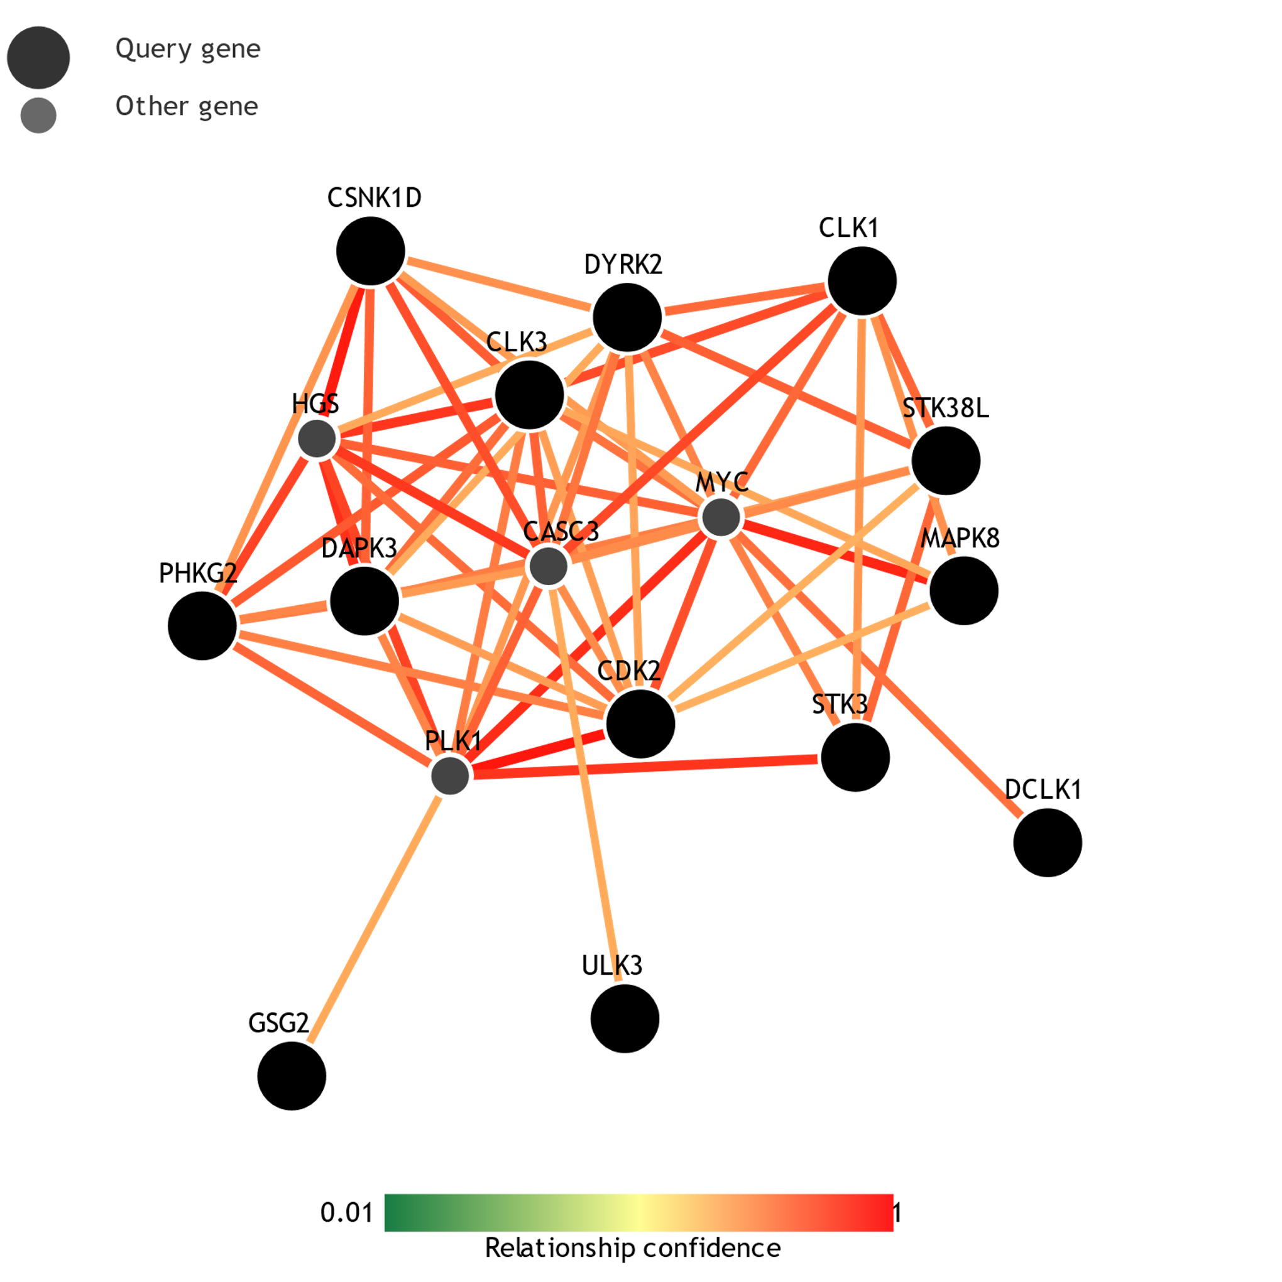
Supplementary Figure S3
A
B

