Slide 1
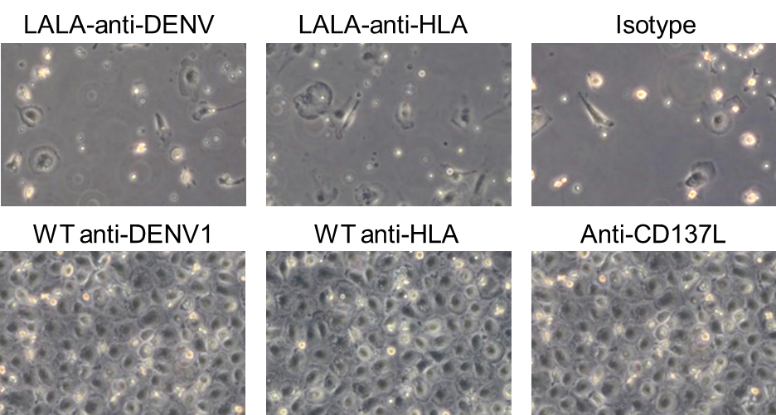
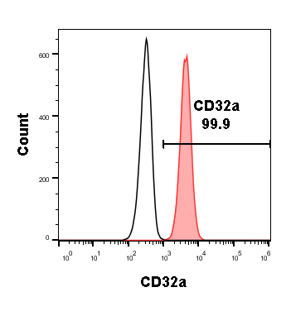
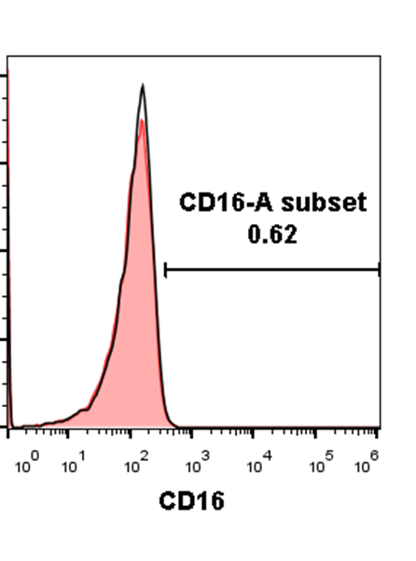
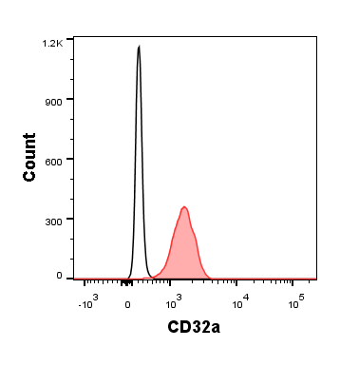
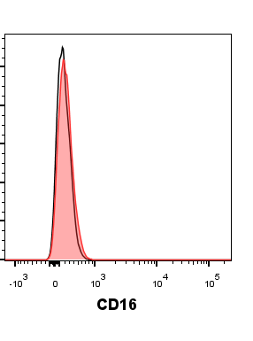
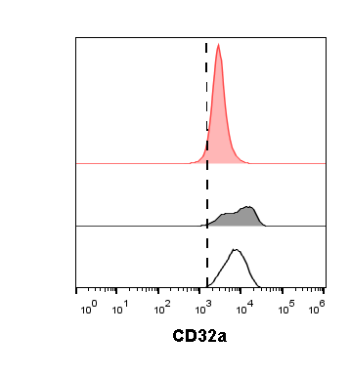
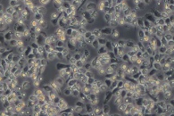
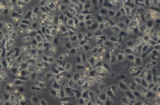
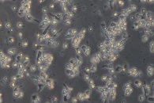
Supplementary Figure 1
a
b
c
d
siRNAs
f
CD32a
NC
NT
E
NT
NC
CD32a siRNAs
Supplementary Figure 1. CD32a is indispensable for reverse CD137L signaling. (A) Cell culture plates were coated with 5 μg/ml of indicated antibodies, before primary monocytes were added. After 7 d, cell morphologies were documented by photography. Surface CD32a and CD16 expressions on (B) THP-1 and (C) primary monocytes were measured by flow cytometry. (D) Fresh isolated primary monocytes were left non-treated or electroporated with non-targeting control (NC) or a combination of CD32a specific siRNAs. Monocytes were left in ultra-low attachment plate for 1 d to allow sufficient knockdown. The expression of CD32a and CD137L 1 d after electroporation was measured by flow cytometry. Monocytes from (D) were washed and cultured on anti-CD137L antibody (5F4)-coated plate for 1 d before (B) the pictures were taken and (C) CD14 and (D) CD83 were measured. Shown are representative data of 3 independent experiments.

Slide 2
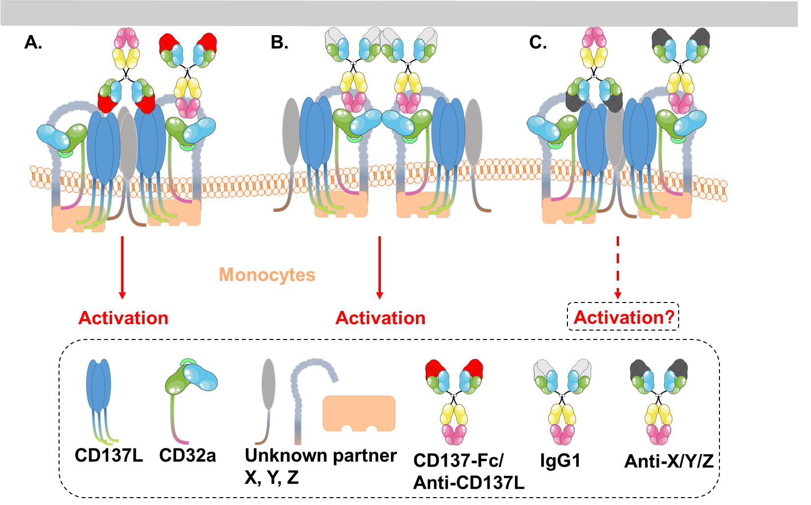
Supplementary Figure 2
Supplementary Figure 2. Working model sketch: CD137L forms a signaling complex with CD32a and other molecules to activate monocytes. (A) Anti-CD137L antibodies crosslink CD137L and CD32a to activate the signaling complex. (B) IgG1s with strong affinities to CD32a can also activate the signaling complex. (C) Antibodies to the other components of the signaling complex may be able to activate the signaling complex as well.

