Slide 1
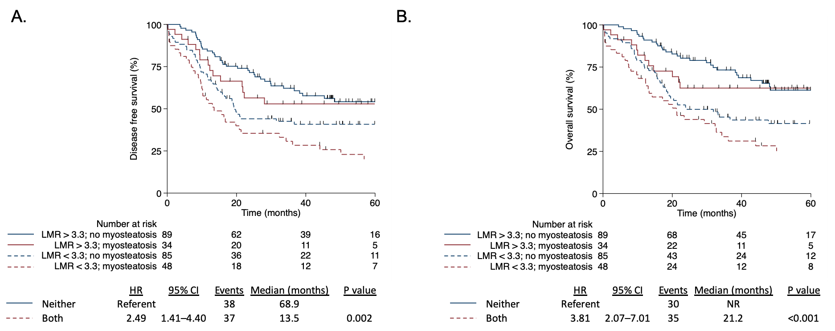
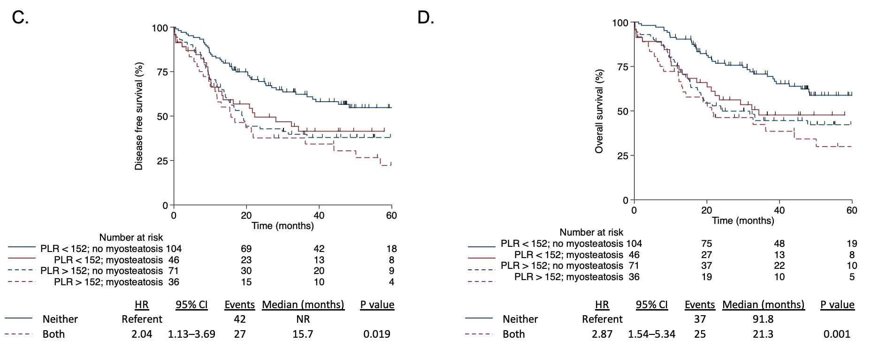
Supplemental Figure 2
Supplemental Figure 2. Kaplan–Meier curves for disease-free survival (A, C) and overall survival (B, D) according to the association between lymphocyte-to-monocyte ratio and myosteatosis (n=256), and platelet-to-lymphocyte ratio (n=257) and myosteatosis, respectively, in patients with gastric cancer submitted to gastrectomy with curative intent. The Cox model was adjusted for age (categorical), body mass index (BMI; categorical), weight loss (categorical), diabetes (binary), location (categorical), surgery type (categorical), histology (categorical), albumin (categorical) and AJCC pathological stage (categorical).

