Slide 1
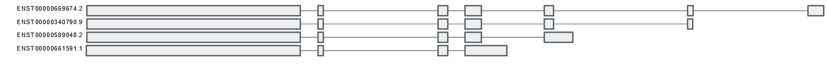
A
Splice Prediction Tools Unanimously Predict Aberrant Splicing
Splice Prediction Tool | c.314+1G>A
SpliceSiteFinder-like | -100%
MaxEntScan | -100%
NNSPLICE | -100%
GeneSplicer | -100%
SpliceAI 10k [≥0.2|0.5|0.8] | 0.99 DL (1)
AbSplice [≥0.01|0.05|0.2] | 0.31
varSEAK [1-5] | 5
B
c.314+1G>A
7
6
5
4
3
2
1
6
5
4
3
2
1
5
4
3
2
1
4
3
2
1

