Slide 1
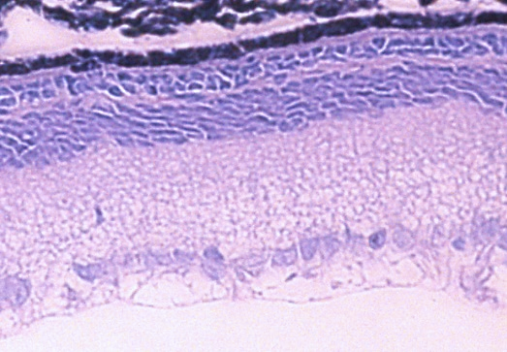
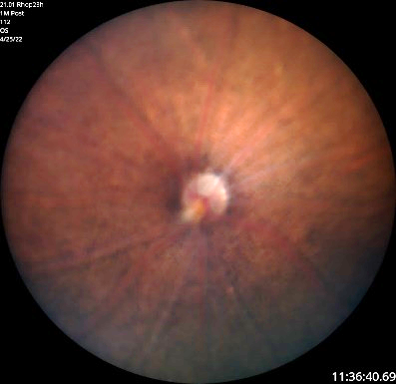
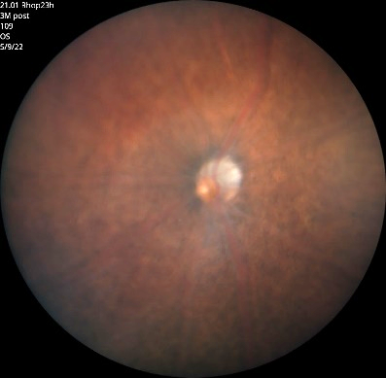
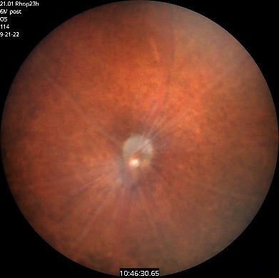
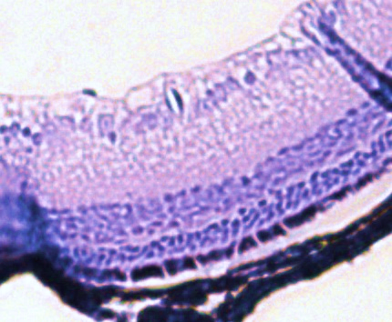
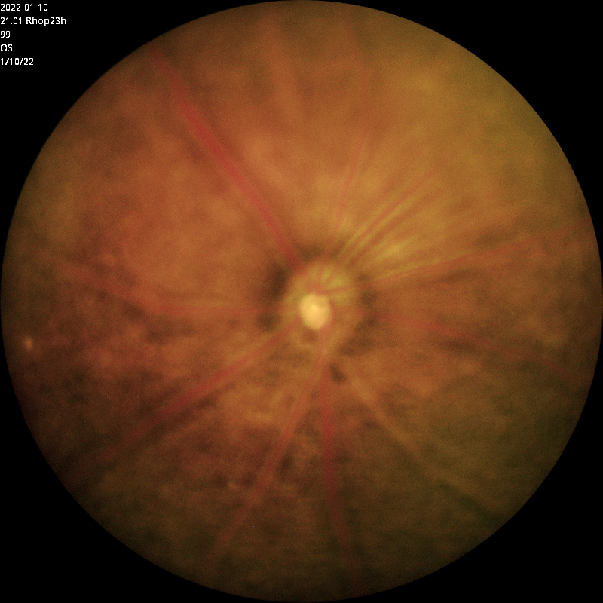
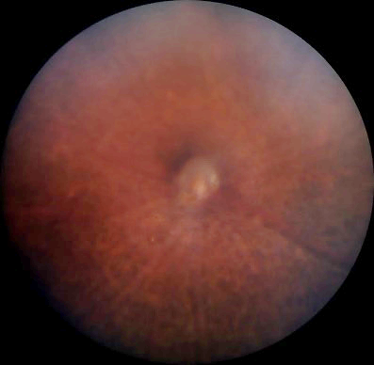
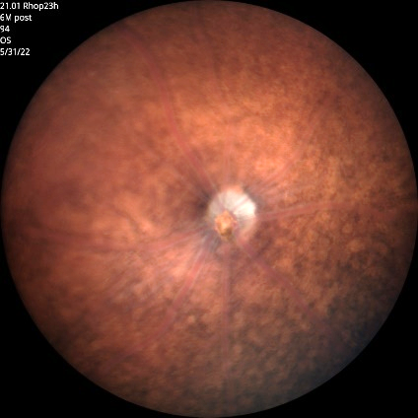
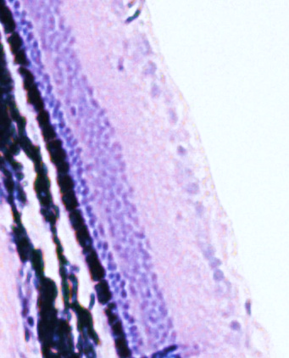
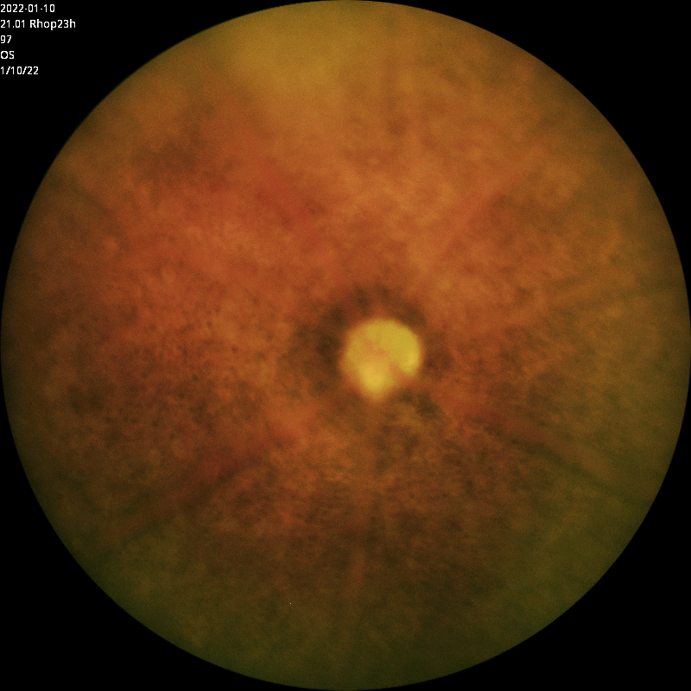
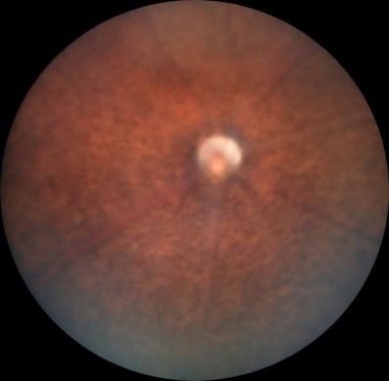
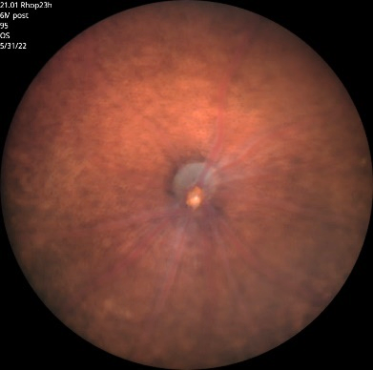
A.
2 Months
4 Months
7 Months
B.
GCL
No Injection Rho^{P23H+/-}
No Injection
Rho^{P23H+/-}
INL
ONL
Mock Injection Rho^{P23H+/-}
GCL
INL
Mock Injection
Rho^{P23H+/-}
ONL
Mock + Buffer Injection Rho^{P23H+/-}
GCL
INL
Mock + Buffer Injection
Rho^{P23H+/-}
ONL
50 µm

