Slide 1
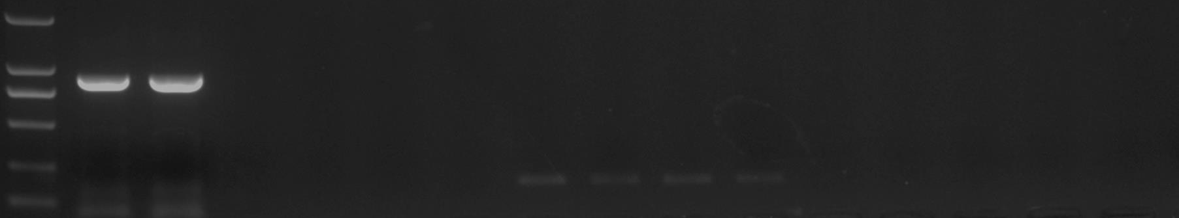
Marker
AC198871.3_FG002
GRMZM2G112377
GRMZM2G123016
GRMZM2G328309
AC192608.3_FG004
GRMZM2G491632
GRMZM2G309269
BR2
Tubulin
Figure S1 RT-PCR analysis for 8 genes in the fine-mapping region of 354 kb.
RT-PCR revealed apparent expressions in the Br2 gene in maize stalk, using Tubulin as internal control. RT-PCR for Tubulin was amplified with primers: 5’-GTGTCCTGTCCACCCACTCTCT-3’ and 5’-GGAACTCGTTCACATCAACGTTC-3’.

Slide 2
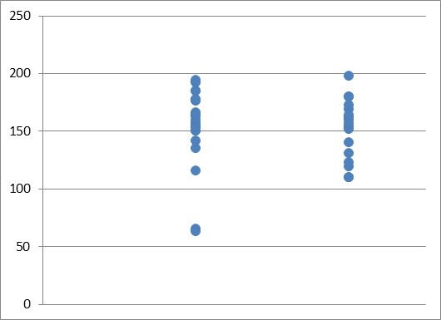
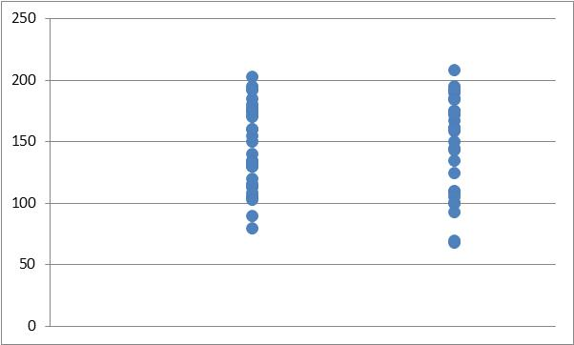
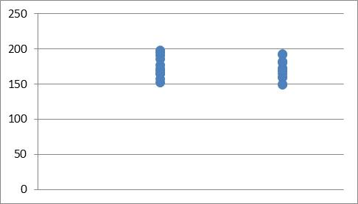
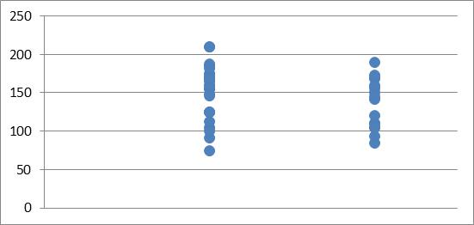
105
114
Ear length (mm)
Br2
br2
Br2
br2
 | Br2 | br2
mean | 157.2692 | 150.7857
SD | 1087.085 | 779.5659
P-value | 0.51
 | Br2 | br2
mean | 140.6 | 138.3125
SD | 1311.543 | 1873.829
P-value | 0.87
162
17
Ear length (mm)
Br2
br2
Br2
br2
 | Br2 | br2
mean | 175.0909 | 169.6667
SD | 238.6909 | 335.8667
P-value | 0.55
 | Br2 | br2
mean | 151.6538 | 136.375
SD | 1223.915 | 1049.983
P-value | 0.16

Slide 3
Figure S2 T-test for ear length in four families
The means, standard deviations (SDs) and P-values were shown under the plots.

Slide 4
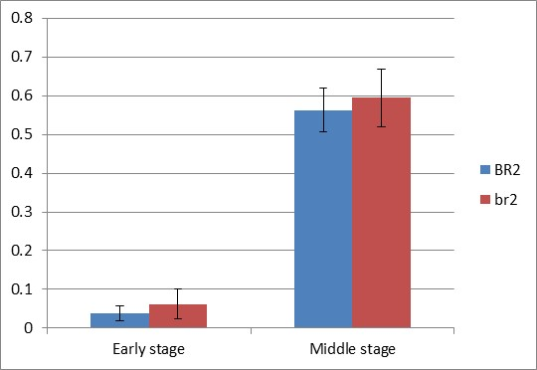
Relative expression
Figure S3 The expression level of Br2 gene in the early and middle stages of jointing.
Student’s T-test showed that no significant transcript was present in both early and middle jointing stages (P<0.05).

Slide 5
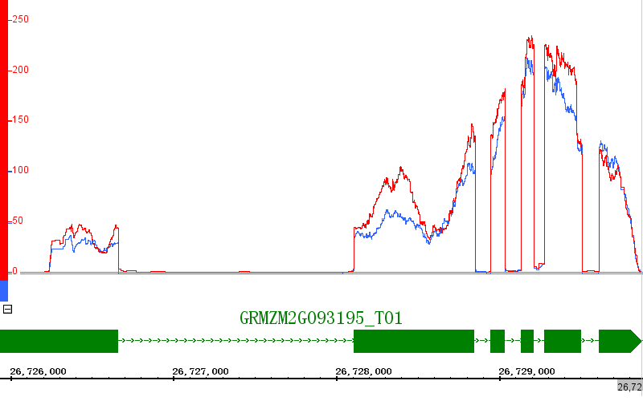
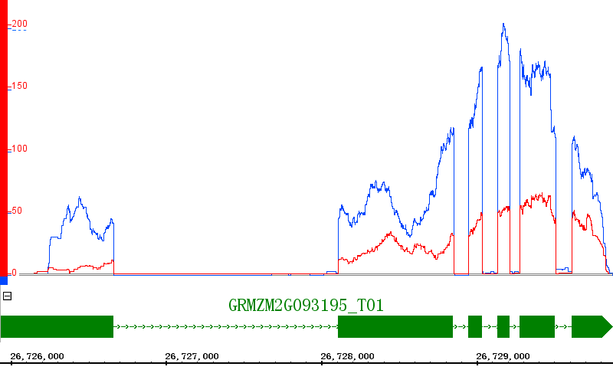
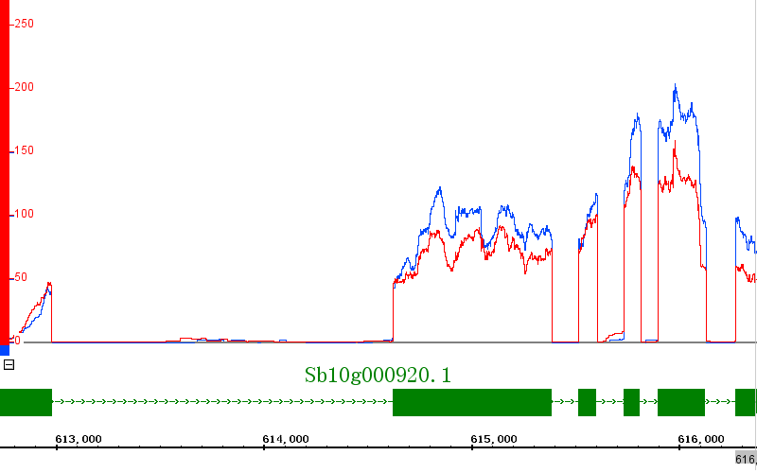
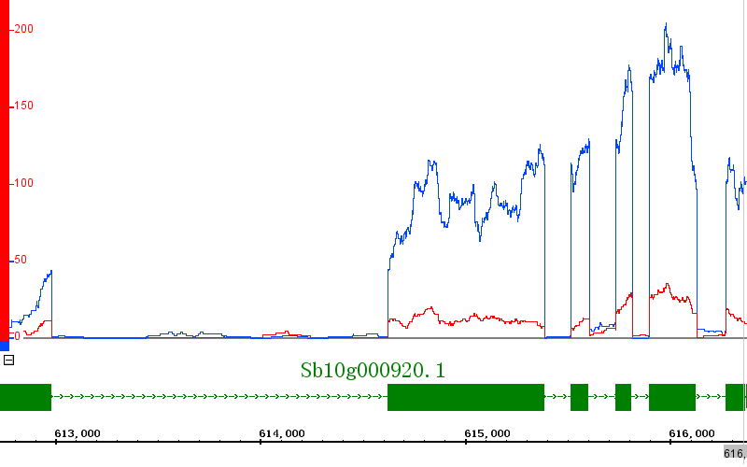
a
D3
early
middle
maize
sorghum

Slide 6
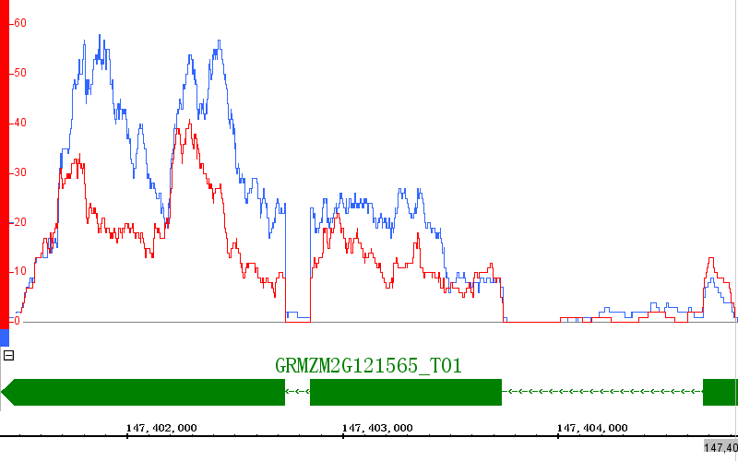
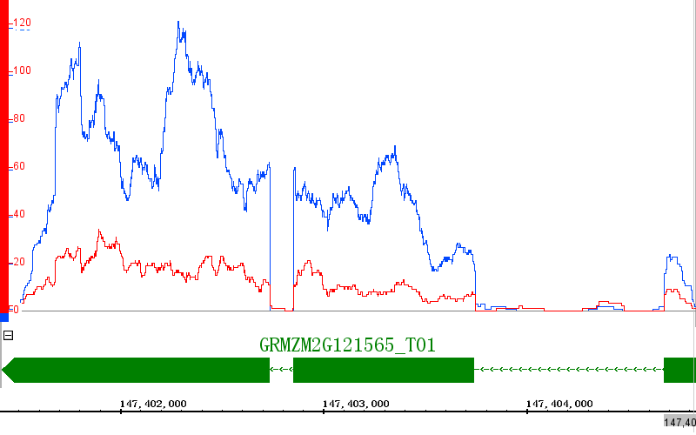
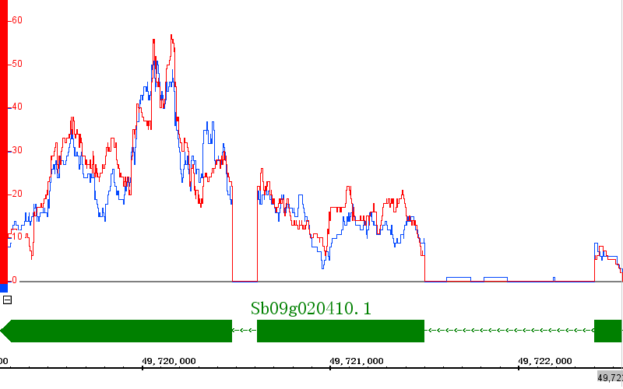
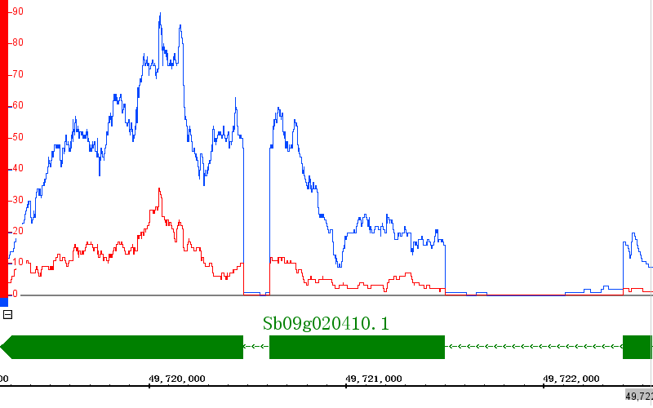
BAK1
b
early
middle
maize
sorghum

Slide 7
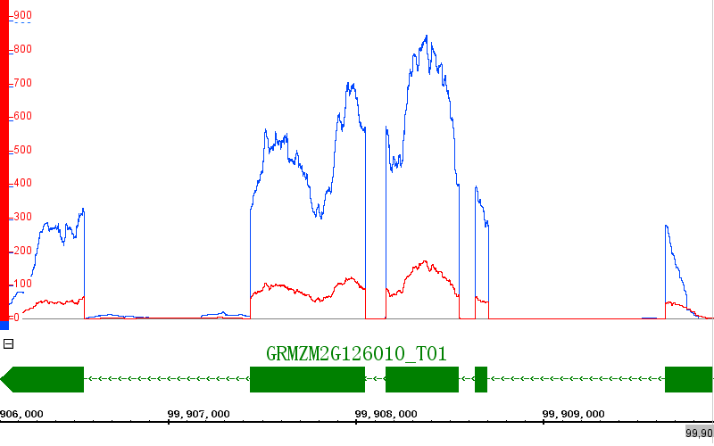
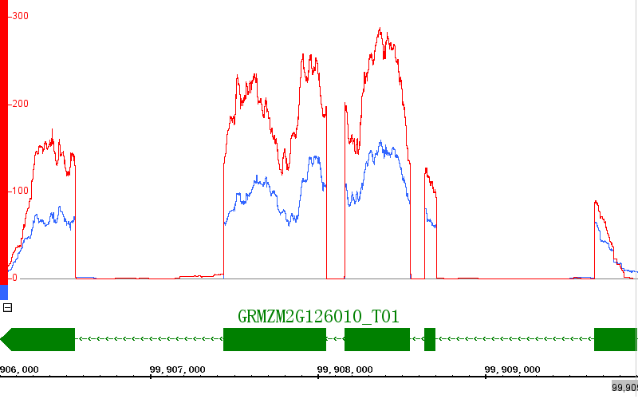
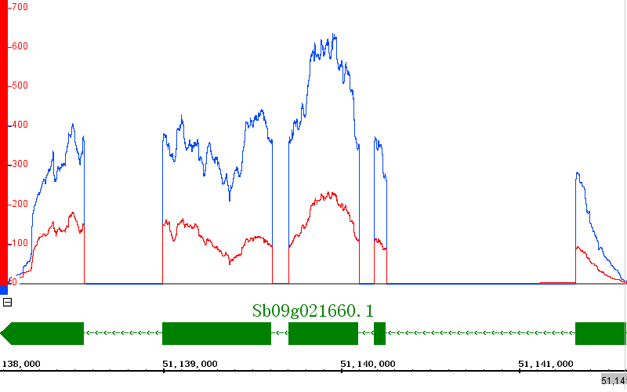
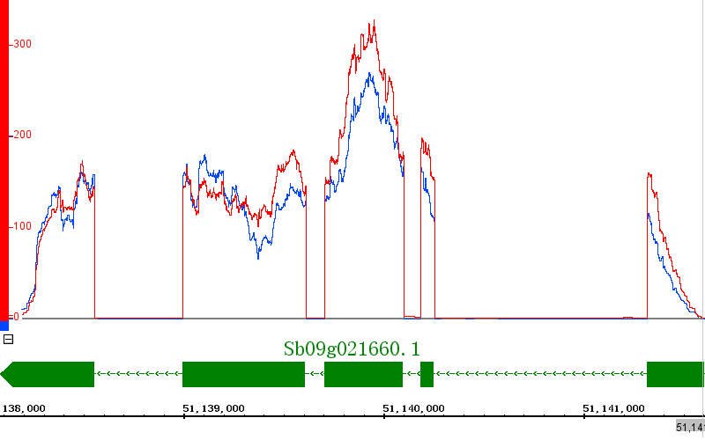
c
Actin7
early
middle
maize
sorghum

Slide 8
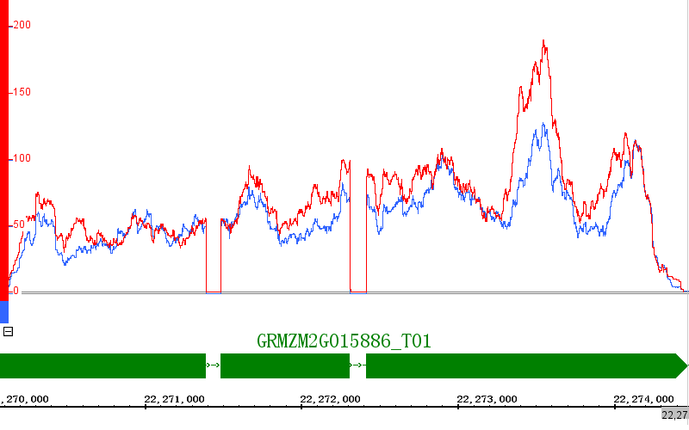
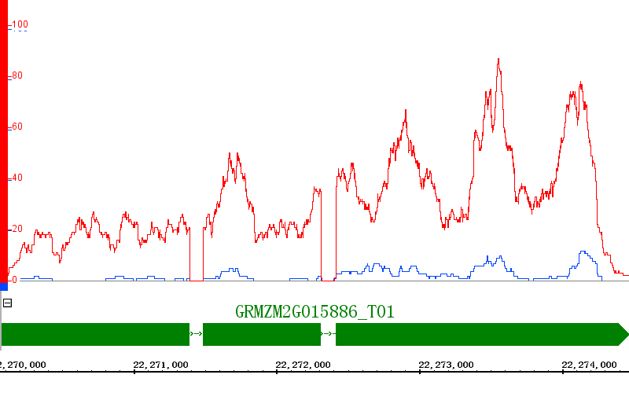
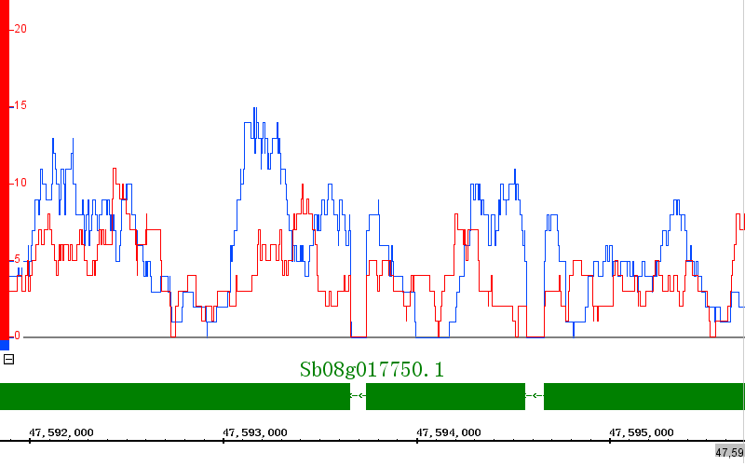
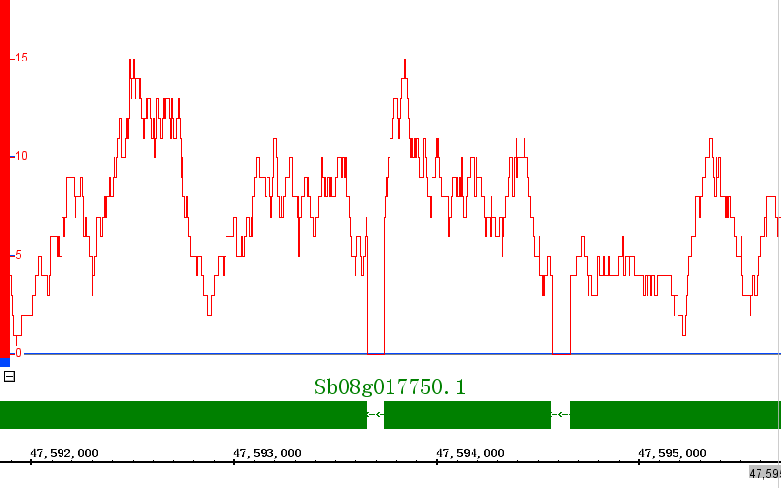
Csld1
d
early
middle
maize
sorghum

Slide 9
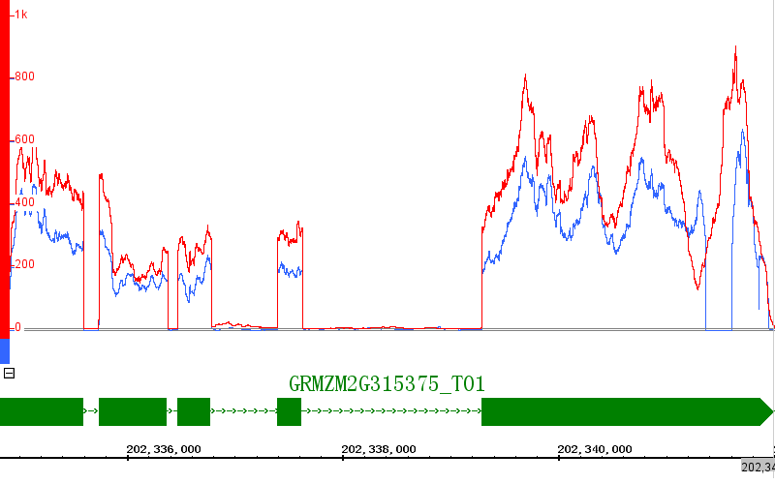
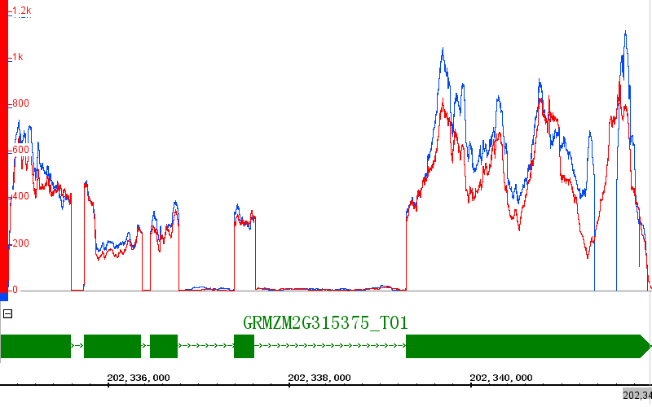
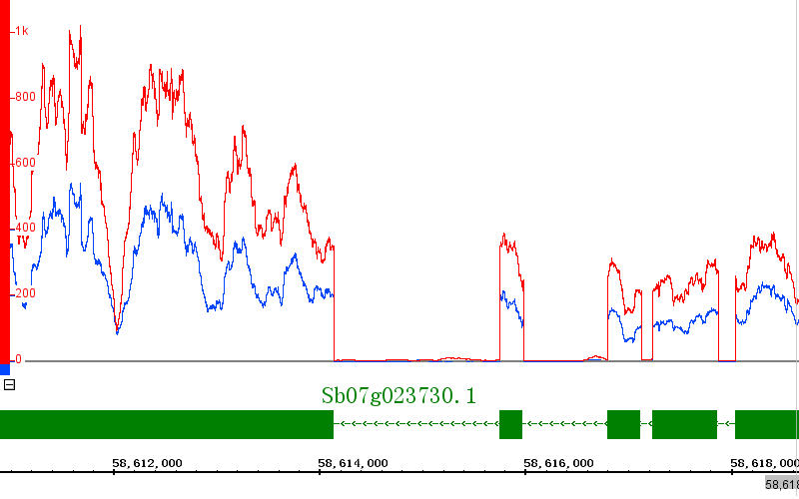
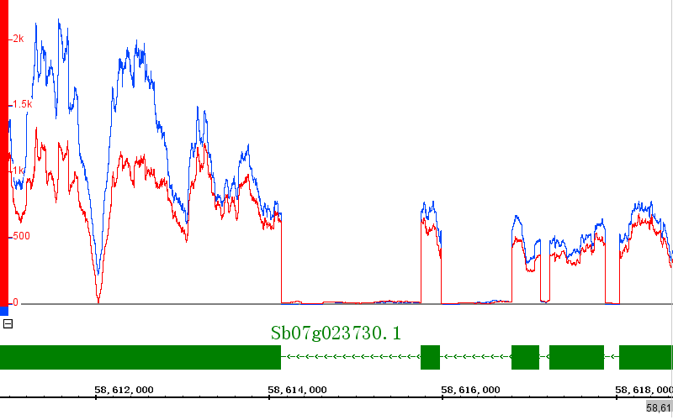
Br2
e
early
middle
maize
sorghum

Slide 10
Figure S4 The transcript patterns of D3 , BAK1 , Actin7, Csld1 and Br2 based on RNA-seq
(a-e) in the early and middle jointing stages in maize and sorghum. The y-axis and x-axis represented the read coverage from RNA-seq data and gene structure. Red and blue lines signified Br2 and br2 plants.

Slide 11
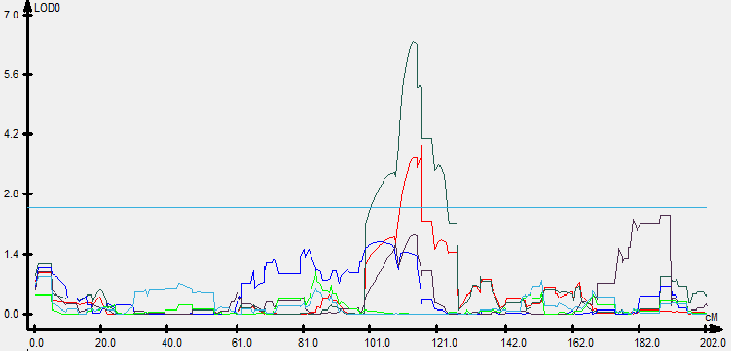
Figure S5 The QTL of plant height corresponding to Br2 was identified in B73×Ki11 RIL population , this QTL can explain 12% of the total phenotypic variations, the additive effect reaches 10cm.

