Slide 1
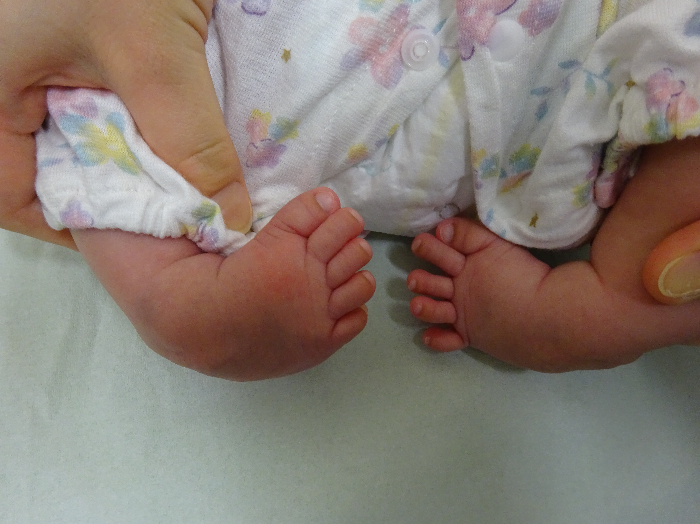
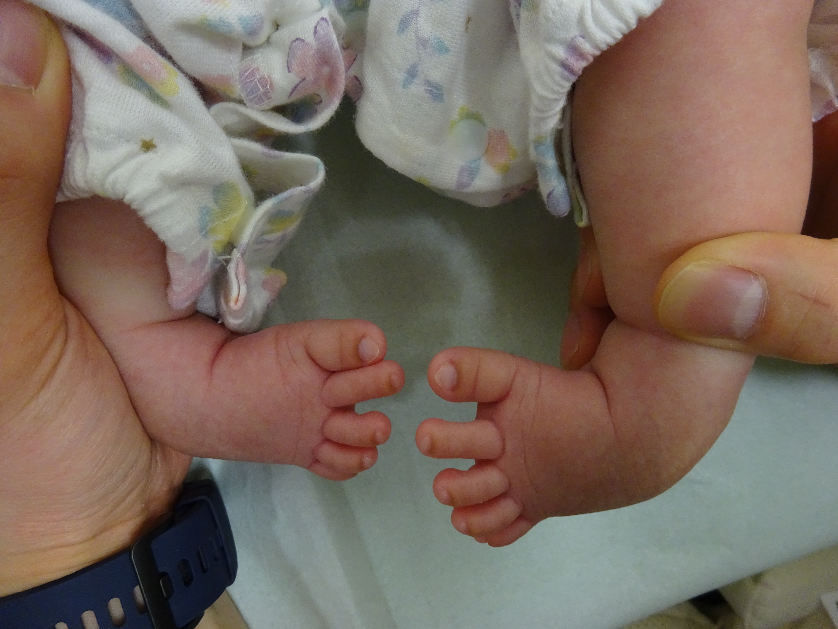
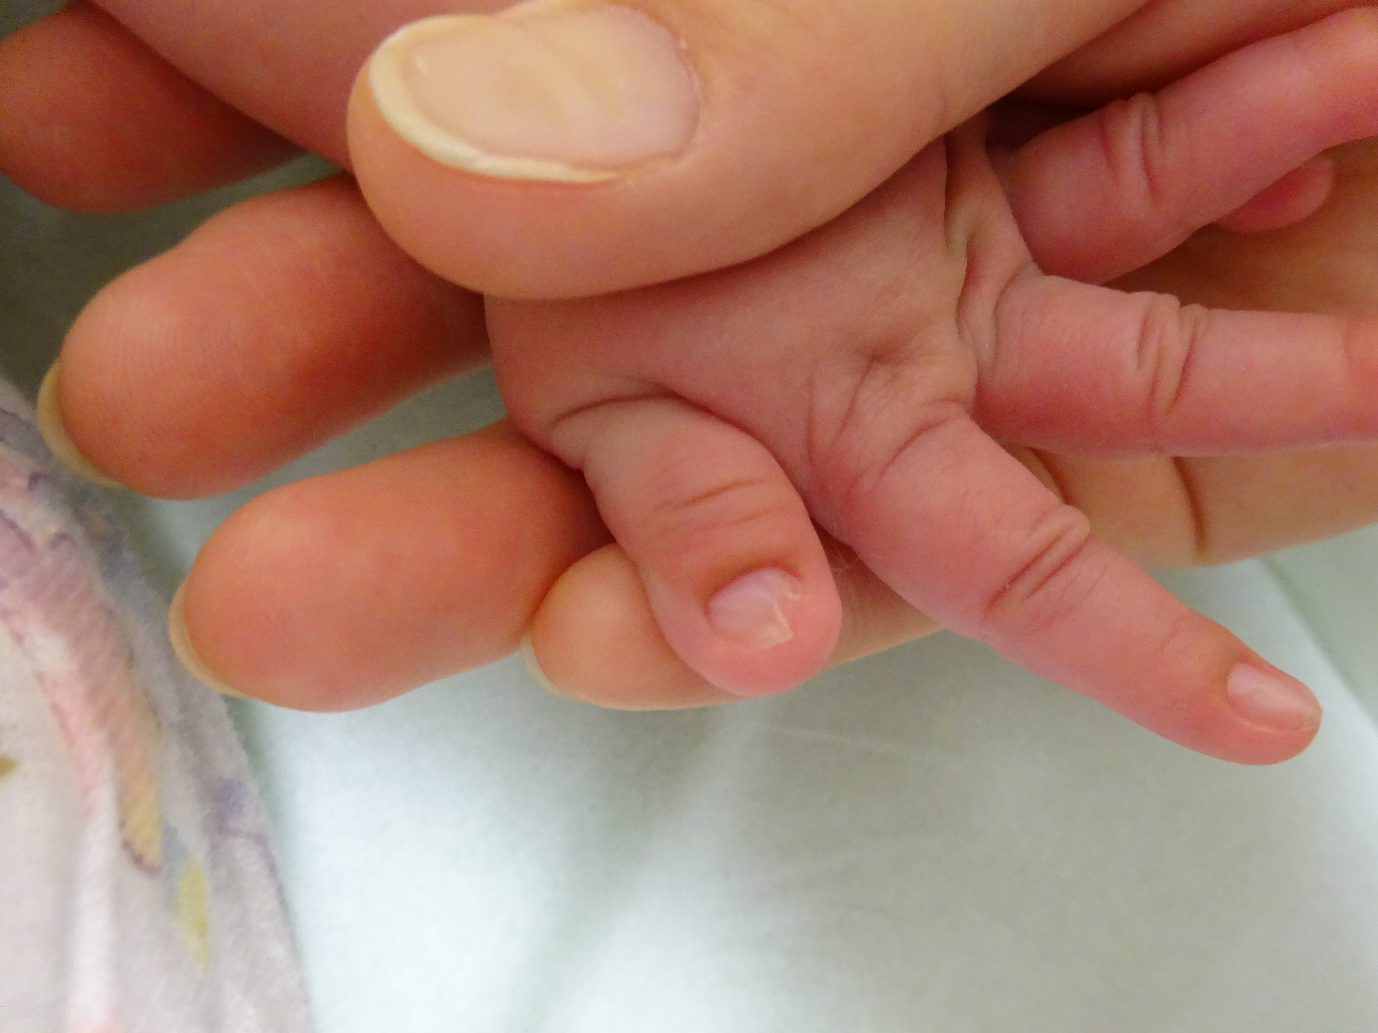
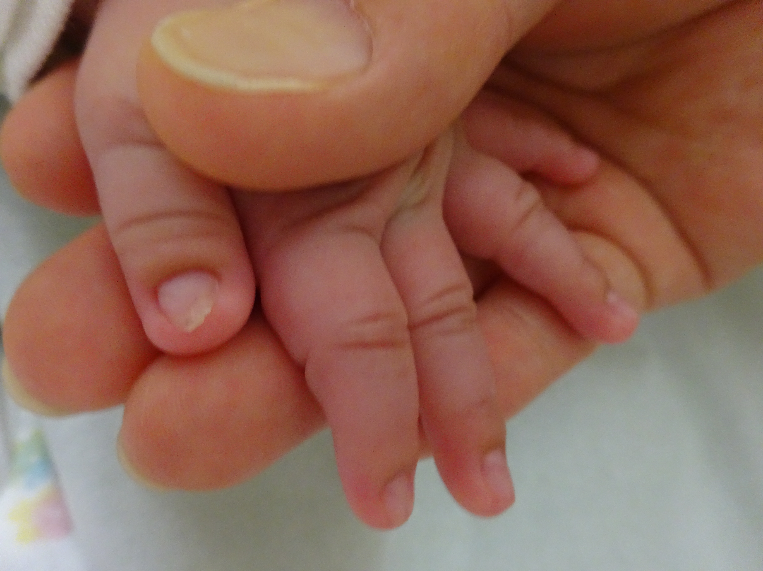
Supplemental figures
A.
B.
C.
D.
Monochorionic diamniotic monozygotic twins, IV-1 and IV-2, had similar phenotypes. IV-1 showed varus deformities of both ankles (A) and deformities of the nail (C). IV-2 had similar deformities (B and D).

